Slide 1
Visualization and optimization
Matplotlib
Jupyter
scipy.optimize.minimize
Notes:
Matpllotlib and Jupyter are just to options – there are many more Python libraries available. Some are mentioned during these slides.

Slide 2

Matplotlib is a Python 2D plotting library which produces publication quality figures in a variety of hardcopy formats and interactive environments across platforms. Matplotlib can be used in Python scripts, the Python and IPython shells, the Jupyter notebook, web application servers, and four graphical user interface toolkits.
Matplotlib tries to make easy things easy and hard things possible. You can generate plots, histograms, power spectra, bar charts, errorcharts, scatterplots, etc., with just a few lines of code. For simple plotting the pyplot module provides a MATLAB-like interface, particularly when combined with IPython. For the power user, you have full control of line styles, font properties, axes properties, etc, via an object oriented interface or via a set of functions familiar to MATLAB users.
pip install matplotlib
matplotlib.org

Slide 3
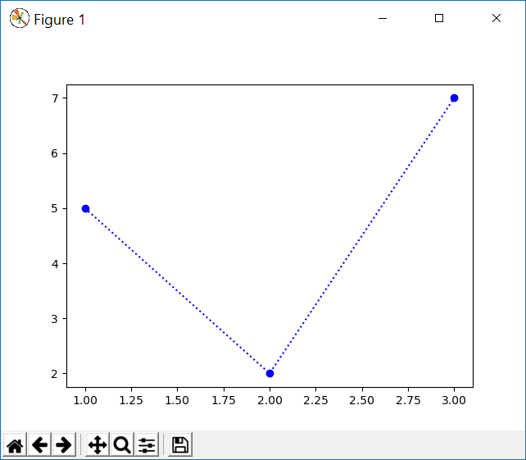

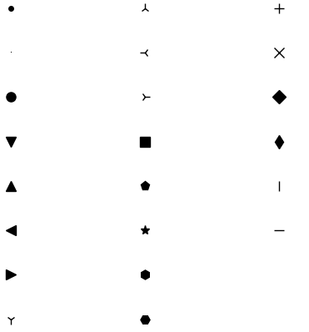
Plot
pyplot module ≈ MATLAB-like plotting framework
matplotlib-simple.py
import matplotlib.pyplot as plt plt.plot([1, 2, 3], [5, 2, 7], 'bo:') plt.show()
add plot to figure
x coordinates
y coordinates
format
string
figure is first shown when show is called
Colors Line styles Marker styles
b
g
r
c
m
y
k
w
-
--
-.
:
. | 2 | +
, | 3 | x
o | 4 | D
v | s | d
^ | p | |
< | * | _
> | h
1 | H
save current view as picture
adjust margins
zoom rectangle
pan and zoom
navigate view history
reset view
Notes:
PyPlot = module in package matplotlib
EN->DK: magenta = lilla, cyan = cyan
# color RGBs
from matplotlib import colors
for i, color in enumerate('bgrcmykw'): # BASE COLORS
plt.plot([0, 1], [i, i], color + 'o-', label=color)
print(color, colors.to_rgba(color))
# line styles
for i, style in enumerate('-|--|-.|:'.split('|')):
plt.plot([0,1],[i,i],'k' + style)
# marker styles
for i, style in enumerate('.,ov^<>1234sp*hH+xDd|_'):
plt.plot(i // 11, -(i % 11), 'k' + style, ms=8)

Slide 4
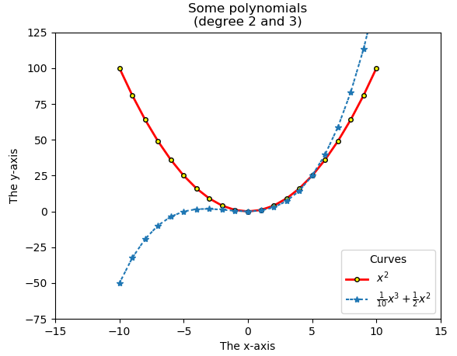

Plot – some keyword arguments
matplotlib-plot.py
import matplotlib.pyplot as plt X = range(-10, 11) Y1 = [x ** 2 for x in X] Y2 = [x ** 3 / 10 + x ** 2 / 2 for x in X] plt.plot(X, Y1, color='red', label='$x^2$', linestyle='-', linewidth=2, marker='o', markersize=4, markeredgewidth=1, markeredgecolor='black', markerfacecolor='yellow') plt.plot(X, Y2, '*', dashes=(2, 0.5, 2, 1.5), label=r'$\frac{1}{10}x^3+\frac{1}{2}x^2$') plt.xlim(-15, 15) plt.ylim(-75, 125) plt.title('Some polynomials\n(degree 2 and 3)') plt.xlabel('The x-axis') plt.ylabel('The y-axis') plt.legend(title='Curves') plt.show() # finally show figure
matplotlib.org/api/_as_gen/matplotlib.pyplot.plot.html
Colors: matplotlib.org/gallery/color/named_colors.html
Notes:
range = can be used as coordinates (need to be indexable)
2 plots in one figure
plot takes many keyword arguments
dash
2nd label: used raw string (sinc string contains \ )
title can contain newlines
xlim / ylim can be set manually – otherwise set automatically by pyplot

Slide 5
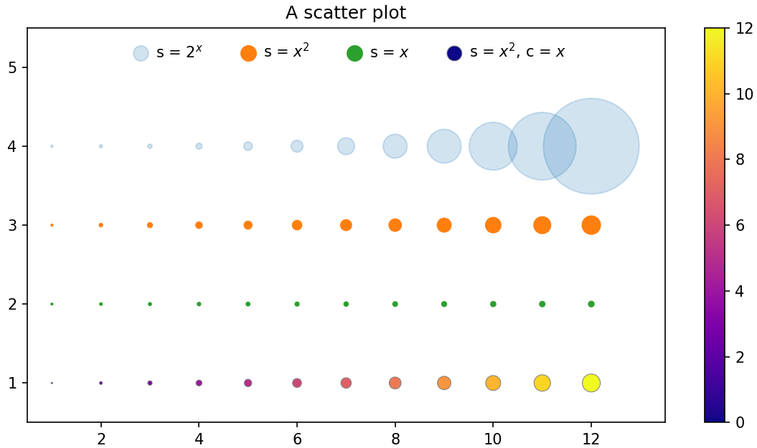
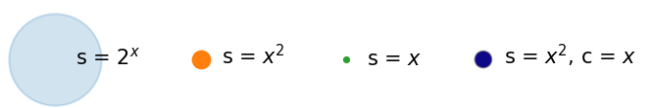
Scatter (points with individual size and color)
colorbar
(of most recently used colormap)
matplotlib-scatter.py
import matplotlib.pyplot as plt n = 13 X = range(n) S = [x ** 2 for x in X] E = [2 ** x for x in X] plt.scatter(X, [4] * n, s=E, label='s = $2^x$', alpha=.2) plt.scatter(X, [3] * n, s=S, label='s = $x^2$') plt.scatter(X, [2] * n, s=X, label='s = $x$') plt.scatter(X, [1] * n, s=S, c=X, cmap='plasma', label='s = $x^2$, c = $x$', edgecolors='gray', linewidth=0.5) plt.colorbar() plt.ylim(0.5, 5.5) plt.xlim(0.5, 13.5) plt.title('A scatter plot') legend = plt.legend(loc='upper center', frameon=False, ncol=4, handletextpad=0) for handle in legend.legend_handles: handle.set_sizes([100]) # fix marker size in legend plt.show()
transparency
colormap (predefined)
color of each point
size ≈ area of each point
point boundary width
point boundary color
Legend without fix
manual placement of legend box (default automatic); remove frame; place legends in 4 columns (default 1); reduce space between marks and label
matplotlib.org/api/_as_gen/matplotlib.pyplot.scatter.html
matplotlib.org/tutorials/colors/colormaps.html
Notes:
Without applying handle.set_sizes to the markers in the top legend box, they will have quite different sizes

Slide 6
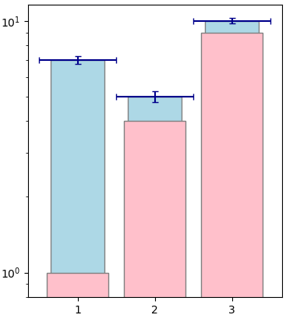
Bars
matplotlib-bars.py
import matplotlib.pyplot as plt x = [1, 2, 3] y = [7, 5, 10] plt.bar(x, y, color='lightblue', # bar background color linewidth=1, # bar boundary width edgecolor='gray', # bar boundary color tick_label=x, # ticks on x-axis width=0.7, # width, default 0.8 yerr=0.25, # Error bar: y length xerr=0.5, # x length capsize=3, # capsize in points ecolor='darkblue', # error bar color log=True) # y-axis log scale plt.bar(x, [v**2 for v in x], color='pink', linewidth=1, edgecolor='gray') plt.show()
matplotlib.org/api/_as_gen/matplotlib.pyplot.bar.html

Slide 7
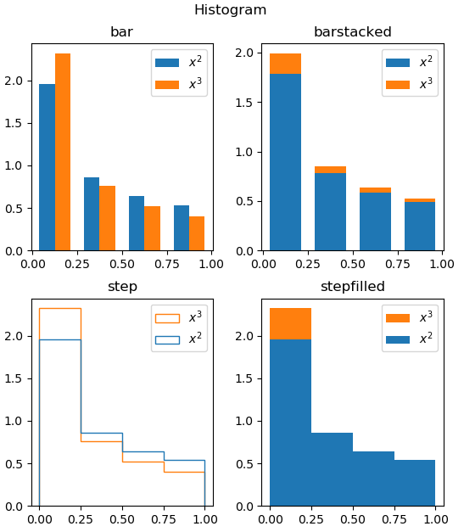
Histogram
matplotlib-histogram.py
import matplotlib.pyplot as plt from random import random values1 = [random()**2 for _ in range(1000)] values2 = [random()**3 for _ in range(100)] bins = [0.0, 0.25, 0.5, 0.75, 1.0] for i, ht in enumerate( ['bar', 'barstacked', 'step', 'stepfilled'], start=1): plt.subplot(2, 2, i) # start new plot plt.hist([values1, values2], # data sets bins, # bucket boundaries histtype=ht, # default ht='bar' rwidth=0.7, # fraction of bucket width label=['$x^2$', '$x^3$'], # labels density=True) # norm. prob. density plt.title(ht) # plot title plt.xticks(bins) # ticks on x-axis plt.legend() plt.suptitle('Histogram') # figure title plt.show()
matplotlib.org/api/_as_gen/matplotlib.pyplot.hist.html
Notes:
note density : values1 is a much larger dataset than values2 – ”density” normalizes the two data sets to a probability distribution

Slide 8
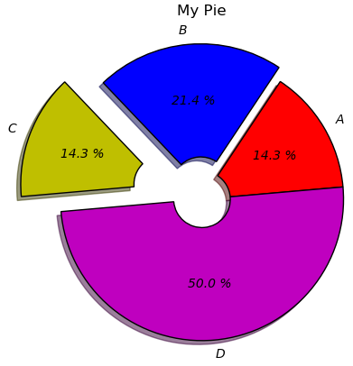
Pie
matplotlib-pie.py
import matplotlib.pyplot as plt plt.title('My Pie') plt.pie([2, 3, 2, 7], # relative wedge sizes labels=['A','B','C','D'], colors=['r', 'b', 'y', 'm'], explode=(0, 0.1, 0.3, 0), # radius fraction startangle=5, # angle above horizontal counterclock=True, # default True rotatelabels=False, # default False shadow=True, # default False textprops=dict( # text properties, dict color='black', # text color style='italic'), # text style wedgeprops=dict( # wedge properties, dict width=0.8, # width (missing center) linewidth=1, # wedge boundary width edgecolor='black'), # boundary color autopct='%1.1f %%') # percent formatting plt.show()
matplotlib.org/api/_as_gen/matplotlib.pyplot.pie.html
Notes:
%x.yf number formatted with at least x characters with y decimals
autopct can also be a lambda called for each number
rotatelabes = labels on a line through center point and middle of pie
width = 1.0 => full pie peace from center and out

Slide 9
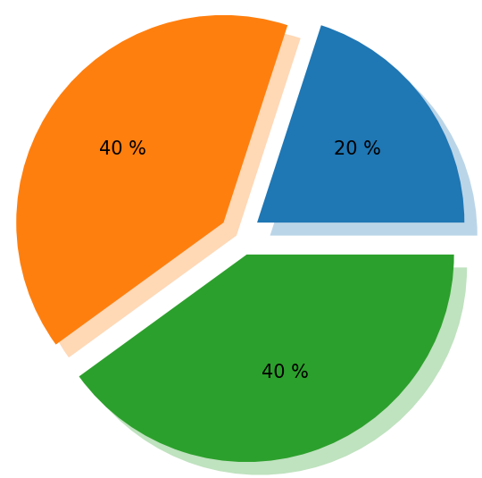
Customizing Pie shadows
Need to do do it manually on each pie using matplotlib.patches.Shadow
matplotlib-pie-shadow.py
import matplotlib.pyplot as plt from matplotlib.patches import Shadow patches, texts, autotexts = plt.pie( [1, 2, 2], explode=(0.1, 0.1, 0.1), autopct='%1.0f %%' ) for pie in patches: pie_shadow = Shadow( pie, 0.03, -0.03, # patch, x-offset, y-offset alpha=0.3, # shadow transparency edgecolor=None, # shadow edge color facecolor=pie._facecolor # shadow fill color ) plt.gca().add_patch(pie_shadow) plt.show()
https://matplotlib.org/stable/api/_as_gen/matplotlib.patches.Shadow.html
Notes:
Note: plt.pie is called without shadow=True
Note: if no autpct is given as argument, no autotexts is returned
Can color and place each shadow independently, e.g. facecolor = pie._facecolor

Slide 10
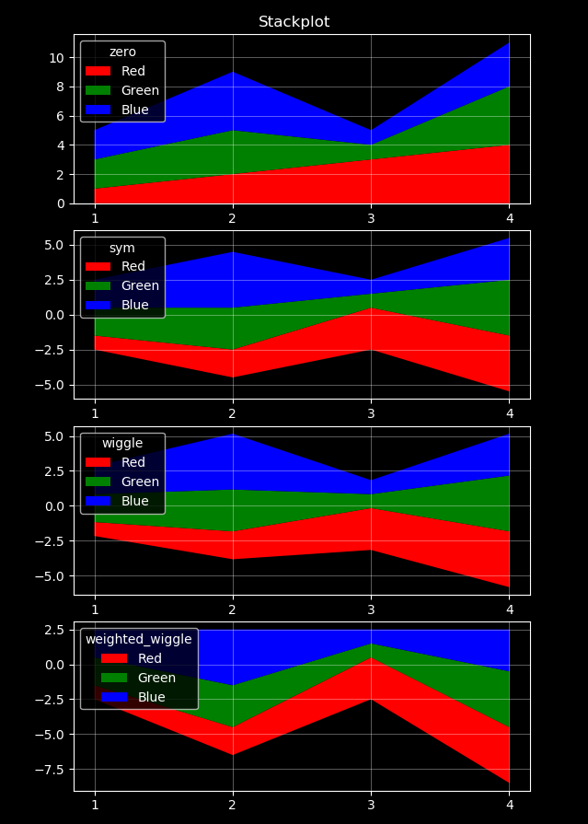
Stackplot
matplotlib-stackplot.py
import matplotlib.pyplot as plt x = [1, 2, 3, 4] y1 = [1, 2, 3, 4] y2 = [2, 3, 1, 4] y3 = [2, 4, 1, 3] plt.style.use('dark_background') for i, base in enumerate( ['zero', 'sym', 'wiggle','weighted_wiggle'], start=1): plt.subplot(4, 1, i) plt.stackplot(x, y1, y2, y3, colors=['r', 'g', 'b'], labels=['Red', 'Green', 'Blue'], baseline=base) plt.grid(axis='both', # 'x', 'y', or 'both' linewidth=0.5, linestyle='-', alpha=0.5) plt.legend(title=base, loc='upper left') plt.xticks(x) # a tick for each value in x plt.suptitle('Stackplot') plt.show()
Stacked Graphs – Geometry & Aesthetics
Lee Byron & Martin Wattenberg, 2008
To list all available styles:
print(plt.style.available)
matplotlib.org/api/_as_gen/matplotlib.pyplot.stackplot.html

Slide 11
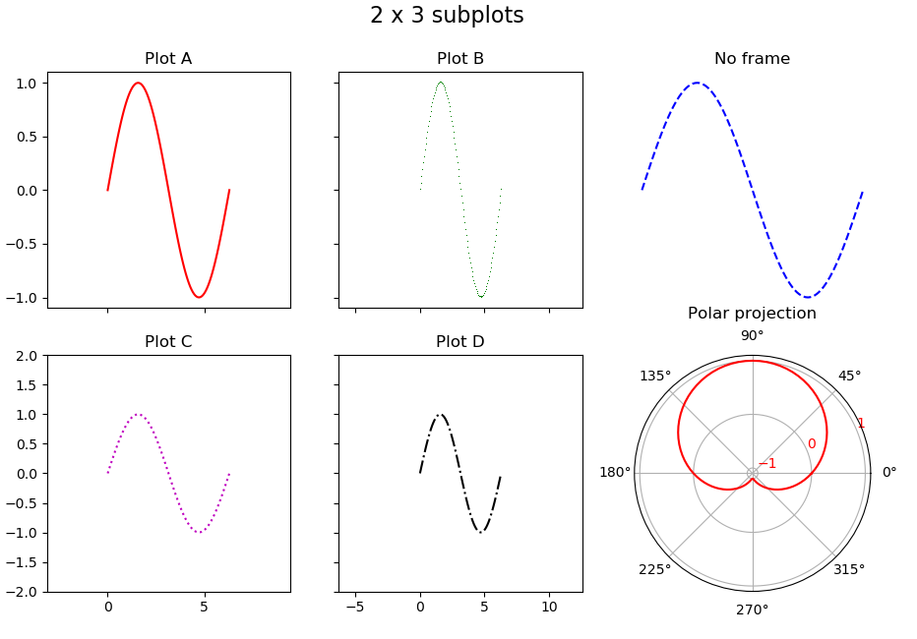
Subplot
(2 rows, 3 columns)
matplotlib-subplot.py
import matplotlib.pyplot as plt from math import pi, sin x_min, x_max, n = 0, 2 * pi, 100 x = [x_min + (x_max - x_min) * i / n for i in range(n + 1)] y = [sin(v) for v in x] ax1 = plt.subplot(2, 3, 1) # 2 rows, 3 columns ax1.label_outer() # removes x-axis labels plt.xlim(-pi, 3 * pi) # increase x-axis range plt.plot(x, y, 'r-') plt.title('Plot A') ax2 = plt.subplot(2, 3, 2) ax2.label_outer() # removes x- and y-axis labels plt.xlim(-2 * pi, 4 * pi) # increase x-axis range plt.plot(x, y, 'g,') plt.title('Plot B') ax3 = plt.subplot(2, 3, 3, frameon=False) # remove frame ax3.set_xticks([]) # remove x-axis ticks & labels ax3.set_yticks([]) # remove x-axis ticks & labels plt.plot(x, y, 'b--') plt.title('No frame') ax4 = plt.subplot(2, 3, 4, sharex=ax1) # share x-axis range plt.ylim(-2, 2) # increase y-axis range plt.plot(x, y, 'm:') plt.title('Plot C') ax5 = plt.subplot(2, 3, 5, sharex=ax2, sharey=ax4) # share ranges ax5.set_xticks(range(-5, 15, 5)) # specific x-ticks & x-labels ax5.label_outer() # removes y-axis labels plt.plot(x, y, 'k-.') plt.title('Plot D') ax6 = plt.subplot(2, 3, 6, projection='polar') # polar projection ax6.set_yticks([-1, 0, 1]) # y-labels ax6.tick_params(axis='y', labelcolor='red') # color of y-labels plt.plot(x, y, 'r') plt.title('Polar projection\n') # \n to avoid overlap with 90° plt.suptitle('2 x 3 subplots', fontsize=16) plt.show()
Subplots are numbered 1..6 row-by-row, starting top-left
subplot returns an axes to access the plot in the figure
matplotlib.org/api/_as_gen/matplotlib.pyplot.subplot.html
Notes:
projection: standard is rectiliniar

Slide 12
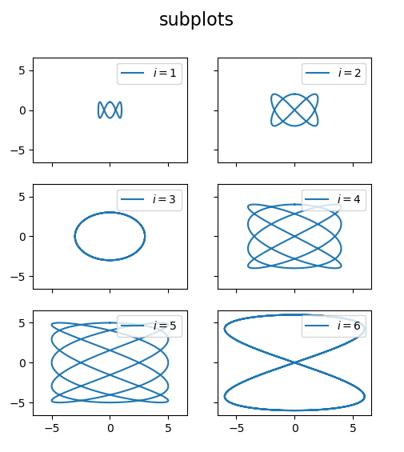
Subplots
matplotlib-subplots.py
import matplotlib.pyplot as plt from math import pi, sin, cos times = [2 * pi * t / 1000 for t in range(1001)] fig, ((ax1, ax2), (ax3, ax4), (ax5, ax6)) = \ plt.subplots(3, 2, sharex=True, sharey=True) for i, ax in enumerate([ax1, ax2, ax3, ax4, ax5, ax6], start=1): x = [i * sin(i * t) for t in times] y = [i * cos(3 * t) for t in times] ax.plot(x, y, label=f'$i = {i}$') # plot to axes ax.legend(loc='upper right') # axes legend fig.suptitle('subplots', fontsize=16) # figure title plt.show()
create 6 axes in 3 rows with 2 colums
share the x- and y-axis ranges (automatically applies label_outer to created axes)
returns a pair (figure, axes)
matplotlib.org/api/_as_gen/matplotlib.pyplot.subplots.html

Slide 13
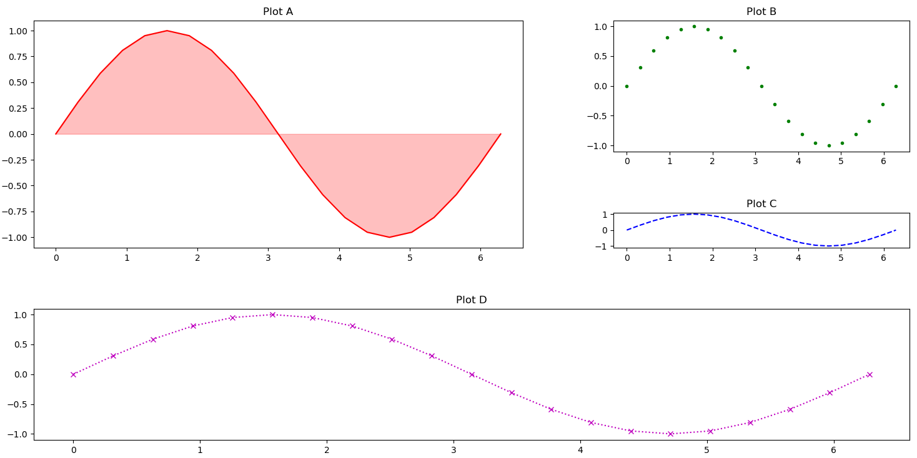
subplot2grid (5 x 5)
matplotlib-subplot2grid.py
import matplotlib.pyplot as plt import math x_min, x_max, n = 0, 2 * math.pi, 20 x = [x_min + (x_max - x_min) * i / n for i in range(n + 1)] y = [math.sin(v) for v in x] plt.subplot2grid((5, 5), (0,0), rowspan=3, colspan=3) plt.fill_between(x, 0.0, y, alpha=0.25, color='r') plt.plot(x, y, 'r-') plt.title('Plot A') plt.subplot2grid((5, 5), (0,3), rowspan=2, colspan=2) plt.plot(x, y, 'g.') plt.title('Plot B') plt.subplot2grid((5, 5), (2,3), rowspan=1, colspan=2) plt.plot(x, y, 'b--') plt.title('Plot C') plt.subplot2grid((5, 5), (3,0), rowspan=2, colspan=5) plt.plot(x, y, 'mx:') plt.title('Plot D') plt.tight_layout() # adjust padding plt.show()
upper left corner (row, column)
matplotlib.org/api/_as_gen/matplotlib.pyplot.subplot2grid.html
Notes:
(row, column) : row = 0..4, column = 0..4

Slide 14
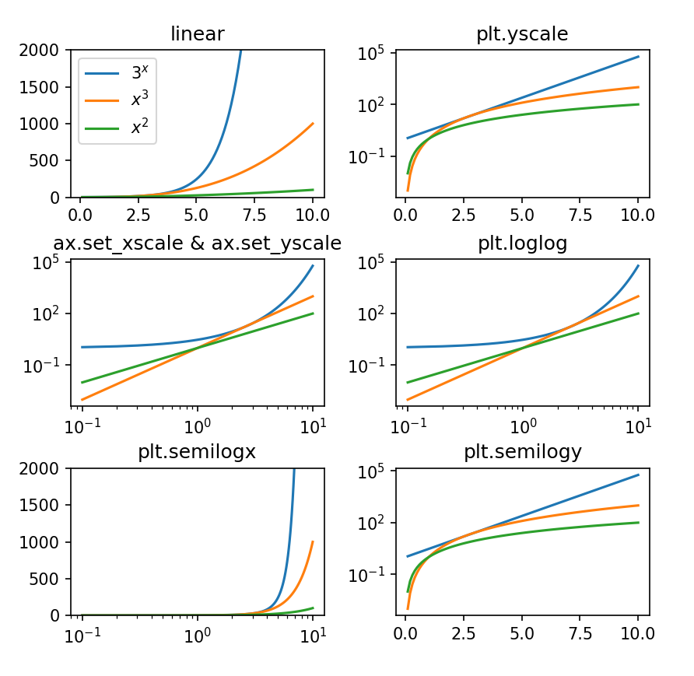
log scales
matplotlib-log.py
import matplotlib.pyplot as plt x = [i / 10 for i in range(1, 101)] y1 = [i ** 2 for i in x] y2 = [i ** 3 for i in x] y3 = [3 ** i for i in x] for i in range(1, 7): ax = plt.subplot(3, 2, i) plt.plot(x, y3, label='$3^x$') plt.plot(x, y2, label='$x^3$') plt.plot(x, y1, label='$x^2$') match i: case 1: plt.ylim(0, 2000) plt.xscale('linear') # default plt.yscale('linear') # default plt.legend() plt.title('linear’) case 2: plt.yscale('log') plt.title('plt.yscale') case 3: ax.set_xscale('log') ax.set_yscale('log') plt.title('ax.set_xscale & ax.set_yscale') case 4: plt.loglog() plt.title('plt.loglog') case 5: plt.ylim(0, 2000) plt.semilogx() plt.title('plt.semilogx') case 6: plt.semilogy() plt.title('plt.semilogy') plt.show()
There are many ways to make the x- and/or y-axis logarithmic with pyplot

Slide 15
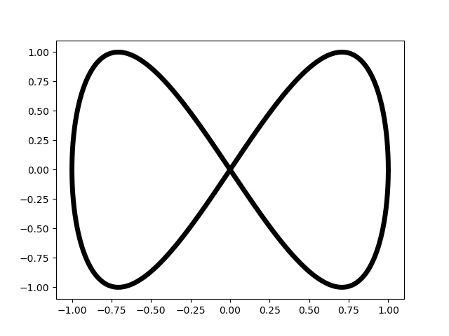
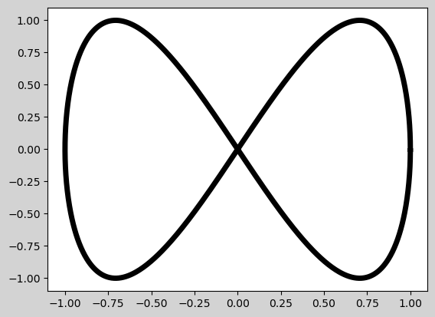
Saving figures
matplotlib-savefig.py
import matplotlib.pyplot as plt from math import pi, sin, cos n = 1000 points = [(cos(2 * pi * i / n), sin(4 * pi * i / n)) for i in range(n)] x, y = zip(*points) plt.plot(x, y, 'k-', linewidth=5) plt.savefig('butterfly.png') # save plot as PNG plt.savefig('butterfly-grey.png', dpi=100, # dots per inch bbox_inches='tight', # crop to bounding box pad_inches=0.1, # space around figure facecolor='lightgrey', # background color format='png') # optional if file extension plt.savefig('butterfly.pdf') # save plot as PDF plt.show() # interactive viewer
butterfly.png
butterfly-grey.png
matplotlib.org/api/_as_gen/matplotlib.pyplot.savefig.html
facecolor
pad_inches
Notes:
can have multiple savefig commands for the same figure
bbox_inches = crop to arbitrary bounding box, tight = minimal containing everything

Slide 16
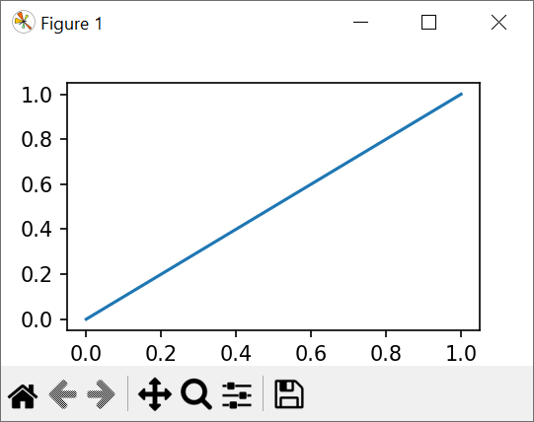
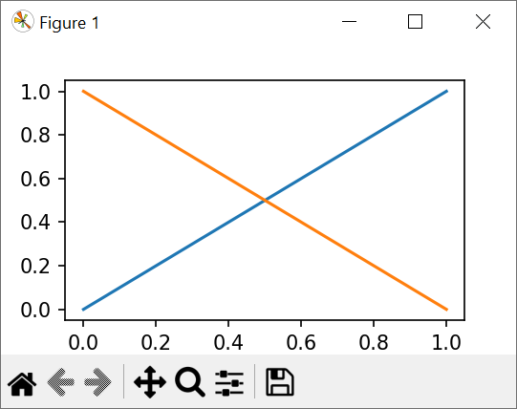
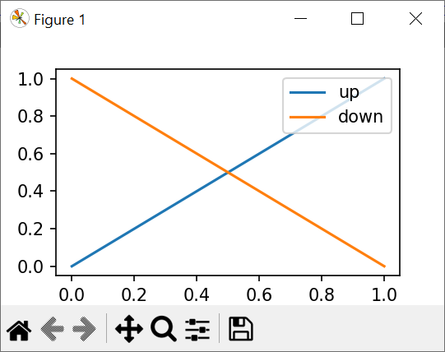
Interactive mode
Python shell
import matplotlib.pyplot as plt plt.ion() # Enable interactive mode plt.plot([0, 1], [0, 1], label='up') # Shows plot immediately plt.plot([0, 1], [1, 0], label='down') # Adds visible line plt.legend(loc='upper right') # Adds visible legend plt.ioff() # Disable interactive mode
Useful when developing plot from Python shell
Automatically shows / updates plot
https://matplotlib.org/stable/api/_as_gen/matplotlib.pyplot.isinteractive.html
Notes:
Can also update and remove shown objects with .set_data and .remove
x = plt.plot([0,1],[0.5,0.5])
x
[<matplotlib.lines.Line2D object at 0x000001CD9AF2BF50>]
x[0].set_data([0,1],[0.25,0.5])
x[0].remove()

Slide 17
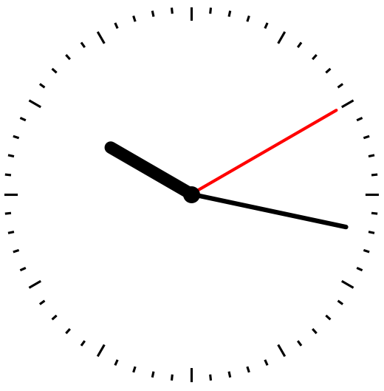
A crude animation
clock.py
import matplotlib.pyplot as plt from math import pi, sin, cos import datetime def plot_clock(hour, minute, second): plt.axis('off') # hide x and y axes plt.gca().set_aspect('equal') # don’t squeeze circle for i in range(60): # show second marks angle = 2 * pi * i / 60 x, y = cos(angle), sin(angle) start = 0.98 if i % 5 else .94 # every 5'th mark should be longer plt.plot([start * x, x], [start * y, y], c='black') # mark for angle, length, style in [ (second / 60, 0.9, dict(c='red', lw=2)), (minute / 60, 0.85, dict(c='black', lw=3)), ((hour + minute / 60) / 12, 0.5, dict(c='black', lw=8)) ]: angle = 2 * pi * (0.25 - angle) x, y = length * cos(angle), length * sin(angle) plt.plot([0, x], [0, y], **style, solid_capstyle='round') # arm plt.plot(0, 0, 'o', ms=10, c='black') # center dot while True: now = datetime.datetime.now() # local time plot_clock(now.hour, now.minute, now.second) plt.pause(1) # show figure and pause 1 second plt.clf() # clear figure
matplotlib.org/stable/api/_as_gen/matplotlib.pyplot.pause.html

Slide 18
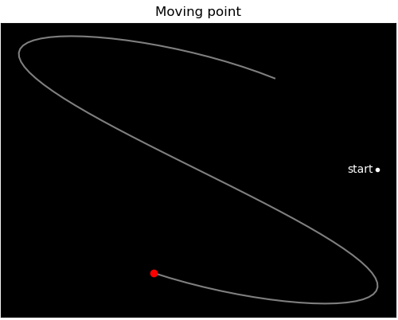
matplotlib-animation.py
import matplotlib.pyplot as plt from matplotlib.animation import FuncAnimation from math import pi, cos, sin n, tail_length = 200, 75 points = [] # tail_length recent poins def point(i): t = 2 * pi * i / n return (cos(3 * t), sin(2 * t)) fig = plt.figure() # new figure ax = plt.gca() # get current axes ax.set_facecolor('black') # set background color plt.xlim(-1.1, 1.1) # set x-axis range plt.ylim(-1.1, 1.1) # set y-axis range plt.xticks([]) # remove x-ticks & labels plt.yticks([]) # remove y-ticks & labels plt.title('Moving point') # plot title x, y = point(0) plt.plot(x, y, 'w.') # start point plt.text(x - 0.025, y, 'start', color='w', # text label ha='right', va='center') # alignment tail, = plt.plot([], [], 'w-', alpha=0.5) # init. tail head, = plt.plot([], [], 'ro') # init. current point def move(frame): # frame = value from frames x, y = point(frame) points.append((x, y)) del points[:-tail_length] # limit tail tail.set_data(*zip(*points)) # update tail points head.set_data([x], [y]) # update head point animation = FuncAnimation(fig, # figure to animate func=move, # function called for each frame frames=range(n), # array like to iterate over interval=25, # milliseconds between frames repeat=True, # repeat frames when done repeat_delay=0) # wait milliseconds before repeat plt.show()
matplotlib.animation.FuncAnimation
plot returns “Line2D” objects representing the plotted data
”Line2D” objects can be updated using set_data
To make an animation you need to repeatedly update the ”line2D” objects
FuncAnimation repeatedly calls func in regular intervals interval, each time with the next value from frames (if frames is None, then the frame values provided to func will be the infinite sequence 0,1,2,3,...)
matplotlib.org/api/_as_gen/matplotlib.animation.FuncAnimation.html
Notes:
< Python 3.11 - FuncAnimation returns an object that needs to be remembered – otherwise it will be garbage collected and the animation fails.
See discussion: https://github.com/matplotlib/matplotlib/issues/1656
>= Python 3.13 - set_data requires sequence as arguments (previously one could provide scalars)

Slide 19

The Jupyter Notebook
The Jupyter Notebook is an open-source web application that allows you to create and share documents that contain live code, equations, visualizations and narrative text. Uses include: data cleaning and transformation, numerical simulation, statistical modeling, data visualization, machine learning, and much more.
jupyter.org
Notes:
Jupyter notebooks also integrated in e.g. Visual Studio Code
JupyterLab: A Next-Generation Notebook Interface

Slide 20
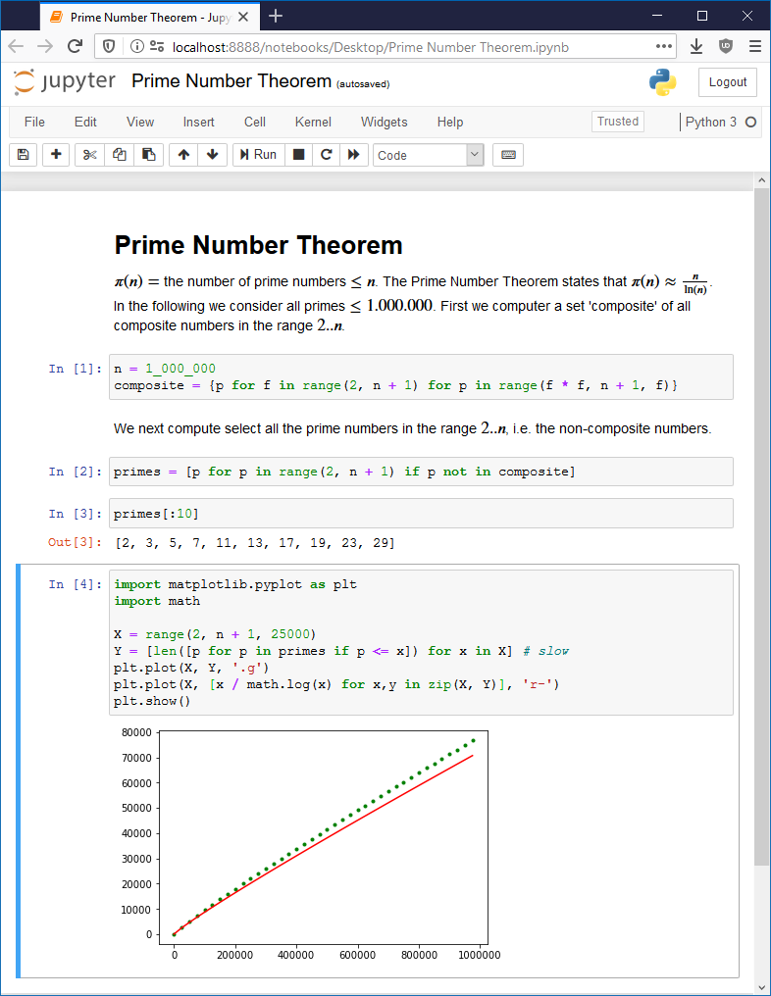
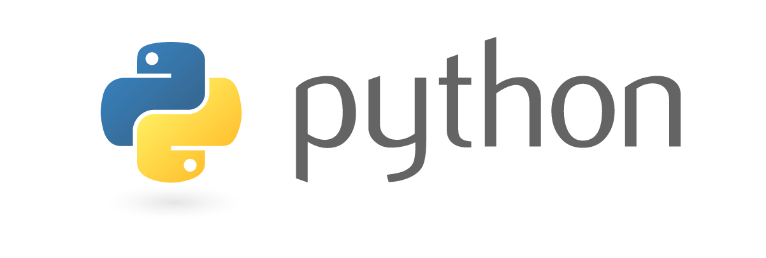
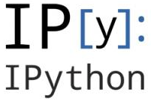


Jupyter Server
(e.g. running on
local machine)
User
Web Browser
Notes:
can also use other kernels. 40+ languages

Slide 21
cells
formatted text: Markdown / LaTeX / HTML / ...
python code
python shell output
matplotlib / numpy / ... output

Slide 22
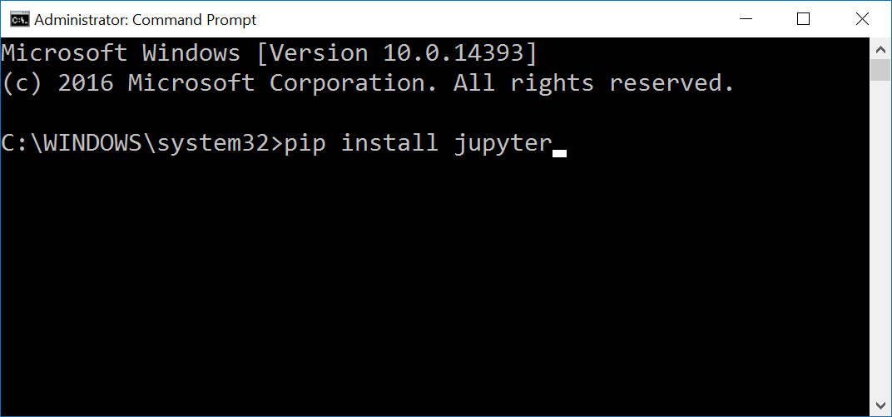
Jupyter - installing
Open a windows shell and run: pip install jupyter
Notes:
Or a ”mac terminal”

Slide 23
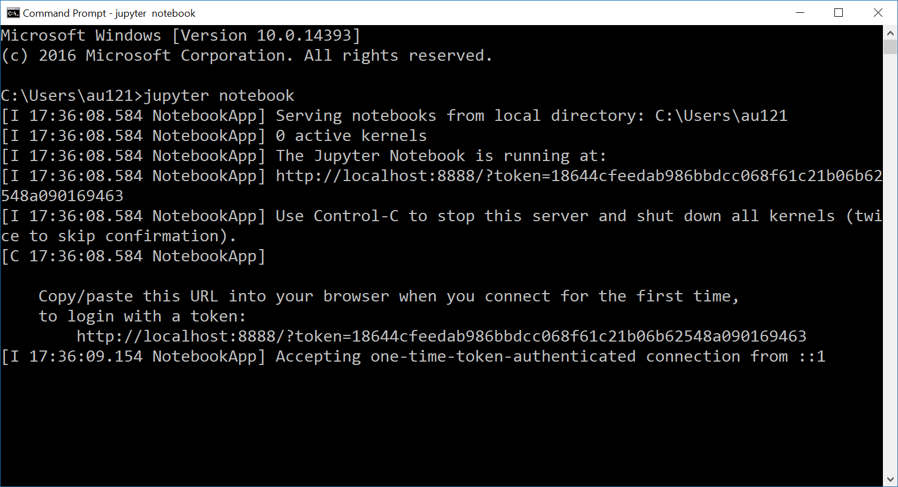
Jupyter – launching the jupyter server
Open a windows shell and run: jupyter notebook
If this does not work, then try python -m notebook
url

Slide 24
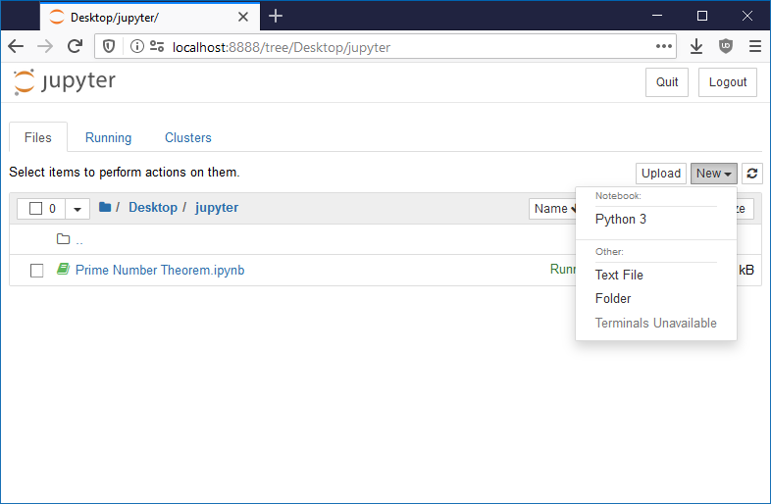
create new notebook

Slide 25
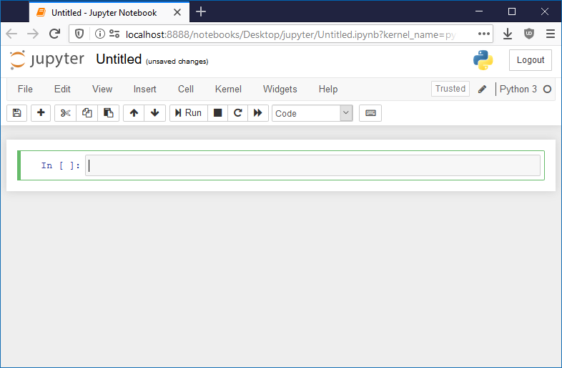
title – double click to change
type of active cell
active cell

Slide 26
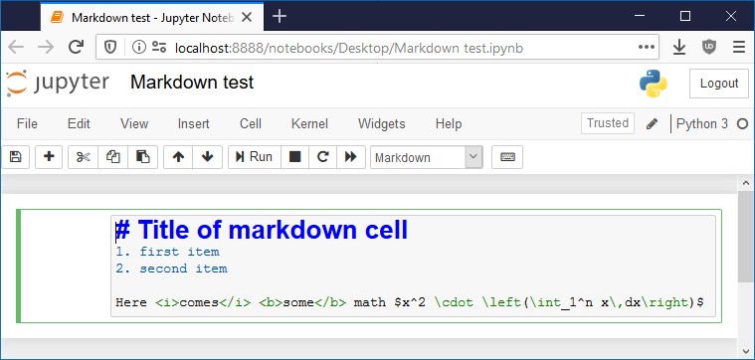
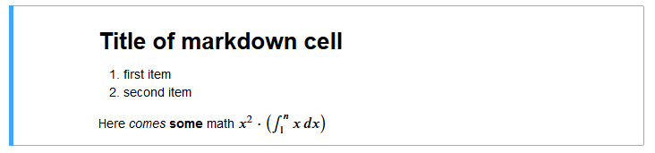
Try:
Help > User Interface Tour
Help > Markdown
HTML formatting
LaTeX mathematics
after pressing
Ctrl + Enter (evaluates)
Alt + Enter (evaluates + new cell)
github.com/adam-p/markdown-here/wiki/Markdown-Cheatsheet

Slide 27
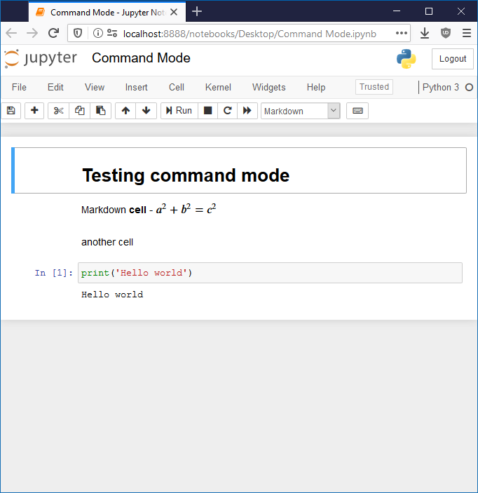
Command Mode
Used to naviagte between cells
Current cell is marked with blue bar
Keyboard shortcuts
ctrl-shift-h | show keyboard shortcuts
enter | enter Edit Mode on current cell
escape | leave Edit Mode
shift-enter | run cell + select below
ctrl-enter | run selected cells
alt-enter | run cell and insert below
Y M R | change cell type (code, markdown, raw text)
1 2 3 4 5 6 | change heading level
ctrl-A | select all cells
down up | move to next/previous cell
space shift-space | scroll down/up
shift-up shift-down | extend selected cells
A B | insert cell above/below
X C V shift-V Z DD | cut, copy, paste below/above, undo, delete cells
shift-L | toggle line numbers in cells
shift-M | merge selected cells (or with cell below)

Slide 28
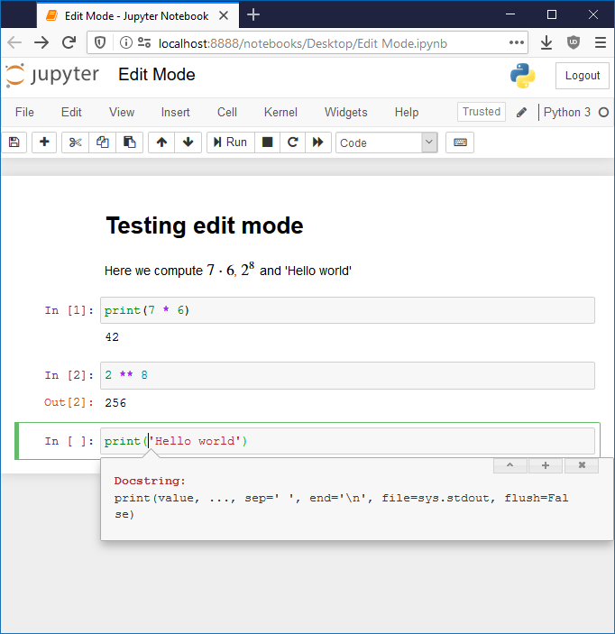
Edit Mode
Used to edit current cell
Current cell is marked with green bar
Keyboard shortcuts
esc | enter Command Mode
shift-enter | run cell + select below
ctrl-enter | run selected cells
alt-enter | run cell and insert below
ctrl-shift- - | split cell at cursor
tab | indent or code completion
shift-tab | show docstring
ctrl-a -x -c -v -z -y | select all, cut, copy, paste, undo, redo
ctrl-d | delete line

Slide 29
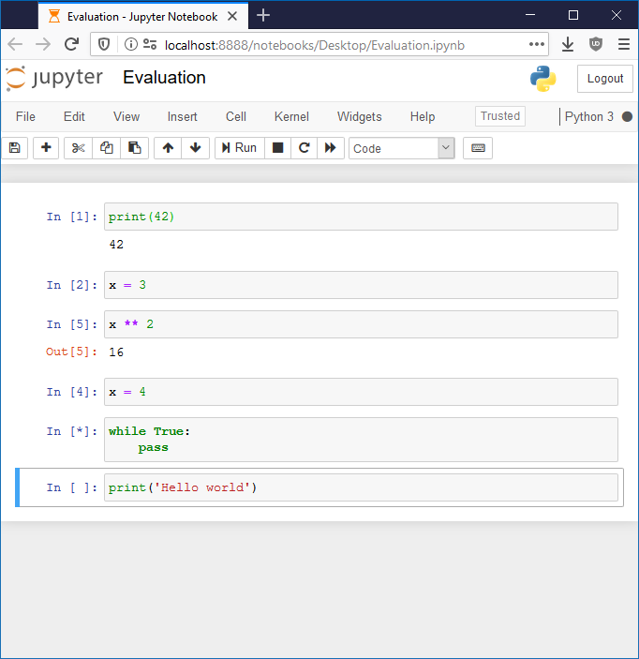

Evaluating cells
To evaluate cell
  ctrl-enter, alt-enter, shift-enter
Output from program shown below cell
Result of last evaluated line
Order of code cells evaluated
  Note ”x ** 2” computed after ”x = 4”
[*] are cells being evaluated / waiting
[ ] not yet evaluated
Recompute all cells top-down
  or Kernel > Restart & Run all

Slide 30
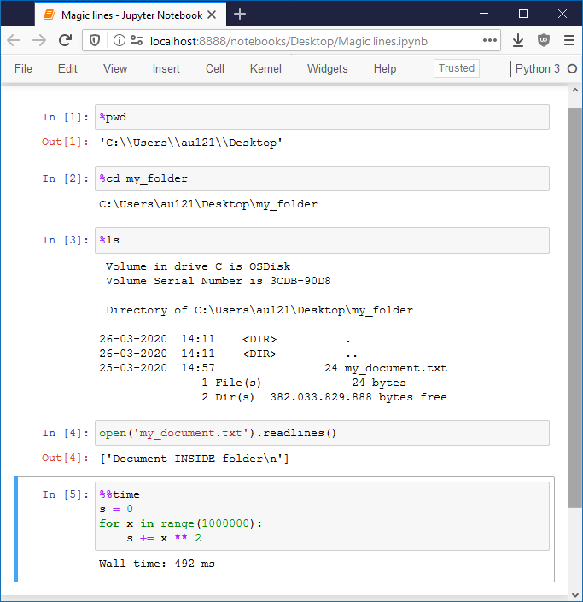
Magic lines
Jupyter code cells support magic commands (actually it is IPython)
% is a line magic
%% is a cell magic
%lsmagic | list magic commands
%quickref | quick reference sheet to IPython
%pwd | print working directory (current folder)
%cd directory | change directory (absolut or relative)
%ls | list content of current directory
%pip or %conda | run pip or conda from jupyter
%load script | insert external script into cell
%run program | run external program and show output
%automagic | toggle if %-prefix is required
%matplotlib inline | no zoom & resize, allows multiple plots
%matplotlib widget | a single plot can be zoomed & resized
%%writefile file | write content of cell to a file
%%time | measure time for cell execution
%timeit expression | time for simple expression

Slide 31
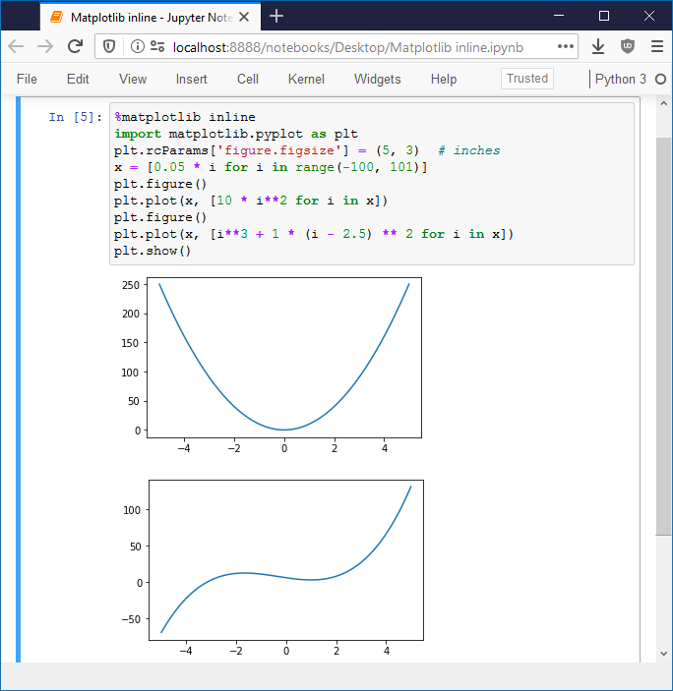
Jupyter and matplotlib
%matplotlib inline
pyplot figures are shown without interactive zoom and pan (default)
Consider changing default figure size
  plt.rcParams['figure.figsize']
Start each figure with plt.figure
Final call to show can be omitted

Slide 32
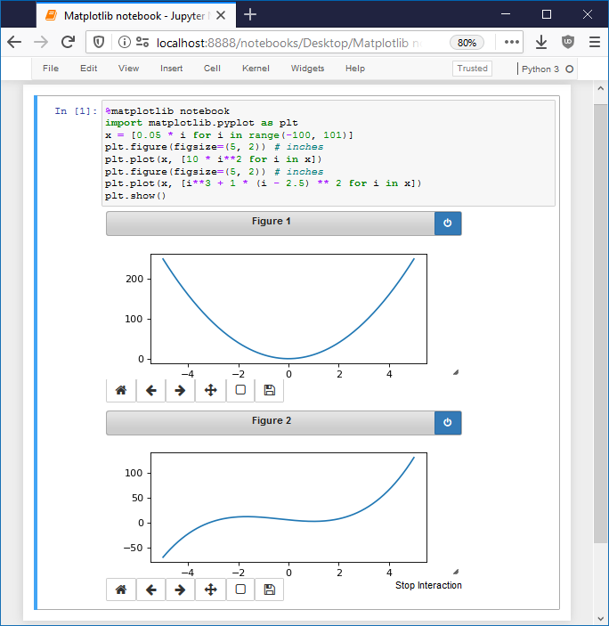
Jupyter and matplotlib
%matplotlib notebook
pyplot figures are shown with interactive zoom and pan
Start each figure with plt.figure (also allows setting figure size)
end
interaction
resize
button
Notes:
The magic below stopped working in recent versions of Jupyter
%matplotlib notebook

Slide 33
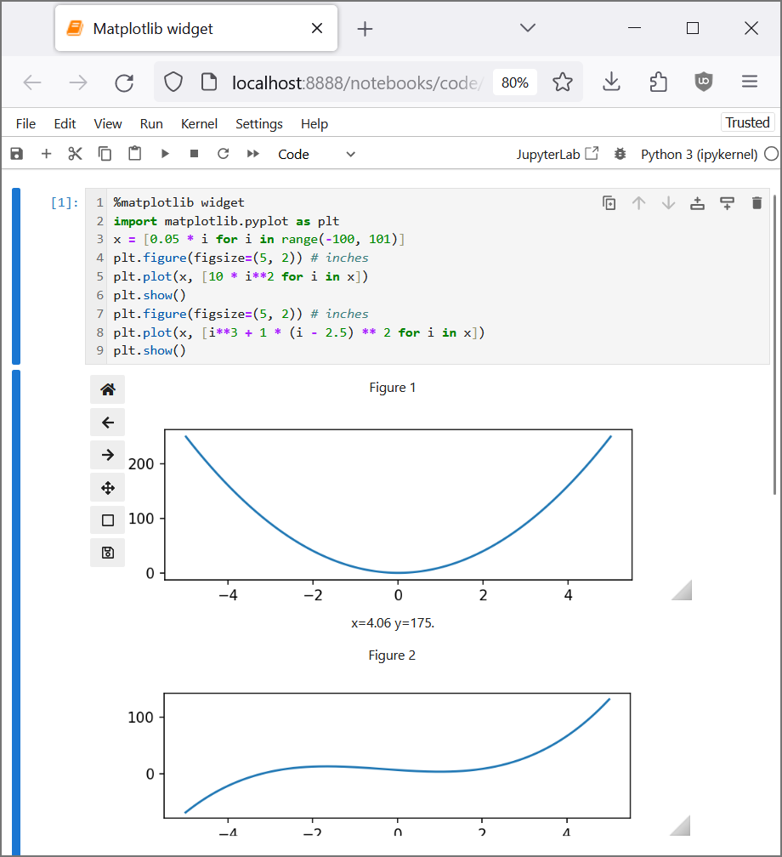
Jupyter and matplotlib
%matplotlib widget
pyplot figures are shown with interactive zoom and pan
pip install ipympl
Start each figure with plt.figure (also allows setting figure size)
Final call to show can be omitted
resize
button
Notes:
matplotlib.pyplot.ion() and matplotlib.pyplot.ioff() # interactive on/off does not seem to be needed when using Jupyter ???

Slide 34

Widespread tool used for data science applications
Documentation, code for data analysis, and resulting visualizations are stored in one common format
Easy to update visualizations
Works with about 100 different programming languages
(not only Python 3), many special features, ....
Easy to share data analysis
IDEs with Notebook support: VS Code, Spyder, PyCharm
Online Jupyter Notebook with no setup: colab.google
Many online tutorials and examples are available
https://www.youtube.com/results?search_query=jupyter+python

Slide 35
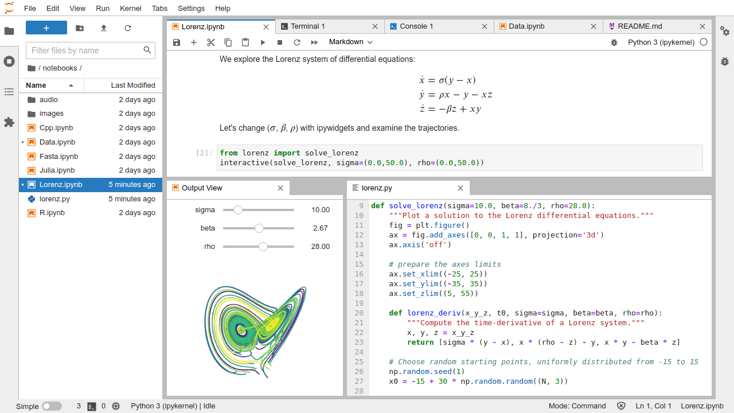
JupyterLab: A Next-Generation Notebook Interface
jupyter.org jupyterlab.readthedocs.io
Notes:
Start from shell using "jupyter lab"
Supports:
Multi tab
OS shell and Python shell
Multiple views to same file
File browser in left pane
…

Slide 36
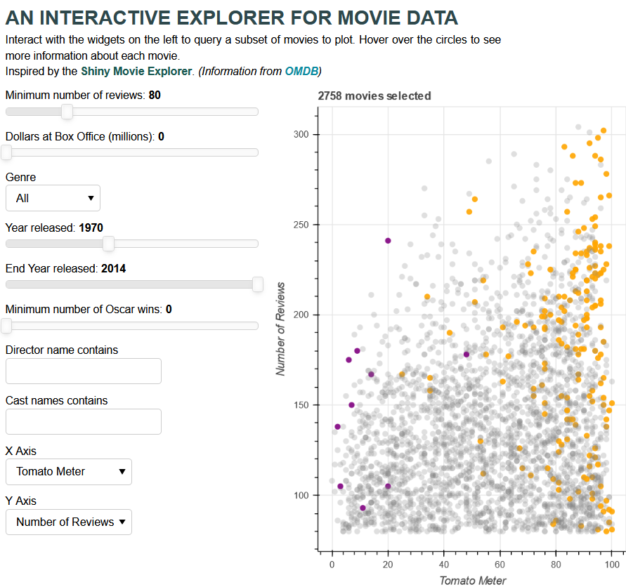
Visualization libraries
Altair - altair-viz.github.io
Bokeh - bokeh.org
Plotly - plotly.com/python
Seaborn - seaborn.pydata.org
demo.bokeh.org/movies
Notes:
For more information: https://kursuskatalog.au.dk/en/course/120246/Data-Visualization
Hans-Jörg recommends BOKEH good for interactive visualizations
Python backend => Javascript frontend (via Json),
where one can inject (Javascript)
uses "listeners" to update different components

Slide 37
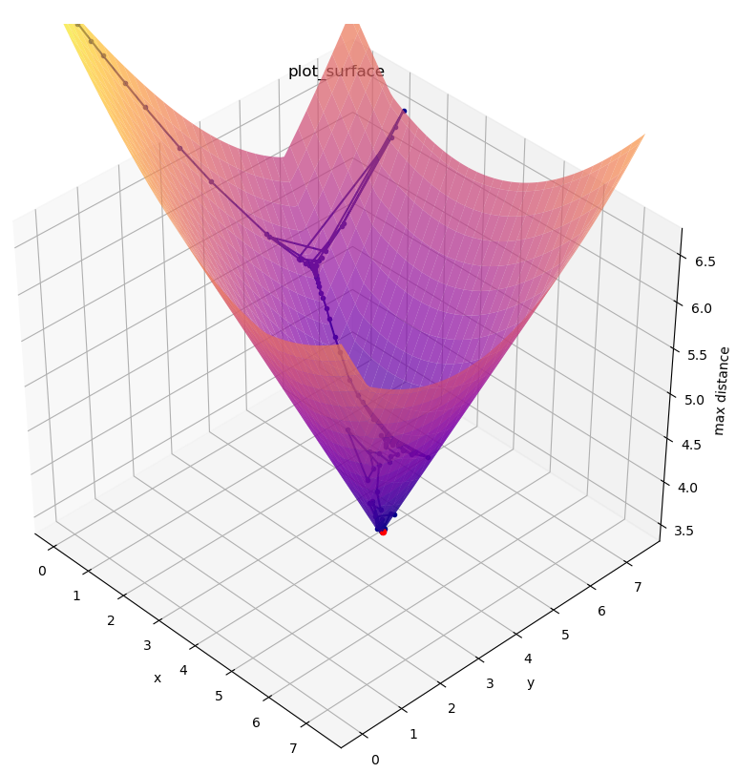

scipy.optimize.minimize
Find point p minimizing function f
Supports 13 algorithms – but no guarantee that result is correct
Knowledge about optimization will help you know what optimization algorithm to select and what parameters to provide for better results
WARNING
Many solvers return the wrong value when used as a black box
pip install scipy
docs.scipy.org/doc/scipy/reference/generated/scipy.optimize.minimize.html

Slide 38
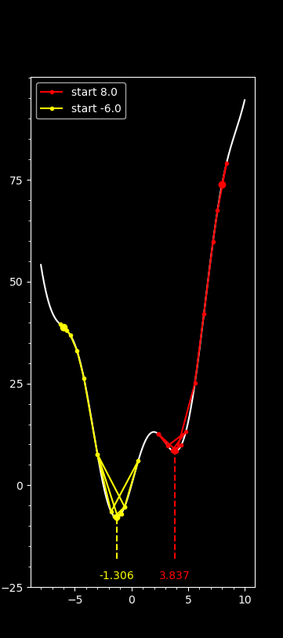
Python shell
print(solution) final_simplex: (array([[-1.3064209 ], [-1.30649414]]), array([-7.94582337, -7.94582336])) fun: -7.94582337348758 message: 'Optimization terminated successfully.' nfev: 38 nit: 19 status: 0 success: True x: array([-1.3064209])
minimize.py
from math import sin import matplotlib.pyplot as plt from scipy.optimize import minimize trace = [] # remember calls to f def f(x): value = x[0]**2 + 10*sin(x[0]) trace.append((x[0], value)) return value X = [-8 + 18 * i / 9999 for i in range(1000)] Y = [f([x]) for x in X] plt.style.use('dark_background') plt.plot(X, Y, 'w-') for start, color in [(8, 'red'), (-6, 'yellow')]: trace = [] solution = minimize(f, [start], method='nelder-mead') x, y = solution.x[0], solution.fun plt.plot(*zip(*trace), '.-', c=color, label=f'start {start:.1f}') # trace plt.plot(*trace[0], 'o', c=color) # first trace point plt.text(x, -23, f'{x:.3f}', c=color, ha='center') # show minimum x plt.plot([x, x], [-18, y], '--', c=color) # dash to minimum plt.xticks(range(-5, 15, 5)) plt.yticks(range(-25, 100, 25)) plt.minorticks_on() plt.legend() plt.show()
minimize tries to find a local minimum for f by repeatedly evaluating f for different x values
Notes:
minimize(lambda x: (x[1] - 4) ** 2 + (x[0] - 3) ** 2, [(0, 0)])

Slide 39
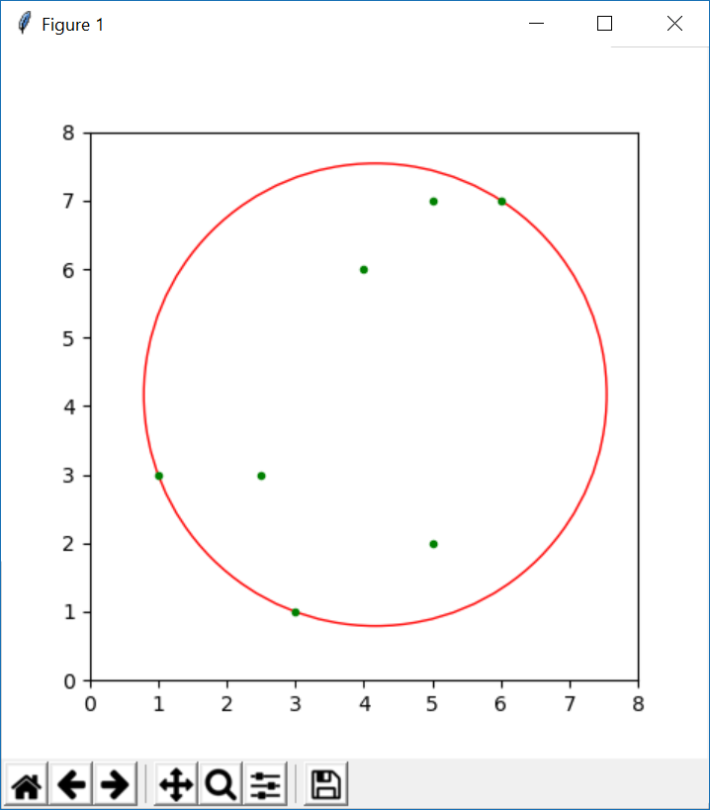
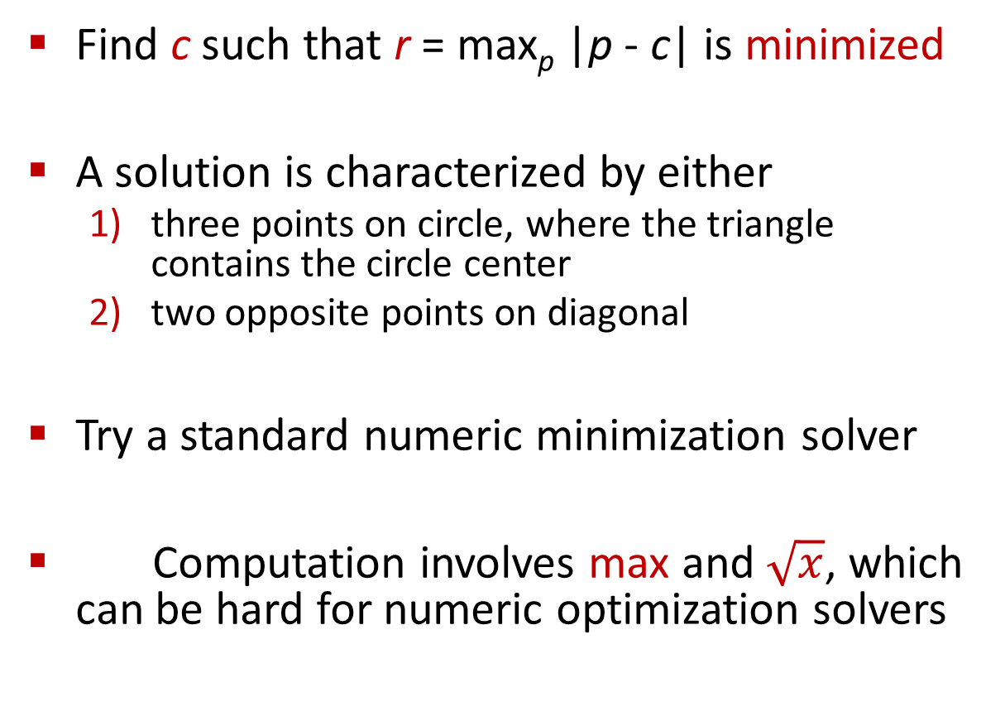
Example: Minimum enclosing circle
Find c such that r = max_{p} |p - c| is minimized
A solution is characterized by either
  three points on circle, where the triangle contains the circle center
  two opposite points on diagonal
Try a standard numeric minimization solver
Computation involves max and $\sqrt{x}$, which can be hard for numeric optimization solvers
r
c = (x, y)
Notes:
c two dimensional point
WARNING: the function r is not convex

Slide 40
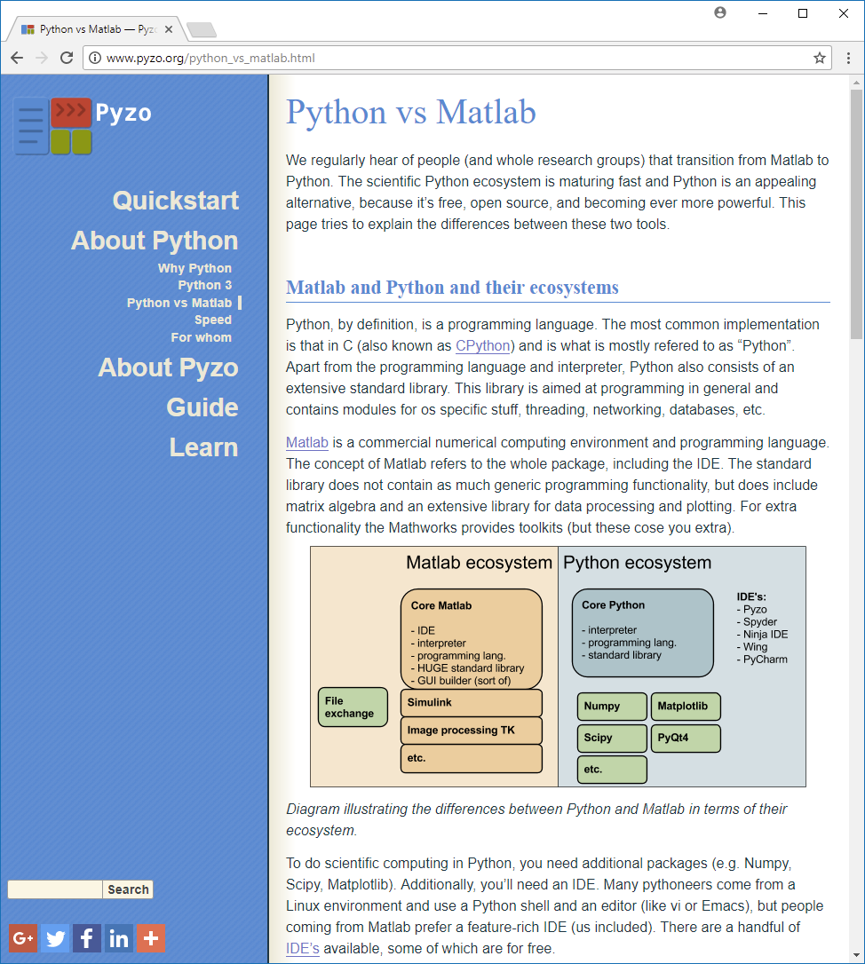
Python/scipy vs MATLAB
Some basic differences
“end” closes a MATLAB block
“;” at end of command avoids command output
a(i) instead a[i]
1st element of a list a(1)
a(i:j) includes both a(i) and a(j)
like R, Mathematica, Julia, AWK, Smalltalk, ...
Notes:
Python vs Matlab
http://www.pyzo.org/python_vs_matlab.html
Matlab: Commercial and proprietary, uses “;”
Python: Free, open source, beautiful and powerful programming language

Slide 41
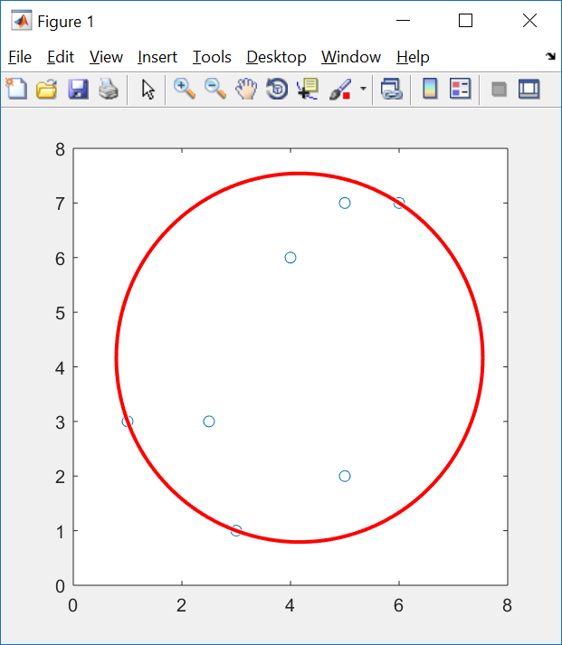
Minimum enclosing circle in MATLAB
enclosing_circle.m
% Minimum enclosing circle of a point set % fminsearch uses the Nelder-Mead algorithm global x y x = [1.0, 3.0, 2.5, 4.0, 5.0, 6.0, 5.0]; y = [3.0, 1.0, 3.0, 6.0, 7.0, 7.0, 2.0]; c = fminsearch(@(x) max_distance(x), [0,0]); plot(x, y, "o"); viscircles(c, max_distance(c)); function dist = max_distance(p) global x y dist = 0.0; for i=1:length(x) dist = max(dist, pdist([p; x(i), y(i)], 'euclidean')); end end
Notes:
pdist computes the distane between two vector wrt different norms
@ = lambda

Slide 42
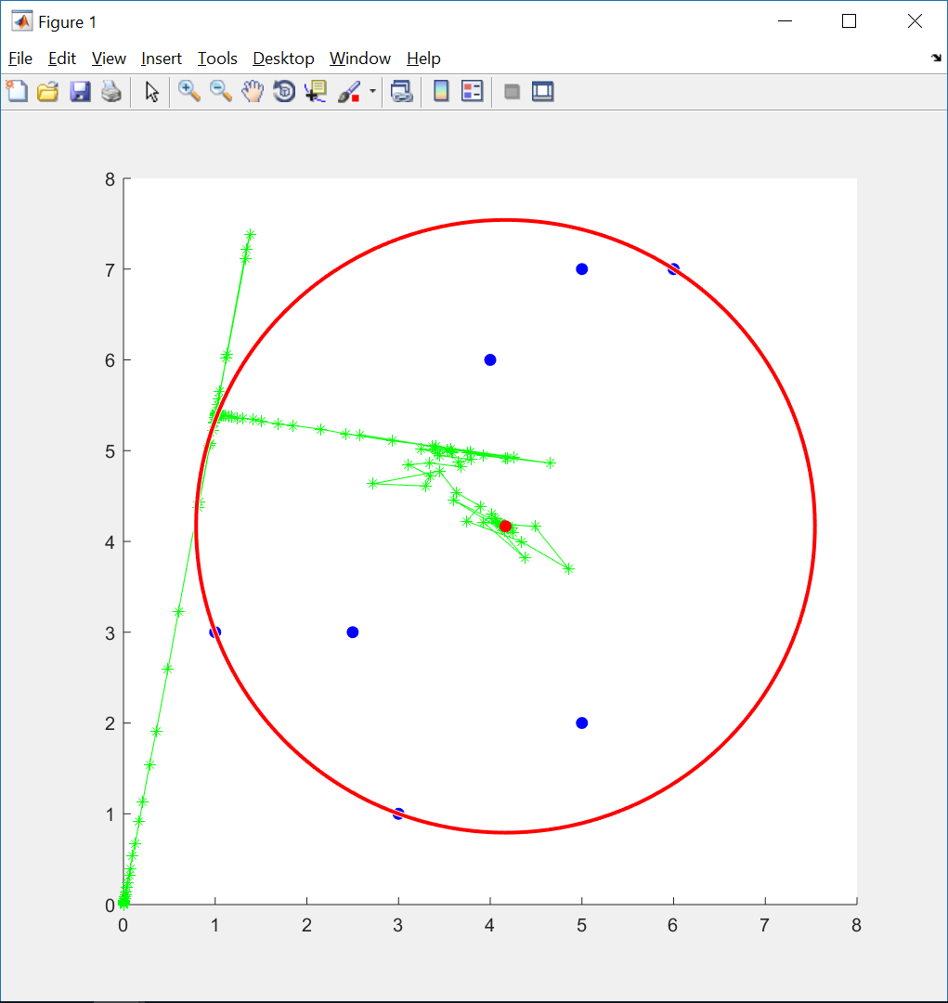
Minimum enclosing circle in MATLAB (trace)
enclosing_circle_trace.m
global x y trace_x trace_y x = [1.0, 3.0, 2.5, 4.0, 5.0, 6.0, 5.0]; y = [3.0, 1.0, 3.0, 6.0, 7.0, 7.0, 2.0]; trace_x = []; trace_y = []; c = fminsearch(@(x) max_distance(x), [0, 0]); hold on plot(x, y, "o", 'color', 'b', 'MarkerFaceColor', 'b'); plot(trace_x, trace_y, "*-", "color", "g"); plot(c(1), c(2), "o", 'color', 'r', 'MarkerFaceColor', 'r'); viscircles(c, max_distance(c), "color", "red"); function dist = max_distance(p) global x y trace_x trace_y trace_x = [trace_x, p(1)]; trace_y = [trace_y, p(2)]; dist = 0.0; for i=1:length(x) dist = max(dist, pdist([p; x(i), y(i)], 'euclidean' )); end end
Notes:
“hold on” used to get all the plots into one plot
Note that function max_distance is called above its definition

Slide 43
Minimum enclosing circle in Python
enclosing_circle.py
from scipy.optimize import minimize import matplotlib.pyplot as plt x = [1.0, 3.0, 2.5, 4.0, 5.0, 6.0, 5.0] y = [3.0, 1.0, 3.0, 6.0, 7.0, 7.0, 2.0] def dist(p, q): return ((p[0] - q[0]) ** 2 + (p[1] - q[1]) ** 2)) ** 0.5 def max_distance(c): return max([dist(p, c) for p in zip(x, y)]) c = minimize(max_distance, [0.0, 0.0], method='nelder-mead').x ax = plt.gca() ax.set_xlim((0, 8)) ax.set_ylim((0, 8)) ax.set_aspect('equal') plt.plot(x, y, 'g.') ax.add_artist(plt.Circle(c, max_distance(c), color='r', fill=False)) plt.show()
import modules
optimization method
manually set axis (force circle inside plot)

Slide 44
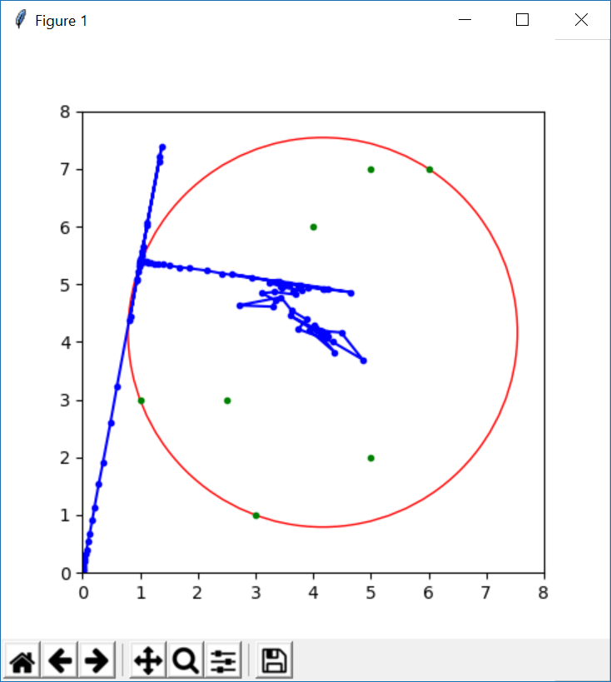
Minimum enclosing circle in Python (trace)
enclosing_circle_trace.py
from scipy.optimize import minimize import matplotlib.pyplot as plt x = [1.0, 3.0, 2.5, 4.0, 5.0, 6.0, 5.0] y = [3.0, 1.0, 3.0, 6.0, 7.0, 7.0, 2.0] trace = [] def dist(p, q): return ((p[0] - q[0]) ** 2 + (p[1] - q[1]) ** 2) ** 0.5 def max_distance(c): trace.append(c) return max([dist(p, c) for p in zip(x, y)]) c = minimize(max_distance, [0.0, 0.0], method='nelder-mead').x ax = plt.gca() ax.set_xlim((0, 8)) ax.set_ylim((0, 8)) ax.set_aspect("equal") plt.plot(x, y, "g.") plt.plot(*zip(*trace), 'b.-') ax.add_artist(plt.Circle(c, max_distance(c), color='r', fill=False)) plt.show()

Slide 45
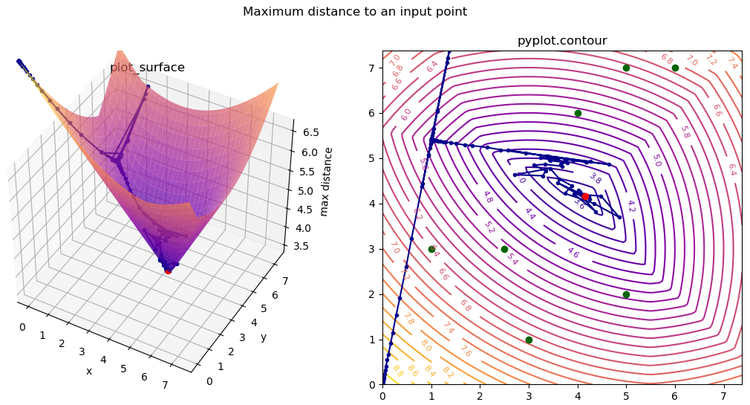
Minimum enclosing circle – search space

Slide 46
enclosing_circle_search_space.py (previous slide)
from scipy.optimize import minimize import matplotlib.pyplot as plt import numpy as np from mpl_toolkits.mplot3d import Axes3D points = [(1.0, 3.0), (3.0, 1.0), (2.5, 3.0), (4.0, 6.0), (5.0, 7.0), (6.0, 7.0), (5.0, 2.0)] # Minimum enclosing circle solver trace = [] def distance(p, q): return ((p[0]-q[0])**2 + (p[1]-q[1])**2)**0.5 def distance_max(q): dist = max([distance(p, q) for p in points]) trace.append((*q, dist)) return dist solution = minimize(distance_max, [0.0, 0.0], method='nelder-mead') center = solution.x radius = solution.fun # unzip point coordinates points_x, points_y = zip(*points) trace_x, trace_y, trace_z = zip(*trace) # Bounding box [x_min, x_max] x [y_min, y_max] xs, ys = points_x + trace_x, points_y + trace_y x_min, x_max = min(xs), max(xs) y_min, y_max = min(ys), max(ys) # enforce apsect ratio x_max = max(x_max, x_min + y_max - y_min) y_max = max(y_max, y_min + x_max - x_min) | # Minimum enclosing circle - 3D surface plot # (plot_surface requires X, Y, Z are 2D numpy.arrays) X, Y = np.meshgrid(np.linspace(x_min, x_max, 100), np.linspace(y_min, y_max, 100)) Z = np.zeros(X.shape) for px, py in points: Z = np.maximum(Z, (X - px)**2 + (Y - py)**2) Z = np.sqrt(Z) ax = plt.subplot(1, 2, 1, projection='3d') ax.plot_surface(X, Y, Z, cmap='plasma', alpha=0.7) ax.plot(trace_x, trace_y, trace_z, '.-', c='darkblue') ax.scatter(*center, radius, 'o', c='red') ax.set_xlabel('x') ax.set_ylabel('y') ax.set_zlabel('max distance') ax.set_title('plot_surface') # Minimum enclosing circle - contour plot plt.subplot(1, 2, 2) plt.title('pyplot.contour') plt.plot(trace_x, trace_y, '.-', color='darkblue') plt.plot(points_x, points_y, 'o', color='darkgreen') plt.plot(*center, 'o', c='red') qcs = plt.contour(X, Y, Z, levels=30, cmap='plasma') plt.clabel(qcs, inline=1, fontsize=8, fmt='%.1f') plt.suptitle('Maximum distance to an input point') plt.tight_layout() plt.show()
numpy arrays
Notes:
plt.contour returns “contour.QuadContourSet”

Slide 47
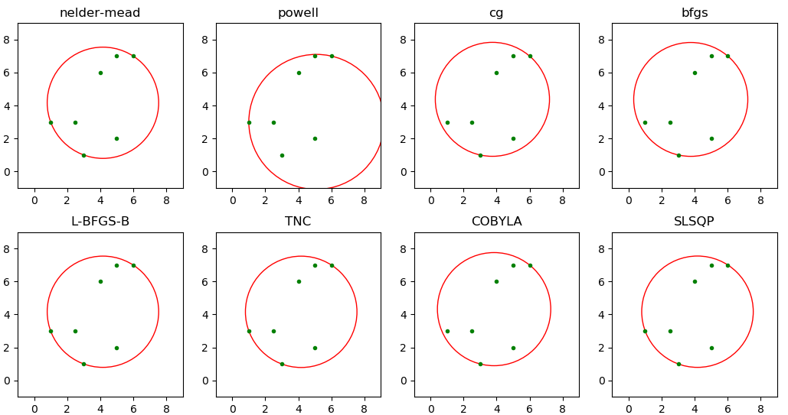


scipy.minimize $f\left(c\right)=\max_{p}{|p−c|}$
scipy default method
docs.scipy.org/doc/scipy/reference/generated/scipy.optimize.minimize.html
Notes:
these are the 8 optimization algorithms that can be run without any arguments further, the remaining algorithms require additional parameters to increase quality of search

Slide 48
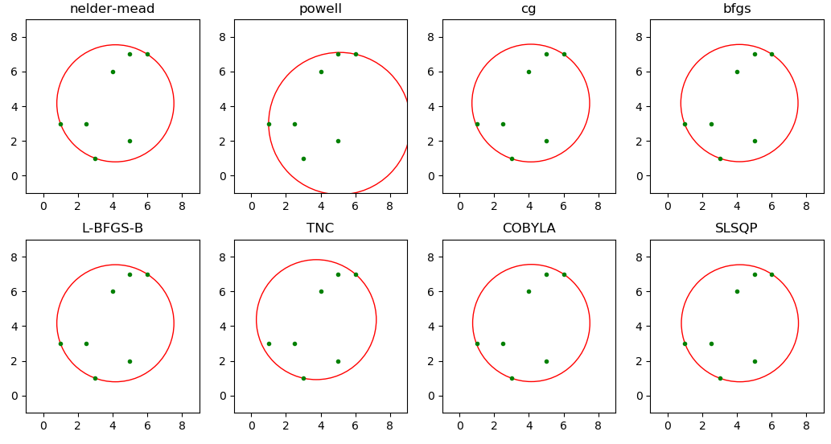

avoids
scipy.minimize $f\left(c\right)=\max_{p}{{|p−c|}^{2}}$
(improved)
scipy default method
(improved)

