Slide 1
Multi-dimensional data
NumPy
matrix multiplication, @
numpy.linalg.solve, numpy.polyfit
Array programming with NumPy
Harris et al.
Nature, volume 585, pages 357–362, 2020
DOI 10.1038/s41586-020-2649-2
Notes:
Nature 2020 article summarizing the history of Numpy

Slide 2

NumPy is a Python package for dealing with multi-dimensional data
www.numpy.org
docs.scipy.org/doc/numpy/user/quickstart.html

Slide 3
pylab ?
Guttag [2nd edition] uses pylab in the examples, but...
“pylab is a convenience module that bulk imports matplotlib.pyplot (for plotting) and numpy (for mathematics and working with arrays) in a single name space. Although many examples use pylab, it is no longer recommended.”
matplotlib.org/faq/usage_faq.html

Slide 4
NumPy arrays (example)
Python shell
range(0, 1, .3) TypeError: 'float' object cannot be interpreted as an integer [1 + i / 4 for i in range(5)] [1.0, 1.25, 1.5, 1.75, 2.0]
python only supports ranges of int
generate 5 uniform values in range [1,2]
Python shell
import numpy as np np.arange(0, 1, 0.3) array([0. , 0.3, 0.6, 0.9]) type(np.arange(0, 1, 0.3)) <class 'numpy.ndarray'> help(numpy.ndarray) +2000 lines of text np.linspace(1, 2, 5) array([1. , 1.25, 1.5 , 1.75, 2. ])
numpy can generate ranges with float
returns a ”NumPy array” (not a list)
”arange” ≡ ”array range” and generates the array explicitly
generate n uniformly spaced values

Slide 5
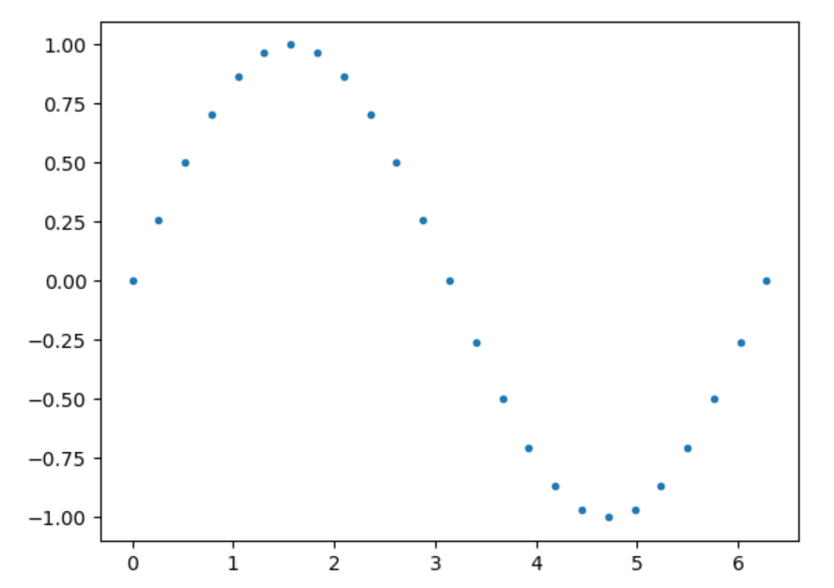
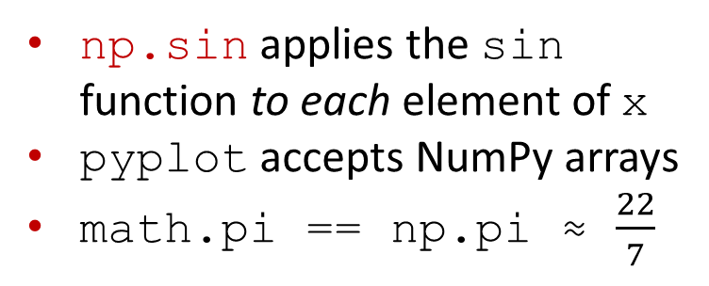
Plotting a function (example)
sin.py
import matplotlib.pyplot as plt import math n = 25 x = [2 * math.pi * i / (n - 1) for i in range(n)] y = [math.sin(v) for v in x] plt.plot(x, y, '.') plt.show()
sin_numpy.py
import matplotlib.pyplot as plt import numpy as np x = np.linspace(0, 2 * np.pi, 25) y = np.sin(x) plt.plot(x, y, '.') plt.show()
np.sin applies the sin function to each element of x
pyplot accepts NumPy arrays
math.pi == np.pi ≈ $\frac{22}{7}$
Notes:
linspace generate by default 50 values if 3rd value omitted

Slide 6
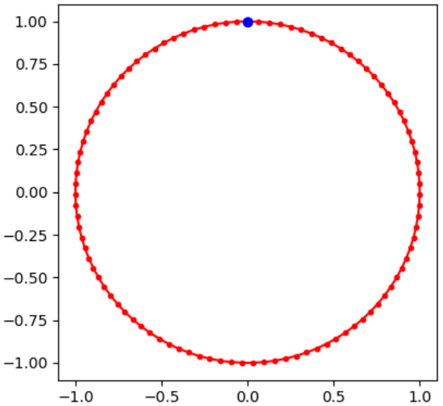
A circle
circle.py
import matplotlib.pyplot as plt import numpy as np a = np.linspace(0, 2 * np.pi, 100) x = np.sin(a) y = np.cos(a) plt.plot(x, y, 'r.-') plt.plot(x[0], y[0], 'bo') plt.show()

Slide 7
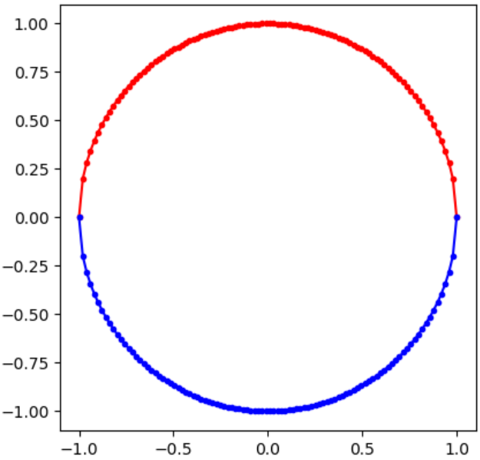

Two half circles
half_circles.py
import matplotlib.pyplot as plt import numpy as np x = np.linspace(-1, 1, 100) plt.plot(x, np.sqrt(1 – x ** 2), 'r.-') plt.plot(x, -np.sqrt(1 – x ** 2), 'b.-') plt.show()
$$x^{2}+y^{2}=1$$
$$⇓$$
$$y=±\sqrt{1−x^{2}}$$
compact expression computing something quite comlicated
x is a NumPy array
** NumPy method __pow__ squaring each element in x
binary - NumPy method __rsub__ that for each element e in x computes 1 - e
np.sqrt NumPy method computing the square root of each element in x
unary – NumPy method __neg__ that negates each element in x
Notes:
Could also have used ”** 0.5”

Slide 8

Creating one-dimensional NumPy arrays
Python shell
np.array([1, 2, 3]) array([1, 2, 3]) np.array((1, 2, 3)) array([1, 2, 3]) np.array(range(1, 4)) array([1, 2, 3]) np.arange(1., 4., 1.) array([1., 2., 3.]) np.linspace(1, 3, 3) array([1., 2., 3.]) np.zeros(3) array([0., 0., 0.]) np.ones(3) array([1., 1., 1.]) np.full(3, 7) array([7, 7, 7]) np.random.random(3) array([0.73761651, 0.60607355, 0.3614118 ]) | np.array([1, 2, 3]).dtype # type of all values dtype('int32') np.arange(3, dtype='float') array([0., 1., 2.]) np.arange(3, dtype='int16') # 16 bit integers array([0, 1, 2], dtype=int16) np.arange(3, dtype='int32') # 32 bit integers array([0, 1, 2]) 1000 ** np.arange(5) array([1, 1000, 1000000, 1000000000, -727379968], dtype=int32) # OOPS.. overflow 1000 ** np.arange(5, dtype='O') array([1, 1000, 1000000, 1000000000, 1000000000000], dtype=object) # Python integer np.arange(3, dtype='complex') array([0.+0.j, 1.+0.j, 2.+0.j])
slow
Elements of a NumPy array are not arbitrary precision integers by default – you can select between +25 number representations
https://numpy.org/doc/stable/reference/arrays.scalars.html
Notes:
np.array accepts an array like argument - e.g. not a generator object
np.array with integers generates an array with int32

Slide 9
Supported dtypes
The supported dtypes is platform dependent
Python shell
import numpy as np list(np.sctypeDict) ['bool', 'float16', 'float32', 'float64', 'longdouble', 'complex64', 'complex128', 'clongdouble', 'bytes_', 'str_', 'void', 'object_', 'datetime64', 'timedelta64', 'int8', 'byte', 'uint8', 'ubyte', 'int16', 'short', 'uint16', 'ushort', 'intc', 'uintc', 'int32', 'long', 'uint32', 'ulong', 'int64', 'longlong', 'uint64', 'ulonglong', 'intp', 'uintp', 'double', 'cdouble', 'single', 'csingle', 'half', 'bool_', 'int_', 'uint', 'float', 'complex', 'object', 'bytes', 'a', 'int', 'str', 'unicode']
https://numpy.org/doc/stable/reference/arrays.scalars.html
Notes:
Until numpy Version 2.0 one could use np.sctypes to get all types

Slide 10
Mantissa size in various numpy floats
Python shell
for data_type in ['half', 'float', 'single', 'double', 'longdouble', 'float32', 'float64']: x = np.array([1], dtype=data_type) for i in range(100): if x == x + (x / 2) ** i: break print(data_type, i - 1, 'bits mantissa') half 10 bits mantissa float 52 bits mantissa single 23 bits mantissa double 52 bits mantissa longdouble 52 bits mantissa float32 23 bits mantissa # platform independent float64 52 bits mantissa # platform independent
mantissa
1.0000100000₂
i
docs.scipy.org/doc/numpy-1.13.0/user/basics.types.html

Slide 11
Creating multi-dimensional NumPy arrays
Python shell
np.array([[1, 2, 3], [4, 5, 6]]) array([[1, 2, 3], [4, 5, 6]]) np.array([[1, 2], [4, 5, 6]]) ValueError: inhomogeneous shape np.arange(1, 7).reshape(2, 3) array([[1, 2, 3], [4, 5, 6]]) x = np.arange(12).reshape(2, 2, 3) x array([[[ 0, 1, 2], [ 3, 4, 5]], [[ 6, 7, 8], [ 9, 10, 11]]]) numpy.zeros((2, 5), dtype='int32') array([[0, 0, 0, 0, 0], [0, 0, 0, 0, 0]]) | x.size 12 x.ndim 3 x.shape (2, 2, 3) x.dtype dtype('int32') x.flatten() array([0,1,2,3,4,5,6,7,8,9,10,11]) list(x.flat) # flat is an iterator [0,1,2,3,4,5,6,7,8,9,10,11] np.eye(3) # diagonal 2D array array([[1., 0., 0.], [0., 1., 0.], [0., 0., 1.]])
Notes:
Rows must contain same number of values
np.array([[1,2],[3,4,5]]) -> ValueError: inhomogeneous shape

Slide 12
View vs Copy
Python shell
x = np.arange(6) y = x.reshape(2, 3) # view y[0][0] = 42 # updates x x array([42, 1, 2, 3, 4, 5]) y array([[42, 1, 2], [ 3, 4, 5]]) z = y.flatten() # copy z[5] = 0 z array([42, 1, 2, 3, 4, 0]) x array([42, 1, 2, 3, 4, 5]) w = y.ravel() # view w[5] = -1 w array([42, 1, 2, 3, 4, -1]) x array([42, 1, 2, 3, 4, -1])
Numpy is optimized to handle big multi-dimensional arrays
To avoid copying data, views allows one to look at the underlying data in different ways (data can be shared by multiple views)
reshape, ravel and slicing are examples creating views
flatten and ravel both turn multiple dimensional arrays into one dimensional arrays but flatten creates an explicit copy whereas ravel creates a space efficient view
Notes:
Views and slices are confusing!!!!
https://scipy-cookbook.readthedocs.io/items/ViewsVsCopies.html

Slide 13
NumPy operations
Python shell
x = numpy.arange(3) x array([0, 1, 2]) x + x # elementwise addition array([0, 2, 4]) 1 + x # add integer to each element array([1, 2, 3]) x * x # elementwise multiplication array([0, 1, 4]) np.dot(x, x) # dot product 5 np.cross([1, 2, 3], [3, 2, 1]) # cross product array([-4, 8, -4]) | a = np.arange(6).reshape(2,3) a array([[0, 1, 2], [3, 4, 5]]) a.T # matrix transposition, view array([[0, 3], [1, 4], [2, 5]]) a @ a.T # matrix multiplication array([[ 5, 14], [14, 50]]) a += 1 # modifies view a array([[1, 2, 3], [4, 5, 6]])
PEP 465 - A dedicated infix operator for matrix multiplication
Notes:
.cross for 3-dimensional vectors
.T is only a view - so updates are applied to original matrix
@ calls method __matmul__ on array

Slide 14
Universal functions (apply to each entry)
Python shell
x = np.array([[1, 2], [3, 4]]) np.sin(x) # also: cos, exp, sqrt, log, ceil, floor, abs array([[ 0.84147098, 0.90929743], [ 0.14112001, -0.7568025 ]]) np.sign(np.sin(x)) array([[ 1., 1.], [ 1., -1.]]) np.mod(np.arange(10), 3) # same as: np.arange(10) % 3 array([0, 1, 2, 0, 1, 2, 0, 1, 2, 0], dtype=int32)
Notes:
np.mod can also take two arrays and applied elementwise modulo

Slide 15
Axis
Python shell
x = np.arange(1, 7).reshape(2, 3) x array([[1, 2, 3], [4, 5, 6]]) x.sum() # = x.sum(axis=(0, 1)) 21 x.sum(axis=0) array([5, 7, 9]) x.sum(axis=1) array([6, 15]) x.min() # = x.min(axis=(0, 1)) 1
Python shell
x.min(axis=0) array([1, 2, 3]) x.min(axis=1) array([1, 4]) x.cumsum() array([ 1, 3, 6, 10, 15, 21], dtype=int32) x.cumsum(axis=0) array([[1, 2, 3], [5, 7, 9]], dtype=int32) x.cumsum(axis=1) array([[ 1, 3, 6], [ 4, 9, 15]], dtype=int32)
Notes:
sum(axis=0) removes axis 0 (sums over this axis)

Slide 16
Slicing
Python shell
x = numpy.arange(20).reshape(4, 5) x array([[ 0, 1, 2, 3, 4], [ 5, 6, 7, 8, 9], [10, 11, 12, 13, 14], [15, 16, 17, 18, 19]]) x[2, 3] # = x[(2, 3)] 13 x[1:4:2, 2:4:1] # rows 1 and 3, and columns 2 and 3, view array([[ 7, 8], [17, 18]]) x[:, 3] array([ 3, 8, 13, 18]) x[..., 3] # ... is placeholder for ':' for all missing dimensions array([ 3, 8, 13, 18]) type(...) <class 'ellipsis'>

Slide 17
Broadcasting (stretching arrays to get same size)
Python shell
x = np.array([[1, 2, 3], [4, 5, 6]]) y = np.array([1, 2, 3]) # one row z = np.array([[1], [2]]) # one column x + 3 # add 3 to each entry array([[4, 5, 6], [7, 8, 9]]) x + y # add y to each row array([[2, 4, 6], [5, 7, 9]]) x + z # add z to each column array([[2, 3, 4], [6, 7, 8]]) y + z # 2 rows with y + 3 columns with z array([[2, 3, 4], [3, 4, 5]]) z == z.T # [[1,1],[2,2]] == [[1,2],[1,2]] array([[ True, False], [False, True]])
Numpy tries to apply broadcasting, if array shapes do not match, i.e. adds missing leading dimensions and repeats a dimension with only one element:
[[1],[2]] + [10,20] column + row vector
≡ [[1],[2]] + [[10,20]] both ndim = 2
≡ [[1,1],[2,2]] + [[10,20]]
≡ [[1,1],[2,2]] + [[10,20],[10,20]]
≡ [[11,21],[12,22]]
To prevent unexpected broadcasting, add an assertion to your program:
assert x.shape == y.shape
docs.scipy.org/doc/numpy/user/basics.broadcasting.html

Slide 18
Masking
Python shell
x = np.arange(1, 11).reshape(2, 5) x array([[ 1, 2, 3, 4, 5], [ 6, 7, 8, 9, 10]]) x % 3 array([[1, 2, 0, 1, 2], [0, 1, 2, 0, 1]], dtype=int32) x % 3 == 0 array([[False, False, True, False, False], [ True, False, False, True, False]]) x[x % 3 == 0] # use Boolean matrix to select entries array([3, 6, 9]) x[:, x.sum(axis=0) % 3 == 0] # columns with sum divisible by 3 array([[ 2, 5], [ 7, 10]])
Notes:
x[:, could also be x[…,

Slide 19
Numpy is fast... but be aware of dtype
Python shell
sum([x**2 for x in range(1000000)]) 333332833333500000 (np.arange(1000000)**2).sum() 584144992 # wrong since overflow when default dtype='int32' (np.arange(1000000, dtype='int64')**2).sum() 333332833333500000 # 64 bit integers do not overflow import timeit from timeit timeit('sum([x**2 for x in range(1000000)])', number=1) 0.5614346340007614 timeit('(np.arange(1000000)**2).sum()', setup='import numpy as np', number=1) 0.014362967000124627 # ridiculous fast but also wrong result... timeit('(np.arange(1000000, dtype='int64')**2).sum()', setup='import numpy as np', number=1) 0.048017077999247704 # fast and correct np.iinfo(np.int32).min -2147483648 np.iinfo(np.int32).max 2147483647
results using a 32-bit Python installation
Notes:
Result assumes a 32 bit Python installation
~40 and ~10 times faster
timeit('sum(A)', setup='A = list(range(10**6))', number=100)
1.6
timeit('sum(A)', setup='import numpy as np; A = np.array(range(10**6))', number=100)
RuntimeWarning: overflow encountered in scalar add
4.1 # slower
timeit('np.sum(A)', setup='import numpy as np; A = np.array(range(10**6))', number=100)
timeit('A.sum()', setup='import numpy as np; A = np.array(range(10**6))', number=100)
0.02 # factor 100 faster

Slide 20
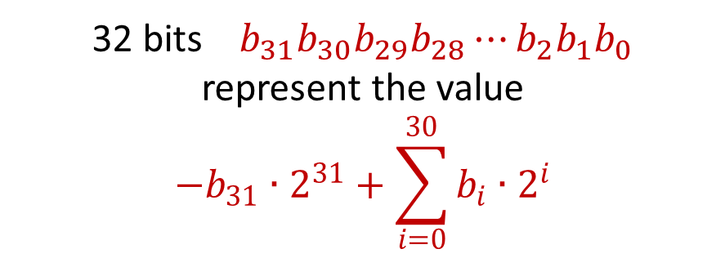
numpy.int32 – 32 bit signed two’s-complement integers
32 bits $b_{31}b_{30}b_{29}b_{28}⋯b_{2}b_{1}b_{0}$
represent the value
$${−b}_{31}∙2^{31}+\sum_{i=0}^{30}{b_{i}∙2^{i}}$$
Python shell
np.int32(- 2 ** 31) -2147483648 np.int32(- 2 ** 31) + 1 -2147483647 np.int32(- 2 ** 31) - 1 2147483647 np.int32(2 ** 31) OverflowError: Python int too large to convert to C long np.int32(2 ** 31 - 1) 2147483647 np.int32(2 ** 31 - 1) + 1 -2147483648 np.abs(np.int32(-2147483647)) 2147483647 np.abs(np.int32(-2147483648)) -2147483648
10000000000000000000000000000000 | -2147483648
10000000000000000000000000000001 | -2147483647
⁞
11111111111111111111111111111110 | -2
11111111111111111111111111111111 | -1
00000000000000000000000000000000 | 0
00000000000000000000000000000001 | 1
00000000000000000000000000000010 | 2
⁞
01111111111111111111111111111110 | 2147483646
01111111111111111111111111111111 | 2147483647
numpy.org/doc/stable/user/basics.types.html
en.wikipedia.org/wiki/Two’s_complement
Note: There is one more negative number than positive

Slide 21
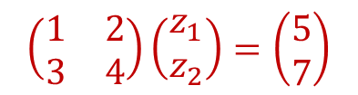
Linear algebra
docs.scipy.org/doc/numpy/reference/routines.linalg.html
numpy.matrix
“It is no longer recommended to use this class, even for linear algebra. Instead use regular arrays. The class may be removed in the future.”
Python shell
x = np.arange(1, 5, dtype=float).reshape(2, 2) x array([[1., 2.], [3., 4.]]) x.T # matrix transpose array([[1., 3.], [2., 4.]]) np.linalg.det(x) # matrix determinant -2.0000000000000004 np.linalg.inv(x) # matrix inverse array([[-2. , 1. ], [ 1.5, -0.5]]) np.linalg.eig(x) # eigenvalues and eigenvectors (array([-0.37228132, 5.37228132]), array([[-0.82456484, -0.41597356], [0.56576746, -0.90937671]])) y = np.array([[5.], [7.]]) np.linalg.solve(x, y) # solve linear matrix equations array([[-3.], # z1 [ 4.]]) # z2
$$\left(\begin{matrix}1 & 2 \\ 3 & 4\end{matrix}\right)\left(\begin{matrix}z_{1} \\ z_{2}\end{matrix}\right)=\left(\begin{matrix}5 \\ 7\end{matrix}\right)$$
Notes:
Eigenvector v for eigenvalue lambda: A * v = lambda * v
eig_values, eig_vectors = np.linalg.eig(x) # eig_vectors = matrix, each column an eigenvector
for i, c in enumerate(eig_values):
v = eig_vectors[:,i]
print(f'{i=}, {c=}, {v=}')
print(x @ v, c * v)

Slide 22
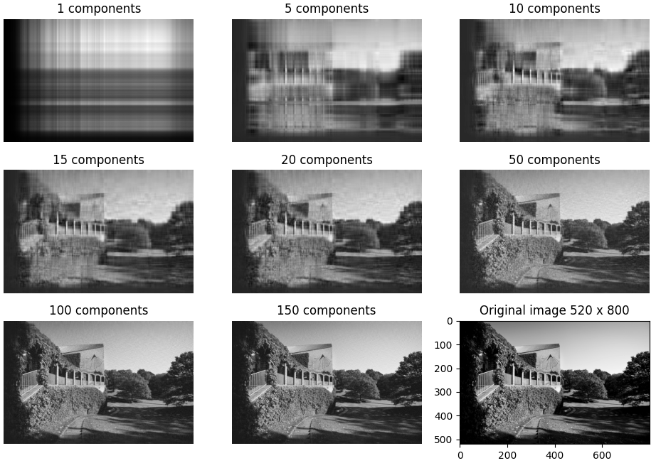
Singular value decomposition, np.linalg.svd
r
r
r
r
V
M
U
s
U and V unitary matrix (UU^{T} = I)
S diagonal matrix, decreasing singular values
=
0
0
m x n
m x m
m x n
n x n
np.ndarray shape=(520, 800) dtype=uint8 min=0 max=252
image-reconstruction.py
import numpy as np import cv2 # Computer Vision, opencv.org import matplotlib.pyplot as plt color = cv2.imread('university.jpg') # color image gray = cv2.cvtColor(color, cv2.COLOR_BGR2GRAY) # convert to gray u, s, v = np.linalg.svd(gray) # Calculating the SVD for i, r in enumerate([1, 5, 10, 15, 20, 50, 100, 150], start=1): rank_r = u[:, :r] @ np.diag(s[:r]) @ v[:r, :] plt.subplot(3, 3, i) plt.imshow(rank_r, cmap='gray', vmin=0, vmax=255) plt.title(f'{r} components') plt.axis('off') plt.subplot(3, 3, 9) plt.imshow(gray, cmap='gray') plt.title(f'Original image {gray.shape[0]} x {gray.shape[1]}') plt.show()
Notes:
image = matrix with values interpreted as how bright each pixel is
SVD not part of “Linear Algebra” course, but chapter 14.3 in lecture notes by Jesper Funch Thomsen
Example shows how SVD can be used for image compression
Pink part of V is required for making U unitary, but is not used at all in the final product (wasted computation…)
u, s, v are numpy arrays with floats

Slide 23
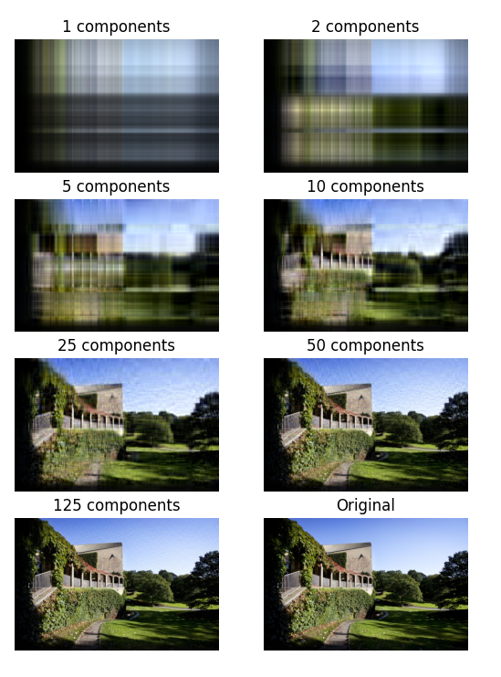
… and in color
image-reconstruction-color.py
import numpy as np import matplotlib.pyplot as plt from matplotlib.image import imread color = imread('university.jpg') color = color / 255 # convert integers 0..255 to floats 0..1 plt.subplot(4, 2, 8) plt.imshow(color) plt.axis('off') plt.title(f'Original') height, width, colors = color.shape u, s, v = np.linalg.svd(color.reshape((height, width * colors)), full_matrices=False) for i, r in enumerate([1, 2, 5, 10, 25, 50, 125], start=1): rank_r = u[:, :r] @ np.diag(s[:r]) @ v[:r, :] plt.subplot(4, 2, i) plt.imshow(rank_r.reshape((height, width, colors))) plt.title(f'{r} components') plt.axis('off') plt.show()
shape=(520, 800, 3)
3 = (red, blue, green)
shape=(520, 2400)
v shape=(520, 2400) instead of (2400, 2400)
shape=(520, 800, 3)
Notes:
np.linalg.svd(…full_matrices=False) only generates the non-zero part of V

Slide 24
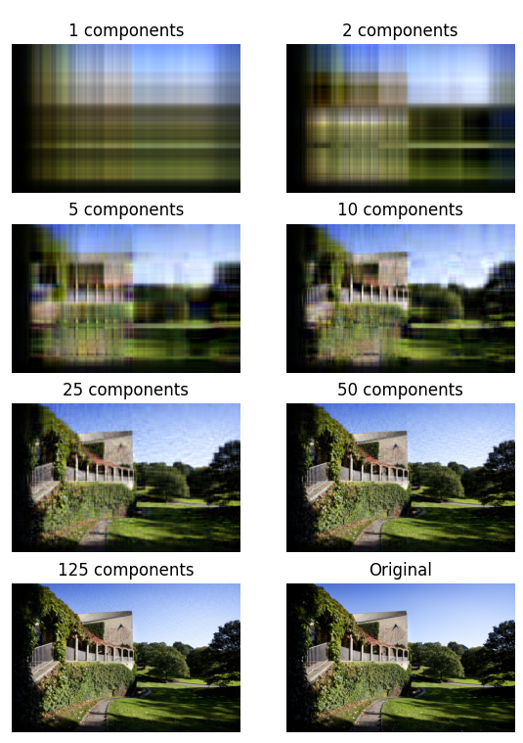
… and in color (stacked)
image-reconstruction-color-stacked.py
import numpy as np import matplotlib.pyplot as plt from matplotlib.image import imread color = imread('university.jpg') color = color / 255 # convert integers 0..255 to floats 0..1 plt.subplot(4, 2, 8) plt.imshow(color) plt.axis('off') plt.title(f'Original') u, s, v = np.linalg.svd(color.transpose(2, 0, 1), full_matrices=False) print(f'{u.shape=} {s.shape=} {v.shape=}') for i, r in enumerate([1, 2, 5, 10, 25, 50, 125], start=1): rank_r = (u[:, :, :r] * s[:, None, :r]) @ v[:, :r, :] plt.subplot(4, 2, i) plt.imshow(rank_r.transpose(1, 2, 0)) plt.title(f'{r} components') plt.axis('off') plt.show()
Python shell
u.shape=(3, 520, 520) s.shape=(3, 520) v.shape=(3, 520, 800)
shape = (520, 800, 3)
shape = (3, 520, 800)
element-wise multiplication (*),
broadcasting (None),
stacked for each color (:)
shape = (520, 800, 3)
Notes:
Apply SVD to each color seaparately
Replace muliplication by diagonal matrix by elementwise multiplication of broadcast row vector
Stacked, applies svd to each of the indexes of the first coordinate

Slide 25
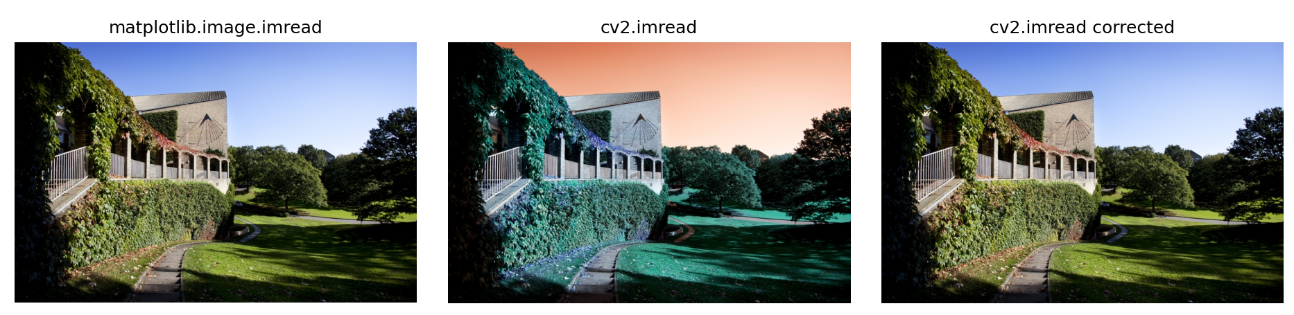
color-image.py
import matplotlib.pyplot as plt import matplotlib.image import cv2 img1 = matplotlib.image.imread('university.jpg') img2 = cv2.imread('university.jpg') # cv2 uses BGR instead of RGB img3 = img2[:, :, ::-1] # change color order BGR to RGB Images = [(img1, 'matplotlib.image.imread'), (img2, 'cv2.imread'), (img3, 'cv2.imread corrected')] for i, (img, title) in enumerate(images, start=1): plt.subplot(1, 3, i) plt.imshow(img) plt.axis('off') plt.title(title) plt.show()
Notes:
Red and Blue are swapped in the representation used by Open CV
Middle picture is not red dust from the Sahara….

Slide 26
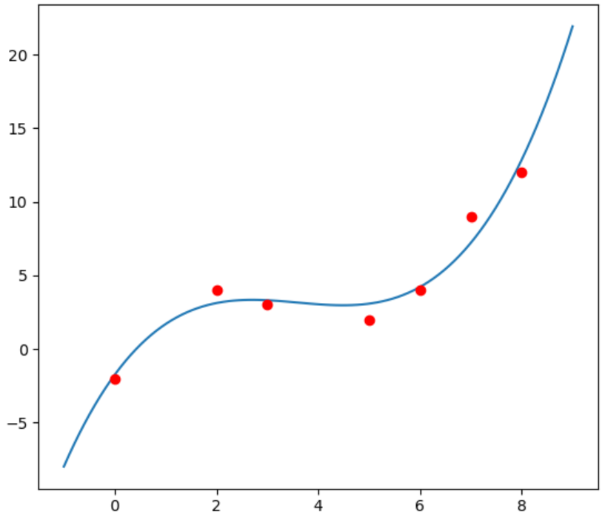
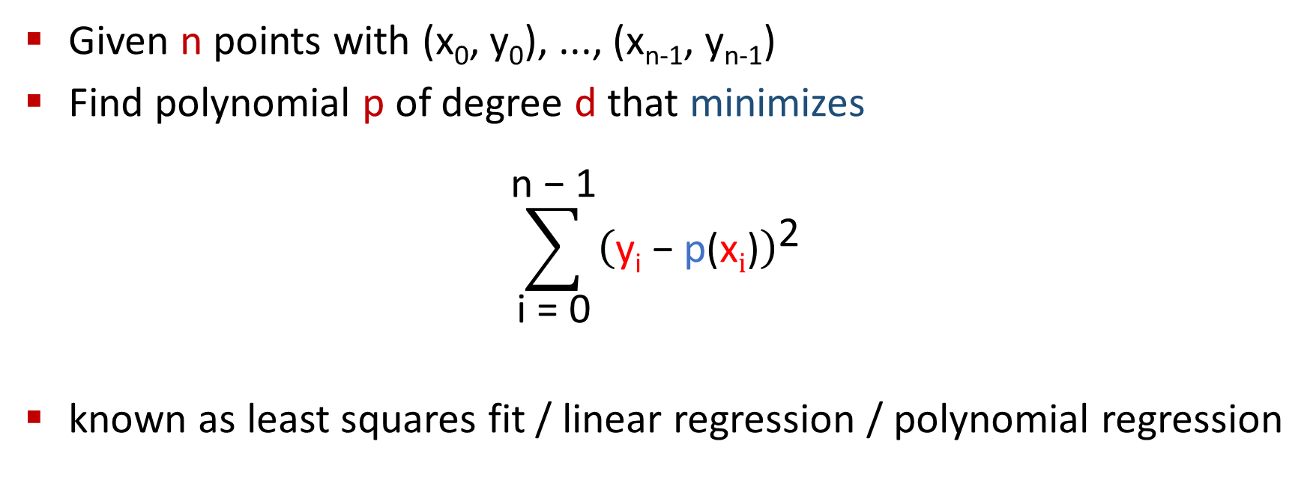
numpy.polyfit
Given n points with (x₀, y₀), ..., (x_{n-1}, y_{n-1})
Find polynomial p of degree d that minimizes
$$\sum_{\text{i} \text{=} \text{0}}^{\text{n} \text{−} \text{1}}{{\left(\text{y}\text{i}\text{ − }\text{p}\text{(}\text{x}\text{i}\text{)}\right)}^{\text{2}}}$$
known as least squares fit / linear regression / polynomial regression
docs.scipy.org/doc/numpy/reference/generated/numpy.polyfit.html
Notes:
d << n – otherwise overfitting

Slide 27
fit.py
import matplotlib.pyplot as plt import numpy as np x = [0, 2, 3, 5, 6, 7, 8] y = [-2, 4, 3, 2, 4, 9, 12] coefficients = np.polyfit(x, y, 3) fx = np.linspace(-1, 9, 100) fy = np.polyval(coefficients, fx) plt.plot(fx, fy, '-') plt.plot(x, y, 'ro') plt.show()
degree

Slide 28
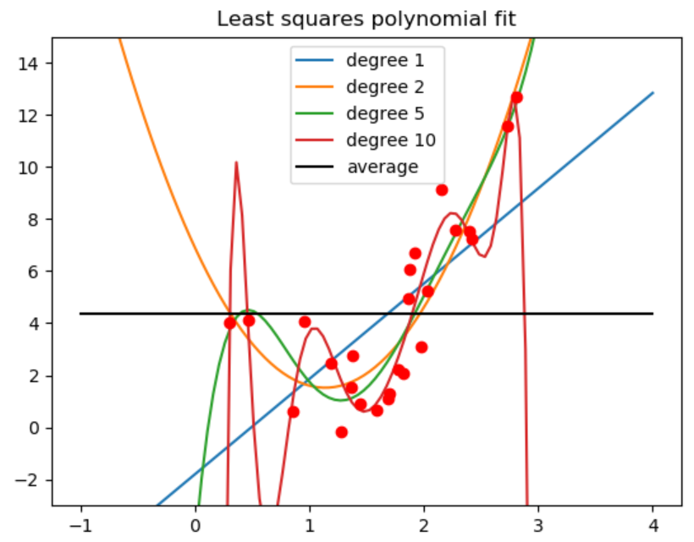

Slide 29
polyfit.py
import matplotlib.pyplot as plt import numpy as np x = 3 * np.random.random(25) noise = np.random.random(x.size) ** 2 y = 5 * x ** 2 - 12 * x + 7 + 5 * noise for degree in [1, 2, 5, 10]: coefficients = np.polyfit(x, y, degree) fx = np.linspace(-1, 4, 100) fy = np.polyval(coefficients, fx) plt.plot(fx, fy, '-', label=f'degree {degree}') avg = np.average(y) plt.plot(x, y, 'ro') plt.plot([-1, 4], [avg, avg], 'k-', label='average') plt.ylim(-3, 15) plt.title('Least squares polynomial fit') plt.legend() plt.show()

Slide 30
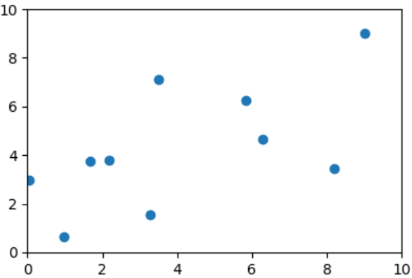
Animating bouncing balls
balls.py
import matplotlib.pyplot as plt from matplotlib.animation import FuncAnimation from numpy import zeros, maximum, minimum from numpy.random import random g = 0.01 N = 10 x, y = 10.0 * random(N), 1.0 + 9.0 * random(N) dx, dy = random(N) / 5, zeros(N) fig = plt.figure() plt.xlim(0, 10) plt.ylim(0, 10) balls, = plt.plot(x, y, 'o') # returns Line2D obj def move(frame): global x, y, dx, dy x += dx bounce = (x > 10.0) | (x < 0.0) # numpy mask dx[bounce] = -dx[bounce] x = minimum(10.0, maximum(0.0, x)) y += dy bounce = y < 0.0 # numpy mask y[bounce] -= dy[bounce] dy[bounce] = -dy[bounce] dy -= g balls.set_data(x, y) # update positions # removing 'ani =' causes program to fail... ani = FuncAnimation(fig, move, interval=25) plt.show()
matplotlib figures can be animated using
matplotlib.animation.FuncAnimation
that as arguments takes the figure to be updated/ redrawn, a function to call for each update, and an interval in milliseconds between updates
Notes:
numpy arrays are passed to matplotlib plot and set_data
y[bounce] -= dy[bounce] important to apply filters to both sides, to ensure the sliced arrays have the same size

Slide 31
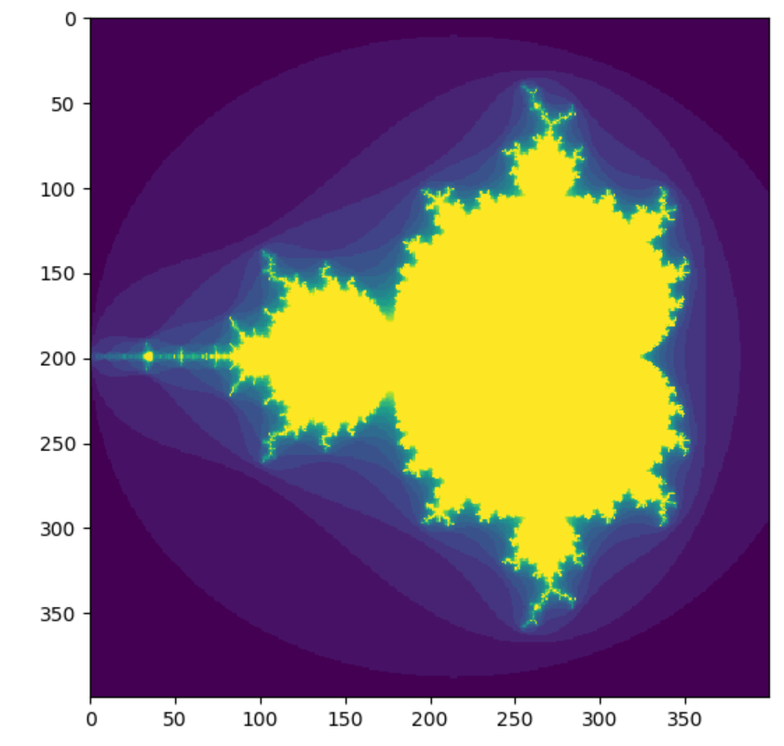

Slide 32
mandelbrot.py
import numpy as np import matplotlib.pyplot as plt def mandelbrot(h, w, maxit=20): '''Returns an image of the Mandelbrot fractal of size (h, w).''' x = np.linspace(-2.0, 0.8, w).reshape(1, w) # row vector y = np.linspace(-1.4, 1.4, h).reshape(h, 1) # column vector c = x + y * 1j # broadcast & complex z = c divtime = np.full(z.shape, maxit, dtype=int) # all values = maxit for i in range(maxit): z = z * z + c # elementwise diverge = z * np.conj(z) > 4 # who is diverging div_now = diverge & (divtime == maxit) # who is diverging now divtime[div_now] = i # note when z[diverge] = 0 # limit divergence return divtime # (avoids overflows) plt.imshow(mandelbrot(400, 400)) plt.show()
code from docs.scipy.org/doc/numpy/user/quickstart.html
Notes:
Basically for each point=convex number iterate a process. Color = number of steps until norm of number > 2.
2D numpy array (numbers 0..20) can be viewed as an image, pyplot applies default colomap (plasma?)
np.conj : Return the complex conjugate, element-wise (changing the sign of its imaginary part)
z * np.conj(z) = squared length of z
z[diverge] = 2 is to avoid overflow messages

