Slide 1
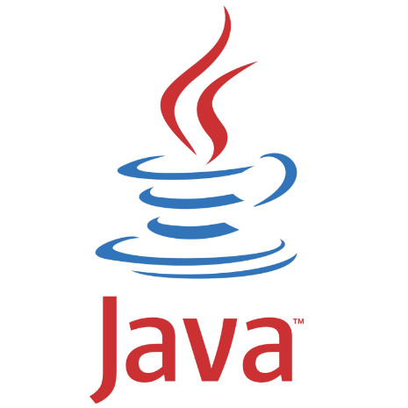
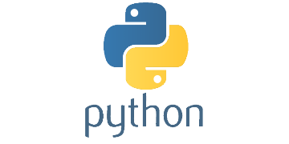
Java vs Python
runestone.academy/ns/books/published/java4python/

Slide 2

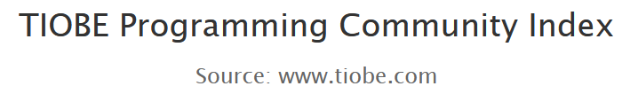
Why should you know something about Java?
Java is an example of a statically typed object oriented language
(like C and C++) opposed to Python’s being dynamically typed
One of the most widespread used programming languages
Used in other courses at the Department of Computer Science

Slide 3

Java history
Java 1.0 released 1995 by Sun Microsystems
(acquired by Oracle 2010)
”Write Once, Run Anywhere”
1999 improved performance by the Java HotSpot Performance Engine
Current version Java 24 (released March 2025)
Java compiler generates Java bytecode that is executed on a
Java virtual machine (JVM) that contains a garbage collector
PyPy is adopting the same ideas to Python
(Just-in-Time compilation)
Notes:
Java mascot Juke
Hotspot primary developer, Lars Bak from Aarhus University
https://en.wikipedia.org/wiki/Java_(programming_language)
Current JDK version:
https://www.oracle.com/java/technologies/downloads/

Slide 4
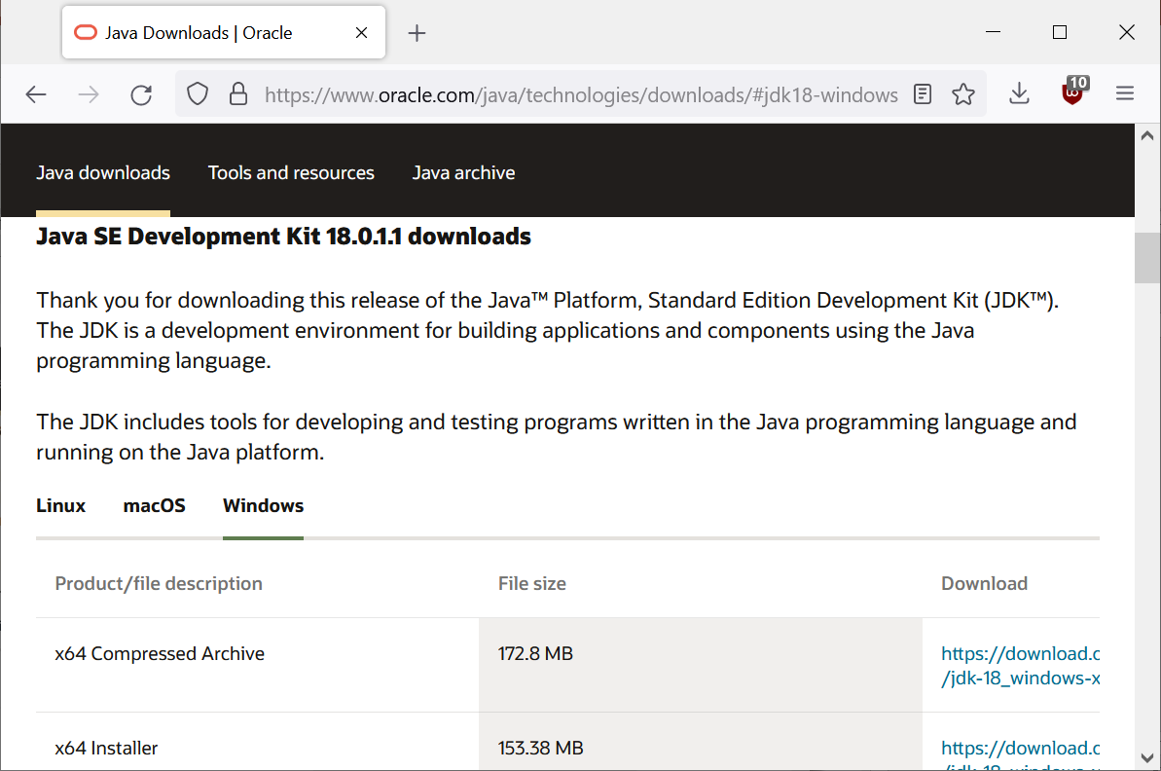

Installing Java
To compile Java programs into bytecode you need a compiler, e.g. from Java SE Development Kit (JDK):
www.oracle.com/java/technologies/downloads/
(you might need to add the JDK directory to your PATH, e.g. C:\Program Files\Java\jdk-18.0.1.1\bin)
To only run compiled Java programs:
java.com/download
(If you use JDK, you should not download this)
Notes:
May 2019: The Java RE from java.com is NOT compatible with the JDK from oracle.com !!!! But JDK includes a JRE.

Slide 5
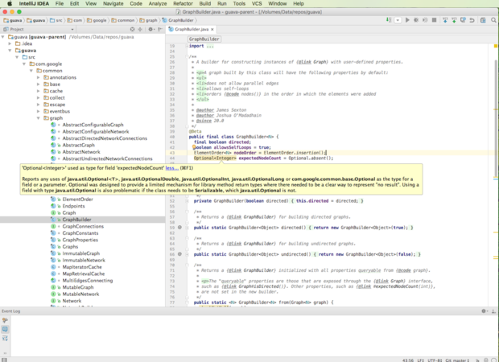
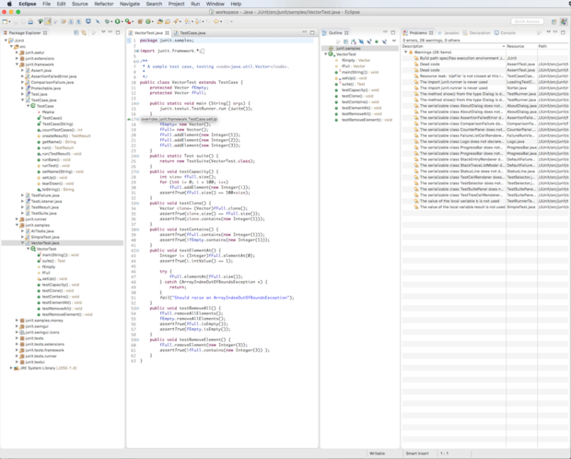
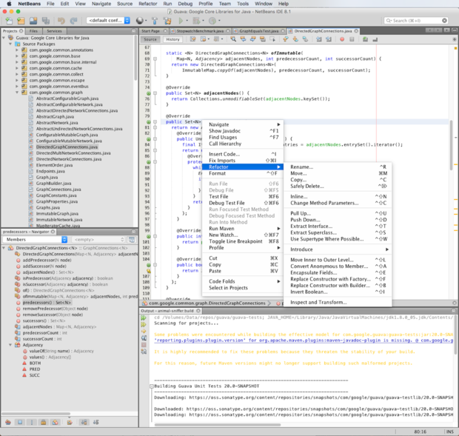
Java IDE
Many available, some popular:
Visual Studie Code, IntelliJ IDEA, Eclipse, and NetBeans
An IDE for beginners: BlueJ

Slide 6
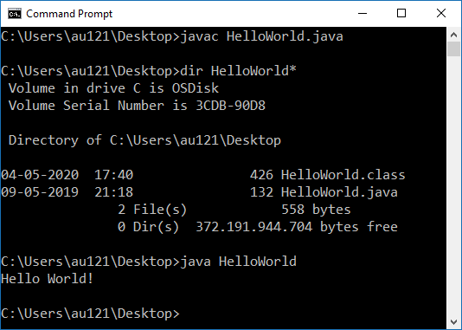
Compiling and running a Java program
HelloWorld.java
public class HelloWorld { public static void main( String[] args ) { System.out.println( "Hello World!" ); } }
HelloWorld.java
Java compiler
(javac)
HelloWorld.class
Java Virtual Machine
(java)
execution
Notes:
”println(1, 2);” fails since println only takes one argument

Slide 7
Java : main
name.java must be equal to the public class name
A class can only be excuted using java name (without .class) if the class has a class method main with signature
public static void main(String[] args)
(main is inherited from C and C++ sharing a lot of syntax with Java)
Java convention is that class names should use CamelCase
PrintArguments.java
public class PrintArguments { public static void main( String[] args ) { for (int i=0; i<args.length; i++) System.out.println( args[i] ); } }
shell
java PrintArguments x y z x y z
Notes:
In Python sys.argv contains the same arguments, except that sys.argv[0] is the name of the program executed.

Slide 8
a static method in
a class is a class method
(exists without creating objects)
method name
there can be several classes in a file – but only one class should be public and have same name as file
type of return value
(void = no return value)
class name containing main must have same name as file
type of argument,
array of String values
PrintArguments.java
public class PrintArguments { public static void main( String[] args ) { for (int i=0; i<args.length; i++) System.out.println( args[i] ); } }
the main method must be public to be visible outside class
name of argument
For-loop equivalent to
int i = 0;
while (i < args.length) {
code
i++;
}
declare new int variable locally inside for-loop
the print statement is found in the System class
java arrays are indexed from 0 to args.length – 1
and the length of an array object is fixed once created
i += 1
Notes:
There exist standard library classes that support arbitrary size arrays like class ArrayList

Slide 9
Argument list also exists in Python...
PrintArguments.py
import sys print(sys.argv)
shell
python PrintArguments.py a b 42 ['PrintArguments.py', 'a', 'b', '42']

Slide 10
Primitive.java
/** * A Java docstring to be processed using 'javadoc' */ // comment until end-of-line public class Primitive { public static void main( String[] args ) { int x; // type of variable must be declared before used x = 1; // remember ';' after each statement int y=2; // indentation does not matter int a=3, b=4; // multiple declarations and initialization System.out.println(x + y + a + b); int[] v={1, 2, 42, 3}; // array of four int System.out.println(v[2]); // prints 42, arrays 0-indexed /* multi-line comment that continues until here */ v = new int[3]; // new array of size three, containing zeros System.out.println(v[2]); // prints 0 if (x == y) { // if-syntax '(' and ')' mandatory a = 1; b = 2; } else { // use '{' and '}' to create block of statements a = 4; b = 3; // two statements on one line } }}
Notes:
/* … */ is in Python often simulated using triple-quoted strings

Slide 11
Why state types – Python works without...
Just enforcing a different programming style (also C and C++)
Helps users to avoid mixing up values of different types
(Some) type errors can be
caught at compile time
More efficient code execution
TypeError.java
public class TypeError { public static void main( String[] args ) { int x = 3; String y = "abc"; System.out.println(x / y); } }
shell
javac TypeError.java javac TypeError.java TypeError.java:5: error: bad operand types for binary operator '/' System.out.println(x / y); ^ first type: int second type: String 1 error
type_error.py
x = 3 y = 'abc' print('program running...') print(x / y)
Python shell
program running... ... ----> 4 print(x / y) TypeError: unsupported operand type(s) for /: 'int' and 'str'

Slide 12
Basic Java types
BigIntegerTest.java
import java.math.*; // import everything // import java.math.BigInteger; // alternativ public class BigIntegerTest { public static void main( String[] args ) { BigInteger x = new BigInteger("2"); while (true) { // BigIntegers are immutable x = x.multiply(x); // java.math.BigInteger.toString() System.out.println(x); } } }
shell
4 16 256 65536 4294967296 18446744073709551616 340282366920938463463374607431768211456 ...
Type | Values
boolean | true or false
byte | 8 bit integer
char | character (16-bit UTF)
short | 16 bit integer
int | 32 bit integer
long | 64 bit integer
float | 32 bit floating bout
double | 64 bit floating point
class BigInteger | arbitrary precision integers
class String | strings
Notes:
byte = -128 to 127
BigInteger have a toString method, like Python __str__ method, and str(x)
Java does not allow uses to overload operators, so we have to write x.multiply(x) instead of x * x

Slide 13
Java arrays
ConcatenateArrayLists.java
import java.util.*; // java.util contains ArrayList public class ConcatenateArrayList { public static void main( String[] args ) { // ArrayList is a generic container ArrayList<String> a = new ArrayList<String>(); ArrayList<String> b = new ArrayList<String>(); ArrayList<String> c = new ArrayList<String>(); a.add("A1"); // in Python .append a.add("A2"); b.add("B1"); c.addAll(a); // in Python .extend c.addAll(b); for (String e : c) { // foreach over iterator System.out.println(e); } } }
shell
A1 A2 B1
The size of a builtin Java array can not be modified when first created.
If you need a bigger array you have to instantiate a new array.
Or better use a standard collection class like ArrayList
ArrayList is a generic class (type of content is given by <element type>; generics available since Java 5, 2004)
The for-each loop was introduced in Java 5

Slide 14

Tired of writing all these types...
In Java 7 (2011) the “diamond operator” <> was introduced for type inference for generic instance creation to reduce verbosity
In Java 10 (2018) the var keyword was introduced to type infer variables
ArrayListTest.java
import java.util.*; // java.util contains ArrayList public class ArrayListTest { public static void main( String[] args ) { // ArrayList is a generic container ArrayList<String> a = new ArrayList<String>(); // Full types List<String> b = new ArrayList<String>(); // ArrayList is subclass of class List ArrayList<String> c = new ArrayList<>(); // <> uses type inference List<String> d = new ArrayList<>(); // <> and ArrayList subclass of List var e = new ArrayList<String>(); // use var to infer type of variable var v = Math.floor(1.5); // not obvious what type v is (double) }}
Notes:
ArrayList<> x = new ArrayList<String>(); --- does not work

Slide 15
Function arguments
Functions.java
public class Functions { private static int f(int x) { return x * x; } private static int f(int x, int y) { return x * y; } private static String f(String a, String b) { return a + b; // string concatenation } public static void main( String[] args ) { System.out.println(f(7)); System.out.println(f(3, 4)); System.out.println(f("abc", "def")); } }
shell
49 12 abcdef
Must declare the number of arguments and their types, and the return type
The argument types are part of the signature of the function
Several functions can have the same name, but different type signatures
Python keyword arguments,
* and ** do not exist in Java
functions.py
def f(x, y=None): if y == None: y = x if type(x) is int: return x * y else: return x + y print(f(7), f(3, 4), f('abc', 'def'))
Notes:
+ = example of builtin overloaded operator

Slide 16
Class
AClass.java
class Rectangle { private int width, height; // declare attributes // constructor, class name, no return type public Rectangle(int width, int height) { this.width = width; this.height = height; } public Rectangle(int side) { width = side; // same as this.width = side height = side; } public int area() { return width * height; } } public class AClass { public static void main( String[] args ) { Rectangle r = new Rectangle(6, 7); System.out.println(r.area()); } }
shell
42
Constructor = method with name equal to class name
(no return type)
this = referes to current object (Python “self”)
Use private / public on attributes / methods to give access outside class
Use new name(arguments) to create new objects
There can be multiple constructors, but with distinct type signatures
Notes:
when having multiple class definitions in a file, only one can be public – and must have same name as the file.

Slide 17
Inheritance
Inheritance.java
class BasicRectangle { // protected allows subclass to access attributes protected int width, height; public BasicRectangle(int width, int height) { this.width = width; this.height = height; } } class Rectangle extends BasicRectangle { public Rectangle(int width, int height) { // call constructor of super class super(width, height); } public int area() { return width * height; } } public class Inheritance { public static void main( String[] args ) { Rectangle r = new Rectangle(6, 7); System.out.println(r.area()); } }
shell
42
Java supports single inheritance using extends
Attributes and methods that should be accessible in a subclass must be declared protected (or public)
Constructors are not inherited but can be called using super
Notes:
When a method or a variable is marked as protected, it can be accessed from:
1) Within the enclosing class.
2) Other classes in the same package as the enclosing class.
3) Sub classes, regardless of packages

Slide 18
Generic class
GenericPair.java
class Pair<element> { private element x, y; public Pair(element x, element y) { this.x = x; this.y = y; } element first() { return x; } element second() { return y; } } public class GenericPair { public static void main( String[] args ) { var p = new Pair<Integer>(6, 7); System.out.println(p.first() * p.second()); } }
shell
42
Class that is parameterized by one or more types
(comma separated)
Primitive types cannot be type parameters
Instead use wrappers, like Integer for int
Notes:
Uses “var p” to avoid writing “Pair<Integer> p”

Slide 19
Interface
RectangleInterface.java
interface Shape { public int area(); // method declaration } class Rectangle implements Shape { private int width, height; // constructor, class name, no return type public Rectangle(int width, int height) { this.width = width; this.height = height; } public int area() { return width * height; } } public class RectangleInterface { public static void main( String[] args ) { Shape r = new Rectangle(6, 7); System.out.println(r.area()); } }
Java does not support multiple inheritance like Python
But a class can implement an arbitrary number of interfaces
An interface specifices a set of attributes and methods a class must have
The type of a variable can be an interface, and the variable can hold any object where the class is stated to implement the interface
Notes:
This ensures that at compile time we know that r has an area method

Slide 20
Abstract classes
AbstractRectangle.java
abstract class Shape { abstract public int circumference(); abstract public int area(); public double fatness() { // convert int from area() to double before / return (double)area() / circumference(); } } class Rectangle extends Shape { private int width, height; // constructor, class name, no return type public Rectangle(int width, int height) { this.width = width; this.height = height; } public int area() { return width * height; } public int circumference() { return 2 * (width + height); } } public class AbstractRectangle { public static void main( String[] args ) { Shape r = new Rectangle(6, 7); System.out.println(r.fatness()); } }
Abstract class = class that cannot be instantiated, labeled abstract
Abstract method = method declared without definition, labeled abstract,
must be in abstract class
An abstract class can be extended to a non-abstract class by providing the missing method definitions
Notes:
A variable can have type that is an abstract class
Int / int returns int (integer division), whereas x / y is type double if x and/or y is double

Slide 21
Default methods in interfaces
DefaultInterface.java
interface Shape { public int circumference(); public int area(); default public double fatness() { // convert int from area() to double before / return (double)area() / circumference(); } } class Rectangle implements Shape { private int width, height; // constructor, class name, no return type public Rectangle(int width, int height) { this.width = width; this.height = height; } public int area() { return width * height; } public int circumference() { return 2 * (width + height); } } public class DefaultRectangle { public static void main( String[] args ) { Shape r = new Rectangle(6, 7); System.out.println(r.fatness()); } }
Before Java 8 all methods in an interface were abstract (no definition)
Since Java 8 interfaces can have default methods with definition
The distinction between abstract classes and interfaces gets blurred
  a class can only extend one abstract class
  a class can implement more interfaces
  ⇒ multiple “inheritance” is possible in Java

Slide 22
Multiple
Inheritance
MultipleInheritance.java
interface A { default public void sayA() { System.out.println("say A"); } default public void sayHi() { System.out.println("A say's Hi"); } } interface B { default public void sayB() { System.out.println("say B"); } default public void sayHi() { System.out.println("B say's Hi"); } } class C implements A, B { @Override // (optional) requests compiler to // check if sayHi exists in supertype public void sayHi() { System.out.println("C say's Hi"); (new A(){}).sayHi(); // instantiate an anonymous class } public void test() { sayA(); sayB(); sayHi(); } } public class MultipleInheritance { public static void main( String[] args ) { new C().test(); } }
Class C implements both interfaces A and B
Inherits default methods sayA and sayB
Cannot inherit sayHi, since in both A and B.
Must be overriden in C
Can use @override to enforce compiler to check if method exists in super class
new A(){} creates an instance of an anonymous class (extending or implementing A)
Shell output
say A say B C say's Hi A say's Hi
Notes:
@override helps to spot misspellings
If C does definde sayHi, we will get an ”Unresolved compilation problem, duplicate default methods”
If new A(){} does not contain {}, then we get “Unresolved compilation problem: Cannot instantiate the type A”
new A() {} : A is class or interface, () is calling the constructor, {} can contain further class implementations for this use-once class
purpose is to avoid having to name the class

Slide 23
Lambda expression
Lambda expressions are possible since Java 8
Syntax : argument -> expression
LambdaPrinting.java
import java.util.*; // ArrayList public class LambdaPrinting { public static void main(String[] args) { var elements = new ArrayList<Integer>(); for (int i = 1; i <= 3; i++) elements.add(i); elements.forEach(e -> System.out.println(e)); }; }
LambdaPrinting.java
1 2 3
Notes:
In Python lambda has been available since version 1.0

Slide 24
