Slide 1
Introduction to Programming with
Scientific Applications
Gerth Stølting Brodal
Department of Computer Science
Aarhus University
Notes:
Introduktion til Programmering med Videnskabelige Anvendelser
https://kursuskatalog.au.dk/da/course/130939/Introduktion-til-programmering-med-videnskabelige-anvendelser

Slide 2

Course evaluation
”The first lecture was intimidating
and overwhelming”
Notes:
(Course evaluation 2018)

Slide 3
Lecturer
Name Gerth Stølting Brodal
Research Algorithms and Data Structures (Computer Science)
Teaching
  2018 - BSc course on Introduction to Programming with Scientific Applications
  2003 - BSc course on Introduction to Algorithms and Data Structures
  1999 - 17 MSc courses on Computational Geometry, Algorithm Engineering,
  Advanced Data Structures, External Memory Algorithms and Data Structures
Python Advanced Beginner

Slide 4
Course description – kursuskatalog.au.dk/en/course/130939/
Introduction to Programming with Scientific Applications
Description of qualifications
After the course the participants will have knowledge of principles and techniques for systematic construction of programs.
At the end of the course, the participants will be able to:
apply constructions of a common programming language,
develop well-structured programs and perform testing and debugging of these,
explain fundamental programming concepts and basic algorithmic techniques,
apply standard tools for scientific applications,
use the documentation for a programming language and available software packages.
Contents
The course gives an introduction to programming with scientific applications.
Programming concepts and techniques are introduced using the Python programming language.
The programming concepts are illustrated in other programming languages. The following content is included.
Basic programming constructs: Data types, operators, variables, flow of control, conditionals, loops, functions, recursion, scope, exceptions. Object orientation: Abstract data types, classes, inheritance, encapsulation. Basic algorithmic techniques: Sorting, binary search, dynamic programming. Systematic development of programs: Testing and debugging. File-based input/output, numerical analysis, functional programming. Scientific computing using standard packages for Python.
ECTS 10
Hours - weeks - periods
Lectures 2 x 2 hours/week
TA sessions 1 x 3 hours/week
Study café 3 x 1 hour/week
Language of instruction
Danish
Instructor
Gerth Stølting Brodal
Academic prerequisites
(Some) Linear algebra
Exam
5 hour programming
Aid: Computer and Internet, headphones, no AI
7-point grading scale
Prerequisites for examination participation
Submission and approval of 10 mandatory
assignments and submission of
1 implementation project
Notes Grade reflects an overall assessment of implementation project and written examination. Project counts 20% and written exam counts 80%
Notes:
Course description discusses AI assistants

Slide 5
Question – Primary Education?
Mathematics
Mathematics-Economics
Data Science
Chemestry
Physics
Other Science-Technology
Other

Slide 6
Question – Programming languages you know?
+750 listed on en.wikipedia.org/wiki/List_of_programming_languages

Slide 7
Question – Programming experience?
For the programming language you know best (if any) please state you proficiency level within the language.
None
Fundamental awareness (basic knowledge)
Novice (limited experience)
Intermediate (practical application)
Advanced (applied theory)
Expert (recognized authority)

Slide 8
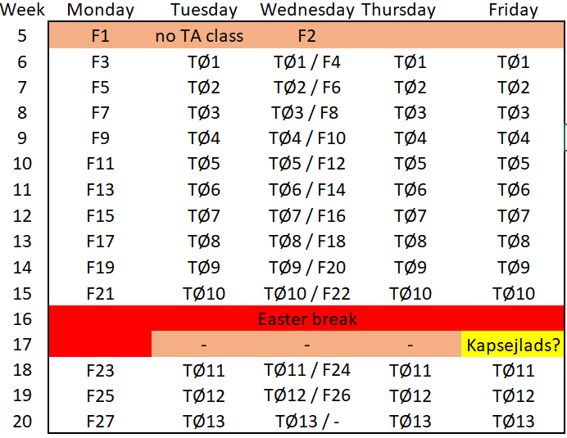
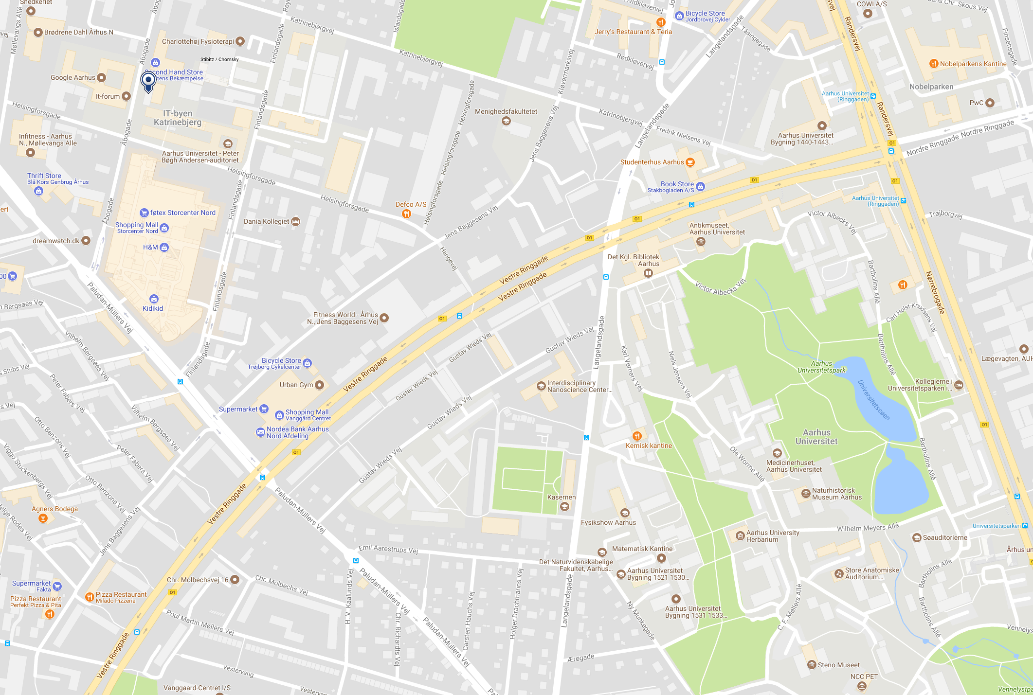
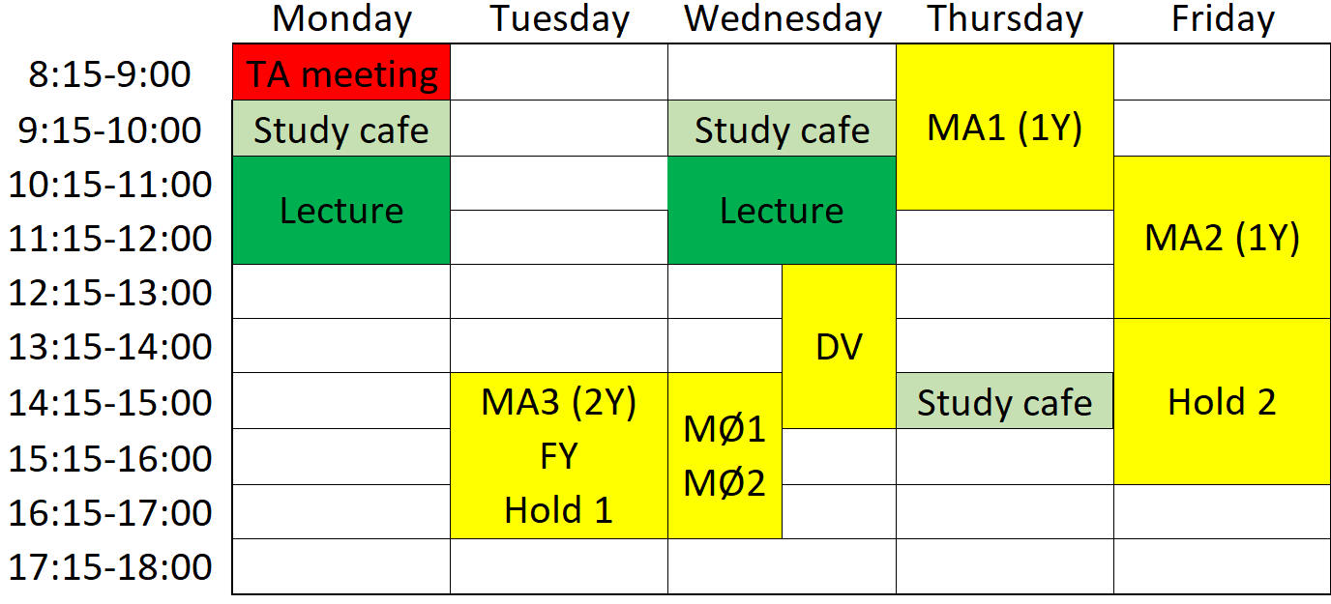
Some course practicalities
Primary lecture material = slides
Aud E

Slide 9
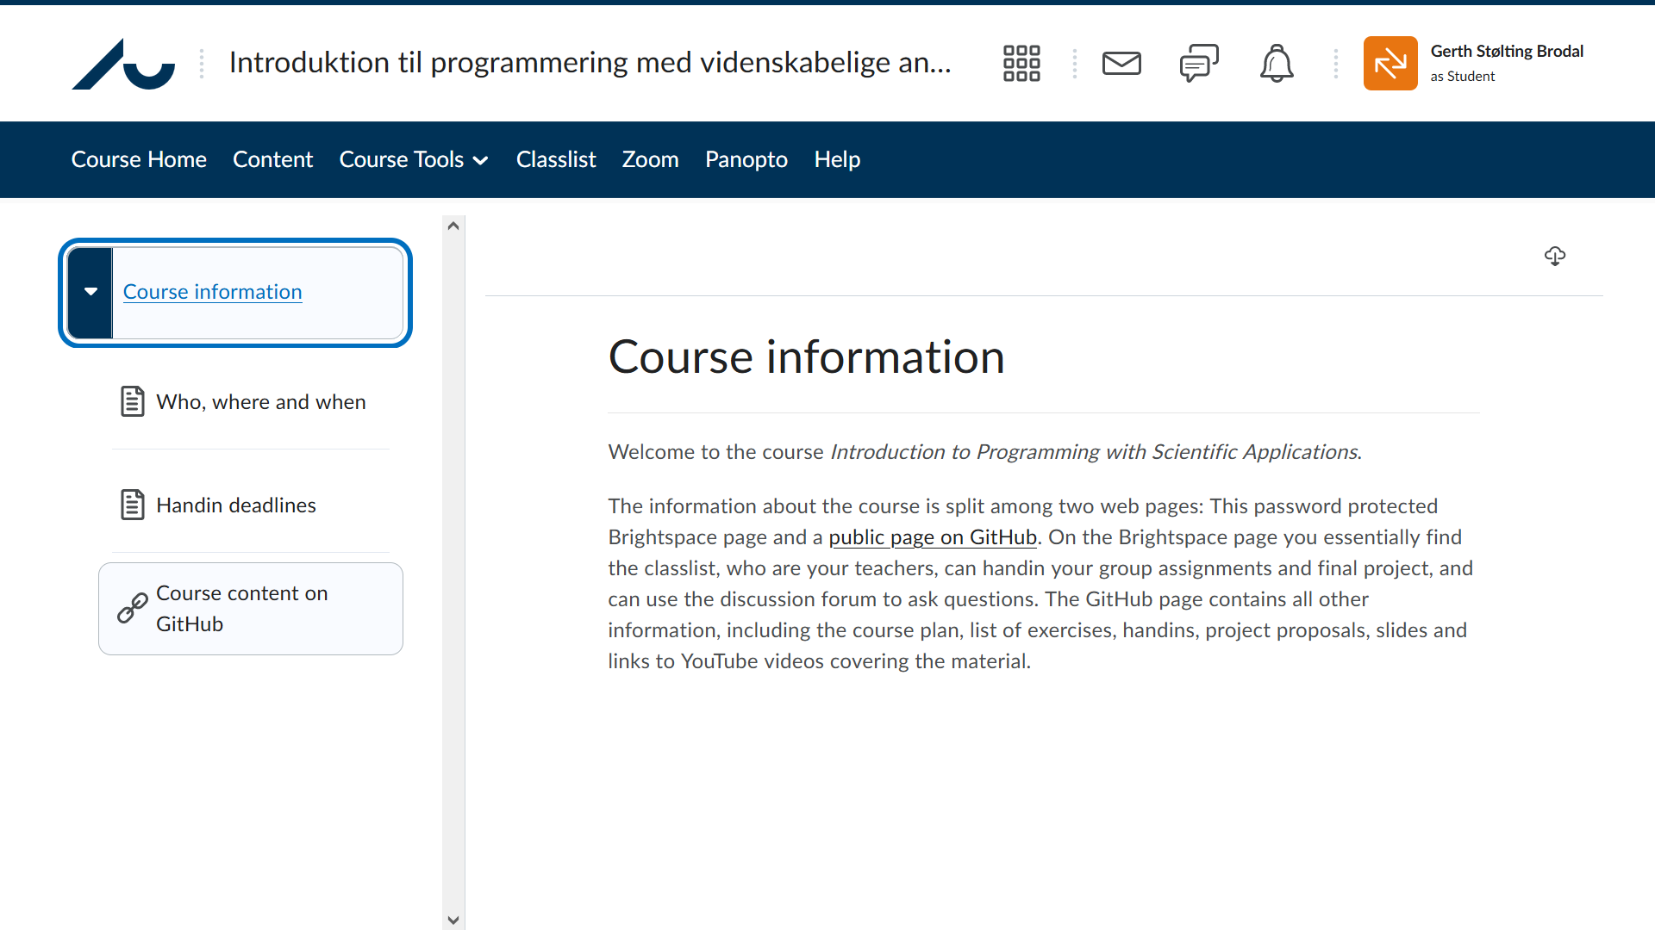
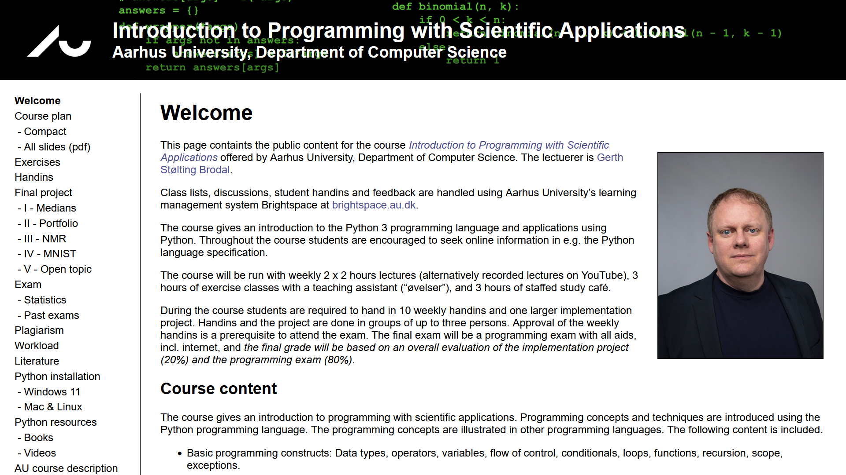
Course page on Brightspace and GitHub
gsbrodal.github.io/ipsa
Notes:
Go over course page structure…

Slide 10
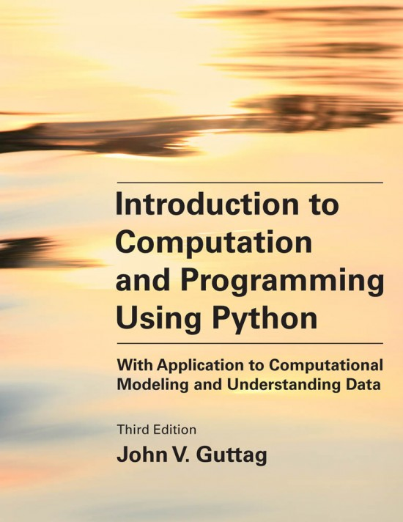
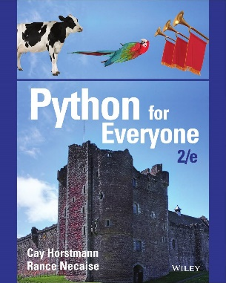
Course text book – optional
John V. Guttag: Introduction to Computation and Programming Using Python, Third Edition With Application to Computational Modeling and Understanding Data. Third Edition. 664 pages. MIT Press, 2021.
[Guttag, 2nd Ed., page 8] ”The reader should be forewarned that this book is by no means a comprehensive introduction to Python”.
3rd Ed. added about 80 pages on introduction to Python.
Covers all basic features of Python enabling you to deal with data in Chapters 1-10 (212 pages) - remaining chapters are applications
Other resources: Google, stackoverflow, Python.org, YouTube, AIs...
Comparison to a standard text book on the programming language Python by Cay Horstmann and Rance Necaise:
Topic recursion is covered by Guttag on page 123 (2nd edition on page 50), Horstmann and Necaise do it on page 611

Slide 11
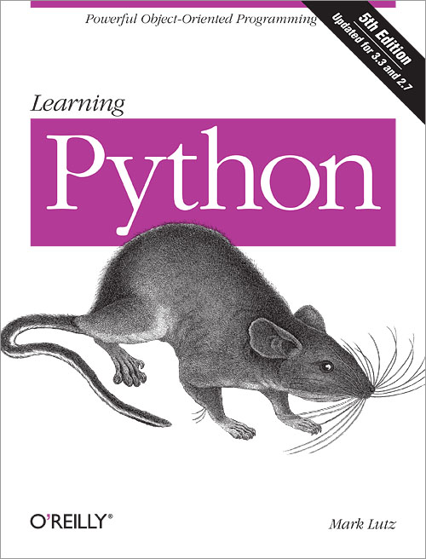
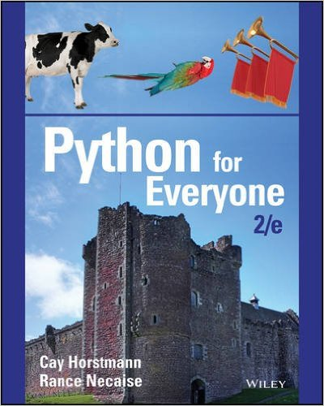
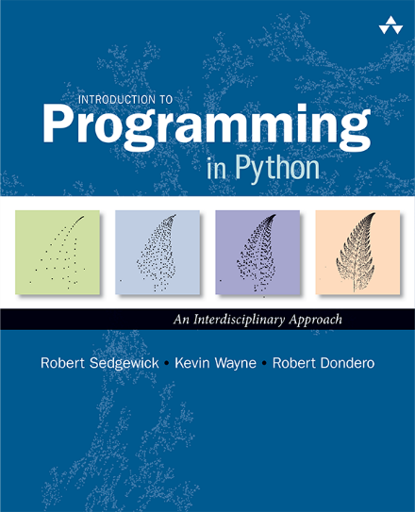
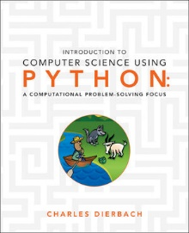
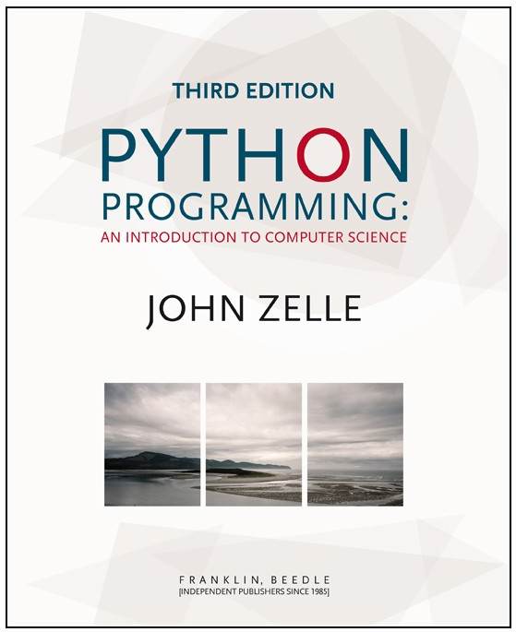
Some other books on Python
O’Reilly, 2013
1684 pages
Wiley, 2016
752 pages
Addison-Wesley, 2015
794 pages
Wiley, 2013
580 pages
Franklin & Beedle, 2016
552 pages
... numerous online introduction texts/courses/videos on Python
Notes:
Try to google “books python”, “books python data science”, “books python data analytics”….

Slide 12
Two Python programs

Slide 13
A Python program
Memory
x | 7
Python shell
x = 7 print(x * x) 49
7 is an integer literal – in Python denoted an “int”
x is the name of a variable that can hold some value
= is assigning a value to a variable
* denotes multiplication
print is the name of a built-in function,
here we call print to print the result of 7 * 7
A program consists of a sequence of statements, executed sequentially

Slide 14
Question – What is the result of this program?
x assigned new value
Python shell
x = 3 y = 5 x = 2 print(x * y)
Memory
old x | 3
y | 5
new x | 2
10
15
25
[15, 10]
Error
Don’t know

Slide 15
Another Python program using lists
Memory
a | 13 | a[0]
 | 27 | a[1]
 | 7 | a[2]
 | 42 | a[3]
Python shell
a = [13, 27, 7, 42] print(a) [13, 27, 7, 42] print(a[2]) 7
[13, 27, 7, 42] is a list containing four integers
a[2] refers to the entry in the list with index 2
(the first element has index 0, i.e. a[2] is the 3rd element of the list)
Note that print also can print a list

Slide 16
Question – What is the result of this program?
Python shell
a = [3, 5, 7] print(a[1] + a[2])
Memory
a | 3 | a[0]
 | 5 | a[1]
 | 7 | a[2]
8
10
12
15
Don’t know

Slide 17
Why Python ? the next slides will be technical

Slide 18
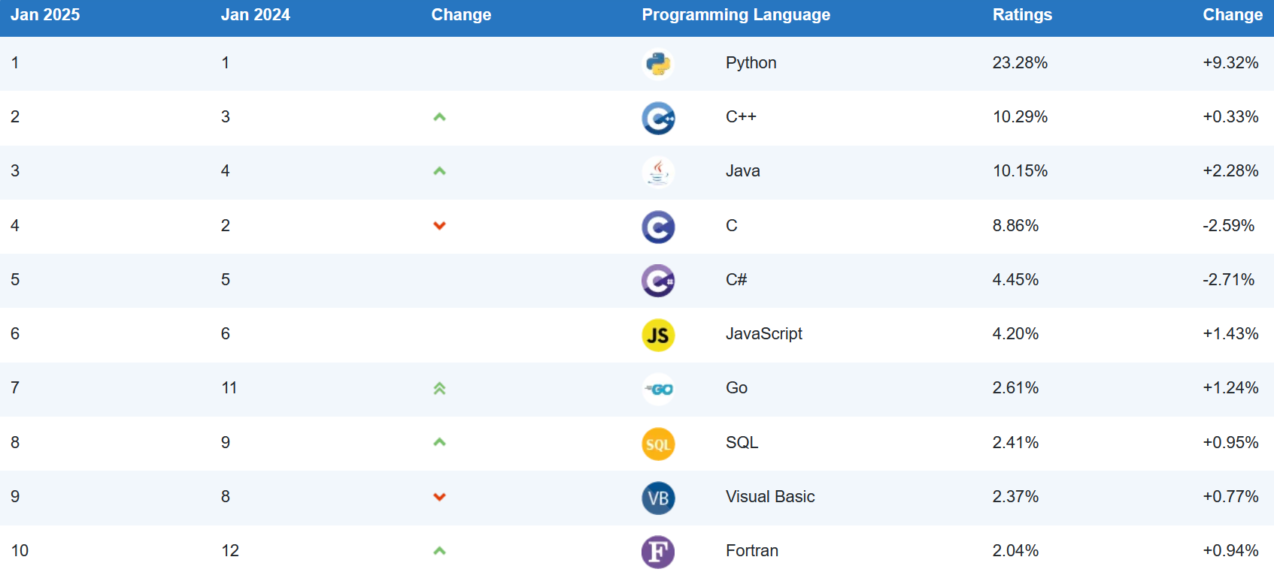
TIOBE Index January 2025
Python #1
Since November 2021
The TIOBE Programming Community index is an indicator of the popularity of programming languages. The index is updated once a month. The ratings are based on the number of skilled engineers world-wide, courses and third party vendors. Popular search engines such as Google, Bing, Yahoo!, Wikipedia, Amazon, YouTube and Baidu are used to calculate the ratings. It is important to note that the TIOBE index is not about the best programming language or the language in which most lines of code have been written. www.tiobe.com
Notes:
Python: 2018 4.7%, 2019 8.3%, 2020 9.7%, 2021 13.6%, 2022 13.6%
The TIOBE Programming Community index is an indicator of the popularity of programming languages. The index is updated once a month. The ratings are based on the number of skilled engineers world-wide, courses and third party vendors. Popular search engines such as Google, Bing, Yahoo!, Wikipedia, Amazon, YouTube and Baidu are used to calculate the ratings. It is important to note that the TIOBE index is not about the best programming language or the language in which most lines of code have been written.
Different programming languages good for different contexts.

Slide 19
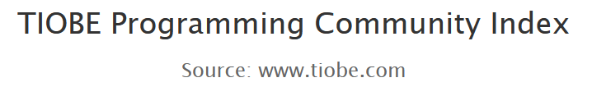
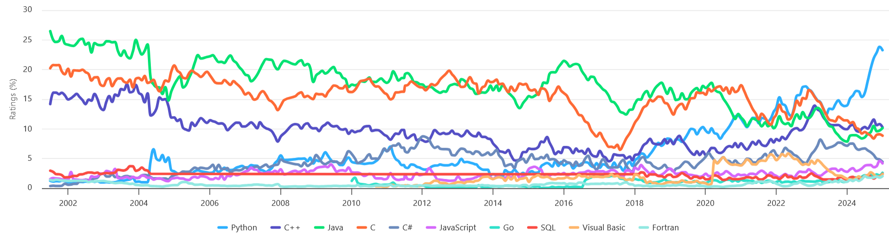
Popularity of programming languages
Most Popular Programming Languages 1958 – 2025 (YouTube)
Notes:
First versions: C = 1972, C++ = 1985, Java = 1995, C# = 2000, Visual Basic = 1991, JavaScript 1995, SQL = 1974, Assembly Language = 1947, PHP = 1995
Anybody tried to run a JavaScript today?
HTML, CSS, JavaScript example: www.au.dk Ctrl-u (on PC; on Mac the shortcut is Command+Alt+U)
CSS https://www.aucdn.dk/2016/assets/css/app.css -> https://www.cleancss.com/css-beautify/
JAVASCRIPT example https://www.aucdn.dk/2016/assets/js/vendor.js -> http://jsbeautifier.org/
Google Chrome: Press F12: document.body.style.background = 'green'
CSS & JavaScript examples of languages with a SYNTAX using { } and ; to structure programs; ugly code generated by other programs
Other overview of popularity:
https://stackify.com/popular-programming-languages-2018/

Slide 20
“Hello World”
C
#include <stdio.h> int main(int argc, char **argv) { printf("Hello World"); return 0; }
In Java, C, C++ a lot of “{“, “}” and “;” are needed
Java tends to have a lot of “public...” details that need to be spelled out
Python is concise
C++
#include <iostream> using namespace std; int main(int argc, char** argv) { cout << "Hello, World!"; return 0; }
Java
public class HelloWorld { public static void main( String[] args ) { System.out.println( "Hello World!" ); System.exit( 0 ); } }
Python 2
print "Hello world"
Python 3
print("Hello world")
Notes:
Last release of Python 2 was 2.7 in 2010
Python 3.0 was released in 2008 (to clean up some unfortunate design in Python 2)

Slide 21
Why Python ?
Short concise code

Slide 22
C index out of bounds
(C developed by Dennis Ritchie 1969-73)
Debugging is the process of finding and resolving defects or problems within a computer program that prevent correct operation of computer software or a system.
en.wikipedia.org/wiki/Debugging
Memory
array A | 2 | A[0]
 | 3 | A[1]
x | 1
indexing.c
#include <stdio.h> int main() { int x = 1; int A[2] = {2, 3}; // A[0] = 2, A[1] = 3 printf("x = %d, A = {%d, %d}\n", x, A[0], A[1]); A[3] = 42; // index A[3] out of bounds printf("x = %d, A = {%d, %d}\n", x, A[0], A[1]); return 0; }
Output
$ gcc indexing.c $ ./a.exe x = 1, A = {2, 3} x = 42, A = {2, 3}
-42
“A” only has size 2, but
tries to update the 4th entry.
No warning is giving.
Something unexpected
is overridden in memory.
Have fun debugging!
Skipping checking for invalid indexing makes programs faster, but also requires disciplined programming

Slide 23
... and C++ index out of bounds
(C++ was developed by Bjarne Stroustrup 1985)
Memory
array A | 2 | A[0]
 | 3 | A[1]
x | 1
indexing.cpp
#include <iostream> int main() { int x = 1; int A[2] = {2, 3}; // A[0] = 2, A[1] = 3 std::cout << "x = " << x << ", A = {" << A[0] << ", " << A[1] << "}" << std::endl; A[2] = 42; // index A[2] out of bounds std::cout << "x = " << x << ", A = {" << A[0] << ", " << A[1] << "}" << std::endl; return 0; }
Output
$ g++ indexing.cpp $ ./a.exe x = 1, A = {2, 3} x = 42, A = {2, 3}
overrides
something unexpected
-42

Slide 24
... and C++ vector index out of bounds
indexing.cpp
#include <iostream> #include <vector> int main() { std::vector<int> A = {2, 3}; // A[0] = 2, A[1] = 3 std::vector<int> B = {4, 5}; // B[0] = 4, B[1] = 5 std::cout << "A={" << A[0] << ", " << A[1] << "}, "; std::cout << "B={" << B[0] << ", " << B[1] << "}" << std::endl; A[9]=42; // index A[9] out of bounds std::cout << "A={" << A[0] << ", " << A[1] << "}, "; std::cout << "B={" << B[0] << ", " << B[1] << "}" << std::endl; return 0; }
Output
$ g++ -std=c++11 indexing-vector.cpp $ ./a.exe A={2, 3}, B={4, 5} A={2, 3}, B={4, 42}
Memory
vector A | 2 | A[0]
 | 3 | A[1]
vector B | 4 | B[0]
 | 5 | B[1]
overrides something unexpected
-42

Slide 25
... and Java index out of bounds exception
(Java was developed by James Gosling 1995)
Memory
array a | 20 | a[0]
 | 21 | a[1]
 | 22 | a[2]
indexing.java
class IndexingTest{ public static void main(String args[]){ int a[] = {20, 21, 22}; a[5] = 42; // index a[5] out of bounds } }
Output
$ javac indexing.java $ java IndexingTest Exception in thread "main" java.lang.ArrayIndexOutOfBoundsException: 5 at IndexingTest.main(indexing.java:5)
Java provides error message when running the program

Slide 26
... and Python index out of bounds exception
(Python first release by Guido van Rossum 1991)
Memory
array a | 20 | a[0]
 | 21 | a[1]
 | 22 | a[2]
indexing.py
a = [20, 21, 22] a[5] = 42 # index a[5] out of bounds
Output
$ python indexing.py Traceback (most recent call last): File "indexing.py", line 3, in <module> a[5] = 42 IndexError: list assignment index out of range
Python provides error message when running the program

Slide 27

Memory safety
(Rust created by Graydon Hoare 2006)
The White House 2024 | Press Release: “Future Software Should Be Memory Safe” (www.whitehouse.gov)
National Security Agency 2022 | Cybersecurity Information Sheet: Software Memory Safety (media.defense.gov)
C and C++ are flexible but memory unsafe programming languages
  Unintended writes or reads to memory can be exploited by malicious cyber actors
Python, Java, Rust are examples of memory safe languages
Rust aims at achieving the efficiency of C by slightly restricting flexibility
indexing.rs
fn main() { let mut a = [3, 4]; a[2] = 7; // Compile error: this operation will panic at runtime for i in 2..3 { a[i] = 7 } // Run-time panic: index out of bounds let b = &mut a; a[1] = 6; // Compile error: cannot use `a` because it was mutably borrowed (*b)[0] = 5; for i in 0..2 { println!("a[{}] = {}", i, a[i]) } }
Memory
 |  | b
 | 3 | a[0]
 | 4 | a[1]
a
www.rust-lang.org
Notes:
Different ways to achieve memory safety: Index out of bounds check, garbage collection (prevent memory leaks), restrict allowed code (Rust way using concepts of owner and borrowing)
It is very hard to avoid bugs in code, let the design of the language help you limit the consequences of the bugs
You can still do very unsecure things in Python…
(Moving ”a[1] = 6” after the assignment to ”b” avoids the Compile error, since now lifespans are nested)

Slide 28
Why Python ?
Short concise code
Index out-of-range exceptions

Slide 29
C++ different ways to print a vector
vector-iterator.cpp
#include <iostream> #include <vector> int main() { // Vector is part of STL (Standard Template Library) std::vector<int> A = {20, 23, 26}; // "C" indexing - since C++98 for (int i = 0; i < A.size(); i++) std::cout << A[i] << std::endl; // iterator - since C++98 for (std::vector<int>::iterator it = A.begin(); it != A.end(); ++it) std::cout << *it << std:: endl; // "auto" iterator - since C++11 for (auto it = A.begin(); it != A.end(); ++it) std::cout << *it << std:: endl; // Range-based for-loop - since C++11 for (auto e : A) std::cout << e << std:: endl; }
elegant

Slide 30
Java - different ways to print a vector
vector-iterator.java
import java.util.Vector; import java.util.Iterator; class IteratorTest{ public static void main(String[] args) { Vector<Integer> a = new Vector<Integer>(); a.add(7); a.add(42); // "C" for-loop & get method for (int i = 0; i < a.size(); i++) System.out.println(a.get(i)); // iterator for (Iterator it = a.iterator(); it.hasNext(); ) System.out.println(it.next()); // for-each loop – since Java 5 for (Integer e : a) System.out.println(e); } }
elegant

Slide 31
The Python way to print a list
print-list.py
a = [20, 23, 26] for e in a: print(e)
Output
$ python print-list.py 20 23 26

Slide 32
Why Python ?
Short concise code
Index out of range exceptions
Elegant for-each loop

Slide 33
C++ how not to print a vector
$ g++ -std=c++11 print-vector.cpp
cpp-error-message.cpp: In function ‘int main()’:
cpp-error-message.cpp:7:13: error: no match for ‘operator<<’ (operand types are ‘std::ostream {aka std::basic_ostream<char>}’ and ‘std::vector<int>’)
std::cout << A << std::endl;
^
In file included from /usr/lib/gcc/x86_64-pc-cygwin/5.4.0/include/c++/iostream:39:0,
from cpp-error-message.cpp:1:
/usr/lib/gcc/x86_64-pc-cygwin/5.4.0/include/c++/ostream:628:5: note: candidate: std::basic_ostream<_CharT, _Traits>& std::operator<<(std::basic_ostream<_CharT, _Traits>&&, const _Tp&) [with _CharT = char; _Traits = std::char_traits<char>; _Tp = std::vector<int>] <near match>
operator<<(basic_ostream<_CharT, _Traits>&& __os, const _Tp& __x)
^
/usr/lib/gcc/x86_64-pc-cygwin/5.4.0/include/c++/ostream:628:5: note: conversion of argument 1 would be ill-formed:
cpp-error-message.cpp:7:16: error: cannot bind ‘std::ostream {aka std::basic_ostream<char>}’ lvalue to ‘std::basic_ostream<char>&&’
std::cout << A << std::endl;
^
In file included from /usr/lib/gcc/x86_64-pc-cygwin/5.4.0/include/c++/iostream:39:0,
from cpp-error-message.cpp:1:
/usr/lib/gcc/x86_64-pc-cygwin/5.4.0/include/c++/ostream:108:7: note: candidate: std::basic_ostream<_CharT, _Traits>::__ostream_type& std::basic_ostream<_CharT, _Traits>::operator<<(std::basic_ostream<_CharT, _Traits>::__ostream_type& (*)(std::basic_ostream<_CharT, _Traits>::__ostream_type&)) [with _CharT = char; _Traits = std::char_traits<char>; std::basic_ostream<_CharT, _Traits>::__ostream_type = std::basic_ostream<char>]
operator<<(__ostream_type& (*__pf)(__ostream_type&))
^
/usr/lib/gcc/x86_64-pc-cygwin/5.4.0/include/c++/ostream:108:7: note: no known conversion for argument 1 from ‘std::vector<int>’ to ‘std::basic_ostream<char>::__ostream_type& (*)(std::basic_ostream<char>::__ostream_type&) {aka std::basic_ostream<char>& (*)(std::basic_ostream<char>&)}’
/usr/lib/gcc/x86_64-pc-cygwin/5.4.0/include/c++/ostream:117:7: note: candidate: std::basic_ostream<_CharT, _Traits>::__ostream_type& std::basic_ostream<_CharT, _Traits>::operator<<(std::basic_ostream<_CharT, _Traits>::__ios_type& (*)(std::basic_ostream<_CharT, _Traits>::__ios_type&)) [with _CharT = char; _Traits = std::char_traits<char>; std::basic_ostream<_CharT, _Traits>::__ostream_type = std::basic_ostream<char>; std::basic_ostream<_CharT, _Traits>::__ios_type = std::basic_ios<char>]
operator<<(__ios_type& (*__pf)(__ios_type&))
^
/usr/lib/gcc/x86_64-pc-cygwin/5.4.0/include/c++/ostream:117:7: note: no known conversion for argument 1 from ‘std::vector<int>’ to ‘std::basic_ostream<char>::__ios_type& (*)(std::basic_ostream<char>::__ios_type&) {aka std::basic_ios<char>& (*)(std::basic_ios<char>&)}’
/usr/lib/gcc/x86_64-pc-cygwin/5.4.0/include/c++/ostream:127:7: note: candidate: std::basic_ostream<_CharT, _Traits>::__ostream_type& std::basic_ostream<_CharT, _Traits>::operator<<(std::ios_base& (*)(std::ios_base&)) [with _CharT = char; _Traits = std::char_traits<char>; std::basic_ostream<_CharT, _Traits>::__ostream_type = std::basic_ostream<char>]
operator<<(ios_base& (*__pf) (ios_base&))
^
/usr/lib/gcc/x86_64-pc-cygwin/5.4.0/include/c++/ostream:127:7: note: no known conversion for argument 1 from ‘std::vector<int>’ to ‘std::ios_base& (*)(std::ios_base&)’
/usr/lib/gcc/x86_64-pc-cygwin/5.4.0/include/c++/ostream:166:7: note: candidate: std::basic_ostream<_CharT, _Traits>::__ostream_type& std::basic_ostream<_CharT, _Traits>::operator<<(long int) [with _CharT = char; _Traits = std::char_traits<char>; std::basic_ostream<_CharT, _Traits>::__ostream_type = std::basic_ostream<char>]
operator<<(long __n)
^
/usr/lib/gcc/x86_64-pc-cygwin/5.4.0/include/c++/ostream:166:7: note: no known conversion for argument 1 from ‘std::vector<int>’ to ‘long int’
/usr/lib/gcc/x86_64-pc-cygwin/5.4.0/include/c++/ostream:170:7: note: candidate: std::basic_ostream<_CharT, _Traits>::__ostream_type& std::basic_ostream<_CharT, _Traits>::operator<<(long unsigned int) [with _CharT = char; _Traits = std::char_traits<char>; std::basic_ostream<_CharT, _Traits>::__ostream_type = std::basic_ostream<char>]
operator<<(unsigned long __n)
^
/usr/lib/gcc/x86_64-pc-cygwin/5.4.0/include/c++/ostream:170:7: note: no known conversion for argument 1 from ‘std::vector<int>’ to ‘long unsigned int’
/usr/lib/gcc/x86_64-pc-cygwin/5.4.0/include/c++/ostream:174:7: note: candidate: std::basic_ostream<_CharT, _Traits>::__ostream_type& std::basic_ostream<_CharT, _Traits>::operator<<(bool) [with _CharT = char; _Traits = std::char_traits<char>; std::basic_ostream<_CharT, _Traits>::__ostream_type = std::basic_ostream<char>]
operator<<(bool __n)
^
/usr/lib/gcc/x86_64-pc-cygwin/5.4.0/include/c++/ostream:174:7: note: no known conversion for argument 1 from ‘std::vector<int>’ to ‘bool’
In file included from /usr/lib/gcc/x86_64-pc-cygwin/5.4.0/include/c++/ostream:638:0,
from /usr/lib/gcc/x86_64-pc-cygwin/5.4.0/include/c++/iostream:39,
from cpp-error-message.cpp:1:
/usr/lib/gcc/x86_64-pc-cygwin/5.4.0/include/c++/bits/ostream.tcc:91:5: note: candidate: std::basic_ostream<_CharT, _Traits>& std::basic_ostream<_CharT, _Traits>::operator<<(short int) [with _CharT = char; _Traits = std::char_traits<char>]
basic_ostream<_CharT, _Traits>::
^
/usr/lib/gcc/x86_64-pc-cygwin/5.4.0/include/c++/bits/ostream.tcc:91:5: note: no known conversion for argument 1 from ‘std::vector<int>’ to ‘short int’
In file included from /usr/lib/gcc/x86_64-pc-cygwin/5.4.0/include/c++/iostream:39:0,
from cpp-error-message.cpp:1:
/usr/lib/gcc/x86_64-pc-cygwin/5.4.0/include/c++/ostream:181:7: note: candidate: std::basic_ostream<_CharT, _Traits>::__ostream_type& std::basic_ostream<_CharT, _Traits>::operator<<(short unsigned int) [with _CharT = char; _Traits = std::char_traits<char>; std::basic_ostream<_CharT, _Traits>::__ostream_type = std::basic_ostream<char>]
operator<<(unsigned short __n)
^
/usr/lib/gcc/x86_64-pc-cygwin/5.4.0/include/c++/ostream:181:7: note: no known conversion for argument 1 from ‘std::vector<int>’ to ‘short unsigned int’
In file included from /usr/lib/gcc/x86_64-pc-cygwin/5.4.0/include/c++/ostream:638:0,
from /usr/lib/gcc/x86_64-pc-cygwin/5.4.0/include/c++/iostream:39,
from cpp-error-message.cpp:1:
/usr/lib/gcc/x86_64-pc-cygwin/5.4.0/include/c++/bits/ostream.tcc:105:5: note: candidate: std::basic_ostream<_CharT, _Traits>& std::basic_ostream<_CharT, _Traits>::operator<<(int) [with _CharT = char; _Traits = std::char_traits<char>]
basic_ostream<_CharT, _Traits>::
^
/usr/lib/gcc/x86_64-pc-cygwin/5.4.0/include/c++/bits/ostream.tcc:105:5: note: no known conversion for argument 1 from ‘std::vector<int>’ to ‘int’
In file included from /usr/lib/gcc/x86_64-pc-cygwin/5.4.0/include/c++/iostream:39:0,
from cpp-error-message.cpp:1:
/usr/lib/gcc/x86_64-pc-cygwin/5.4.0/include/c++/ostream:192:7: note: candidate: std::basic_ostream<_CharT, _Traits>::__ostream_type& std::basic_ostream<_CharT, _Traits>::operator<<(unsigned int) [with _CharT = char; _Traits = std::char_traits<char>; std::basic_ostream<_CharT, _Traits>::__ostream_type = std::basic_ostream<char>]
operator<<(unsigned int __n)
^
/usr/lib/gcc/x86_64-pc-cygwin/5.4.0/include/c++/ostream:192:7: note: no known conversion for argument 1 from ‘std::vector<int>’ to ‘unsigned int’
/usr/lib/gcc/x86_64-pc-cygwin/5.4.0/include/c++/ostream:201:7: note: candidate: std::basic_ostream<_CharT, _Traits>::__ostream_type& std::basic_ostream<_CharT, _Traits>::operator<<(long long int) [with _CharT = char; _Traits = std::char_traits<char>; std::basic_ostream<_CharT, _Traits>::__ostream_type = std::basic_ostream<char>]
operator<<(long long __n)
^
/usr/lib/gcc/x86_64-pc-cygwin/5.4.0/include/c++/ostream:201:7: note: no known conversion for argument 1 from ‘std::vector<int>’ to ‘long long int’
/usr/lib/gcc/x86_64-pc-cygwin/5.4.0/include/c++/ostream:205:7: note: candidate: std::basic_ostream<_CharT, _Traits>::__ostream_type& std::basic_ostream<_CharT, _Traits>::operator<<(long long unsigned int) [with _CharT = char; _Traits = std::char_traits<char>; std::basic_ostream<_CharT, _Traits>::__ostream_type = std::basic_ostream<char>]
operator<<(unsigned long long __n)
^
/usr/lib/gcc/x86_64-pc-cygwin/5.4.0/include/c++/ostream:205:7: note: no known conversion for argument 1 from ‘std::vector<int>’ to ‘long long unsigned int’
/usr/lib/gcc/x86_64-pc-cygwin/5.4.0/include/c++/ostream:220:7: note: candidate: std::basic_ostream<_CharT, _Traits>::__ostream_type& std::basic_ostream<_CharT, _Traits>::operator<<(double) [with _CharT = char; _Traits = std::char_traits<char>; std::basic_ostream<_CharT, _Traits>::__ostream_type = std::basic_ostream<char>]
operator<<(double __f)
^
/usr/lib/gcc/x86_64-pc-cygwin/5.4.0/include/c++/ostream:220:7: note: no known conversion for argument 1 from ‘std::vector<int>’ to ‘double’
/usr/lib/gcc/x86_64-pc-cygwin/5.4.0/include/c++/ostream:224:7: note: candidate: std::basic_ostream<_CharT, _Traits>::__ostream_type& std::basic_ostream<_CharT, _Traits>::operator<<(float) [with _CharT = char; _Traits = std::char_traits<char>; std::basic_ostream<_CharT, _Traits>::__ostream_type = std::basic_ostream<char>]
operator<<(float __f)
^
/usr/lib/gcc/x86_64-pc-cygwin/5.4.0/include/c++/ostream:224:7: note: no known conversion for argument 1 from ‘std::vector<int>’ to ‘float’
/usr/lib/gcc/x86_64-pc-cygwin/5.4.0/include/c++/ostream:232:7: note: candidate: std::basic_ostream<_CharT, _Traits>::__ostream_type& std::basic_ostream<_CharT, _Traits>::operator<<(long double) [with _CharT = char; _Traits = std::char_traits<char>; std::basic_ostream<_CharT, _Traits>::__ostream_type = std::basic_ostream<char>]
operator<<(long double __f)
^
/usr/lib/gcc/x86_64-pc-cygwin/5.4.0/include/c++/ostream:232:7: note: no known conversion for argument 1 from ‘std::vector<int>’ to ‘long double’
/usr/lib/gcc/x86_64-pc-cygwin/5.4.0/include/c++/ostream:245:7: note: candidate: std::basic_ostream<_CharT, _Traits>::__ostream_type& std::basic_ostream<_CharT, _Traits>::operator<<(const void*) [with _CharT = char; _Traits = std::char_traits<char>; std::basic_ostream<_CharT, _Traits>::__ostream_type = std::basic_ostream<char>]
operator<<(const void* __p)
^
/usr/lib/gcc/x86_64-pc-cygwin/5.4.0/include/c++/ostream:245:7: note: no known conversion for argument 1 from ‘std::vector<int>’ to ‘const void*’
In file included from /usr/lib/gcc/x86_64-pc-cygwin/5.4.0/include/c++/ostream:638:0,
from /usr/lib/gcc/x86_64-pc-cygwin/5.4.0/include/c++/iostream:39,
from cpp-error-message.cpp:1:
/usr/lib/gcc/x86_64-pc-cygwin/5.4.0/include/c++/bits/ostream.tcc:119:5: note: candidate: std::basic_ostream<_CharT, _Traits>& std::basic_ostream<_CharT, _Traits>::operator<<(std::basic_ostream<_CharT, _Traits>::__streambuf_type*) [with _CharT = char; _Traits = std::char_traits<char>; std::basic_ostream<_CharT, _Traits>::__streambuf_type = std::basic_streambuf<char>]
basic_ostream<_CharT, _Traits>::
^
/usr/lib/gcc/x86_64-pc-cygwin/5.4.0/include/c++/bits/ostream.tcc:119:5: note: no known conversion for argument 1 from ‘std::vector<int>’ to ‘std::basic_ostream<char>::__streambuf_type* {aka std::basic_streambuf<char>*}’
In file included from /usr/lib/gcc/x86_64-pc-cygwin/5.4.0/include/c++/iostream:39:0,
from cpp-error-message.cpp:1:
/usr/lib/gcc/x86_64-pc-cygwin/5.4.0/include/c++/ostream:574:5: note: candidate: template<class _Traits> std::basic_ostream<char, _Traits>& std::operator<<(std::basic_ostream<char, _Traits>&, const unsigned char*)
operator<<(basic_ostream<char, _Traits>& __out, const unsigned char* __s)
^
/usr/lib/gcc/x86_64-pc-cygwin/5.4.0/include/c++/ostream:574:5: note: template argument deduction/substitution failed:
cpp-error-message.cpp:7:16: note: cannot convert ‘A’ (type ‘std::vector<int>’) to type ‘const unsigned char*’
std::cout << A << std::endl;
^
In file included from /usr/lib/gcc/x86_64-pc-cygwin/5.4.0/include/c++/iostream:39:0,
from cpp-error-message.cpp:1:
/usr/lib/gcc/x86_64-pc-cygwin/5.4.0/include/c++/ostream:569:5: note: candidate: template<class _Traits> std::basic_ostream<char, _Traits>& std::operator<<(std::basic_ostream<char, _Traits>&, const signed char*)
operator<<(basic_ostream<char, _Traits>& __out, const signed char* __s)
^
/usr/lib/gcc/x86_64-pc-cygwin/5.4.0/include/c++/ostream:569:5: note: template argument deduction/substitution failed:
cpp-error-message.cpp:7:16: note: cannot convert ‘A’ (type ‘std::vector<int>’) to type ‘const signed char*’
std::cout << A << std::endl;
^
In file included from /usr/lib/gcc/x86_64-pc-cygwin/5.4.0/include/c++/iostream:39:0,
from cpp-error-message.cpp:1:
/usr/lib/gcc/x86_64-pc-cygwin/5.4.0/include/c++/ostream:556:5: note: candidate: template<class _Traits> std::basic_ostream<char, _Traits>& std::operator<<(std::basic_ostream<char, _Traits>&, const char*)
operator<<(basic_ostream<char, _Traits>& __out, const char* __s)
^
/usr/lib/gcc/x86_64-pc-cygwin/5.4.0/include/c++/ostream:556:5: note: template argument deduction/substitution failed:
cpp-error-message.cpp:7:16: note: cannot convert ‘A’ (type ‘std::vector<int>’) to type ‘const char*’
std::cout << A << std::endl;
^
In file included from /usr/lib/gcc/x86_64-pc-cygwin/5.4.0/include/c++/ostream:638:0,
from /usr/lib/gcc/x86_64-pc-cygwin/5.4.0/include/c++/iostream:39,
from cpp-error-message.cpp:1:
/usr/lib/gcc/x86_64-pc-cygwin/5.4.0/include/c++/bits/ostream.tcc:321:5: note: candidate: template<class _CharT, class _Traits> std::basic_ostream<_CharT, _Traits>& std::operator<<(std::basic_ostream<_CharT, _Traits>&, const char*)
operator<<(basic_ostream<_CharT, _Traits>& __out, const char* __s)
^
/usr/lib/gcc/x86_64-pc-cygwin/5.4.0/include/c++/bits/ostream.tcc:321:5: note: template argument deduction/substitution failed:
cpp-error-message.cpp:7:16: note: cannot convert ‘A’ (type ‘std::vector<int>’) to type ‘const char*’
std::cout << A << std::endl;
^
In file included from /usr/lib/gcc/x86_64-pc-cygwin/5.4.0/include/c++/iostream:39:0,
from cpp-error-message.cpp:1:
/usr/lib/gcc/x86_64-pc-cygwin/5.4.0/include/c++/ostream:539:5: note: candidate: template<class _CharT, class _Traits> std::basic_ostream<_CharT, _Traits>& std::operator<<(std::basic_ostream<_CharT, _Traits>&, const _CharT*)
operator<<(basic_ostream<_CharT, _Traits>& __out, const _CharT* __s)
^
/usr/lib/gcc/x86_64-pc-cygwin/5.4.0/include/c++/ostream:539:5: note: template argument deduction/substitution failed:
cpp-error-message.cpp:7:16: note: mismatched types ‘const _CharT*’ and ‘std::vector<int>’
std::cout << A << std::endl;
^
In file included from /usr/lib/gcc/x86_64-pc-cygwin/5.4.0/include/c++/iostream:39:0,
from cpp-error-message.cpp:1:
/usr/lib/gcc/x86_64-pc-cygwin/5.4.0/include/c++/ostream:519:5: note: candidate: template<class _Traits> std::basic_ostream<char, _Traits>& std::operator<<(std::basic_ostream<char, _Traits>&, unsigned char)
operator<<(basic_ostream<char, _Traits>& __out, unsigned char __c)
^
/usr/lib/gcc/x86_64-pc-cygwin/5.4.0/include/c++/ostream:519:5: note: template argument deduction/substitution failed:
cpp-error-message.cpp:7:16: note: cannot convert ‘A’ (type ‘std::vector<int>’) to type ‘unsigned char’
std::cout << A << std::endl;
^
In file included from /usr/lib/gcc/x86_64-pc-cygwin/5.4.0/include/c++/iostream:39:0,
from cpp-error-message.cpp:1:
/usr/lib/gcc/x86_64-pc-cygwin/5.4.0/include/c++/ostream:514:5: note: candidate: template<class _Traits> std::basic_ostream<char, _Traits>& std::operator<<(std::basic_ostream<char, _Traits>&, signed char)
operator<<(basic_ostream<char, _Traits>& __out, signed char __c)
^
/usr/lib/gcc/x86_64-pc-cygwin/5.4.0/include/c++/ostream:514:5: note: template argument deduction/substitution failed:
cpp-error-message.cpp:7:16: note: cannot convert ‘A’ (type ‘std::vector<int>’) to type ‘signed char’
std::cout << A << std::endl;
^
In file included from /usr/lib/gcc/x86_64-pc-cygwin/5.4.0/include/c++/iostream:39:0,
from cpp-error-message.cpp:1:
/usr/lib/gcc/x86_64-pc-cygwin/5.4.0/include/c++/ostream:508:5: note: candidate: template<class _Traits> std::basic_ostream<char, _Traits>& std::operator<<(std::basic_ostream<char, _Traits>&, char)
operator<<(basic_ostream<char, _Traits>& __out, char __c)
^
/usr/lib/gcc/x86_64-pc-cygwin/5.4.0/include/c++/ostream:508:5: note: template argument deduction/substitution failed:
cpp-error-message.cpp:7:16: note: cannot convert ‘A’ (type ‘std::vector<int>’) to type ‘char’
std::cout << A << std::endl;
^
In file included from /usr/lib/gcc/x86_64-pc-cygwin/5.4.0/include/c++/iostream:39:0,
from cpp-error-message.cpp:1:
/usr/lib/gcc/x86_64-pc-cygwin/5.4.0/include/c++/ostream:502:5: note: candidate: template<class _CharT, class _Traits> std::basic_ostream<_CharT, _Traits>& std::operator<<(std::basic_ostream<_CharT, _Traits>&, char)
operator<<(basic_ostream<_CharT, _Traits>& __out, char __c)
^
/usr/lib/gcc/x86_64-pc-cygwin/5.4.0/include/c++/ostream:502:5: note: template argument deduction/substitution failed:
cpp-error-message.cpp:7:16: note: cannot convert ‘A’ (type ‘std::vector<int>’) to type ‘char’
std::cout << A << std::endl;
^
In file included from /usr/lib/gcc/x86_64-pc-cygwin/5.4.0/include/c++/iostream:39:0,
from cpp-error-message.cpp:1:
/usr/lib/gcc/x86_64-pc-cygwin/5.4.0/include/c++/ostream:497:5: note: candidate: template<class _CharT, class _Traits> std::basic_ostream<_CharT, _Traits>& std::operator<<(std::basic_ostream<_CharT, _Traits>&, _CharT)
operator<<(basic_ostream<_CharT, _Traits>& __out, _CharT __c)
^
/usr/lib/gcc/x86_64-pc-cygwin/5.4.0/include/c++/ostream:497:5: note: template argument deduction/substitution failed:
cpp-error-message.cpp:7:16: note: deduced conflicting types for parameter ‘_CharT’ (‘char’ and ‘std::vector<int>’)
std::cout << A << std::endl;
^
In file included from /usr/lib/gcc/x86_64-pc-cygwin/5.4.0/include/c++/bits/ios_base.h:46:0,
from /usr/lib/gcc/x86_64-pc-cygwin/5.4.0/include/c++/ios:42,
from /usr/lib/gcc/x86_64-pc-cygwin/5.4.0/include/c++/ostream:38,
from /usr/lib/gcc/x86_64-pc-cygwin/5.4.0/include/c++/iostream:39,
from cpp-error-message.cpp:1:
/usr/lib/gcc/x86_64-pc-cygwin/5.4.0/include/c++/system_error:209:5: note: candidate: template<class _CharT, class _Traits> std::basic_ostream<_CharT, _Traits>& std::operator<<(std::basic_ostream<_CharT, _Traits>&, const std::error_code&)
operator<<(basic_ostream<_CharT, _Traits>& __os, const error_code& __e)
^
/usr/lib/gcc/x86_64-pc-cygwin/5.4.0/include/c++/system_error:209:5: note: template argument deduction/substitution failed:
cpp-error-message.cpp:7:16: note: cannot convert ‘A’ (type ‘std::vector<int>’) to type ‘const std::error_code&’
std::cout << A << std::endl;
^
In file included from /usr/lib/gcc/x86_64-pc-cygwin/5.4.0/include/c++/string:52:0,
from /usr/lib/gcc/x86_64-pc-cygwin/5.4.0/include/c++/bits/locale_classes.h:40,
from /usr/lib/gcc/x86_64-pc-cygwin/5.4.0/include/c++/bits/ios_base.h:41,
from /usr/lib/gcc/x86_64-pc-cygwin/5.4.0/include/c++/ios:42,
from /usr/lib/gcc/x86_64-pc-cygwin/5.4.0/include/c++/ostream:38,
from /usr/lib/gcc/x86_64-pc-cygwin/5.4.0/include/c++/iostream:39,
from cpp-error-message.cpp:1:
/usr/lib/gcc/x86_64-pc-cygwin/5.4.0/include/c++/bits/basic_string.h:5172:5: note: candidate: template<class _CharT, class _Traits, class _Alloc> std::basic_ostream<_CharT, _Traits>& std::operator<<(std::basic_ostream<_CharT, _Traits>&, const std::basic_string<_CharT, _Traits, _Alloc>&)
operator<<(basic_ostream<_CharT, _Traits>& __os,
^
/usr/lib/gcc/x86_64-pc-cygwin/5.4.0/include/c++/bits/basic_string.h:5172:5: note: template argument deduction/substitution failed:
cpp-error-message.cpp:7:16: note: ‘std::vector<int>’ is not derived from ‘const std::basic_string<_CharT, _Traits, _Alloc>’
std::cout << A << std::endl;
^
print-vector.cpp
#include <iostream> #include <vector> int main() { std::vector<int> A = {2, 3}; std::cout << A << std::endl; return 0; }
C++ vectors cannot be printed directly – mistake results in +200 lines of error messages

Slide 34
Why Python ?
Short concise code
Index out of range exceptions
Elegant for-each loop
Python hopefully better error messages than C++
Notes:
Python 3.10 - 3.13 focus on better error reporting

Slide 35
Python and garbage collection
Memory
 | 2
 | 5
 | 3
 | 2
 | 5
 | 3
 | 7
 | 4
garbage.py
a = [2, 5, 3] a = [7,4]
a gets new value
garbage, since no variable contains this data any longer
a
Python and e.g. Java, C# and JavaScript have a garbage collector to automatically recycle garbage
C and C++ garbage collection must be done explicitly by the program; forgetting to free memory again results in memory leaks – which can be really hard to find. Have fun debugging!
Automatic garbage collection increases memory safety
a

Slide 36
Why Python ?
Short concise code
Index out of range exceptions
Elegant for-each loop
Python hopefully better error messages than C++
Garbage collection is done automatically

Slide 37
Python performance vs C, C++ and Java
Compute sum 1 + 2 + 3 + ∙∙∙ + n
= n²/2 + n/2
n
3
2
1
1
2
3
4
∙∙∙
n

Slide 38
1 + 2 + ∙∙∙ + n
add.cpp
#include <iostream> #include <cstdlib> using namespace std; int main(int argc, char *argv[]) { int n = atoi(argv[1]); int sum = 0; for (int i = 1; i <= n; i++) sum += i; cout << "Sum = " << sum << endl; }
add.py
import sys n = int(sys.argv[1]) sum = 0 for i in range(1, n + 1): sum += i print("Sum =", sum)
add.c
#include <stdio.h> #include <stdlib.h> int main(int argc, char *argv[]) { int n = atoi(argv[1]); int sum = 0; for (int i = 1; i <= n; i++) sum += i; printf("Sum = %d\n", sum); }
add.java
class Add{ public static void main(String args[]){ int n = Integer.parseInt(args[0]); int sum = 0; for (int i = 1; i <= n; i++) sum += i; System.out.println("Sum = " + sum); } }
Notes:
Python: overrides builtin function ”sum”

Slide 39
Timing results
Python
n | C (gcc 9.2) | C++, int (g++ 9.2 ) | C++, long (g++ 9.2 ) | Java (12.0) | CPython (3.8.1) | PyPy (7.3.0) | Numba, int64
10⁷ | 0.001 sec* | 0.001 sec* | 0.003 sec | 0.006 sec* | 1.5 sec | 0.27 sec | 0.002 sec
10⁹ | 0.10 sec** | 0.10 sec** | 0.30 sec | 0.40 sec** | 145 sec | 27 sec | 0.2 sec
Wrong output (overflow)
* -2004260032 instead of 50000005000000
** -243309312 instead of 500000000500000000
- since C, C++, and Java only uses 32 bits to represent integers (and 64 bits for ”long” integers)
Have fun debugging!
Bit 6666666666555555555544444444443333333333222222222211111111110000000000
position 9876543210987654321098765432109876543210987654321098765432109876543210
bin(10**9) 111011100110101100101000000000
bin(50000005000000) 1011010111100110001000100010010110101101000000
bin(-2004260032+2**32) 10001000100010010110101101000000
bin(500000000500000000) 11011110000010110110101100111110001011111110110010100000000
bin(-243309312+2**32) 11110001011111110110010100000000
Try Google: civilization gandhi overflow
Notes:
Complete un-scientific measurements
gcc –O3
gcc/g++/Java ran for-loop sufficiently many times to be able to measure running time (Windows 10 clock resolution 0.015s)
C++: in fact g++ ”long long”´to enforce 64 bit numbers
Numba = Jit compiler for Python; add ‘jit’ decorator to functions with requested types – rest is done by Numba
To get Numba not optimize all code away, computed x = i – x instead of x = i + x in loop....
Python: Can have arbitrary large numbers, e.g. ”x = 2 ** 10_000_000_000 – 1” requires a few gigabytes of memory

Slide 40
Timing results
Python
n | C (gcc 9.2) | C++, int (g++ 9.2 ) | C++, long (g++ 9.2 ) | Java (12.0) | Python (3.8.1) | PyPy (7.3.0) | Numba, int64
10⁷ | 0.001 sec* | 0.001 sec* | 0.003 sec | 0.006 sec* | 1.5 sec | 0.27 sec | 0.002 sec
10⁹ | 0.10 sec** | 0.10 sec** | 0.30 sec | 0.40 sec** | 145 sec | 27 sec | 0.2 sec
Relative speed
C ≈ C++ > Java >> Python
C, C++, Java need to care about integer overflows – select integer representation carefully with sufficient number of bits (8, 16, 32, 64, 128)
Python natively works with arbitrary long integers (as memory on your machine allows).
Also possible in Java using the class java.math.BigInteger
Python programs can (sometimes) run faster using PyPy
Number crunching in Python should be delegated to specialized modules (e.g. Numpy, CPLEX, Numba) – often written in C or C++ and requires selecting right integer representation
Notes:
Complete un-scientific measurements

Slide 41
Interpreter vs Compiler
C / C++ program
(.c, .cpp)
Java program
(.java)
Python program
(.py)
Java compiler
(javac)
Internally generates Assembly code
.L4:
movl -8(%rbp), %eax
addl %eax, -4(%rbp)
addl $1, -8(%rbp)
.L3:
movl -8(%rbp), %eax
cmpl -12(%rbp), %eax
jle .L4
movl -4(%rbp), %edx
movl -12(%rbp), %eax
movl %edx, %r8d
movl %eax, %edx
leaq .LC1(%rip), %rcx
call printf
movl $0, %eax
addq $48, %rsp
popq %rbp
Compiler
(gcc, g++)
Java bytecode
(.class)
Internally CPython generates bytecode
0 LOAD_CONST 1 (0)
2 STORE_FAST 1 (sum)
4 SETUP_LOOP 30 (to 36)
6 LOAD_GLOBAL 0 (range)
8 LOAD_CONST 2 (1)
10 LOAD_FAST 0 (n)
12 LOAD_CONST 2 (1)
14 BINARY_ADD
16 CALL_FUNCTIO 2
18 GET_ITER
20 FOR_ITER 12 (to 34)
22 STORE_FAST 2 (i)
24 LOAD_FAST 1 (sum)
26 LOAD_FAST 2 (i)
28 INPLACE_ADD
30 STORE_FAST 1 (sum)
32 JUMP_ABSOLUT 20
34 POP_BLOCK
36 LOAD_FAST 1 (sum)
38 RETURN_VALUE
Executable code
(.exe)
Java Virtual Machine
(java)
CPython interpreter
(python)
execution
execution
execution
Notes:
CPython bytecode: import dis, did.dis(f) to get bytecode
Numba package introduces compilation to LLVM bytecode

Slide 42

Why Python ?
Short concise code
Index out of range exceptions
Elegant for-each loop
Python hopefully better error messages than C++
Garbage collection is done automatically
Exact integer arithmetic (no overflows)
Can delegate number crunching to C, C++, ...
Notes:
Python is a very flexiable language, supports many programming styles, but often comes with the price of slower programs

Slide 43

This course
Programming Languages
(Scientific)
Applications
Rust
C
Machine learning
Java
JavaScript
Visualization
C++
Haskell
GPS tracking
R
Python
MatLab
Optimization
IPython
NumPy
matplotlib
Algorithms and Data Structures
Computer Science Courses
Django
Jupyter
BeautifulSoup
Computability and Logic
SciPy
Programming modules/packages/libraries...
Programming Languages
Compilation

Slide 44
Course overview
Basic programming
Advanced / specific python
Libraries & applications
1. Introduction to Python | 10. Functions as objects | 19. Linear programming
2. Python basics / if | 11. Object oriented programming | 20. Generators, iterators, with
3. Basic operations | 12. Class hierarchies | 21. Modules and packages
4. Lists / while / for | 13. Exceptions and files | 22. Working with text
5. Tuples / comprehensions | 14. Doc, testing, debugging | 23. Relational data
6. Dictionaries and sets | 15. Decorators | 24. Clustering
7. Functions | 16. Dynamic programming | 25. Graphical user interfaces (GUI)
8. Recursion | 17. Visualization and optimization | 26. Java vs Python
9. Recursion and Iteration | 18. Multi-dimensional data | 27. Final lecture
10 handins
1 final project (last 1 month)

Slide 45
History of Python development
Python created by Guido van Rossum in 1989, first release 0.9.0 1991
Python 2 → Python 3 (clean up of Python 2 language)
  Python 2 – version 2.0 released 2000, final version 2.7 released mid-2010
  Python 3 – released 2008, current release 3.13.1
Python 3 is not backward compatible, libraries incompatible
Python 2 | Python 3
print 42 | print(42)
int = C long (32 bits) | int = arbitrary number of digits (= named “long” in Python 2)
7/3 → 2 returns “int” | 7/3 → 2.333... returns “float”
range() returns list (memory intensive) | range() returns iterator (memory efficient; xrange in Python 2)
100th episode of Talk Python To Me: Python past, present, and future with Guido van Rossum
Notes:
Python 2.7.18
Release Date: April 20, 2020
Python 2.7.18 is a bug fix release in the Python 2.7.x series. It is the penultimate release for Python 2.7.
Be aware when Google for information, that you might find information on Python 2 instead of Python 3.

Slide 46
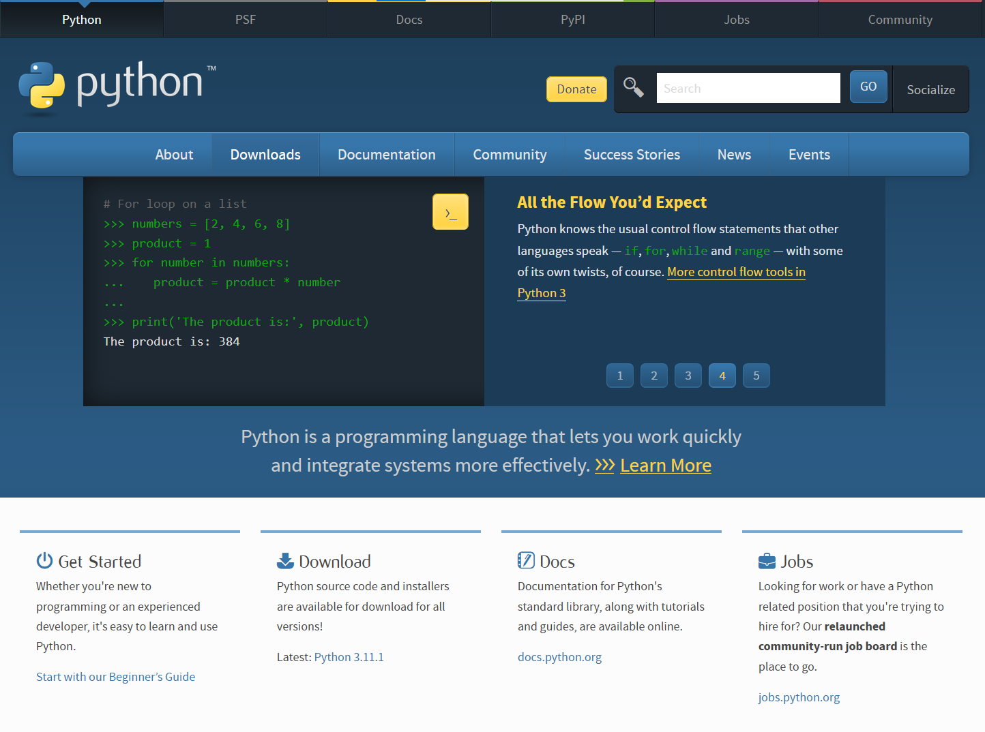
Python.org
+500.000 Python packages
Documentation
Download Python and IDLE

Slide 47
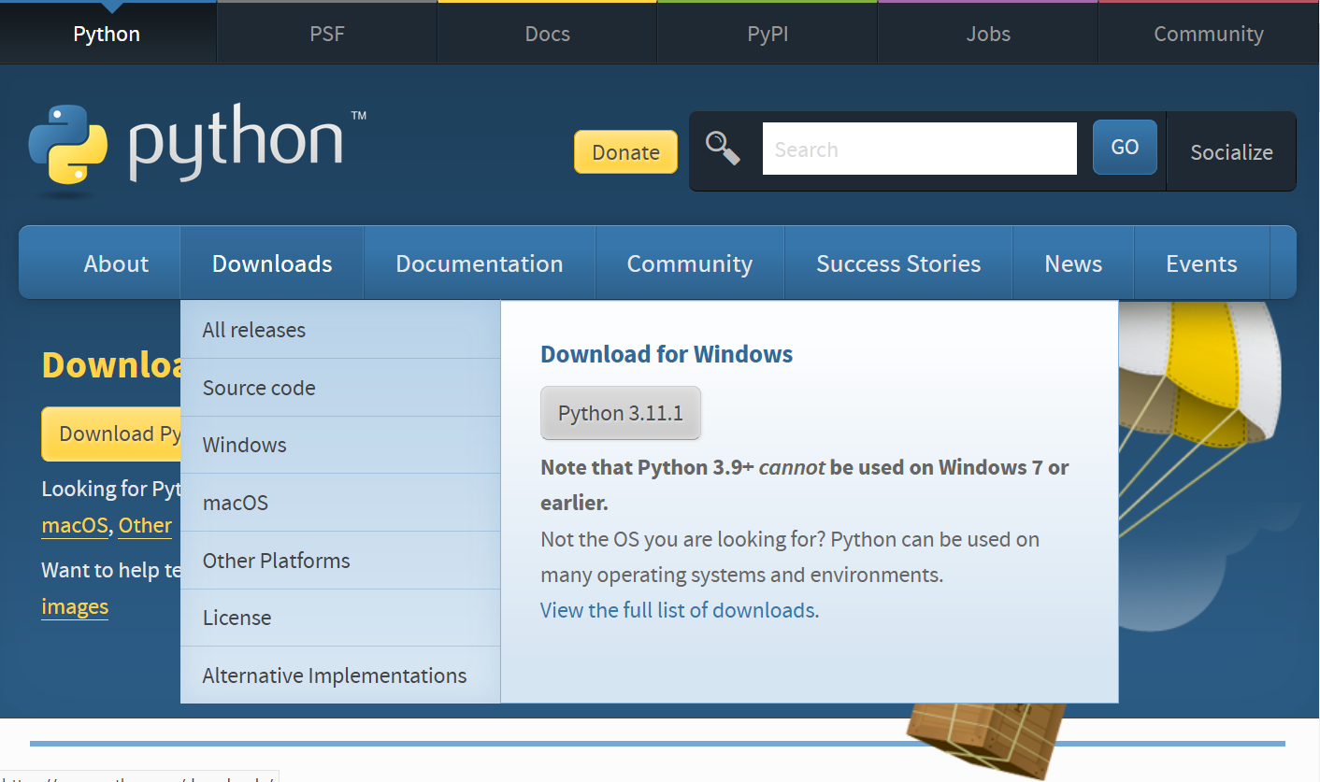
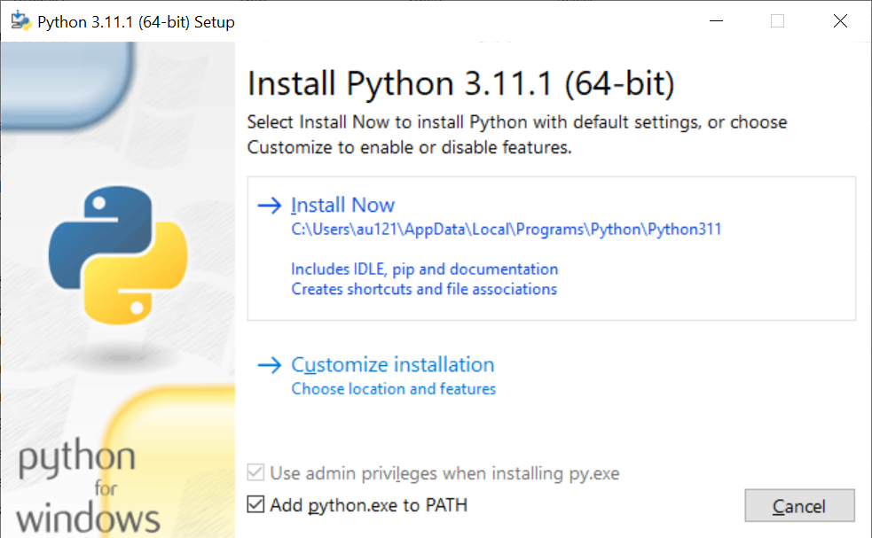
Installing Python
1
2
4
IMPORTANT
3

Slide 48
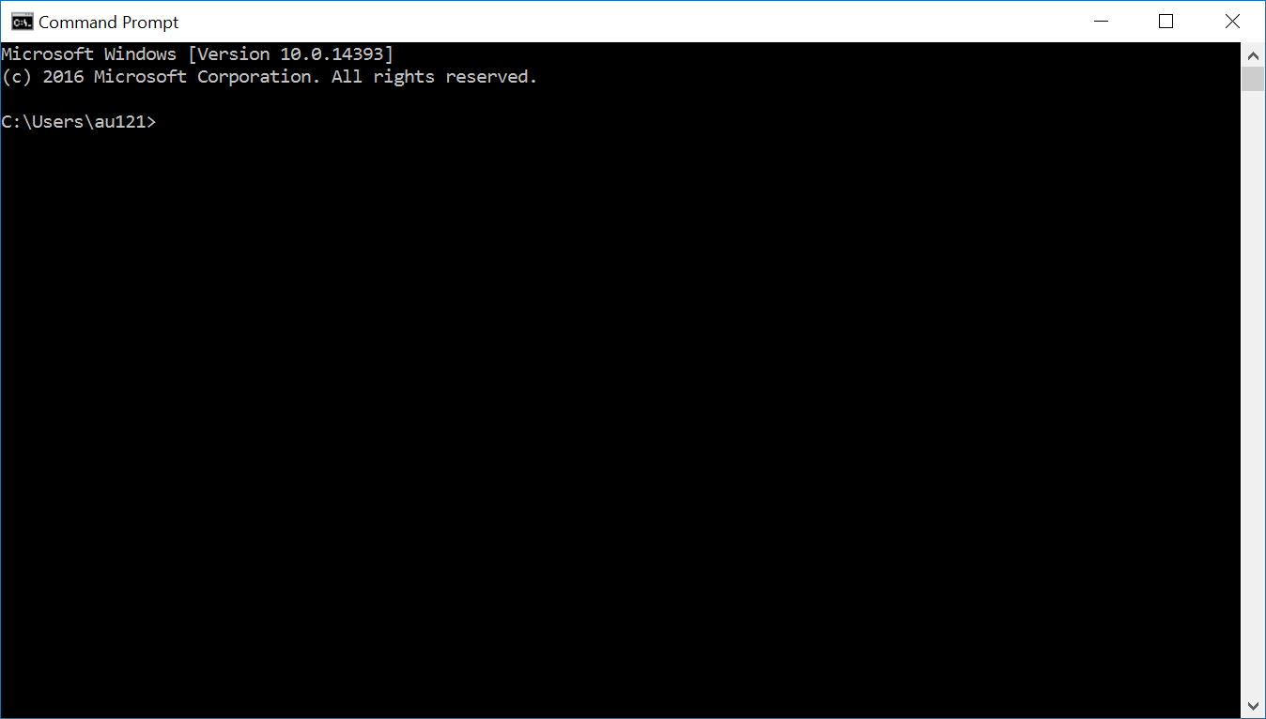
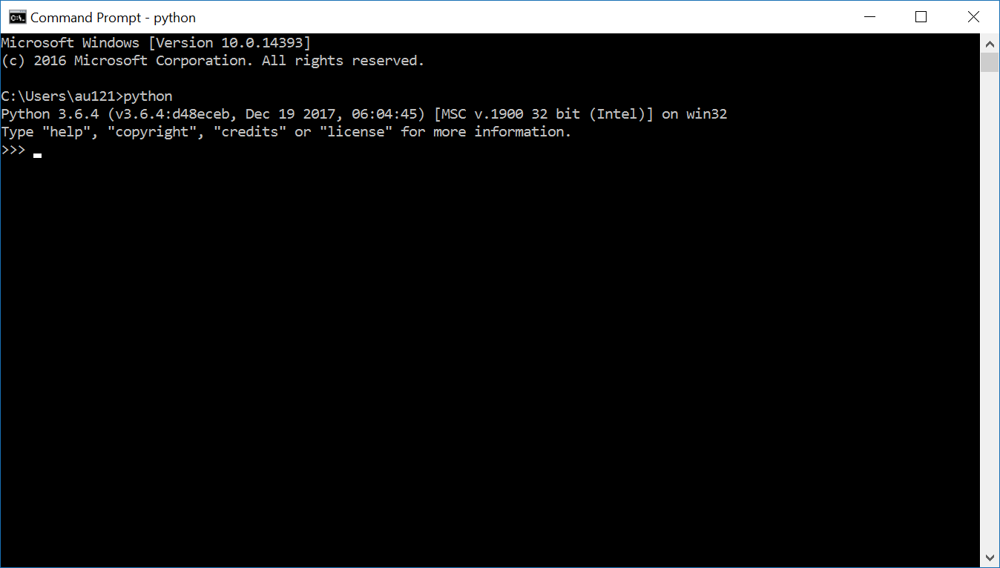
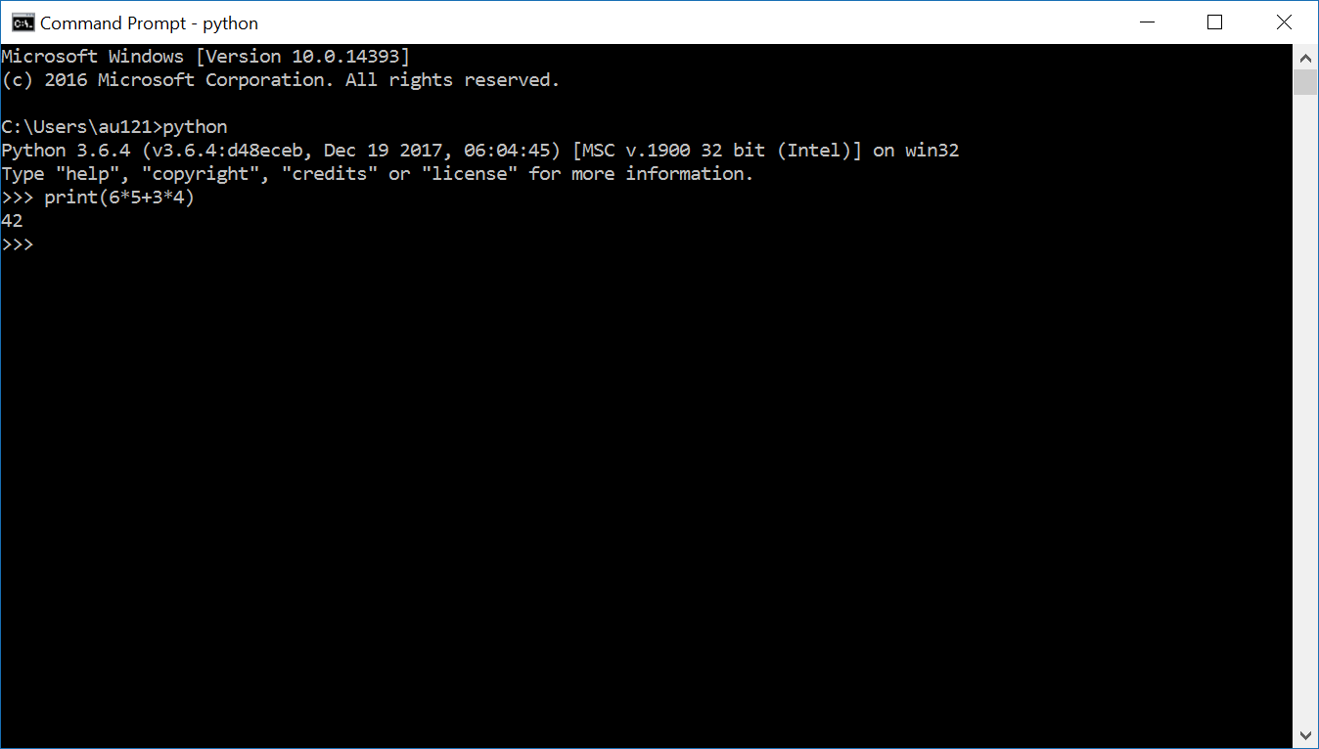
Running the Python Interpreter from a terminal
Open Command Prompt
(Windows-key + cmd)
Type “python” + return
Start executing
Python statements
To exit shell:
Ctrl-Z + return or
exit() + return
Note: Sometimes “python” is installed as “python3”
Notes:
On Mac use the “terminal” application; python3 and pip3 names also in particular relevant for Mac users.

Slide 49
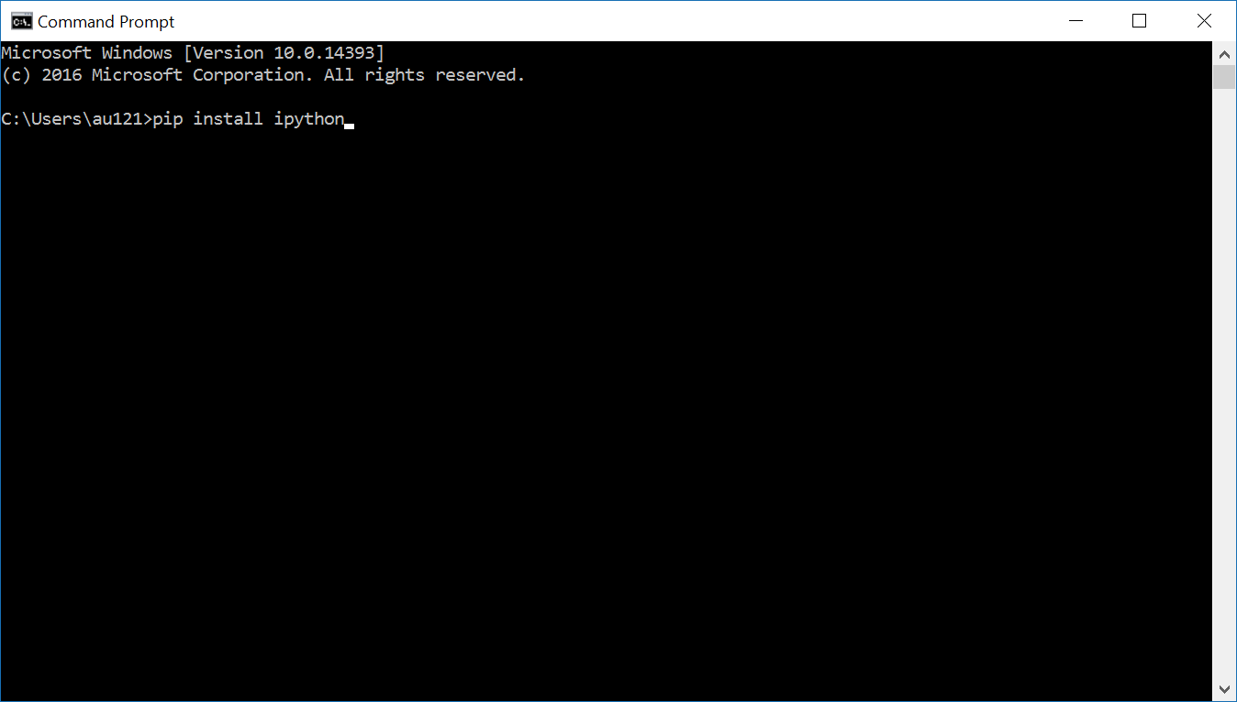
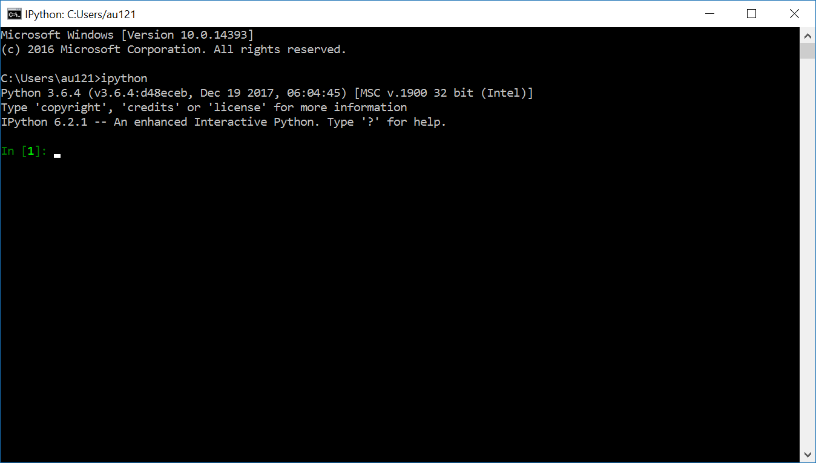
Installing IPython –
A more powerful interactive Python shell
Open Command Prompt
Execute:
pip install ipython
Start IPython
ipython
pip = the Python package manager
Note: Sometimes “pip” is installed as “pip3”

Slide 50
Some other usefull packages
Try installing some more Python packages:
pip install numpy linear algebra support (N-dimensional arrays)
pip install scipy numerical integration and optimization
pip install matplotlib 2D and 3D plotting library
pip install pylint Python source code analyzer enforcing a coding standard

Slide 51
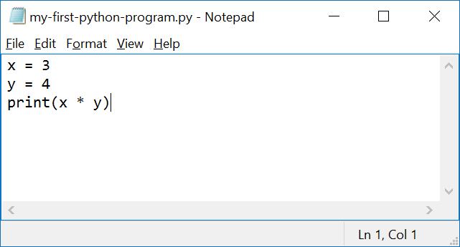
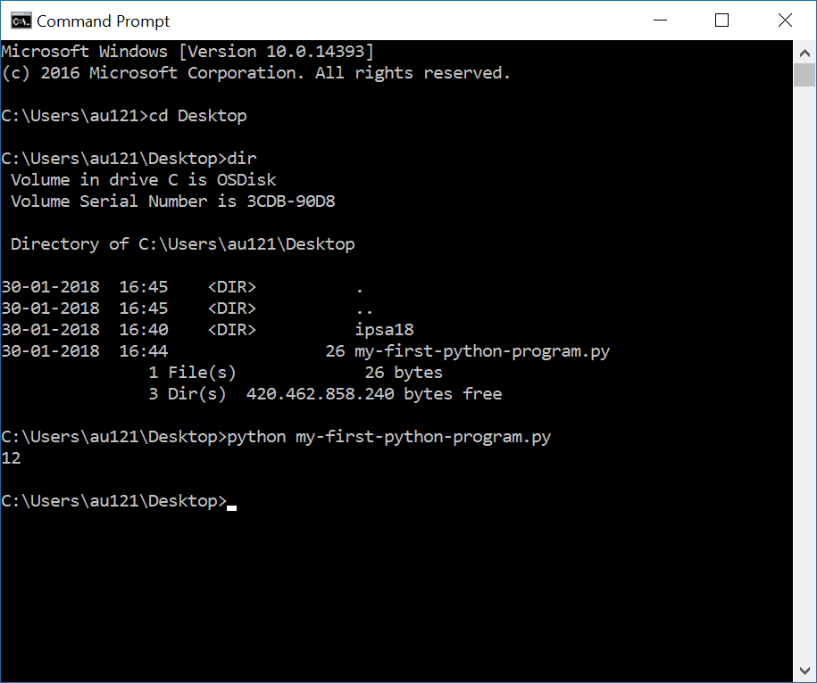
Creating a Python program the very basic way
Open Notepad (or TextEdit on Mac)
  write a simple Python program
  save it
Open a command prompt
  go to folder (using cd)
  run the program using
  python <program name>.py

Slide 52
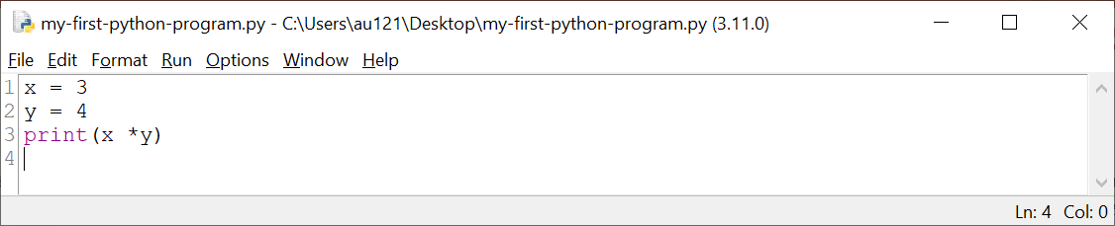
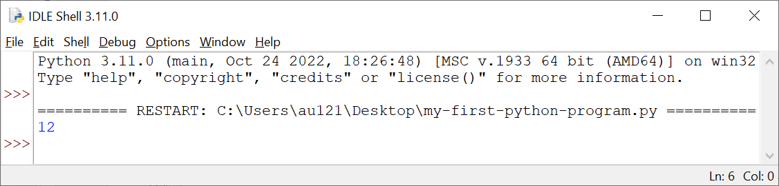
... or open IDLE and run program with F5
enable
line numbers under options
IDLE ships with Python from python.org
Good beginner IDE (Integrated Development Environment)
Notes:
Line numbers good when discussion code with others
IDLE = Integrated Development and Learning Environment
IDLE named after Eric Idle founding member of Monty Python (and Guido van Rossum named Python after … Monty Python)

Slide 53
The Python Ecosystem
Interpreters/compiler
  CPython – reference C implementation from python.org
  PyPy – written in RPython (a subset of Python) – faster than Cpython
  Jython – written in Java and compiles to Java bytecode, runs on the JVM
  IronPython – written in C#, compiles to Microsoft’s Common Language Runtime (CLR) bytecode
  Cython – project translating Python-ish code to C
Shells (IPython, IDLE, Jupyter)
Libraries/modules/packages
  pypi.python.org/pypi (PyPI - the Python Package Index, +500.000 packages)
IDEs (Integrated development environment)
  IDLE comes with Python (docs.python.org/3/library/idle.html)
  Anaconda w. Spyder, IPython (www.anaconda.com/download)
  Canopy (enthought.com/product/canopy)
  Visual Studio Code (code.visualstudio.com)
  Python tools for Visual Studio (github.com/Microsoft/PTVS)
  PyCharm (www.jetbrains.com/pycharm/)
  Emacs (Python mode and ElPy mode)
  Notepad++
Python Style guide (PEP8)
  pylint, pep8, flake8
Python online
  Google colab (colab.research.google.com), repl.it, sagemath.org, …
Good beginer Python IDE
“Visual Studio Code is used by more than twice as many developers than its nearest alternative”, Stack overflow survey 2024
Try to google ”best ide python”

Slide 54
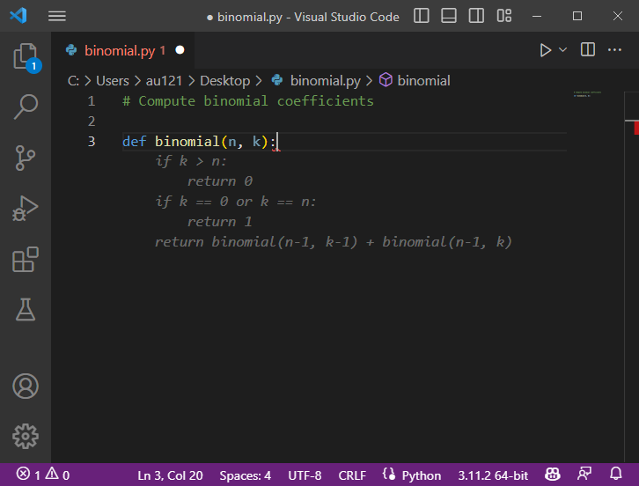
IDEs and AI assistants
Some IDEs integrate AI assistants to support code suggestions,
e.g. GitHub Copilot in VS Code
AI assistants increase productivity if you understand their output
Interacting with an AI assistant can be a great programming tutor
AI assistants are not allowed at the exam
suggestion
Guido van Rossum, inventor of Python, on GitHub Copilot
”I use it every day. It writes a lot of code for me… and usually it is slightly wrong but it still safes me typing.”
Python and the Future of Programming, Guido van Rossum interviewed by Lex Fridman
Notes:
The focus of this course is to understand basic programming. It is not about how good AI assistants are at solving exercises, and it also not about learning you to use AI assistants. AI are cool tools, and can help you learn programming through suggesting outputs.

