Slide 1
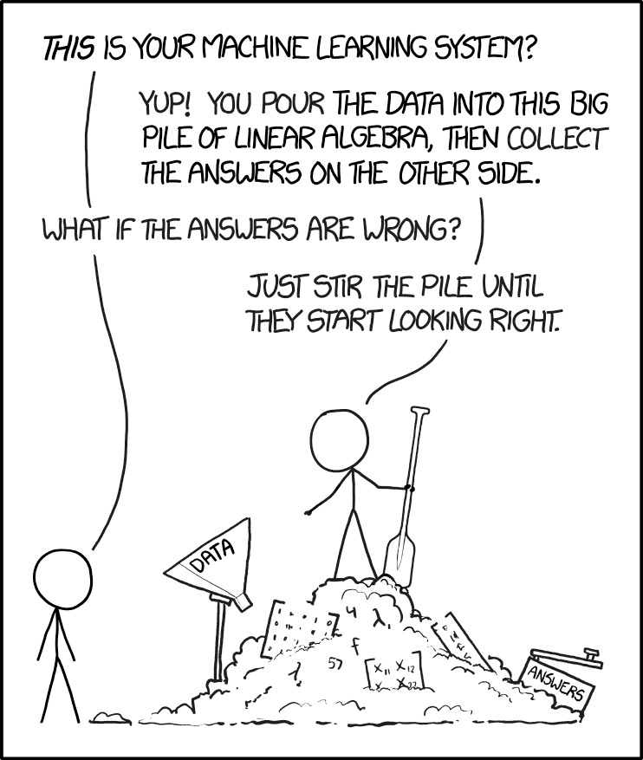
Clustering
k-means
scipy.cluster.vq.kmeans
DBSCAN*
neural networks
xkcd.com/1838/

Slide 2
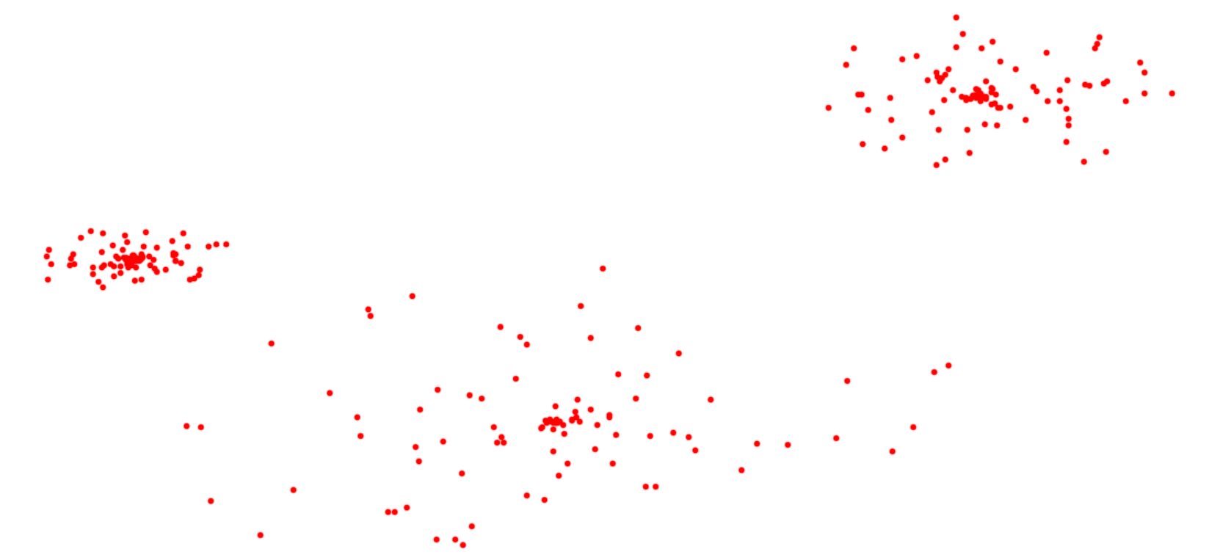
3 clusters / groups of points

Slide 3
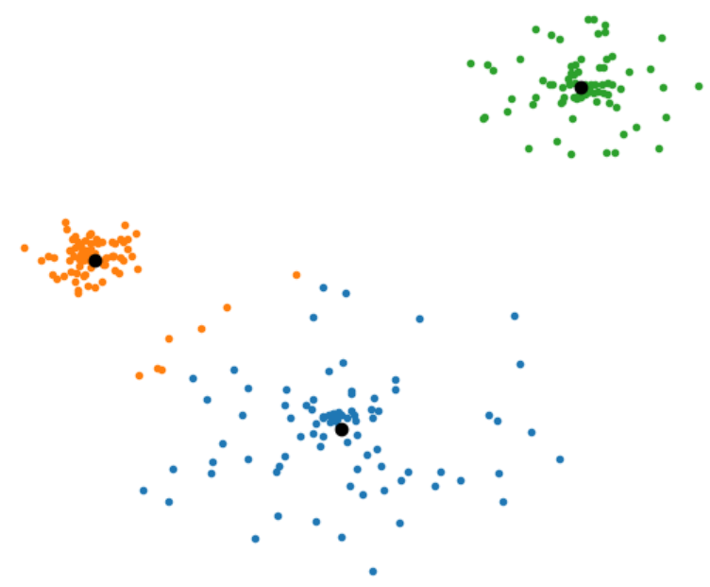
Clustering = Optimization problem
Example: k-means
Find k points centroids
Assign each input point to nearest centroid → k clusters C
distortion = $\sum_{\text{C}∈\text{C}}{ \sum_{\text{p}∈\text{C}}{{\text{ |}\text{p}\text{ −} \text{centroid}\text{(}\text{C}\text{)}|}^{2}}}$
Goal : Find k centroids that minimize distortion
Notes:
Note the orange points in blue cluster – this is a shortcomming of using the distance to the centers of the clusters

Slide 4
k-means for k = 1
Let the centroid point c for a point set C be the point minimizing the
distortion = $\sum_{\text{p}∈\text{C}}{{\text{ |}\text{p}\text{ − }\text{c}|}^{2}}$
Theorem c = average(C)
Notes:
Proof is exercise
* can minimize independently for x and
* look at the derivative at the average – where it will be zero

Slide 5
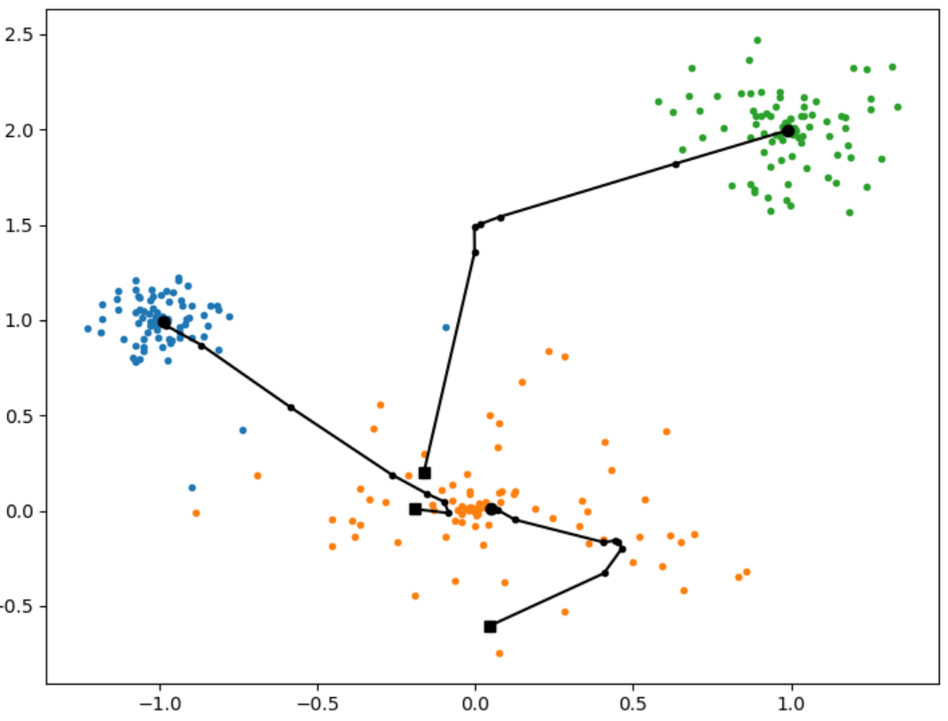
k-means - Lloyd’s method (pseudo code)
centroids = k distinct random input points while centroids change: create clusters C by assigning points to the nearest centroid centroids = average of each cluster
Notes:
Algorithm does not relate to the optimization criteria
Starts with k input points, but hereafter the centroid candidates are the average
The distortion provably becomes better for each step – but can end up in a local minima

Slide 6
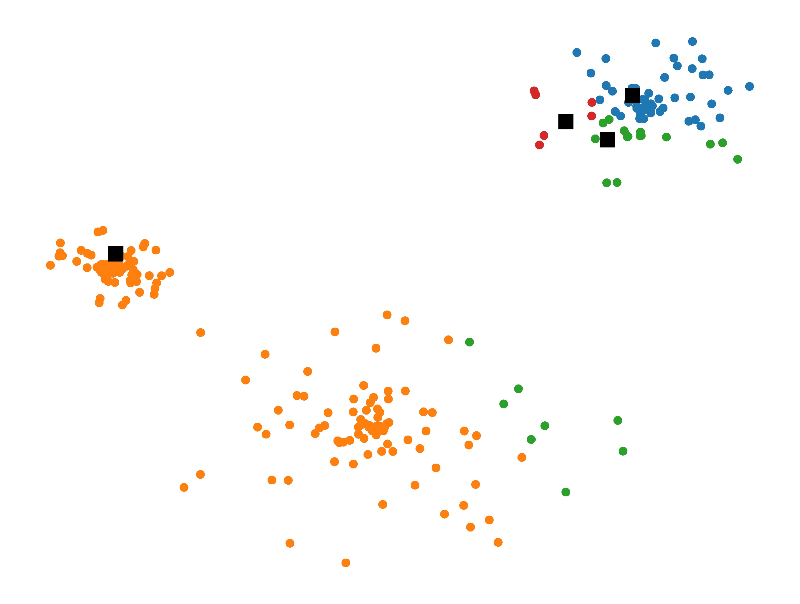
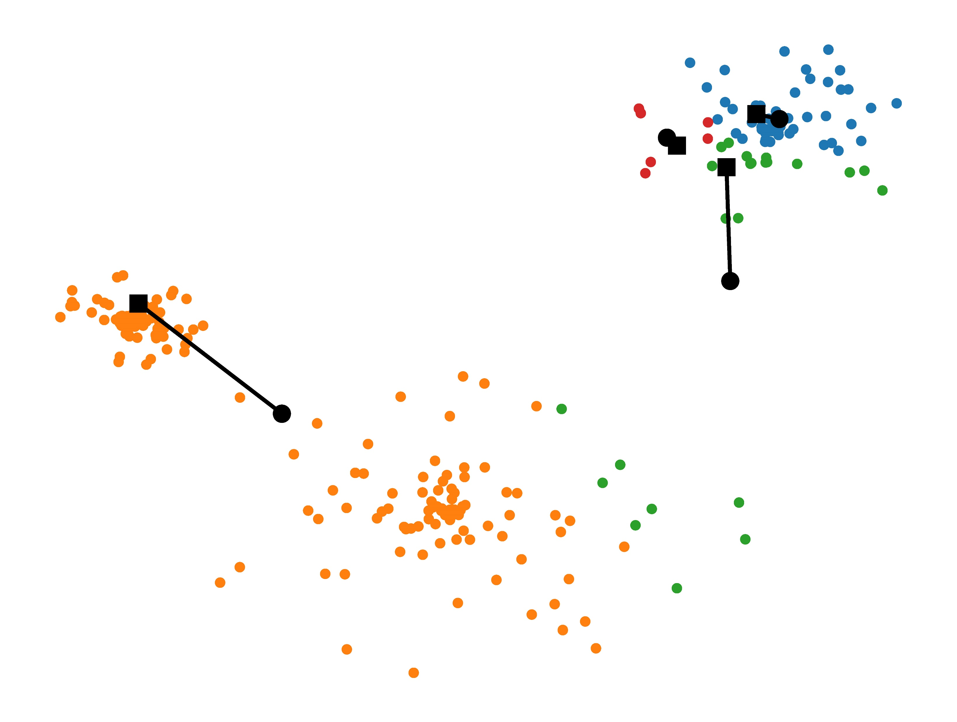
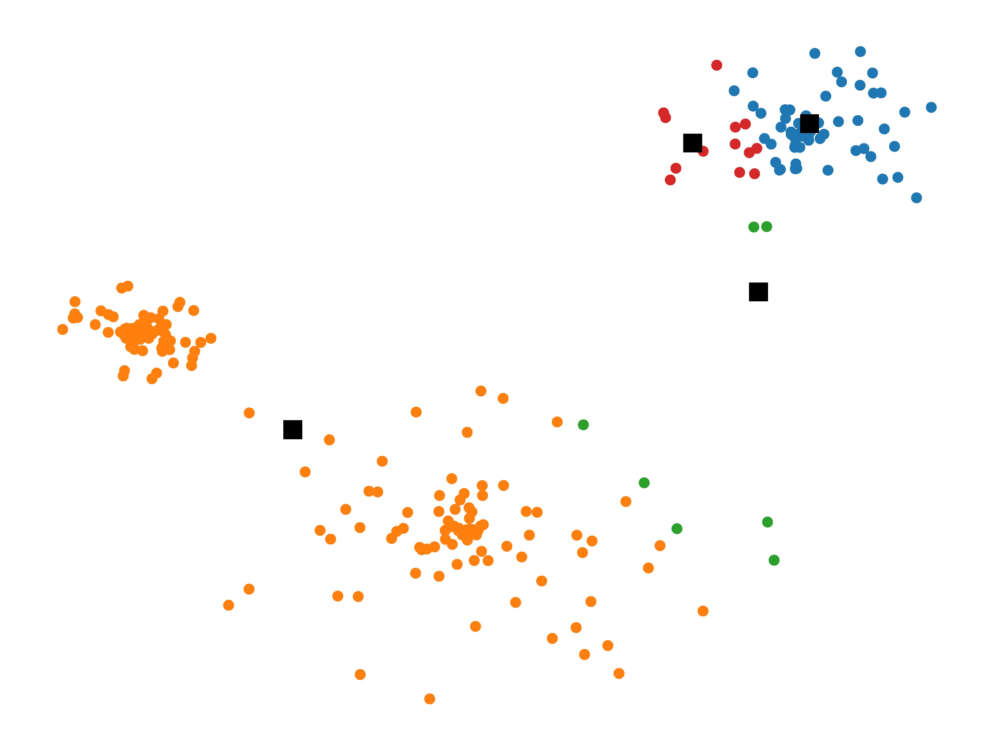
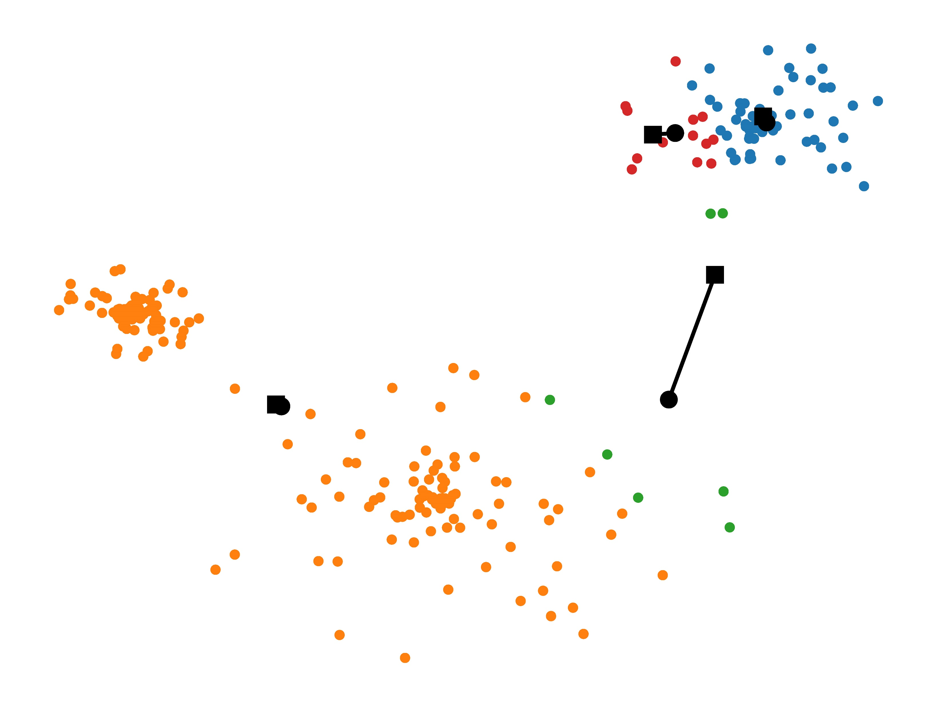
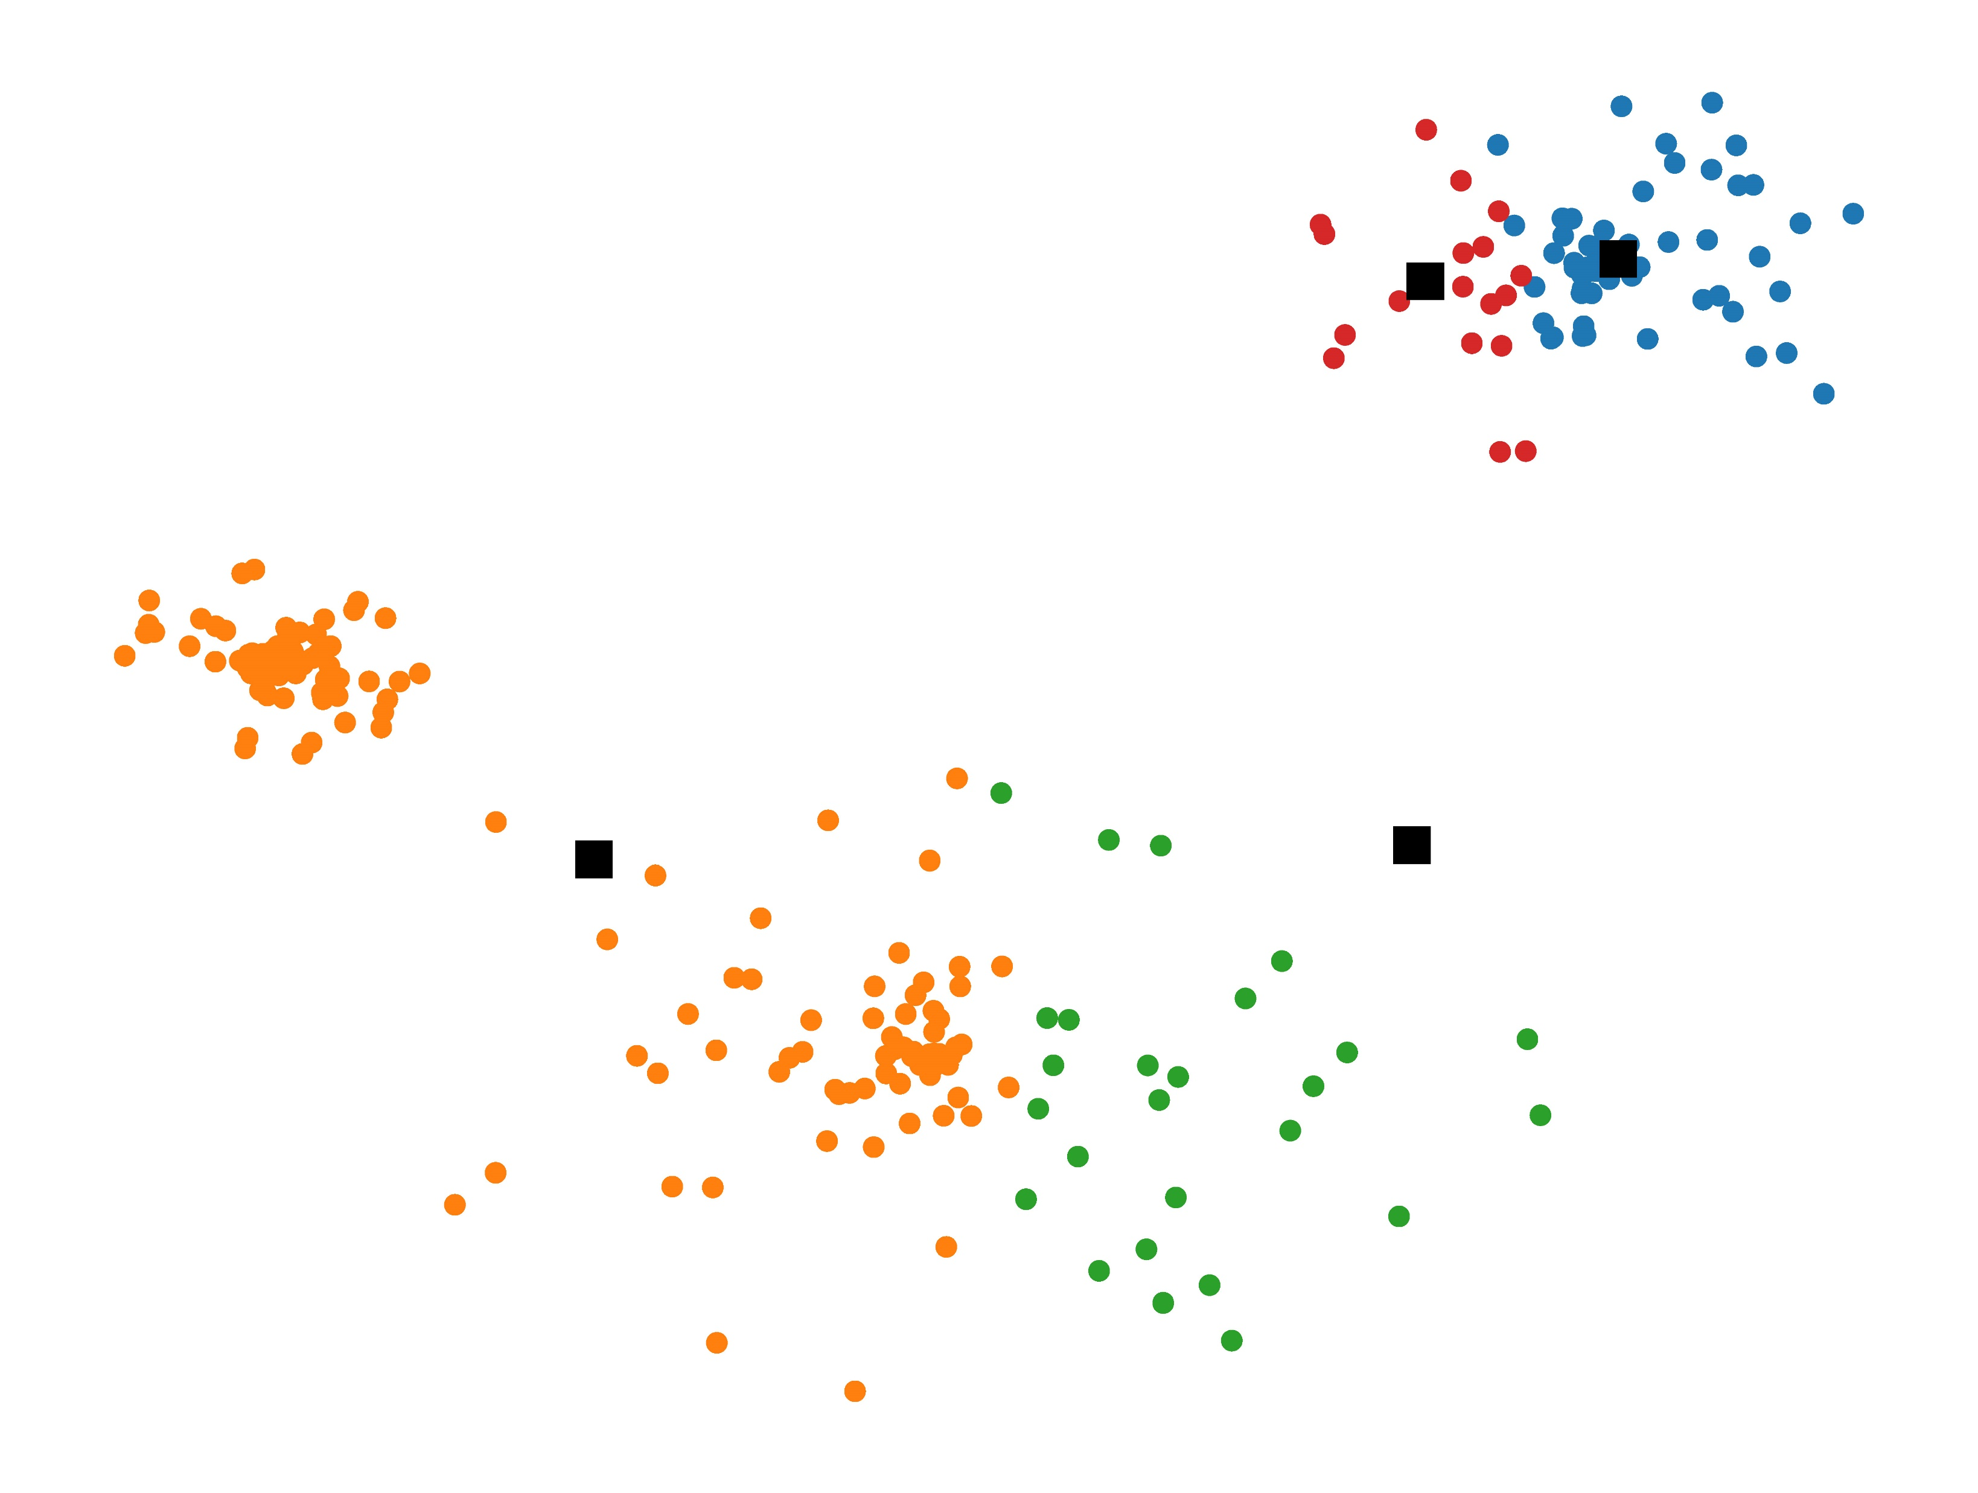
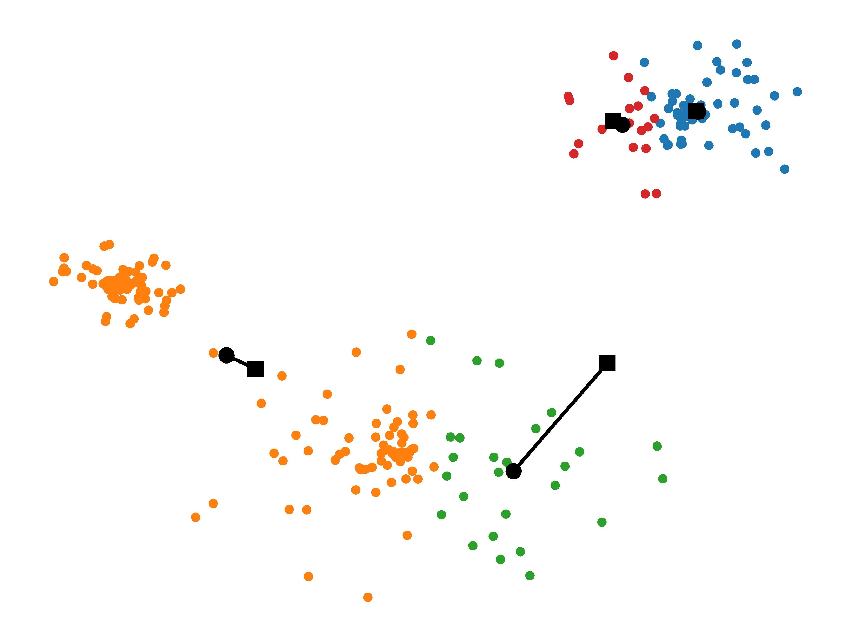
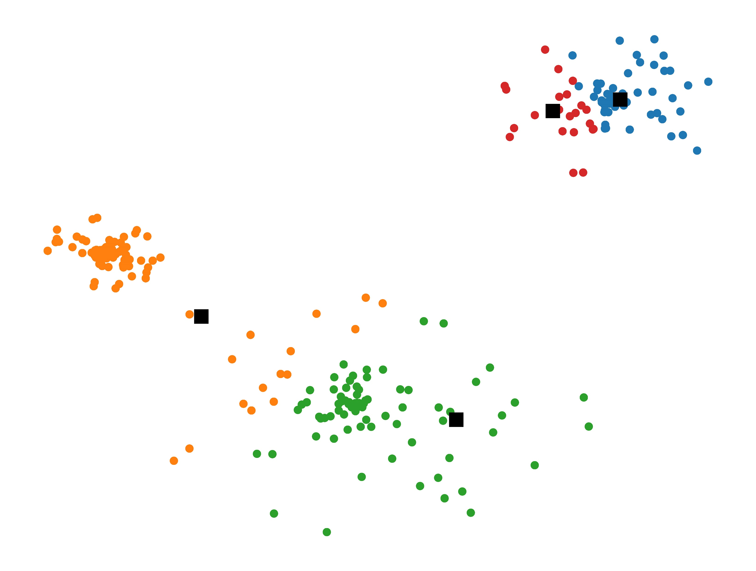
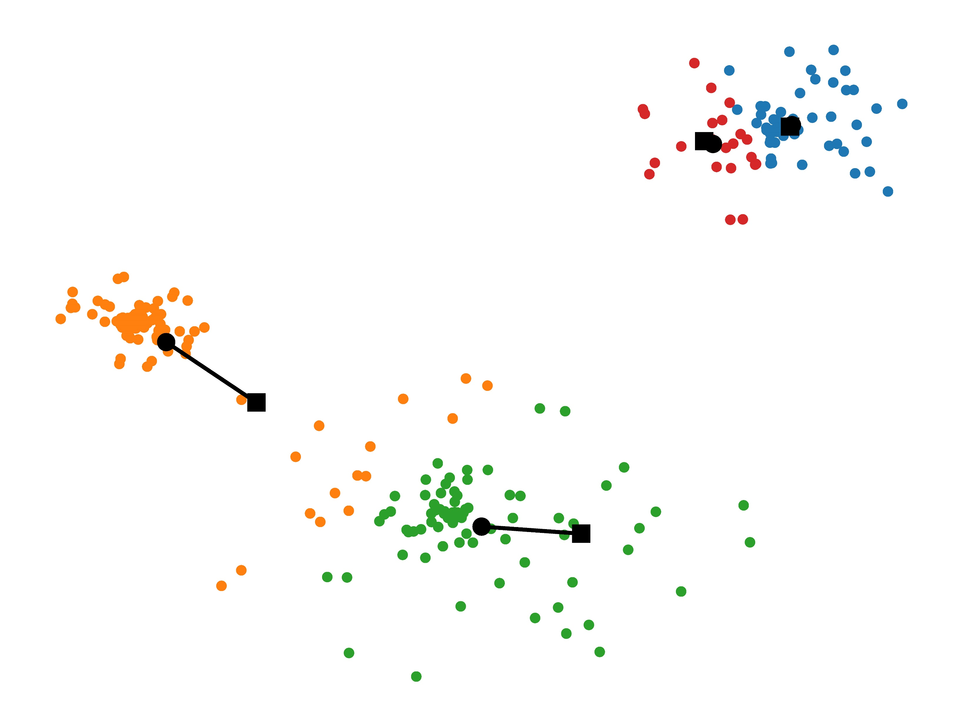
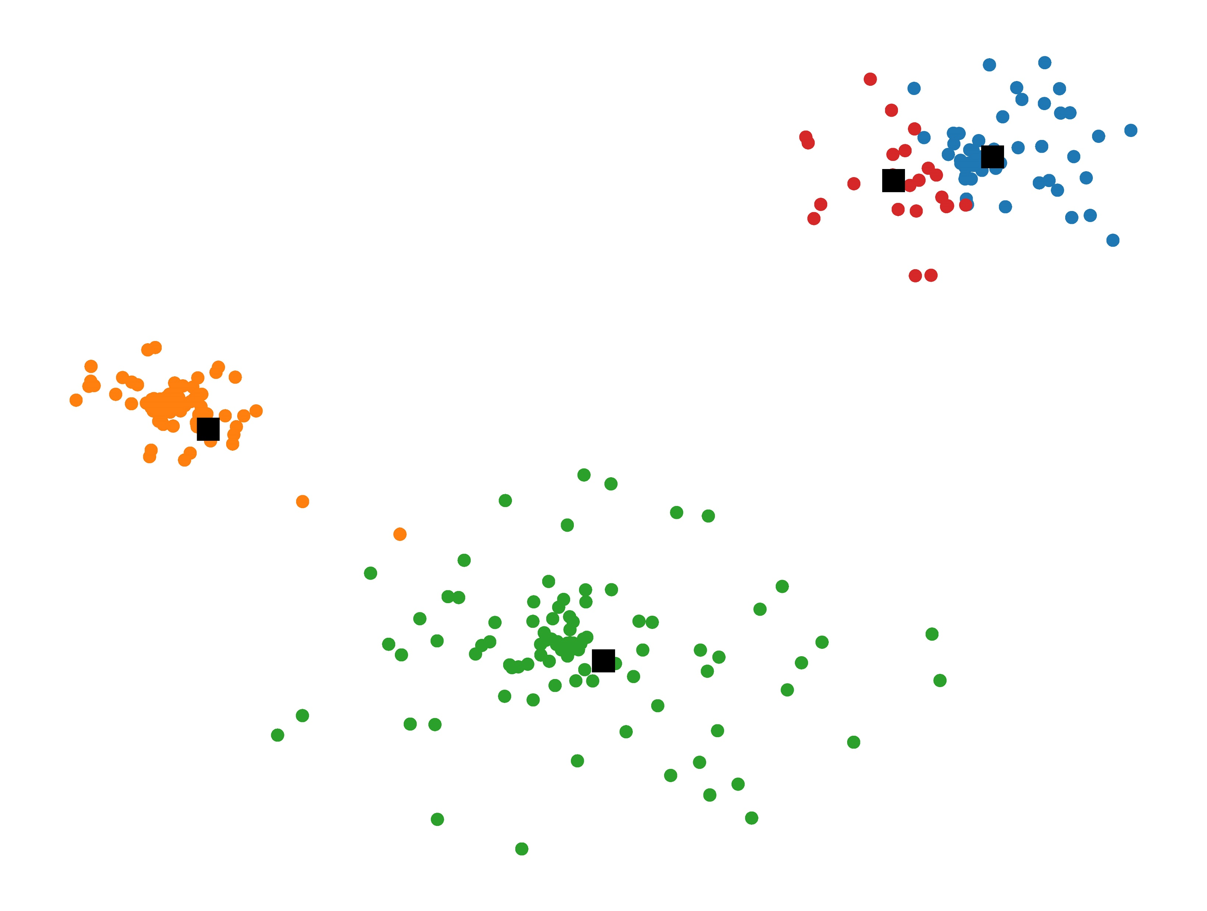
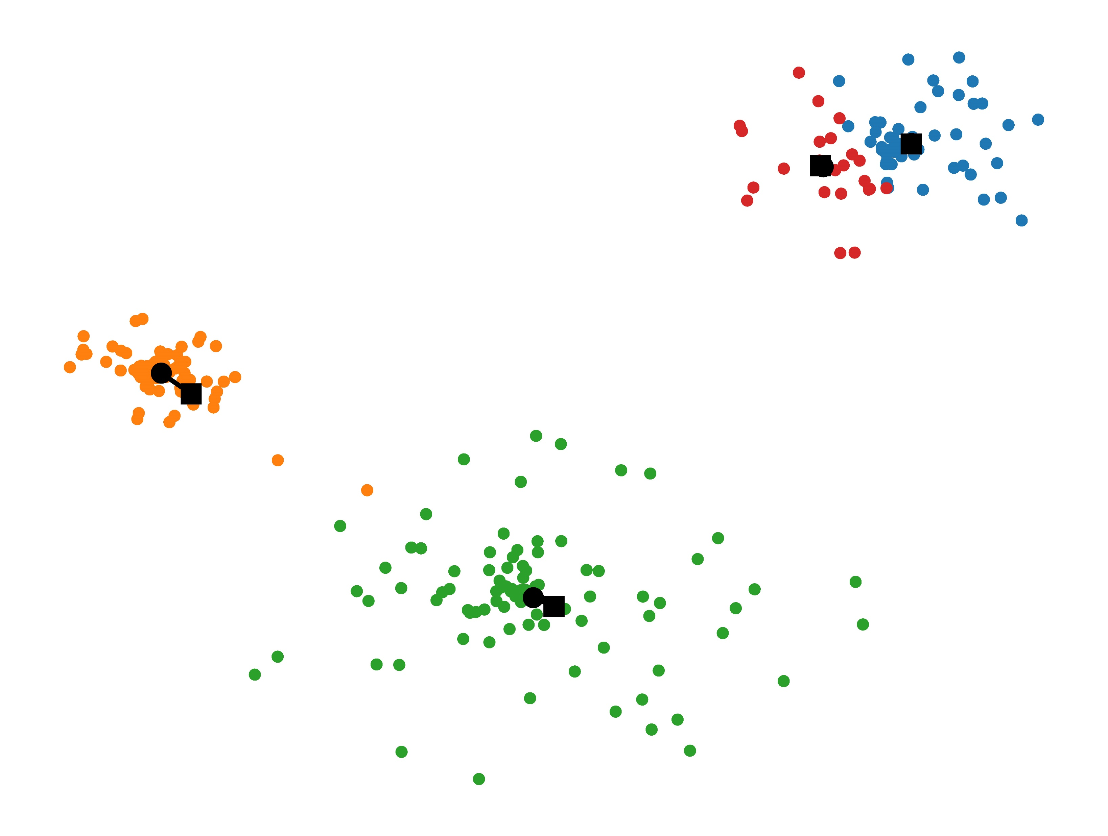
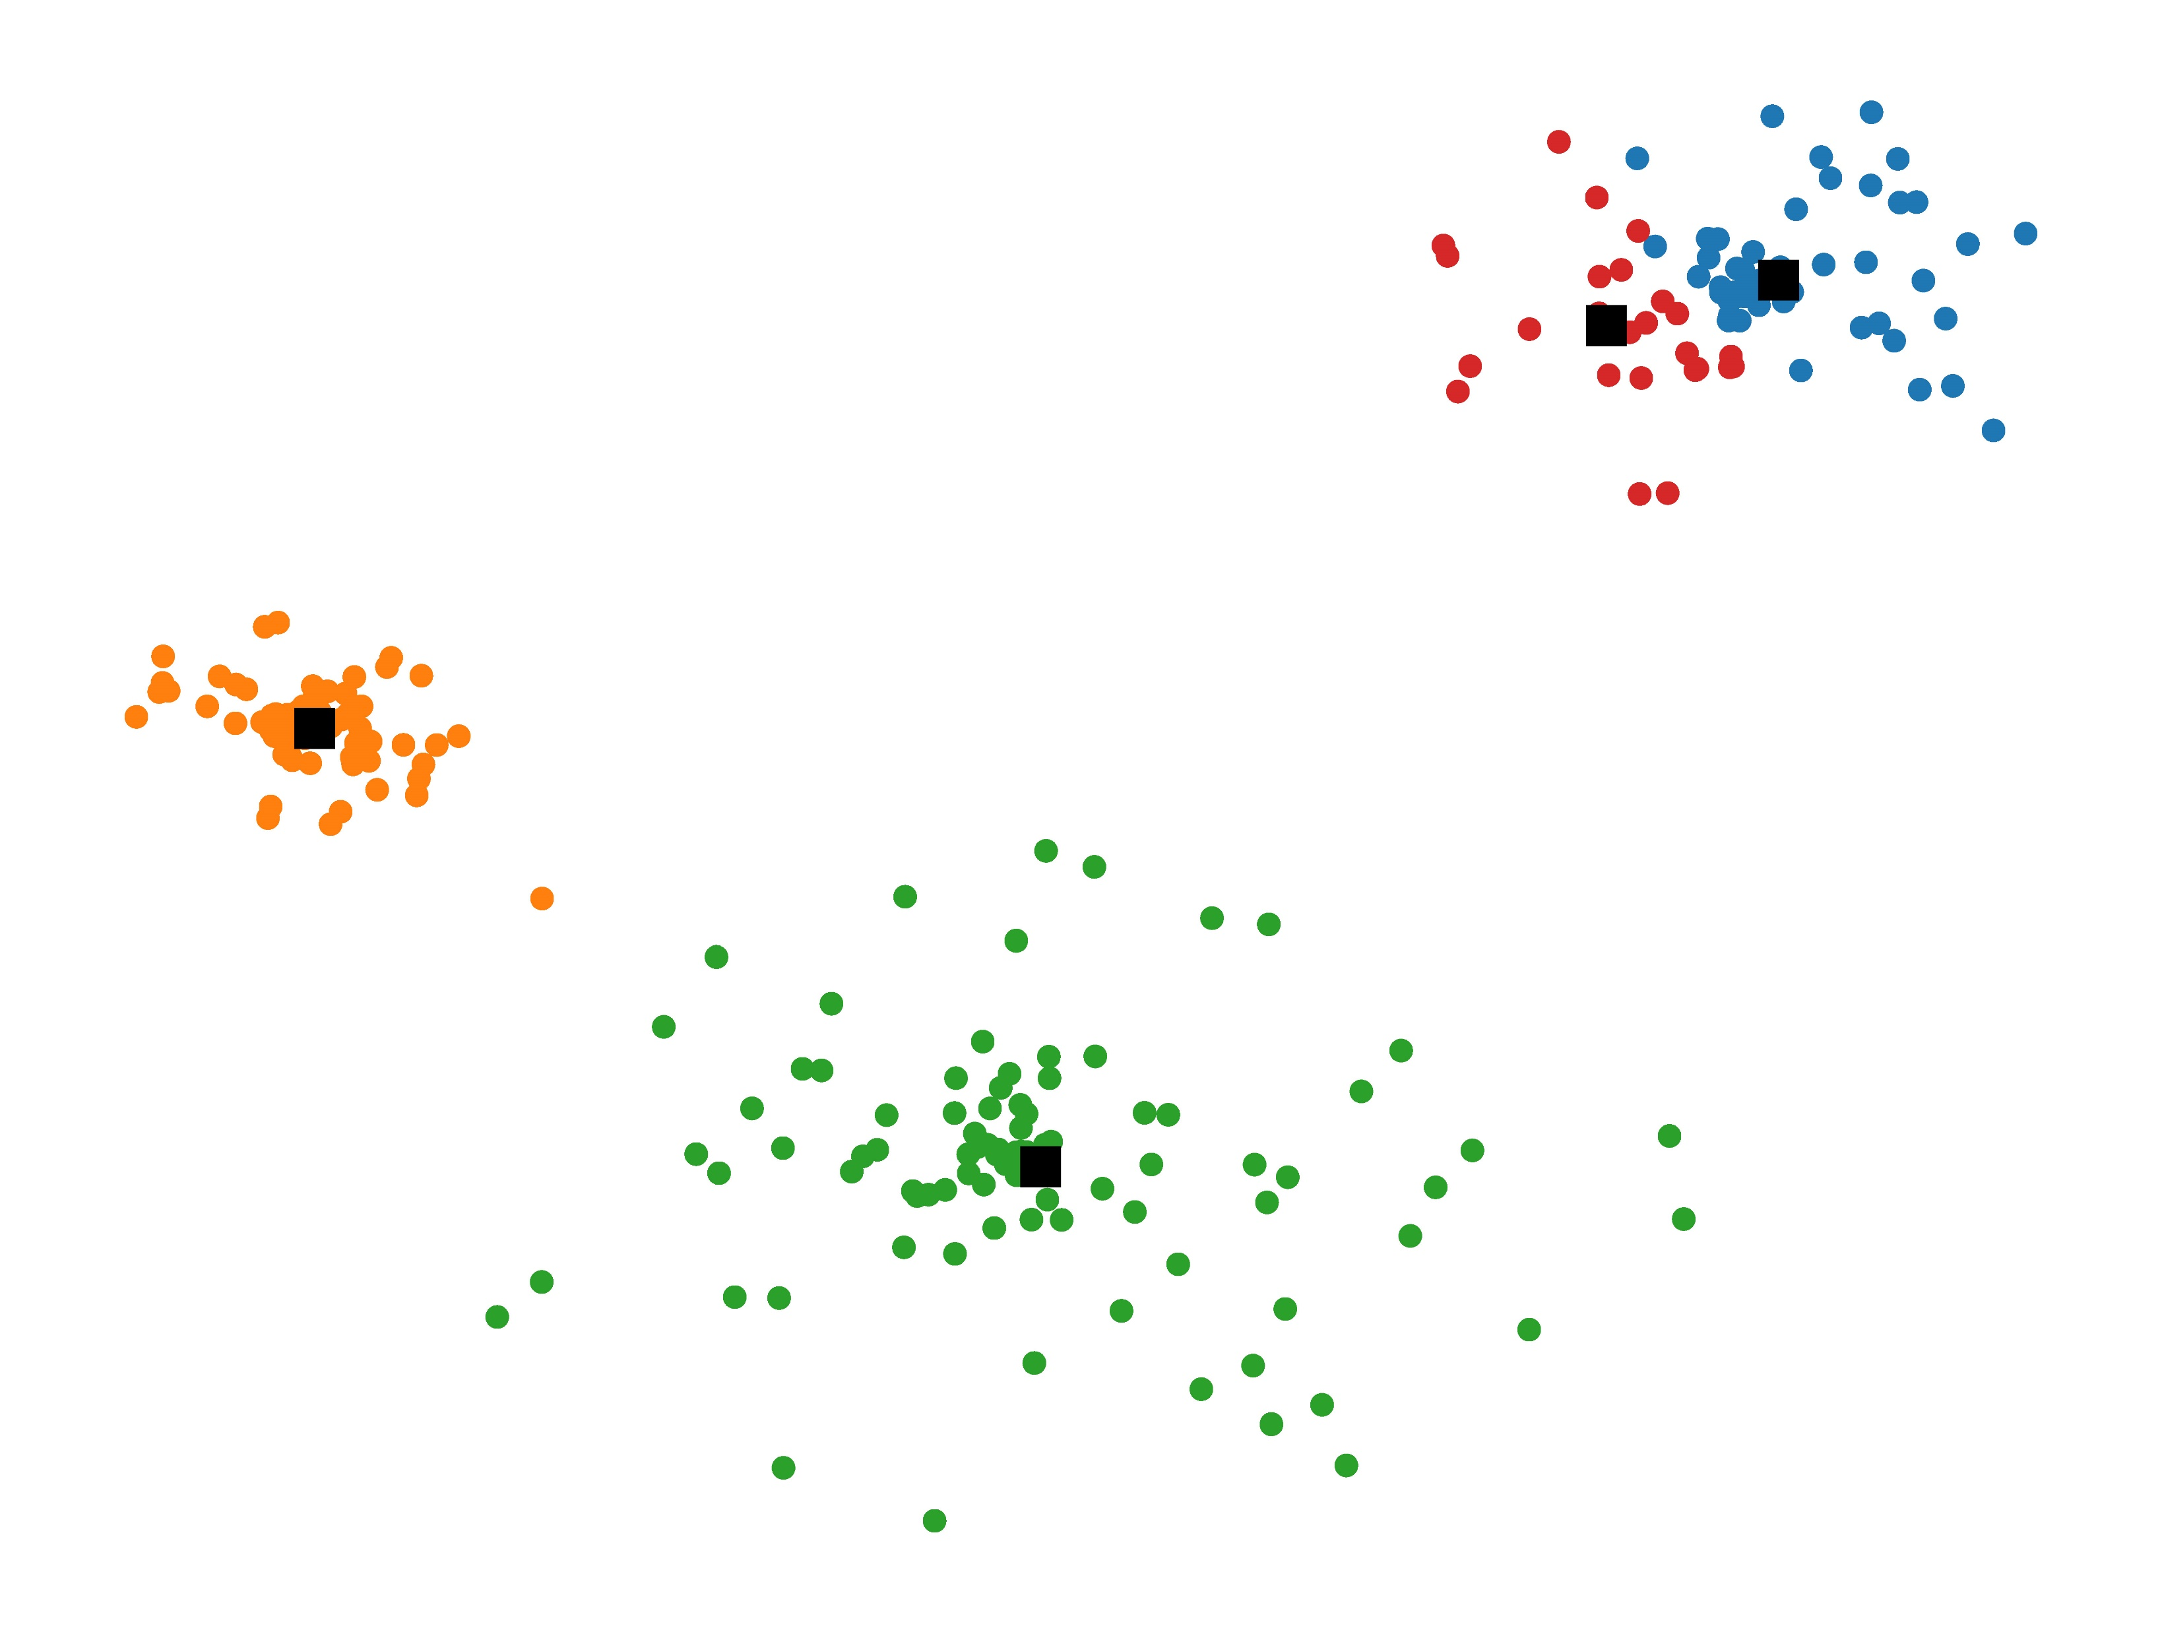
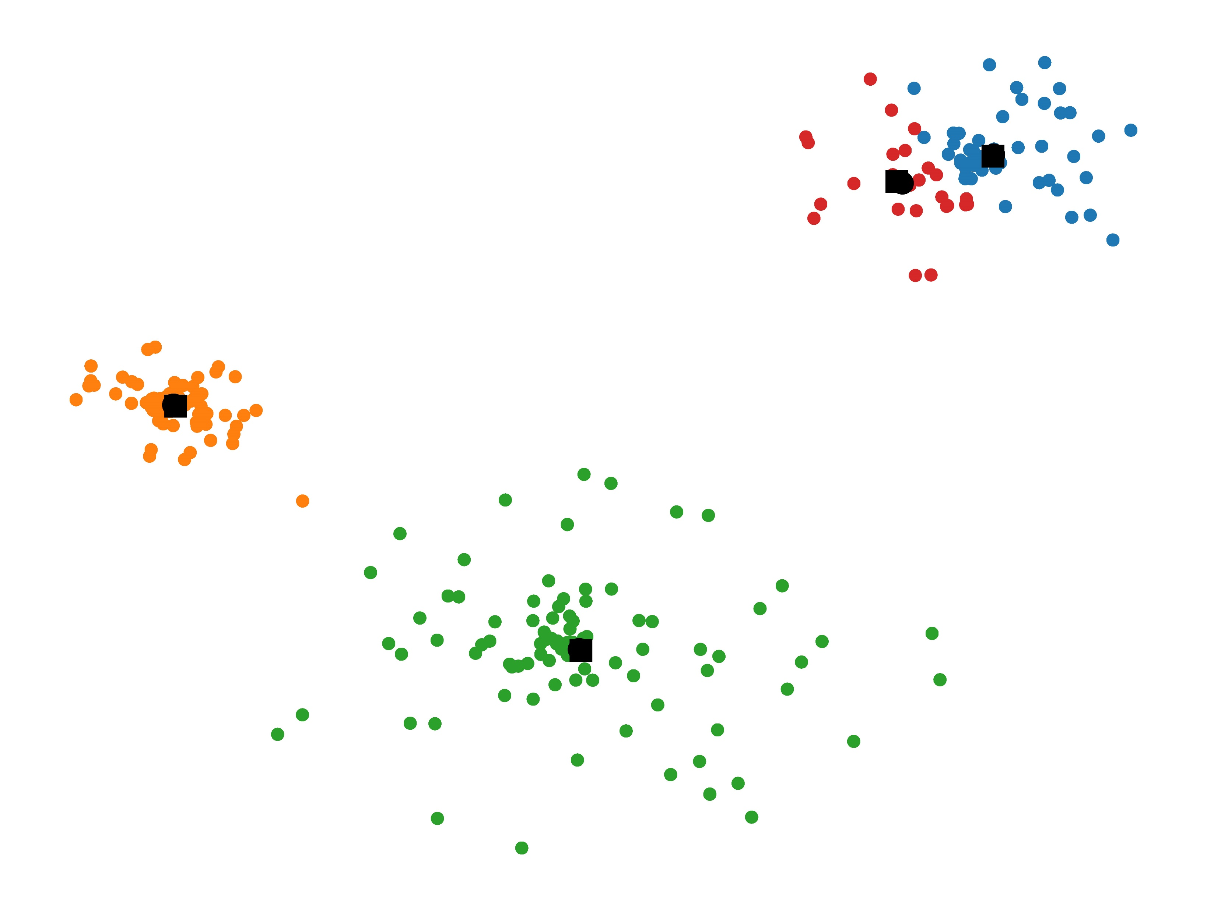
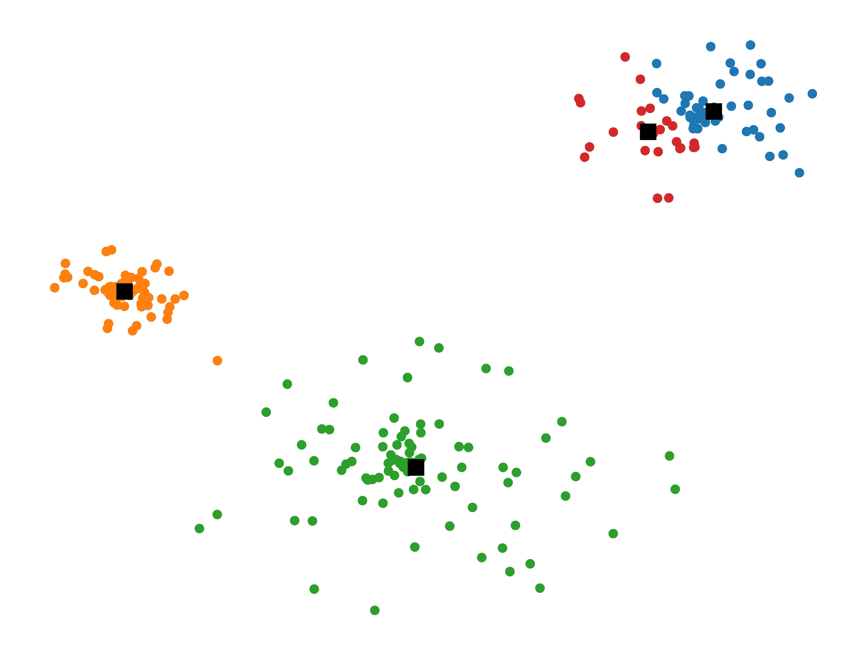
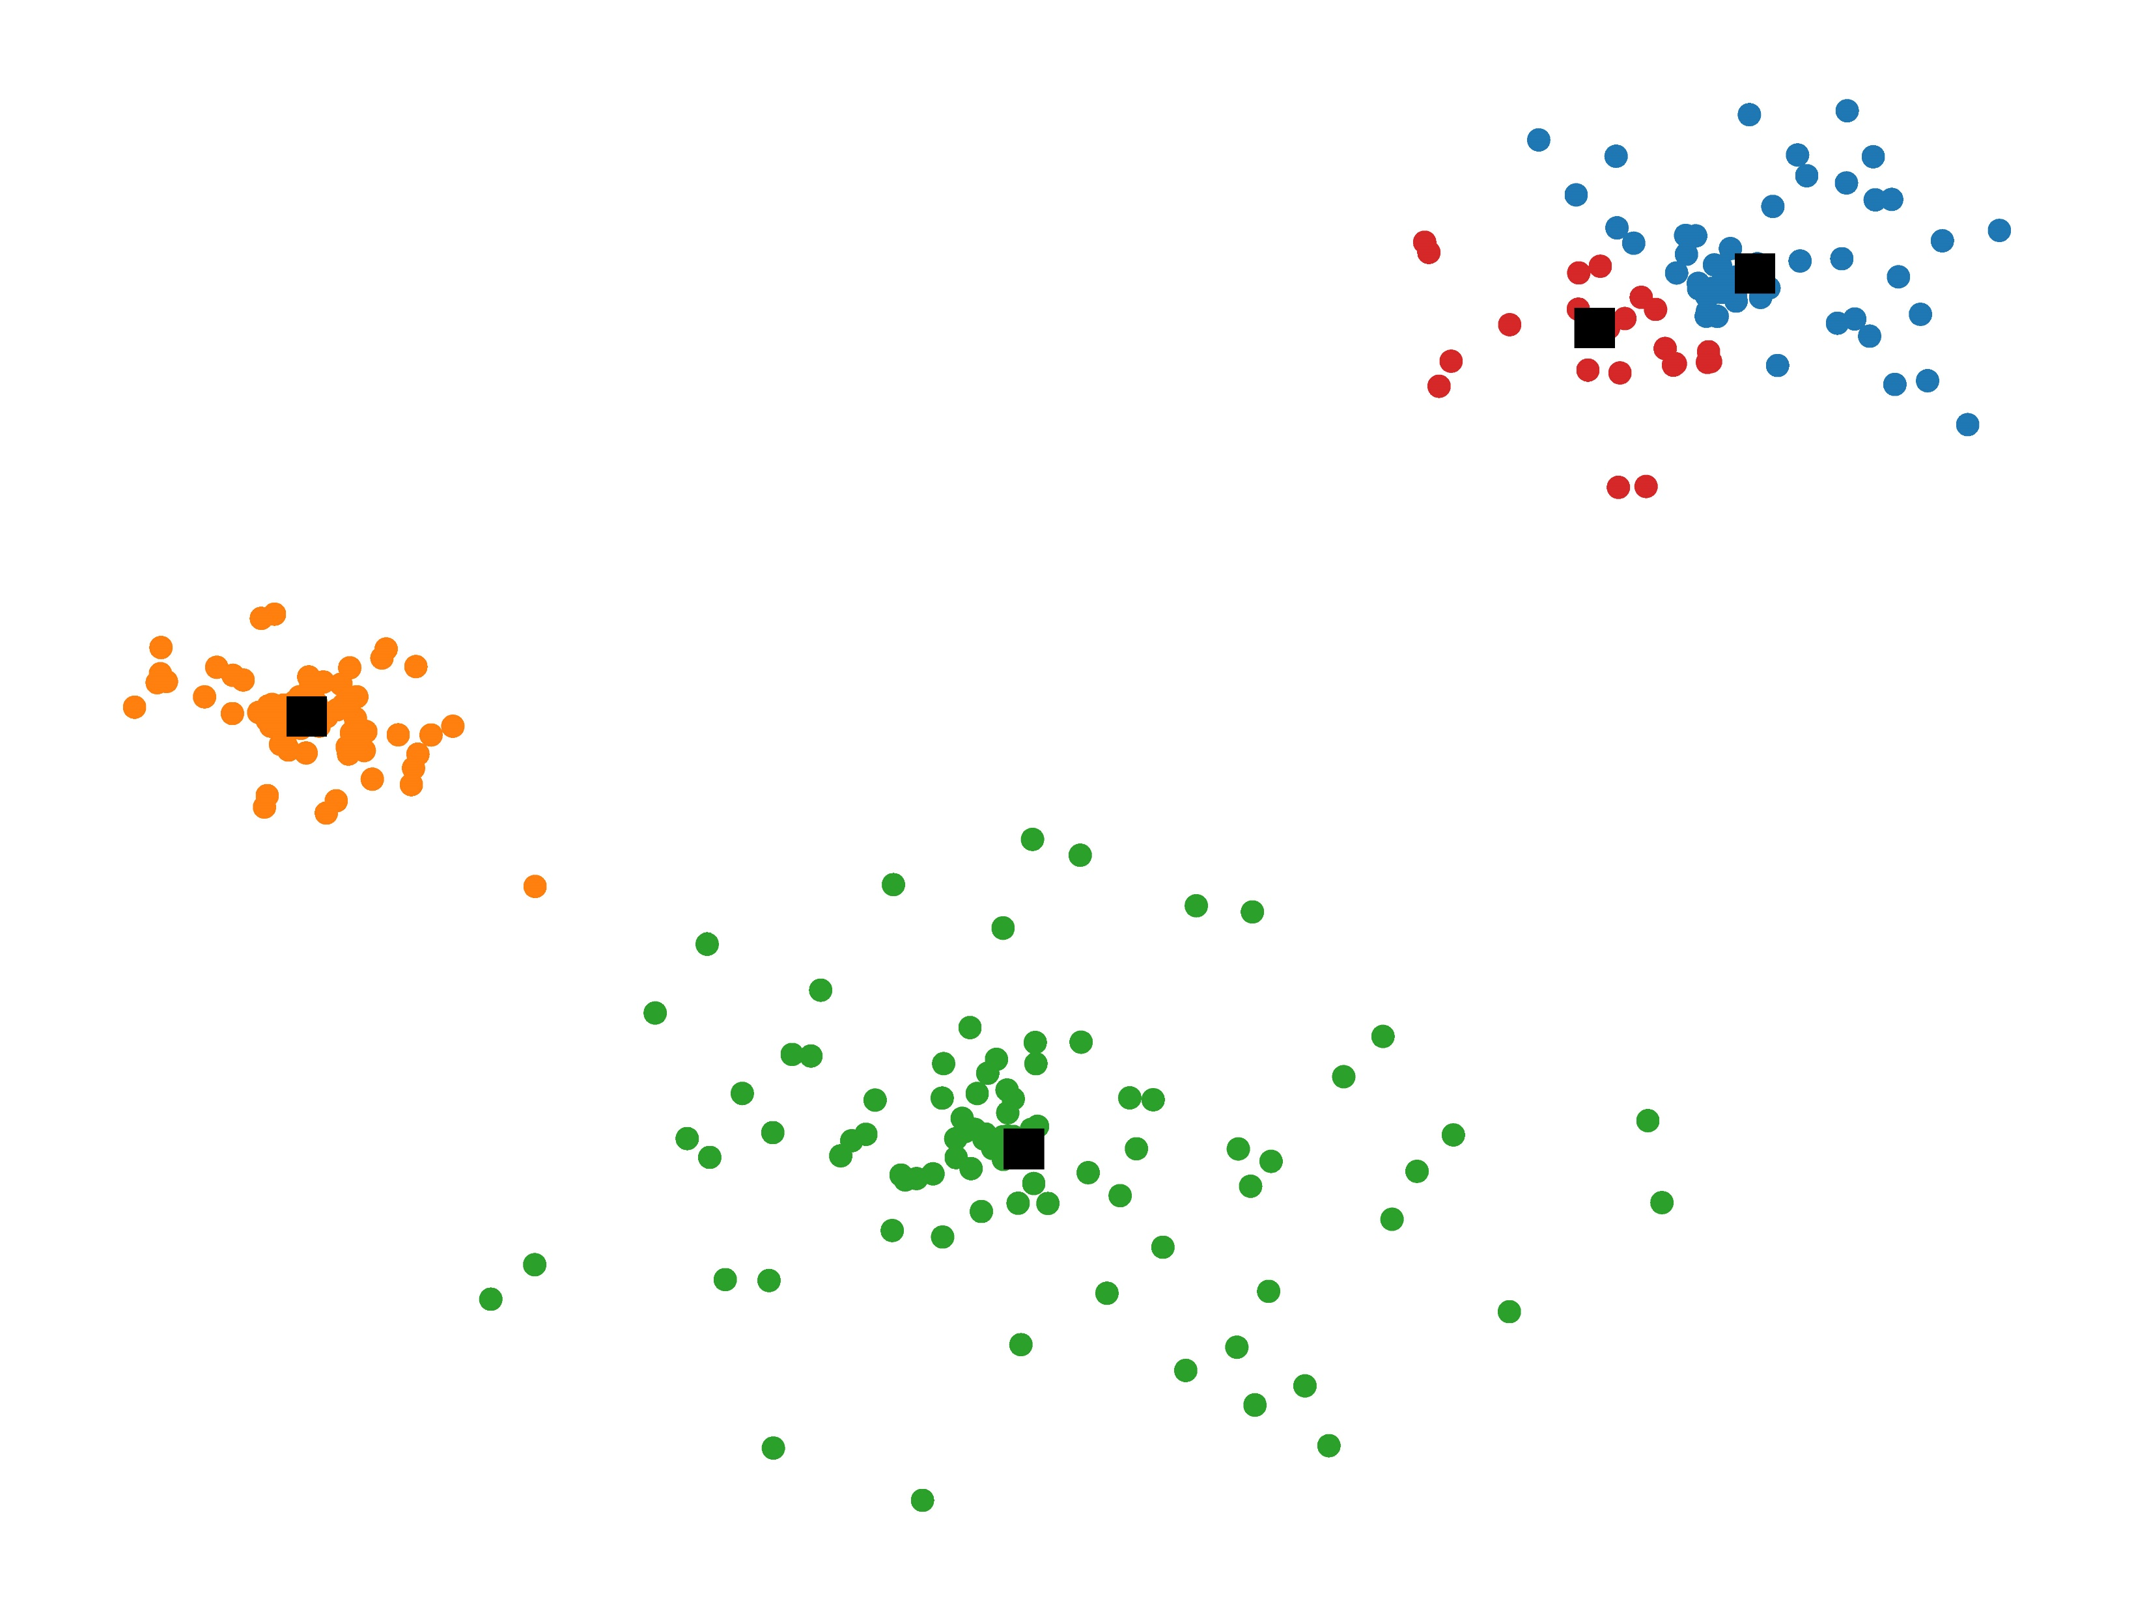

Slide 7
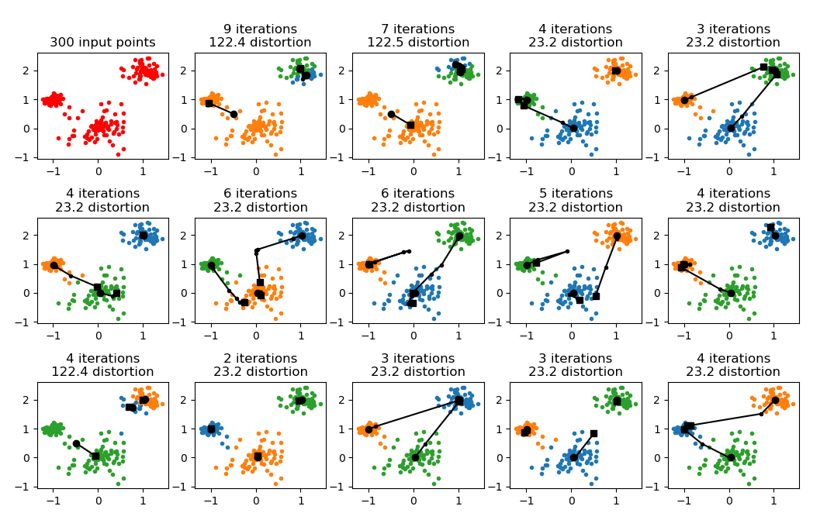
k-means is a heuristic
output can be far from optimal
Notes:
Finding 3 clusters
Heuristic – to avoid getting stuck in local minima repeat for several different random start positions and take best

Slide 8
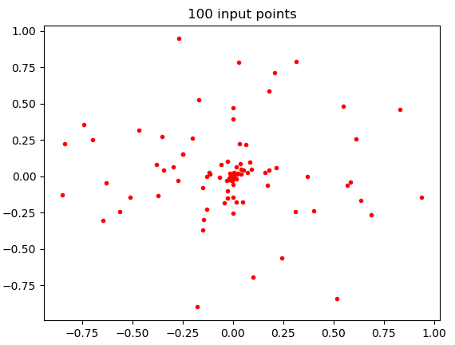
Generating random points (just one random approach)
k_means.py
from random import random from math import pi, cos, sin def random_point(x, y, radius): angle = 2 * pi * random() r = radius * random() ** 2 return x + r * cos(angle), y + r * sin(angle) def random_points(n, x, y, radius): for _ in range(n): yield random_point(x, y, radius)

Slide 9
k-means
k_means.py
from random import sample from numpy import argmin, mean def k_means(points, k): centroid = sample(points, k) centroids = [ centroid ] # history for visualization while True: clusters = [[] for _ in centroid] for p in points: i = argmin([dist(p, c) for c in centroid]) clusters[i].append(p) centroid = [tuple(map(mean, zip(*c))) for c in clusters] if centroid == centroids[-1]: break centroids.append(centroid) if min(len(c) for c in clusters) == 0: print('Not good - empty cluster') break return clusters
Notes:
This code deviates from the code in the book, that gives an object oriented approach to store objects

Slide 10
k-mean limitations
Can easily converge to a solution far from a global minimum
Solution – try several times and take the best (possibly since we can measure the quality (= distortion) of a solution)
Clusters can become empty
Solution – discard and restart / take a random point out as a new centroid / take point furthest away from existing centroids / ....
Sensitive to the scales of the different dimensions
Solution – apply some kind of initial normalization of coordinates

Slide 11
k-means - better bounds
The k-means++ algorithm achieves an expected guarantee to be at most a factor 8(2 + ln k) from the optimal [Vassilvitskii & Arthur]
There exist polynomial time approximation schemes that find a solution that is guaranteed 1 + ε of the optimal (but running time exponential in k and dimension of points) [Har Peled et al.]
In practice: A heuristic is most often the algorithm of choice
Notes:
k-means++ just chooses an initial set of centroids incrementally, always selecting the point furthest away from all other points

Slide 12
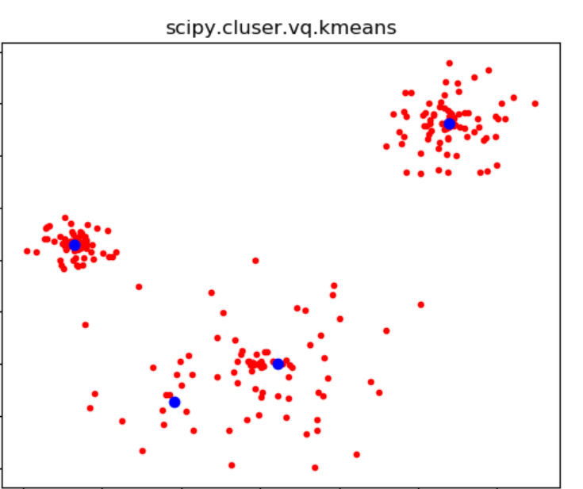
scipy.cluster.vq.kmeans
k_means.py
from scipy.cluster.vq import kmeans, whiten import matplotlib.pyplot as plt points = whiten(points) # normalize variance of points centroids, distortion = kmeans(points, K) plt.plot(*zip(*points), 'r.') plt.plot(*zip(*centroids), 'bo') plt.title('scipy.cluster.vq.kmeans') plt.show()
Note: According to the documentation ”whiten must be called prior to passing an observation matrix to kmeans”
docs.scipy.org/doc/scipy/reference/generated/scipy.cluster.vq.kmeans.html
Notes:
vq = vector quantization

Slide 13
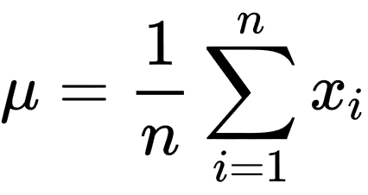
scipy.cluster.vq.whiten
Normalizes / scales each dimension to have unit variance 1.0
https://docs.scipy.org/doc/scipy/reference/generated/scipy.cluster.vq.kmeans.html
Notes:
Does this make sense at all????

Slide 14
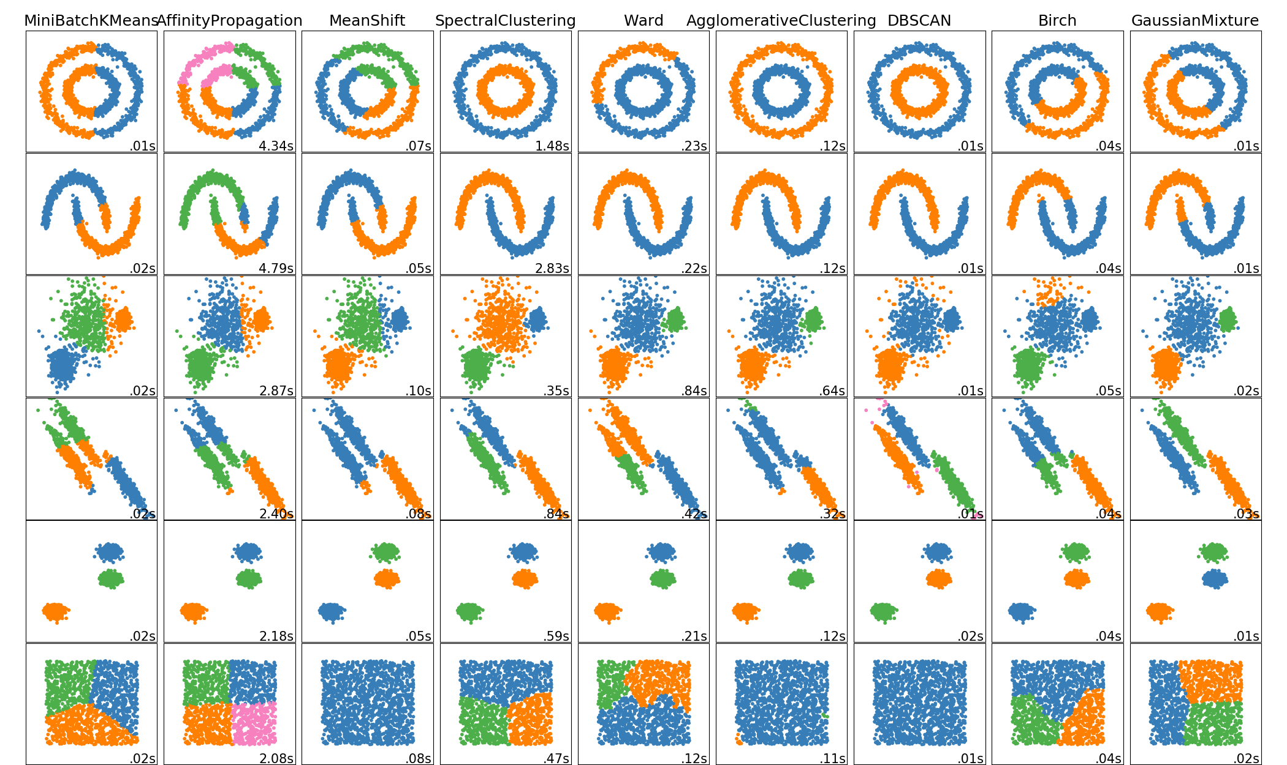
Other Python clustering methods - sklearn.cluster
http://scikit-learn.org/stable/modules/clustering.html

Slide 15
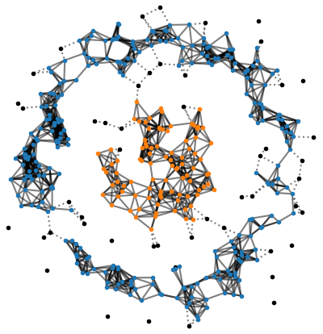
DBSCAN*
Parameters ε and m
p is a core point when
|{q | |p – q| ≤ ε}| ≥ m
Remaining points are noise
Core points p and q are in the same cluster if |p – q| ≤ ε
dbscan.py
def dbscan(points, epsilon, m): def dist(p, q): return sum((pi - qi) ** 2 for pi, qi in zip(p, q)) def close(p, q): return dist(p, q) <= epsilon ** 2 core, noise, clusters = [], [], [] for p in points: if sum(close(p, q) for q in points) >= m: core.append(p) else: noise.append(p) while core: cluster = [core.pop()] for p in cluster: for q in list(core): if close(p, q): cluster.append(q) core.remove(q) clusters.append(cluster) return clusters, noise
ε
m = 5
noise
Notes:
The number of clusters defined is determined by ε and m
Noise = black points = Few close points (close points connected by edges) – on previous slide pink
Code:
sum(close…) --- sum counts number of entries equal to True
cluster.append(q) --- appends to the list cluster that the loop iterates over, dangerous but works…
list(core) – creates a copy of core; required since we will be deleting from core during the scan (not an elegant solution, but short)
Complexity: O(n^2), the clustering is in fact a BFS traversal of a connected component
Classic DBSCAN:
noise points close to at least one cluster are assigned the first cluster constructed of these

Slide 16
Data Mining Algorithms
k-means, and more generally clustering, is just one field in the area of Data Mining
For more information see the webpage Top 10 Data Mining Algorithms, Explained a follow up to the below paper
X. Wu et al., Top 10 algorithms in data mining, Knowledge and Information Systems, 14(1):1–37, 2008. DOI 10.1007/s10115-007-0114-2
www.kdnuggets.com/2015/05/top-10-data-mining-algorithms-explained.html
Notes:
Input from Panos

Slide 17
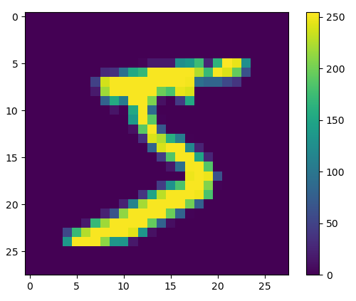
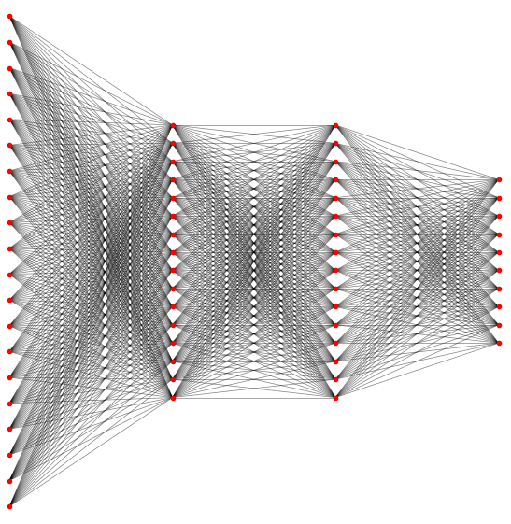
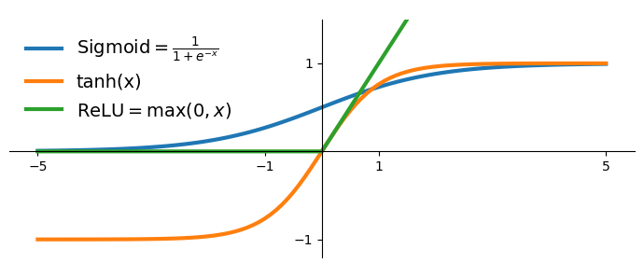
Neural networks (one slide introduction)
a⁽⁰⁾
$$f^{(l)}\left(\sum{} \right)$$
A⁽¹⁾
activation $a_{i}^{(l)}= \sum_{j}{a_{j}^{(l−1)}∙}A_{ji}^{(l)}$
$$+{ b}_{i}^{(l)}$$
a⁽¹⁾
A⁽²⁾
a⁽²⁾
activation function
weight
bias
A⁽³⁾
MNIST : 28 x 28 pixel values from [0, 255]
a⁽³⁾
Classification, like MNIST, prediction = index of node with maximum output
Common activation functions
output layer
e.g. mean squared error
$$\frac{1}{n}\sum_{(x,y)}{{\left|\text{out}\left(x\right)−y\right|}^{2}}$$
Learning Find As and bs performing well (minimize a cost function) on a set of n training inputs x with known output y using backpropagation / stochastic gradient descend
zero or more hidden layers
(zero = linear classifier)
input layer
MNIST, 784 input pixels scaled to [0.0, 1.0]
Notes:
For MNIST with 2 hidden layers of size 16, total number of variables in optimization problem is 13.002
MNIST = 60.000 training pictures + 10.000 test pictures

Slide 18
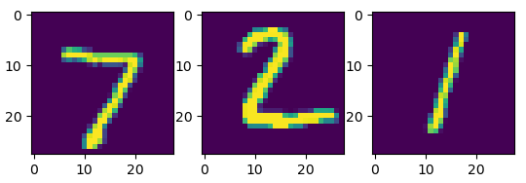
Applying a linear classifier using Numpy: x ∙ A + b
Python shell
import matplotlib.pyplot as plt import numpy as np from tensorflow import keras (train_images, train_labels), (test_images, test_labels) = keras.datasets.mnist.load_data() type(test_images) <class 'numpy.ndarray'> test_images.shape (10000, 28, 28) # 10_000 images 28 x 28 test_labels.shape (10000,) # 10_000 labels test_labels[:3] array([7, 2, 1], dtype=uint8) for i, image in zip(range(3), test_images): plt.subplot(1, 3, i + 1) plt.imshow(image) plt.show() A, b = map(np.array, eval(open('mnist_linear.weights').read())) # read A and b from file print(A.shape, A.dtype, b.shape, b.dtype) (784, 10) float64 (10,) float64 print([np.argmax(image.reshape(28 * 28) @ A + b) for image in test_images[:3]]) [7, 2, 1] # correct on 9_142 of the 10_000 images for the above file, ie accuracy 91%
manually generated labels
network prediction
Notes:
the weights A and b were generated using Keras
Training set size: 60.000, test set 10.000

