Slide 1
Overlaying Circuit Clauses
for Secure Computation
Sean Kennedy
Vladimir Kolesnikov
Gordon Wilfong
Bell Labs

Slide 2
Outline
Boolean circuits
Motivation for overlaying branches
A heuristic
Performance
GC protocols

Slide 3
Boolean circuits
Two-party SFE
Given function F
  Generate bool circuit C computing F
  Run Yao or GMW

Slide 4
Boolean circuits
Circuit representation is inefficient
  Random access (lots of work)
  Unroll loops
  Duplicate if/switch clauses
    today

Slide 5
Example: semi-private function evaluation
F(c,x,y) = f_{c}(y), where f₁(x,y) = y/2<x<y
              f₂(x,y) = xy > 9000
              f₃(x,y) = Ham(x,y) < 30
              …
              f₃₀(x,y) = x²+y²<9000
Why: private policy selection

Slide 6
Example: semi-private function evaluation
F(c,x,y) = f_{c}(y), where f₁(x,y) = y/2<x<y
            f₂(x,y) = xy > 9000
            f₃(x,y) = Ham(x,y) < 30
            …
            f₃₀(x,y) = x²+y²<9000
f₁(x,y)
f₂(x,y)
f₃(x,y)
f₃₀(x,y)
…
c
Sel

Slide 7
Semi-private function evaluation via circuit overlay
In GC gate function is hidden and
can be set by Generator to anything.
C₃
D₀
C₁
C₂
C₃₀
GC Generator will program the gates according to its input choice c. Any of C₁…C₃₀ is programmable in D₀
…
c
Sel

Slide 8
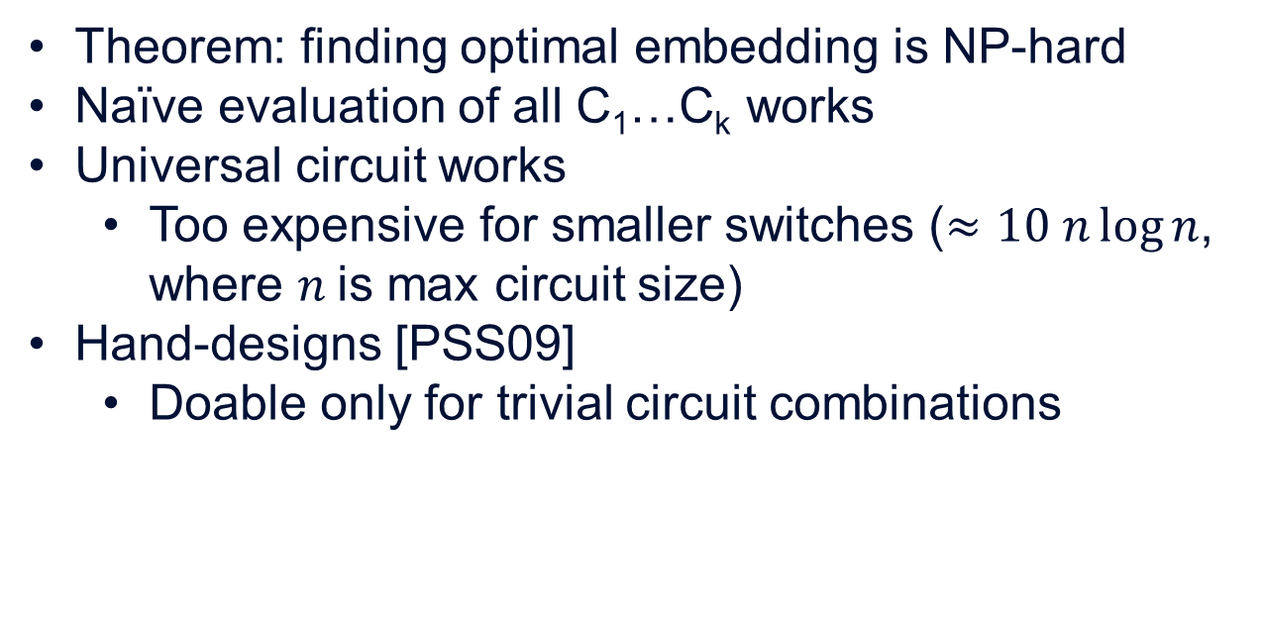
Embed how?
Theorem: finding optimal embedding is NP-hard
Naïve evaluation of all C₁…C_{k} works
Universal circuit works
  Too expensive for smaller switches ($≈10 n\log{n}$, where $n$is max circuit size)
Hand-designs [PSS09]
  Doable only for trivial circuit combinations

Slide 9
Embed how?
Exploit common topologies
Can insert no-op/pass through nodes, edges as needed

Slide 10









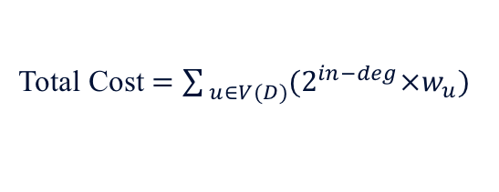



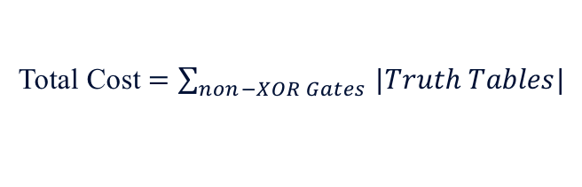


From circuits to weighted directed acyclic graphs (DAGs)
2-bit Adder
D
0
0
$$n_{5}$$
$$n_{1}$$
$$n_{12}$$
0
$$n_{6}$$
$$n_{9}$$
0
$$n_{2}$$
$$n_{13}$$
1
0
0
0
$$n_{7}$$
$$n_{10}$$
$$n_{3}$$
0
1
$$n_{11}$$
0
$$n_{8}$$
$$n_{4}$$
$$n_{14}$$
1
1
0
Total Cost $=\sum_{non−XOR Gates }{|Truth Tables|}$
Total Cost $=\sum_{ u∈V(D)}{(2^{in−deg}×w_{u})}$

Slide 11












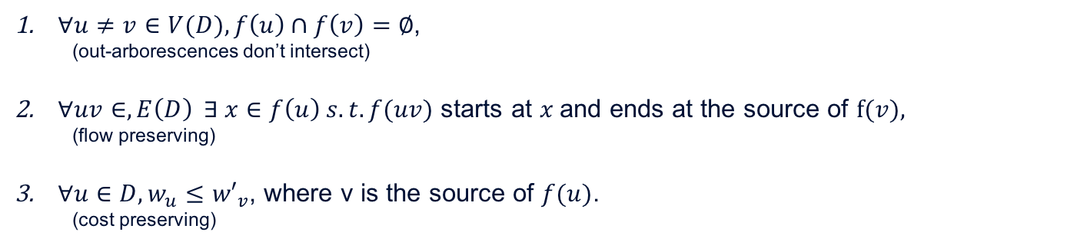








Embeddings
D
D$′$
$${f(n}_{9})$$
$${f(n}_{10})$$
An embedding of D into D' is a mapping f:
→ from nodes of D to out-arborescences of D',
→ from directed-edges of D to directed-edges of D’
satisfying:
$$n_{9}$$
$$n_{10}$$
0
1
0
0
0
0
1
$$n_{7}$$
0
$$n_{8}$$
$${f(n}_{7})$$
1
0
1
$${f(n}_{8})$$
1
1
0
0
$${f(n}_{6})$$
$$n_{5}$$
1
$$n_{6}$$
$${f(n}_{5})$$
1
0
0
0
0
0
0
0
0
$∀u≠v∈V(D), f\left(u\right)∩f\left(v\right)=∅$,
  (out-arborescences don’t intersect)
$∀uv∈,E\left(D\right) ∃ x∈f\left(u\right) s.t. f(uv)$ starts at $x$and ends at the source of $f(v),$
  (flow preserving)
$∀u∈D, w_{u}≤{w′}_{v}$, where v is the source of $f(u)$.
  (cost preserving)
$$n_{1}$$
$$n_{2}$$
$$n_{3}$$
$$n_{4}$$
$${f(n}_{1})$$
$${f(n}_{2})$$
$${f(n}_{3})$$
$${f(n}_{4})$$

Slide 12

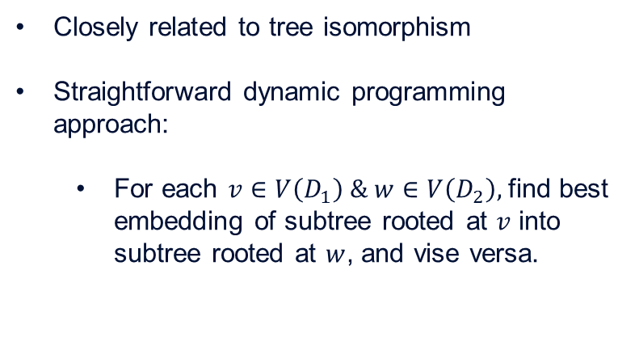



The easy case: formulas
Closely related to tree isomorphism
Straightforward dynamic programming approach:
  For each $v∈V\left(D_{1}\right) \& w∈V\left(D_{2}\right),$find best embedding of subtree rooted at $v$ into subtree rooted at $w$, and vise versa.
$$v$$
$$w$$
$$w$$
$$v$$
D₁
D₂
Theorem: There exists an O(|D1||D2|) algorithm to determine an optimal circuit D embedding both D1 and D2.

Slide 13
















General Case
Find spanning forest rooted at each output node.
For each pair of trees apply formula algorithm.
  Determine pairwise embedding cost
Min cost perfect matching determines best pairing.
D₁
D₂
$$n_{9}$$
$$n_{10}$$
$$x_{8}$$
$$x_{9}$$
$$n_{7}$$
$$n_{8}$$
$$x_{7}$$
2
$$x_{6}$$
3
2
$$n_{5}$$
$$n_{6}$$
$$x_{5}$$
3
$$n_{1}$$
$$n_{2}$$
$$n_{3}$$
$$n_{4}$$
$$x_{1}$$
$$x_{2}$$
$$x_{3}$$
$$x_{4}$$

Slide 14
General Case continued
Possible complications when adding back “ignored” edges:
Keeping fan-in at most two.
Cycles.
Combine the embeddings

Slide 15
Fixing cycles
a
c
1
3
a=1
c=3
c
c=3
1
b
d
2
4
b=2
d=4
2
b
d=4

Slide 16
Empirical
Results

Slide 17
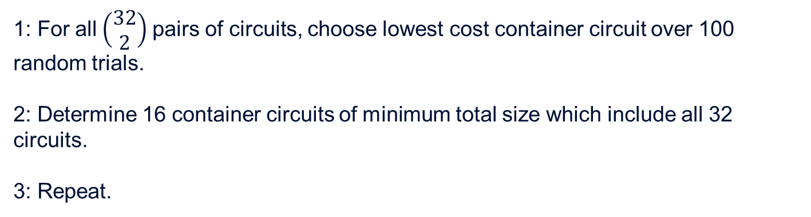
Empirical Results
1: For all$\left(\begin{matrix}32 \\ 2\end{matrix}\right)$ pairs of circuits, choose lowest cost container circuit over 100 random trials.
2: Determine 16 container circuits of minimum total size which include all 32 circuits.
3: Repeat.
Best pairings →

Slide 18
Empirical Results.

Slide 19
General GC with switch
Programming of D₀
  set of garbled tables
Generator G cannot directly program D₀ as selection c is private variable.
G prepares k programmings and send via natural OT variant.
Need to send k programmings under the hood of OT

Slide 20
General GC with switch
Idea:
  Programming string is a string of gate functions (symbols, e.g. AND, OR).
G secret-shares k programming strings
For each gate:
  1 out of 5 OT of gate tables, where OT selection is based on secret sharing of programming symbol for the gate.

Slide 21
General GC with switch
switch can be nested cheaply
Only need to adjust secret sharing of the programming strings. Not trivial, but not hard either.
Gate OT costs remain same

Slide 22
General GC with switch
Approx 13x overhead compared to [ZRE15].
Expect to break even at 64 circuits based on empirical results
  Sooner with optimizations (lots of room to follow up) or with more aligned input circuits.

Slide 23
GMW with switch
Natural combination of GMW and this talk.
Unlike GC, don’t need to do OT of 1-out of-5 gate tables
Just do 1-out-of-5*4 OT of 1-bit secrets via [KK13] with sending extra 16 bits per gate as compared to standard GMW and 1-out of 4 OT (plus need OT of programming strings).
Overlay improvement => SFE improvement

Slide 24

Bell Labs

