Slide 1



Privacy-Free Garbled Gates
Tore K. Frederiksen, Jesper B. Nielsen, Claudio Orlandi

Slide 2
Yao’s garbled gates
Construction
Garble

Slide 3
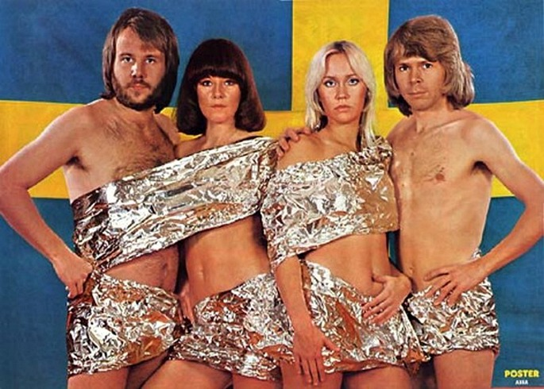

Yao’s garbled gates
Features
Given a key we don’t know if b=0 or b=1
Given and we can only learn
Yes! But we only loose privacy, not authenticity.
Why would you do that?! Now you have less security!
Notes:
-Has some implicit featues towards the evaluator, privacy and authenticity
-What if we eliminate the first one

Slide 4
Privacy-free garbled gates
Sometimes lack of privacy doesn’t hurt
E.g. secure computation where only one party has private input
Yes! But maybe privacy-free garbled gates are more efficient?
You can still just use “normal” garbled gates!

Slide 5


Privacy-free garbled gates
Efficiency
Let k be the security parameter and measure computational efficiency as hashes per gate
 |  | Garble Privacy free H/gate | Garble Normal H/gate | Eval Privacy free H/gate | Eval Normal H/gate | Comm. Privacy free bit/gate | Comm. Normal bit/gate
With free XOR | AND | 2 | 4 | 1 | 1 | 2k | 3k
 | XOR | - | - | - | - | - | -
Without free XOR | AND | 3 | 4 | 1 | 1 | k | 2k
 | XOR | 2 | 4 | 1 | 1 | k | 2k
Alright! That is cool! Communication is always my problem when I use garbled gates
Now tell me how to make them!
Notes:
Normal is with garbled row reduction optimization or polynomial interpolation based
So we can eliminate 33 percent communication (good according to thomas)
One ciphertext per gate.

Slide 6
Privacy-free garbled gates
Construction – Without free-XOR
AND gate:
XOR gate:
Notes:
First consider an AND gate
The idea is basically to use the knowledge of the evaluator (I.e. he knows the meaning of his input keys) and, like in garbled row reduction, use the input keys to construct the output keys
Then an XOR

Slide 7

Privacy-free garbled gates
Construction – With free-XOR
AND gate:
XOR gate:
But I want bigger optimizations!
Notes:
Remember that when we do free xor we have the constraint that two keys XORed together on any wire yields the same difference Delta.

Slide 8
Privacy-free garbled gates
Large fan-in
Notes:
Consider large fan in gates, e.g. AND
In normal garbled gates increase is exponential in input wires. E.g. 4 input wires need 2^4 entries
With privacy free gates the increases is linear, i.e. e.g. 4 gates needs 4 entries. 10 gates need 10 entries.
The idea is to look at the truth table and then find common outputs given specific key combinations. I.e. we make partitions based on

Slide 9
Privacy-free garbled gates
Intuition – AND gate
Out | 0 | 0 | 0 | 0 | 0 | 0 | 0 | 0 | 0 | 0 | 0 | 0 | 0 | 0 | 0 | 1
I₀ | 0 | 1 | 0 | 1 | 0 | 1 | 0 | 1 | 0 | 1 | 0 | 1 | 0 | 1 | 0 | 1
I₁ | 0 | 0 | 1 | 1 | 0 | 0 | 1 | 1 | 0 | 0 | 1 | 1 | 0 | 0 | 1 | 1
I₂ | 0 | 0 | 0 | 0 | 1 | 1 | 1 | 1 | 0 | 0 | 0 | 0 | 1 | 1 | 1 | 1
I₃ | 0 | 0 | 0 | 0 | 0 | 0 | 0 | 0 | 1 | 1 | 1 | 1 | 1 | 1 | 1 | 1
Notes:
Only one way we get the 1 key
Any other combination of input keys should yield the 0 key, partition as large chunks as possible
Use the largest to define the key,
And the other chunks to hide this key.
Unfortunately this does not work for all gates with large fan in, only those with either many 1’s or 0’s in the output table

Slide 10

Thank you for your time
And happy workshop and
EUROCRYPT
?

