Slide 1
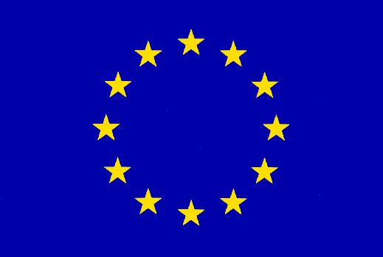
Saving peace in Europe
Using MPC
Carsten Baum
Aarhus University

Slide 2
After the first half of the 20th century, we Europeans had enough…
Enough of these wars! Let‘s all be peaceful and happy.

Slide 3
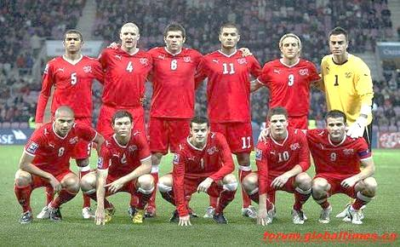
Approach #1
Футбол, fútbol, Fußball, fodbold, ποδόσφαιρο, calcio, …

Slide 4
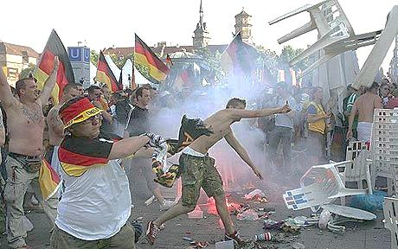
Well, that did not work…

Slide 5
Approach #2: Let‘s all sing!

Slide 6
What is Eurovision?
Big TV event (this Saturday!!)
How it works:
Every country is allowed to send someone to present a song

Slide 7
What is Eurovision?
Big TV event (this Saturday!!)
How it works:
Every country is allowed to send someone to present a song
Big Europe-wide vote afterwards to determine who won

Slide 8
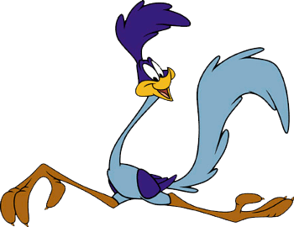
Vote you say??
21st century approach: Online voting!

Slide 9
Vote you say??
21st century approach: Online voting!
Using MPC for voting gives advantages in some scenarios (see paper)

Slide 10
Vote you say??
21st century approach: Online voting!
Using MPC for voting gives advantages in some scenarios (see paper)
For example, use a fast online protocol (SPDZ) to obtain the answer very quickly

Slide 11
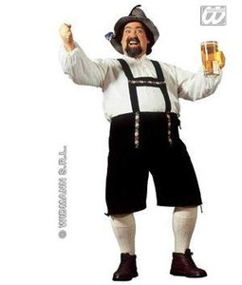
MPC needs Audit
Because…do you really trust any of the participating countries???

Slide 12
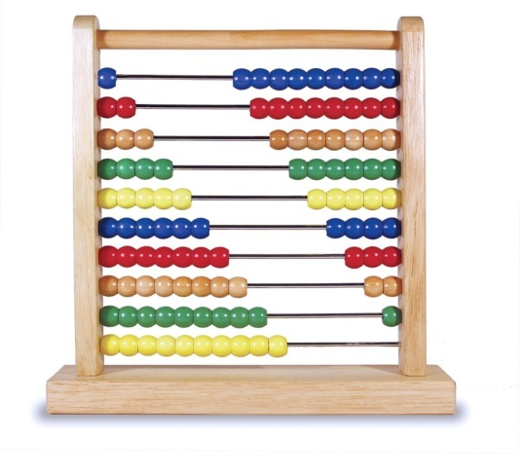
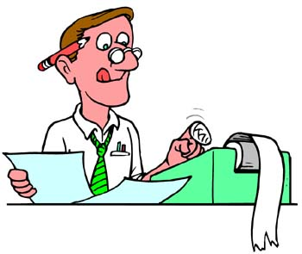
Publicly Auditable MPC – the model
Clients: Provide input and will obtain output
Workers: Do the actual computation
The Auditor: Checks whether the computation was correct

Slide 13
Publicly Auditable MPC – the model
Downside:
If every party is corrupted, privacy is lost

Slide 14
Publicly Auditable MPC – the model
Downside:
If every party is corrupted, privacy is lost
BUT:
The Auditor (anyone!) can establish correctness (by looking at the π-transcript) even if every Worker is corrupted

Slide 15
Publicly Auditable MPC – the model
Downside:
If every party is corrupted, privacy is lost
BUT:
The Auditor (anyone!) can establish correctness (by looking at the π-transcript) even if every Worker is corrupted
If at least one Worker is honest, then we obtain both privacy and correctness

Slide 16
Publicly Auditable MPC – the model
We model this by assuming the existence of an uncorruptible party
This party does not participate during the π-execution

Slide 17
Publicly Auditable MPC – the model
We model this by assuming the existence of an uncorruptible party
This party does not participate during the π-execution
In fact, it must not even exist until π was executed

Slide 18
Publicly Auditable MPC – the model
We model this by assuming the existence of an uncorruptible party
This party does not participate during the π-execution
In fact, it must not even exist until π was executed
This is a generalization of „public verifiability“ for online voting, but here for general MPC

Slide 19
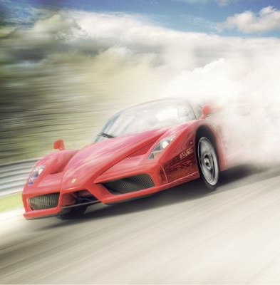
Publicly Auditable MPC as a SPDZ extension
Extension of the SPDZ online phase – but (almost) no heavy crypto required
Extend the SPDZ preprocessing as well (must also be auditable, and indeed is)
(optional) Audit phase if you doubt that the result is correct

Slide 20
eprint 2014/075
More details:
„Publicly Auditable Secure Multi-Party Computation“
(joint work with Ivan Damgård and Claudio Orlandi)

