Slide 1
Privacy-Friendly Eurovision Voting
Meilof Veeningen (TU/e: Eindhoven University of Technology)
Joint work with: Niels de Vreede (TU/e), Thomas Toft (Aarhus)

Slide 2
Motivation: Eurovision Song Contest
Next Saturday in Copenhagen
Contest between songs from 26 European countries, held since 1956
People from each country vote for the winner
Top-10 countries: 1,2,3,4,5,6,7,8,10,12 points
50% televoting/SMS; 50% “professional jury”
Can’t vote for own country
Most points win (today: ignore ties)
2008: Russia (Dima Bilan)
Meilof Veeningen: Privacy-Friendly Eurovision Voting

Slide 3
Motivation: Eurovision Voting
1. votes: 1,2,3,4,5,
6,7,8,10,12 to …
country
presenter
2.show
results
general public
Problems:
- takes ages
- countries learn each
other’s votes!
2009: Norway (Alexander Rybak)
Meilof Veeningen: Privacy-Friendly Eurovision Voting

Slide 4
Eurovision Voting: Requirements
We need a procedure for counting Eurovision votes:
(Performance I) Can be performed within 1.5 hours
(Correctness) Anybody can verify the result and correctness of voter’s inputs (no self-votes, votes 1,2,3,4,5,6,7,8,10,12 to different countries)
(Privacy) Don’t know what individial countries voted
(Performance II) Needs to be ready before Saturday
Existing solutions: everything except privacy
Although we may improve performance in the process…
2010: Germany (Lena)
Meilof Veeningen: Privacy-Friendly Eurovision Voting

Slide 5
Eurovision Voting: Our Solution (I)
Need to have a simple solution that is not a lot of work to program
SCAPI: offers Damgard-Jurik (Pallier) encryption, (non-interactive) zero knowledge proofs of encrypted value; AND and OR composition
Idea: use MPC based on threshold homomorphic encryption [CDN01] w/Fiat-Shamir
Broadcast threshold homomorphic encryptions of votes
Add votes, perform threshold decryption
Prove correct voting by countries, correct decryption of output
For correct voting, ZK proof of (e.g., for n=3): (E1->1 OR E2->1 OR E3->1) AND (E1->2 OR E2->2 OR E3->2) AND (E1->3 OR E2->3 OR E3->3)
Multiple zero votes: encode as 0,1,2,3,…,15; encode real votes as 1000,2000,3000,…
2011: Azerbaijan (Ell/Nikki)

Slide 6
Eurovision Voting: Our Solution (II)
{E_pk(v1),…,
E_pk(vn),NIZKPOCV}
country
presenter i
(pk)
(threshold sk)
{{E_pk(v1),…,E_pk(vn),NIZKPOCV}_i,
dv1,…,dvn,NIZKPOCDs}
general public
(pk)
This satisfies correctness and privacy (with random oracle, trusted key setup)!
2012: Loreen (Sweden)

Slide 7
Demo

Slide 9
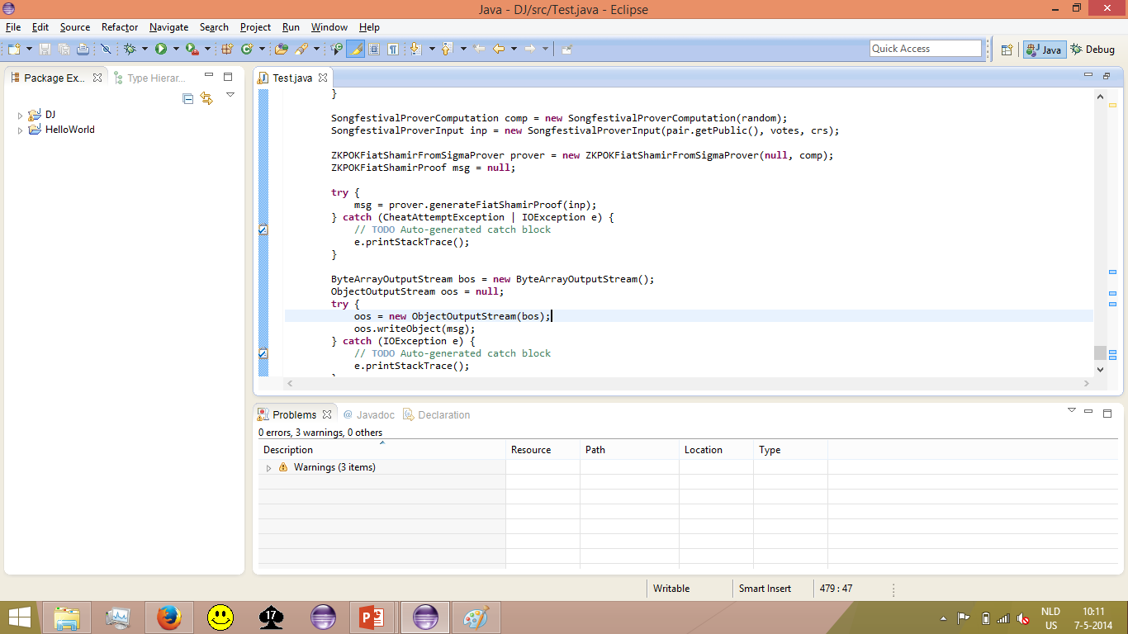

Slide 10
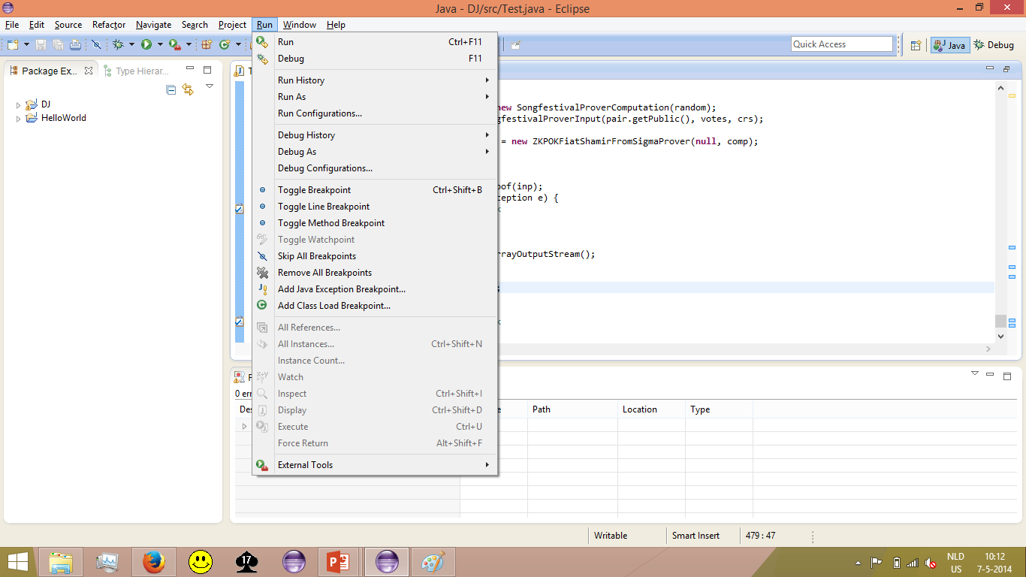

Slide 15
Demo

Slide 16
Performance (I)
Can proofs be produced and transmitted within Europe in 1.5 hours?
Proof time (s)
2013: Denmark (Emmelie de Forest)
Meilof Veeningen: Privacy-Friendly Eurovision Voting

Slide 17
Conclusion & Performance II & Future Work
Solution based on SCAPI: ~500 lines of code for proving correctness of votes
Satisfies Correctness, Privacy, Performance I
Performance II (“ready before Saturday”)? Kind of…
Future work:
What happens with a tie?
Preliminary round: only determine finalists
Making the Netherlands win with kleptography?
2014: ?
Meilof Veeningen: Privacy-Friendly Eurovision Voting

