Slide 1
Private Function Evaluation
Payman Mohassel & Saeed Sadeghian
University of Calgary

Slide 2
Secure Function Evaluation
Correctness:
honest parties learn
the correct output
Privacy:
Nothing but the
final output is leaked
…
P₂, x₂
P₁, x₁
P₃, x₃
P₄, x₄
P₅, x₅
Parties learn f(x₁,…,x_{n})

Slide 3
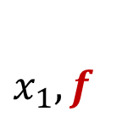
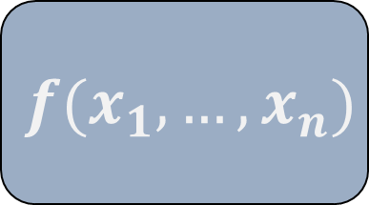
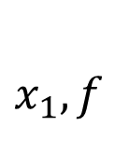
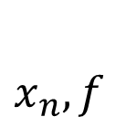
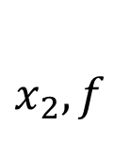
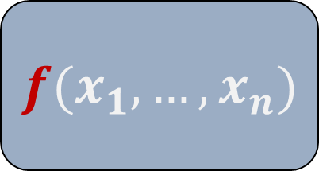
Private vs. Secure Function Evaluation
$x_{1},f$
$x_{n},f$
$x_{2},f$
$x_{1},f$
$x_{n}$
$$⋯$$
$x_{2}$
$$⋯$$
$$f(x_{1},…, x_{n})$$
$$f(x_{1},…, x_{n})$$
$$⋯$$
$$⋯$$
PFE
SFE
Notes:
But in general the function can be shared among a subset of parties.

Slide 4
Why Hide The Function?
Private functions
Proprietary, intellectual property
E.g., medical diagnosis, error reporting systems …
Sensitive functions
Revealing vulnerabilities
E.g. IDS containing zero-day signatures
In SFE output leaks info
Hiding the function can help
Prevents dictionary attacks

Slide 5
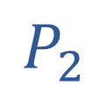
Hide Everything
Fully Homomorphic Encryption
$$E(x)$$
$$x$$
$$y, f$$
$$P_{2}$$
$$P_{1}$$
$$E(f(x,y))$$
Also hides size of $f$ and $y$
$$f(x,y)$$

Slide 6
Relaxation
leak
Function/circuit size
Input size
But
More efficient primitives
Milder assumptions

Slide 7
Is PFE Hard?
Not really!
All SFE feasibility results extend to PFE
Using Universal Circuits
The only interesting questions are efficiency questions

Slide 8
Universal Circuits
C
Universal Circuit
C(x)
x

Slide 9
Universal Circuits
Boolean
For a circuit C with g gates
[Valiant’ 76]:$???g\log{g}+ …$ (good for large circuits)
Actually building it seems complicated
[KS’ 08]: $1.5g\log^{2}{g}+2.5g\log{g}+…$ (good for small circuits )
Arithmetic
For a circuit C with g gates and depth d
[Raz’ 08]: $O\left(gd^{4}\right)$ gates, i.e. $O\left(g^{5}\right)$ in the worst case
Or use a Boolean circuit

Slide 10
PFE Constructions
Two-party setting
Universal Circuit + Yao’s protocol
$O(glogg)$ or $O(g\log^{2}g)$ symmetric ops + $O(n)$ OTs
[KM’ 11]: Singly Homomorphic Enc + Yao’s protocol
$O\left(g\right)$ public-key ops + $O\left(g\right)$ symmetric ops
Multi-party setting
Universal Circuit + GMW protocol
$O\left(t^{2}glogg\right)$ OTs
Arithmetic circuits
Universal Circuit + HE-based MPC [CDN’ 01]
$O(g^{5})$ public-key ops

Slide 11
Efficiency Questions
Asymptotic Efficiency
Can we design PFE with linear complexity in all standard settings?
The multiparty case
The malicious case
Practical Efficiency
Can we improve practical efficiency of universal circuit approach?
Constant factors are important

Slide 12
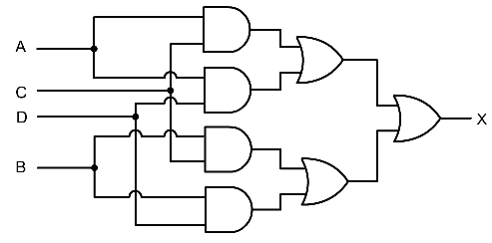
What Does UC Hide?
Function of each gate
Topology of circuit

Slide 13
Our Framework

Slide 14

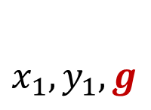

Private Gate Evaluation
Inputs are shared
$x=x_{1}⊕ x_{2}$
$y=y_{1}⊕y_{2}$
Gate function
$g=AND, OR, XOR$
$g= +, ×$
Known only to $P_{1}$
Output is shared
$z=z_{1}⊕z_{2}$
$x_{2},y_{2}$
$x_{1},y_{1},g$
$$g(x,y)$$
$$z_{1}$$
$$z_{2}$$
Actual sharing mechanism depends on the protocol

Slide 15
Circuit Topology
Topology captured using
an extended permutation
$$o_{1}$$
$$i_{1}$$
$$i_{5}$$
$$π_{C}$$
$$o_{2}$$
$$i_{2}$$
$$o_{5}$$
$$i_{6}$$
$o_{1}$
$$i_{1}$$
$$i_{2}$$
$$i_{3}$$
$$i_{7}$$
$$o_{3}$$
$o_{2}$
$$i_{3}$$
$$i_{8}$$
$$o_{4}$$
$$i_{4}$$
$$o_{6}$$
$$i_{4}$$
$o_{3}$
$$i_{5}$$
$$i_{9}$$
$$i_{6}$$
$$i_{10}$$
$o_{4}$
$$i_{7}$$
$o_{5}$
$$i_{8}$$
$o_{6}$
$$i_{9}$$
$$i_{10}$$

Slide 16
CTH Functionality
Reveal
Map
Inputs are shared
$x=x_{1}⊕x_{2}$
Mapping
$π_{c}$ known by $P_{1}$ only
Outputs are shared
$x=x_{1}^{′}⊕x_{2}^{′}$
Query types
Map: done internally
Reveal: reveal result of map
On-demand mapping
$$π_{C}$$
$$x=x_{1}⊕x_{2}$$
$${x′}_{1}⊕{x^{′}}_{2 }=x$$
$${x′′}_{1}⊕{x^{′′}}_{2 }=x$$
$$y=y_{1}⊕y_{2}$$
$${y′}_{1}⊕{y^{′}}_{2}=y$$

Slide 17
PGE + CTH
$$i_{1}$$
$$i_{5}$$
$$o_{1}$$
$$i_{2}$$
CTH
$$o_{2}$$
$$o_{5}$$
$$i_{6}$$
$$5$$
$$7$$
$$i_{7}$$
$$o_{1}$$
PGE
$$o_{5}$$
$$i_{3}$$
$$1$$
$$6$$
$$o_{3}$$
$$i_{8}$$
$$o_{4}$$
$$i_{4}$$
$$11$$
$$o_{6}$$
$$o_{2}$$
$$9$$
$$o_{6}$$
$$i_{9}$$
$$2$$
PGE
$$10$$
$$i_{10}$$
$$o_{3}$$
$$15$$
$$3$$
$$13$$
PGE
$$14$$
Topological order
$$o_{4}$$
$$16$$
$$18$$
$$4$$
PGE
$$o_{5}$$
$$17$$
$$8$$
$$21$$
$$19$$
PGE
$$o_{6}$$
$$12$$
$$20$$
Map
Reveal
PGE

Slide 18
Instantiating PGE

Slide 19
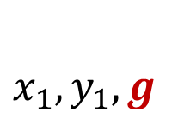

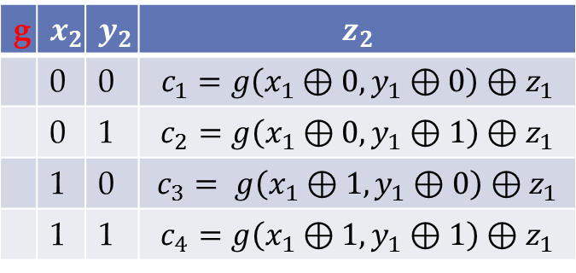
PGE for GMW
$x_{2},y_{2}$
$x_{1},y_{1},g$
$$x_{2},y_{2}$$
$$g(x,y)$$
$$P_{1}$$
1-out-of-4 OT
$$P_{2}$$
$$z_{1}$$
$$z_{2}$$
g
 | 0 | 0
 | 0 | 1
 | 1 | 0
 | 1 | 1
g | x | y | z
 | 0 | 0 | g(0,0)
 | 0 | 1 | g(0,1)
 | 1 | 0 | g(1,0)
 | 1 | 1 | g(1,1)

Slide 20
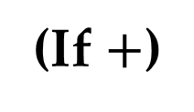
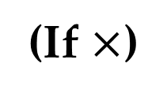
PGE for AC
$a,b∈F$
$a=a_{1}+a_{2}, b=b_{1}+b_{2}$
$c=c_{1}+c_{2}, c=(a+b) or c=(a×b)$
$Enc$is an additively homomrphic encryption
$$a_{1},b_{1},pk$$
$$Enc_{pk}\left(a_{2}\right),Enc_{pk}\left(b_{2}\right), Enc_{pk}(a_{2}b_{2})$$
$$a_{2},b_{2},pk,sk$$
$$P_{1}$$
$$P_{2}$$
(If $+$)
$$r←F$$
$$c_{1}← a_{1} + b_{1} − r$$
$$C= Enc_{pk}(a_{2} + b_{2} + r)$$
(If $×$)
$$c_{1}←F$$
$$C= Enc_{pk}({a_{1}b_{1}+a}_{2}b_{1} +a_{1}b_{2}+a_{2}b_{2} −c_{1})$$
$$c_{2}← Dec_{sk}(C)$$

Slide 21
Instantiating CTH

Slide 22



Oblivious Extended Perm.
Assume inputs are ready
$$π_{C}$$
$$a_{1}⊕ t_{1}$$
$$a_{1}$$
$$a_{2}⊕t_{2}$$
π$:\left[n\right]→[m]$
$$a_{2}$$
$$a_{3}⊕t_{3}$$
$$\left(\begin{aligned}t_{1} \\ t_{2} \\ . \\ . \\ . \\ t_{m}\end{aligned}\right)$$
$$\left(\begin{aligned}a_{1} \\ a_{2} \\ . \\ . \\ . \\ a_{n}\end{aligned}\right)$$
$$a_{4}⊕t_{4}$$
$$a_{3}$$
$$a_{1}⊕t_{5}$$
$$P_{1}$$
$$P_{2}$$
$$a_{5}⊕t_{6}$$
$$a_{4}$$
$$a_{5}⊕t_{7}$$
$$a_{6}⊕t_{8}$$
$$a_{5}$$
$$\left(\begin{aligned}{a_{π^{−1}\left(1\right)}⊕t}_{1} \\ {a_{π^{−1}\left(2\right)}⊕t}_{2} \\ . \\ . \\ . \\ {{a_{π^{−1}\left(m\right)}⊕t}_{m}}_{}\end{aligned}\right)$$
$$a_{6}⊕t_{9}$$
$$a_{6}$$
$a_{4}⊕t_{10}$

Slide 23
OEP
Using any MPC
Inefficient
Not on-demand
Using singly HE
Linear complexity
Requires public-key ops
Using oblivious transfer
Not linear
But better concrete efficiency (OT extension)

Slide 24
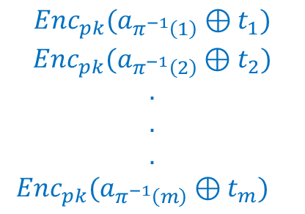
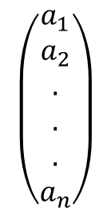
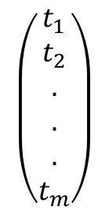
HE-based
$$π_{}$$
$$pk,sk$$
$$Enc_{pk}(a_{1})$$
$$\left(\begin{aligned}a_{1} \\ a_{2} \\ . \\ . \\ . \\ a_{n}\end{aligned}\right)$$
$$\left(\begin{aligned}t_{1} \\ t_{2} \\ . \\ . \\ . \\ t_{m}\end{aligned}\right)$$
$$Enc_{pk}(a_{2})$$
.
$$P_{1}$$
$$P_{2}$$
.
.
$$Enc_{pk}(a_{n})$$
$$\begin{aligned}{{Enc_{pk}(a}_{π^{−1}\left(1\right)}⊕t}_{1}) \\ {Enc_{pk}(a_{π^{−1}\left(2\right)}⊕t}_{2}) \\ . \\ . \\ . \\ {{{Enc_{pk}(a}_{π^{−1}\left(m\right)}⊕t}_{m})}_{}\end{aligned}$$
Easy to make on-demand

Slide 25
Permutation Networks
Switches
Permutation Network
selection bit
0
$$…$$
$$a$$
$$a$$
$$b$$
$$b$$
$$…$$
1
$$…$$
$$a$$
$$b$$
$$b$$
$$a$$
$$…$$
[Waksman’ 68]: any permutation $π:\left[n\right]→[n]$ can be implemented using a permutation network of size $nlog n −n+1$
The permutation is determined using $nlog n −n+1$ selection bits

Slide 26
EP Networks
Need one more switch type
0
0
$$a$$
$$a$$
$$a$$
$$a$$
$$b$$
$$b$$
$$b$$
$$b$$
1
1
$$a$$
$$b$$
$$a$$
$$a$$
$$b$$
$$a$$
$$b$$
$$a$$

Slide 27
EP Networks
1
$$a_{1}$$
$$\begin{aligned}a_{1} \\ a_{2} \\ . \\ . \\ . \\ a_{n}\end{aligned}$$
Waksman
network
$$\begin{aligned}a_{1} \\ d \\ d \\ a_{2} \\ d \\ a_{3} \\ a_{4} \\ . \\ . \\ . \\ d \\ a_{n}\end{aligned}$$
1
Waksman
network
$$a_{1}$$
$$a_{1}$$
$$a_{1}$$
0
$$a_{1}$$
$a_{2}$
.
.
.
$$\begin{aligned}d \\ d \\ . \\ . \\ . \\ d\end{aligned}$$
$$mlogm−m+1 + m + mlogm −m+1$$

Slide 28
Oblivious Switch
$$a,b$$
$$s$$
$$P_{2}$$
$$P_{1}$$
$$r_{1}$$
$$r_{3}$$
$$a⊕ r_{1}, b⊕r_{2}$$
$$r_{2}$$
$$r_{4}$$
$$\begin{matrix}{(r}_{1}⊕r_{3}, r_{2}⊕r_{4}) \\ {(r}_{1}⊕r_{4}, r_{2}⊕r_{3})\end{matrix}$$
1-out-of-2 OT
$$s$$
$$s=0→\begin{matrix} (a⊕r_{1})⊕ \left(r_{1}⊕r_{3}\right)=a⊕r_{3} \\ (b⊕r_{2})⊕\left(r_{2}⊕r_{4}\right)= b⊕r_{4}\end{matrix}$$
$$s=1→\begin{matrix} (b⊕r_{2})⊕ \left(r_{2}⊕r_{3}\right)=b⊕r_{3} \\ (a⊕r_{1})⊕\left(r_{1}⊕r_{4}\right)=a⊕r_{4}\end{matrix}$$

Slide 29
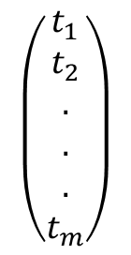
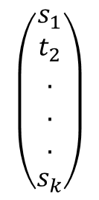
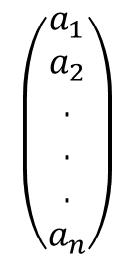
OEP
π$:\left[n\right]→[m]$
$$\left(\begin{aligned}s_{1} \\ t_{2} \\ . \\ . \\ . \\ s_{k}\end{aligned}\right)$$
$$\left(\begin{aligned}t_{1} \\ t_{2} \\ . \\ . \\ . \\ t_{m}\end{aligned}\right)$$
MAP
0
$$a⊕r_{1}$$
$$r_{1}$$
$$r_{3}$$
$$a⊕r_{3}$$
1
$$\left(\begin{aligned}a_{1} \\ a_{2} \\ . \\ . \\ . \\ a_{n}\end{aligned}\right)$$
$$r_{2}$$
$$r_{4}$$
$$r_{3}$$
$$r_{5}$$
$$P_{1}$$
$$a⊕ r_{6}$$
$$r_{4}$$
$$r_{6}$$
1
$$P_{2}$$
$$a⊕r_{7}$$
$$r_{6}$$
$$r_{7}$$
$$r_{5}$$
$$r_{8}$$
$$a⊕t_{7}$$
$$a⊕r_{7}⊕t_{7}$$
Reveal

Slide 30
Efficiency
One OT per switch
O(nlogn) OTs total
Practical thanks to OT extension
Fast online phase
OTs done offline
Constant round

Slide 31
Instantiations
First Multiparty PFE with linear complexity
GMW + HE-Based OEP
First Arithmetic PFE with linear complexity
[CDN 01] + HE-based OEP
More efficient two-party PFE with linear complexity
Yao + HE-based OEP
Subsumes and improves construction of [KM’11]
More practical PFE
Yao/GMW + OT-based OEP + OT extension

Slide 32
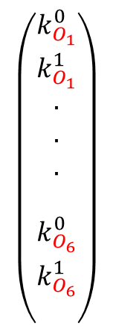
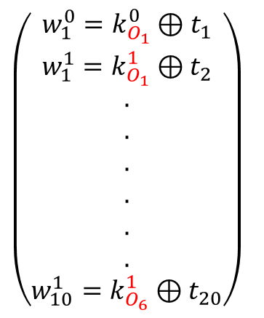
Yao-based PFE
$$\left(\begin{aligned}t_{1} \\ t_{2} \\ . \\ . \\ . \\ . \\ . \\ . \\ . \\ . \\ t_{20}\end{aligned}\right)$$
$$\left(\begin{aligned}\begin{aligned}k_{O_{1}}^{0} \\ k_{O_{1}}^{1} \\ . \\ . \\ . \\ \\ k_{O_{6}}^{0} \\ k_{O_{6}}^{1}\end{aligned} \\ \end{aligned}\right)$$
$$i_{1}$$
$$i_{5}$$
$$o_{1}$$
$$i_{2}$$
$$o_{2}$$
$$o_{5}$$
$$i_{6}$$
$$i_{3}$$
$$i_{7}$$
$$o_{3}$$
$$i_{8}$$
OEP
$$o_{4}$$
$$i_{4}$$
$$o_{6}$$
$$i_{9}$$
$$i_{10}$$
$$P_{2}$$
$$P_{1}$$
$\left(\begin{aligned}{{w_{1}^{0}=k}_{O_{1}}^{0}⊕t}_{1} \\ w_{1}^{1}={k_{O_{1}}^{1}⊕t}_{2} \\ . \\ . \\ . \\ . \\ . \\ . \\ {{w_{10}^{1}=k}_{O_{6}}^{1}⊕t}_{20}\end{aligned}\right)$
$E_{w_{3}^{0}}(E_{w_{4}^{0}}(k_{o_{6}}^{1})$)
$E_{w_{3}^{0}}(E_{w_{4}^{1}}(k_{o_{6}}^{1})$)
$E_{w_{3}^{1}}(E_{w_{4}^{0}}(k_{o_{6}}^{1})$)
$E_{w_{3}^{1}}(E_{w_{4}^{0}}(k_{o_{6}}^{0})$)

Slide 33
Open Questions

Slide 34
Stronger Security
Linear PFE with malicious security
Recently solved! [Mohassel-Sadeghian-Smart 2014]
Linear PFE with IT security
Our linear solution relies on HE-based OEP
Hide circuit size without FHE?
Use FHE in a limited way?
Use somewhat FHE?

Slide 35
PFE for Practice
Linear PFE with good concrete efficiency
OEP with linear symmetric-key Ops
Can use free-XOR if you leak number of XOR gates
Can PFE help improve efficiency of SFE?
An Idea:
One party embeds his input in the circuit
Shrinks the circuit significantly
Circuit structure leaks information
Use PFE to hide the structure
PFE for RAM programs

Slide 36
Thank you!

