Slide 1
Adaptive UC from
New Notions of Non-Malleability
15 years of UC-Security [Canetti00]
dynamic
25 years of Adaptive Security [Beaver89]
Muthuramakrishnan Venkitasubramaniam
Joint with Dana Dachman-Soled, Maryana Raykova, Tal Malkin
WORKSHOP: THEORY AND PRACTICE OF SECURE MULTIPARTY COMPUTATION

Slide 2
O(1)-rnd
How can we achieve semi-honest
2-party computation?
^
Y
A
O

Slide 3
Security by Comparison
REAL
IDEAL
Simulator
≈
∀A_{R}
∃A_{I}
x₁ y₁
x₂ y₂
x₁ y₁
x₂y₂
Mesgs
“as correct & private as”
Correctness: The output of every player is the same in real and ideal
Privacy: Mesgs can be generated from the simulator’s input & output
Notes:
We say that a protocol implements a goal, if the protocol essentially emulates the execution with TTP. More precisely, a protocol is secure if attack that can be performed in the protocol, could be performed in the “ideal” execution with the trusted party. Since ideal is golden standard, no attack, thus no attacks on real protocol. This is formalized by stating that for any malicious party in the real protocol execution, there exist some party in the ideal execution that obtains the same input and outputs. This specifies correctness. To define privacy we also need to make sure that the Messages that the the devil gets in the real execution don’t provide him with additional info. This is defined by requiring that the devil in the ideal world could given only his input and output essentially identically reconstruct these messages. If he is able to to that then we know that these messages carry no further information than just the input, and output.
Note that this is a VERY strong requirement. Not only we require that the messages don’t reveal what input alice had that is consistent with the devils input and output, but in fact that they can be reconstructed! This means that the protocol interaction is essentially identical to the interaction with the TTP. Since this is very strong we call it HYPER security.
How can we formalize this?
One way to do this would be to say that for every advesary in the rela world (remove bob) there exists an adversary I nideal world that essentially see s same thing
On life side bob gets x2 and y2
On right side, that’s exactly same thing devil here get son right side
But note guy on left also gets a bunch of messages that MIGHT contain something about alice’s input. The strongest way for me to say that these messages don’t contain anything about alice’s input would be if I could generate (or imagine) these messages [point to ideal world]
That is what we mean by hypersecurity
Now given our general way of defining goals, and this very strong definition of security, we might ask: what goals can be securely implemented.

Slide 4
Concurrent Security
REAL
IDEAL
≈
many executions of
different protocols
many executions with
independent trusted parties
Notes:
We say that a protocol implements a goal, if the protocol essentially emulates the execution with TTP. More precisely, a protocol is secure if attack that can be performed in the protocol, could be performed in the “ideal” execution with the trusted party. Since ideal is golden standard, no attack, thus no attacks on real protocol. This is formalized by stating that for any malicious party in the real protocol execution, there exist some party in the ideal execution that obtains the same input and outputs. This specifies correctness. To define privacy we also need to make sure that the Messages that the the devil gets in the real execution don’t provide him with additional info. This is defined by requiring that the devil in the ideal world could given only his input and output essentially identically reconstruct these messages. If he is able to to that then we know that these messages carry no further information than just the input, and output.
Note that this is a VERY strong requirement. Not only we require that the messages don’t reveal what input alice had that is consistent with the devils input and output, but in fact that they can be reconstructed! This means that the protocol interaction is essentially identical to the interaction with the TTP. Since this is very strong we call it HYPER security.
How can we formalize this?
One way to do this would be to say that for every advesary in the rela world (remove bob) there exists an adversary I nideal world that essentially see s same thing
On life side bob gets x2 and y2
On right side, that’s exactly same thing devil here get son right side
But note guy on left also gets a bunch of messages that MIGHT contain something about alice’s input. The strongest way for me to say that these messages don’t contain anything about alice’s input would be if I could generate (or imagine) these messages [point to ideal world]
That is what we mean by hypersecurity
Now given our general way of defining goals, and this very strong definition of security, we might ask: what goals can be securely implemented.

Slide 5
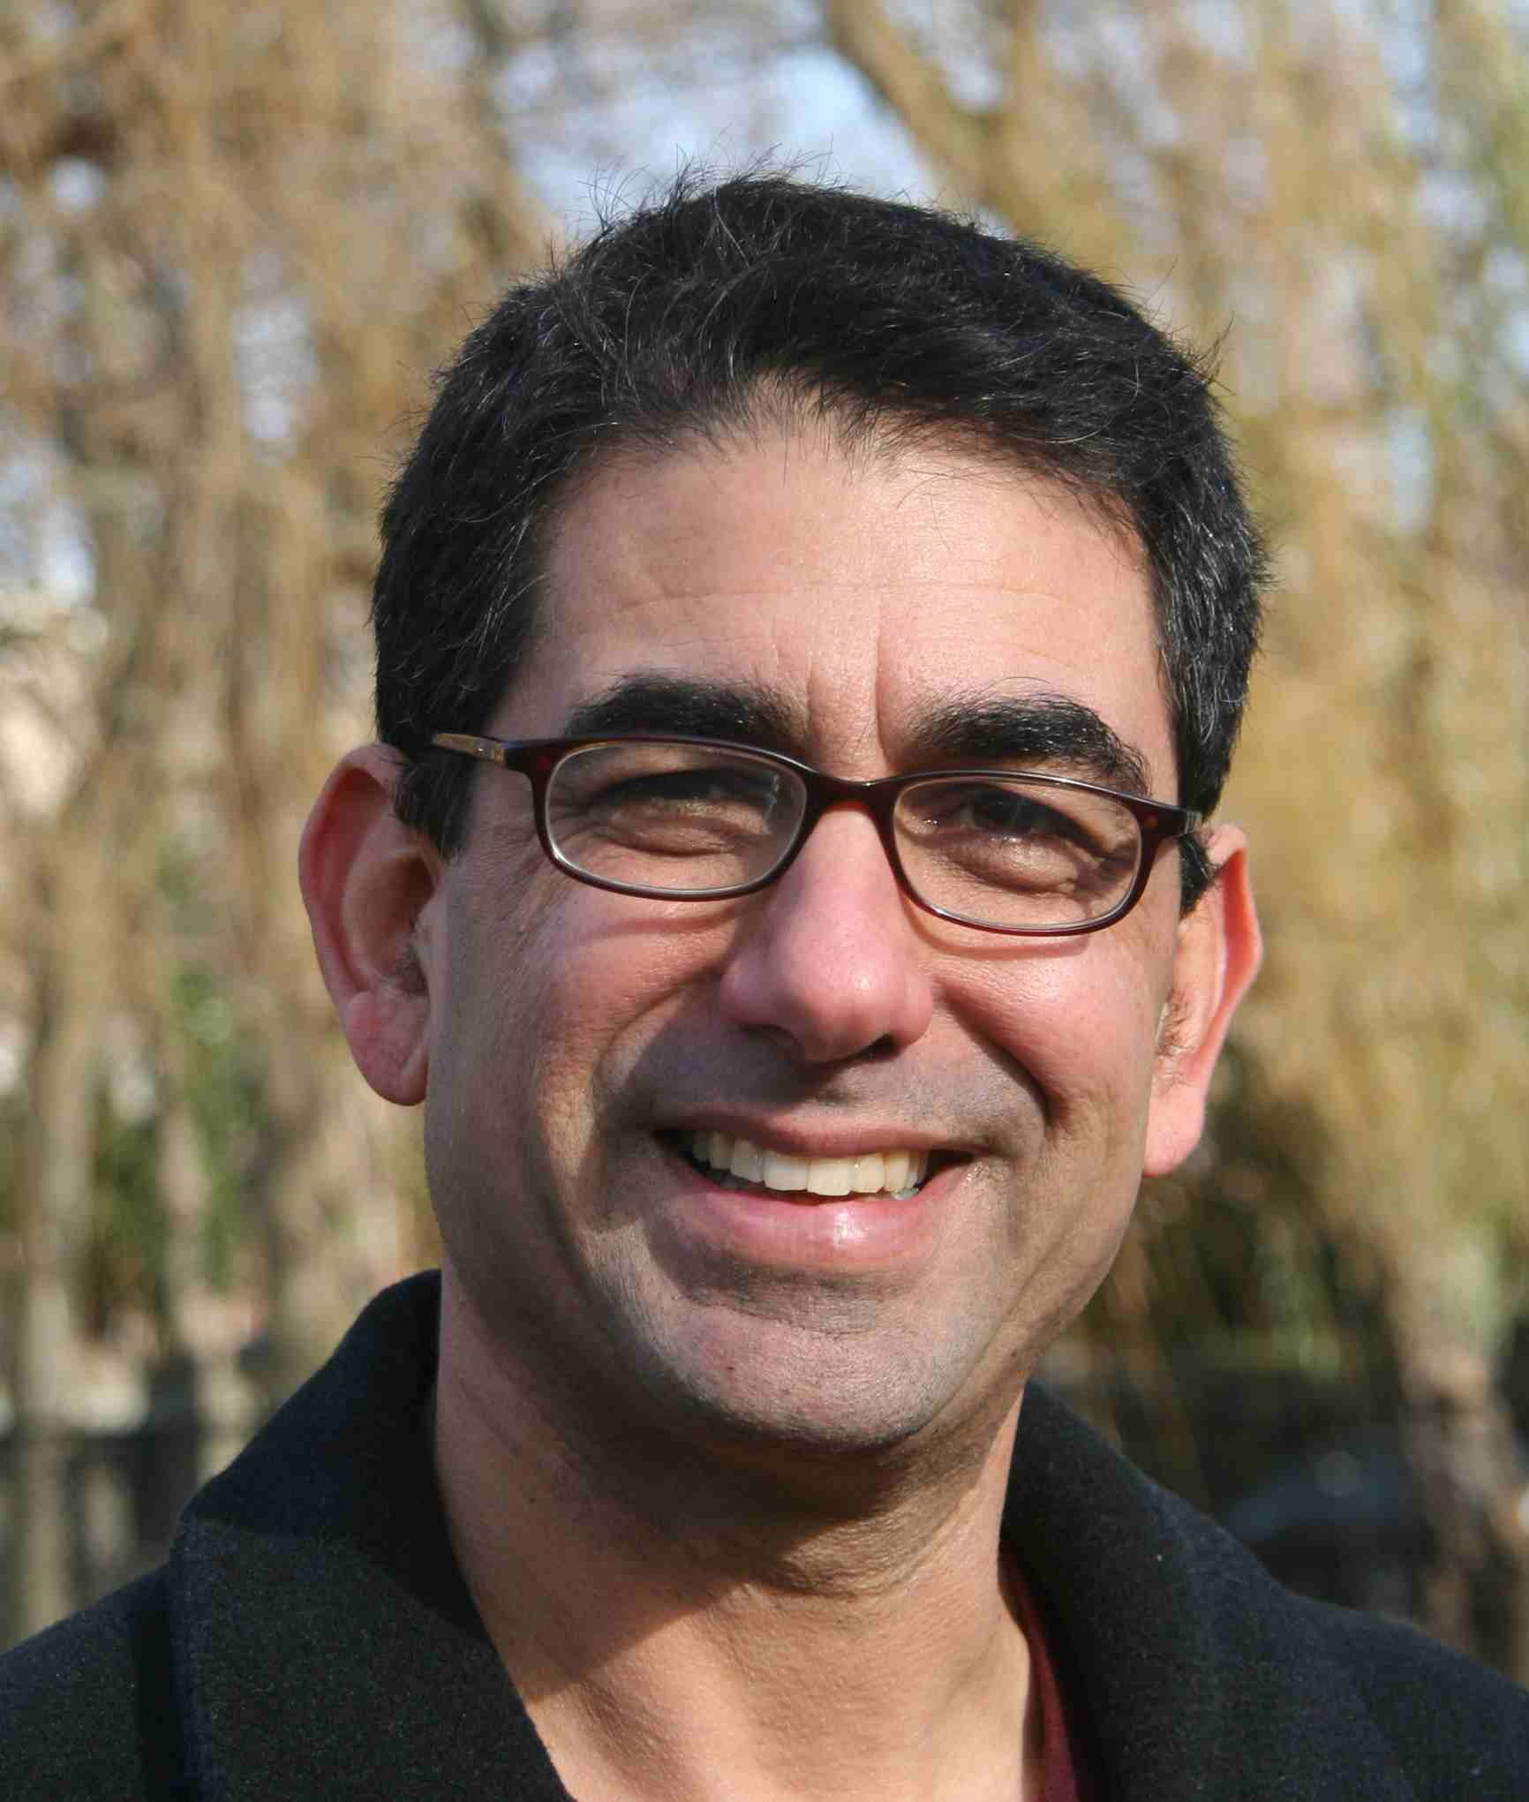
Universal Composability [C]
Arbitrary network
Arbitrary network
≈
∀A_{R}
∃A_{I}
REAL WORLD
IDEAL WORLD
Simulate messages without honest input
Independence of executions

Slide 6
What can we implement with
UC- Security?
Theorem [CF, CKL, L]: It is impossible to achieve UC-security for all “non-trivial functionalities”
SOLUTION: Get some “limited” help
from a trusted party
OR
Relax definition of security

Slide 7
Static Corruption
corrupt in the
beginning
…
Adaptive Corruption
corrupt adaptively
during execution
…

Slide 8
Why Adaptive Security?
Stronger definition of security
  Static security does not imply adaptive security
Implies leakage resilience* [BCH12,NVZ13]
Relevant to cloud security [RTSS09]
  Adaptively co-locate VMs
  Side channel attacks

Slide 9
General Results in Adaptive UC-Security?
What about Static UC-Security?
Trusted Setups
— Common Reference String [CLOS02,DN02,DG03,CPS07]
— Public Key Registration [BCNP04]
Relaxed Security
— Super-Poly Time Simulation (SPS) [BS05]
Notes:
So what can be done. Two lines of research. Either assume some trusted infrastructure---so called set-up assumptions, such as PKI, CRS etc.
Or relax the security requirements. The main relaxation is super-polynomial-time simulation---SPS---where we allow the simulator to run in super-polynomial time (as opposed to polynomial-time), and stronger variants of this notion such as angel-based security, UC with super-poly helpers.
By now, there are lots and lots of results in these different directions.

Slide 10
What about Static UC-Security?
Trusted Setups
— Common Reference String [CLOS02,DN02,DG03,CPS07,DNO10]
— Public Key Registration [BCNP04,DNO10]
— Tamper-Proof Hardware [Kat07,CGS08,GISVW10]
— Timing Model [DNS98,KLP05]
Relaxed Security
— Super-Poly Time Simulation (SPS) [Pas03, BS05, GGJS12]
— Angel-based Security Model [PS04, MMY06,CLP10]
— Bounded (Player) Concurrent[Barak]
— Non-Uniform Simulation [LPV09]
Notes:
So what can be done. Two lines of research. Either assume some trusted infrastructure---so called set-up assumptions, such as PKI, CRS etc.
Or relax the security requirements. The main relaxation is super-polynomial-time simulation---SPS---where we allow the simulator to run in super-polynomial time (as opposed to polynomial-time), and stronger variants of this notion such as angel-based security, UC with super-poly helpers.
By now, there are lots and lots of results in these different directions.

Slide 11
State of the Art
Static Security :
— A unified framework to achieve security in any setup under minimal trusted infrastructure [LPV09]
— Can achieve security assuming only SA-OT [DNO10,LPV12]
Adaptive Security :
— Construction only in a few trusted setups
— Constructions based on specific assumptions such as dense cryptosystems, trapdoor simulatable PKE
— Require independent setups for every pair of parties, e.g sunspots [CPS07]
Notes:
So what can be done. Two lines of research. Either assume some trusted infrastructure---so called set-up assumptions, such as PKI, CRS etc.
Or relax the security requirements. The main relaxation is super-polynomial-time simulation---SPS---where we allow the simulator to run in super-polynomial time (as opposed to polynomial-time), and stronger variants of this notion such as angel-based security, UC with super-poly helpers.
By now, there are lots and lots of results in these different directions.

Slide 12
Achieving UC-Security - Static Case [LPV09]
Stand-Alone
Non-malleabilty
One-Way Functions
Puzzle
Trusted Setup
Simulation
Non-malleability
UC-puzzle
UC-Security

Slide 13
Achieving UC-Security - Static Case [LPV09,LPV12]
Static Security :
NMC
Static OT
Puzzle
Static
UC
This work: When, and at what cost, can Adaptive UC security be acheived?
Notes:
So what can be done. Two lines of research. Either assume some trusted infrastructure---so called set-up assumptions, such as PKI, CRS etc.
Or relax the security requirements. The main relaxation is super-polynomial-time simulation---SPS---where we allow the simulator to run in super-polynomial time (as opposed to polynomial-time), and stronger variants of this notion such as angel-based security, UC with super-poly helpers.
By now, there are lots and lots of results in these different directions.

Slide 14
Ideally…
Static Security :
NMC
Static OT
Puzzle
Static
UC
Adaptive Security :
?
Adap. OT
Adap.
Puzzle
Adap.
UC
Notes:
So what can be done. Two lines of research. Either assume some trusted infrastructure---so called set-up assumptions, such as PKI, CRS etc.
Or relax the security requirements. The main relaxation is super-polynomial-time simulation---SPS---where we allow the simulator to run in super-polynomial time (as opposed to polynomial-time), and stronger variants of this notion such as angel-based security, UC with super-poly helpers.
By now, there are lots and lots of results in these different directions.

Slide 15
Our Work
Static Security :
NMC
Static OT
Puzzle
Static
UC
Adaptive Security :
?
Adap. OT
Adap.
Puzzle
Adap.
UC
Notes:
So what can be done. Two lines of research. Either assume some trusted infrastructure---so called set-up assumptions, such as PKI, CRS etc.
Or relax the security requirements. The main relaxation is super-polynomial-time simulation---SPS---where we allow the simulator to run in super-polynomial time (as opposed to polynomial-time), and stronger variants of this notion such as angel-based security, UC with super-poly helpers.
By now, there are lots and lots of results in these different directions.

Slide 16
Our Work
Static Security :
NMC
Static OT
Puzzle
Static
UC
Adaptive Security :
?
Simul. PKE
Adap. OT
Adap.
Puzzle
Adap.
UC
Notes:
So what can be done. Two lines of research. Either assume some trusted infrastructure---so called set-up assumptions, such as PKI, CRS etc.
Or relax the security requirements. The main relaxation is super-polynomial-time simulation---SPS---where we allow the simulator to run in super-polynomial time (as opposed to polynomial-time), and stronger variants of this notion such as angel-based security, UC with super-poly helpers.
By now, there are lots and lots of results in these different directions.

Slide 17
Our Work
Static Security :
NMC
Static OT
Puzzle
Static
UC
Adaptive Security :
NM*
Simul. PKE
Adap. OT
Adap.
Puzzle
Adap.
UC
Notes:
So what can be done. Two lines of research. Either assume some trusted infrastructure---so called set-up assumptions, such as PKI, CRS etc.
Or relax the security requirements. The main relaxation is super-polynomial-time simulation---SPS---where we allow the simulator to run in super-polynomial time (as opposed to polynomial-time), and stronger variants of this notion such as angel-based security, UC with super-poly helpers.
By now, there are lots and lots of results in these different directions.

Slide 18
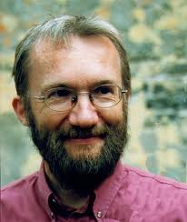
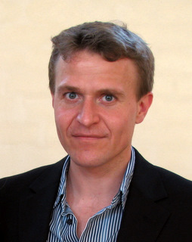
Our Work
Simulatable Public Key Encryption [DN00]
Oblivious Sampling of Public Keys/Ciphertexts
Invertable randomness for oblivious algs.
=> Non-commiting Encryption [CFGN96,DN00]
Adaptive Security :
NM*
Simul. PKE
Adap. OT
Adap.
Puzzle
Adap.
UC
Notes:
So what can be done. Two lines of research. Either assume some trusted infrastructure---so called set-up assumptions, such as PKI, CRS etc.
Or relax the security requirements. The main relaxation is super-polynomial-time simulation---SPS---where we allow the simulator to run in super-polynomial time (as opposed to polynomial-time), and stronger variants of this notion such as angel-based security, UC with super-poly helpers.
By now, there are lots and lots of results in these different directions.

Slide 19
Main Theorem
Assuming existence of simulatable PKE, Adaptive UC-security is achievable in any setup that admits an Adaptive Puzzle
Previous results - simple corollaries
Improved complexity assumptions
New models – non-uniform, bounded conc.

Slide 20
Achieving UC-Security - Adaptive Case
Cannot decouple!
stand alone adaptivity requires setup
Trusted Setup
Adap. Simulation
Adap. Non-malleability
UC-puzzle
Adaptive UC-Security

Slide 21
Achieving UC-Security - Adaptive Case
Trusted Setup
[LPV09]
Adap. UC-Puzzle
TODAY
Adap. Simulation
Adap. Non-malleability
UC-puzzle
Adaptive UC-Security

Slide 22


Commitment Scheme
The “digital analogue” of sealed envelopes.
Sender/committer
Receiver
Com(v)
Commitment
phase
d
Decommitment
phase
Hiding: The commitment hides the committed value
Binding: The commitment can only open to one value

Slide 23
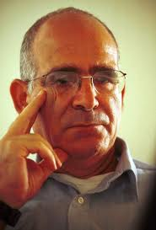

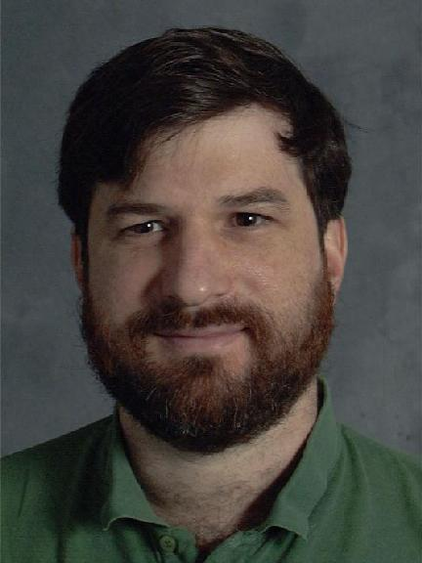
MIM Attack on Commitments
[DDN91]
Man in the Middle
Sender
Receiver/Sender
Receiver
Com(u)
Com(u+1)
MIM ”mauls” left commitment
into another to a related value
Notes:
Lead to the question: what is “independence”?

Slide 24
Non-Malleable w.r.t commitment
[DDN91, PR05, LPV08]
REAL
i
j ≠ i
C_{i}(u)
C_{j}(v)
∀ MIM
IDEAL
C_{j}(v’)
∃ Simulator
Output v’ = v
Can construct O(1) round concurrent NMC w.r.t commitment
based on OWFs [LP12,Goy12]
Notes:
Explain computationally independence by the indistinguishability based definition.
View is important, which makes composibility easier

Slide 25
Non-Malleable w.r.t opening
[CIO98,FF00,PR05]
REAL
i
j ≠ i
C_{i}(u)
C_{j}(v)
u
v
∀ MIM
IDEAL
C_{j}(v’)
u
v'
∃ Simulator
Can construct O(1) round stand-alone NMC w.r.t opening
based on CRHs for sychronized adversaries [PR05]
Notes:
Explain computationally independence by the indistinguishability based definition.
View is important, which makes composibility easier

Slide 26
What we need?
C_{i1}(u)
C_{j2}(v’)
C_{i2}(t)
u
v'
t
C_{i4}(x)
C_{j1}(v)
C_{i3}(w)
v
w
x
C_{i5}(y)
∀ MIM
C_{j3}(u’)
u'
y
Adaptively Secure
Concurrent Non-Malleable Commitments
w.r.t opening
Notes:
Explain computationally independence by the indistinguishability based definition.
View is important, which makes composibility easier

Slide 27
Relaxation: Left commitments are i.i.d samples
C_{i1}(u)
…
…
u
≈
u
C_{j}(v’)
C_{j}(v’)
v’
C_{i2}(w)
v'
v'
w
…
w
…
∀ MIM
∃ Simulator
Adaptively Secure
Concurrent Non-Malleable Commitments
w.r.t opening
Notes:
Explain computationally independence by the indistinguishability based definition.
View is important, which makes composibility easier

Slide 28
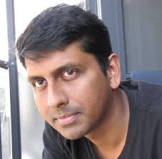
Relaxation: Left commitments are i.i.d samples
Main Lemma: Assuming OWFs and Puzzle,
O(n)-round Adaptively-secure Conc. NMC w.r.t opening and i.i.d samples
No additional trusted infrastructure to achieve non-malleability!
A single CRS/URS/sunspot is sufficient
same gains as static case
“What is a few rounds of communication between friends”

Slide 29


Ingredient I – Scheduling [DDN]
Non-Malleable Sub-protocols
i.e., Receiving Green does not help giving Orange and vice versa

Slide 30
Ingredient I – Scheduling [DDN]
Id = 0
Id = 1
Can rewind the right without rewinding the left!

Slide 31


Puzzle
UC-
TRAPDOOR
NP-statement
NP-witness
Challenger
Solver
Soundness
No Malicious Solver can output trapdoor after interaction
Simulation
∀ Concurrent Adversary Challenger A, ∃ Simulator S that simulates all puzzles indistinguishably while extracting the trapdoor
Notes:
Rafael, you only mentioned that I have tell them that the adversary has only one role.
You dint mention I have to put it in the slide.

Slide 32
Ingredient II – Instance Based Comm. [LZ09]
UC-Puzzle
NP-statement
Hamiltonian Circuit
Scheme: Commit to adjacency matrix
Commit 0 : Commit to true adjacency matrix
Commit 1 : Commit to a simple cycle
Equivocate : Commit to true adjacency matrix
W/O Trapdoor: Commitment is binding
With Trapdoor: Reveal it to 0 and 1

Slide 33
Application: Conc. NM Coin Tossing
ANMCOM(r)
r'
r
Coin toss output = r+r’
IDEA FOR UC-COM: Create two URS
Sender to Receiver (URS1) – equivocate (using OWF)
Receiver to Sender (URS2) – extract (using sim PKE)

Slide 34
Main Lemma
Assuming existence of OWFs and Adap.UC Puzzle,
O(n)-round Adaptively-secure
Concurrent NMC w.r.t opening and i.i.d samples
Main Theorem
Assuming existence of sim. PKE and Adap.UC Puzzle, Adaptive UC-security is achievable
UC-Puzzle: Hard for Adversary to solve in real world
Easy for Simulator to obtain trapdoor

Slide 35
Corollaries
Trusted Setups
✓
— Common Reference String [CLOS02,CPS07,CDPW07,DNO10]
— Public Key Registration [BCNP04,DNO10]
— Tamper-Proof Hardware [Kat07,CGS08,GISVW10]
— Timing Model [DNS98,KLP05]
✓
✓
✓
Relaxed Security
✓
— Super-Poly Time Simulation (SPS) [Pas03, BS05, GGJS12]
— Angel-based Security Model [PS04, MMY06,CLP10]
— Bounded (Player) Concurrent[Barak, Goyal1, Goyal2]
— Non-Uniform Simulation [LPV09]
✓
✓
Notes:
So what can be done. Two lines of research. Either assume some trusted infrastructure---so called set-up assumptions, such as PKI, CRS etc.
Or relax the security requirements. The main relaxation is super-polynomial-time simulation---SPS---where we allow the simulator to run in super-polynomial time (as opposed to polynomial-time), and stronger variants of this notion such as angel-based security, UC with super-poly helpers.
By now, there are lots and lots of results in these different directions.

Slide 36
Static vs Adaptive
 | Static UC Security
Assumptions | SA-OT and Puzzle NECESS. And SUFF.
Rounds | O(1)-rounds
What can we compute? | Any PPT computation
Adaptive UC Security
Sim. PKE and Puzzle
O(nd)-rounds (d = depth(C))
Not Everything! [IKOS10]

Slide 37
Conclusion
Characterize when Adaptive UC is achievable
Next… Reduce complexity assumptions
  trapdoor simulatable PKE are suff. for NCE [CDMW09]
  improve round complexity
    [Recent] UC-Adaptive Security in O(d)-rounds [V14]
Angel Based UC-Security [PS04,CLP10,…]
  reasonable model without any setup
  implies SPS
  linear-blowup in rounds with black-box tech. [GS12]

Slide 38
O(1)-rnd adaptive
How can we achieve semi-honest
2-party computation?
^
… still open

Slide 39
THANKS

