Slide 1
Optimal Planar Orthogonal Skyline Counting Queries
Gerth Stølting Brodal and Kasper Green Larsen
Aarhus University
14th Scandinavian Workshop on Algorithm Theory, Copenhagen, Denmark, July 3, 2014

Slide 2
n points
k output
not dominated
= skyline point
dominated by 4 points
skyline count = 5
orthogonal query range
Assumptions
coordinates { 0, 1, ... , n-1 }
Unit cost RAM with word size w = Ω(log n)

Slide 3
Results
 | Orthogonal range |  |  | Skyline
 | Space (words) | Query |  | Space (words) | Query
Reporting | n n⋅lg^{ε} n n⋅lg^{O(1)} n ⇒ | k⋅lg^{ε} n k + lglg n Ω(k + lglg n) | CLP11 ABR00PT06 | n n⋅lglg n n⋅lg^{ε} n n⋅lg n/lglg n | k⋅lg^{ε} n k⋅(lglg n)² k⋅lglg n + lg n/lglg n k⋅lglg n k + lg n/lglg n k + lg n/lglg n | new NN12 new NN12 new DGKASK12
Counting | n n⋅lg^{O(1)} n ⇒ | lg n/lglg n lg n/lglg n | JMS04P07 | n⋅lg n n⋅lg³ n/lglg n n n⋅lg^{O(1)} n ⇒ | lg n lg n/lglg n lg n/lglg n Ω(lg n/lglg n) | DGKASK12 DGS13 new new
{
{
Notes:
CLP = Chan Larsen Patrascu
ABR = Alstrup Brodal Rauhe
PT = Patrascu Thorup
JMS = JaJa Mortensen Shi
P = Patrascu
NN = Nekrich Navarro
DGKASK = Das Gupta Kalavagattu Agarwal Srinathan Kothapalli
DGS = Das Gupta Srinathan

Slide 4
Basic Geometry – Divide and Conquer
recurse
topmost point
(x,y)
y+1
recurse

Slide 5
Basic Counting – Vertical Slab
2
2
2
3
12
0
topmost
4
1
3
skyline count = 4 - 2 + 1
rightmost
0
topmost
1
3
2
rightmost
0
2
3
0
1
prefix sum = 8
3
Data Structure
succinct
prefix sum
O(n) bits
+
succinct
range maxima
O(n) bits
2
2
0
3
0
2
1
1
0
1

Slide 6
Upper Bound
degree lg^{ε} n
height
lg n / lglg n
Data Structure
succinct
fractional cascading on y
O(n⋅lg n) bits

Slide 7
Upper Bound – Multi-slab
degree lg^{ε} n
Block B_{top}
right
1
4
top
2
right
lg^{O(ε)} n points
5
B_{bottom}
3
top
+ tabulation ( blocks have o(lg n) bit signatures )
1
3
4
+ single slab queries ( succinct prefix sum )
5
2
lg^{2ε} n multi-slab structures using lglg n bits per block ( succinct prefix sum, range maxima )
3

Slide 8
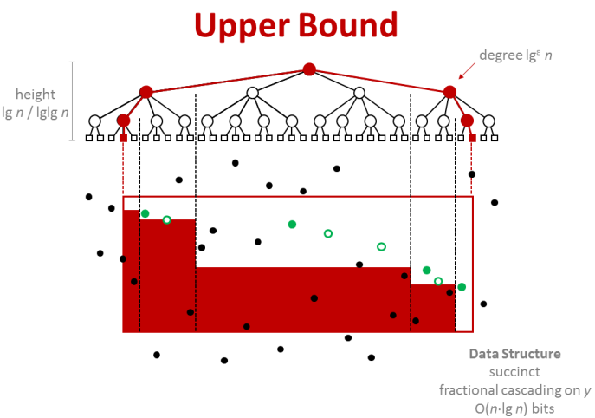
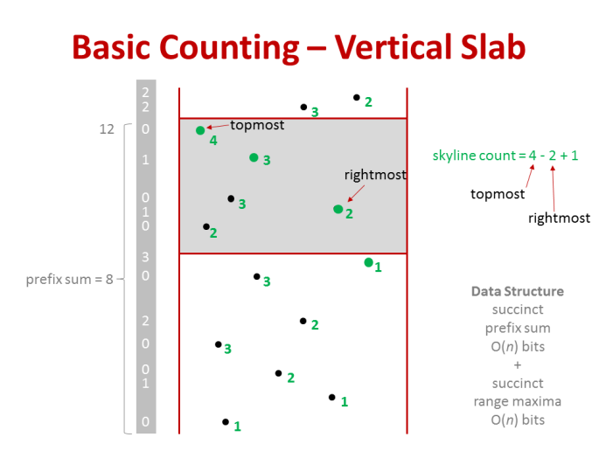
Upper Bound – Summary
+ succinct stuff ...
O(lg n / lglg n) orthogonal skyline counting
Space O(n) words

Slide 9
Lower Bound – Skyline Counting
Reduction
Reachability in the Butterfly Graph ⇒ Skyline Counting
[-∞, x] × [-∞, y]
Word size lg^{O(1)} n bits, space O(n⋅lg^{O(1)} n) ⇒ Ω(lg n / lglg n) query
s
000
001
010
011
100
101
110
111
000
001
010
011
100
101
110
111
Butterfly Graph
000
001
010
011
100
101
110
111
000
001
010
011
100
101
110
t
111
Notes:
st path is unique

Slide 10
s
000
001
010
011
100
101
110
111
Butterfly Graph
dashed edges are deleted
s-t paths are unique
a
000
001
010
011
100
101
110
111
b
000
001
010
011
100
101
110
111
c
000
001
010
011
100
101
110
t
111
111
110
c
101
100
a
rev(t)
011
2-sided Skyline Range Counting
depth of edge → aspect ratio of rectangle
edge = 1 point, deleted edge = 2 points
b
010
001
000
000
001
010
011
100
101
110
111
s

Slide 11
Results
 | Orthogonal range |  |  | Skyline
 | Space (words) | Query |  | Space (words) | Query
Reporting | n n⋅lg^{ε} n n⋅lg^{O(1)} n ⇒ | k⋅lg^{ε} n k + lglg n Ω(k + lglg n) | CLP11 ABR00PT06 | n n⋅lglg n n⋅lg^{ε} n n⋅lg n/lglg n | k⋅lg^{ε} n k⋅(lglg n)² k⋅lglg n + lg n/lglg n k⋅lglg n k + lg n/lglg n k + lg n/lglg n | new NN12 new NN12 new DGKASK12
Counting | n n⋅lg^{O(1)} n ⇒ | lg n/lglg n lg n/lglg n | JMS04P07 | n⋅lg n n⋅lg³ n/lglg n n n⋅lg^{O(1)} n ⇒ | lg n lg n/lglg n lg n/lglg n Ω(lg n/lglg n) | DGKASK12 DGS13 new new
improve
improve
{
{
improve

