Slide 1
Triplet and Quartet Distances Between Trees of Arbitrary Degree
Gerth Stølting Brodal Aarhus University | Rolf Fagerberg University of Southern Denmark
Thomas Mailund, Christian N. S. Pedersen, Andreas Sand Aarhus University, Bioinformatics Research Center
ACM-SIAM Symposium on Discrete Algorithms, New Orleans, Louisiana, USA, 8 January 2013

Slide 2
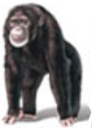
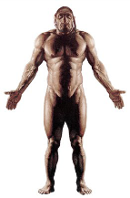
Evolutionary Tree
Rooted
Time
Bonobo | Chimpanzee | Human | Neanderthal | Gorilla | Orangutan
Notes:
Evolutionary tree = phylogeny

Slide 3
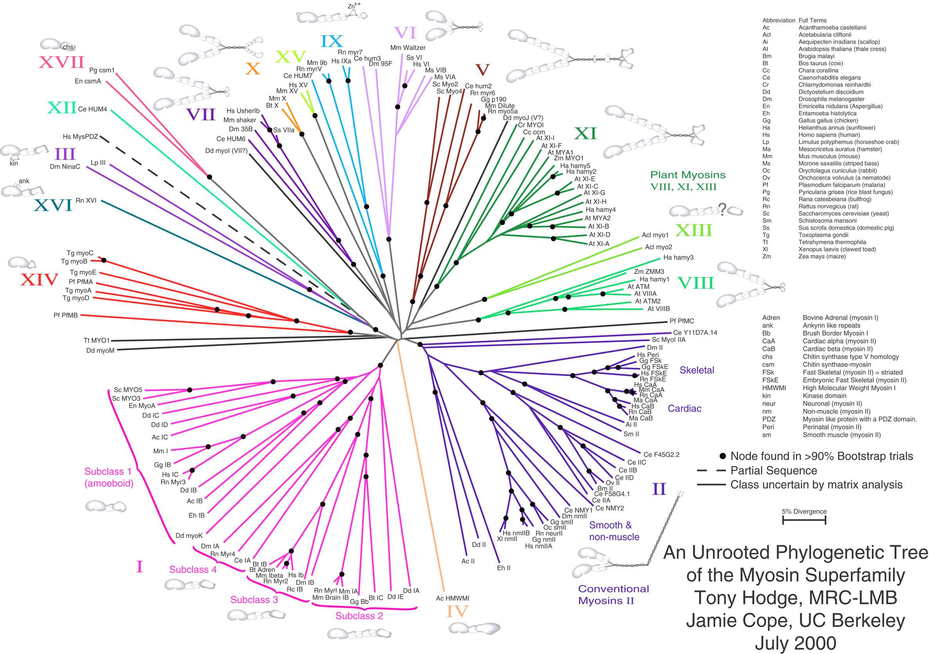
Unrooted Evolutionary Tree
Dominant modern approach to study evolution is from DNA analysis
Notes:
Exists techniques to make unrooted trees rooted:
1) this is normally done by including an outgroup in the input data
2) introducing additional assumptions about the relative rates of evolution on each branch, such as an application of the molecular clock hypothesis.

Slide 4
Constructing Evolutionary Trees – Binary or Arbitrary Degrees ?
Distance matrix
Sequence data
 | 1 | 2 | 3 | ··· | n
1
2
3
···
n
1
2
3
···
n
Binary trees
(despite no evidence in distance data)
Arbitrary degree (compromise ; good support for all edges)
Arbitrary degrees
(strong support for all edges ; few branches)
....
....
Neighbor Joining
Saitou, Nei 1987
[ O(n³) Saitou, Nei 1987 ]
Refined Buneman Trees
Moulton, Steel 1999
[ O(n³) Brodal et al. 2003 ]
Buneman Trees
Buneman 1971
[ O(n³) Berry, Bryan 1999 ]
Notes:
In Language/Linguistic’s, expert trees typically have non-binary nodes.

Slide 5
Data Analysis vs Expert Trees – Binary vs Arbitrary Degrees ?
Cultural Phylogenetics of the Tupi Language Family in Lowland South America.
R. S. Walker, S. Wichmann, T. Mailund, C. J. Atkisson. PLoS One. 7(4), 2012.
Linguistic expert classification (Aryon Rodrigues)
Neighbor Joining on linguistic data

Slide 6
Evolutionary Tree Comparison
split 1357|2468
8
2
?
≈
7
6
4
4
7
6
5
5
8
2
3
1
1
3
T₁
T₂
Common | Only T₁ | Only T₂
1357|2468 | 35|124678 | 57|123468
13567|248 | 48|123567
Robinson-Foulds distance = # non-common splits = 2 + 1 = 3
D. F. Robinson and L. R. Foulds. Comparison of weighted labeled trees. In Combinatorial
mathematics, VI, Lecture Notes in Mathematics, pages 119–126. Springer, 1979.
[Day 1985] O(n) time algorithm using 2 x DFS + radix sort
Notes:
Note
* We do not count trivial splits like 1|2345678.
* Only T1 and T2 might be different, if the number of internal edges are different. For binary trees they are equal.
Day’s algorithm:
DFS T1, label leaves, internal edges labeled with interval below => output interval
DFS T2, compute (min,max,size) for each subtree; max-min+1==size => consecutive interval
Radix sort intervals => identify common splits

Slide 7
Robinson-Foulds Distance (unrooted trees)
D. F. Robinson and L. R. Foulds. Comparison of weighted labeled trees. In Combinatorial
mathematics, VI, Lecture Notes in Mathematics, pages 119–126. Springer, 1979.
3
4
3
4
6
6
8
Common | Only T₁ | Only T₂
(none) | 12567|348 1257|3468 157|23468 57|123468 | 125678|34 12578|346 1578|2346 578|12346 78|123456
?
≈
1
2
2
1
5
5
8
7
7
T₁
T₂
RF-dist(T₁ , T₂) = 4 + 5 = 9
RF-dist(T₁\{8} , T₂\{8}) = 0
Robinson-Foulds very sensitive to outliers
Notes:
Note
* We do not count trivial splits like 1|2345678.
* Only T1 and T2 might be different, if the number of internal edges are different. For binary trees they are equal.
Day’s algorithm:
DFS T1, label leaves, internal edges labeled with interval below => output interval
DFS T2, compute (min,max,size) for each subtree; max-min+1==size => consecutive interval
Radix sort intervals => identify common splits

Slide 8
Quartet Distance (unrooted trees)
G. Estabrook, F. McMorris, and C. Meacham. Comparison of undirected phylogenetic trees based on subtrees of four evolutionary units. Systematic Zoology, 34:193-200, 1985.
Consider all $\left(\begin{matrix}\text{n} \\ \text{4}\end{matrix}\right)$ quartets, i.e. topologies of subsets of 4 leaves {i,j,k,l}
j
l
j
l
i
k
i
k
resolved : ij|kl
unresolved : ijkl
(only non-binary trees)
2
5
5
Quartet | T₁ | T₂
{1,2,3,4} | 14|23 | 14|23
{1,2,3,5} | 13|25 | 15|23
{1,2,4,5} | 14|25 | 1245
{1,3,4,5} | 14|35 | 1345
{2,3,4,5} | 25|34 | 23|45
3
1
3
4
4
2
T₁
1
T₂
Quartet-dist(T₁ , T₂) = $\left(\begin{matrix}\text{n} \\ \text{4}\end{matrix}\right)$- # common quartets = 5 - 1 = 4

Slide 9
Triplet Distance (rooted trees)
D. E. Critchlow, D. K. Pearl, C. L. Qian: The triples distance for rooted bifurcating phylogenetic trees. Systematic Biology, 45(3):323-334, 1996.
Consider all $\left(\begin{matrix}\text{n} \\ \text{3}\end{matrix}\right)$ triplets, i.e. topologies of subsets of 3 leaves {i,j,k}
k
i
j
k
i
j
resolved : k|ij
unresolved : ijk
(only non-binary trees)
Triplet | T₁ | T₂
{1,2,3} | 2|13 | 2|13
{1,2,4} | 1|24 | 4|12
{1,2,5} | 1|25 | 5|12
{1,3,4} | 4|13 | 4|13
{1,3,5} | 5|13 | 5|13
{1,4,5} | 1|45 | 1|45
{2,3,4} | 3|24 | 4|23
{2,3,5} | 3|25 | 5|23
{2,4,5} | 5|24 | 2|45
{3,4,5} | 3|45 | 3|45
3
1
5
2
4
5
4
2
3
1
T₁
T₂
Triplet-dist(T₁ , T₂) = $\left(\begin{matrix}\text{n} \\ \text{3}\end{matrix}\right)$- # common triplets = 10 - 5 = 5

Slide 10
Computational Results
 | Rooted Triplet distance |  | Unrooted Quartet distance
Binary | O(n²) O(n⋅log n) | CPQ 1996 [SODA 2013] | O(n³) O(n²) O(n⋅log² n) O(n⋅log n) | D 1985 BTKL 2000 BFP 2001 BFP 2003
Degrees ≤ d | O(n²) O(n⋅log n) | BDF 2011 [SODA 2013] | O(d ⁹⋅n⋅log n) O(n^{2.688}) O(d⋅n⋅log n) | SPMBF 2007 NKMP 2011 [SODA 2013]
2
5
3
3
1
5
4
4
2
1
10
5
3
1
9
8
7
3
1
5
12
6
7
11
4
6
2
13
Notes:
BDF = Bansal, Dong and Fernandez-Baca
NKMP = Nielsen, Kristensen, Mailund, and Pedersen
SPDMBF = Stissing, Pedersen, Mailund, Brodal, and Fagerberg
D = Doucette
BTKL = Bryant, Tsang, Kearney, Li
CPQ = Critchlow, Pearl, and Qian
BFP = Brodal, Fagerberg, Pedersen

Slide 11
Distance Computation
O(n·log n) triplets & quartets
Triplet-dist(T₁ , T₂) = $\left(\begin{matrix}\text{n} \\ \text{3}\end{matrix}\right)\text{–}$ A – E = B + C + D
 |  | T₂
 |  | Resolved | Unresolved
T₁ | Resolved | A : Agree | C
 |  | B : Disagree
 | Unresolved | D | E
k
O(d·n·log n) quartets
i
j
k
i
j
i
j
k
O(n·log n) triplets
i
j
j
k
i
k
O(n) triplets & quartets
i
k
k
j
i
i
j
k
j
i
j
i
k
j
k
A + B + C + D + E = $\left(\begin{matrix}\text{n} \\ \text{3}\end{matrix}\right)$
D + E and C + E unresolved in one tree
Sufficient to compute A and E or A and B

Slide 12
Parameterized Triplet & Quartet Distances
B + α·(C + D) , 0 ≤ α ≤ 1
 |  | T₂
 |  | Resolved | Unresolved
T₁ | Resolved | A : Agree | C
 |  | B : Disagree
 | Unresolved | D | E
k
i
j
k
i
j
i
j
k
i
j
j
k
i
k
i
k
k
j
i
i
j
k
j
i
j
i
k
j
k
BDF 2011 O(n²) for triplet, NKMP 2011 O(n^{2.688}) for quartet
[SODA 13] O(n·log n) and O(d·n·log n), respectively
Notes:
BDF = Bansal, Dong and Fernandez-Baca
NKMP = Nielsen, Kristensen, Mailund, and Pedersen

Slide 13
Counting Unresolved Triplets in One Tree
$$\sum_{\text{v}}{\sum_{\text{i}\text{<}\text{j}\text{<}\text{k}}{\text{n}\text{i}\text{·}\text{n}\text{j}\text{·}\text{n}\text{k} }}$$
v
n₁ n₂ n₃ ··· n_{d}
Triplet anchored at v
Computable in O(n) time using DFS + dynamic programming
Quartets (root tree arbitrary)
$$\sum_{\text{v}}{\left(\sum_{\text{i}\text{<}\text{j}\text{<}\text{k}\text{<}\text{l}}{\text{n}\text{i}\text{·}\text{n}\text{j}\text{·}\text{n}\text{k}\text{·}\text{n}\text{l}}+\left(\text{n}−\sum_{\text{l}}{\text{n}\text{l}}\right)\sum_{\text{i}\text{<}\text{j}\text{<}\text{k}}{\text{n}\text{i}\text{·}\text{n}\text{j}\text{·}\text{n}\text{k}}\right)}$$
v
n₁ n₂ n₃ ··· n_{d}
Quartet anchored at v

Slide 14
Counting Agreeing Triplets (Basic Idea)
0
v
w
j
c
1
i
j
d
i i
T₁
T₂
$$\sum_{\text{v}\text{∈}\text{T}\text{1}}{\sum_{\text{w}\text{∈}\text{T}\text{2}}{\sum_{\text{c}}{\sum_{\text{1}\text{≤}\text{i}\text{≤}\text{d}}{\left(\begin{matrix}{{\text{n}}_{\text{i}}^{}}^{\text{c}} \\ \text{2}\end{matrix}\right)\left({\text{n}}^{\text{w}}−{\text{n}}^{\text{c}}−{{\text{n}}_{\text{i}}^{}}^{\text{w}}+{{\text{n}}_{\text{i}}^{}}^{\text{c}}\right) }}}}$$
$$\sum_{\text{1}\text{≤}\text{i}\text{≤}\text{d}}{{{\text{n}}_{\text{i}}^{}}^{\text{w}}}$$

Slide 15
Efficient Computation
0
Limit recolorings in T₁ (and T₂) to O(n·log n)
v
T₁
0
0
Recolor
0
Recolor
Recurse
0
1
v
v
v
v
...
0
1
1
1
1
2
d
1
v
(precondition)
Count T₂ contribution
Recolor & recurse
1
Reduce recoloring cost in T₂ to O(n·log² n)
T₂
_{arbitrary}
_{height}
_{degree}
H(T₂)
_{binary}
_{height O(log n)}
7
9
8
5
2
6
3
1
3
6
9
4
4
1
2
7
5
8
Reduce recoloring cost in T₂ from O(n·log² n) to O(n·log n)
Contract T₂ and reconstruct H(T₂) during recursion

Slide 16
Counting Agreeing Triplets (II)
C₂
node in H(T₂) =
component composition in T₂
T₁
0
j
i
v
i
i
j
C₁
1
i
j
d
i
i
i
j
Contribution to agreeing triplets at node in H(T₂)
$$\sum_{\text{1}\text{≤}\text{i}\text{≤}\text{d}}{{{\text{n}}_{\text{i}}^{}}^{\text{C}\text{1}}{·{\text{n}}_{\text{i}↑∗}^{}}^{\text{C}\text{2}}}$$
$$\sum_{\text{1}\text{≤}\text{i}\text{≤}\text{d}}{\left(\begin{matrix}{{\text{n}}_{\text{i}}^{}}^{\text{C}\text{1}} \\ 2\end{matrix}\right)\left({{\text{n}}_{∗}^{}}^{\text{C}\text{2}}{−{\text{n}}_{\text{i}}^{}}^{\text{C}\text{2}}\right)}$$
$$\sum_{\text{1}\text{≤}\text{i}\text{≤}\text{d}}{\left({{\text{n}}_{∗}^{}}^{\text{C}\text{1}}{−{\text{n}}_{\text{i}}^{}}^{\text{C}\text{1}}\right){{\text{n}}_{\text{(}\text{ii}\text{)}}^{}}^{\text{C}\text{2}}}$$
+ +

Slide 17
From O(n·log² n) to O(n·log n)
Compressed version of T₂ of size O(n_{v})
Update O(1) counters for all colors through node
T₁
0
v
$$\text{H}\text{(}\overline{\text{T}}\text{2}\text{)}$$
w
1
i
j
d
n_{i}
n_{v}
$$\sum_{\text{2}\text{≤}\text{i}\text{≤}\text{d}}{\text{log}\left(\begin{matrix}|\overline{\text{T}}\text{2}| \\ \text{n}\text{i}\end{matrix}\right)}=\sum_{\text{2}\text{≤}\text{i}\text{≤}\text{d}}{\text{n}\text{i}∙\text{log}{\frac{{\text{n}}^{\text{v}}}{\text{n}\text{i}}}}$$
Colored path lengths
a⁽⁵⁾
Total cost for updating counters
a⁽⁴⁾
$$\sum_{\text{leaf} \text{l}\text{∈}\text{T}\text{1}}{\sum_{\begin{aligned}\text{ancestor} \text{a}\text{(}\text{j}\text{)} \\ \text{not} \text{heavy} \text{child}\end{aligned}}{\text{log}{\frac{{\text{n}}^{\text{a}\text{(}\text{j}\text{+1)}}}{{\text{n}}^{\text{a}\text{(}\text{j}\text{)}}}}}} \text{=} \text{n}\text{∙}\text{log}{\text{n}}$$
T₁
a⁽³⁾
a⁽²⁾
a⁽¹⁾
l=a⁽⁰⁾

Slide 18
Counting Quartets...
Root T₁ and T₂ arbitrary
Keep up to 15+38d different counters per node in H(T₂)...
Bottleneck in computing disagreeing resolved-resolved quartets
T₁
0
T₂
v
G₁
i
j
i
j
G₂
$$\sum_{\text{1}\text{≤}\text{i}\text{<}\text{d} }{\sum_{\text{i}\text{<}\text{j}\text{≤}\text{d}}{{\text{n}\text{(}\text{ij}\text{)}}^{\text{G}\text{1}}\text{·}{\text{n}\text{(}\text{ij}\text{)}}^{\text{G}\text{2}}}}$$
1
i
j
d
double-sum ⇒ factor d time

Slide 19
Distance Computation
O(n·log n) triplets & quartets
Triplet-dist(T₁ , T₂) = $\left(\begin{matrix}\text{n} \\ \text{3}\end{matrix}\right)\text{–}$ A – E = B + C + D
 |  | T₂
 |  | Resolved | Unresolved
T₁ | Resolved | A : Agree | C
 |  | B : Disagree
 | Unresolved | D | E
k
O(d·n·log n) quartets
i
j
k
i
j
i
j
k
O(n·log n) triplets
i
j
j
k
i
k
O(n) triplets & quartets
i
k
k
j
i
i
j
k
j
i
j
i
k
j
k
A + B + C + D + E = $\left(\begin{matrix}\text{n} \\ \text{3}\end{matrix}\right)$
D + E and C + E unresolved in one tree
Sufficient to compute A and E or A and B

Slide 20
Summary
 | Rooted Triplet distance |  | Unrooted Quartet distance
Binary | O(n²) O(n⋅log n) | CPQ 1996 [SODA 2013] | O(n³) O(n²) O(n⋅log² n) O(n⋅log n) | D 1985 BTKL 2000 BFP 2001 BFP 2003
Degrees ≤ d | O(n²) O(n⋅log n) | BDF 2011 [SODA 2013] | O(d ⁹⋅n⋅log n) O(n^{2.688}) O(d⋅n⋅log n) | SPMBF 2007 NKMP 2011 [SODA 2013]
5
T^{h}e E_{n}^{d}
2
3
3
1
5
4
4
2
1
o(n·log n) ?
10
5
3
1
9
8
7
3
1
5
12
6
7
11
4
6
2
13
d = maximal degree of any node in T₁ and T₂
O(n·log n) ?

