Slide 1
A Simple Integer Successor-Delete Data Structure Gerth Stølting Brodal Aarhus University
23rd International Symposium on Experimental Algorithms (SEA 2025), July 22, 2025, Venice, Italy

Slide 2
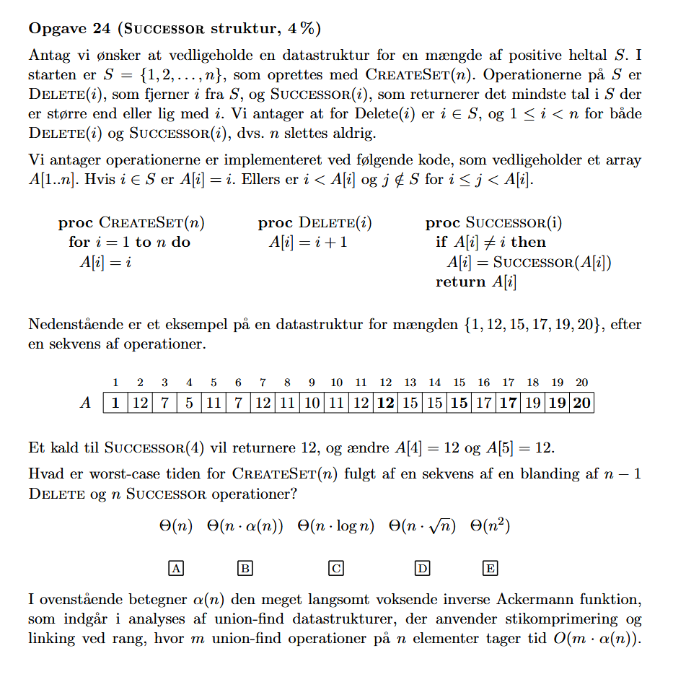
Background
Algorithms and Data Structures
Exam question
Amortized analysis
Simple data structure
Notes:
The analysis turned out to be slightly less trivial than expected…

Slide 3
Problem – Internal Union-Find
Main a subset of S ⊆ {1, 2, ..., n}
Operations: Init(n) Delete(i) Succ(i)
[Gabow, Tarjan JCSS 1981] O(n) init, O(1) Succ, amortized O(1) Delete
Topic of this talk A very simple data structure (with slightly worse theoretical bounds)
Succ(8) = 12
n
1 | 2 | 3 | 4 | 5 | 6 | 7 | 8 | 9 | 10 | 11 | 12 | 13 | 14 | 15 | 16 | 17 | 18 | 19 | 20

Slide 4
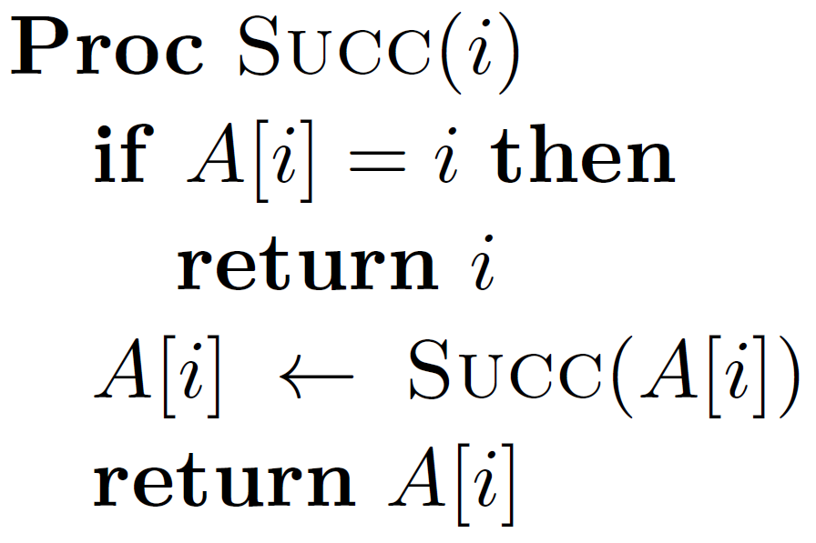
The Data Structure
Init(20)
 | 1 | 2 | 3 | 4 | 5 | 6 | 7 | 8 | 9 | 10 | 11 | 12 | 13 | 14 | 15 | 16 | 17 | 18 | 19 | 20
A | 1 | 2 | 3 | 4 | 5 | 6 | 7 | 8 | 9 | 10 | 11 | 12 | 13 | 14 | 15 | 16 | 17 | 18 | 19 | 20
Delete(4) Delete(5) ∙∙∙
 | 1 | 2 | 3 | 4 | 5 | 6 | 7 | 8 | 9 | 10 | 11 | 12 | 13 | 14 | 15 | 16 | 17 | 18 | 19 | 20
A | 1 | 2 | 3 | 5 | 6 | 7 | 8 | 8 | 10 | 11 | 11 | 13 | 14 | 15 | 15 | 16 | 17 | 18 | 19 | 20
Succ(5) = 8
 | 1 | 2 | 3 | 4 | 5 | 6 | 7 | 8 | 9 | 10 | 11 | 12 | 13 | 14 | 15 | 16 | 17 | 18 | 19 | 20
A | 1 | 2 | 3 | 5 | 8 | 8 | 8 | 8 | 10 | 11 | 11 | 13 | 14 | 15 | 15 | 16 | 17 | 18 | 19 | 20
Delete(8) Succ(5)=11 Delete(11) Succ(6)=15 Delete(12)
 | 1 | 2 | 3 | 4 | 5 | 6 | 7 | 8 | 9 | 10 | 11 | 12 | 13 | 14 | 15 | 16 | 17 | 18 | 19 | 20
A | 1 | 2 | 3 | 5 | 11 | 15 | 8 | 11 | 11 | 11 | 15 | 13 | 15 | 15 | 15 | 16 | 17 | 18 | 19 | 20
path compression
Notes:
Arcs can intersect
Delete(12) deletes an already deleted value

Slide 5
Invariants
If i not deleted, A[i] = i
If i deleted, i < A[i] ≤ succ(S, i)
(1 and n are never deleted)
 | 1 | 2 | 3 | 4 | 5 | 6 | 7 | 8 | 9 | 10 | 11 | 12 | 13 | 14 | 15 | 16 | 17 | 18 | 19 | 20
A | 1 | 2 | 3 | 5 | 11 | 15 | 8 | 11 | 11 | 11 | 15 | 13 | 15 | 15 | 15 | 16 | 17 | 18 | 19 | 20
path compression
Notes:
Arcs can intersect
Delete(12) deletes an already deleted value

Slide 6
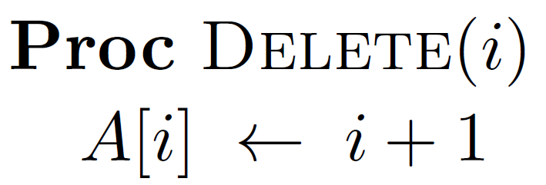
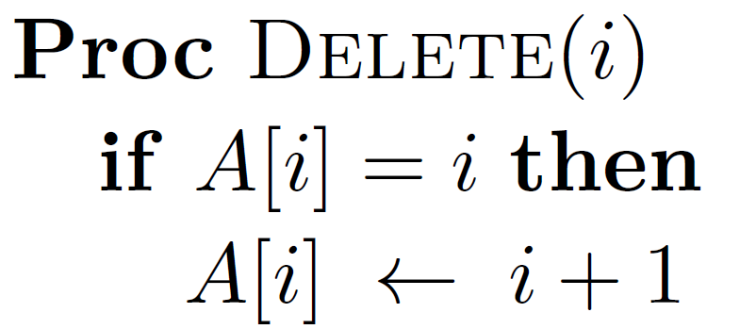
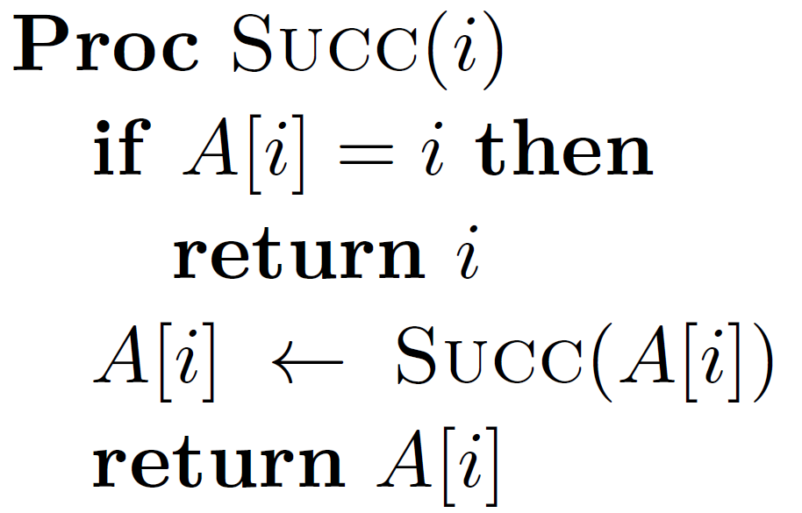
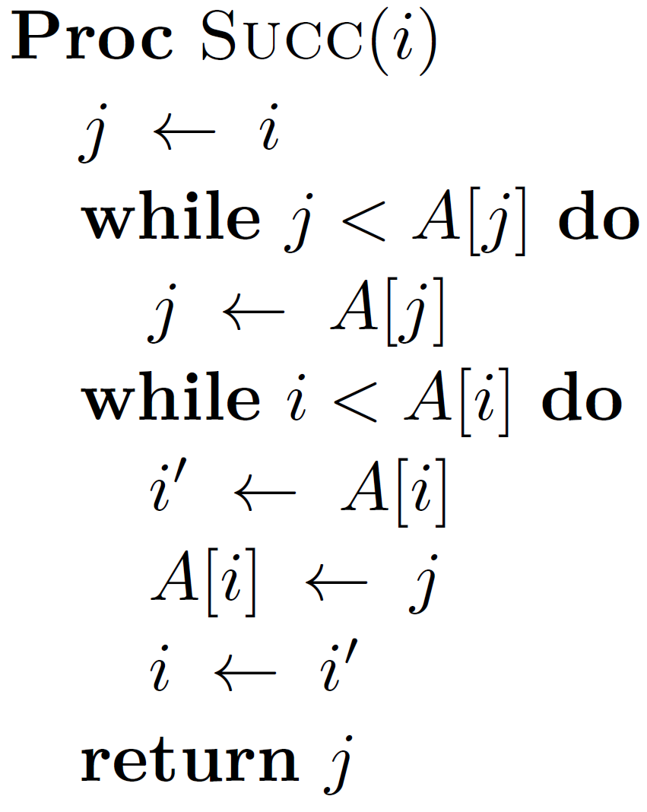
Variants
Deletions can check if value already deleted
Path compression can be recursive or 2-pass iterative

Slide 7
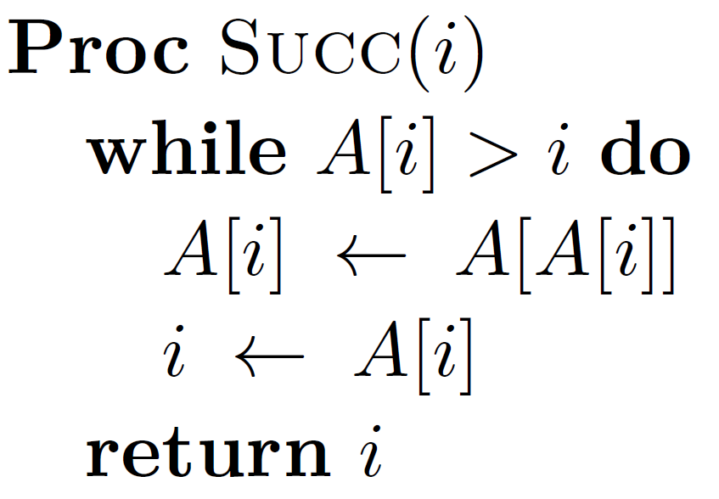
Variant – 1-pass Path Halving
 | 1 | 2 | 3 | 4 | 5 | 6 | 7 | 8 | 9 | 10 | 11
A | 1 | 3 | 4 | 5 | 6 | 7 | 8 | 9 | 10 | 11 | 11
Succ(4) = 11
 | 1 | 2 | 3 | 4 | 5 | 6 | 7 | 8 | 9 | 10 | 11
A | 1 | 3 | 4 | 6 | 6 | 8 | 8 | 10 | 10 | 11 | 11
Notes:
Only studied experimentally in the paper

Slide 8
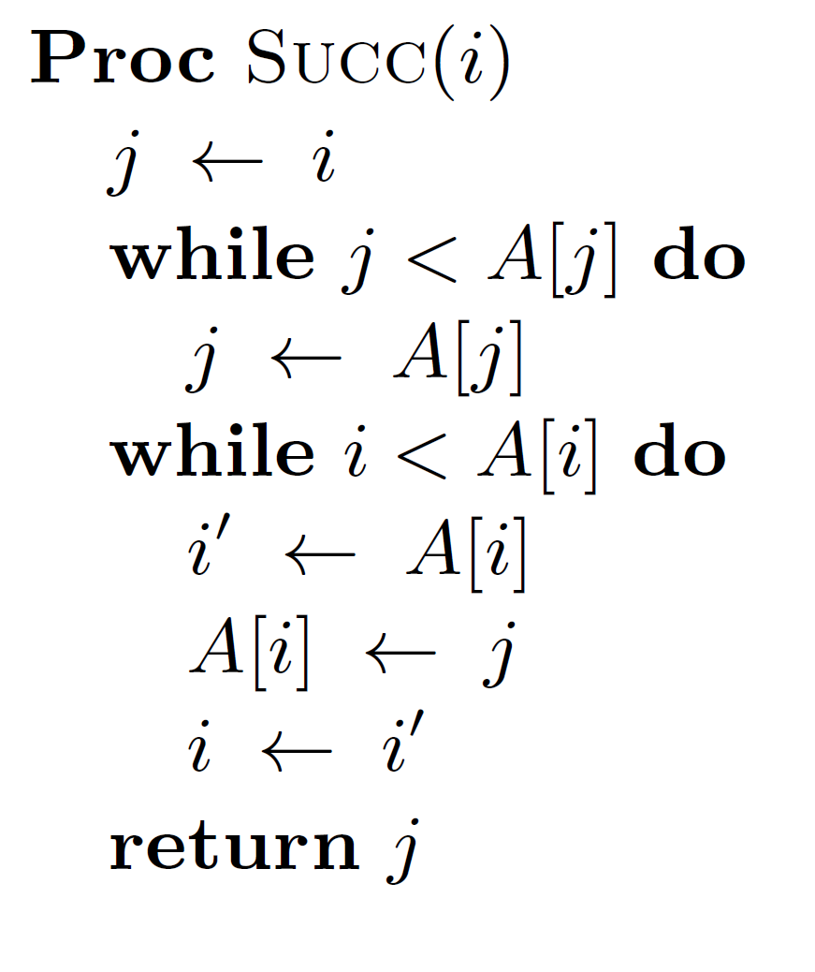
Supporting Succ, Pred, RangeReport
 | 1 | 2 | 3 | 4 | 5 | 6 | 7 | 8 | 9 | 10 | 11 | 12 | 13 | 14 | 15 | 16 | 17 | 18 | 19 | 20
A | 0 | 1 | 2 | 5 | 8 | 8 | 8 | 3 | 10 | 11 | 8 | 13 | 14 | 15 | 11 | 15 | 16 | 17 | 18 | 19
Invariant If i not deleted, A[i] = pred(S, i - 1); otherwise, i < A[i] ≤ succ(S, i)
Notes:
2-pass path compression

Slide 9
Previous and New Results
 | Successor | Insert | Delete
Binary search trees | O(log n) | O(log n) | O(log n)
van Emde Boas trees | O(loglog n) | O(loglog n) | O(loglog n)
Weighted quick-find | O(1) |  | O_{A}(log n)
Interval union-find | O(1) |  | O_{A}(1)
This paper* | O_{A}(log n) |  | O(1)
Theorem* Init(n), d Delete, s Succ operations : O(n + d + s∙(1 + log_{max(2,s/n)} min(s, n)))
Interval
union-find
weight 1 succ
weight 4 succ
weight 3 succ
Gabow, Tarjan [JCSS 1985]
 | 1 | 2 | 3 | 4 | 5 | 6 | 7 | 8
quick-find
microsets | 00010000 | 00000000 | 00000000 | 00000000 | 00100010 | 00000000 | 00000000 | 00010001
 |  |  | log n bits word
Notes:
Interval union-find: Gabow-Tarjan 1985.
Our data structure can also be combined with microsets and avoid the "root records"
The analysis follows a proof for the union-find problem (unweighted linking) by Tarjan and van Leeuwen, JACM 1981

Slide 10
Theoretical Analysis
Theorem: Init(n), d Delete, s Succ operations takes time
O(n + d + s∙(1 + log_{max(2,s/n)} min(s, n)))
Note: Time is O(n + d + s) if s = O(n / log n) or s = Ω(n^{1+ε})
Our data structure is a special case of Rem’s general union-find data structure described by Dijkstra [1976]
Tarjan, van Leeuwen [1984] analyzed Union-Find with naïve linking

Slide 11
Experimental Results
Intel Core i7-1365U, Windows 11 (23H2), GCC 14.2.0 (MSYS2), A = 64 bit ints
Data structures
1) no path compression
2) recursive path compression
3) 2-pass path compression
4) 2-pass path compression and checked deletions
5) path halving
6) union-find (weighted linking, path compression)
7) weighted quick-find
Microset-macroset (microset = 64 bits, __builtin_ctzll)
8) 2-pass path compression 9) union-find
10) weighted quick-find (interval union-find)

Slide 12
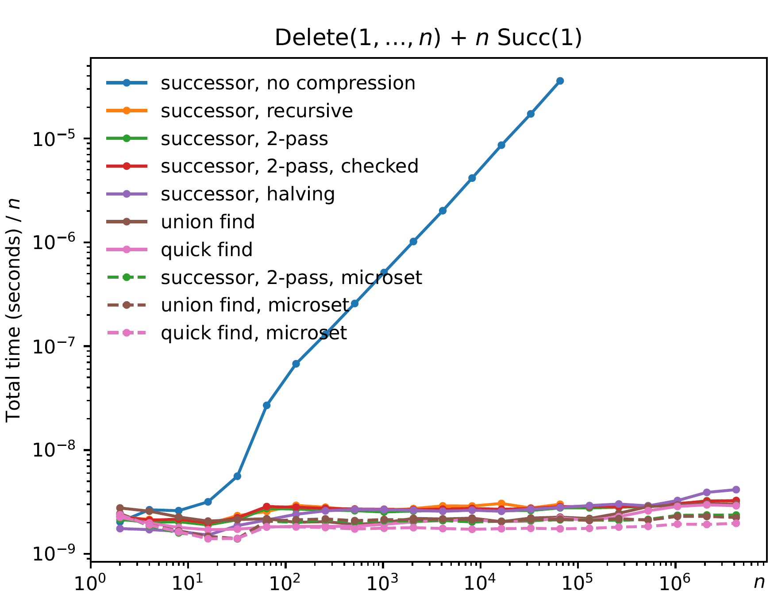
Bad Idea – Skip Path Compression…
Init(n)
Delete(1)
Delete(2)
⋮
Delete(n)
Succ(1)
Succ(1)
⋮
Succ(1)

Slide 13
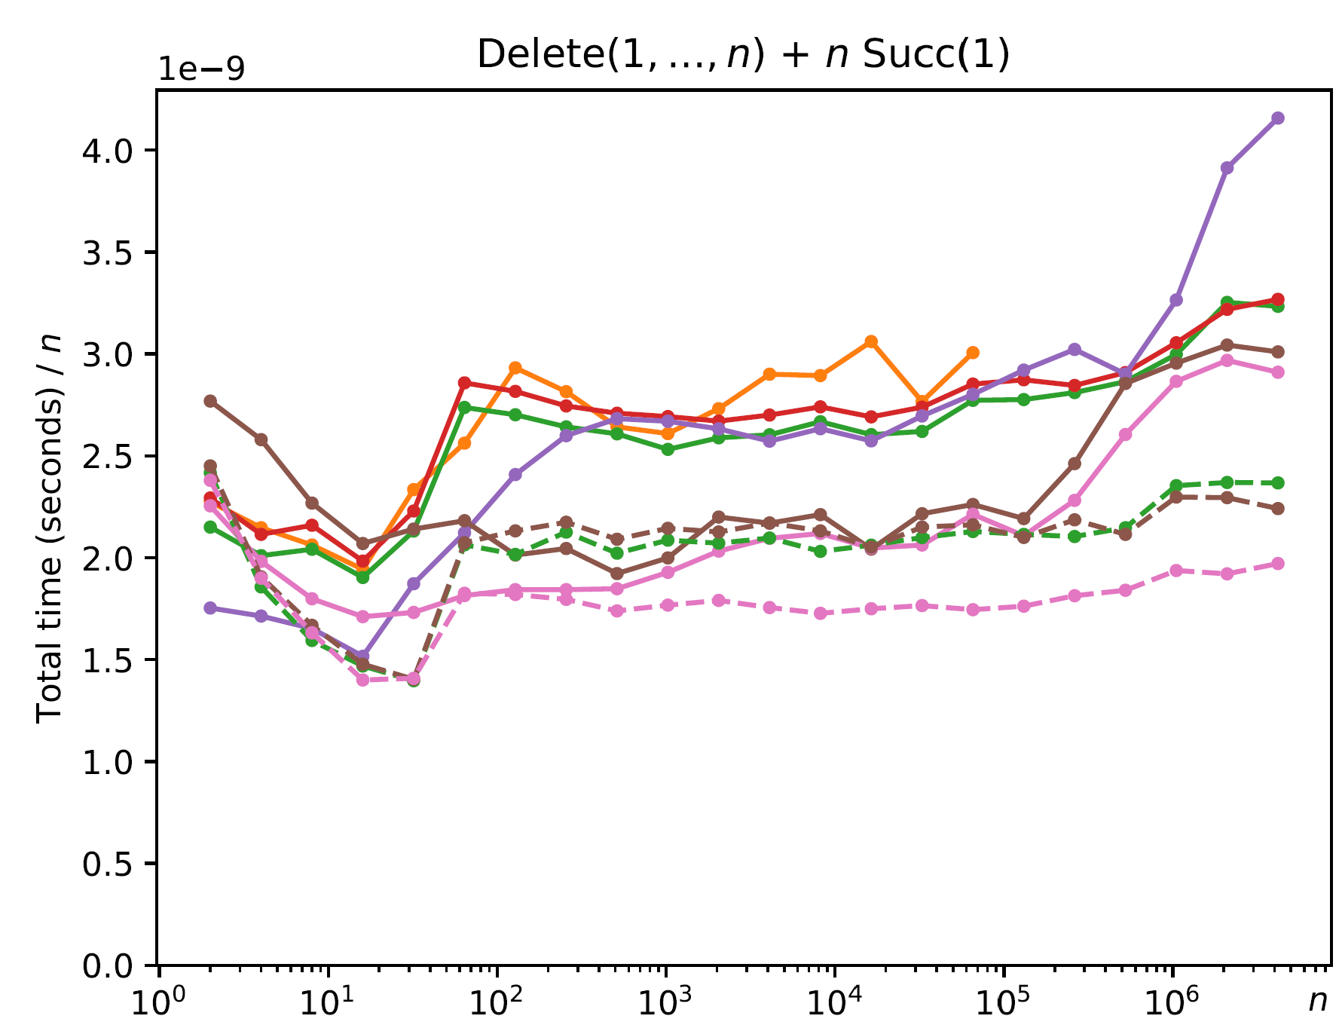
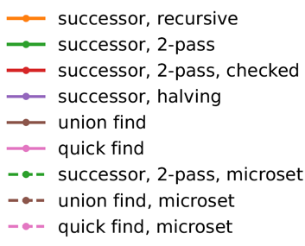
Recursion – Stack Overflow…
Init(n)
Delete(1)
Delete(2)
⋮
Delete(n)
Succ(1)
Succ(1)
⋮
Succ(1)

Slide 14
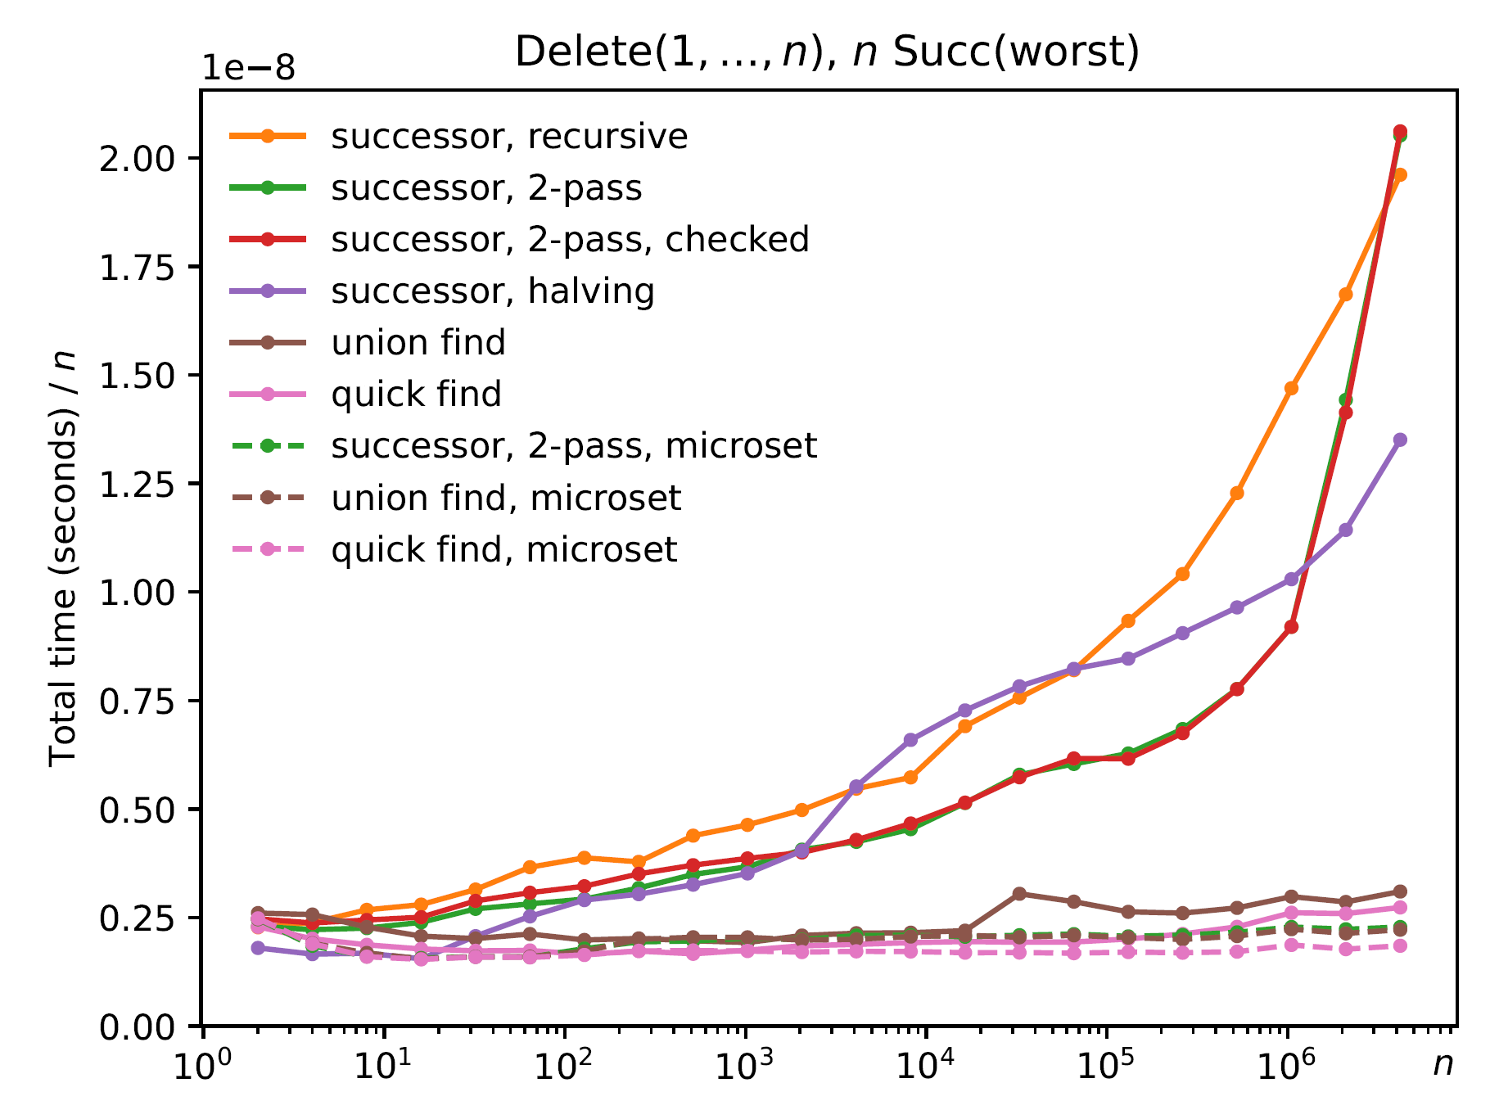
Worst-Case Sequence ("add new root")
Init(n)
Delete(1)
Succ(worst)
Delete(2)
Succ(worst)
Delete(3)
Succ(worst)
⋮
Delete(n)
Succ(worst)
Θ(log n)
Θ(1)
Θ(1)
Notes:
Gap worst-case when #pred = #delete according to analysis
worst = query with longest path to root (most recently deleted)
Union-find, quick-find union a sets of sizes 1 and i.

Slide 15
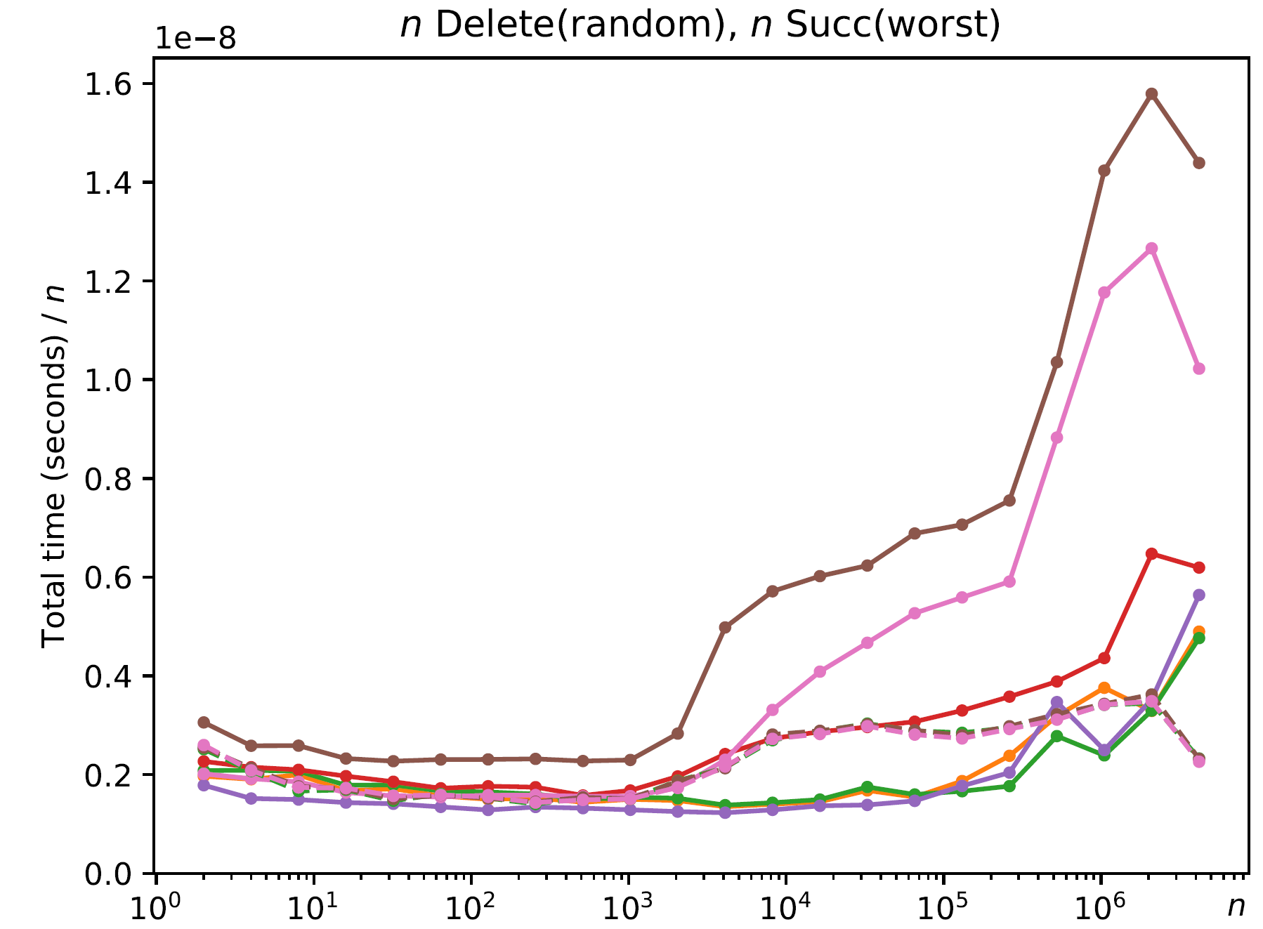
Random Sequence (n Delete & Succ)
Init(n)
Delete(random)
Succ(worst)
Delete(random)
Succ(worst)
Delete(random)
Succ(worst)
⋮
Delete(random)
Succ(worst)
Union-find & Quick find
Delete skips already deleted
Delete oblivious
Notes:
Initial phase creates many small trees
Later many deletions delete already deleted values
Overhead of checking already deleted (branch mispredictions?)

Slide 16
Conclusion
Simple internal union-find data structure
Theoretical better structures exist
Performance in same ballpark
Performs very well with microset-macroset idea
 | 1 | 2 | 3 | 4 | 5 | 6 | 7 | 8 | 9 | 10 | 11 | 12 | 13 | 14 | 15 | 16 | 17 | 18 | 19 | 20
A | 1 | 2 | 3 | 5 | 11 | 15 | 8 | 11 | 11 | 11 | 15 | 13 | 15 | 15 | 15 | 16 | 17 | 18 | 19 | 20
Notes:
Arcs can intersect
Delete(12) deletes an already deleted value

