Slide 1
Something On Teaching
Gerth Stølting Brodal
Curriculum Vitæ 1989–1997 PhD Computer Science, Aarhus University
1997–1998 PostDoc at the Max-Planck-Institut for Computer Science, Saarbrücken, Germany
1998– Research Assistant Professor / Research Associate Professor /
Associate Professor (non-tenured / tenured 2004 / MSK) / Professor, Aarhus University
2014–2019 Chair of the education committee Department of Computer Science
Aarhus University, Department of Computer Science, Post Doc retreat, Aarhus, August 25, 2022
Notes:
Time: 13:00-14:00, Duration: 45 minutes followed by a Q&A (approx. 15 minutes)
Topic: Lecture relevant for postdocs.

Slide 2
Oregon State University Learning Innovation Center
Notes:
A colleague asks you to take over a class, since he/she would like to attend. This is the lecture hall, what do you do? …
Definitely, this is the way a lecture hall should be
Yes, sounds interesting and worth a try
If I had to
Preferably not
No way, does not make sense at all
600-seat arena class room, 8 rows
http://is.oregonstate.edu/sites/is.oregonstate.edu/files/article_designing_activeclassroom_wilkerson_0.pdf
Designed for ”active learning”

Slide 3
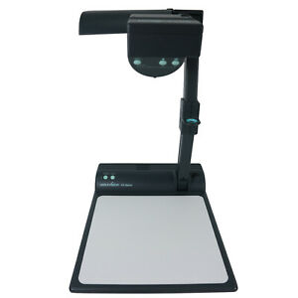
Teaching CV
programming project part of grade
Two projectors
study café
exam generator
PhD
online quiz
+
all_slides.pdf
 |  | 92 | 93 | 94 | 95 | 96 | 97 | 98 | 99 | 00 | 01 | 02 | 03 | 04 | 05 | 06 | 07 | 08 | 09 | 10 | 11 | 12 | 13 | 14 | 15 | 16 | 17 | 18 | 19 | 20 |  | 21 |  | 22
BSc | ADS
 | IPSA
 | CS:persp | 1 week
 | CS:talent
 | TA
PhD
Msc | IO
 | AADS
 | CG
 | AE
 | WWW
Outreach |  |  |  |  |  |  |  |  |  |  |  |  |  |  | “Gymnasiepraktik” / IT Camp
 |  | 92 | 93 | 94 | 95 | 96 | 97 | 98 | 99 | 00 | 01 | 02 | 03 | 04 | 05 | 06 | 07 | 08 | 09 | 10 | 11 | 12 | 13 | 14 | 15 | 16 | 17 | 18 | 19 | 20 |  | 21 |  | 22
BSc | ADS
 | IPSA
 | CS:persp | 1 week
 | CS:talent
 | TA
PhD
Msc | IO
 | AADS
 | CG
 | AE
 | WWW
Outreach |  |  |  |  |  |  |  |  |  |  |  |  |  |  | “Gymnasiepraktik” / IT Camp
?
}
 | VKF
Weekend course on being a TA
 | = slides available on course webpage (until then primarily blackboard / whiteboard)
course webpages (all still exist on my homepage)
Notes:
ADS 96 for engineering students
TA course:
Record yourself (using VHS), very hand waving (juggling)
Electricity disappeared for several hours – for warning: Over the years, whatever tool you try to use in your teaching, be prepared that the do not work...
Introduction of clickers, strongly inspired by colleagues bringing Eric Mazur and Tin Tin Su’s influence to the department
MentiMeter: Introducing Cliquer questions, did not force me to reduce the material to covered
Changing to MentiMeter: My impression is that the quality of the answers is lower (fewer students dare to submit wrong answers)
LifeSize – no chance to see what you write on the blackboard, but using visualizer makes perfect sense
Study café – way to differentiate teaching (I try to be there part of the time); by being there yourself you learn where students struggle; a source to figure out where to focus elaborating
March 11(!) TAs suggested to move to Discord, so we did March 12
Programming projects = IPSA, used colleagues from Chemistry, Math, and CS.

Slide 4
The Academic Ladder
BSc
student
MSc
student
PhD
student
Post Doc
Assistant Professor
Associate Professor
Full Professor
Department Chair
Dean
Rector
Research
Service
Teaching

Slide 5
How much time is optimal for you to spend on teaching and advising as a Post Doc ?
Notes:
No correct answer – it is up to your career plans if you need to consider teaching at all

Slide 6
Why should you teach and advise students as a Post Doc ?

Slide 7
Moving Up The Academic Ladder Laura Bonetta, Science, February 2011 www.sciencemag.org/careers/features/2011/02/moving-academic-ladder
“Although tenure decisions at primarily research institutions are based mostly on publications and grants, more and more universities want faculty members who are also good teachers.
”When I first started you just had to be an okay teacher, but today excellence in teaching is more important," says UC Riverside's Linda Walling.
Teaching ability is typically evaluated based on student evaluations as well as assessments from other faculty in the department.
Therefore it pays for junior faculty to take any "how to teach" courses that may be offered on campus and or sit in on the lectures of colleagues who are known for teaching well.
In addition, junior faculty should ask senior colleagues to sit in on their own lectures, not only to obtain feedback but also because "they will be able to write letters about your teaching abilities for your tenure dossier," says Brett Finlay, a professor at the University of British Columbia in Canada.
”
https://ced.au.dk/en/courses/introduction-to-teaching-and-learning
Notes:
From Science magasin - section on ” Becoming a Teacher”

Slide 8
Aarhus University, Faculty of Science
https://nat.au.dk/en/about-the-faculty/vacant-positions-and-career/guidelines-and-rules/
http://scitech.medarbejdere.au.dk/fileadmin/site_files/scitech.medarbejdere.au.dk/Karriere_dokumenter/Evaluation_Criteria.pdf
Notes:
Document from Science webpages about hiring process
https://scitech.medarbejdere.au.dk/fileadmin/site_files/scitech.medarbejdere.au.dk/files/Evaluation_Criteria.pdf
https://nat.au.dk/fileadmin/nat.au.dk/HR/Vejledninger_Nat_DK/Kriterier_for_varig_ansaettelse__Nat_.pdf

Slide 9
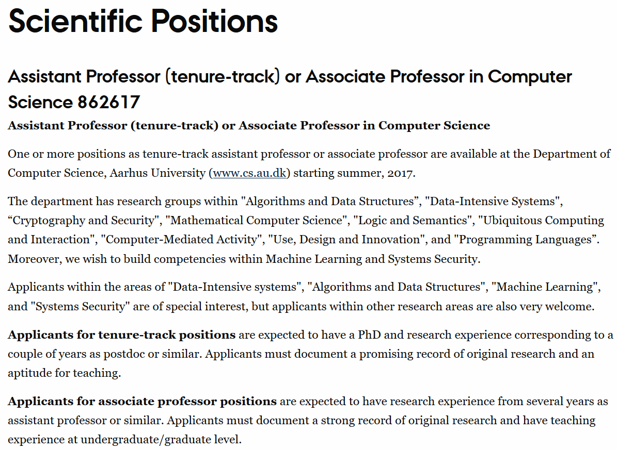
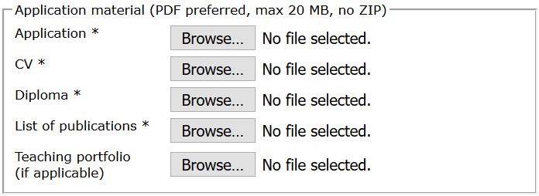
Notes:
Openings often ask for Teaching portfolios

Slide 10
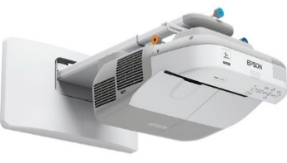
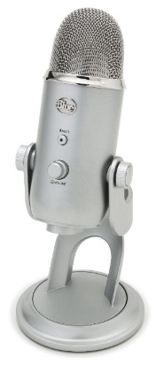
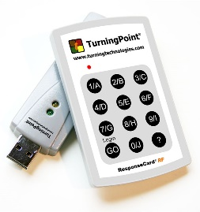
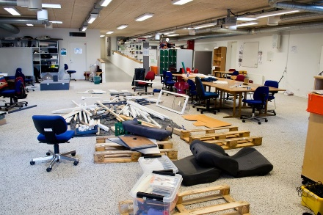
Teaching
Blackboards and chalk
Whiteboards, color pens, magnets, rope, tape…
Slides, PowerPoint, interactive projectors…
Videos – record lectures, podcasts, pencasts
Prepare videos of material, flipped classroom
Voting systems, clickers, active learning
Online material, quizzes, tests
Peer reviewing
Learning Managment Systems, e.g. Brightspace
TA sessions, study café, office hours, lab

Slide 11
Types of teaching
Project advisor
BSc Thesis project advisor
MSc Thesis project advisor
PhD course lecturer
MSc course lecturer
BSc course lecturer
Teaching assistant on BSc/MSc course
Outreach (highschool, primary school)
More projects simultaniously ?
Individual vs group projects ?
Milestones ?
What is the level of the students ?
Can the project result in research paper ?

Slide 12
Advising pitfalls
Deadlines are typically strict – at least bachelor project and master thesis @ CS.AU
Students not showing up / answering emails
Procrastination
Dealing with personal problems (depression, stress, ...)
Unrealistic ambition level (student and/or advisor?)
Too much focus on the technical problems, instead of delivering polished report
Only MSc project is full time work for the students !
One big goal instead of a sequence of milestones

Slide 13
Different kind of courses
 | BSc | MSc | PhD
Teaching time
Interaction with students | (goal 6 hours per week) | (goal 5 hours per week)
Interaction with TAs
Exam, administration
Polishing lecture material
Research benefit

Slide 14
Exams – types of evaluation
Oral exam
Multiple choice exam
Written (computer allowed?)
Projects + report + oral exam
48h Take home
…
Alignment between teaching activities and exam ?
External censors ?

Slide 15
Written Exams
My early years
More recently
Hardness
Hardness
hard
hard
medium
medium
easy
easy
ridiculous easy
Exercise number
ridiculous easy
Exercise number
Too many challenging exercises
Hard to differentiate around passing grade
Sufficiently many easy exercises to get evidence for passing
Challenge top students

Slide 16
Some final remarks
As a Post Doc make a plan for your teaching
Keep track of your teaching portfolio
Reflect on your teaching – e.g. course evaluations, courses on teaching, …
Try new techniques / approaches / organization / …
Discuss your teaching with colleagues and steel good tricks
Courses evolve over time
Teaching takes time !

Slide 17
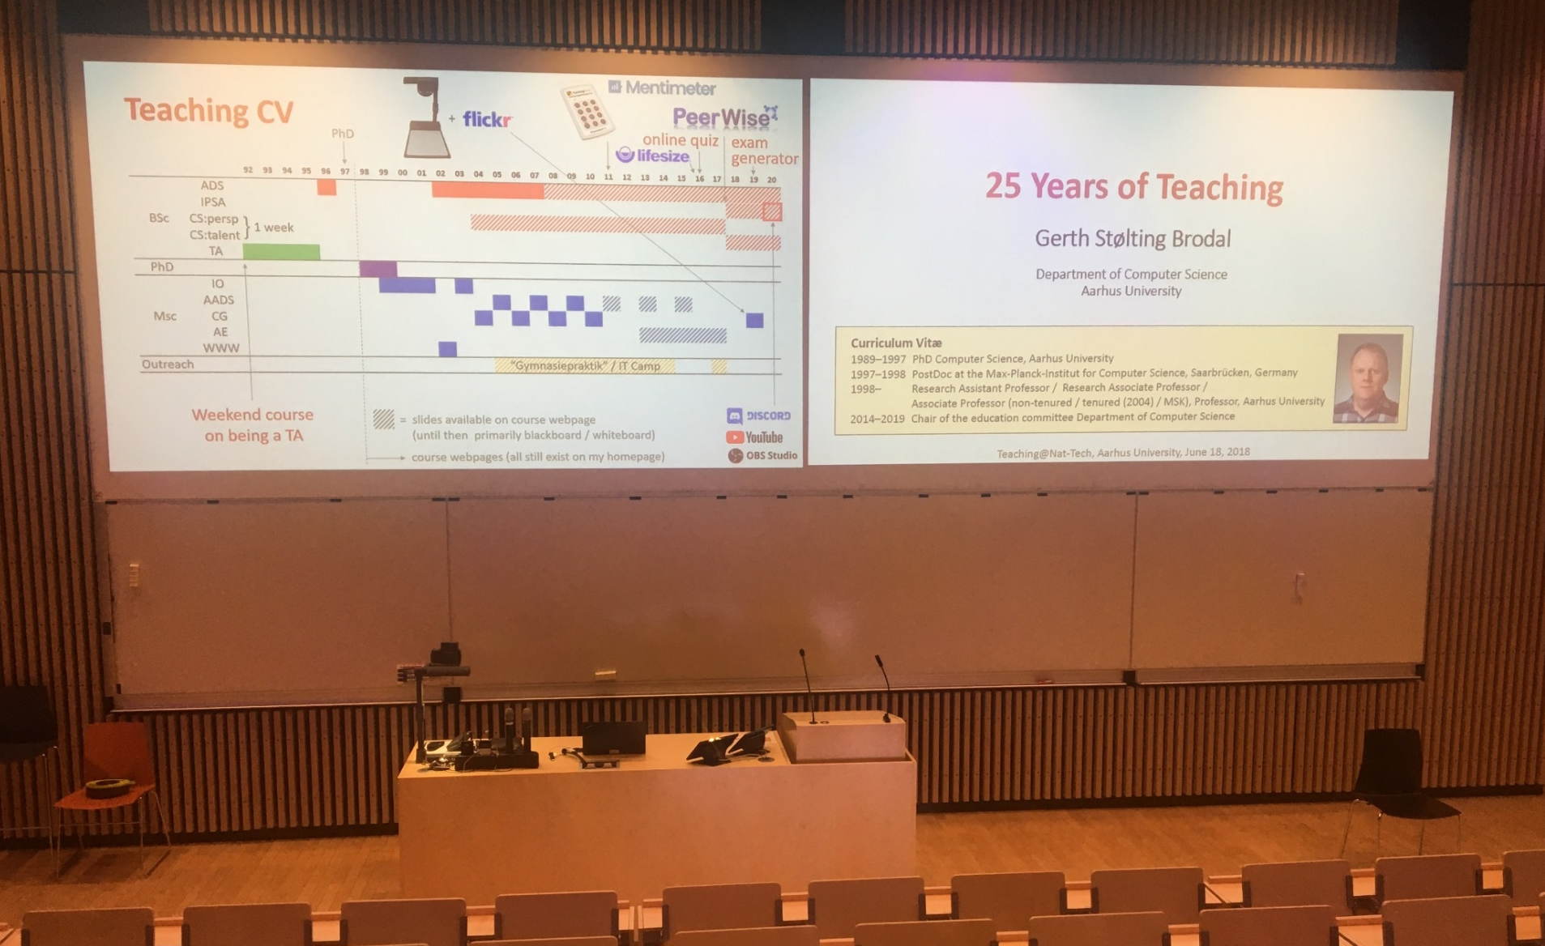
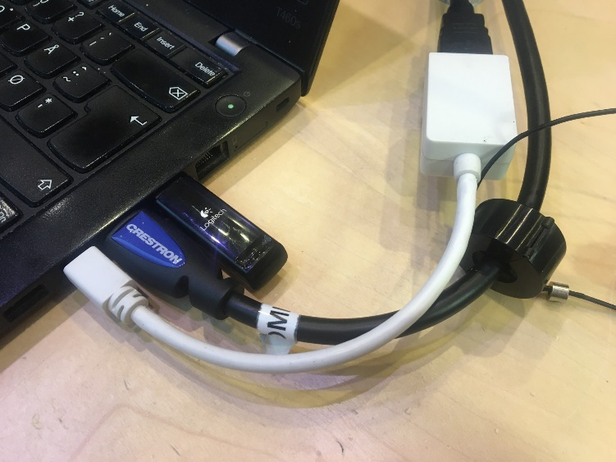
Using two projectors
PowerPoint
Adobe Acrobat (PDF)
PowerPoint presenter view
Gerth’s laptop
Visualizer
2 screens
Logitech USB
HDMI
HDMI – MiniDisplay adapter
Notes:
Auditorium
often 2 projectors in bigger auditoriums
used to use two computers, 1 = the permanent PC in the auditorium, then two computers and docking station; recently only one computer
boards, often good blackboards, but sometimes bad white boards with no
the two screens are not available in Aud E

Slide 18
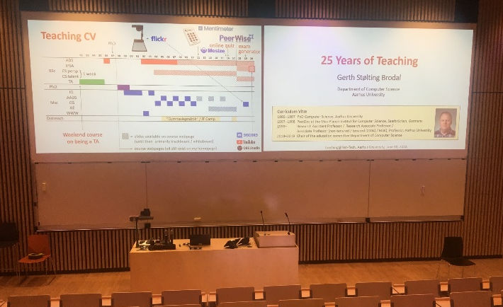
Controlling two projectors with Logitech R700 (when you like to run around in the auditorium)
laser pointer (small red point , hard to track)
next slide
(page down)
(.)
black screen
reprogrammed to alternate focus between PowerPoint and Adobe Acrobat
(page up)
previous slide
(ESC / F5)
start presentation
reprogrammed to send Ctrl-L in Adobe Acrobat and ESC / Shift-F5 in PowerPoint

Slide 19
works also with Logitech Spotlight
hold to alternate between PowerPoint and Adobe Acrobat (when configured to “.”)
...easier to follow and gets recorded on

Slide 20
Auto Hot Key script
;; Map '.' to switch toggle between AcroRead and PowerPoint presentation $.:: ; used $ to avoid recursion if WinActive("ahk_class AcrobatSDIWindow") && WinExist("ahk_class screenClass") WinActivate ahk_class screenClass else if WinActive("ahk_class screenClass") && WinExist("ahk_class AcrobatSDIWindow") WinActivate ahk_class AcrobatSDIWindow else Send . ;; Default send '.' if other window not present, ;; or other type of window return ;; In AcroRead allow Logitech presenter to toggle Fullscreen ;; by mapping escape and F5 to Ctrl-L (remote alternates between ;; submitting F5 and escape) $ESC:: if WinActive("ahk_class AcrobatSDIWindow") send ^l else send {ESC} return $F5:: if WinActive("ahk_class AcrobatSDIWindow") send ^l else if WinActive("ahk_class PPTFrameClass") ;; For PowerPoint send Shift-F5 instead of F5 ;; to continue pressentation at current slide ;; (instead of starting from slide 1) send +{F5} else send {F5} return

