Slide 1
Dynamic Planar Range Maxima Queries (presented at ICALP 2011) Gerth Stølting Brodal Aarhus University Kostas Tsakalidis
LIAFA, Université Paris Diderot, France, November 22, 2011

Slide 2
Orthogonal Range Queries
y_{t}
y_{b}
x_{l}
x_{r}

Slide 3
Priority Search Tree [McCreight’75]
Space: O(n)
Update:
Recursively move up maximum y
O(log n)
1-Sided reporting:
O(1+t)
y

Slide 4
3-Sided Reporting Queries
O(log n + t )
Priority search tree
y_{b}
x_{l}
x_{r}
O(log n) trees

Slide 5
Orthogonal Range MAXIMA Reporting alias “Generalized Planar SKYLINE Operator”
Dominance Maxima Queries
Report all maximal points among
points with x in [x_{l},+∞) and y in [y_{b},+∞)
Contour Maxima Queries
Report all maximal points among
points with x in (-∞, x_{r}]
3-Sided Maxima Queries
Report all maximal points among
points with x in [x_{l}, x_{r}] and y in [y_{b},+∞)
4-Sided Maxima Queries
Report all maximal points among
points with x in [x_{l}, x_{r}] and y in [y_{b},y_{t}]
Maximal Points
Maximal Point
y_{t}
y_{b}
y_{b}
y_{b}
y_{b}
x_{l}
x_{l}
x_{l}
x_{l}
x_{r}
x_{r}
Static maximal points in O(n∙log n) time [Kung, Luccio, Preparata, J.ACM’75]
Notes:
Maximal = interesting

Slide 6
Dynamic Range Maxima Reporting
 | Space |  |  | Insert | Delete
Overmars, van Leeuwen ‘81 | n | log n + t | log² n + t | log² n
Frederickson, Rodger ‘90 | n | log n + t | log² n + t (1+t)log n | log n | log² n
Janardan ‘91 | n | log n + t |  | log n | log² n
Kapoor ‘00 | n | log n + t amo. | - | log n
B., Tsakalidis [ICALP ’11] | n | log n / loglog n + t |  | log n / loglog n
 | n∙log n | log² n / loglog n + t |  | log² n / loglog n
RAM
Notes:
%

Slide 7
Overmars, van Leeuwen [JCSS ’81]
O(log n + t )
Updates: O(log² n)

Slide 8
Our Structure - Tournament Tree
u
Right(u) =
Copy Up
Maximum y

Slide 9
Tournament Tree
u
Find next point
to be reported
in O(1) time
MAX( )
Right(u)
y

Slide 10
Computation of MAX(Right(u))
MAX(Right(u))
U
[Sundar ‘89]
Priority Queue
with Attrition
MAX(Right(u_{L}))
U_{L}
U_{R}
MAX(Right(u_{R}))
O(1) time

Slide 11
Update Operation
Space:O(n)
Update:O(log n)
Priority Queue
with Attrition
with Rollback
Reconstruct
Rollback

Slide 12
Priority Queues with Attrition [Sundar, IPL ‘89]
Deletemin()
InsertAndAttrite(element)
O(1) worst case time

Slide 13
Priority Queues with Attrition [Sundar, IPL ‘89]
Invariants
C, B, D_{f} sorted
max C ≤ min (B ᴜ D_{f} ᴜ D_{r})
|C|≥ |D_{f}|+2|D_{r}|
17 ≥ 4+2∙5
C
B
D_{f}
D_{r}
insertion order

Slide 14
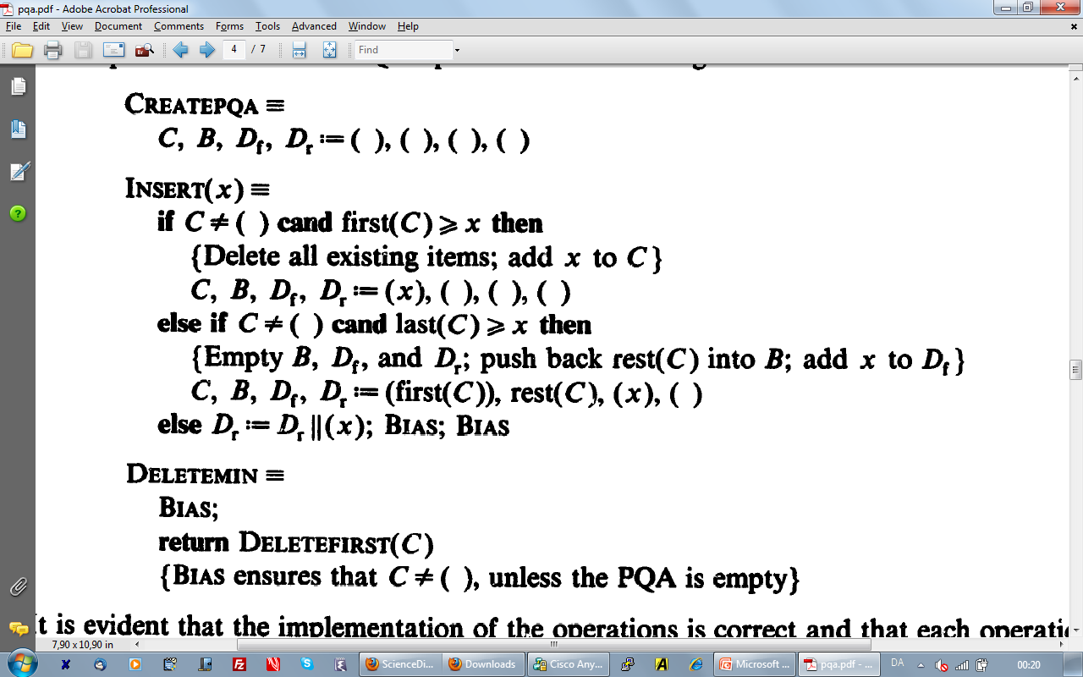
Invariants
C, B, D_{f} sorted
max C ≤ min (B ᴜ D_{f} ᴜ D_{r})
|C|≥ |D_{f}|+2|D_{r}|
1
≥ “+1”
Bias
2
3
3
2
1
C
B
D_{f}
D_{r}

Slide 15
Invariants
C, B, D_{f} sorted
max C ≤ min (B ᴜ D_{f} ᴜ D_{r})
|C|≥ |D_{f}|+2|D_{r}|
≥ “+1”
A
Bias
B
C
D
A
B
C
D
D_{f} -1
D_{f} +1 D_{r} -1
C=C+D_{f} B=D_{f}=0
C +1 B -1
D_{r}
C
B
D_{r}
C
B
D_{f}
D_{r}
C
B
D_{f}
D_{r}
C
B
D_{f}
D_{f}

Slide 16
Dominance Range Maxima Queries
O(log n) trees
Query time O(log n + t )

Slide 17
Contour Range Maxima Queries
O(log n) trees
Query time O(log n + t )

Slide 18
3-Sided Range Maxima Queries
O(log n) trees
Query time O(log n + t )

Slide 19
4-Sided Range MAXIMA Reporting and Rectangular Visibility Queries
Proximity Queries/Similarity Search
(-∞,+∞)
(+∞,+∞)
4^{x}
4-Sided Range
Maxima Queries
(-∞,-∞)
(+∞,-∞)
 | Space |  | Insert | Delete
Overmars, Wood ‘88 | n∙log n | log² n + t log² n + t∙log n | log² n | log³ n log² n
[ICALP ’11] | n∙log n | log² n + t | log² n | log² n

Slide 20
4-sided Range Maxima Queries
Query time O(log² n + t), space O(n∙log n)

Slide 21
RAM – O(log n/loglog n + t)
U
…
Height O(log n / loglog n)
MAX(Right(u)) maintained using Q-heaps [Fredman, Willard, JCSS ´94]
O(log^{ε} n)
Notes:
Every node has maxx maxy of each child
Define Winning path: 1st
Define argument for UpdateL 2nd
[Fredman, Willard, J.CSS ‘94]
Q-Heap
At most log^{ε}n elements
Predecessor, Insert, Delete: O(1) worst case time
Values in Q-heap
Precompute permutations all contour, dominance, 3sided : That is all consecutive intervals.

Slide 22
Thank You Gerth Stølting Brodal Aarhus University
 | Space | Query | Insert/Delete
 | O(n) | O(log n/loglog n + t) | O(log n/loglog n)
 | O(n∙log n) | O(log² n + t) | O(log² n/loglog n)
RAM

Slide 23
Laboratoire d'Informatique Algorithmique: Fondements et Applications
Université Paris Diderot
Title: Dynamic Planar Range Maxima Queries. Abstract: We consider the dynamic two-dimensional maxima query problem. Let P be a set of n points in the plane. A point is maximal if it is not dominated by any other point in P. We describe two data structures that support the reporting of the t maximal points that dominate a given query point, and allow for insertions and deletions of points in P. In the pointer machine model we present a linear space data structure with O(log n + t) worst case query time and O(log n) worst case update time. This is the first dynamic data structure for the planar maxima dominance query problem that achieves these bounds in the worst case. The data structure also supports the more general query of reporting the maximal points among the points that lie in a given 3-sided orthogonal range unbounded from above in the same complexity. We can support 4-sided queries in O(log^{^2} n + t) worst case time, and O(log^{^2} n) worst case update time, using O(n*log n) space, where t is the size of the output. This improves the worst case deletion time of the dynamic rectangular visibility query problem from O(log^{^3} n) to O(log^{^2} n). We adapt the data structure to the RAM model with word size w, where the coordinates of the points are integers in the range U = {0,...,2^w-1}. We present a linear space data structure that supports 3-sided range maxima queries in O((log n)/(loglog n) + t) worst case time and updates in O((log n)/(loglog n)) worst case time. These are the first sublogarithmic worst case bounds for all operations in the RAM model. Joint work with Konstas Tsakalidis

