Slide 1
Sorting Integers in the RAM Model
Gerth Stølting Brodal
Joint work with Djamal Belazzougui and Jesper Sindal Nielsen
(to be presented at the 14th Scandinavian Workshop on Algorithm Theory)
MADALGO Review Meeting, April 28, 2014

Slide 2
Sorting (Integers)
n integers
1 | 2 | 3 | 4 | 5 | 6 | 7 | 8 | 9 | 10
Input
58 | 13 | 138 | 55 | 141 | 137 | 11 | 53 | 10 | 54
00111010 | 00001101 | 10001010 | 00110111 | 10001101 | 10001001 | 00001010 | 00110101 | 00001010 | 00110110
w bits
Output
10 | 11 | 13 | 53 | 54 | 55 | 58 | 137 | 138 | 141
00001010 | 00001010 | 00001101 | 00110101 | 00110110 | 00110111 | 00111010 | 10001001 | 10001010 | 10001101
0
1
0
1
0
0
-
-
0
1
0
0
1
-
Trie
0
1
0
Patricia trie
(branching charcters only)
-
-
-
1
0
1
1
-
0
1
-
0
1
1
0
0
1
0
1
-
-
0
1
1
0
0
1
1
0
1
0
-
-
0
1
-
0
1
-
permutation
0
1
1
1
0
1
0
1
0
1
0
1
-
-
0
-
-
-
-
-
9
7
2
8
10
4
1
6
3
5
9
7
2
8
10
4
1
6
3
5
Notes:
SWAT 2014 paper: Describes how to construct the Patricia trie efficiently + use leaf information to permute in O(n) time

Slide 3
Comparison Based Sorting
Merge sort: von Neumann 1945
Ford et al. 1959: Lower bound ≥ $\text{n}{\text{log}}_{\text{2}}{\text{n}}\text{−}\frac{\text{n}}{\text{ln}{\text{2}}}$ comparions
58
13 | 58
next
13
scanning
13 | 55 | 58 | 138
13 | 55 | 58 | 138
138
55 | 138
scanning
next
55
11 | 13 | 53 | 55 | 58 | 137 | 138 | 141
11 | 13 | 53 | 55 | 58 | 137 | 138 | 141
141
137 | 141
next
137
scanning
11 | 53 | 137 | 141
11 | 53 | 137 | 141
11
11 | 53
53
10 | 11 | 13 | 53 | 54 | 55 | 58 | 137 | 138 | 141
10
10 | 54
$\text{≤ }\text{n}\left.\left\lceil {\text{log}}_{\text{2}}{\text{n}}\right.\right\rceil$ comparions
54

Slide 4
Sorting Networks
Input
Output
138
138
13
13
13
13
13
138
58
55
55
58
58
55
55
58
58
55
55
58
138
138
Original motivated by hardware implementations
Renewed interest since data-oblivious
applications in privacy preserving computations
allows for parallel computations on bit-level and GPU
O(n·log² n) size : Batcher 1968
O(n·log n) size : Ajtai, Komlós, Szemerédi 1983; Paterson 1990; Goodrich 2014

Slide 5
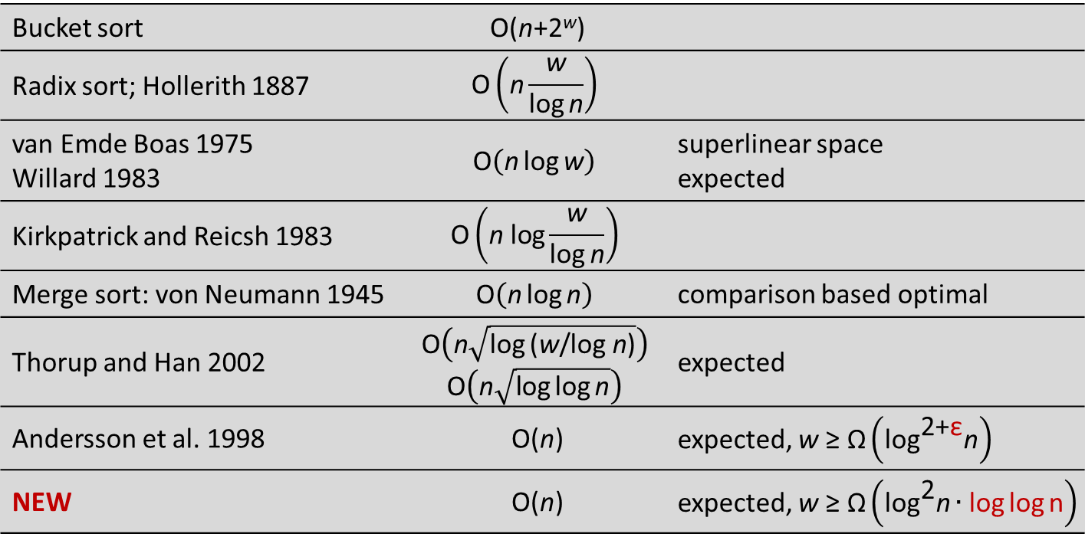
Results
Time per element
$$\text{O}\left(\sqrt{\text{log}{\text{log}{\text{n}}}}\right)$$
2
O(1)
1
NEW
3
w
log n
log² n·loglog n
log^{2+ε} n
1
Bucket sort | O(n+2^{w})
Radix sort; Hollerith 1887 | $$\text{O}\left(\text{n}\frac{\text{w}}{\text{log}{\text{n}}}\right)$$
van Emde Boas 1975 Willard 1983 | $$\text{O}\left(\text{n}\text{log}{\text{w}}\right)$$ | superlinear space expected
Kirkpatrick and Reicsh 1983 | $$\text{O}\left(\text{n} \text{log}\frac{\text{w}}{\text{log}{\text{n}}}\right)$$
Merge sort: von Neumann 1945 | $$\text{O}\left(\text{n}\text{log}{\text{n}}\right)$$ | comparison based optimal
Thorup and Han 2002 | $$\text{O}\left(\text{n}\sqrt{\text{log}{\text{(}\text{w}\text{/}\text{log} \text{n}\text{)}}}\right)$$ $$\text{O}\left(\text{n}\sqrt{\text{log}{\text{log}{\text{n}}}}\right)$$ | expected
Andersson et al. 1998 | O(n) | expected, $\text{w} \text{≥} \text{Ω}\left({\text{log}}^{\text{2+}\text{ε}}\text{n}\right)$
NEW | O(n) | expected, $\text{w} \text{≥} \text{Ω}\left({\text{log}}^{\text{2}}\text{n}∙\text{log}{\text{log}{\text{n}}}\right)$
2
3

Slide 6
Open Question
Time per element
$$\text{O}\left(\sqrt{\text{log}{\text{log}{\text{n}}}}\right)$$
NEW
O(1)
w
log n
log² n·loglog n
log^{2+ε} n
Sorting in linear time for all w?

