Slide 1
The challenges of implementing Dijkstra’s algorithm
Gerth Stølting Brodal
Aarhus University
(Work presented at the 11th International Conference on Fun with Algorithms, FUN 2022)
Department of Computer Science, University of Liverpool, UK, January 9, 2023
Notes:
Monday, January 9, 2023, 13:00-14:00
This talk is on priority queue data structures.
Typically store items that are (key, value) pairs.
Can insert items and extract items with the minimum key.,
This talk is on what happens if the key of an item can decrease over time..
Announcement
https://www.csc.liv.ac.uk/research/seminars/abstract.php?id=1026
TITLE
Challenges of implementing Dijkstra's algorithm
ABSTRACT
Any introductory textbook on algorithms considers Dijkstra's algorithm (Dijkstra 1956) for finding the shortest distance from a source node in a graph to all other nodes in the graph. The standard implementation is to use a priority queue, typically the binary heap (Williams 1964) introduced in the same textbook. Surprisingly, many students are challenged by implementing Dijkstra's algorithm, when using the algorithm to find shortest paths in graphs on the scale of Open Street Map graphs. Instead of getting nearly linear running time, some students get quadratic running time when using the Java built-in priority queue, and wonder why the code gets slow when running on graphs with millions of nodes. Many students get slightly wrong distances on a few distance queries, and blame it on numerical issues. The real issue is a subtle misusage of the Java priority queue interface. A common implementation of Dijkstra's algorithm fails to work correctly with the provided built-in binary heap because it misuses Java's priority queue comparator interface. Surprisingly, the same algorithm works correctly with essentially any other priority queue implementing satisfying this priority queue interface. This observation lead us to the introduction of the notion of priority queues supporting decreasing keys (not to be confused with a priority queue supporting a decrease-key operation), allowing for a slightly reduced space usage in Dijkstra's algorithm.
This talk is based on work presented at the 11th International Conference on Fun with Algorithms (FUN 2022).
BIOGRAPHY
Gerth Stølting Brodal is a Professor at Aarhus University, Denmark. He received his PhD in computer science from Aarhus University in 1997 for a thesis on “Worst Case Efficient Data Structures”. From 1997 to 1998 he was a PostDoc in the group of Kurt Mehlhorn at the Max-Planck-Institute for Computer Science in Saarbrücken, Germany. Since 1998 he has been at Aarhus University, where he 1998–2005 was affiliated with the Center for Basic Research in Computer Science (BRICS) and 2007–2017 with the Center for Massive Data Algorithmics (MADALGO), both founded by the Danish National Research Foundation.
His main research interests are the design and analysis of algorithms and data structures. He has done work on fundamental data structures, including dictionaries and priority queues, persistent data structures, computational geometry, graph algorithms, string algorithms, I/O-efficient and cache-oblivious algorithms and data structures, algorithm engineering, and computational biology.
ADDITIONAL MATERIALS
https://doi.org/10.4230/LIPIcs.FUN.2022.8

Slide 2
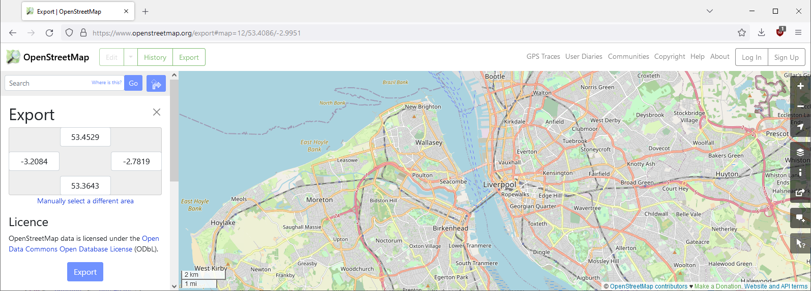
Background
Bachelorproject = shortest paths on Open Street Map graphs
Students have trouble implementing Dijkstra's algorithm in JavaTM
Notes:
1st semester computer science students are introduced to Dijkstra’s algorithm
6th semester students try to work with a real-world graph and more advanced shortest path algorithms

Slide 3
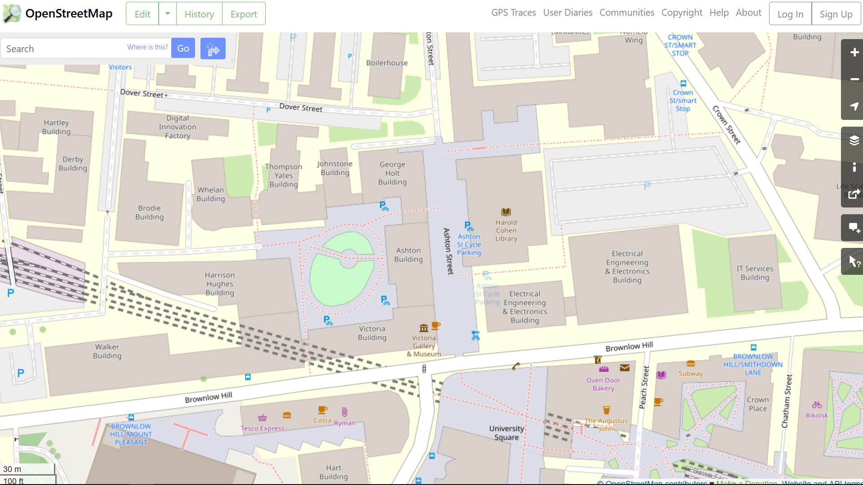
Notes:
openstreetmap.org

Slide 4
<node id="4606377719" visible="true" version="1" changeset="45143381" timestamp="2017-01-13T19:11:48Z" user="Dyserth" uid="1892838" lat="53.4064488" lon="-2.9660774"/>
<way id="4961017" visible="true" version="11" changeset="66454995" timestamp="2019-01-19T14:25:32Z" user="Redhochs" uid="1744940">
<nd ref="348087292"/>
<nd ref="4606377719"/>
<nd ref="268780437"/>
<nd ref="2700274352"/>
<nd ref="268779145"/>
<tag k="highway" v="pedestrian"/>
<tag k="lit" v="yes"/>
<tag k="name" v="Ashton Street"/>
<tag k="surface" v="paving_stones"/>
</way>
<way id="826473129" visible="true" version="3" changeset="129789472" timestamp="2022-12-06T16:23:14Z" user="pmyteh" uid="81653">
<nd ref="107366213"/>
<nd ref="3468209232"/>
<nd ref="3476406048"/>
<nd ref="4112993338"/>
<nd ref="2188828954"/>
<nd ref="534390991"/>
<nd ref="7839585527"/>
<nd ref="348087295"/>
<tag k="bicycle" v="yes"/>
<tag k="foot" v="yes"/>
<tag k="highway" v="tertiary"/>
<tag k="horse" v="yes"/>
<tag k="lanes" v="3"/>
<tag k="lit" v="yes"/>
<tag k="maxspeed" v="30 mph"/>
<tag k="name" v="Brownlow Hill"/>
<tag k="oneway" v="no"/>
<tag k="postal_code" v="L3"/>
<tag k="sidewalk" v="both"/>
<tag k="surface" v="asphalt"/>
</way>
Notes:
This is the real code from OpenSteetMap.org
Apparently “Ashton Steet” is a “Pedestrian highway” and “Brownlow Hill” allows people riding horses (key k=“horse”)
Goal: Software project where students need to deal with real world data on scale motivating IO algorithms to parse the data, mapping nodes to integers becomes nontrivial, …

Slide 5
Dijkstra’s algorithm (1956)
2
+∞
B
4
4
6
6
0
2
+∞
+∞
source
A
1
D
2
E
4
Non-negative edge weights
Visits nodes in increasing distance from source
1
C
Q = ⟨0,A⟩
+∞
⟨2,B⟩ ⟨4,C⟩
4
relax
3
⟨3,C⟩ ⟨6,D⟩
⟨4,D⟩
⟨6,E⟩
Fibonacci heaps (Fredman, Tarjan 1984)
⇒ O(m + n ∙ log n)
O(log n) Remove
⇒ O(m ∙ log n)
relax
Notes:
Weights can be physical distance projections or spherical coordinates, travel time using speedlimits, height increase…
Will present 4 variations of Dijkstra’s algorithm typically implemented by the students
CLRS asumes all nodes are inserted with +infty initially
Fibonacci heaps not part of standard library; anyway road maps are sparse, so the theoretical gain from Fibonacci heaps is not relevant
[CLRS4] does not contain Fibonacci heap any longer
Dijkstra2: ”v in Q” could mentain a bitvector/set to test for this.

Slide 6
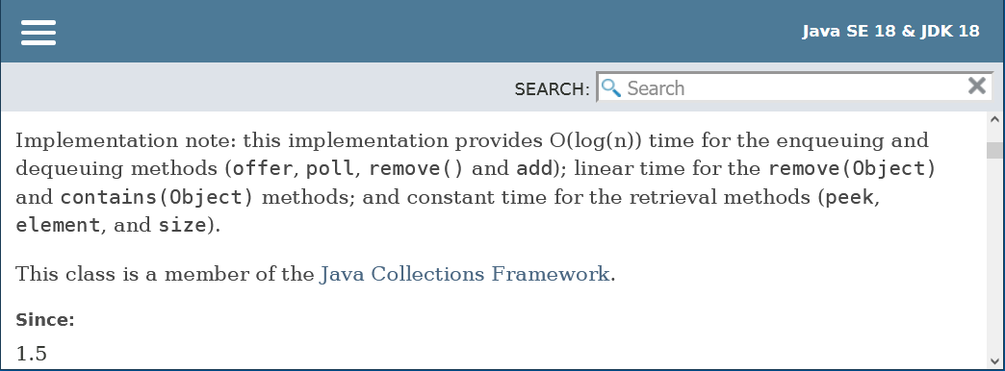
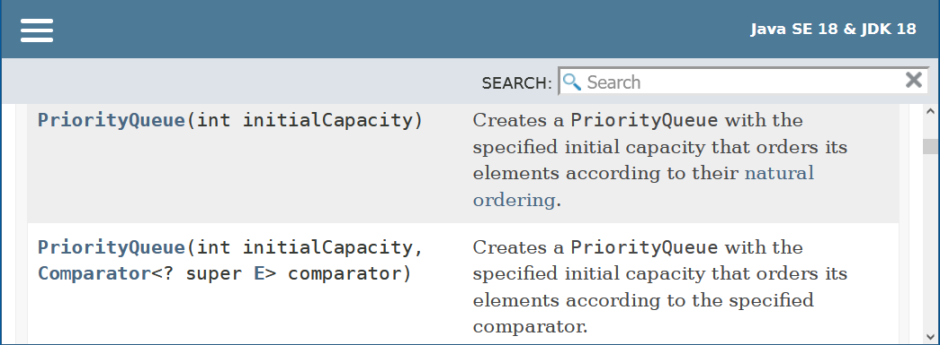
The Challenge - Java's builtin binary heap
no decreasekey
remove O(n) time
⇒ Dijkstra O(m ∙ n)
comparator function
Notes:
Remove: Fortunately relaxing edges that connect to an already discovered vertex relatively rarely find shorter distances, so the running time in practice is not completely n^2.
Key value pairs not part of Java’s standard library – but it can be found in the javafx.util library
In Python you can just write the pair (key, value) as part of the language

Slide 7
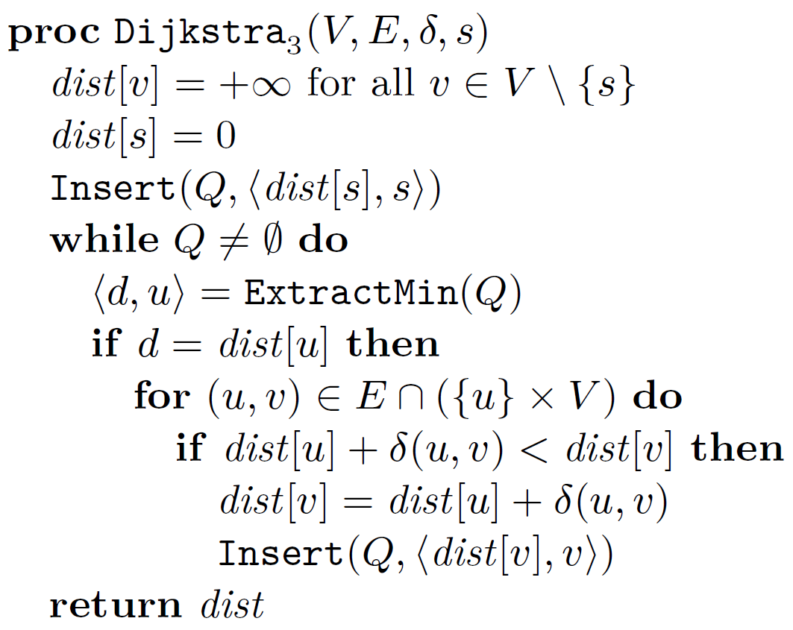
Repeated insertions
2
+∞
B
4
4
6
6
0
2
+∞
+∞
source
A
1
D
2
E
Relax inserts new copies of item
Skip outdated items
4
1
C
+∞
4
Q = ⟨0,A⟩
3
⟨2,B⟩ ⟨4,C⟩
⟨3,C⟩ ⟨4,C⟩ ⟨6,D⟩
⟨4,C⟩ ⟨4,D⟩ ⟨6,D⟩
⟨4,D⟩ ⟨6,D⟩
outdated ?
⟨6,D⟩ ⟨6,E⟩
⟨6,E⟩
relax
= reinsert
Notes:
Lazy deletion
Only having the priority operations ExtraxtMin and Insert makes it easier to implement the priority queue, and make it cache and IO efficiently

Slide 8
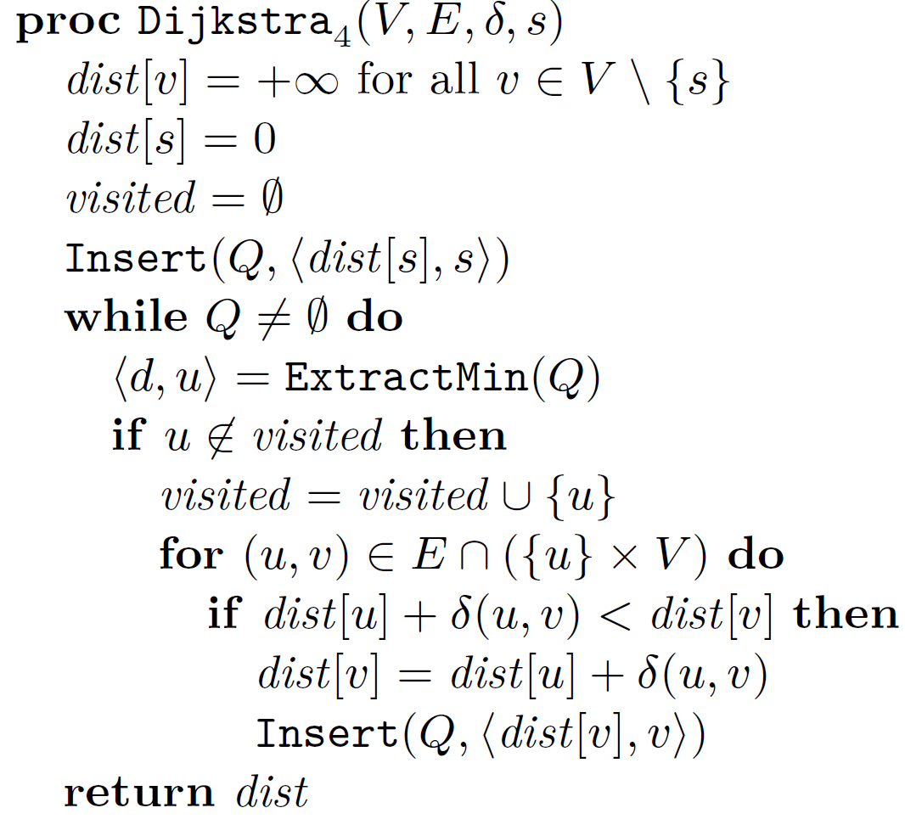
Using a visited set
2
+∞
B
4
4
6
6
0
2
+∞
+∞
source
A
1
D
2
E
4
1
C
+∞
4
Q = ⟨0,A⟩
3
⟨2,B⟩ ⟨4,C⟩
⟨3,C⟩ ⟨4,C⟩ ⟨6,D⟩
⟨4,C⟩ ⟨4,D⟩ ⟨6,D⟩
use bitvector
⟨4,D⟩ ⟨6,D⟩
⟨6,D⟩ ⟨6,E⟩
⟨6,E⟩
Notes:
Alternative way to identify outdated extracted pairs
bitvector og hashtable

Slide 9
A shaky idea…
Q only store nodes (save space)
Comparator
Key = current distance dist
Heap invariants break
d never used
Notes:
a-e are nodes in the graph, and associated distances
Student implementations.
Some worked, because they did not use visited and just revisited nodes (no runtime guarantee)
Others essentially worked, except a few test cases having ”nummerical” issues (a heap most times does the correct thing)

Slide 10
Experimental study
visited = set()
Q = Queue()
Q.insert(Item(0, source))
while not Q.empty():
u = Q.extract_min().value
if u not in visited:
visited.add(u)
for v in G.out[u]:
dist_v = dist[u] + G.weights[(u, v)]
if dist_v < dist[v]:
dist[v] = dist_v
parent[v] = u
Q.insert(Item(dist[v], v))
Implemented Dijkstra₄ in Python
Stress test on random cliques
Binary heaps
Skew heaps
Leftist heaps
Pairing heaps
Binomial queues
Post-order heaps
Binary heaps with top-down insertions
failed
worked
worked
worked
worked
worked
worked
(default priority queue in Java and Python)
Pointer based
Implicit (space efficient)
Notes:
Class Item implements the comparator to use either the static key or the current dist value
Harvey and Zatloukal, FUN 2004

Slide 11
Binary heap insertions – bottom-up vs top-down
2
2
Insert(7)
3
top-down
5
3
5
9
4
8
bottom- up
12
9
4
7
12
10
14
6
20
17
7
10
14
6
20
17
8
Notes:
Standard heap both in Java and Python use bottom-up insertions
top-down insertions would normally never be choice of algorithm, since you need to touch all nodes on the root to leaf path, whereas bottom-up very likely only need to consider a few nodes at the bottom of the path and is much easier to implement.

Slide 12
Binary heaps using dist in a comparator fails
not smallest key
outdated
wrong placement
ignored since visited
Notes:
Autogenerated example from stress test….

Slide 13
Definition Priority Queues supporting Decreasing Keys
Items = ⟨key, value⟩
Over time keys can decrease – priority queue is not informed
Items are compared w.r.t. their current keys
The original key of an item is the key when it was inserted
Insert(item)
ExtractMin() returns an item with current key less than or equal to all original keys in the priority queue
Notes:
In Dijkstra’s algorithm all outdated items are items with current key < original key
Note ExtractMin does not necessarily have to return item with minimum current key

Slide 14
Theorem 1
Dijkstra₄ correctly computes shortest paths when using dist as current key and a priority queue supporting decreasing keys
Theorem 2
The following priority queues support decreasing keys (out of the box)
binary heaps with top-down insertions ((Williams 1964))
leftist heaps (Crane 1972)
binomial queues (Vuillemin, 1978)
skew heaps (Sleator, Tarjan 1986)
pairing heaps (Fredman, Sedgewick, Sleator, Tarjan 1986)
post-order heaps (Harvey, Zatloukal 2004)
Notes:
Theorem 1 – states that the shaky idea is not always that shaky after all

Slide 15
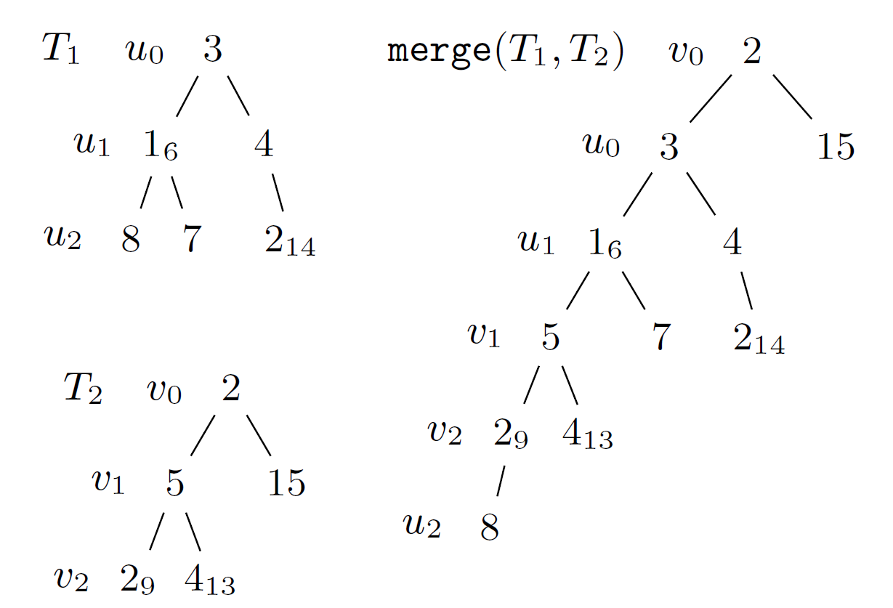
Proof of Theorem 2 - Basic idea
Decreased heap order
u ancestor of v ⇒ current key u ≤ original key v
Root valid item to extract
Top-down merging two paths preserves decreased heap order
⇒ skew heaps and leftist heaps support decreasing keys
Notes:
subscripts = original keys
the only addition modifications to the trees done by skew/leftist heaps is that subtrees are swapped

Slide 16
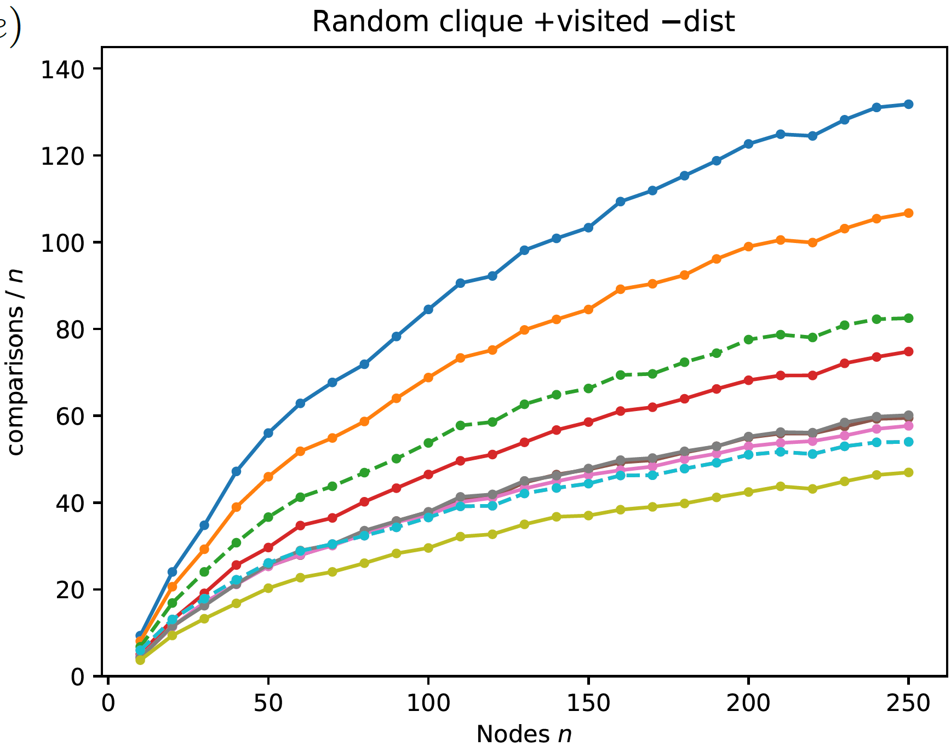
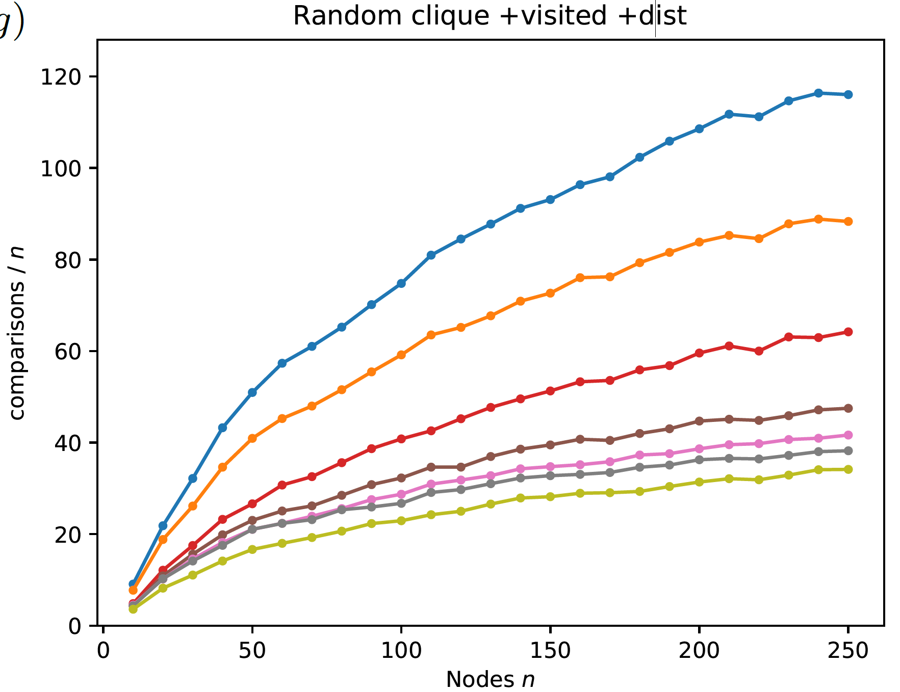
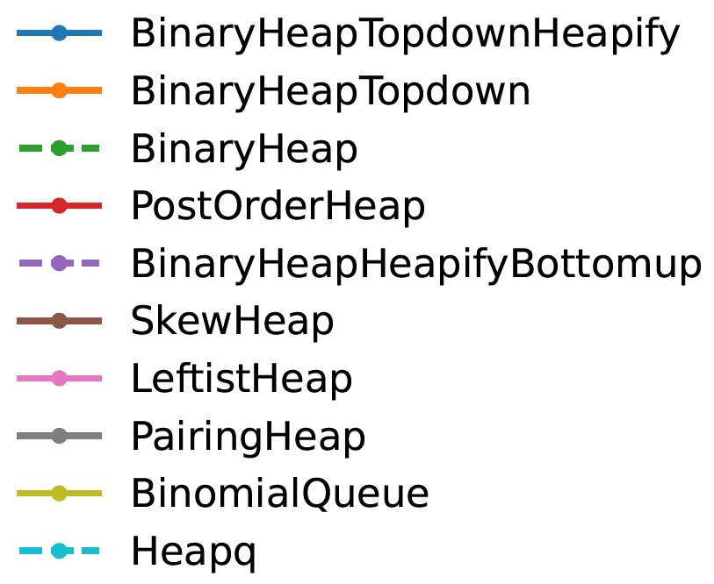
Experimental evaluation of various heaps
Cliques with uniform random weights
With decreasing keys less comparisons (outdated items removed earlier)
⟨key, value⟩ pairs
decreasing keys
smaller
Notes:
Clique uniform random weights => expected O(n*log n) decrease keys, i.e. insertions into priority queues
Only comparisons internal in heap are measured
heapq = BinaryHeapHeapifyBottomup (Heapify = recursive pull up smallest until leaf, and then insert there)
Binary heap = heapify top-down until right position
Binary Heap topdown is bad – although implicit. PostOrderHeap falls in the same category of being implicit.

Slide 17
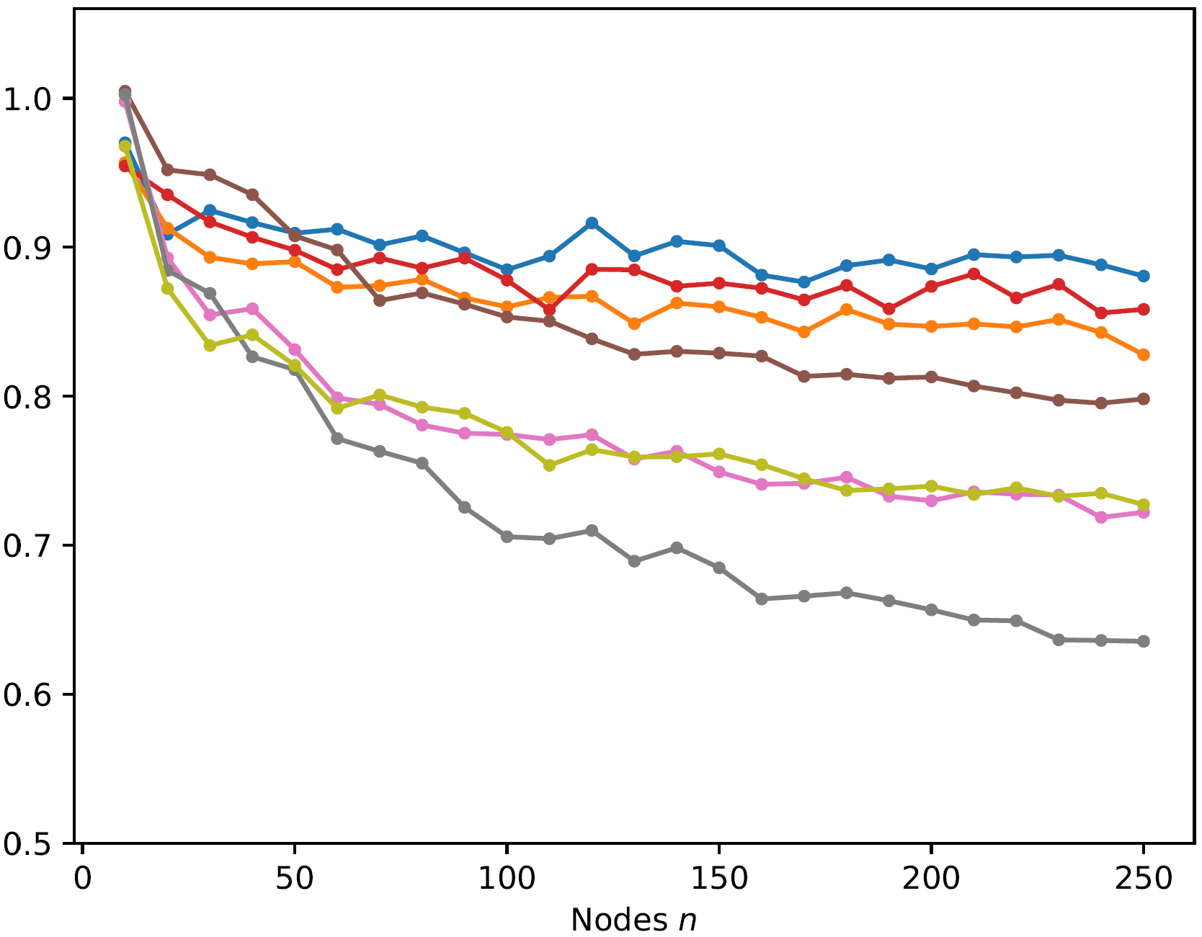
Reduction in comparisons
comparisons decreasing keys / comparisons ⟨key, value⟩ pairs
Notes:
gains largest for pointer-based structures
for worst-case weights on cliques the gains are smaller (alle edges cause a new insertion)

Slide 18
Postorder heap [Harvey and Zatloukal, FUN 2004]
Insert amortized O(1), ExtractMin amortized O(log n)
Implicit (space efficient)
Best implicit comparison performance (and good time performance)

Slide 19
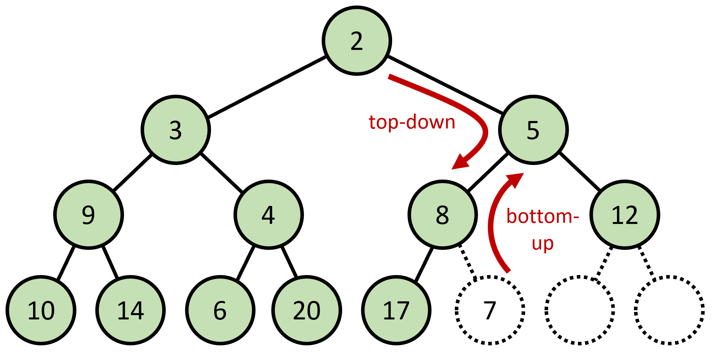
Conclusion
Introduced notion of priority queues with decreasing keys … as an approach to deal with outdated items in Dijkstra’s algorithm
Experiments identified priority queues supporting decreasing keys … just had to prove it
Builtin priority queues in Java and Python are binary heaps … do not support decreasing keys
Binary heaps with top-down insertions do support decreasing keys
… and also
skew heaps, leftist heaps, pairing heaps, binomial queues, post-order heaps
Notes:
What I really liked was that the algorithm came before the proof.

