Slide 1
Speaker: Gerth Stølting Brodal, Aarhus University, Department of Computer Science
Title: External-Memory Priority Queues and Persistent Search Trees
Abstract: We present recent results on priority queues and search trees in the external memory model by Aggarwal and vitter [CACM 1988]. In this model we have an (infinite) external memory and a limited internal memory, where all computations need to be performed in internal memory. The IO cost of a computation is the number of block transfers of data between internal and external memory. In the first part of the talk we discuss the first external memory priority queue that achieves simultaneously optimal amortized internal computation cost and IO cost, where insertions are constant and deletions logarithmic. In the second part we discuss how to make a B-tree partially persistent, i.e., all previous versions of the tree are remembered, while simultaneously speeding up the amortized IO cost of insertions and deletions by a factor B^{1-ɛ}, for any constant ɛ > 0.
The talk is based on joint work with Michael Goodrich, John Iacono, Jared Lo, Ulrich Meyer, Victor Pagan, Casper Moldrup Rysgaard, Nodari Sitchinava, and Rolf Svenning presented at ESA 2025: http://dx.doi.org/10.4230/LIPIcs.ESA.2025.5 and http://dx.doi.org/10.4230/LIPIcs.ESA.2025.
Bio: Gerth Stølting Brodal is a Professor at the Department of Computer Science, Aarhus University, Denmark. He received his PhD in computer science in 1997 from Aarhus University. His main research interests are the design and analysis of algorithms and data structures. He has done work on fundamental data structures, including dictionaries and priority queues, persistent data structures, computational geometry, graph algorithms, string algorithms, I/O-efficient and cache-oblivious algorithms and data structures, algorithm engineering, and computational biology.
Time: Total 60 min incl Q&A

Slide 2





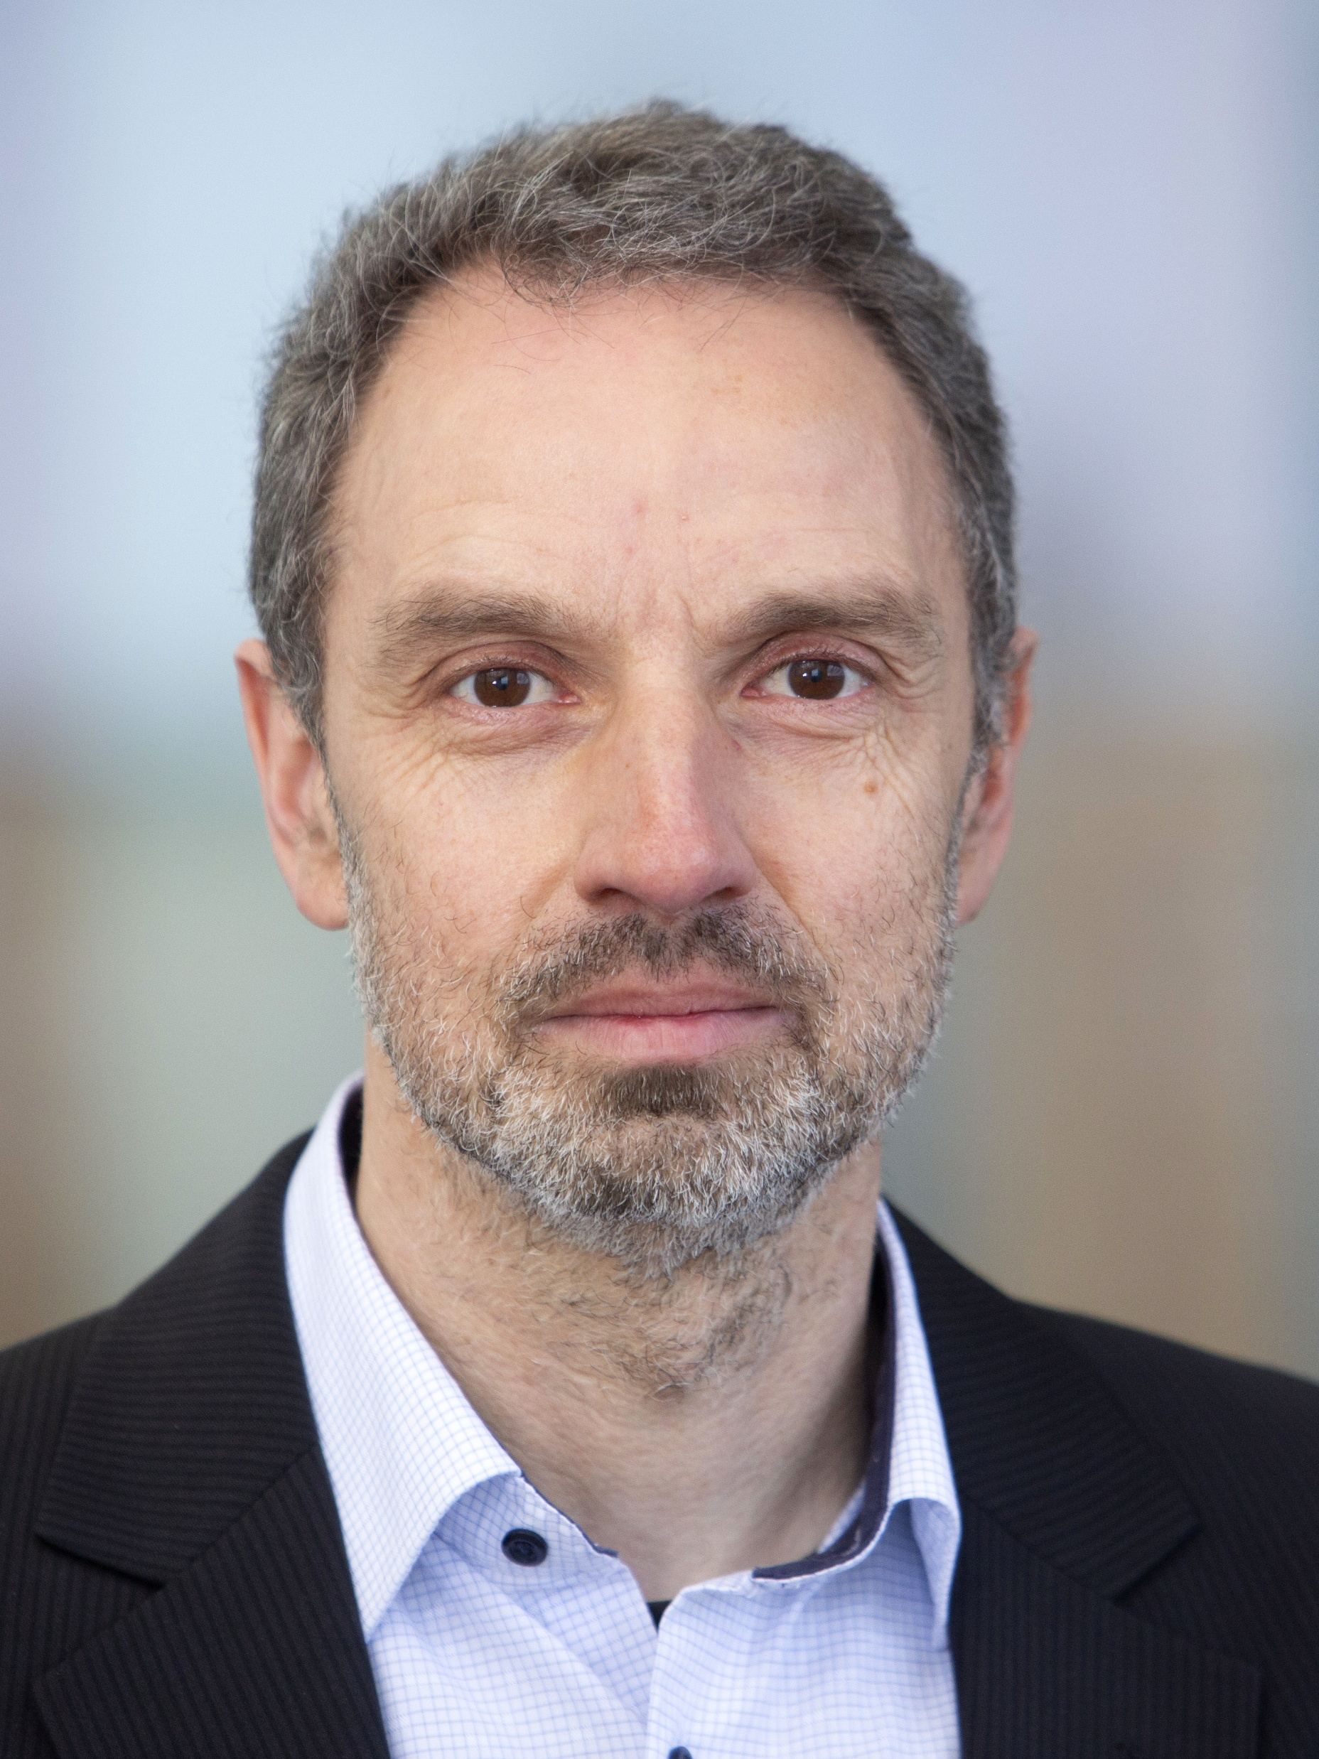
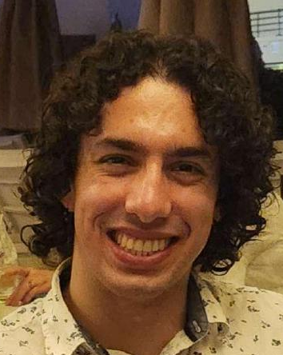

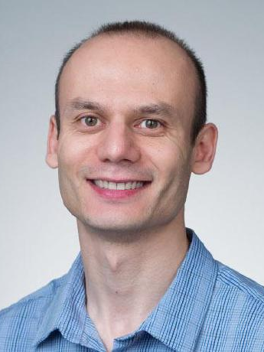

External-Memory
Priority Queues and
Persistent Search Trees
Gerth Stølting Brodal
Aarhus University
University of Primorska, Koper, Slovenia, December 8, 2025
Notes:
(coauthors Jared Lo & Victor Pagan students of Nodari Sitchinava)
Talk is based on two papers presented at ESA 2025
Design of External-Memory Data Structures

Slide 3
External-Memory Model
Aggarwal, Vitter [CACM 1988]
CPU
Internal memory (M)
I/O (B)
External memory (∞)
Notes:
Topic of the talk are algorithms for the external memory model
Assumption is that the bottleneck in computations is the IO communication (in particular random access in external memory)
Modern hardware – sequential external access can be extremely fast, so internal computation is also important

Slide 4
Part I
External-Memory Priority Queues with Optimal Insertions
Gerth Stølting Brodal Aarhus University | Michael Goodrich University of California, Irvine | John Iacono Université libre de Bruxelles | Jared Lo University of Hawai’i at Mānoa
Ulrich Meyer Goethe University Frankfurt am Main | Victor Pagan University of Hawai’i at Mānoa | Nodari Sitchinava University of Hawai’i at Mānoa | Rolf Svenning Aarhus University
33rd Annual European Symposium on Algorithms (ESA), September 15, 2025, Warsaw, Poland
Notes:
Work done at:
3rd Hawaii Workshop on Parallel Algorithms and Data Structures
University of Hawaii at Manoa, March 17-21, 2025

Slide 5
Priority Queues
Insert(e) DeleteMin()
Binary heap
(Williams 1964)
Binomial queue
(Vuillemin 1978)
1
O(log N) O(log N)
4
3
bubble up
5
7
6
2
cascaded linking
4
1
3
2
4
Can we achieve a similar result in external memory ?
O_{A}(1) O(log N)
5
6
7
5
6
7
7
8
9
9
9
Sorting = N × Insert + N × DeleteMin ⇒ Insert or DeleteMin Ω(log N) comparisons
# Insert ≥ # DeleteMin
Notes:
Insert worst-case O(1) by only linking one pair of trees of equal size per insertion
Can achieve O(1) DeleteMin and O(log n) using a search tree
This talk: No arbitrary Delete, Meld or DecreaseKey

Slide 6
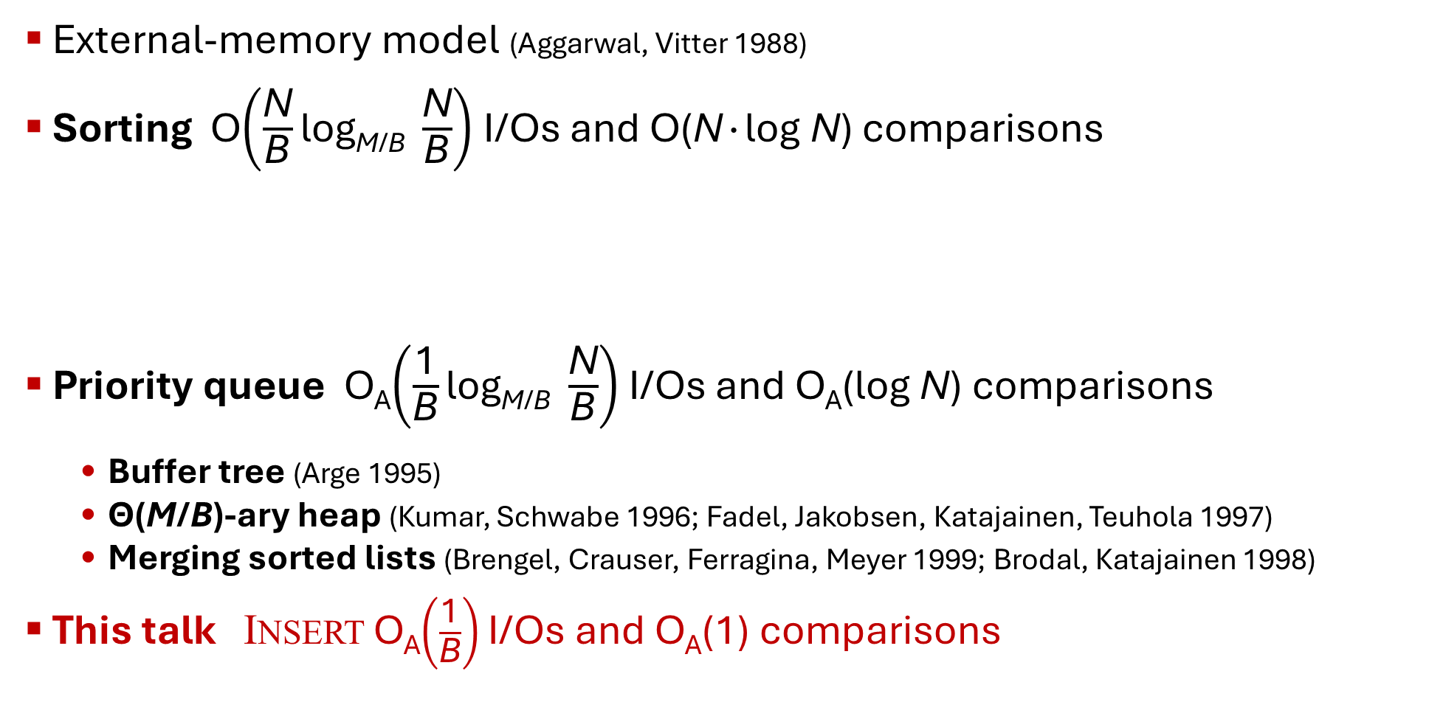
External Memory
CPU
Internal memory (M)
External-memory model (Aggarwal, Vitter 1988)
Sorting O$\left(\frac{\text{N}}{\text{B}}\text{log}\text{M}\text{/}\text{B} \frac{\text{N}}{\text{B}}\right)$ I/Os and O(N∙log N) comparisons
Priority queue O_{A}$\left(\frac{\text{1}}{\text{B}}\text{log}\text{M}\text{/}\text{B} \frac{\text{N}}{\text{B}}\right)$ I/Os and O_{A}(log N) comparisons
  Buffer tree (Arge 1995)
  Θ(M/B)-ary heap (Kumar, Schwabe 1996; Fadel, Jakobsen, Katajainen, Teuhola 1997)
  Merging sorted lists (Brengel, Crauser, Ferragina, Meyer 1999; Brodal, Katajainen 1998)
This talk Insert O_{A}$\left(\frac{\text{1}}{\text{B}}\right)$I/Os and O_{A}(1) comparisons
I/O (B)
External memory (∞)
Θ(M/B)-way merging
sorted
M
∙∙∙
M
Insert
DeleteMin
Notes:
Buffer trees & merging list inherently Θ(log N) comparisons since they essentially generate a sorted lists
Heap based require buffers to be sorted, likely insertions O(log M + log_{M/B} N/B) comparisons

Slide 7
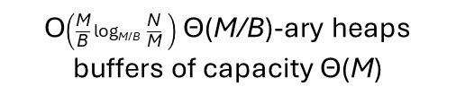
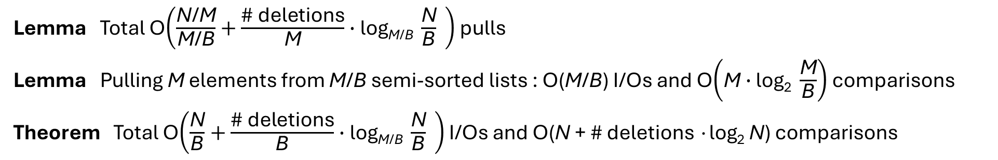
New External-Memory Priority Queue
Insert(e)
DeleteMin()
Internal memory
External memory
O$\left(\frac{\text{M}}{\text{B}}\text{log}\text{M}\text{/}\text{B} \frac{\text{N}}{\text{M}} \right)$ Θ(M/B)-ary heaps
buffers of capacity Θ(M)
internal buffer = semi-sorted
min-buffer S
insert-buffer L
insert Θ(M)
≤
≤
≤
≤
≤
≤
≤
≤
≤
≤
≤
≤
≤
≤
≤
1
3
2
pull
B
B
∙∙∙
≤
5
6
7
≤ p ≤
unsorted
≤
9
extract Θ(M) smallest
leaf buffer = lazy semi-sorted
Insert O_{A}(1)
DeleteMin O(log |S|)
|S|=O(M)
Insert O(1)
|L|=O(M)
≤
≤
≤
≤
≤
≤
≤
≤
≤
B
B
2B
4B
8B
Lemma Total O$\left(\frac{\text{N}\text{/}\text{M}}{\text{M}\text{/}\text{B}}+\frac{\text{\# }\text{deletions}}{\text{M}}∙\text{log}\text{M}\text{/}\text{B} \frac{\text{N}}{\text{B}} \right)$ pulls
Lemma Pulling M elements from M/B semi-sorted lists : O(M/B) I/Os and O$\left(\text{M}∙\text{log}\text{2} \frac{\text{M}}{\text{B}}\right)$ comparisons
Theorem Total O$\left(\frac{\text{N}}{\text{B}}+\frac{\text{\# }\text{deletions}}{\text{B}}∙\text{log}\text{M}\text{/}\text{B} \frac{\text{N}}{\text{B}} \right)$ I/Os and O(N + # deletions ∙log₂ N) comparisons
Notes:
S ≤ elements in external memory
We cannot sort elements in new leaves, would cost O(log₂ M) comparisons per insert
(Lazy) semi-sorted buffers are created using repeated median selection
N = # insertions

Slide 8
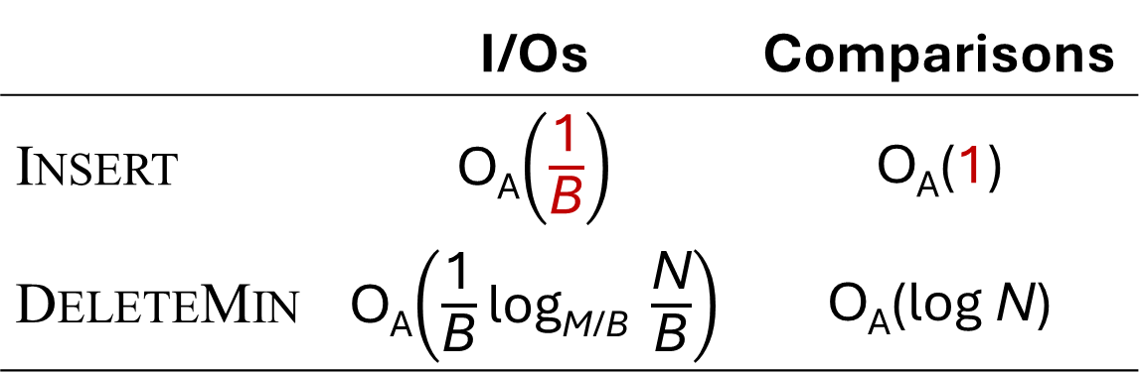
Summary – Part I
New optimal external memory priority queue
Open problems
  Our data structure is inherently amortized – can it be made worst-case ?
  Structure inherently cache-aware – is there a cache-oblivious data structure with matching I/O and comparison bounds ?
 | I/Os | Comparisons
Insert | O_{A}$\left(\frac{\text{1}}{\text{B}}\right)$ | O_{A}(1)
DeleteMin | O_{A}$\left(\frac{\text{1}}{\text{B}}\text{log}\text{M}\text{/}\text{B} \frac{\text{N}}{\text{B}}\right)$ | O_{A}(log N)
Frigo, Leiserson, Prokop, Ramachandran, Cache-Oblivious Algorithms, FOCS 1999

Slide 9
Part II
Buffered Partially-Persistent
External-Memory Search Trees
— or, partially-persistent B-trees meet B^{ε}-trees
Gerth Stølting Brodal Aarhus University | Casper Moldrup Rysgaard Aarhus University | Rolf Svenning Aarhus University
33rd Annual European Symposium on Algorithms (ESA), September 15, 2025, Warsaw, Poland
Notes:
15 min talk + 2 min Q&A

Slide 10
Persistent Data Structures
Ephemeral
Partial persistence
Full
persistence
Confluently
persistence
v₀
version
list
v₀
version
tree
v₀
version DAG
v₀
update
v₁
v₁
v₁
v₂
v₁
v₂
v₂
v₂
v₃
v₆
v₃
query only
v₃
v₃
v₄
v₅
v₅
updates at leaves
any version can be copied
query all versions
update/merge/query
all versions
v₄
v₄
v₅
v₅
v₆
v₆
update
& query
query

Slide 11
Buffered partially-persistent external-memory search trees
CPU
Internal memory (M)
I/O (B)
External memory (∞)
Search tree (B-tree, Bayer & McCreight 1972)
Partial persistence = remember all previous versions
  Copy path from root to updated nodes = space O(log_{B} N) blocks per update
  Associate with each element and pointer a time interval where it is part of the structure (fat node and node copying)
B^{ε}-tree – reduced degree B^{ε}, add buffers = blocks of delayed updates
degree Θ(B)
Insert(x)
height
O(log_{B} N)
add x to leaf
O(log_{B} N) I/Os
Θ(B) elements
range query
O(log_{B} N + K/B) I/Os
Notes:
Trivial solution copy full structure pr update -> bad space and time
Path copy pr update -> B∙log_{B} N space per update, log_{B} N IOS

Slide 12

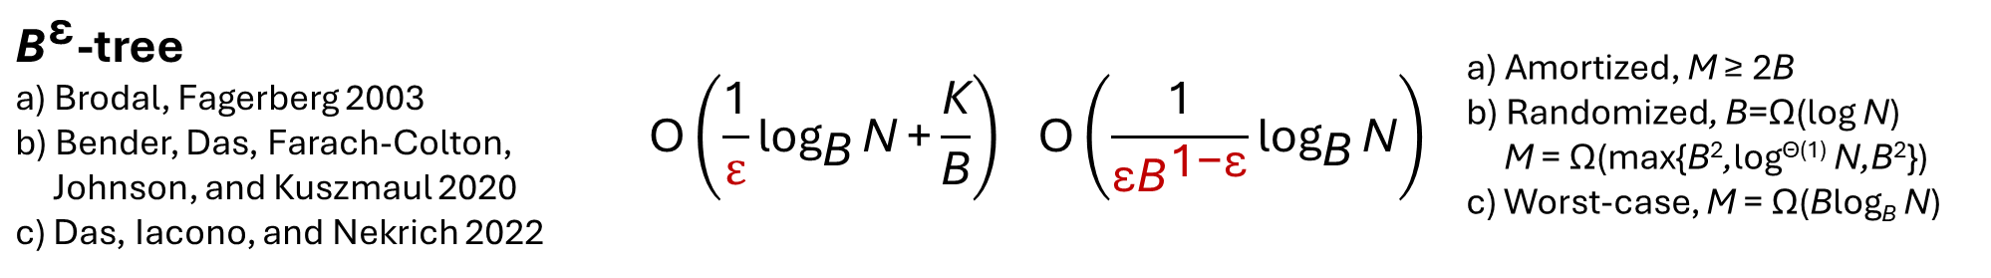
I/O results (all linear space)
Ephemeral | Range query | Insert/Delete | Assumption
B-tree Bayer, McCreight 1972 | $$\text{O}\left({\text{log}}_{\text{B}}{\text{N}}\text{+}\frac{\text{K}}{\text{B}}\right)$$ | $$\text{O}\left({\text{log}}_{\text{B}}{\text{N}}\right)$$ | M ≥ 2B
${\text{B}}^{\text{ε}}$-tree a) Brodal, Fagerberg 2003 b) Bender, Das, Farach-Colton, Johnson, and Kuszmaul 2020 c) Das, Iacono, and Nekrich 2022 | $$\text{O}\left(\frac{\text{1}}{ε}{\text{log}}_{\text{B}}{\text{N}}\text{+}\frac{\text{K}}{\text{B}}\right)$$ | $$\text{O}\left(\frac{\text{1}}{{\text{ε}\text{B}}^{\text{1−}\text{ε}}}{\text{log}}_{\text{B}}{\text{N}}\right)$$ | a) Amortized, M ≥ 2B b) Randomized, B=Ω(log N) M = Ω(max{B²,log^{Θ(1)} N,B²}) c) Worst-case, M = Ω(Blog_{B} N)
Partial persistence
Partially-persistent B-tree Becker, Gschwind, Ohler, Seeger, and Widmayer 1996 | $$\text{O}\left({\text{log}}_{\text{B}}{\text{N}}\text{+}\frac{\text{K}}{\text{B}}\right)$$ | $$\text{O}\left({\text{log}}_{\text{B}}{\text{N}}\right)$$ | M ≥ 2B
This talk | $$\text{O}\left(\frac{\text{1}}{ε}{\text{log}}_{\text{B}}{\text{N}}\text{+}\frac{\text{K}}{\text{B}}\right)$$ | $$\text{O}\left(\frac{\text{1}}{{\text{ε}\text{B}}^{\text{1−}\text{ε}}}{\text{log}}_{\text{B}}{\text{N}}\right)$$ | a) Amortized, M ≥ 2B b) Worst-case, M = Ω(B^{1-ε}log₂ N)
Notes:
Randomized is with high probability
Partial persistence is essentially the node copying technique by Driscoll, Sarnak, Sleator, Tarjan
Our worst-case bound has a slightly weaker assumption on M as the result of Das et al. and our result is partially persistent
In paper we also present a deterministic construction for M ≥ 2B, but with slightly increased IO bounds

Slide 13
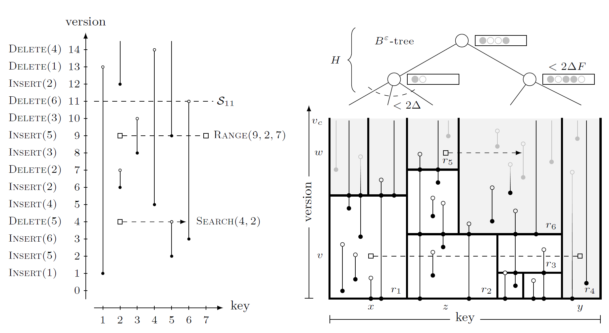
Geometric interpretation
Insertions and deletions are endpoints of vertical segments
Search and range queries are horizontal ray shooting and segment intersection queries

Slide 14
Rectangle partition
Partition plan into rectangles
Topmost rectangles are open
(can received more updates)
Segments crossing multiple
rectangles are split
Rectangles store Θ(B∙log_{B} N)
endpoints where Ω(B∙log_{B} N)
segments span bottom-to-top
Global rebuild when N
doubles/halves
Segments in a rectangle are sorted by key
Notes:
Global rebuilding => will have independent structures for a partition of the version universe

Slide 15
Top structure
B^{ε}-tree with updates heading for the open rectangles
Degree B^{ε} , buffer capacity B
Close a rectangle when it has received Θ(Blog_{B} N) updates
(move all buffered updates to it)
Join and split open rectangles like in a B-tree (after closing them)

Slide 16
Point location
Queries need to locate relevant rectangles
For each version have a B-tree with the rectangles left-to-right intersection the version
Make it partially-persistent using simple path copying for updates
A query to an open rectangle moves all buffered updates to the rectangle
Notes:
The path to an open rectangle can at most store a fraction of the capacity of the rectangle

Slide 17
Achieving worst-case I/O bounds
Buffer overflow = incremental flush a single path,
pushing B^{1-ε} updates to the child with most updates
(ensures never more than B^{1-ε}∙log₂ B updates in a
buffer heading for a single child)
Incrementally closing an open rectangle, collect all buffered updates in internal memory, requires M = Ω(B^{1-ε}∙log₂ N)
Incremental global rebuild for changing N
Never merge internal nodes in top structure (avoids flushing buffers, incremental global rebuilding bounds height)
Notes:
Closing rectangles are part of incremental flush and searches
Decremental game ensures that a buffer cannot contain B elements heading for the same child

Slide 18
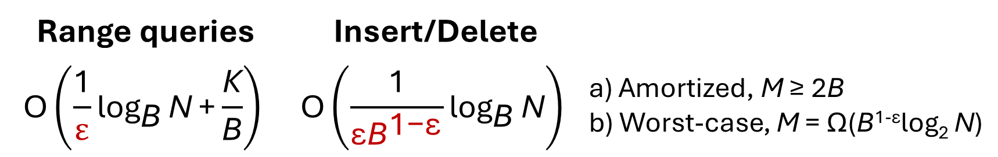
Summary – Part II
Linear space buffered partially-persistent B-trees, with I/O bounds
Open problems
  Worst-case for M ≥ 2B
  Let fully-persistent B-trees meet B^{ε}-trees
  (Brodal, Rysgaard, Svenning, STOC 2023, O(log_{B} N) I/Os queries & updates)
Range queries | Insert/Delete
$$\text{O}\left(\frac{\text{1}}{ε}{\text{log}}_{\text{B}}{\text{N}}\text{+}\frac{\text{K}}{\text{B}}\right)$$ | $$\text{O}\left(\frac{\text{1}}{{\text{ε}\text{B}}^{\text{1−}\text{ε}}}{\text{log}}_{\text{B}}{\text{N}}\right)$$ | a) Amortized, M ≥ 2B b) Worst-case, M = Ω(B^{1-ε}log₂ N)

Slide 19
Thanks
Gerth Stølting Brodal
gerth@cs.au.dk
Brodal, Goodrich, Iacono, Lo, Meyer, Pagan, Sitchinava, Svenning, External-Memory Priority Queues with Optimal Insertions, ESA 2025
Brodal, Rysgaard, Svenning, Buffered Partially-Persistent External-Memory Search Trees, ESA 2025

