Slide 1

Gerth Stølting Brodal
Aarhus Universitet
www.cs.au.dk/~gerth/julehjerter

Slide 2
fold
x
x
x
extra (1-2 mm)

Slide 7


Slide 8
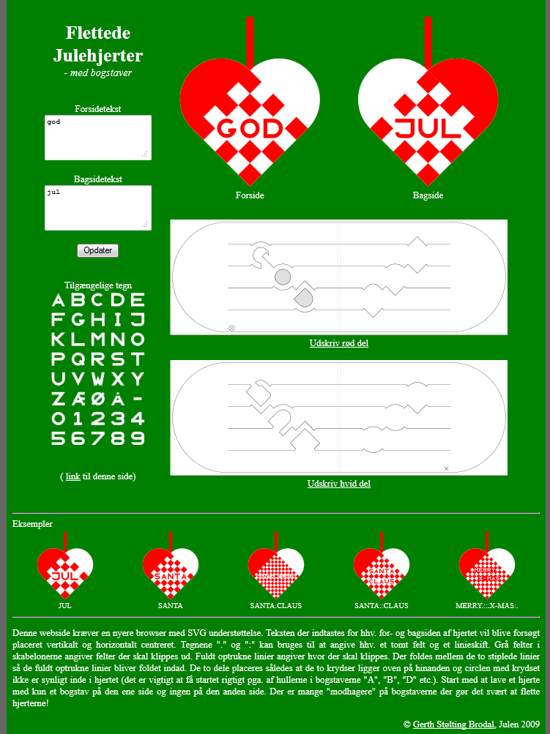
1
2
HTML + CSS + PHP + SVG
(32 Kb)
3
4
index.php
style.css
preview.php
template.php
letters.php
definitions.php
www.cs.au.dk/~gerth/julehjerter
1
2
3
4
5
Notes:
All images by SVG, initially not supported by Internet Explorer (designed with Firefox)
2012: Updated html from ”Embed” to ”Object” tags, and now also works with Internet Explorer 9.0

Slide 9
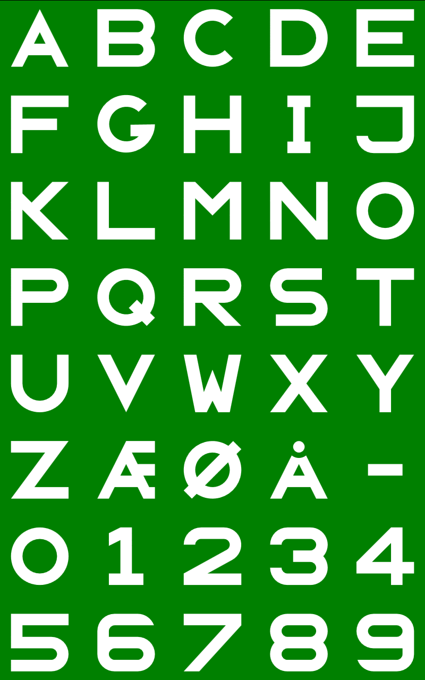
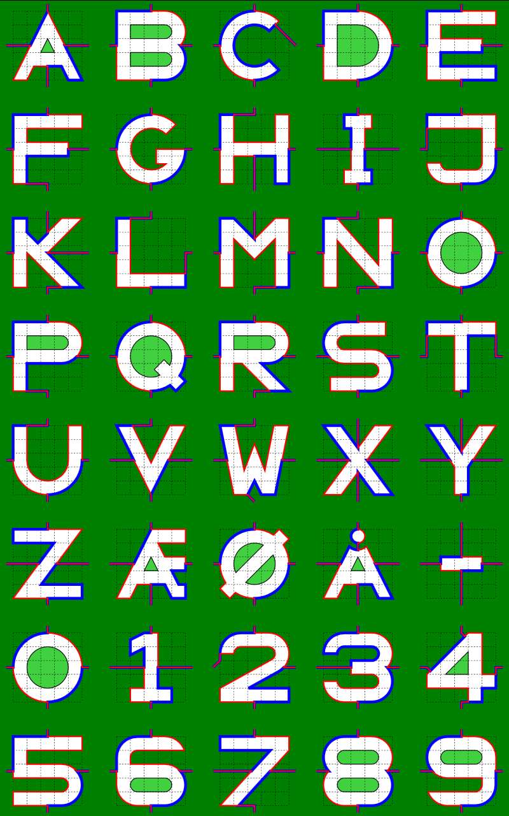
letters.php
letters.php?debug=1

Slide 10
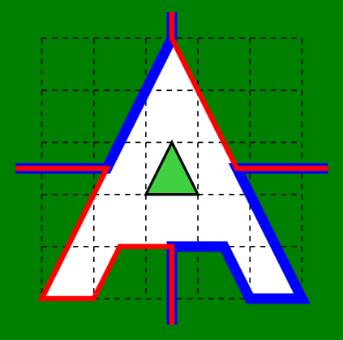
(100,-100)
(0,0)
letters.php?debug=1
$letter["A"] = 'l 50,-100 l 50,100 l -20,0 l -10,-20 l -40,0 l -10,20 z';
$LUcut["A"] = 'm -10,-50 l 35,0 l 25,-50 l 0,-10
m 0,120 l 0,-30 l 20,0 l 10,20 l 20,0 l -25,-50 l 35,0';
$DRcut["A"] = 'm 50,10 l 0,-30 l -20,0 l -10,20 l -20,0 l 25,-50 l -35,0
m 120,0 l -35,0 l -25,-50 l 0,-10';
$hole["A"] = 'm 40,-40 l 10,-20 l 10,20 z';
definitions.php

Slide 11


preview.php
backside=1&text=god&text_other_side=jul&debug=1
text=jul&text_other_side=god
Notes:
text_other_side = only used to dermine the size of the grid
backside = used to figure out if ears should flip color

Slide 12
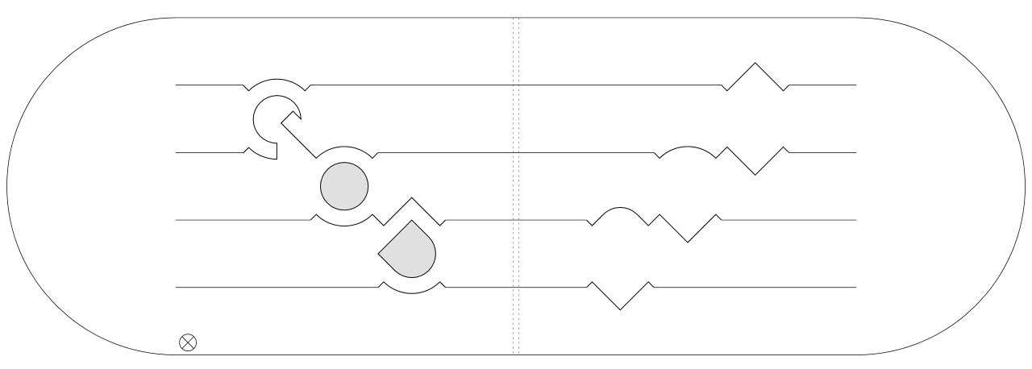
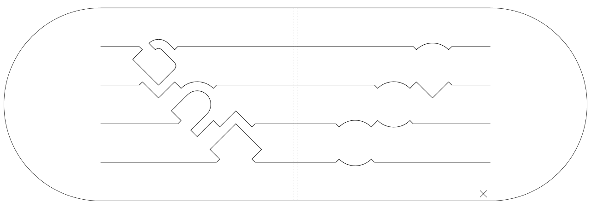
template.php?piece=0&text_front=god&text_back=jul
template.php?piece=1&text_front=god&text_back=jul
Notes:
When folded, two crosses inside, ontop of each other, circle with cross not visible

Slide 13
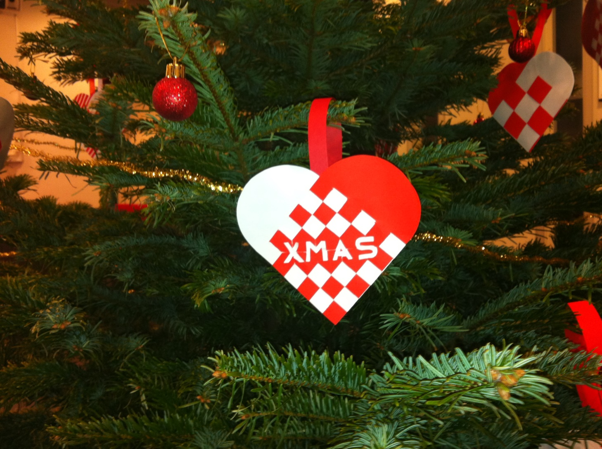

Slide 14

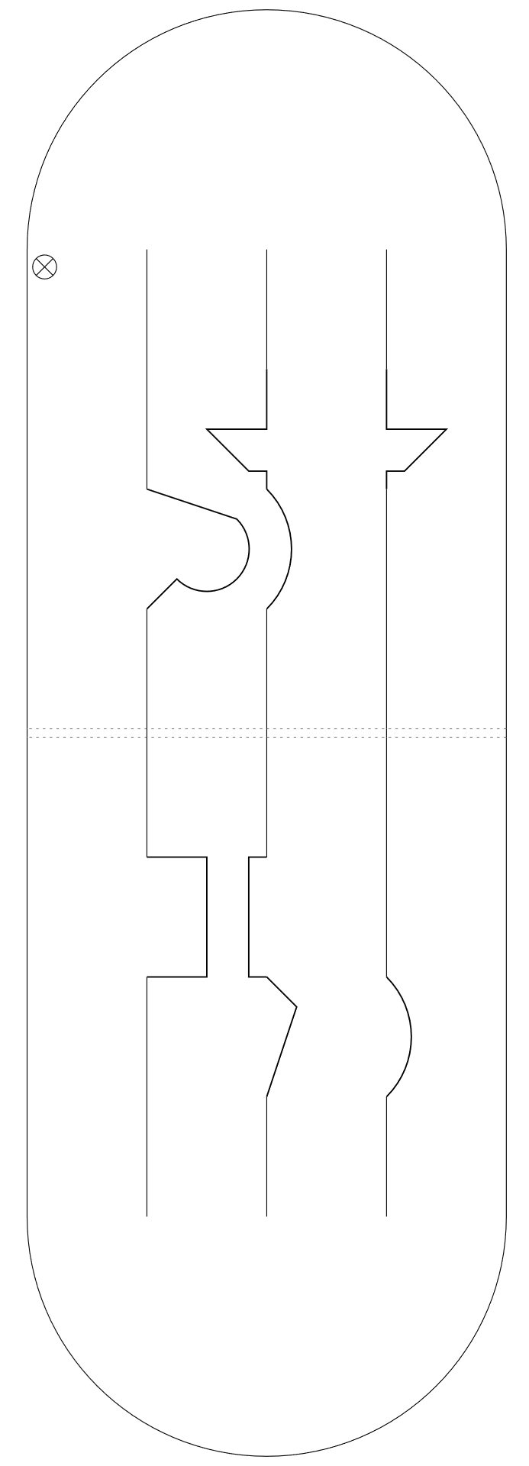

Slide 15
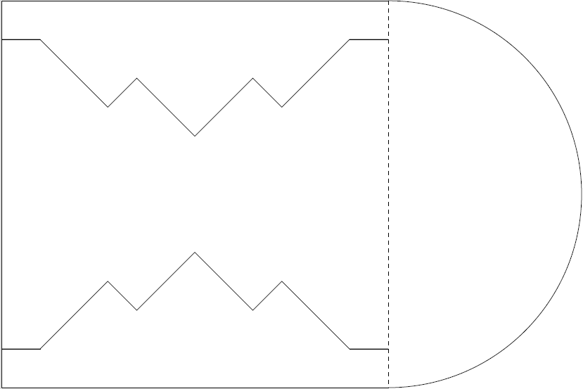
Hvad er det ?

Slide 16
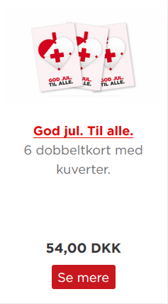
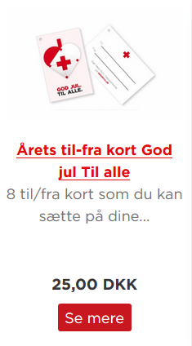

www.rodekors.dk

Slide 17
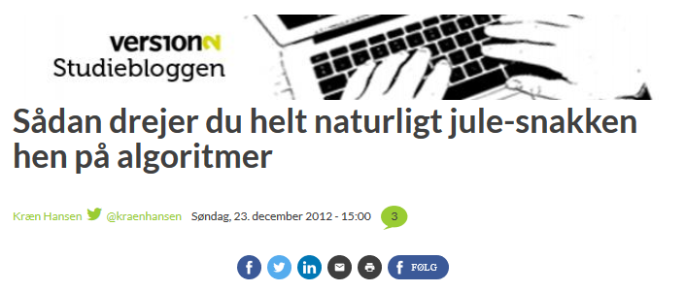
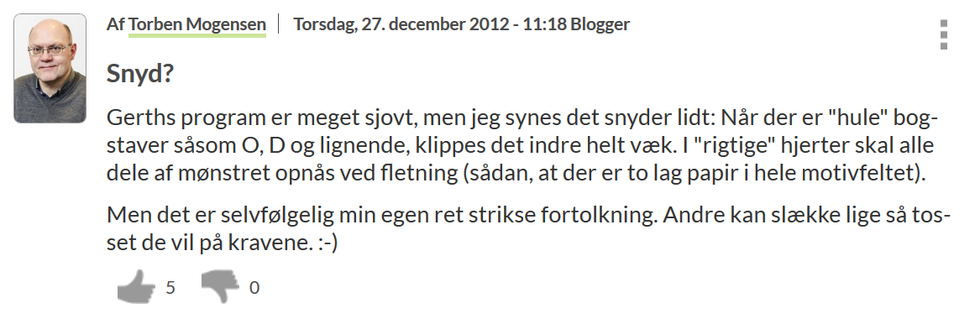

Slide 18
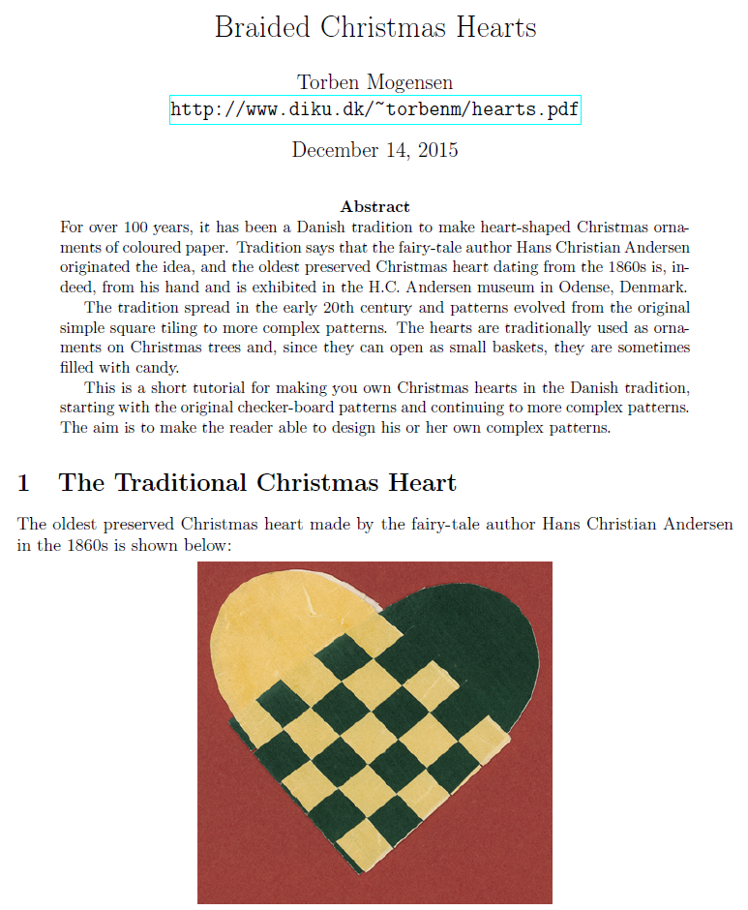
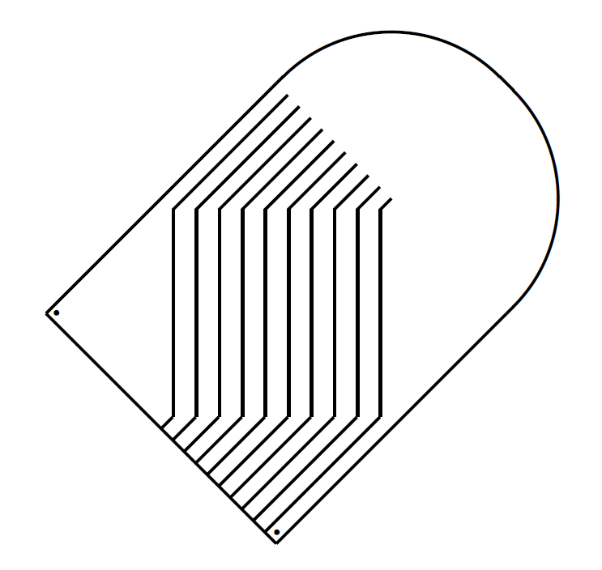
Torben Ægidius Mogensen hjemmesider.diku.dk/~torbenm/hearts.pdf

Slide 19
Julehjerte Designer

Slide 20

Gerth Stølting Brodal
Aarhus Universitet
www.cs.au.dk/~gerth/julehjerter

