Slide 1
Abstract
Efficient data structures are the core of many algorithms and the design of data structures is a classical topic covered in most introductory text books on algorithms. Most algorithmic text books assume that a good approximation of a computer is the RAM (Random Access Machine) model of computation, where it assumed that each memory access and register computation takes one time unit. The high popularity of the RAM model in algorithm and data structure design is due to the model’s simplicity while traditionally allowing for a good estimate of running time on actual computers. Unfortunately, modern computer architectures deviate from the classical RAM model in many aspects, invalidating the basic assumption of unit cost for each primitive instruction. This fact has sparked a lot of algorithmic research trying to model the essential bottlenecks in modern computer hardware and to understand the inherent trade-offs between the different limitations.
This talk will provide an overview of various directions in data structures ­­­­research for various models of computation.

Slide 2
Data Structures and Models of Computation
Gerth Stølting Brodal
Inauguration talk, Department of Computer Science, Aarhus University, February 12, 2016

Slide 3
Looking back... publications since 1994
STACS12 | APBC13 | ISAAC02 | ESA10 | NJC96 | SWAT96 | SODA12
ESA13 | IPPS97 | SWAT00 | JFP96 | SWAT14 | SODA03 | SODA02
ISAAC10 | SODA00 | ESA06 | WADS95 | SODA98 | WADS15 | Algorithmica02
PhD97 | CPM99 | ORS08 | STOC12 | APBC07 | ESA07 | Handbook05
TAMC11 | ISAAC09 | FOCS00 | ISAAC10 | SODA13 | ISAAC08 | Encyclopedia08
ICALP01 | ESA06 | ISAAC12 | STOC01 | STACS97 | FOCS02 | STOC02
TCS11 | CPM06 | ESA12 | ISAAC09 | ICALP11 | WADS09 | BRICS-RS-96
FOCS06 | ESA13 | Biology13 | SWAT96 | SWAT04 | WABI03 | Handbook05
IPL00 | SOCG05 | SPAA07 | ICALP02 | ICALP02 | CPM00 | Algorithmica04
STACS16 | ISAAC01 | ICALP05 | SODA11 | MFCS07 | ISAAC09 | SODA99
SWAT98 | ALENEX14 | ISAAC09 | APBC07 | SODA96 | ALENEX05 | BRICS-RS-96
MFCS07 | WADS99 | SWAT02 | SODA06 | SWAT04 | Bioinformatics14
FOCS03 | SWAT98 | ATMOS03 | Survey13 | SOCG08 | Progress-Report94
SWAT00 | ICATPN07 | ALENEX04 | CPM96 | SODA10 | Acta-Informatica05
WADS11 | SWAT14 | WADS05 | WAOA11 | STOC03 | BMC-Bioinformatics06
Notes:
While thinking about what to say at such an inaugaration talk, had to look back...
Papers listed are without doublicates (i.e. journal versions are typically not listed)

Slide 4
Thanks to my co-authors
Peyman Afshani, Pankaj K. Agarwal, Stephen Alstrup, Lars Arge, Djamal Belazzougui
Michael A. Bender, Andrej Brodnik, Shiva Chaudhuri, Pooya Davoodi, Erik D. Demaine
Rolf Fagerberg, Jeremy T. Fineman, Irene Finocchi, Dongdong Ge, Loukas Georgiadis
Beat Gfeller, Fabrizio Grandoni, Mark Greve, Leszek Gasieniec, Inge Li Gørtz
Kristoffer A. Hansen, Simai He, Morten Kragelund Holt, Haodong Hu, Thore Husfeldt
John Iacono, Giuseppe Italiano, Riko Jacob, Jens Johansen, Allan Grønlund Jørgensen
Kanela Kaligosi, Alexis Kaporis, Alexis C. Kaporis, Jyrki Katajainen, Irit Katriel
Casper Kejlberg-Rasmussen, Lars Michael Kristensen, Martin Kutz
Alejandro López-Ortiz, George Lagogiannis, Stefan Langerman, Kasper Green Larsen
Morten Laustsen, Moshe Lewenstein, Rune Bang Lyngsø, Thomas Mailund
Christos Makris, Ulrich Meyer, Gabriel Moruz, J. Ian Munro, Thomas Mølhave
Andrei Negoescu, Jesper Sindahl Nielsen, Chris Okasaki, Vineet Pandey
Apostolos Papadopoulos, Christian Nørgaard Storm Pedersen, Derek Phillips
M. Cristina Pinotti, Jaikumar Radhakrishnan, Rajeev Raman, S. Srinivasa Rao
Theis Rauhe, Andreas Sand, Peter Sanders, Spyros Sioutas, Sven Skyum
Venkatesh Srinivasan, Martin Stissing, Jens Stoye, Robert E. Tarjan, Laura Toma
Jakob Truelsen, Jesper Larsson Träff, Athanasios Tsakalidis, Konstantinos Tsakalidis
Kostas Tsichlas, Constantinos Tsirogiannis, Elias Vicari, Kristoffer Vinther, Jeff Vitter
Michael Westergaard, Christos D. Zaroliagis, Norbert Zeh, Anna Östlin
Notes:
Thanks to all my coauthors (since 1996, 85 coauthors) – often doing the hard work of putting things together, but also for pulling my research into new directions
Bold = coauthored 5+ papers
Rolf Fagerberg 27 Christian Nørgaard Storm Pedersen 14 Lars Arge 8 Thomas Mailund 7 Allan Grønlund Jørgensen 7 Gabriel Moruz 7 Kostas Tsichlas 6 S Srinivasa Rao 6 Riko Jacob 5 Pooya Davoodi 4 Spyros Sioutas 4 Andreas Sand 4 Jakob Truelsen 4 Stephen Alstrup 4 Theis Rauhe 4 Anna Östlin 3 Thomas Mølhave 3 Irit Katriel 3 Loukas Georgiadis 3 Konstantinos Tsakalidis 3 Morten Kragelund Holt 3 Jens Johansen 3 Christos Makris 3 Jesper Sindahl Nielsen 3 Rune Bang Lyngsø 2 Martin Stissing 2 George Lagogiannis 2 Michael A Bender 2 Erik D Demaine 2 Christos D Zaroliagis 2 Athanasios Tsakalidis 2 Norbert Zeh 2 Mark Greve 2 Casper Kejlberg-Rasmussen 2 J Ian Munro 2 John Iacono 2

Slide 5
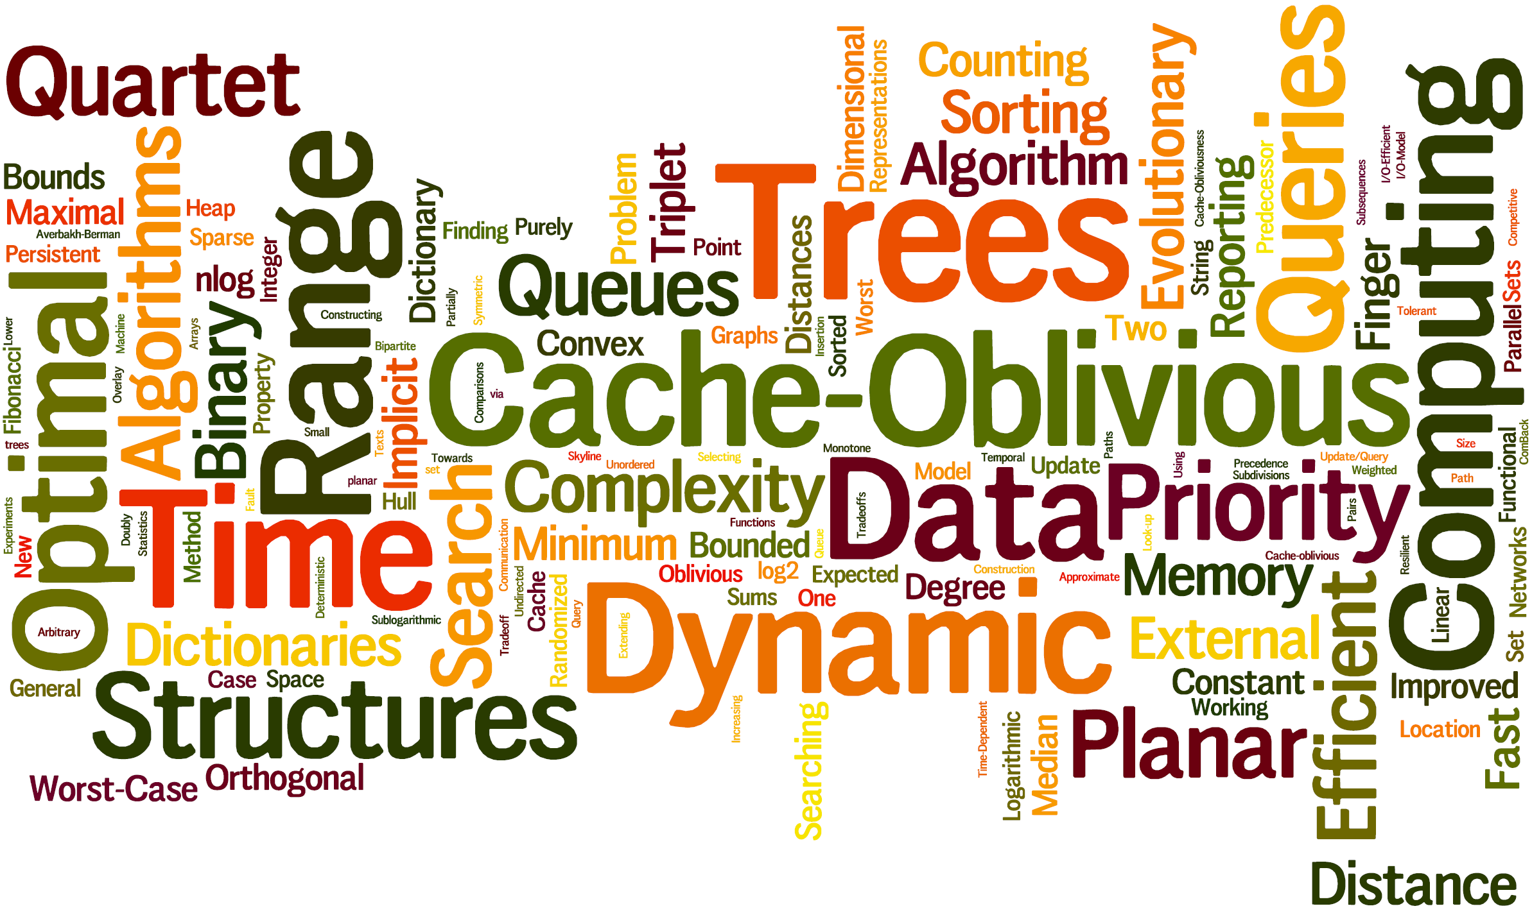
www.wordle.net
Notes:
Applied wordle.net to the titles of all my papers... Listed are the 150 top words.

Slide 6
Data Structures
Dictionaries
Phylogenetic Trees
CPM96 STACS97 IPL00 SODA02 FOCS03 SODA06 ESA06 ESA07 WADS09 SODA10 ISAAC10 STACS12 SODA13
Finger search SODA98 STOC02 Handbook05 ISAAC12
Quartets/Triplets comparison ISAAC01 Algorithmica04 APBC07-07-13 Biology13 SODA13 ALENEX14 Bioinformatics14
Construction : experiments, Bunemann, neighbor-joining
ICALP01 WABI03 BMC-Bioinformatics06
Graphs
Selection
Computational Geometry
WADS99 SWAT00 ATMOS03 SWAT04 MFCS07
MFCS07 ISAAC08 ORS08 ISAAC09 TCS11
Point location SODA99 FOCS06 S0CG08
Range searching FOCS00 STOC01 SOCG05 ISAAC09-09 SODA11 ICALP11 SWAT14 STACS16
Convex hull SWAT00 FOCS02
Distribution sweeping ICALP02
String Searching
System
CPM99 SODA00 CPM00 ICALP02 CPM06
SWAT02 Acta-Informatica05 ISAAC10 WAOA11
Priority Queues
Range Minimum
Miscellaneous
WADS95 SODA96 SWAT96 STOC12 Survey13
JFP96 SWAT96 IPPS97 SWAT98 SWAT98 ISAAC02 WADS15
Matrix ESA10 ESA12 ESA13
Trees WADS11
Persistence NJC96 SODA12
Lists ESA06 Algoritmica02
Counting ISAAC09 TAMC11
Progress-Report94 PhD97 SWAT04 Handbook05
Sorting
BRICS-RS-96 BRICS-RS-96 ICATPN07 SPAA07 ESA13
STOC03 WADS05 ALENEX04 ALENEX05 ICALP05 Encyclopedia08 SWAT14
IO Cache oblivious Implicit Parallel Functional Fault tolerant

Slide 7
Research Context
Data Structures
Priority Queues
Tries Search Trees Finger Search Trees Priority Search Trees
Computational Models
RAM Pointer Machine
IO Cache oblivious Implicit Succinct Parallel Functional Fault tolerant
Bit-probe Succinct
Theory
Algorithm Engineering
Hardware
TLB Cache-faults Paging Memory hierarchies
Branch mispredictions Conditional operations
Notes:
Goal understand the limitations of the models
Simultaniously implicit and cache oblivious ?

Slide 8
Example 1 : Binary Search
BSc (Algorithms and Data Structures 1)
Store data in sorted order
Binary search from the center
MSc (Algorithm Engineering)
Don’t store data in sorted order
Don’t do binary search from the center
1 | 2 | 3 | 4 | 5 | 6 | 7 | 8 | 9 | 10 | 11 | 12 | 13 | 14 | 15
Why?
cache lines and branch prediction
WADS05
Sorting
O(n·log n) comparisons → Ω(n·log n) mispredictions
ESA06
Notes:
Recusive van Emde Boas layout
Inadequate model – traditional RAM model, but not sufficient.
Recent work (Pat Morin, Paul-Virak Khuong 2015) showed importance of prefetching and the difference between standard CPUs and energi saving CPUs

Slide 9
Example 2 : Counting [ Bit-probe ]
Reflected Gray code
0000
0001
0011
0010
0110
0111
0101
0100
1100
1101
1111
1110
1010
1011
1001
1000
0000
Decimal
0
1
2
3
4
5
6
7
8
9
10
11
12
13
14
15
0
Binary
0000
0001
0010
0011
0100
0101
0110
0111
1000
1001
1010
1011
1100
1101
1110
1111
0000
Binary
0000
0001
0010
0011
0100
0101
0110
0111
1000
1001
1010
1011
1100
1101
1110
1111
0000
Binary
0000
0001
0010
0011
0100
0101
0110
0111
1000
1001
1010
1011
1100
1101
1110
1111
0000
Question
Does there exist a counter where one never needs to read all bits to increment the counter ?
Reads 4 bits
Writes 4 bits
Reads 4 bits
Writes 1 bit

Slide 10
Example 2 : Counting [ Bit-probe ]
Decimal
0 | 0000
1 | 0001
2 | 0100
3 | 0101
4 | 1101
5 | 1001
6 | 1100
7 | 1110
8 | 0110
9 | 0111
10 | 1111
11 | 1011
12 | 1000
13 | 1010
14 | 0010
15 | 0011
0 | 0000
b₃b₂b₁b₀
b₀
0 1
b₁
b₂
0 1
0 1
b₃
b₃
b₁
b₃
0 1
0 1
0 1
0 1
---1
-0--
--1-
---1
0---
-1-0
--00
1---
Always reads 3 bits
Always writes ≤ 2 bits
General case
n-bit counter n-1 reads and 3 writes
lower bound log₂ n reads
Redundant counters
use 1 extra bit → Θ(log n) reads sufficient
Ridiculous
TAMC11
Notes:
Pat Nicholson from Bells Labs – ”I wasted a lot of time on this problem”

Slide 11
Example 3 : Integer Sorting [ RAM ]
n integers
1 | 2 | 3 | 4 | 5 | 6 | 7 | 8 | 9 | 10
Input
58 | 13 | 138 | 55 | 141 | 137 | 11 | 53 | 10 | 54
00111010 | 00001101 | 10001010 | 00110111 | 10001101 | 10001001 | 00001010 | 00110101 | 00001010 | 00110110
w bits
Output
10 | 11 | 13 | 53 | 54 | 55 | 58 | 137 | 138 | 141
00001010 | 00001010 | 00001101 | 00110101 | 00110110 | 00110111 | 00111010 | 10001001 | 10001010 | 10001101
Notes:
SWAT 2014 paper: Describes how to construct the Patricia trie efficiently + use leaf information to permute in O(n) time

Slide 12
Example 3 :
Integer Sorting [ RAM ]
Time per element
$$\text{O}\left(\sqrt{\text{log}{\text{log}{\text{n}}}}\right)$$
2
?
O(1)
1
SWAT14
3
w
log n
log² n·loglog n
log^{2+ε} n
1
Bucket sort | O(n+2^{w})
Radix sort; Hollerith 1887 | $$\text{O}\left(\text{n}\frac{\text{w}}{\text{log}{\text{n}}}\right)$$
van Emde Boas 1975 Willard 1983 | $$\text{O}\left(\text{n}\text{log}{\text{w}}\right)$$ | superlinear space expected
Kirkpatrick and Reicsh 1983 | $$\text{O}\left(\text{n} \text{log}\frac{\text{w}}{\text{log}{\text{n}}}\right)$$
Merge sort: von Neumann 1945 | $$\text{O}\left(\text{n}\text{log}{\text{n}}\right)$$ | comparison based optimal
Thorup and Han 2002 | $$\text{O}\left(\text{n}\sqrt{\text{log}{\text{(}\text{w}\text{/}\text{log} \text{n}\text{)}}}\right)$$ $$\text{O}\left(\text{n}\sqrt{\text{log}{\text{log}{\text{n}}}}\right)$$ | expected
Andersson et al. 1998 | O(n) | expected, $\text{w} \text{≥} \text{Ω}\left({\text{log}}^{\text{2+}\text{ε}}\text{n}\right)$
SWAT14 | O(n) | expected, $\text{w} \text{≥} \text{Ω}\left({\text{log}}^{\text{2}}\text{n}∙\text{log}{\text{log}{\text{n}}}\right)$
2
Open w ≤ log² n
3
Notes:
Joint work with Djamal Belazzougui and Jesper Sindal Nielsen

Slide 13
Example 4 : Persistence [ Pointer Machine ]
Driscoll et al. STOC86
General techniques to make data structures of constant degree partial and fully persistent with constant amortized overhead.
Theorem
Pointer based data structures of constant degree can be made partial persistent with worst-case constant overhead.
NJC96
Open if worst-case full persistence result exist ?
Progress-Report94
Fully persistent B-tree SODA12

Slide 14
Progress-Report94
Notes:
Censor (Joan Boyar) – strange section, questionable if it will be usefull.

Slide 15
Example 5 : Finger Search Trees [ Pointer Machine ]
Failed to solve cascaded splittings in full persistence technique
Turned towards the simpler (but related) problem of cascaded splittings in (a,b)-trees with finger search

Slide 16
Notes:
Slides from 1994

Slide 17
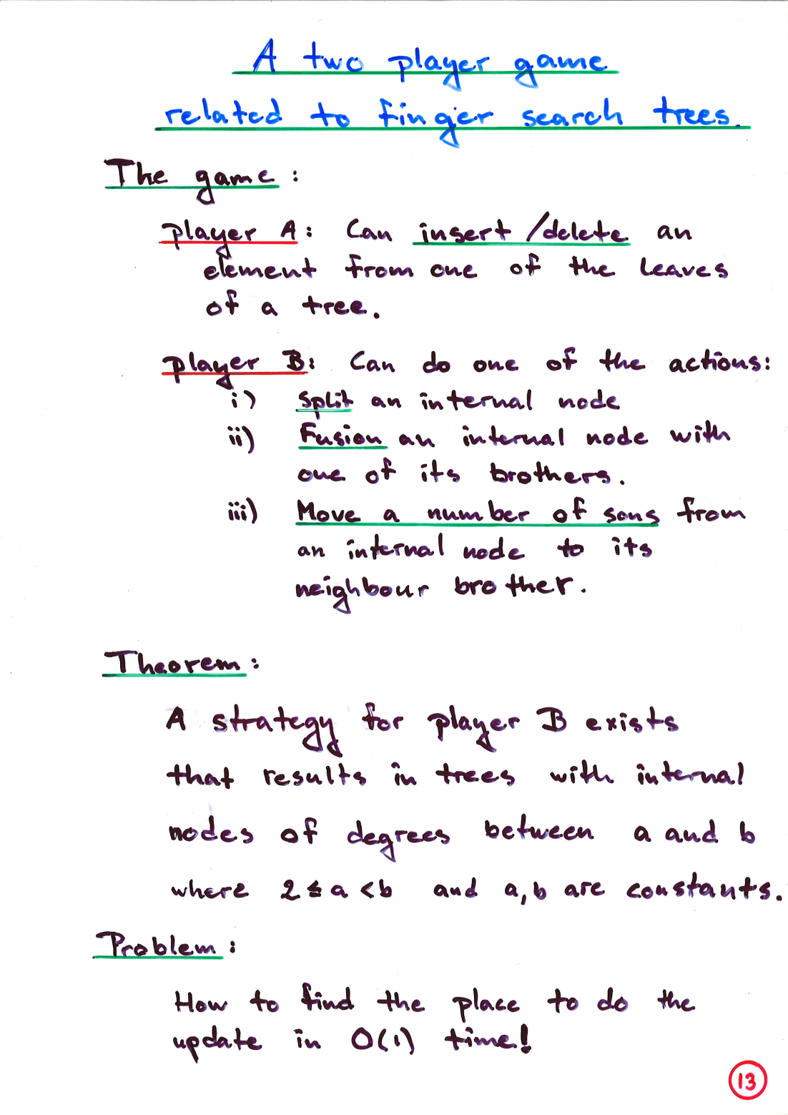
August 1997, Finger Search Trees with Constant Insertion Time. Oberwolfach Seminar on ``Effiziente Algoritmen''
May 1994, Finger Search Trees. BRICS Strategy Workshop. Hjarnø, Denmark
Solution presented at STOC02
February 2002, Optimal Finger Search Trees in the Pointer Machine. Dagstuhl Seminar on ``Data Structures''
Notes:
First academic talk (on PhD part A)

Slide 18
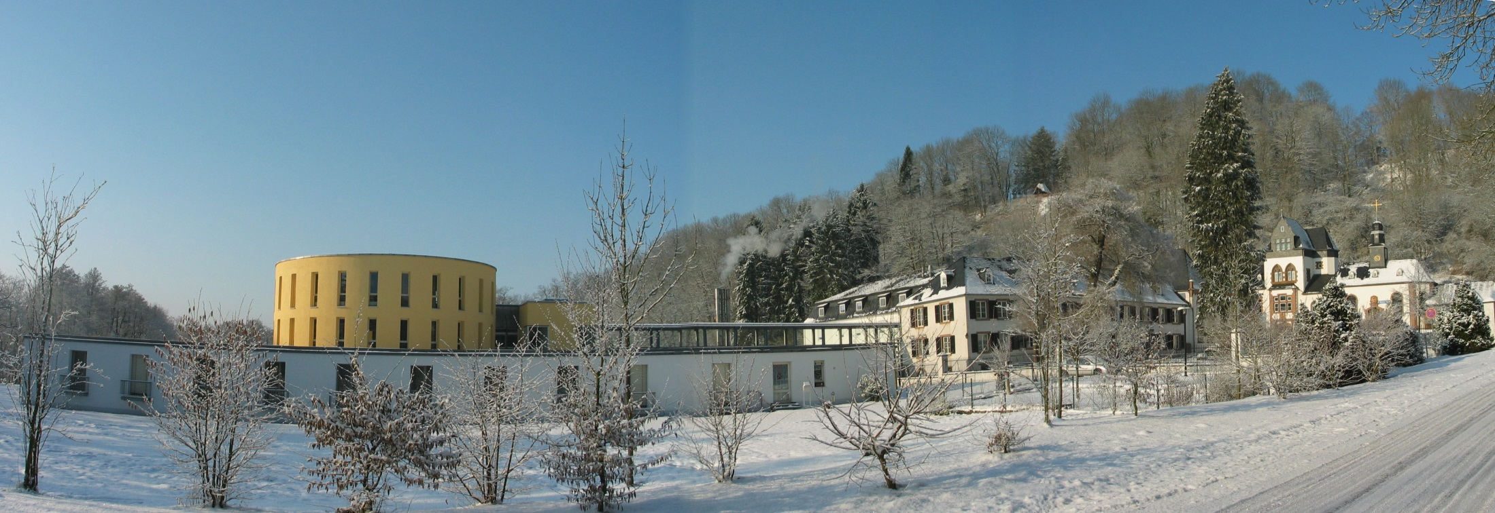
Dagstuhl

Slide 19
Example 6 : Meldable Priority Queues [ RAM & Pointer Machine & Functional ]
JFP96 [ Functional ]
WADS95 [ Pointer ]
SODA96 [ RAM ]
STOC12 [ Pointer ]

Slide 20
Example 7 : Functional Catenable Sorted Lists [ Functional ]
Join( (1,3,9,11),(14,19,21) ) → (1,3,9,11,14,19,21)
Extend to Finger Search ?
Open
ESA06

Slide 21
Example 8 : Range Minimum Queries [ Succinct ]
j₁
j₂
≥ m
 | 1 | 2 | 3 | 4 | ⋅⋅⋅ | n
1 | 3 | 1 | 3 | 42 | 12 | 8
2 | 7 | 14 | 6 | 11 | 15 | 37
3 | 13 | 99 | 21 | 27 | 44 | 16
⋅⋅⋅ | 23 | 28 | 5 | 13 | 4 | 47
m | 34 | 24 | 1 | 24 | 9 | 11
i₁
i₂
RMQ(i₁, i₂, j₁, j₂) = (2,3)
= position of min
 | Indexing Model (input accessible) | Encoding Model (input not accessable)
m = 1 1D | 2n+o(n) bits, O(1) time [FH07] n/c bits ⇒ Θ(c) time ESA10 | ≥ 2n - O(log n) bits 2n+o(n) bits, O(1) time [F10]
1 < m < n | O(mn⋅log n) bits, O(1) time [AY10] O(mn) bits, O(1) time ESA10 mn/c bits ⇒ Ω(c) time ESA10 O(c⋅log² c) time ESA10 O(c⋅log c⋅(loglog c)²) time ESA12 | Ω(mn⋅log m) bits ESA10 O(mn⋅log n) bits, O(1) time ESA10 O(mn⋅log m) bits, O(mn) time ESA13
m = n squared |  | Θ(mn⋅log n) bits, O(1) time [DLW09,AY10]
Completely
Ridiculous
better upper or lower bound ?
Notes:
FH07 = Fischer & Heun, ESCAPE 2007
DLW09 = Demaine, Landau & Weiman ICALP 2009
AY10 = Atallah, Yuan SODA 2010
F10 = Fischer STACS 2010
ESA13 = Brodal, Brodnik, Davoodi
ESA12 = Brodal, Davoodi, Lewenstein, Raman, Ra
ESA10 = Brodal, Davoodi, Rao

Slide 22
Summary
Classic data structures – still a lot of open problems
Lesson learned – some problems take long time to solve
Future – new technologies → new models of computation ?
→ intrinsic trade-offs ?
Notes:
Exsamples: Edvin, orientation in graphs; Kostas, cache performance for hierarchical decomposition of phylogenetic trees

