Slide 1
Deterministic Cache-Oblivious Funnelselect
Gerth Stølting Brodal | Sebastian Wild
19th Scandinavian Symposium on Algorithm Theory (SWAT), June 12-14, 2024, Helsinki, Finland
Notes:
Work to be presented at SWAT 2024.
Randomized result was presented at ESA 2023.

Slide 3
Problem
Algorithm
Computational Model
2
Randomized
Sorting
Internal memory
77 | 24 | 36 | 58 | 70 | 1 | 29 | 42 | 13 | 92
Memory access (element comparisons)
1 | 13 | 24 | 29 | 36 | 42 | 58 | 70 | 77 | 92
77 | 24 | 36 | 58 | 70 | 1 | 29 | 42 | 13 | 92
2
4
10
Single selection
Deterministic
External memory
Cache aware, I/O
77 | 24 | 36 | 58 | 70 | 1 | 29 | 42 | 13 | 92
M
I/O
B
rank
CPU
4
29
internal
external
Aggarwal, Vitter 1988
Multiple selection
Cache oblivious
77 | 24 | 36 | 58 | 70 | 1 | 29 | 42 | 13 | 92
Result of this talk
Algorithms do not know B and M (optimal offline cache replacement)
ranks
M
I/O
B
2 | 4 | 10
13 | 29 | 92
CPU
sorted
internal
external
Frigo, Leiserson, Prokop, Ramachandran 1999
Notes:
Going to present 3x3x3 = 18 different results
Source: Dizes = wikipedia

Slide 4
Internal Memory Sorting – Randomized
random pivot
9 | 1 | 36 | 74 | 39 | 16 | 38 | 63 | 66 | 20 | 51 | 19 | 71 | 48 | 86 | 10 | 26 | 12 | 11 | 97
Quicksort [Hoare 1959]
Expected time
O(n log₂ n)
Cache-oblivious
$\text{O}\left(\frac{\text{n}}{\text{B}}\text{log}\text{2}{\frac{\text{n}}{\text{M}}}\right)$ I/Os
partition
9 | 1 | 36 | 39 | 16 | 38 | 20 | 19 | 10 | 26 | 12 | 11 | 48 | 74 | 63 | 66 | 51 | 71 | 86 | 97
9 | 1 | 10 | 12 | 11 | 16 | 36 | 39 | 38 | 20 | 19 | 26
63 | 51 | 66 | 74 | 71 | 86 | 97
1 | 9 | 10 | 12 | 11
20 | 19 | 26 | 36 | 39 | 38
51 | 63
74 | 71 | 86 | 97
10 | 11 | 12
19 | 20
36 | 39 | 38
71 | 74
38 | 39
1 | 9 | 10 | 11 | 12 | 16 | 19 | 20 | 26 | 36 | 38 | 39 | 48 | 51 | 63 | 66 | 71 | 74 | 86 | 97
sorted result (in original array)

Slide 5
Internal Memory Single Selection – Randomized
rank 8
random pivot
9 | 1 | 36 | 74 | 39 | 16 | 38 | 63 | 66 | 20 | 51 | 19 | 71 | 48 | 86 | 10 | 26 | 12 | 11 | 97
Quickselect [Hoare 1961]
Expected time
O(n)
Cache-oblivious
$\text{O}\left(\frac{\text{n}}{\text{B}}\right)$ I/Os
partition
9 | 1 | 36 | 39 | 16 | 38 | 20 | 19 | 10 | 26 | 12 | 11 | 48 | 74 | 63 | 66 | 51 | 71 | 86 | 97
9 | 1 | 10 | 12 | 11 | 16 | 36 | 39 | 38 | 20 | 19 | 26
63 | 51 | 66 | 74 | 71 | 86 | 97
1 | 9 | 10 | 12 | 11
20 | 19 | 26 | 36 | 39 | 38
51 | 63
74 | 71 | 86 | 97
10 | 11 | 12
19 | 20
36 | 39 | 38
71 | 74
38 | 39
1 | 9 | 10 | 11 | 12 | 16 | 19 | 20 | 26 | 36 | 38 | 39 | 48 | 51 | 63 | 66 | 71 | 74 | 86 | 97
sorted result (in original array)

Slide 6
Internal Memory Multiple Selection – Randomized
rank 2
rank 5
rank 16
rank 18
9 | 1 | 36 | 74 | 39 | 16 | 38 | 63 | 66 | 20 | 51 | 19 | 71 | 48 | 86 | 10 | 26 | 12 | 11 | 97
Multiple selection [Chambers 1971]
Expected time
O(n log₂ q)
q = # query ranks
Cache-oblivious
$\text{O}\left(\frac{\text{n}}{\text{B}}\text{log}\text{2} \text{q}\right)$ I/Os
partition
9 | 1 | 36 | 39 | 16 | 38 | 20 | 19 | 10 | 26 | 12 | 11 | 48 | 74 | 63 | 66 | 51 | 71 | 86 | 97
9 | 1 | 10 | 12 | 11 | 16 | 36 | 39 | 38 | 20 | 19 | 26
63 | 51 | 66 | 74 | 71 | 86 | 97
1 | 9 | 10 | 12 | 11
20 | 19 | 26 | 36 | 39 | 38
51 | 63
74 | 71 | 86 | 97
10 | 11 | 12
19 | 20
36 | 39 | 38
71 | 74
38 | 39
1 | 9 | 10 | 11 | 12 | 16 | 19 | 20 | 26 | 36 | 38 | 39 | 48 | 51 | 63 | 66 | 71 | 74 | 86 | 97
sorted result (in original array)

Slide 7
Internal Memory Multiple Selection – Randomized
r₁
r₂
r₃
r₄
Δ₁
Δ₂
Δ₃
Δ₄
Δ₅
9 | 1 | 36 | 74 | 39 | 16 | 38 | 63 | 66 | 20 | 51 | 19 | 71 | 48 | 86 | 10 | 26 | 12 | 11 | 97
Multiple selection [Chambers 1971]
Expected time [Prodinger 1995]
O($ℬ$ + n)
$$ℬ\text{ =}\sum_{\text{i}=1}^{\text{q}+1}{Δ_{\text{i}}\log_{\text{2}}{\frac{\text{n}}{Δ_{\text{i}}}}}$$
(query rank entropy)
partition
9 | 1 | 36 | 39 | 16 | 38 | 20 | 19 | 10 | 26 | 12 | 11 | 48 | 74 | 63 | 66 | 51 | 71 | 86 | 97
9 | 1 | 10 | 12 | 11 | 16 | 36 | 39 | 38 | 20 | 19 | 26
63 | 51 | 66 | 74 | 71 | 86 | 97
1 | 9 | 10 | 12 | 11
20 | 19 | 26 | 36 | 39 | 38
51 | 63
74 | 71 | 86 | 97
10 | 11 | 12
19 | 20
36 | 39 | 38
71 | 74
38 | 39
1 | 9 | 10 | 11 | 12 | 16 | 19 | 20 | 26 | 36 | 38 | 39 | 48 | 51 | 63 | 66 | 71 | 74 | 86 | 97
sorted result (in original array)
Notes:
Prodinger did an analysis sensitive to rank distribution / adaptive
Cache oblivious bound: Divide by B
Maximized for equally spaced query ranks
Simple backwards analysis: The expected number of partitions an element is involved in is ≤ 2 sum_{i=d..n} 1/i ~ ln (n/d), where d is the distance to the nearest rank query and i is considering the position in the completely sorted sequence (any pivot between element and nearest rank left/rank will cause no more recursions from pivots left/rank of element)

Slide 8
Internal Memory Single Selection – Deterministic
[Blum, Floyd, Pratt, Rivest, Tarjan 1973] Worst-case linear time
T(n) ≤ T(1/5 ∙ n) + T(7/10 ∙n) + O(n)
r
45 | 23 | 20 | 28 | 66 | 40 | 38 | 2 | 22 | 61 | 54 | 59 | 32 | 6 | 97 | 92 | 81 | 57 | 69 | 55 | 95 | 42 | 43 | 78 | 48 | 90 | 65 | 3 | 53 | 15 | 64 | 33 | 85 | 80 | 52
medians groups of 5
28 | 38 | 54 | 69 | 48 | 53 | 64
1/5 ∙ n
partition
recursive select(n/10)
r
53
pivot
45 | 23 | 20 | 28 | 40 | 38 | 2 | 22 | 32 | 6 | 42 | 43 | 48 | 3 | 15 | 33 | 52 | 53 | 66 | 61 | 54 | 97 | 92 | 81 | 57 | 69 | 55 | 95 | 78 | 90 | 65 | 64 | 59 | 85 | 80
Cache-oblivious $\text{O}\left(\frac{\text{n}}{\text{B}}\right)$ I/Os
≤ 7/10 ∙ n
recursive select(r)
Notes:
Maximized for equally spaced query ranks
Simple backwards analysis: The expected number of partitions an element is involved in is ≤ 2 sum_{i=d..n} 1/i ~ ln (n/d), where d is the distance to the nearest rank query and i is considering the position in the completely sorted sequence (any pivot between element and nearest rank left/rank will cause no more recursions from pivots left/rank of element)

Slide 9
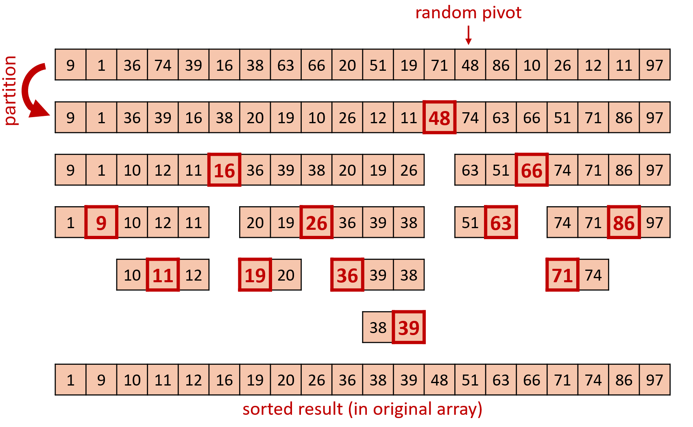
Internal Memory Distribution Sorting – Deterministic
+
Quicksort [Hoare 1959]
Linear time median → pivots [Blum, Floyd, Pratt, Rivest, Tarjan 1973]
↓
Deterministic distribution sorting
optimal O(n log₂ n) time
Cache-oblivious $\text{O}\left(\frac{\text{n}}{\text{B}}\text{log}\text{2}{\frac{\text{n}}{\text{M}}}\right)$ I/Os

Slide 10
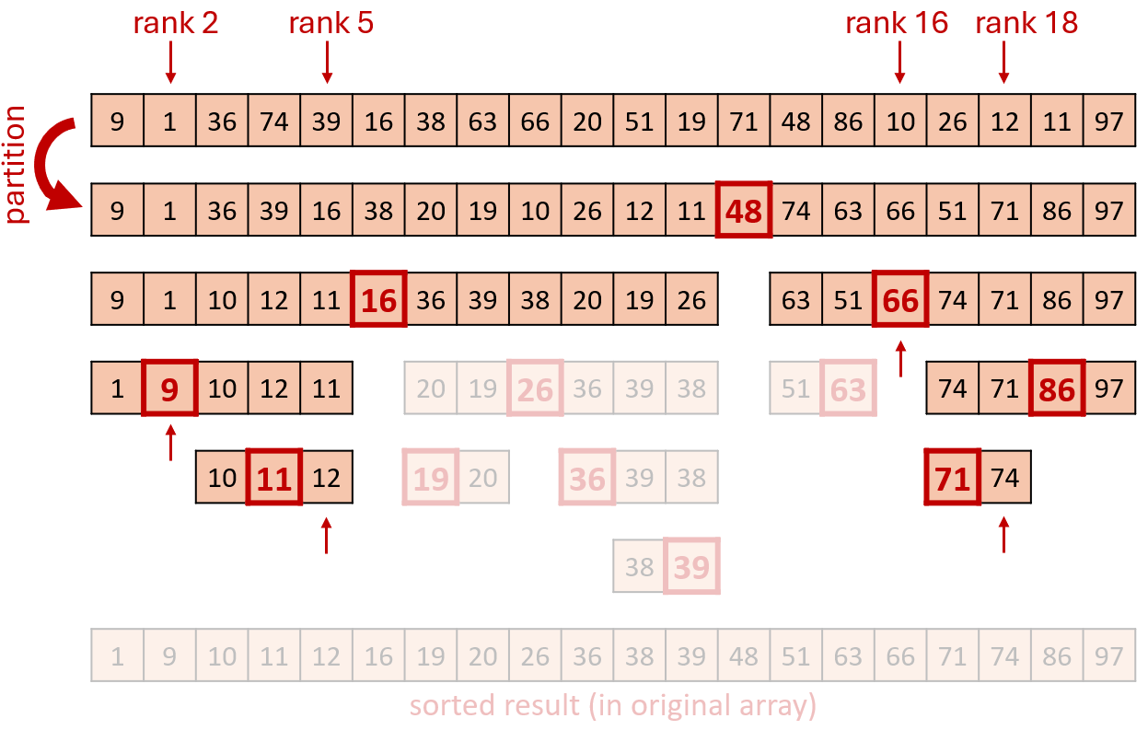
Internal Memory Multiple Selection – Deterministic
+
Multiple selection [Chambers 1971]
Linear time median → pivots [Blum, Floyd, Pratt, Rivest, Tarjan 1973]
↓
Deterministic multiple selection [Dobkin, Munro 1981]
optimal O($ℬ$ + n) time
Cache-oblivious O((ℬ + n) / B) I/Os
Notes:
Dobkin-Munro proved matching lower bound

Slide 11
Summary Internal Memory
 | Randomized / Deterministic | Cache-oblivious I/Os
Sorting | O(n log₂ n) | $\text{O}\left(\frac{\text{n}}{\text{B}}\text{log}\text{2}{ \frac{\text{n}}{\text{M}}}\right)$
Single selection | O(n) | O(n / B)
Multiple selection | O($ℬ$ + n) | O($\text{n}\text{ / }\text{B}+ℬ$ / B)
Optimal I/O ?
$\text{O}\left(\frac{\text{n}}{\text{B}}\text{log}\text{M}\text{/}\text{B}{ \frac{\text{n}}{\text{M}}}\right)$
✓
O($\text{n}\text{ / }\text{B}+ℬ$ / B / log₂ $\frac{\text{M}}{\text{B}}$)
$$ℬ\text{ =}\sum_{\text{i}=1}^{\text{q}+1}{Δ_{\text{i}}\log_{\text{2}}{\frac{\text{n}}{Δ_{\text{i}}}}}$$
(query rank entropy)
Lower bound
[Dobkin, Munro 1981] +
[Arge, Knudsen, Larsen 1993]
Upper bounds
Randomized [ESA 2023] Deterministic [SWAT 2024]
r₁
r₂
r₃
r₄
Δ₁
Δ₂
Δ₃
Δ₄
Δ₅
9 | 1 | 36 | 74 | 39 | 16 | 38 | 63 | 66 | 20 | 51 | 19 | 71 | 48 | 86 | 10 | 26 | 12 | 11 | 97

Slide 12
Cache-aware Distribution Sort – Randomized
45 | 23 | 20 | 28 | 66 | 40 | 38 | 2 | 22 | 61 | 54 | 59 | 32 | 6 | 97 | 92 | 81 | 57 | 69 | 55 | 95 | 42 | 43 | 78 | 48 | 90 | 65 | 3 | 53 | 15 | 64 | 33 | 85 | 80 | 52
multi-way partition
23 | 20 | 28 | 2 | 22 | 32 | 6 | 3 | 15 | 33 | 38 | 45 | 40 | 42 | 43 | 48 | 66 | 61 | 54 | 59 | 57 | 55 | 65 | 53 | 64 | 52 | 69 | 97 | 92 | 81 | 95 | 78 | 90 | 85 | 80
recurse
Generalize Quicksort
Pick Θ(M/B) random pivots
Multi-way partition: Scan and distribute to buckets [internal memory: Θ(M/B) pivots + 1 block input + 1 block per output bucket]
Recurse on buckets ( ≤ M elements sorted in internal memory)
Expected $\text{O}\left(\frac{\text{n}}{\text{B}}\text{log}\text{M}\text{/}\text{B}{ \frac{\text{n}}{\text{M}}}\right)$ I/Os and O(n log n) internal work
Notes:
Memory is a linked list of full blocks
or
perform 2 scans: 1) compute bucket sizes, 2) move directly to the correct position in one big array

Slide 13
Cache-aware Multiple Selection – Randomized
r₁
r₂
r₃
r₄
45 | 23 | 20 | 28 | 66 | 40 | 38 | 2 | 22 | 61 | 54 | 59 | 32 | 6 | 97 | 92 | 81 | 57 | 69 | 55 | 95 | 42 | 43 | 78 | 48 | 90 | 65 | 3 | 53 | 15 | 64 | 33 | 85 | 80 | 52
multi-way partition
23 | 20 | 28 | 2 | 22 | 32 | 6 | 3 | 15 | 33 | 38 | 45 | 40 | 42 | 43 | 48 | 66 | 61 | 54 | 59 | 57 | 55 | 65 | 53 | 64 | 52 | 69 | 97 | 92 | 81 | 95 | 78 | 90 | 85 | 80
recurse
recurse
Θ(M/B)-way distribution sort with pruning (à la Chambers)
Expected optimal O($\text{n}\text{ / }\text{B}+ℬ$ / B / log₂ $\frac{\text{M}}{\text{B}}$) I/Os
Notes:
Work not guaranteed to be optimal ! A partition spends Θ(log(M/B)) on each element

Slide 14
Cache-aware Multi-way Partition – Deterministic
next batch
45 | 23 | 20 | 28 | 66 | 40 | 38 | 2 | 22 | 61 | 54 | 59 | 32 | 6 | 97 | 92 | 81 | 57 | 69 | 55 | 95 | 42 | 43 | 78 | 48 | 90 | 65 | 3 | 53 | 15 | 64 | 33 | 85 | 80 | 52
23 | 20 | 2 | 22 | 6
28
45 | 30 | 38 | 54 | 32 | 55
57
66 | 61 | 59 | 97 | 92 | 81 | 69
current buckets
Goal : create k = Θ(M/B) buckets each of size O(n/k)
Repeatedly distribute batches of n/k elements into buckets (initially one)
Split overflowing buckets (> 2∙n/k elements; at most 3n/k) [using Blum et al. median finding algorithm; split creates pivot]
Result : ≤ k buckets each of size [n/k, 2n/k]
Distribution sort : $\text{O}\left(\frac{\text{n}}{\text{B}}\text{log}\text{M}\text{/}\text{B}{ \frac{\text{n}}{\text{M}}}\right)$ I/Os and O(n log n) internal work
Multiple selection : O($\text{n}\text{ / }\text{B}+ℬ$ / B / log₂ $\frac{\text{M}}{\text{B}}$) I/Os

Slide 15
Summary Cache-aware
Sorting | $\text{O}\left(\frac{\text{n}}{\text{B}}\text{log}\text{M}\text{/}\text{B}{ \frac{\text{n}}{\text{M}}}\right)$ I/Os
Single selection | O(n / B) I/Os
Multiple selection | O($\text{n}\text{ / }\text{B}+ℬ$ / B / log₂ $\frac{\text{M}}{\text{B}}$) I/Os
[Hu, Tao, Yang, Zhou 2014] achieved both I/O and work optimality
Notes:
Lower bounds:

Slide 16
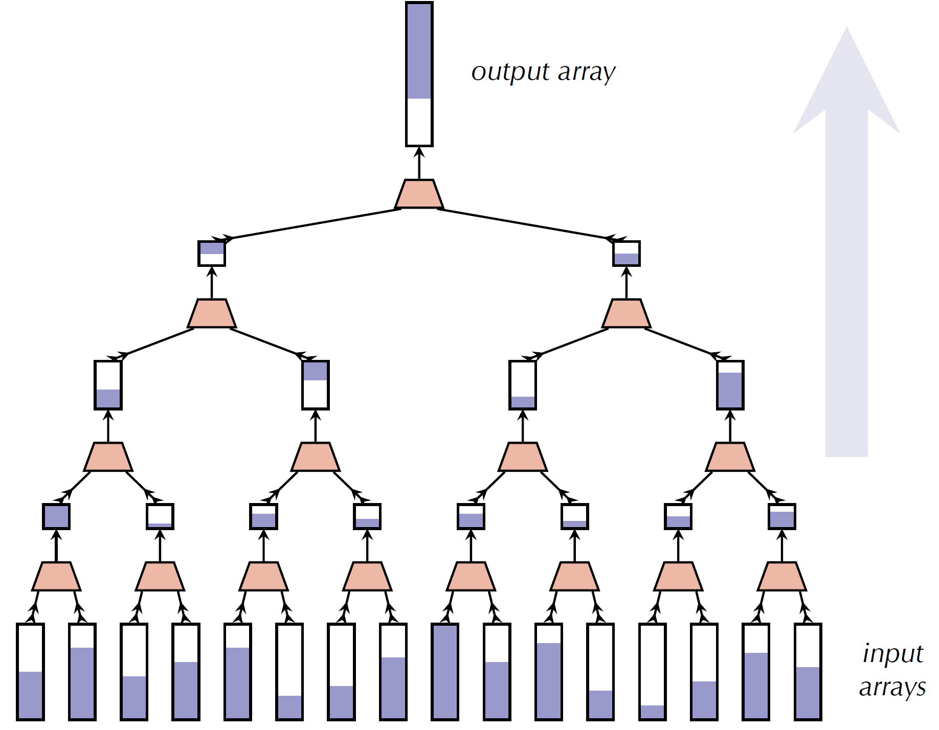
Cache-oblivious Funnelsort – Deterministic
[Frigo, Leiserson, Prokop, Ramachandran 1999]
k-merger
sorted output
Tall cache assumption
M ≥ B^{1+ε}
Neccessary [Brodal, Fagerberg 2002]
Binary mergesort with buffered output
k-merger , k = n^{Θ(ε)}
$\text{O}\left(\frac{\text{n}}{\text{B}}\text{lo}\text{g}\text{M}\text{/}\text{B}{ \frac{\text{n}}{\text{M}}}\right)$ I/Os
buffer size k^{Θ(1/ε)}
$\sqrt{\text{k}}$-merger
k recursively sorted input streams
Notes:
Analysis requires input streams to be sufficiently large (outer recursion, k suffiently small)

Slide 17
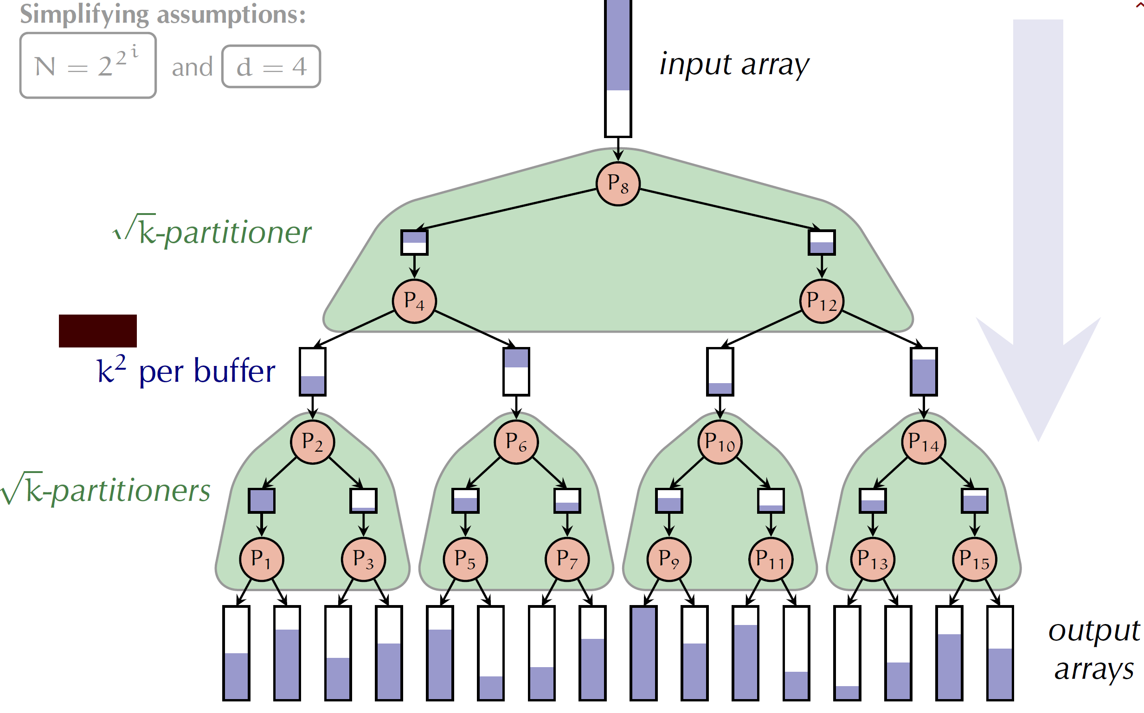
Cache-oblivious Multiple Selection – Idea
unsorted elements
sorted ranks
k-partitioner
Reverse computation of k-merger → k-partitioner
algorithm à la Chambers
Challenges
Pivots ?
Pruning subtree computations before knowning ranks of pivots ?
pivot

Slide 18
Cache-oblivious Multiple Selection – Randomized
[Brodal, Wild 2023]
unsorted elements
sorted ranks
k-partitioner
Sort n / log n size sample
Select k = n^{Θ(ε)} pivots uniformly in sample
Estimate pivot ranks within ±n^{2/3} w.h.p.
Prune inside k-partitioner subtrees w.h.p. no query
Buckets just sort
Expected O($\text{n}\text{ / }\text{B}+ℬ$ / B / log₂ $\frac{\text{M}}{\text{B}}$) I/Os
pivot

Slide 19
Cache-oblivious Multiple Selection – Deterministic
[Brodal, Wild 2024]
Entropy bound ≈ sort → sort
Smaller k
Prune buckets with no query
≥ n/2 elements pruned
Recurse on buckets
Pivots deterministically
Incremental batches size n/k
Split bucket + rebuild k-partitioner
O($\text{n}\text{ / }\text{B}+ℬ$ / B / log₂ $\frac{\text{M}}{\text{B}}$) I/Os
k = n/Δ Δ = $\text{min}{\text{\{}{\text{Δ}}_{\text{i}}\text{|}\sum_{{\text{Δ}}_{\text{j}}\text{≤}{\text{Δ}}_{\text{i}}}{{\text{Δ}}_{\text{j}}}\text{≥} \text{n}\text{/2\}}}$
unsorted elements
sorted ranks
k-partitioner
pivot
Notes:
If the entropy bound is the sorting bound => apply sorting

Slide 20
Summary

