Slide 1
Bottom-up Rebalancing Binary Search Trees by Flipping a Coin
Gerth Stølting Brodal
Aarhus University
12th International Conference on Fun with Algorithms (FUN 2024), Island of La Maddalena, Sardinia, Italy, June 4-8, 2024
Notes:
20 min
Image: https://pixabay.com/da/illustrations/m%C3%B8nt-flipping-m%C3%B8nt-h%C3%A5nd-flip-svirp-5822271/

Slide 2
Review
The paper considers an important problem…
The paper fails to solve the problem…
Notes:
Goal of this talk is to present an open problem, and present ideas that fail to solve the general problem, but in some special cases solve the problem

Slide 3
Unbalanced binary search trees – Insertions
4
Locate insertion point (empty leaf)
Create new leaf node
3
8
1
5
9
7
Notes:
A sorted input is a bad input
Shuffle elements before insertion gives an (expected) balanced tree

Slide 4
Unbalanced binary search trees
Inserting 1 2 3 4 5 6
Inserting 3 5 2 4 1 6
random permutation gives expected logarithmic depth [Hilbard 1962]
increasing sequence gives linear depth
Notes:
A sorted input is a bad input
Shuffle elements before insertion gives an (expected) balanced tree

Slide 5
Balanced binary search trees
Structural invariants implying logarithmic depth
Rebalance using rotations
60s AVL-tree
70s Red-black tree
80s Splay tree
90s Treap
v
4
3
4
0.110
2
7
6
1
0.101
7
0.011
6
9
5
7
No two adjacent red & root-to-leaf paths same #black
Always rotate accessed node to the root
Elements random priority, stored using heap order
|h(v.left) – h(v.right)| ≤ 1
Notes:
AVL : 1962 Adelson-Velsky, Landis
Red-black : 1978 Guibas, Sedgewick
Treap : 1996 Seidel, Aragon = Structure equals a random permutation

Slide 6
Balanced binary search tree insertions : rebalancing cost
Reference | Name | Time | Rotations | Random bits | Space pr node
[AVL62] | AVL-trees | O_{A}(1) | O(1) | 0 | 2
[GS78] | Red-black trees | O_{A}(1) | O(1) | 0 | 1
[B79] | Encoded 2-3 trees | O(lg n) | O(lg n) | 0 | 0
[ST85] | Splay trees | O_{A}(lg n) | O_{A}(lg n) | 0 | 0
[A89,GR93] | Scapegoat | O(lg n) | O(lg n) | 0 | global O(lg n)
[SA96] | Treaps | O_{E}(1) | O_{E}(1) | O_{E}(1) | O_{E}(1)
[MR98] | Randomized BST | O_{E}(lg n) | O_{E}(1) | O_{E}(lg² n) | O(lg n)
[S09] | Seidel | O_{E}(lg² n) | O_{E}(1) | O_{E}(lg³ n) | 0
 | Open problem | O_{E}(1) | O(1) | O_{E}(1) | 0
random BST
Notes:
AVL proof by Mehlhorn & Tsakalidis 86
Seidel stated the open problem if bottom-up rebalancing is possible
Brown 79 : Encodes a bit using two consecutive values and an empty leaf
Martinez & Roura 98 : Randomized BST – stores subtree sizes at each node
Seidel, Aragon 96 : Treaps store expected O(1) bits per node – sufficient to compare with parent priority
Seidel 09 : Computes 1/(subtree size + 1) by a random process at each node
Andersson 89; Galperin, Rivest 93: Scapegoat trees store total tree size and all leaves must have depth O(log n), rebuilds subtrees
Sleator, Tarjan 85 : Splay trees worst case depth is linear

Slide 7
Question asked in this paper
Does there exists a randomized rebalancing scheme satisfying…
No balance information stored
Worst-case O(1) rotations
Most rotations near the insertion
Local information only
Expected O(1) time
O(1) random bits per insertion
Nodes expected depth O(lg n)
Notes:
1) Like splay, encoded 2-3 trees, scapegoat [Assumes access to parent path of leaf created – either in tree representation or on a recursion stack]
2-3) Like AVL and red-black tree
4) Not like scapegoat that requires global n
5-6) Like treaps
7) Balanced tree… (unbalanced trees satisfy 1-6)

Slide 8
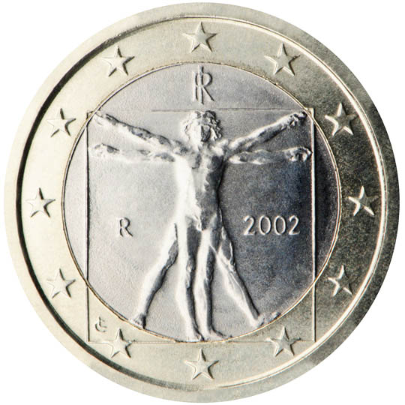
Algorithm RebalanceZig
v
7
Fact 1 RebalanceZig takes expected O(1) time and performs ≤ 1 rotation
Theorem 1 RebalanceZig on increasing sequence each node expected depth O(lg n), for 0 < p < 1 (p = Pr[tail])

Slide 9
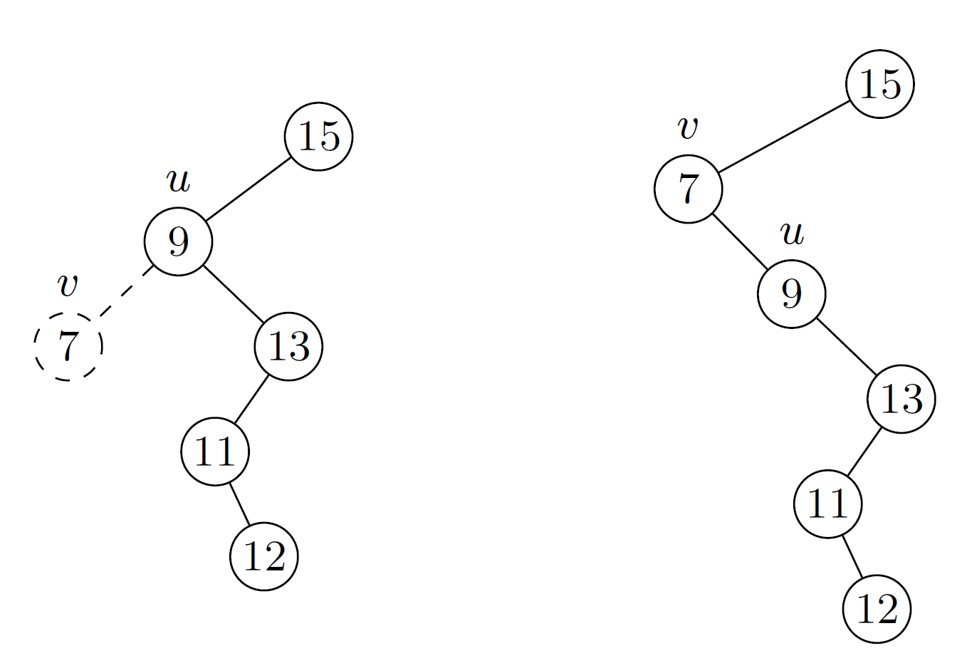
Algorithm RebalanceZig extreme probabilities
v
7
Pr[tail] = 1 never performs rotation i.e. unbalanced binary search tree
Pr[tail] = 0 always rotates up new leaf i.e. tree is always a path

Slide 10
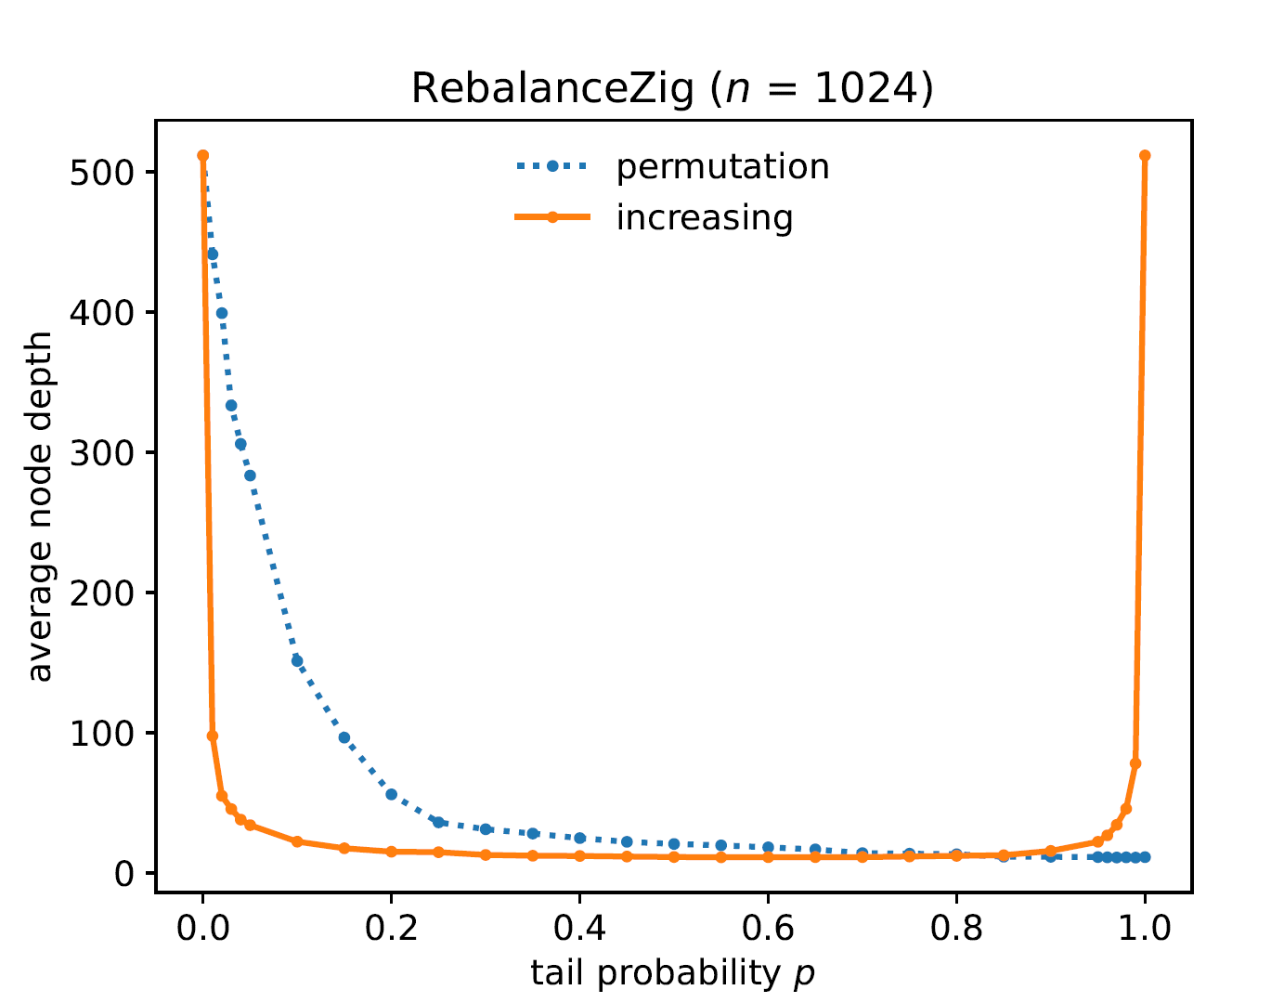
Rotate onto path
No rebalancing
Theorem 1 Increasing is Θ(lg n) for 0 < p < 1
Fair coin
Notes:
Looks promising to use a fair coin

Slide 11
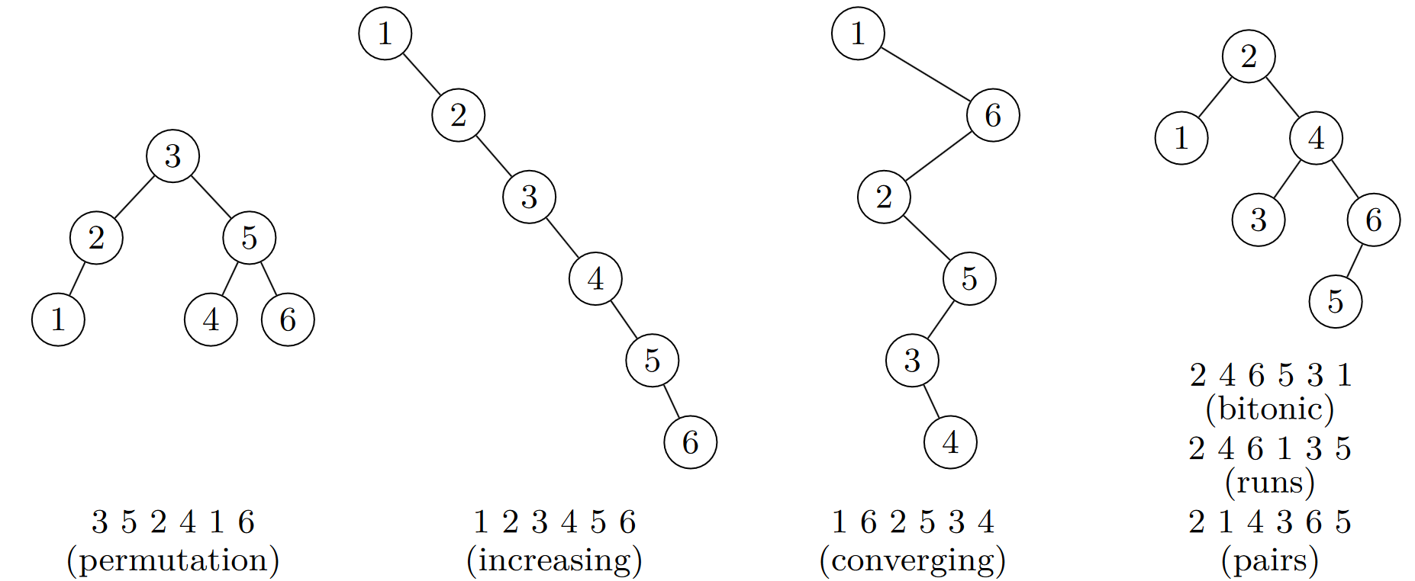
Different insertion sequences

Slide 12
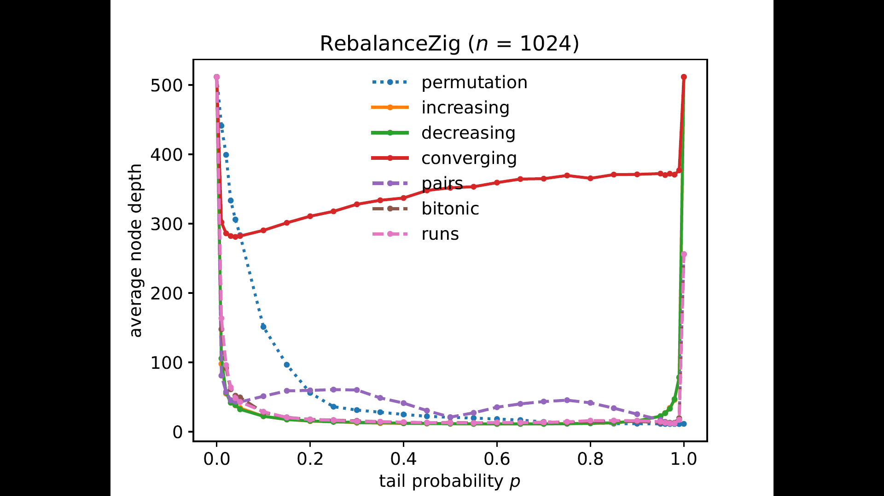
Rotate onto path
No rebalancing
Theorem 2 Convering is Θ(n)
Theorem 3 Pairs is Θ(n) for p ≠ ½
Conjecture Pairs is Θ($\sqrt{\text{n}}$) for p = ½
Fair coin
Notes:
Converging sequence killed the hope for RebalanceZig
Pairs = bitonic = runs for no rebalancing, but behave differently with pairs significantly worse

Slide 13
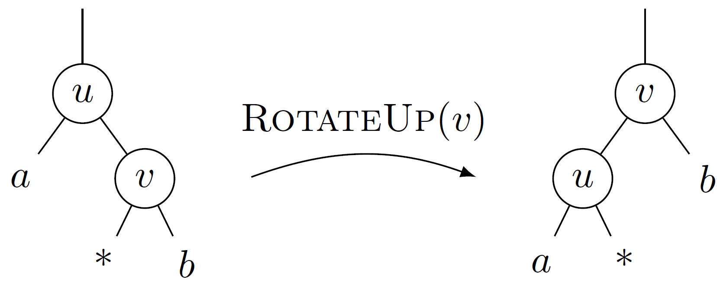
Why ReblanceZig is bad on convering
“Proof” of Theorem 2
For each pair the depth of the insertion point increases by ≥ 1 with probability ≥ p(1-p) : If inserting u rotates a (strict) ancestor of u up, and inserting v rotates v up, then depth of insertion point * increases by inserting the pair
Notes:
Each insertion increases the depth of the insertion point by one – the subsequent rotation can decrease it by one

Slide 14
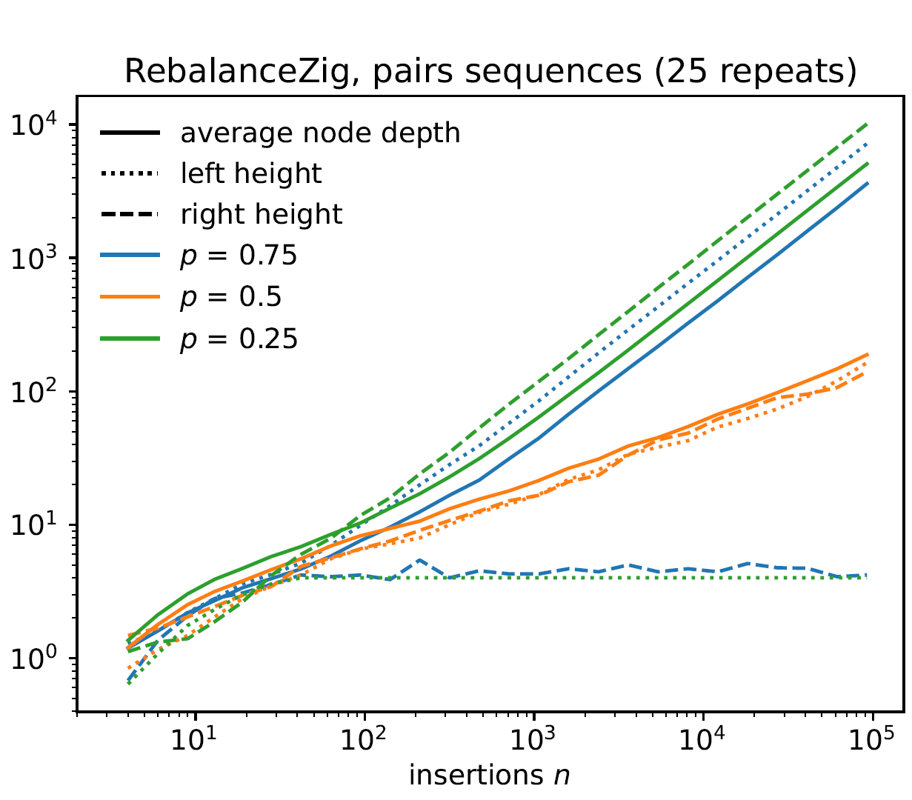
Why ReblanceZig is bad on pairs
“Proof” of Theorem 3
p < ½ , odd numbers tend to be rotated on rightmost path, right path expected Θ(n) nodes
p > ½, rightmost path tends to contain O(1) nodes, left path expected Θ(n) nodes
Notes:
p = ½ the expected change to the right path per pair is 0, but it can never become negative, implying right most path is O(sqrt(n))
Left/right height = length of path from root to leftmost/rightmost leaf

Slide 15
Find a randomized algorithm that handles coverging sequences
Notes:
Converging sequence killed the hope for RebalanceZig
Pairs + fair coin, somewhat balanced =conjectured sqrt(n)
Pairs = bitonic = runs for no rebalancing, but behave differently with pairs significantly worse

Slide 16
Algorithm RebalanceZigZag
Notes:
Two modifications
First case rotates v.p up instead of v
Zig-zag case borrowed from splay trees, to address exactly the hard case for RebalanceZig

Slide 17
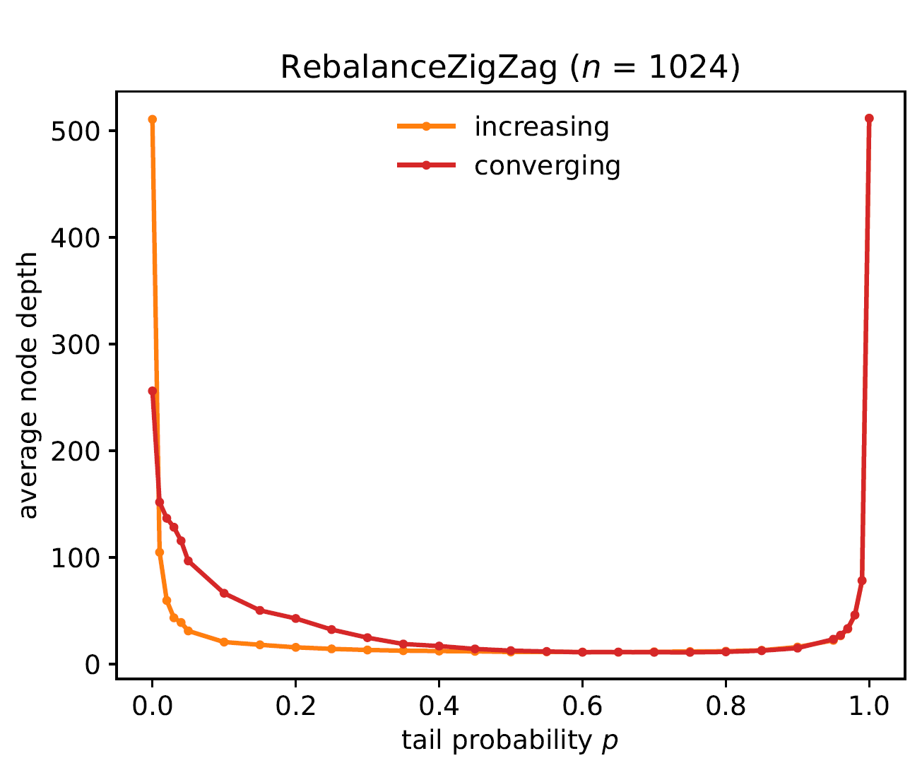
No rebalancing
Theorem 4 Increasing is Θ(lg n) for 0 < p < 1
Theorem 5 Converging is Θ(lg n) for 0.62 < p < 1
Notes:
For increasing sequences ZigZag performs exactly one rotation on right spine, like algorithm Zig. Proof essentially the same.
For converging sequences the analysis is very similar to increasing sequences, since a transformation always reduces the depth of the insertion point (here it is important that we rotate up v.p in the first case).

Slide 18
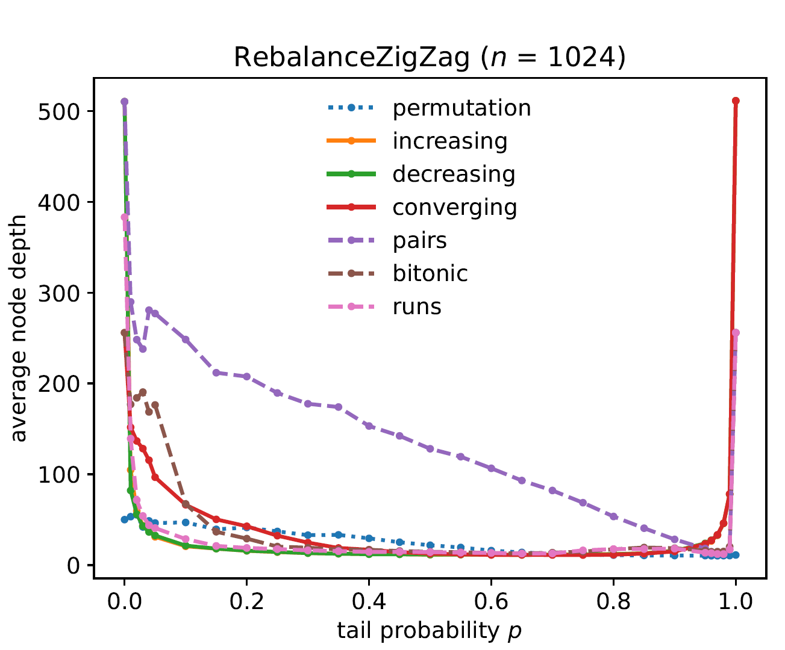
Theorem 6 Pairs is Θ(n) for 0 ≤ p ≤ 1
Notes:
The lower bound for pairs is dependent on p. Note pairs is also Θ(n) for p = ½.
The expected change to the right path is negative, ie., right path has expected O(1) length, and left path has expected length Θ(n)

Slide 19
Summary
Notes:
Unknown for what p < 1 random permutations achieve expected logarithmic height

Slide 20
Bottom-up Rebalancing Binary Search Trees by Flipping a Coin
Notes:
Summary slide

Slide 21
Bottom-up Rebalancing Balanced Binary Search Trees by Flipping a Coin
?
Notes:
Open problem – the original working title of the paper…
Goal: just logarithmic height - not the same distribution as inserting a random permutation (likely impossible?)
Idea: Seidel computes subtree sizes using randomization, but that idea breaks when applied bottom-up

Slide 22
Review
The paper considers an important problem…
The paper fails to solve the problem…
SCORE: 3 (strong accept)
Notes:
Goal of this talk is to present an open problem, and present ideas that fail to solve the general problem, but in some special cases solve the problem

Slide 23
Flow diagram of research progress
known
fails
?
?
Want to go to FUN
Come up with
problem
Literature review
Open
problem
Propose solution
Make proof
Theorem
new
perhaps interesting
stupied idea
missing insights
trivial
Try to solve it
Code it
Evaluate
Observe
Prove simpler
result
Lemma / Claim
debug
appears promising

