Slide 1
Priority Queues with Decreasing Keys
Gerth Stølting Brodal
Aarhus University
11th FUN with Algorithms, Island of Favignana, Sicily, Italy, May 30-June 3, 2022
Notes:
Thursday, June 2, 2022, 10:45-11:10
This talk is on priority queue data structures.
Typically store items that are (key, value) pairs.
Can insert items and extract items with the minimum key.,
This talk is on what happens if the key of an item can decrease over time..

Slide 2
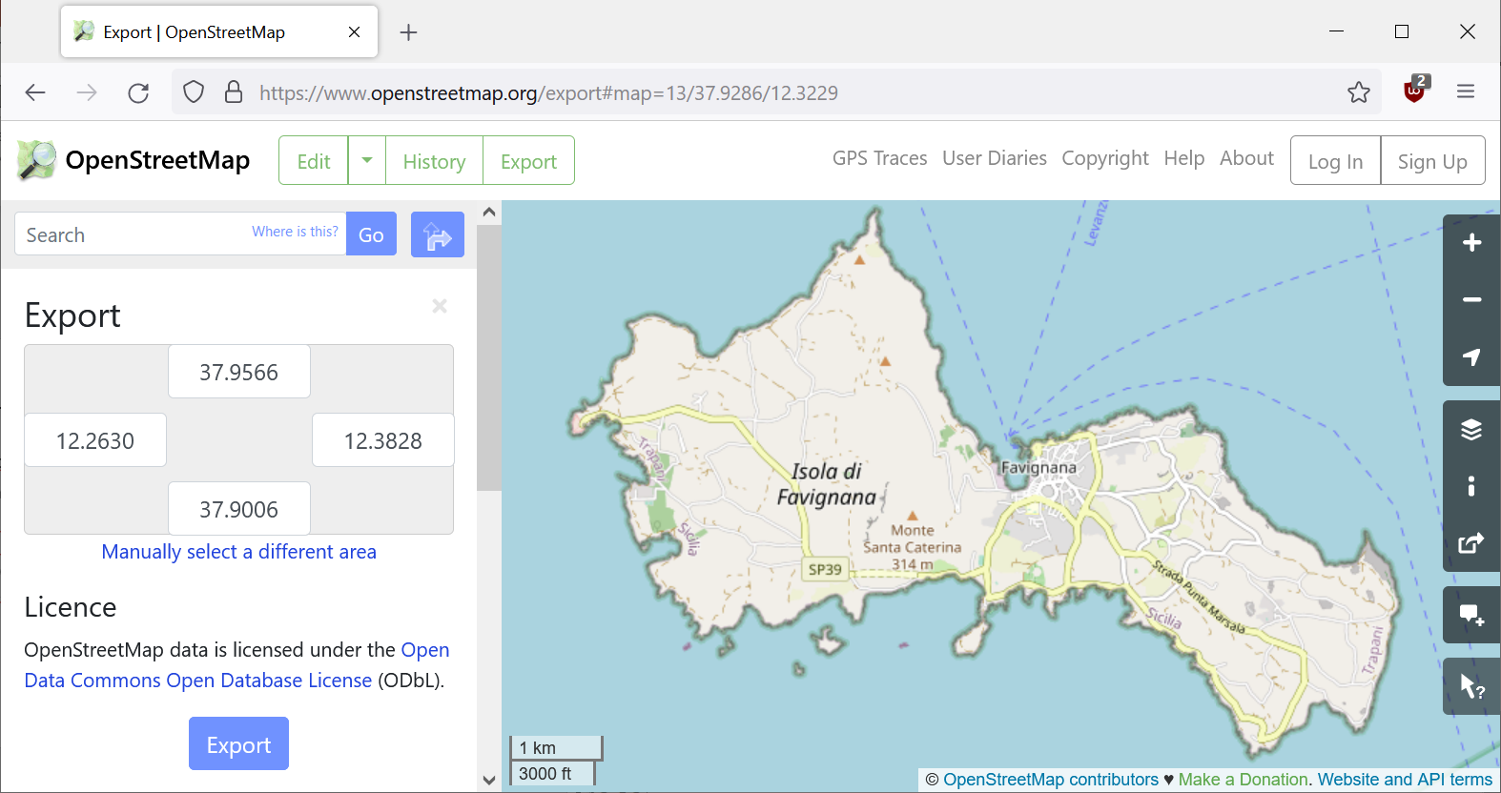
Background
Bachelorproject = shortest paths on Open Street Map graphs
Students have trouble implementing Dijkstra's algorithm in JavaTM

Slide 3
Dijkstra’s algorithm
2
+∞
B
4
4
6
6
0
2
+∞
+∞
source
A
1
D
2
E
4
Non-negative edge weights
Visits nodes in increasing distance from source
1
C
Q = ⟨0,A⟩
+∞
⟨2,B⟩ ⟨4,C⟩
4
relax
3
⟨3,C⟩ ⟨6,D⟩
⟨4,D⟩
⟨6,E⟩
Fibonacci heaps
⇒ O(m + n ∙ log n)
O(log n) Remove
⇒ O(m ∙ log n)
relax
Notes:
Fibonacci heaps not part of standard library; anyway road maps are sparse, so the theoretical gain from Fibonacci heaps is not relevant
Dijkstra2: ”v in Q” could mentain a bitvector/set to test for this.

Slide 4
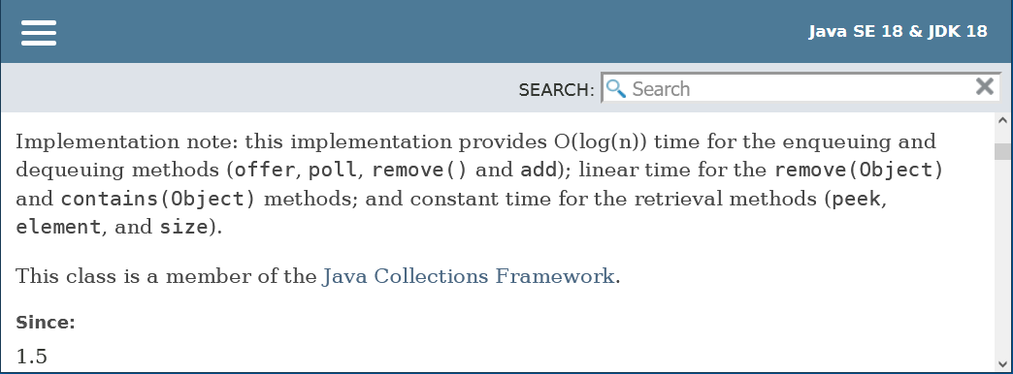
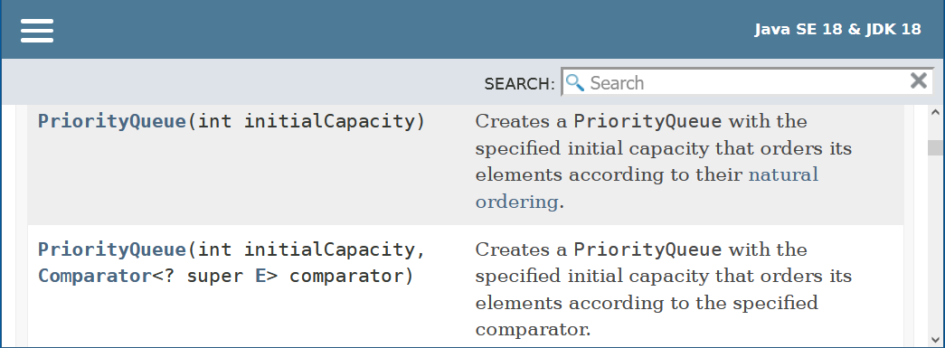
The Challenge - Java's builtin binary heap
no decreasekey
remove O(n) time
⇒ Dijkstra O(m ∙ n)
comparator function

Slide 5
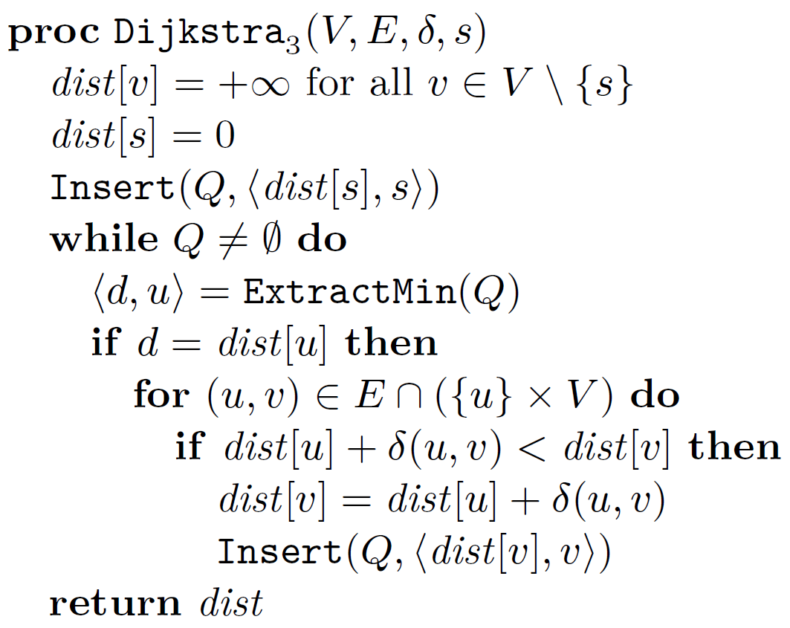
Repeated insertions
2
+∞
B
4
4
6
6
0
2
+∞
+∞
source
A
1
D
2
E
Relax inserts new copies of item
Skip outdated items
4
1
C
+∞
4
Q = ⟨0,A⟩
3
⟨2,B⟩ ⟨4,C⟩
⟨3,C⟩ ⟨4,C⟩ ⟨6,D⟩
⟨4,C⟩ ⟨4,D⟩ ⟨6,D⟩
⟨4,D⟩ ⟨6,D⟩
outdated ?
⟨6,D⟩ ⟨6,E⟩
⟨6,E⟩
relax
= reinsert
Notes:
Fibonacci heaps not part of standard library; anyway road maps are sparse, so the theoretical gain from Fibonacci heaps is not relevant
Dijkstra2: ”v in Q” could mentain a bitvector/set to test for this.

Slide 6
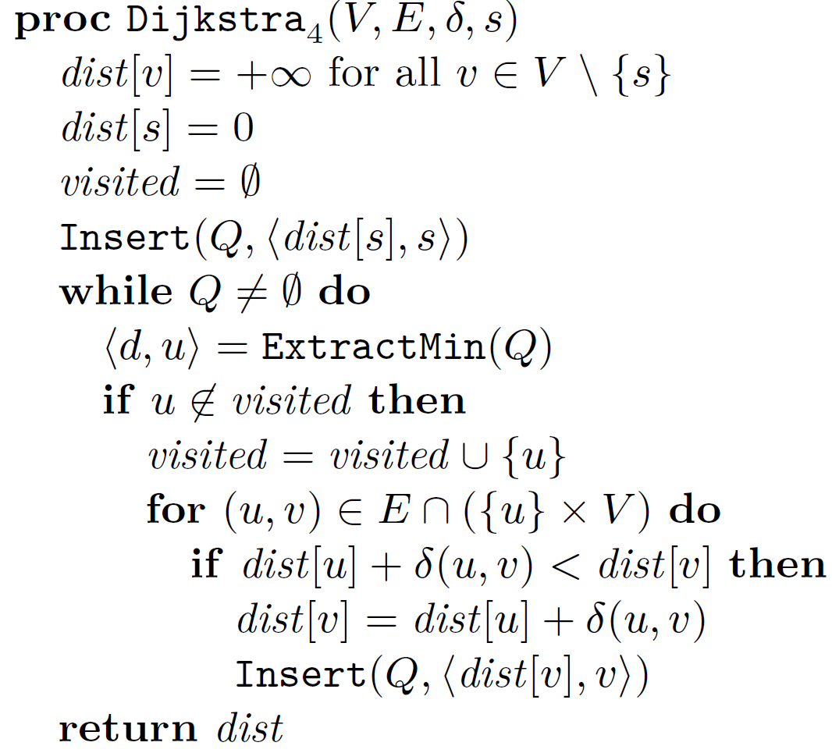
Using a visited set
2
+∞
B
4
4
6
6
0
2
+∞
+∞
source
A
1
D
2
E
4
1
C
+∞
4
Q = ⟨0,A⟩
3
⟨2,B⟩ ⟨4,C⟩
⟨3,C⟩ ⟨4,C⟩ ⟨6,D⟩
⟨4,C⟩ ⟨4,D⟩ ⟨6,D⟩
use bitvector
⟨4,D⟩ ⟨6,D⟩
⟨6,D⟩ ⟨6,E⟩
⟨6,E⟩

Slide 7
A shaky idea…
Only store nodes in Q (save space)
Comparator
Key = current distance dist
Heap invariants break
d never used
Notes:
Student implementations.
Some worked, because they did not use visited and just revisited nodes (no runtime guarantee)
Others essentially worked, except a few test cases having ”nummerical” issues (a heap most times does the correct thing)

Slide 8
Experimental study
visited = set()
Q = Queue()
Q.insert(Item(0, source))
while not Q.empty():
u = Q.extract_min().value
if u not in visited:
visited.add(u)
for v in G.out[u]:
dist_v = dist[u] + G.weights[(u, v)]
if dist_v < dist[v]:
dist[v] = dist_v
parent[v] = u
Q.insert(Item(dist[v], v))
Implemented Dijkstra₄ in Python
Stress test on random cliques
Binary heaps
Skew heaps
Leftist heaps
Pairing heaps
Binomial queues
Post-order heaps
Binary heaps with top-down insertions
failed
worked
worked
worked
worked
worked
worked
(default priority queue in Java and Python)
Pointer based
Implicit (space efficient)
Notes:
Class Item implements the comparator to use either the static key or the current dist value
Harvey and Zatloukal, FUN 2004

Slide 9
Binary heap insertions – bottom-up vs top-down
2
2
Insert(7)
3
top-down
5
3
5
9
4
8
bottom- up
12
9
4
7
12
10
14
6
20
17
7
10
14
6
20
17
8
Notes:
Standard heap both in Java and Python

Slide 10
Binary heaps using dist in a comparator fails
not smallest key
outdated
wrong placement
ignored since visited
Notes:
Autogenerated example from stress test….

Slide 11
Definition Priority Queues with Decreasing Keys
Items = ⟨key, value⟩
Over time keys can decrease – priority queue is not informed
Items are compared w.r.t. their current keys
The original key of an item is the key when it was inserted
Insert(item)
ExtractMin() returns an item with current key less than or equal to all original keys in the priority queue
Notes:
In Dijkstra’s algorithm all outdated items are items with current key < original key
Note ExtractMin does not necessarily have to return item with minimum current key

Slide 12
Theorem 1
Dijkstra₄ correctly computes shortest paths when using dist as current key and a priority queue supporting decreasing keys
Theorem 2
The following priority queues support decreasing keys (out of the box)
binary heaps with top-down insertions
skew heaps
leftist heaps
pairing heaps
binomial queues
post-order heaps

Slide 13
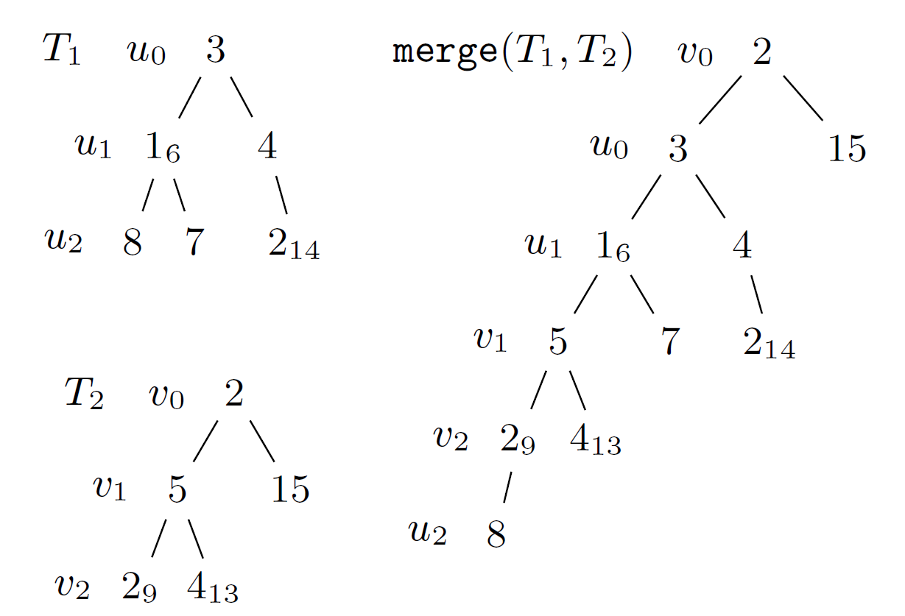
Proof of Theorem 2 - Basic idea
Decreased heap order
u ancestor of v ⇒ current key u ≤ original key v
Root valid item to extract
Top-down merging two paths preserves decreased heap order
⇒ skew heaps and leftist heaps support decreasing keys

Slide 14
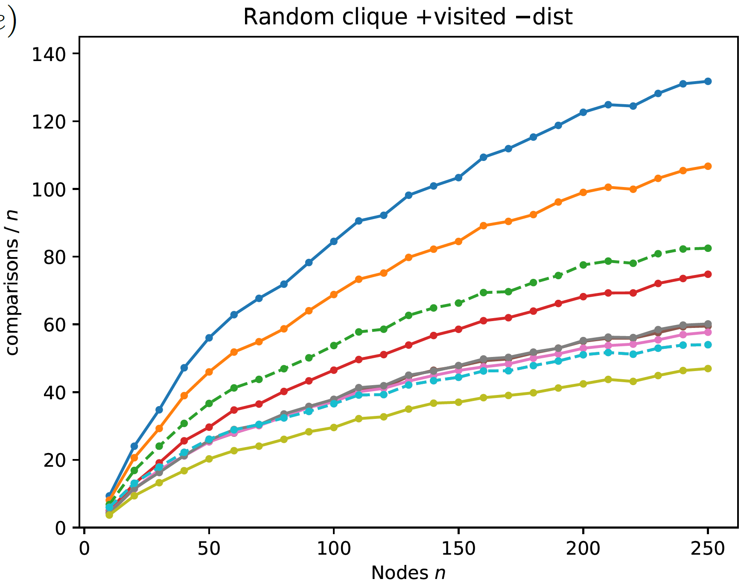
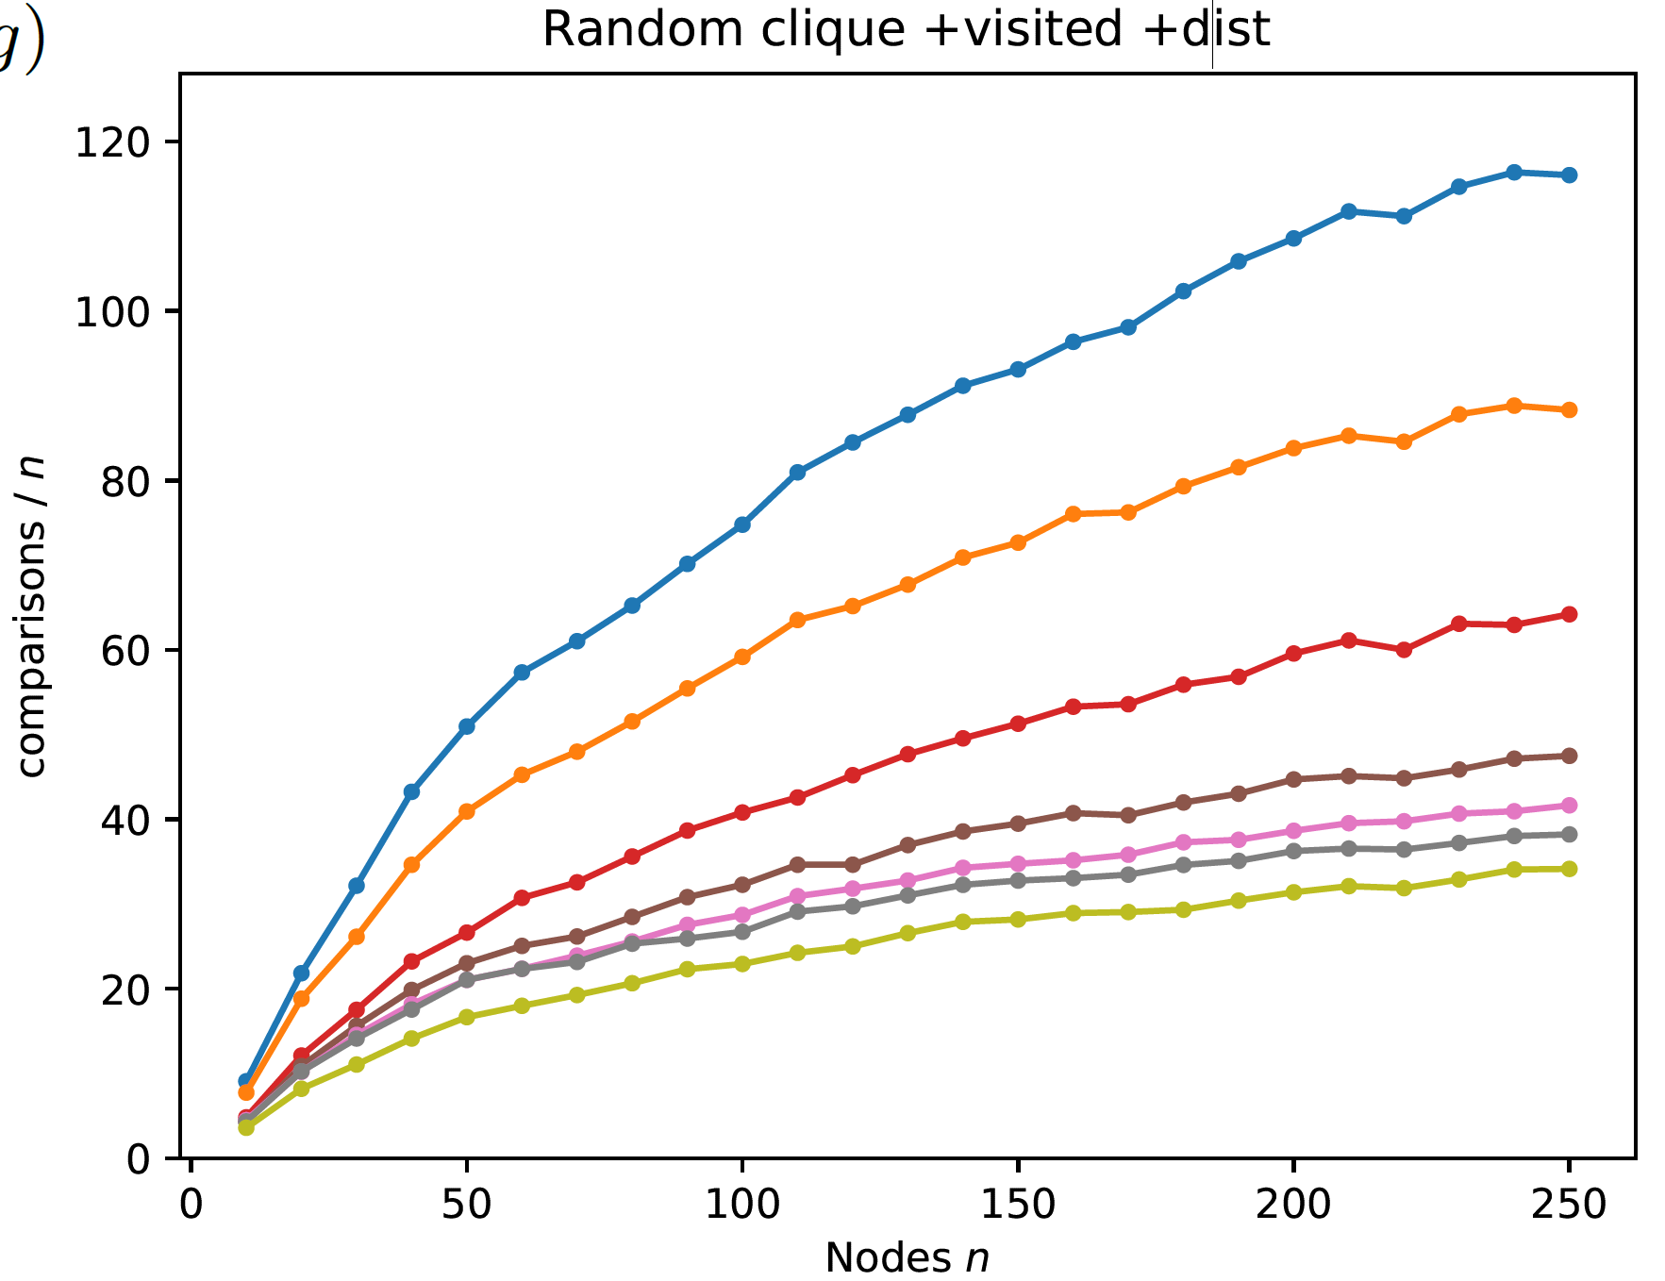
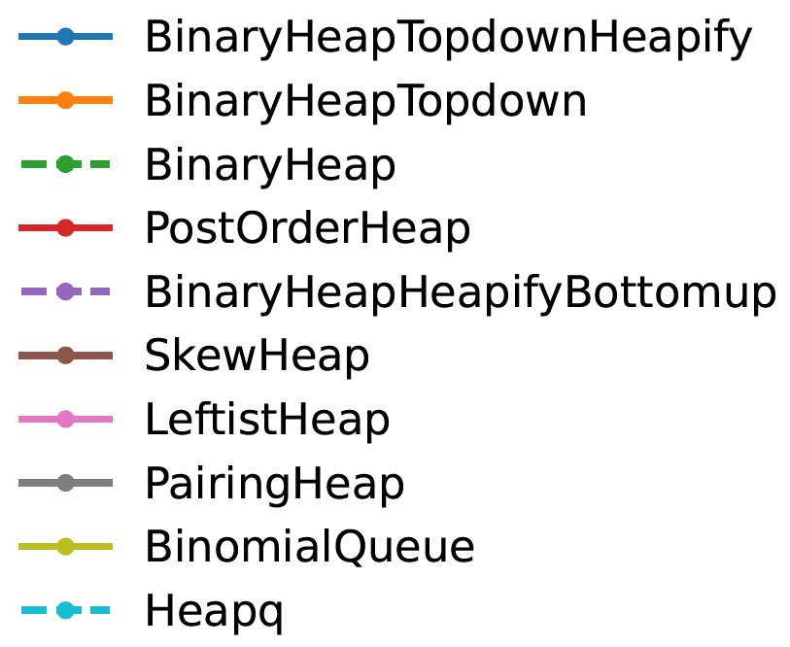
Experimental evaluation of various heaps
Cliques with uniform random weights
With decreasing keys less comparisons (outdated items removed earlier)
⟨key, value⟩ pairs
decreasing keys
Notes:
Only comparisons internal in heap are measured
heapq = BinaryHeapHeapifyBottomup (Heapify = recursive pull up smallest until leaf, and then insert there)
Binary heao = heapify top-down until right poisition
Binary Heap topdown is bad

Slide 15
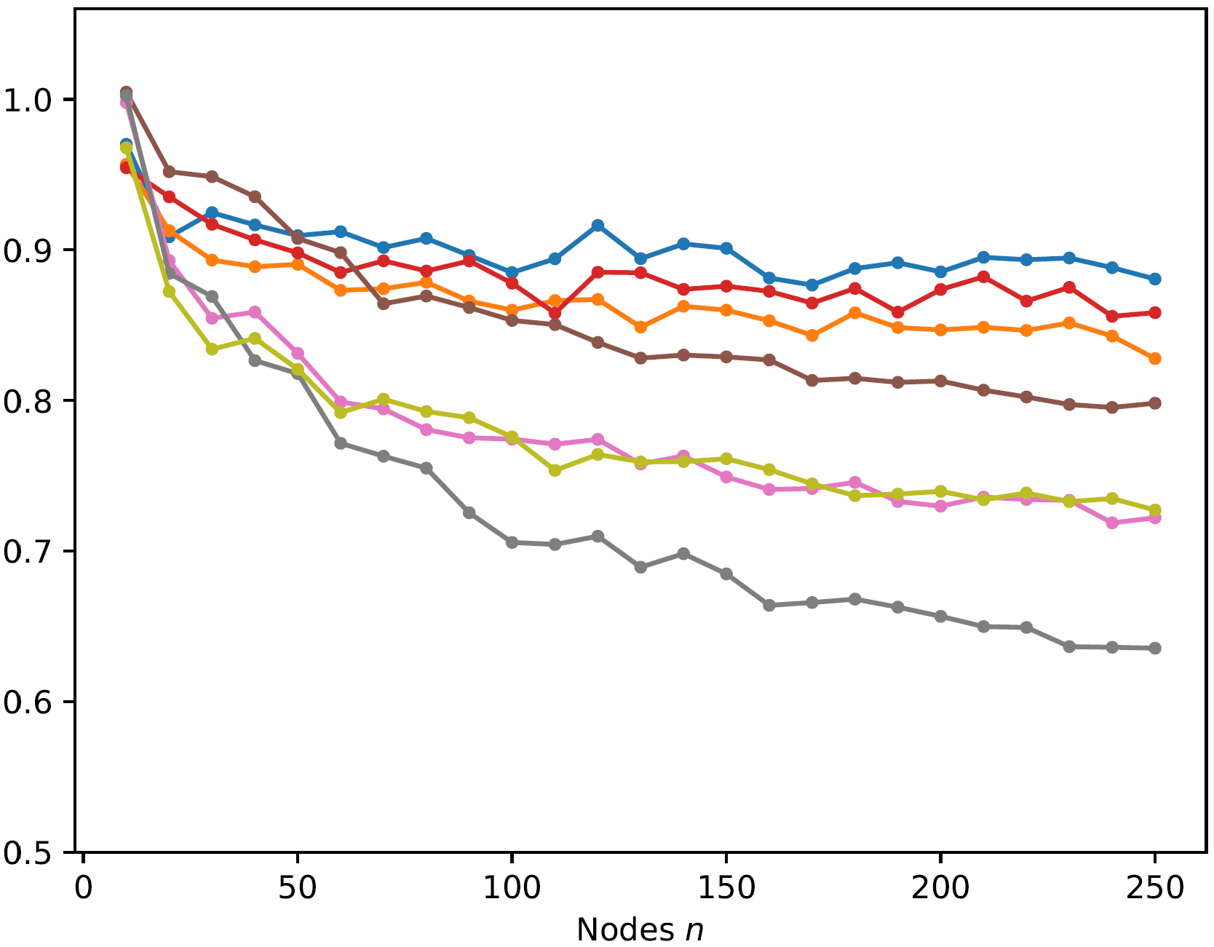
Reduction in comparisons
comparisons decreasing keys / comparisons ⟨key, value⟩ pairs
Notes:
for worst-case weights on cliques the gains are smaller (alle edges cause a new insertion)

Slide 16
Postorder heap [Harvey and Zatloukal, FUN 2004]
Insert amortized O(1), ExtractMin amortized O(log n)
Implicit (space efficient)
Best implicit comparison performance (and good time performance)

Slide 17
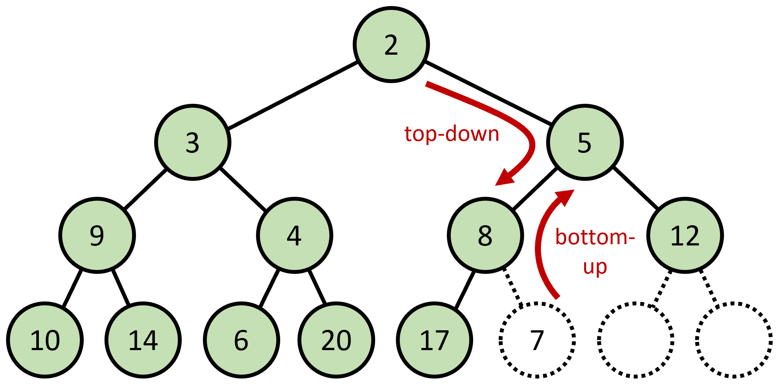
Conclusion
Introduced notion of priority queues with decreasing keys … as an approach to deal with outdated items in Dijkstra’s algorithm
Experiments identified priority queues supporting decreasing keys … just had to prove it
Builtin priority queues in Java and Python are binary heaps … do not support decreasing keys
Binary heaps with top-down insertions do support decreasing keys
… and also
skew heaps, leftist heaps, pairing heaps, binomial queues, post-order heaps

Slide 18
<way id="106231197" visible="true" version="8" changeset="90539127" timestamp="2020-09-07T15:29:03Z" user="vbertola" uid="4347030">
<nd ref="1222984792"/>
<nd ref="6789155595"/>
<nd ref="1222984775"/>
<nd ref="1222984838"/>
...
<nd ref="4439326163"/>
<nd ref="4439326143"/>
<nd ref="1222984725"/>
<nd ref="6789155593"/>
<nd ref="1222984792"/>
<tag k="addr:city" v="Favignana"/>
<tag k="addr:housenumber" v="29"/>
<tag k="addr:postcode" v="91023"/>
<tag k="addr:street" v="Via Giovanni Amendola"/>
<tag k="contact:facebook" v="www.facebook.com/exstabilimentofloriofavignana"/>
<tag k="description" v="Museo regionale di storia - apertura stagionale marzo-novembre"/>
<tag k="heritage:website" v="http://pti.regione.sicilia.it/portal/page/portal/PIR_PORTALE/PIR_LaStrutturaRegionale/PIR_AssBeniCulturali/PIR_BeniCulturaliAmbientali"/>
<tag k="name" v="Ex stabilimento Florio delle tonnare di Favignana e Formica"/>
<tag k="operator" v="Regione siciliana"/>
<tag k="operator:type" v="public"/>
<tag k="tourism" v="museum"/>
<tag k="website" v="http://www.visitsicily.info/ex-stabilimento-florio-tonnara-favignana/"/>
</way>

