Slide 1
Primtalssætningen skalerer billeder Gerth Stølting Brodal Institut for Datalogi
Notes:
Titel: Primtalssætningen Skalerer Billeder
Abstrakt: Geologerne Woodcock og Strahler beskrev i 1987 hvordan man kunne identificere trækroner ud fra at skalere luftfotos til forskellige opløsninger. I dette foredrag gennemgås effektive algoritmer for at foretage sådanne skaleringer af billeder - og specielt hvordan primtalssætningen spiller en overraskende central rolle i udviklingen af algoritmer, der adresser udfordringer ved moderne computer arkitekturer.

Slide 2
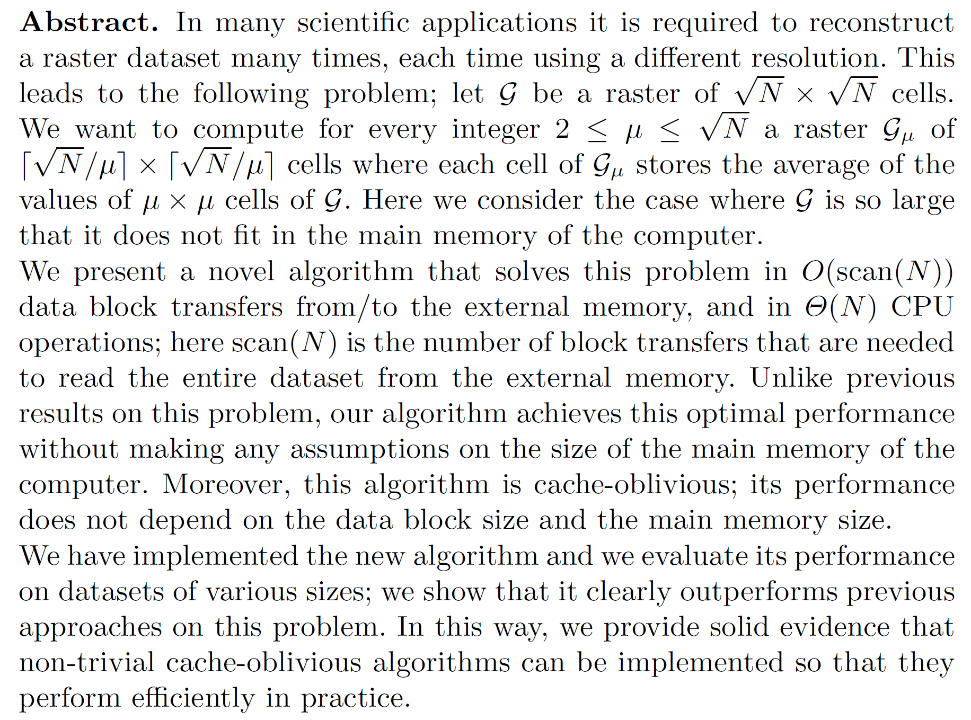
Proc. 21st Annual European Symposium on Algorithms, Sophia Antipolis, France, volume 8125 of Lecture Notes in Computer Science, pages 61-72, Springer Verlag, Berlin, 2013, 10.1007/978-3-642-40450-4_6
Notes:
Græske medforfattere kan godt lide at bruge det græske alfabet…

Slide 3
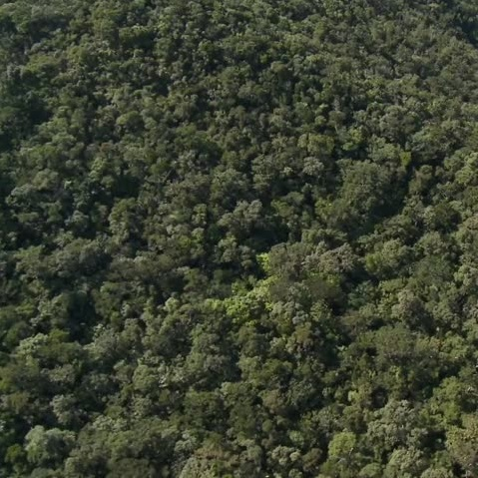
Rød: 64% = Grøn: 70% Blå: 44%

Slide 4
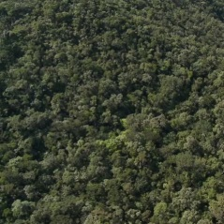
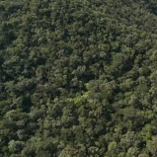
Input n x n billede M₁
Output M₂ M₃ ∙∙∙ M_{d} ∙∙∙ M_{n}, hvor M_{d} størrelse $\frac{\text{n}}{\text{d}}$ x $\frac{\text{n}}{\text{d}}$
C.E. Woodcock and A.H. Strahler. The Factor of Scale in Remote Sensing. Remote Sensing of Environments, 21:311-332, 1987
n x n
$\frac{\text{n}}{\text{2}}$ x $\frac{\text{n}}{\text{2}}$
M₁ (input)
$\frac{\text{n}}{\text{3}}$ x $\frac{\text{n}}{\text{3}}$
$\frac{\text{n}}{\text{4}}$ x $\frac{\text{n}}{\text{4}}$
$\frac{\text{n}}{\text{5}}$ x $\frac{\text{n}}{\text{5}}$
$\frac{\text{n}}{\text{6}}$ x $\frac{\text{n}}{\text{6}}$
$\frac{\text{n}}{\text{7}}$ x $\frac{\text{n}}{\text{7}}$
M₂
M₃
M₄
M₅
M₆
M₇
$\frac{\text{n}}{\text{8}}$ x $\frac{\text{n}}{\text{8}}$
$\frac{\text{n}}{\text{9}}$ x $\frac{\text{n}}{\text{9}}$
…
Notes:
Billeder for d=1-75; input billedet har størrelse 479
Woodcock og Strahler introducerede problemet til at finde gennemsnitlige ”canopies” (trækrone?) i gråtone billeder

Slide 5
Samlet bredde
= $\frac{\text{n}}{\text{1}}$ + $\frac{\text{n}}{\text{2}}$ + $\frac{\text{n}}{\text{3}}$ + ∙∙∙ + $\frac{\text{n}}{\text{d}}$ + ∙∙∙ + $\frac{\text{n}}{\text{n}\text{−1}}$ + $\frac{\text{n}}{\text{n}}$
=
$$\sum_{\text{d}\text{=1}}^{\text{n}}{\frac{\text{n}}{\text{d}}} = \text{n}\sum_{\text{d}\text{=1}}^{\text{n}}{\frac{\text{1}}{\text{d}}} ≤ \text{n}\left(\text{1}+\int_{\text{1}}^{\text{n}}{\frac{\text{1}}{\text{x}}\text{dx}}\right) =\text{n}\left({\text{1}+\left[\text{ln}{\text{(}\text{x}\text{)}}\right]}_{\text{1}}^{\text{n}}\right)\text{ = }\text{n}\left(\text{1 + }\text{ln}{\text{(}\text{n}\text{)}}\right)$$
= H_{n} = n’te harmoniske tal
1
1/x
1/2
n x n
1
7
n
2
3
4
5
6
$\frac{\text{n}}{\text{2}}$ x $\frac{\text{n}}{\text{2}}$
$\frac{\text{n}}{\text{3}}$ x $\frac{\text{n}}{\text{3}}$
$\frac{\text{n}}{\text{4}}$ x $\frac{\text{n}}{\text{4}}$
$\frac{\text{n}}{\text{5}}$ x $\frac{\text{n}}{\text{5}}$
$\frac{\text{n}}{\text{6}}$ x $\frac{\text{n}}{\text{6}}$
$\frac{\text{n}}{\text{7}}$ x $\frac{\text{n}}{\text{7}}$
$\frac{\text{n}}{\text{8}}$ x $\frac{\text{n}}{\text{8}}$
M₁
M₂
M₃
M₄
M₅
M₆
M₇

Slide 6
Samlet størrelse
= ${\left(\frac{\text{n}}{\text{1}}\right)}^{\text{2}}\text{+}{\left(\frac{\text{n}}{\text{2}}\right)}^{\text{2}}{\text{+}\left(\frac{\text{n}}{\text{3}}\right)}^{\text{2}}\text{+}$ ∙∙∙ $\text{+}{\left(\frac{\text{n}}{\text{d}}\right)}^{\text{2}}\text{+}$ ∙∙∙ $\text{+}{\left(\frac{\text{n}}{\text{n}\text{−1}}\right)}^{\text{2}}\text{+}{\left(\frac{\text{n}}{\text{n}}\right)}^{\text{2}}$
=
$$\sum_{\text{d}\text{=1}}^{\text{n}}{{\left(\frac{\text{n}}{\text{d}}\right)}^{2}}={\text{n}}^{2}\sum_{\text{d}\text{=1}}^{\text{n}}{\frac{\text{1}}{{\text{d}}^{2}}}≤{\text{n}}^{2}\left(\text{1}+\int_{\text{1}}^{\text{n}}{\frac{\text{1}}{{\text{x}}^{2}}\text{dx}}\right)={\text{n}}^{2}\left(\text{1}+{\left[−\frac{\text{1}}{\text{x}}\right]}_{\text{1}}^{\text{n}}\right)≤{\text{2}\text{n}}^{2}$$
1
1/x²
1/2
n x n
1
7
n
2
3
4
5
6
$\frac{\text{n}}{\text{2}}$ x $\frac{\text{n}}{\text{2}}$
$\frac{\text{n}}{\text{3}}$ x $\frac{\text{n}}{\text{3}}$
$\frac{\text{n}}{\text{4}}$ x $\frac{\text{n}}{\text{4}}$
$\frac{\text{n}}{\text{5}}$ x $\frac{\text{n}}{\text{5}}$
$\frac{\text{n}}{\text{6}}$ x $\frac{\text{n}}{\text{6}}$
$\frac{\text{n}}{\text{7}}$ x $\frac{\text{n}}{\text{7}}$
$\frac{\text{n}}{\text{8}}$ x $\frac{\text{n}}{\text{8}}$
M₁
M₂
M₃
M₄
M₅
M₆
M₇

Slide 7
M₃
M₂
M₁
M₆
M₇
M₄
M₅
M₈
M₉
M₁₀
M₁₁
M₁₂
M₁₃
M₁₄
M₁₅
M₁₆
M₁₇
M₁₈
M₁₉
M₂₀
M₂₁
M₂₂
M₂₃
M₂₄
M₂₅
M₂₆
M₂₇
M₂₈
M₂₉
M₃₀
M₃₁
M₃₂
M₃₃
Input n x n
Output n x n
Notes:
Billeder for d=1-75; input billedet har størrelse 479

Slide 8
j*d
d
M₁
Algoritme 1
for d = 2 to n
for i = 0 to $\left\lfloor \text{n}\text{/}\text{d}\right\rfloor$-1
for j = 0 to $\left\lfloor \text{n}\text{/}\text{d}\right\rfloor$-1
sum = 0
for r = 0 to d-1
for k = 0 to d-1
sum = sum + M₁[i*d+r, j*d+k]
M_{d}[i, j] = $\left\lfloor \text{sum}\text{/}\text{d}\text{2}\right\rfloor$
 | 0 | 1 | 2 | 3 | 4 | 5 | 6 | 7 | 8 | ∙∙∙ |  |  |  |  | n-1
0 | 7 | 10 | 3 | 12 | 28 | 34 | 11 | 49 | 95 | 43 | 23 | 78 | 75 | 86 | 7
1 | 13 | 54 | 16 | 40 | 93 | 43 | 72 | 91 | 60 | 22 | 26 | 99 | 65 | 16 | 13
2 | 87 | 97 | 91 | 88 | 90 | 61 | 87 | 17 | 100 | 18 | 64 | 76 | 14 | 89 | 87
3 | 23 | 14 | 61 | 94 | 98 | 15 | 17 | 85 | 55 | 38 | 80 | 67 | 39 | 8 | 23
4 | 21 | 95 | 93 | 8 | 86 | 76 | 23 | 90 | 21 | 96 | 30 | 80 | 98 | 89 | 21
5 | 99 | 100 | 12 | 1 | 55 | 56 | 22 | 48 | 80 | 55 | 37 | 28 | 97 | 12 | 99
6 | 15 | 5 | 41 | 24 | 45 | 66 | 81 | 86 | 79 | 94 | 27 | 6 | 90 | 71 | 15
7 | 3 | 54 | 96 | 48 | 98 | 52 | 94 | 56 | 98 | 49 | 91 | 68 | 17 | 54 | 3
8 | 47 | 48 | 90 | 13 | 72 | 75 | 83 | 100 | 33 | 78 | 16 | 27 | 27 | 55 | 47
∙∙∙ | 14 | 9 | 70 | 62 | 10 | 89 | 53 | 70 | 55 | 26 | 89 | 24 | 54 | 17 | 14
 | 60 | 81 | 30 | 16 | 70 | 20 | 28 | 72 | 62 | 48 | 3 | 55 | 61 | 95 | 60
 | 59 | 30 | 81 | 69 | 11 | 75 | 34 | 60 | 65 | 26 | 31 | 37 | 52 | 42 | 59
 | 24 | 76 | 84 | 42 | 41 | 4 | 70 | 33 | 89 | 49 | 97 | 45 | 51 | 90 | 24
 | 63 | 37 | 73 | 3 | 9 | 68 | 79 | 40 | 34 | 57 | 2 | 100 | 92 | 51 | 63
n-1 | 7 | 10 | 3 | 12 | 28 | 34 | 11 | 49 | 95 | 43 | 23 | 78 | 75 | 86 | 7
i*d
d
gennemsnit
n
j
M₁ tilgås ≈ n³ gange
M_{d}
 | 0 | 1 | 2 | ∙∙∙ | $$\frac{\text{n}}{\text{d}}\text{−1}$$
0 | 42 | 54 | 65 | 50 | 50
1 | 58 | 54 | 49 | 57 | 54
2 | 44 | 55 | 79 | 51 | 42
∙∙∙ | 48 | 47 | 55 | 38 | 50
$$\frac{\text{n}}{\text{d}}\text{−1}$$ | 42 | 27 | 56 | 55 | 60
i
n/d
$\left\lfloor \frac{\text{17+85+55+23+90+21+22+48+80} }{\text{9}}\right\rfloor$ = 49
n
$$\text{n}\text{/}\text{d}$$

Slide 9
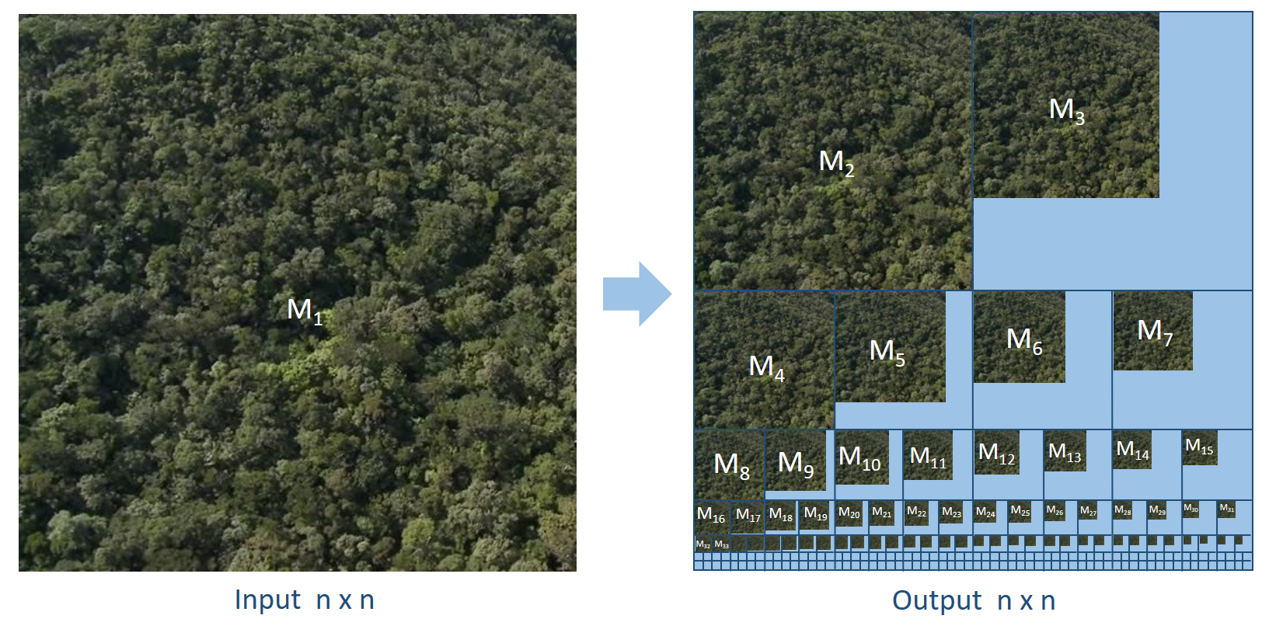
Algoritme 1
for d = 2 to n
for i = 0 to $\left\lfloor \text{n}\text{/}\text{d}\right\rfloor$-1 Tid ≈ n³
for j = 0 to $\left\lfloor \text{n}\text{/}\text{d}\right\rfloor$-1
sum = 0
for r = 0 to d-1
for k = 0 to d-1
sum = sum + M₁[i*d+r, j*d+k]
M_{d}[i, j] = $\left\lfloor \text{sum}\text{/}\text{d}\text{2}\right\rfloor$
Input og output størrelse n², men Algoritme 1 tager tid n³.
Kan man løse problemet hurtigere ?
Notes:
Algoritmik fokuserer på at lave effektive algoritmer

Slide 10
S
M₁
 | -1 | 0 | 1 | 2 | 3 | 4 | 5 | 6 | 7 | 8 | ∙∙∙ |  |  |  |  | n-1
-1 | 0 | 0 | 0 | 0 | 0 | 0 | 0 | 0 | 0 | 0 | 0 | 0 | 0 | 0 | 0 | 0
0 | 0 | 7 | 17 | 20 | 32 | 60 | 94 | 105 | 154 | 249 | 292 | 315 | 393 | 468 | 554 | 561
1 | 0 | 20 | 84 | 103 | 155 | 276 | 353 | 436 | 576 | 731 | 796 | 845 | 1022 | 1162 | 1264 | 1284
2 | 0 | 107 | 268 | 378 | 518 | 729 | 867 | 1037 | 1194 | 1449 | 1532 | 1645 | 1898 | 2052 | 2243 | 2350
3 | 0 | 130 | 305 | 476 | 710 | 1019 | 1172 | 1359 | 1601 | 1911 | 2032 | 2225 | 2545 | 2738 | 2937 | 3067
4 | 0 | 151 | 421 | 685 | 927 | 1322 | 1551 | 1761 | 2093 | 2424 | 2641 | 2864 | 3264 | 3555 | 3843 | 3994
5 | 0 | 250 | 620 | 896 | 1139 | 1589 | 1874 | 2106 | 2486 | 2897 | 3169 | 3429 | 3857 | 4245 | 4545 | 4795
6 | 0 | 265 | 640 | 957 | 1224 | 1719 | 2070 | 2383 | 2849 | 3339 | 3705 | 3992 | 4426 | 4904 | 5275 | 5540
7 | 0 | 268 | 697 | 1110 | 1425 | 2018 | 2421 | 2828 | 3350 | 3938 | 4353 | 4731 | 5233 | 5728 | 6153 | 6421
8 | 0 | 315 | 792 | 1295 | 1623 | 2288 | 2766 | 3256 | 3878 | 4499 | 4992 | 5386 | 5915 | 6437 | 6917 | 7232
∙∙∙ | 0 | 329 | 815 | 1388 | 1778 | 2453 | 3020 | 3563 | 4255 | 4931 | 5450 | 5933 | 6486 | 7062 | 7559 | 7888
 | 0 | 389 | 956 | 1559 | 1965 | 2710 | 3297 | 3868 | 4632 | 5370 | 5937 | 6423 | 7031 | 7668 | 8260 | 8649
 | 0 | 448 | 1045 | 1729 | 2204 | 2960 | 3622 | 4227 | 5051 | 5854 | 6447 | 6964 | 7609 | 8298 | 8932 | 9380
 | 0 | 472 | 1145 | 1913 | 2430 | 3227 | 3893 | 4568 | 5425 | 6317 | 6959 | 7573 | 8263 | 9003 | 9727 | 10199
 | 0 | 535 | 1245 | 2086 | 2606 | 3412 | 4146 | 4900 | 5797 | 6723 | 7422 | 8038 | 8828 | 9660 | 10435 | 10970
n-1 | 0 | 542 | 1262 | 2106 | 2638 | 3472 | 4240 | 5005 | 5951 | 6972 | 7714 | 8353 | 9221 | 10128 | 10989 | 11531
 | 0 | 1 | 2 | 3 | 4 | 5 | 6 | 7 | 8 | ∙∙∙ |  |  |  |  | n-1
0 | 7 | 10 | 3 | 12 | 28 | 34 | 11 | 49 | 95 | 43 | 23 | 78 | 75 | 86 | 7
1 | 13 | 54 | 16 | 40 | 93 | 43 | 72 | 91 | 60 | 22 | 26 | 99 | 65 | 16 | 13
2 | 87 | 97 | 91 | 88 | 90 | 61 | 87 | 17 | 100 | 18 | 64 | 76 | 14 | 89 | 87
3 | 23 | 14 | 61 | 94 | 98 | 15 | 17 | 85 | 55 | 38 | 80 | 67 | 39 | 8 | 23
4 | 21 | 95 | 93 | 8 | 86 | 76 | 23 | 90 | 21 | 96 | 30 | 80 | 98 | 89 | 21
5 | 99 | 100 | 12 | 1 | 55 | 56 | 22 | 48 | 80 | 55 | 37 | 28 | 97 | 12 | 99
6 | 15 | 5 | 41 | 24 | 45 | 66 | 81 | 86 | 79 | 94 | 27 | 6 | 90 | 71 | 15
7 | 3 | 54 | 96 | 48 | 98 | 52 | 94 | 56 | 98 | 49 | 91 | 68 | 17 | 54 | 3
8 | 47 | 48 | 90 | 13 | 72 | 75 | 83 | 100 | 33 | 78 | 16 | 27 | 27 | 55 | 47
∙∙∙ | 14 | 9 | 70 | 62 | 10 | 89 | 53 | 70 | 55 | 26 | 89 | 24 | 54 | 17 | 14
 | 60 | 81 | 30 | 16 | 70 | 20 | 28 | 72 | 62 | 48 | 3 | 55 | 61 | 95 | 60
 | 59 | 30 | 81 | 69 | 11 | 75 | 34 | 60 | 65 | 26 | 31 | 37 | 52 | 42 | 59
 | 24 | 76 | 84 | 42 | 41 | 4 | 70 | 33 | 89 | 49 | 97 | 45 | 51 | 90 | 24
 | 63 | 37 | 73 | 3 | 9 | 68 | 79 | 40 | 34 | 57 | 2 | 100 | 92 | 51 | 63
n-1 | 7 | 10 | 3 | 12 | 28 | 34 | 11 | 49 | 95 | 43 | 23 | 78 | 75 | 86 | 7
sum
E
C
B
D
A
Algoritme S
for i = -1 to n-1
S[i,-1] = 0, S[-1,i] = 0
for i = 0 to n-1
for j = 0 to n-1
S[i, j] = M₁[i,j] + S[i-1, j] + S[i, j-1] – S[i-1, j-1]
Tid ≈ n²
$$\text{17} \text{+} \text{85} \text{+} \text{55} \text{+} \text{23} \text{+} \text{90} \text{+} \text{21} \text{+} \text{22} \text{+} \text{48} \text{+} \text{80}\text{ = 2897 − 1874 − 1449 + 867}$$
A
B
C
D
E

Slide 11
S
k
 | -1 | 0 | 1 | 2 | 3 | 4 | 5 | 6 | 7 | 8 | ∙∙∙ |  |  |  |  | n-1
-1 | 0 | 0 | 0 | 0 | 0 | 0 | 0 | 0 | 0 | 0 | 0 | 0 | 0 | 0 | 0 | 0
0 | 0 | 7 | 17 | 20 | 32 | 60 | 94 | 105 | 154 | 249 | 292 | 315 | 393 | 468 | 554 | 561
1 | 0 | 20 | 84 | 103 | 155 | 276 | 353 | 436 | 576 | 731 | 796 | 845 | 1022 | 1162 | 1264 | 1284
2 | 0 | 107 | 268 | 378 | 518 | 729 | 867 | 1037 | 1194 | 1449 | 1532 | 1645 | 1898 | 2052 | 2243 | 2350
3 | 0 | 130 | 305 | 476 | 710 | 1019 | 1172 | 1359 | 1601 | 1911 | 2032 | 2225 | 2545 | 2738 | 2937 | 3067
4 | 0 | 151 | 421 | 685 | 927 | 1322 | 1551 | 1761 | 2093 | 2424 | 2641 | 2864 | 3264 | 3555 | 3843 | 3994
5 | 0 | 250 | 620 | 896 | 1139 | 1589 | 1874 | 2106 | 2486 | 2897 | 3169 | 3429 | 3857 | 4245 | 4545 | 4795
6 | 0 | 265 | 640 | 957 | 1224 | 1719 | 2070 | 2383 | 2849 | 3339 | 3705 | 3992 | 4426 | 4904 | 5275 | 5540
7 | 0 | 268 | 697 | 1110 | 1425 | 2018 | 2421 | 2828 | 3350 | 3938 | 4353 | 4731 | 5233 | 5728 | 6153 | 6421
8 | 0 | 315 | 792 | 1295 | 1623 | 2288 | 2766 | 3256 | 3878 | 4499 | 4992 | 5386 | 5915 | 6437 | 6917 | 7232
∙∙∙ | 0 | 329 | 815 | 1388 | 1778 | 2453 | 3020 | 3563 | 4255 | 4931 | 5450 | 5933 | 6486 | 7062 | 7559 | 7888
 | 0 | 389 | 956 | 1559 | 1965 | 2710 | 3297 | 3868 | 4632 | 5370 | 5937 | 6423 | 7031 | 7668 | 8260 | 8649
 | 0 | 448 | 1045 | 1729 | 2204 | 2960 | 3622 | 4227 | 5051 | 5854 | 6447 | 6964 | 7609 | 8298 | 8932 | 9380
 | 0 | 472 | 1145 | 1913 | 2430 | 3227 | 3893 | 4568 | 5425 | 6317 | 6959 | 7573 | 8263 | 9003 | 9727 | 10199
 | 0 | 535 | 1245 | 2086 | 2606 | 3412 | 4146 | 4900 | 5797 | 6723 | 7422 | 8038 | 8828 | 9660 | 10435 | 10970
n-1 | 0 | 542 | 1262 | 2106 | 2638 | 3472 | 4240 | 5005 | 5951 | 6972 | 7714 | 8353 | 9221 | 10128 | 10989 | 11531
Algoritme 2
for d = 2 to n
for i = 0 to $\left\lfloor \text{n}\text{/}\text{d}\right\rfloor$-1
for j = 0 to $\left\lfloor \text{n}\text{/}\text{d}\right\rfloor$-1
r = i * d + d + 1, k = j * d + d + 1
M_{d}[i,j] = $\left\lfloor \text{(}\text{S}\text{[}\text{r}\text{,}\text{k}\text{] – }\text{S}\text{[}\text{r}\text{−}\text{d}\text{,}\text{k}\text{] – }\text{S}\text{[}\text{r}\text{,}\text{k}\text{−}\text{d}\text{] + }\text{S}\text{[}\text{r}\text{−}\text{d}\text{,}\text{k}\text{−}\text{d}\text{]}\text{)}\text{/}\text{d}\text{2}\right\rfloor$
Tid ≈ n²
r
S tilgås ≤ 4n² gange
j
M_{d}
 | 0 | 1 | 2 | ∙∙∙ | $$\frac{\text{n}}{\text{d}}\text{−1}$$
0 | 42 | 54 | 65 | 50 | 50
1 | 58 | 54 | 49 | 57 | 54
2 | 44 | 55 | 79 | 51 | 42
∙∙∙ | 48 | 47 | 55 | 38 | 50
$$\frac{\text{n}}{\text{d}}\text{−1}$$ | 42 | 27 | 56 | 55 | 60
i
n/d
$$\text{n}\text{/}\text{d}$$

Slide 12
Algoritme 2
for d = 2 to n
for i = 0 to $\left\lfloor \text{n}\text{/}\text{d}\right\rfloor$-1
for j = 0 to $\left\lfloor \text{n}\text{/}\text{d}\right\rfloor$-1
r = i * d + d + 1, k = j * d + d + 1
M_{d}[i,j] = $\left\lfloor \text{(}\text{S}\text{[}\text{r}\text{,}\text{k}\text{] – }\text{S}\text{[}\text{r}\text{−}\text{d}\text{,}\text{k}\text{] – }\text{S}\text{[}\text{r}\text{,}\text{k}\text{−}\text{d}\text{] + }\text{S}\text{[}\text{r}\text{−}\text{d}\text{,}\text{k}\text{−}\text{d}\text{]}\text{)}\text{/}\text{d}\text{2}\right\rfloor$
Tid ≈ n²
Algoritme 2 tager optimal tid ≈ n²

Slide 13
Algoritme 2 bruger den fysiske hukommelse uhensigtsmæssigt

Slide 14
Lenovo ThinkStation P710
12 x hukommelse
12 x 32 GigaBytes
= 384 x 10⁹ bytes
2 x CPU
2 x Intel Xeon E5-2643 v4-processor
4 x harddiske
4 x 4 TeraBytes
= 16 x 10¹² bytes
lenovo.com
Notes:
http://www3.lenovo.com/il/en/workstations/thinkstation-p-series/ThinkStation-P710/p/33TS3TPP710/gallery/image http://ark.intel.com/products/92989/Intel-Xeon-Processor-E5-2643-v4-20M-Cache-3_40-GHz
Konfiguration på Lenovo’s hjemmeside var +100.000 DKK

Slide 15
Intel Xeon E5-2643 v4-processor
Transistors 3,200,000,000
The number of CPU cores 6
The number of threads 12
Level 1 instruction cache 6 x 32 KB 8-way set associative
Level 1 data cache 6 x 32 KB 8-way set associative
Level 2 cache 6 x 256 KB 8-way set associative
Level 3 cache 20 MB 20-way set associative shared
Cache line size 64 bytes
Data width 64 bit
Notes:
http://www.cpu-world.com/CPUs/Xeon/Intel-Xeon%20E5-2643%20v4.html
https://ark.intel.com/products/92989/Intel-Xeon-Processor-E5-2643-v4-20M-Cache-3_40-GHz
https://en.wikichip.org/wiki/intel/xeon_e5/e5-2643_v4

Slide 16
Hukommelseshierarki
Harddisk
Hukommelse (RAM)
L2
L3
L1
Beregninger (ALU)
Bus
CPU
Cache størrelse
Tilgangstid
Blokstørrelse
32 KB
5 ns
64 bytes
256 KB 20 ns
64 bytes
20 MB
30 ns
64 bytes
32 GB
60 ns
64 bytes
1 TB
5.000.000 ns
4.096 bytes

Slide 17
Algoritme 2 og Cache
Cache blokstørrelse = 4
S
 | -1 | 0 | 1 | 2 | 3 | 4 | 5 | 6 | 7 | 8 | ∙∙∙ |  |  |  |  | n-1
-1 | 0 | 0 | 0 | 0 | 0 | 0 | 0 | 0 | 0 | 0 | 0 | 0 | 0 | 0 | 0 | 0
0 | 0 | 7 | 17 | 20 | 32 | 60 | 94 | 105 | 154 | 249 | 292 | 315 | 393 | 468 | 554 | 561
1 | 0 | 20 | 84 | 103 | 155 | 276 | 353 | 436 | 576 | 731 | 796 | 845 | 1022 | 1162 | 1264 | 1284
2 | 0 | 107 | 268 | 378 | 518 | 729 | 867 | 1037 | 1194 | 1449 | 1532 | 1645 | 1898 | 2052 | 2243 | 2350
3 | 0 | 130 | 305 | 476 | 710 | 1019 | 1172 | 1359 | 1601 | 1911 | 2032 | 2225 | 2545 | 2738 | 2937 | 3067
4 | 0 | 151 | 421 | 685 | 927 | 1322 | 1551 | 1761 | 2093 | 2424 | 2641 | 2864 | 3264 | 3555 | 3843 | 3994
5 | 0 | 250 | 620 | 896 | 1139 | 1589 | 1874 | 2106 | 2486 | 2897 | 3169 | 3429 | 3857 | 4245 | 4545 | 4795
6 | 0 | 265 | 640 | 957 | 1224 | 1719 | 2070 | 2383 | 2849 | 3339 | 3705 | 3992 | 4426 | 4904 | 5275 | 5540
7 | 0 | 268 | 697 | 1110 | 1425 | 2018 | 2421 | 2828 | 3350 | 3938 | 4353 | 4731 | 5233 | 5728 | 6153 | 6421
8 | 0 | 315 | 792 | 1295 | 1623 | 2288 | 2766 | 3256 | 3878 | 4499 | 4992 | 5386 | 5915 | 6437 | 6917 | d
∙∙∙ | 0 | 329 | 815 | 1388 | 1778 | 2453 | 3020 | 3563 | 4255 | 4931 | 5450 | 5933 | 6486 | 7062 | 7559 | 7888
 | 0 | 389 | 956 | 1559 | 1965 | 2710 | 3297 | 3868 | 4632 | 5370 | 5937 | 6423 | 7031 | 7668 | 8260 | 8649
 | 0 | 448 | 1045 | 1729 | 2204 | 2960 | 3622 | 4227 | 5051 | 5854 | 6447 | 6964 | 7609 | 8298 | 8932 | 9380
 | 0 | 472 | 1145 | 1913 | 2430 | 3227 | 3893 | 4568 | 5425 | 6317 | 6959 | 7573 | 8263 | 9003 | 9727 | 10199
 | 0 | 535 | 1245 | 2086 | 2606 | 3412 | 4146 | 4900 | 5797 | 6723 | 7422 | 8038 | 8828 | 9660 | 10435 | 10970
n-1 | 0 | 542 | 1262 | 2106 | 2638 | 3472 | 4240 | 5005 | 5951 | 6972 | 7714 | 8353 | 9221 | 10128 | 10989 | 11531
Algoritme 2
for d = 2 to n
for i = 0 to $\left\lfloor \text{n}\text{/}\text{d}\right\rfloor$-1
for j = 0 to $\left\lfloor \text{n}\text{/}\text{d}\right\rfloor$-1
r = i * d, k = j * d
M_{d}[i,j] = $\left\lfloor \text{(}\text{S}\text{[}\text{r}\text{,}\text{k}\text{] – }\text{S}\text{[}\text{r}\text{−}\text{d}\text{,}\text{k}\text{] – }\text{S}\text{[}\text{r}\text{,}\text{k}\text{−}\text{d}\text{] + }\text{S}\text{[}\text{r}\text{−}\text{d}\text{,}\text{k}\text{−}\text{d}\text{]}\text{)}\text{/}\text{d}\text{2}\right\rfloor$
Tid ≈ n²
Hver tilgang til S kan være i en ny blok ☹
M₆
 | 0 | 1
0 | 52 | 55
1 | 49 | 56

Slide 18
Forskningsområde
algoritmedesign
udnytter at data kommer i blokke
hardware parametrene må ikke indgå i algoritmen
Matteo Frigo, Charles E. Leiserson, Harald Prokop, Sridhar Ramachandran. Cache-Oblivious Algorithms. ACM Transactions on Algorithms, 8(1), Article No. 4, 2012.
Notes:
Conference artikel i 1999

Slide 19
Primtal
Definition Et heltal p er et primtal hvis og kun hvis 1 og p går op i p
2, 3, 5, 7, 11, 13, 17, 19, 23, 29, 31, 37, 41, 43, 47, 53, 59, 61, 67,
71, 73, 79, 83, 89, 97, 101, 103, 107, 109, 113, 127, 131, 137,
139, 149, 151, 157, 163, 167, 173, 179, 181, 191, 193, 197, 199, …
Primtalssætningen Der er π(n) < $\frac{\text{1.26 }\text{n}}{\text{ln}{\text{n}}}$ primtal mellem 2 og n

Slide 20
Primtalsfaktorisering
Definition Opskrivning af et heltal x som produkt af primtal
75460 = 2 * 2 * 5 * 7 * 7 * 7 * 11 = 2² * 5 * 7³ * 11

Slide 21
Ide Konstruer M_{d} ud fra M_{d/p} , hvor p mindste primfaktor i d
M₃
M₂
M₁
M₆
M₇
M₄
M₅
M₈
M₉
M₁₀
M₁₁
M₁₂
M₁₃
M₁₄
M₁₅
M₁₆
M₁₇
M₁₈
M₁₉
M₂₀
M₂₁
M₂₂
M₂₃
M₂₄
M₂₅
M₂₆
M₂₇
M₂₈
M₂₉
M₃₀
M₃₁
M₃₂
M₃₃
Input n x n
Output n x n

Slide 22
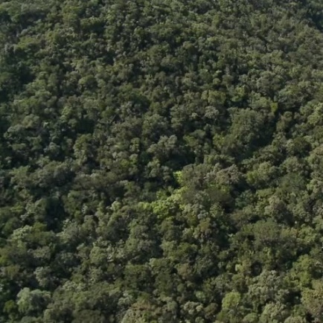
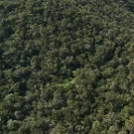
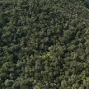
Cache Oblivious Algoritme
S₁
Algoritme S
Tid ≈ n²
M₁
n x n input
scan
1
og cache effektivt pga. scanning
Input n²
Output ≤ n²
Sum |S_{i}| ≤ 2n²
+ scanner ≤ 3n²
gentagne scanninger og fjern alt som ikke skal bruges for større p
$\sum_{\text{p}\text{rimtal} \text{p}}{{\left(\frac{\text{m}}{\text{p}}\right)}^{2}\text{π}\text{(}\text{p}\text{)}}$ ≤ c∙m²
$\text{π}\text{(}\text{p}\text{)}$ er antal primtal ≤ p
Primtalssætningen
2
2
…alle primtal ≤ n
2
1
3
2
S₂
scan
M₂
S₃
scan
scan
M₃
S₅
M₅
3
m x m
3
3
2
2
2
2
p=2
S₁₀
M₁₀
p=2
S₆
scan
M₆
S₄
scan
M₄
S₁₅
scan
p=2
S₉
p=3
M₁₅
p=3
M₉
3
3
p=5
S₂₅
3
M₂₅
Eksempel for S₅: Scan S₅ og uddrag S₁₀ og fjern alt der ikke indgår i S₁₅$∪$ S₂₅ . Scan igen og uddrag S₁₅ og fjern alt der ikke indgår i S₂₅ .
2
Notes:
S2, S3… blot en delmængde af cellerne ved faderen
Fra S_15 konstrueres S_30 og S_45 da 15 = 3 * 5, og primtal <= 3 er 2 og 3.

Slide 23
Bevis
$$\sum_{\text{p}\text{rimtal} p}{{\left(\frac{n}{p}\right)}^{2}}∙π\left(p\right)=n^{2}\sum_{i=0}^{∞}{\sum_{2^{i}≤\text{p}\text{rimtal} p<2^{i+1}}{\frac{π\left(p\right)}{p^{2}}}} \\ ≤n^{2}\sum_{i=0}^{∞}{\frac{{\left(π\left(2^{i+1}\right)\right)}^{2}}{{(2^{i})}^{2}}}≤n^{2}\sum_{i=0}^{∞}{{\left(\frac{c2^{i+1}/\log{2^{i+1}}}{2^{i}}\right)}^{2}}≤4c^{2}n^{2}\sum_{i=1}^{∞}{\frac{1}{i^{2}}}≤8c^{2}n^{2}$$
Primtalssætningen
Alle primtal $p$, $n<p≤2n$, går op i $\left(\begin{matrix}2n \\ n\end{matrix}\right)$ Da $n^{π\left(2n\right)−π(n)}≤\prod_{n<p≤2n}{p}≤\left(\begin{matrix}2n \\ n\end{matrix}\right)≤2^{2n}$ har vi $(2n) − (n)  2n / log⁡n$, hvorfor
$$π\left(2^{k}\right)≤\sum_{i=1}^{k−1}{\left(π\left(2^{i+1}\right)−π\left(2^{i}\right)\right)+π\left(2\right)}≤\sum_{i=1}^{k−1}{\frac{2^{i+1}}{i}}+1≤c\frac{2^{k}}{k}$$

Slide 24
Eksperimentelle Resultater
Sekunder / millioner celler
Algoritme 2
Cache aware
Arge, Haverkort, Tsirogiannis 2012
Cache oblivious Arge, Brodal, Truelsen, Tsirogiannis 2012
millioner celler
Notes:
Grøn = merge, rød = heap

Slide 25
Opsummering
Eksempel på datalogisk forskning (med biologisk anvendelse)
Kombination af teori og praksis
Matematik et centralt værktøj
n x n
$\frac{\text{n}}{\text{2}}$ x $\frac{\text{n}}{\text{2}}$
$\frac{\text{n}}{\text{3}}$ x $\frac{\text{n}}{\text{3}}$
$\frac{\text{n}}{\text{4}}$ x $\frac{\text{n}}{\text{4}}$
$\frac{\text{n}}{\text{5}}$ x $\frac{\text{n}}{\text{5}}$
$\frac{\text{n}}{\text{6}}$ x $\frac{\text{n}}{\text{6}}$
$\frac{\text{n}}{\text{7}}$ x $\frac{\text{n}}{\text{7}}$
$\frac{\text{n}}{\text{8}}$ x $\frac{\text{n}}{\text{8}}$
M₁
M₂
M₃
M₄
M₅
M₆
M₇

