Slide 1


Algorithm Exercises Skyline and Young Tableau:
Divide-and-Conquer Revisited
Gerth Stølting Brodal
Aarhus University
(Author)
Daniel Anker Hermansen
Aarhus University
(Presenter)
European Symposium on Algorithms (ESA), ALGO 2026, L’Aquila, Italy, August 31, 2026
Notes:
Paper: https://cs.au.dk/~gerth/papers/esa26skyline.pdf
Talk slots 17 min incl. Q&A + swaps. Talk length max 15 min.
Figures as LaTeX
\documentclass{article}
\pdfoutput=1
\usepackage[utf8]{inputenc}
\usepackage{tikz}
\usetikzlibrary{decorations.pathreplacing, calligraphy}
\def\smallColor{yellow!60}
\def\largeColor{blue!25!red!30}
\begin{document}
\sffamily
\begin{tikzpicture}[scale=0.25]
\begin{scope}[xshift=25cm]
\draw[color=red,line width=3]
(1,0)--(1,2)--(16,2)--(16,0);
\end{scope}
\draw[color=red,line width=3]
(1,0)--(1,1)--(2,1)--(2,2)--(3,2)--(3,1)--(4,1)--(4,2)--(5,2)--(5,1)--
(6,1)--(6,2)--(7,2)--(7,1)--(8,1)--(8,2)--(9,2)--(9,1)--(10,1)--(10,2)--
(11,2)--(11,1)--(12,1)--(12,2)--(13,2)--(13,1)--(14,1)--(14,2)--(15,2)--
(15,1)--(16,1)--(16,0);
\foreach \fig in {0, 1} {
\begin{scope}[xshift=25*\fig cm]
\foreach \x in {2, 4, ..., 14}
\draw (\x,0)--(\x,2-\fig)--(\x+1,2-\fig)--(\x+1,0);
\draw (1,0)--(1,1+\fig)--(16,1+\fig)--(16,0);
\draw[line width=2] (-1,0)--(18,0);
\end{scope}
}
\end{tikzpicture}
\begin{tikzpicture}[scale=0.55]
\fill[\smallColor] (0,0)--(0,-5)--(3,-5)--(3,-4)--(5,-4)--(5,-1)--(7,-1)--(7,0)--(10,0);
\fill[\largeColor] (10,-5)--(0,-5)--(3,-5)--(3,-4)--(5,-4)--(5,-1)--(7,-1)--(7,0)--(10,0);
\draw[line width=2] (0,-5)--(3,-5)--(3,-4)--(5,-4)--(5,-1)--(7,-1)--(7,0)--(10,0);
\draw[dashed] (0,0) grid (10,-5);
\foreach \row [count=\i] in {
{1, 4, 9, 14, 25, 35, 38, 60, 70, 81},
{3, 6, 15, 17, 29, 52, 56, 64, 72, 83},
{10, 12, 21, 23, 31, 53, 63, 72, 81, 91},
{11, 21, 23, 29, 48, 59, 68, 80, 88, 93},
{12, 22, 30, 53, 57, 64, 69, 89, 90, 99}}
\foreach \y [count=\j] in \row
\node at (\j-0.5, -\i+0.5) {\scriptsize\y};
% \foreach \i/\j in {5/4, 4/5, 2/6, 1/7, 1/8}
% \draw[thick, red!100] (\j-0.5, -\i+0.5) circle (0.4);
\end{tikzpicture}
\def\d{0.1}
\begin{tikzpicture}[scale=0.425]
\foreach \i in {1,...,15}
\node[left] at (0, -\i+0.5) {\tiny\sf \i};
\foreach \j in {1,...,15}
\node[above] at (\j-0.5, 0) {\tiny \j};
\foreach \i/\j/\h/\w in {0/0/8/8, 8/0/4/8, 12/0/2/8, 14/0/1/4, 0/8/2/4, 2/8/1/4}
\draw[fill=\smallColor,draw=\smallColor!black!75] (\j+\d,-\i-\d) rectangle ++(\w-2*\d,-\h+2*\d);
\foreach \i/\j/\h/\w in {7/8/8/7, 3/8/4/7, 1/12/2/3, 0/12/1/3, 14/4/1/4}
\draw[fill=\largeColor,draw=\largeColor!black!75] (\j+\d,-\i-\d) rectangle ++(\w-2*\d,-\h+2*\d);
\foreach \i/\j/\l/\r in {8/8/1/15, 12/8/1/8, 14/8/1/8, 15/4/1/8, 4/8/9/15, 1/12/13/15, 2/12/9/15, 3/12/9/12} {
\draw[fill=black, opacity=0.2] (\l-1+\d,-\i+1-\d) rectangle (\r-\d,-\i+\d);
\node at (\j-0.5, -\i+0.5) {\scriptsize $x_{\sf\i}$};
}
\draw[dashed] (0,0) grid (15,-15);
\draw[line width=3] (0,-15)--(4,-15)--(4,-14)--(8,-14)--(8,-3)--(12,-3)--(12,0)--(15,0);
\foreach \i/\depth in {8/0, 4/1, 12/1, 2/2, 14/2, 1/3, 3/3, 15/3}
\node (\i) at (-5+1*\depth, -\i+0.5) {\scriptsize $x_{\sf\i}$};
\foreach \u/\v in {1/2, 3/2, 2/4, 4/8, 12/8, 14/12, 15/14}
\draw (\u) -- (\v);
\end{tikzpicture}
\end{document}

Slide 2
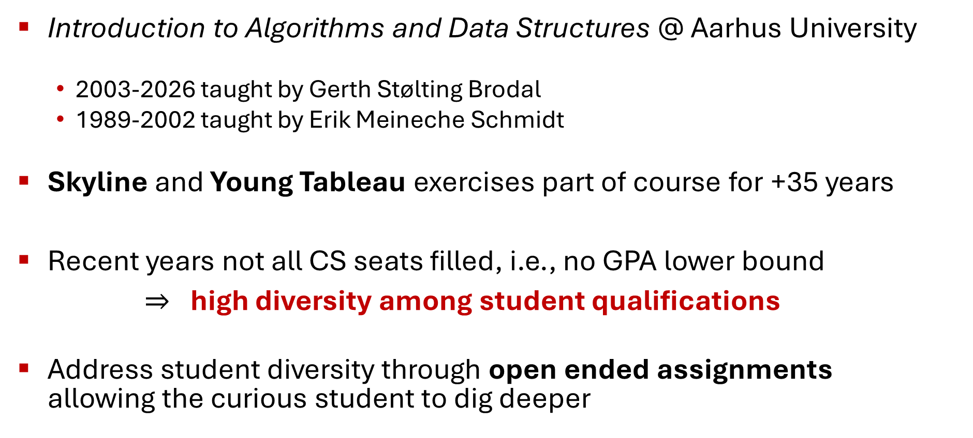
Background
Introduction to Algorithms and Data Structures @ Aarhus University
  2003-2026 taught by Gerth Stølting Brodal
  1989-2002 taught by Erik Meineche Schmidt
Skyline and Young Tableau exercises part of course for +35 years
Recent years not all CS seats filled, i.e., no GPA lower bound
$⇒$high diversity among student qualifications
Address student diversity through open ended assignments
allowing the curious student to dig deeper
Notes:
Course content stable for many years
In this talk we show that Skyline and Young Tableau exercises also allow students to dig one or two levels deeper
(Unclear who taught it until1988, but I think it was Erik Meineche Schmidt and Michael Schwartzbach teaching it together (1987-1988))

Slide 3

Open ended assignments
1st assignment, 1st semester, 1st year – search an unbounded sorted list
Valid solutions – depending on ambition / background / skills
  Linear search: p comparisons
  Exponential search: 2∙lg p + O(1) comparisons
  Bootstrap: lg p + 2∙lg lg p + O(1) comparisons
  Recursive bootstrapping: $\sum_{\text{i}=\text{1}}^{{\text{lg}}^{\text{∗}}\text{p}}{\text{lg}\text{(}\text{i}\text{)}{\text{p}}}$ + O(lg* p) comparisons [Bentley, Yao; IPL 1976]
1 | 2 | 3 | 4 | 5 | 6 | 7 | 8 | 9 | 10 | 11 | 12 | 13 | 14 | 15 | 16 | 17 | 18 | 19 | 20 | 21 | 22 | 23 | 24 | 25
3 | 5 | 10 | 11 | 14 | 20 | 23 | 24 | 26 | 27 | 29 | 32 | 33 | 37 | 38 | 39 | 41 | 42 | 47 | 51 | 53 | 59 | 61 | 80 | 83
p
Find(32)
Notes:
Bentley & Yao also proved a matching lower bound, except constant on lg* .
Address diversity through open ended assignments – goal is to get student formulate algorithms precisely and reason about them, how efficient the algorithm is is of secondary importance
Students have seen binary search

Slide 4

Skyline exercise
Assignment on applying divide-and-conquer
$⟹$
Master Theorem T(n) = 2∙T(n / 2) + O(n) $⟹$ T(n) = O(n lg n)
merge two skylines
left-to-right
Notes:
Input = set of bottom aligned rectangles; Output = polyline equal to the upper envelope
Hard part for students = get the details of the merging correct
One reviewer thinks the output format should be a sequence of points, i.e., an even number of values where the last is 0, to align with leetcode.
In Aarhus, the exercise has always been that the output is a generalization of a single building of an odd number of values.

Slide 5
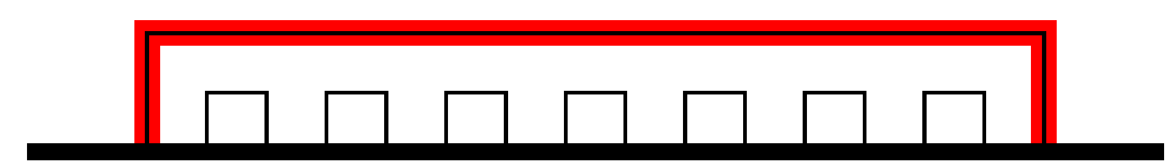
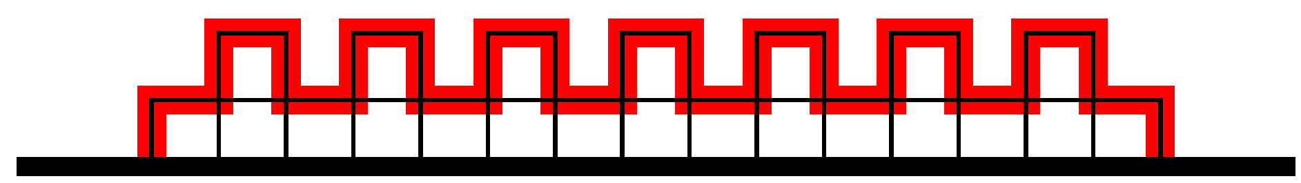
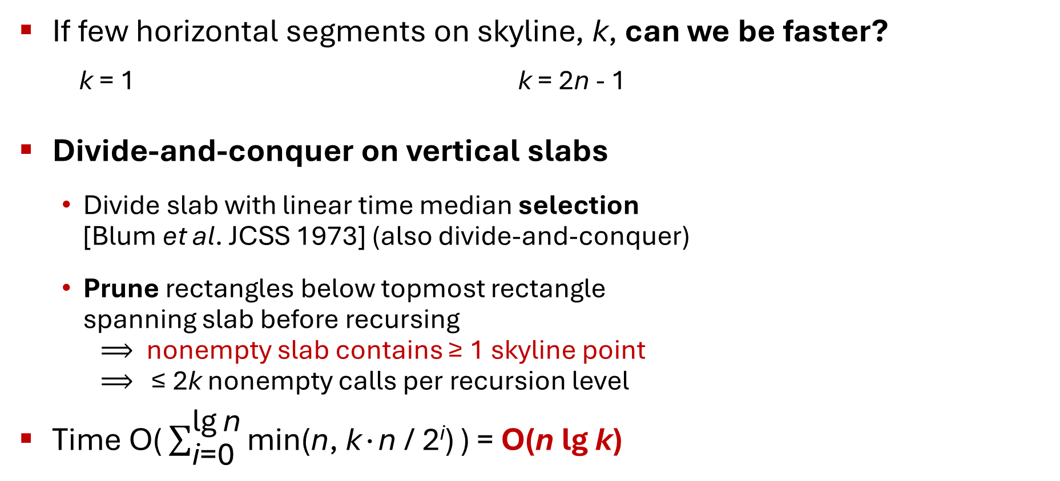
Skyline exercise
If few horizontal segments on skyline, k, can we be faster?
k = 1 k = 2n - 1
Divide-and-conquer on vertical slabs
  Divide slab with linear time median selection
  [Blum et al. JCSS 1973] (also divide-and-conquer)
  Prune rectangles below topmost rectangle
  spanning slab before recursing
  $⟹$ nonempty slab contains ≥ 1 skyline point
  $⟹$ ≤ 2k nonempty calls per recursion level
Time $\text{O(}\sum_{\text{i}\text{=}\text{0}}^{\text{lg}{\text{n}}}{\text{min(}\text{n}\text{, }\text{k}\text{∙}\text{n}\text{ / }\text{2}\text{i}\text{)}}\text{)}$ = O(n lg k)
median
slab
PRUNED
Pruning = marriage-before-conquest [Kirkpatrick & Seidel; SICOMP 1986]
Skyline in O(n lg k) = upper-envelope [Nielsen & Yvinec; IJCGA 1998]
Notes:
Note: Input rectangles are provided in arbitrary order, i.e., cannot assume any ordering
k rectangles are defined by at most 2k corner points
nonempty slab = slab containing rectangles above topmost spanning rectangle
Base case: A single horizontal (topmost) segment spanning slab, everything else is pruned
Time O(n*lg k) is optimal, if time should be expressed in terms of n and k [lower bound in Section 2.2 of paper]
Result was known before [NY98] – but much more complicated since solving the general problem (not horizontal lines only)
Pruning idea is just an application of [KS86]

Slide 6
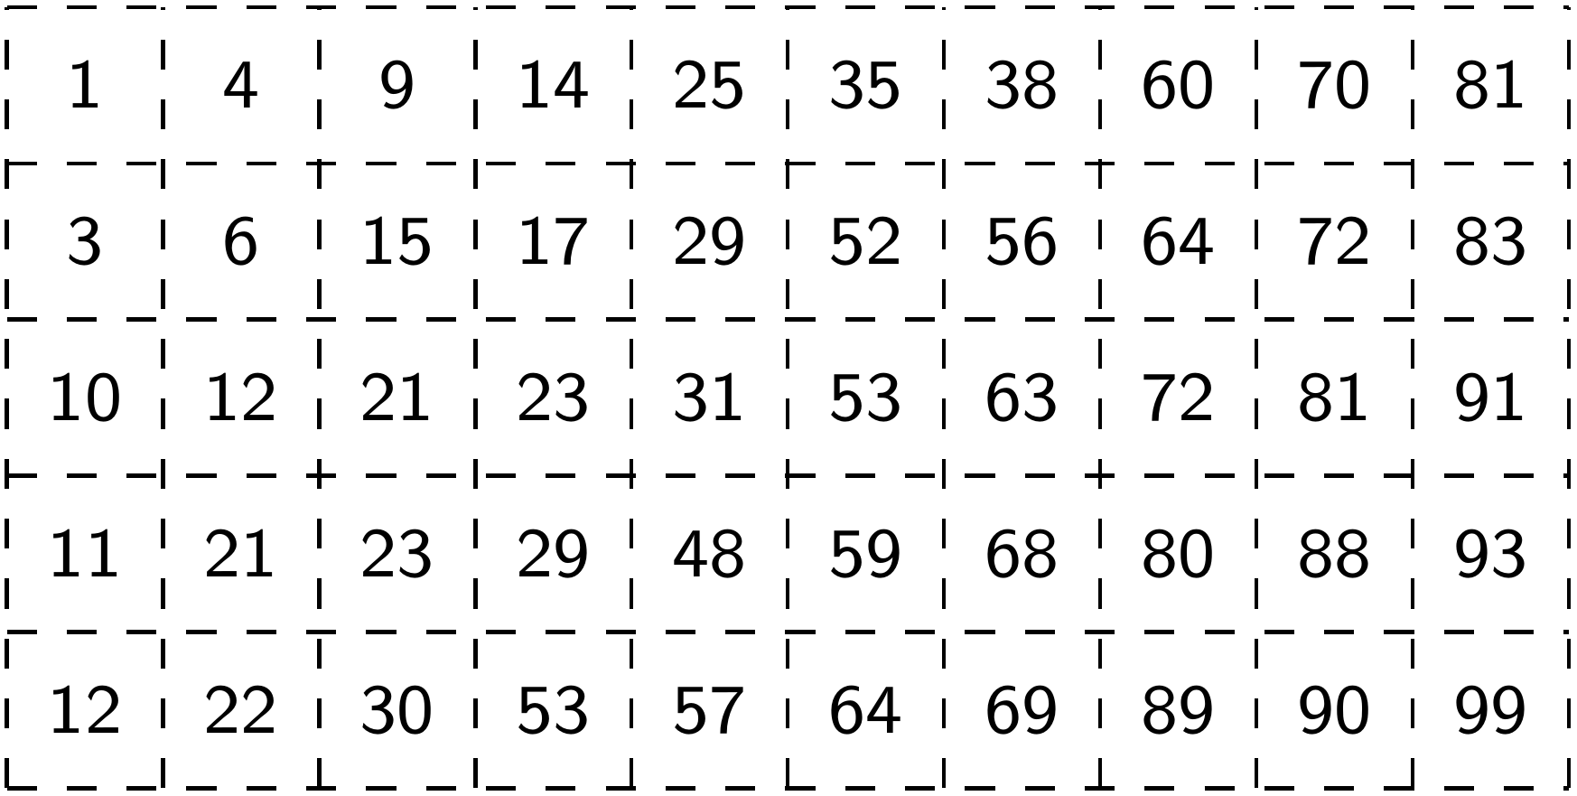
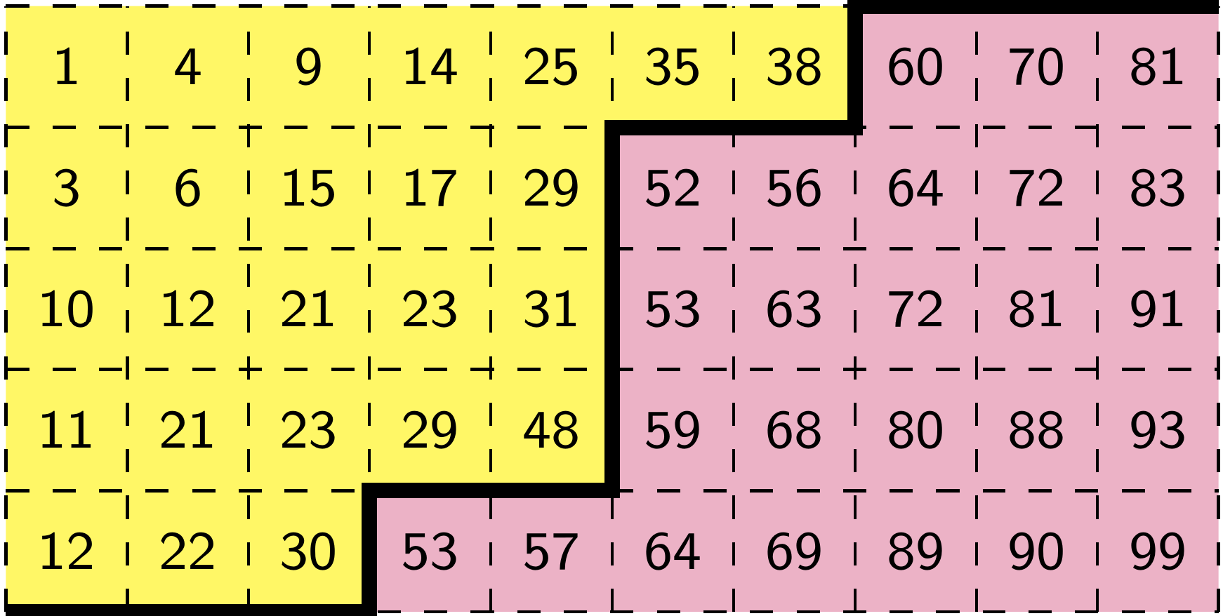
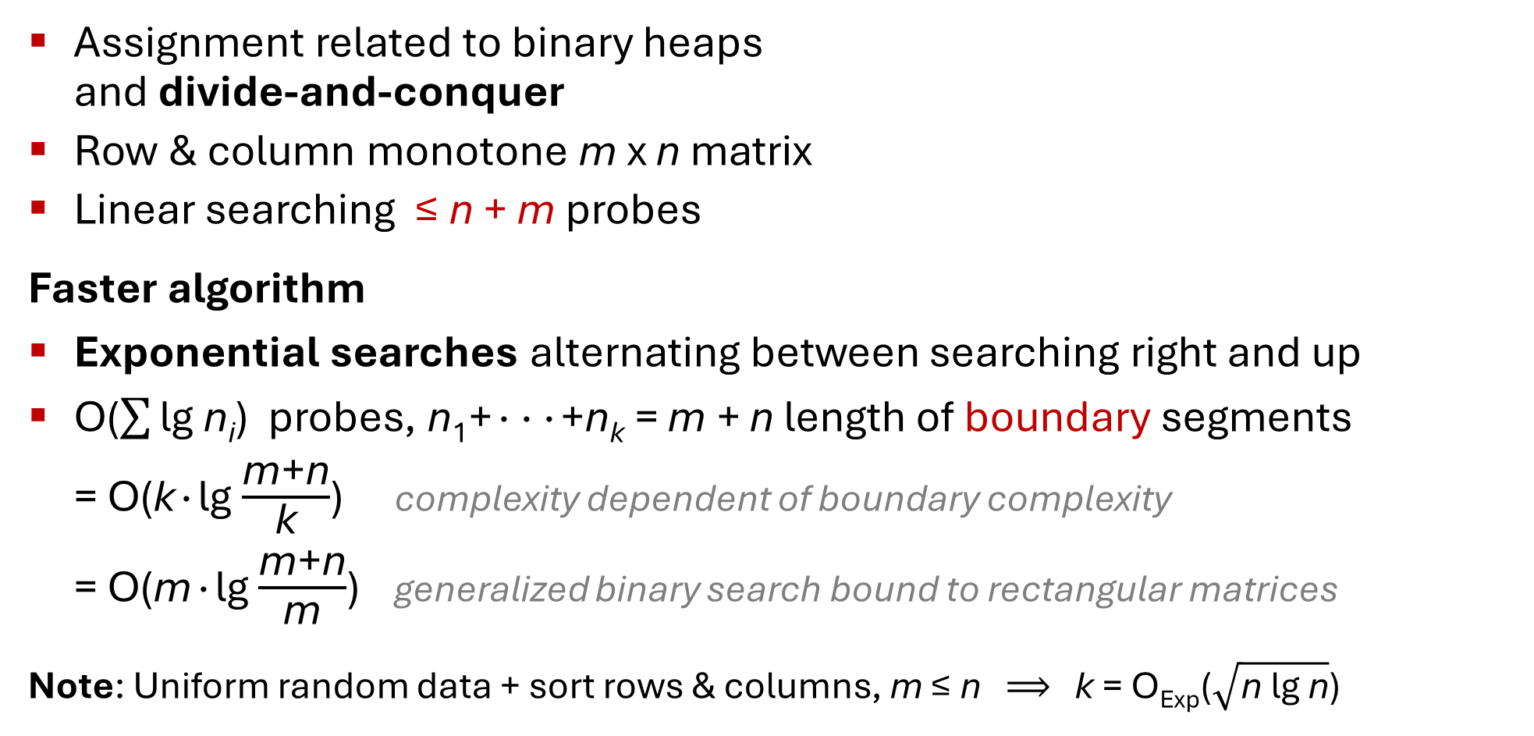
Young Tableau
Assignment related to binary heaps
and divide-and-conquer
Row & column monotone m x n matrix
Linear searching ≤ n + m probes
Faster algorithm
Exponential searches alternating between searching right and up
O($\sum{\text{lg}\text{ n}\text{i}}$) probes, n₁+∙∙∙+n_{k} = m + n length of boundary segments
= O(k∙lg $\frac{\text{m}\text{+}\text{n}}{\text{k}}$) complexity dependent of boundary complexity
= O(m∙lg $\frac{\text{m}\text{+}\text{n}}{\text{m}}$) generalized binary search bound to rectangular matrices
Note: Uniform random data + sort rows & columns, m ≤ n $⟹$ k = O_{Exp}($\sqrt{\text{n}\text{ lg}\text{ n}}$)
boundary
Find(50)
Notes:
Young Tableau order is an alternative to (binary tree) heap order
Circles are cells that must be probed by unsuccessful searches = complexity of boundary
Random bound follows from a Chernoff bound

Slide 7
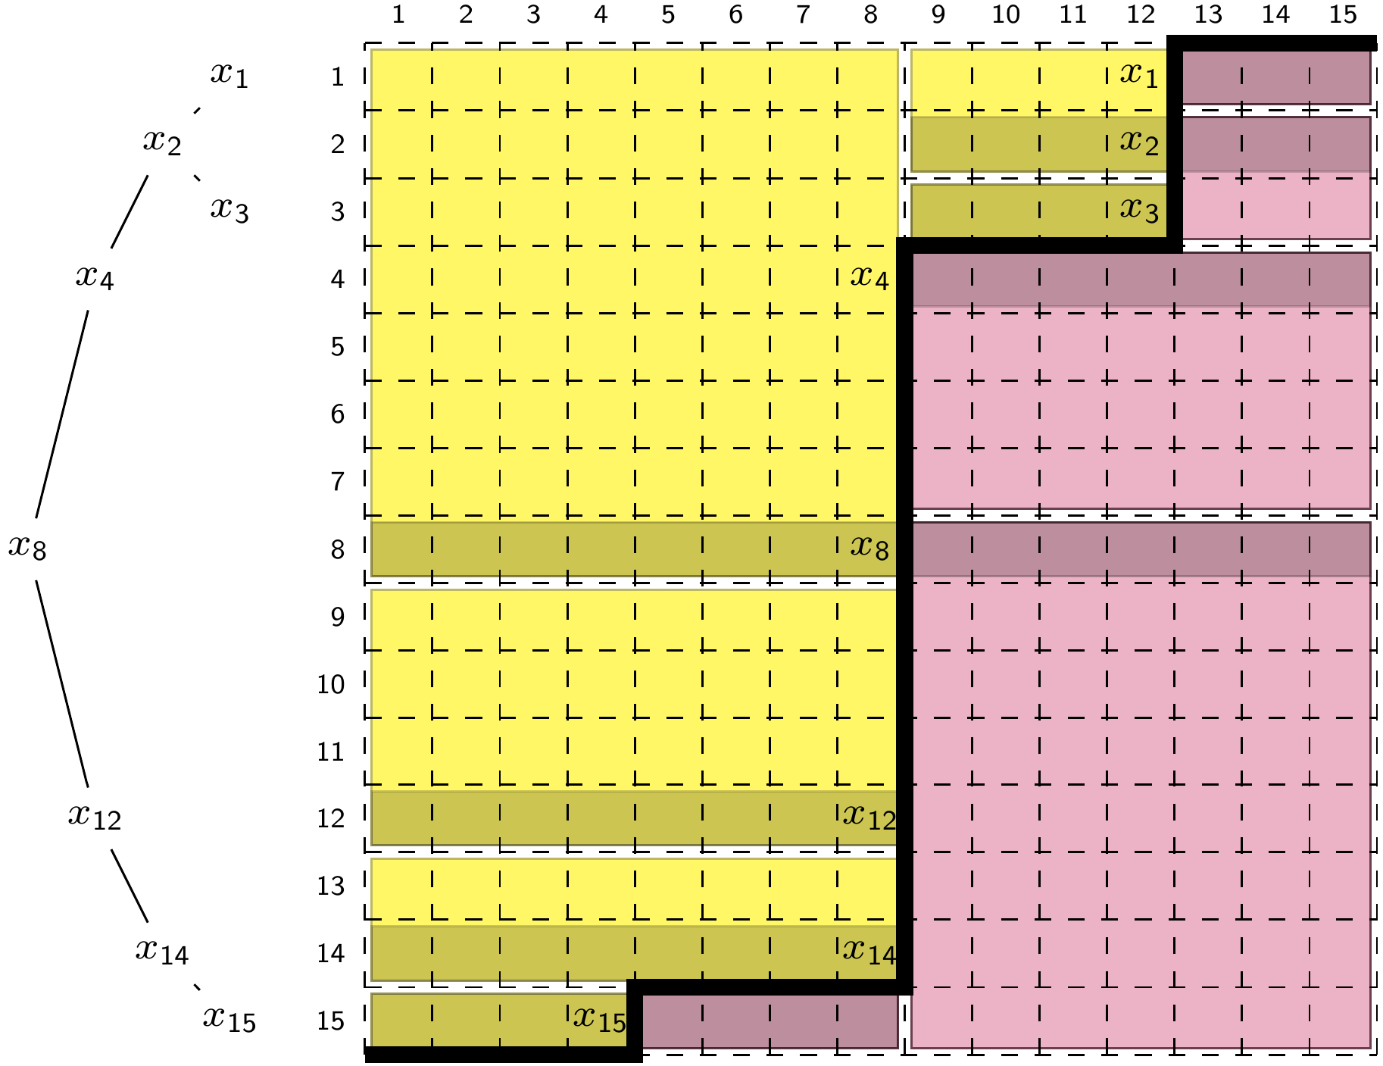
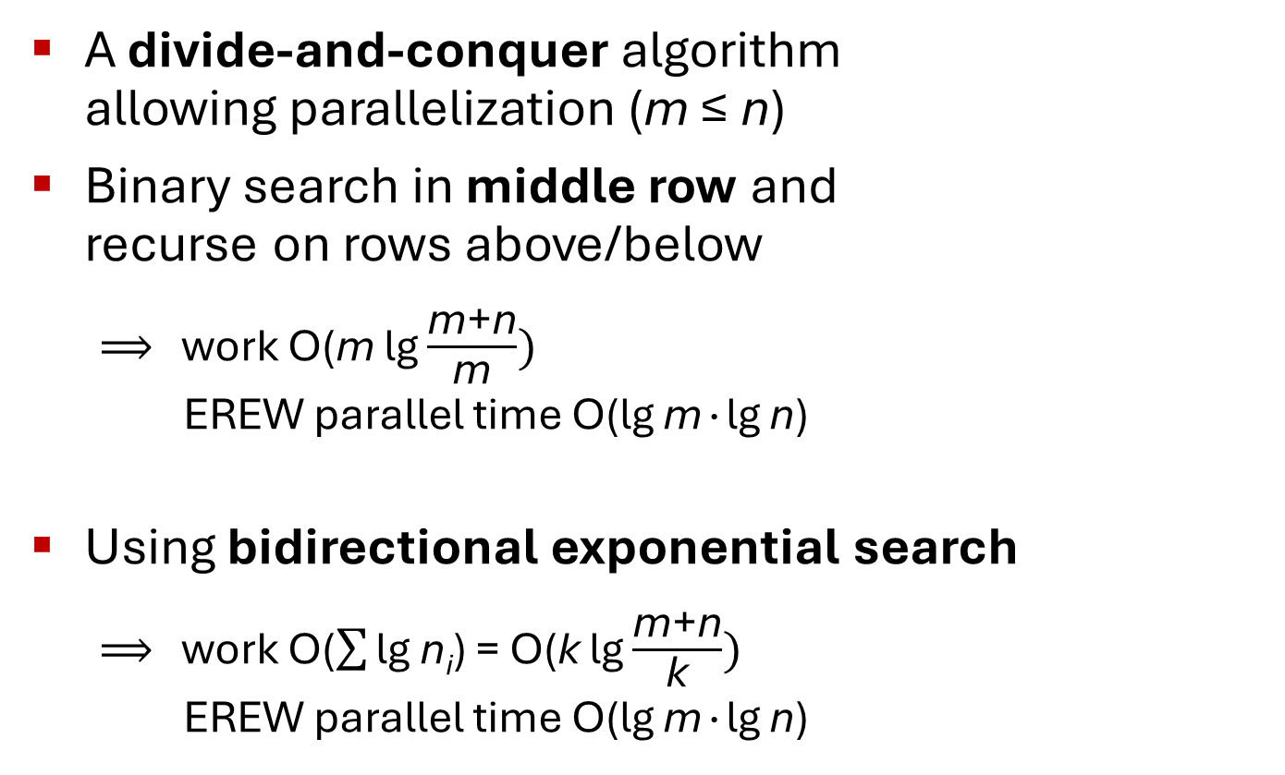
Young Tableau
A divide-and-conquer algorithm
allowing parallelization (m ≤ n)
Binary search in middle row and
recurse on rows above/below
  $⟹$ work O(m lg $\frac{\text{m}\text{+}\text{n}}{\text{m}})$
  EREW parallel time O(lg m∙lg n)
Using bidirectional exponential search
  $⟹$ work O($\sum{\text{lg}\text{ n}\text{i}}$) = O(k lg $\frac{\text{m}\text{+}\text{n}}{\text{k}})$
  EREW parallel time O(lg m∙lg n)
Notes:
Previous solution highly sequential
Search for x₄ identifies that we do not need to search in rows 5-7.
Recall k is the number of segments on the boundary
A vertical segment of length s can at most be hit by O(lg s) searches, the first can be expensive, but the rest cost O(1) when using exponential search
Horizontal segment searches require an amortized analysis…

Slide 8
Summary
The Skyline and Young Tableau are classic algorithm exercises – challenge the curious student to dig deeper by asking
Can we do better if the input or output is “simple”?
Algorithm Exercises Skyline and Young Tableau: Divide-and-Conquer Revisited
Gerth Stølting Brodal (gerth@cs.au.dk)

