Slide 1








External-Memory Priority Queues with Optimal Insertions
Gerth Stølting Brodal Aarhus University | Michael Goodrich University of California, Irvine | John Iacono Université libre de Bruxelles | Jared Lo University of Hawai’i at Mānoa
Ulrich Meyer Goethe University Frankfurt am Main | Victor Pagan University of Hawai’i at Mānoa | Nodari Sitchinava University of Hawai’i at Mānoa | Rolf Svenning Aarhus University
33rd Annual European Symposium on Algorithms (ESA), September 15, 2025, Warsaw, Poland
Notes:
15 min talk + 2 min Q&A
Work done at:
3rd Hawaii Workshop on Parallel Algorithms and Data Structures
University of Hawaii at Manoa, March 17-21, 2025

Slide 2
Priority Queues
Insert(e) DeleteMin()
Binary heap (Williams 1964)
Binomial queue (Vuillemin 1978)
1
O(log N) O(log N)
4
3
bubble up
5
7
6
2
cascaded linking
1
3
2
4
Can we achieve a similar result in external memory ?
O_{A}(1) O(log N)
5
6
7
9
Sorting = N × Insert + N × DeleteMin ⇒ Insert or DeleteMin Ω(log N) comparisons
# Insert ≥ # DeleteMin
Notes:
Insert worst-case O(1) by only linking one pair of trees of equal size per insertion
Can achieve O(1) DeleteMin and O(log n) using a search tree
This talk: No arbitrary Delete, Meld or DecreaseKey

Slide 3
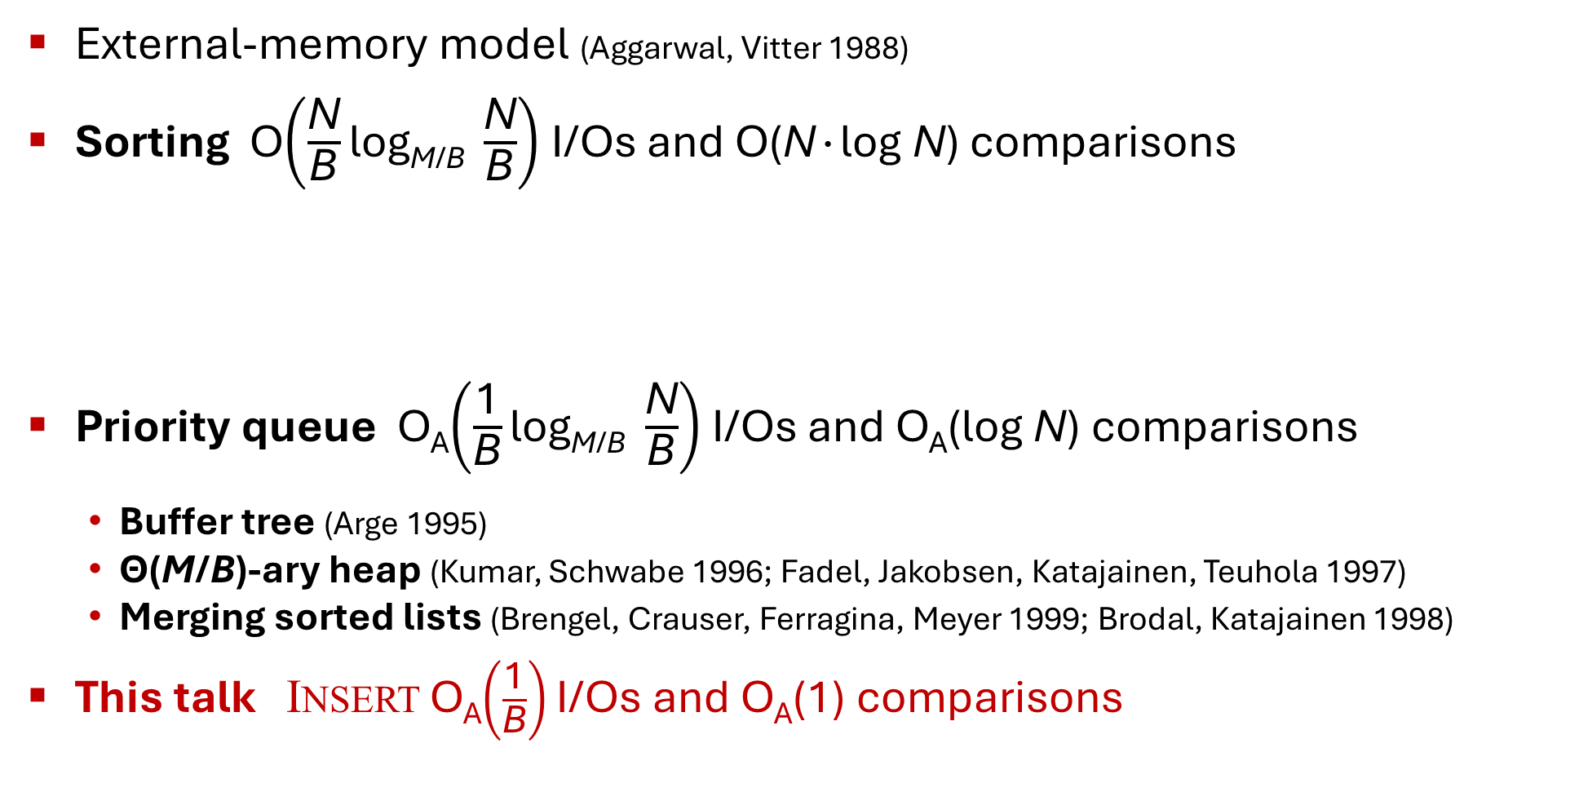
External Memory
CPU
Internal memory (M)
External-memory model (Aggarwal, Vitter 1988)
Sorting O$\left(\frac{\text{N}}{\text{B}}\text{log}\text{M}\text{/}\text{B} \frac{\text{N}}{\text{B}}\right)$ I/Os and O(N∙log N) comparisons
Priority queue O_{A}$\left(\frac{\text{1}}{\text{B}}\text{log}\text{M}\text{/}\text{B} \frac{\text{N}}{\text{B}}\right)$ I/Os and O_{A}(log N) comparisons
Buffer tree (Arge 1995)
Θ(M/B)-ary heap (Kumar, Schwabe 1996; Fadel, Jakobsen, Katajainen, Teuhola 1997)
Merging sorted lists (Brengel, Crauser, Ferragina, Meyer 1999; Brodal, Katajainen 1998)
This talk Insert O_{A}$\left(\frac{\text{1}}{\text{B}}\right)$I/Os and O_{A}(1) comparisons
I/O (B)
External memory (∞)
Θ(M/B)-way merging
sorted
M
∙∙∙
M
Insert DeleteMin
Notes:
Buffer trees & merging list inherently Θ(log N) comparisons since they essentially generate a sorted lists
Heap based require buffers to be sorted, likely insertions O(log M + log_{M/B} N/B) comparisons

Slide 4
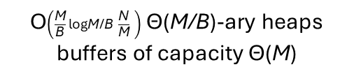
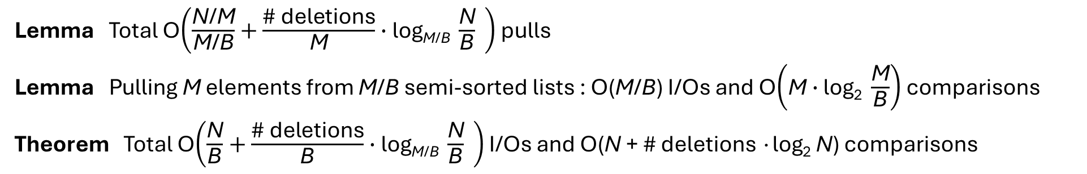
New External-Memory Priority Queue
Insert(e)
DeleteMin()
Internal memory
External memory
O$\left(\frac{\text{M}}{\text{B}}\text{log}\text{M}\text{/}\text{B} \frac{\text{N}}{\text{M}} \right)$ Θ(M/B)-ary heaps
buffers of capacity Θ(M)
internal buffer = semi-sorted
min-buffer S
insert-buffer L
insert Θ(M)
≤
≤
≤
≤
≤
≤
≤
≤
≤
≤
≤
≤
≤
≤
≤
1
3
2
pull
B
B
∙∙∙
≤
5
6
7
≤ p ≤
unsorted
≤
9
extract Θ(M) smallest
leaf buffer = lazy semi-sorted
Insert O_{A}(1)
DeleteMin O(log |S|)
|S|=O(M)
Insert O(1)
|L|=O(M)
≤
≤
≤
≤
≤
≤
≤
≤
≤
B
B
2B
4B
8B
Lemma Total O$\left(\frac{\text{N}\text{/}\text{M}}{\text{M}\text{/}\text{B}}+\frac{\text{\# }\text{deletions}}{\text{M}}∙\text{log}\text{M}\text{/}\text{B} \frac{\text{N}}{\text{B}} \right)$ pulls
Lemma Pulling M elements from M/B semi-sorted lists : O(M/B) I/Os and O$\left(\text{M}∙\text{log}\text{2} \frac{\text{M}}{\text{B}}\right)$ comparisons
Theorem Total O$\left(\frac{\text{N}}{\text{B}}+\frac{\text{\# }\text{deletions}}{\text{B}}∙\text{log}\text{M}\text{/}\text{B} \frac{\text{N}}{\text{B}} \right)$ I/Os and O(N + # deletions ∙log₂ N) comparisons
Notes:
We cannot sort elements in new leaves, would cost O(log₂ M) comparisons per insert
(Lazy) semi-sorted buffers are created using repeated median selection
N = # insertions

Slide 5
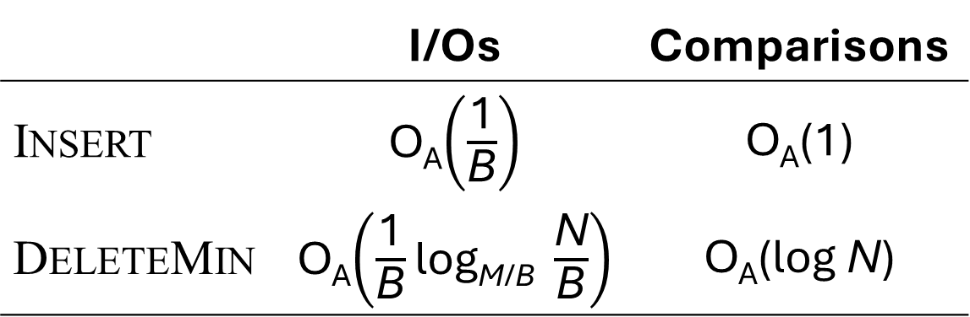
Summary
New optimal external memory priority queue
Open problems
Our data structure is inherently amortized – can it be made worst-case ?
Structure inherently cache-aware – is there a cache-oblivious data structure with matching I/O and comparison bounds ?
 | I/Os | Comparisons
Insert | O_{A}$\left(\frac{\text{1}}{\text{B}}\right)$ | O_{A}(1)
DeleteMin | O_{A}$\left(\frac{\text{1}}{\text{B}}\text{log}\text{M}\text{/}\text{B} \frac{\text{N}}{\text{B}}\right)$ | O_{A}(log N)

