Slide 1



Buffered Partially-Persistent External-Memory Search Trees
— or, partially-persistent B-trees meet B^{ε}-trees
Gerth Stølting Brodal Aarhus University | Casper Moldrup Rysgaard Aarhus University | Rolf Svenning Aarhus University
33rd Annual European Symposium on Algorithms (ESA), September 15, 2025, Warsaw, Poland
Notes:
15 min talk + 2 min Q&A

Slide 2
Buffered partially-persistent external-memory search trees
CPU
Internal memory (M)
I/O (B)
External memory (∞)
Search tree (B-tree)
Partial persistence = remember all previous versions
Copy path from root to updated nodes = space O(log_{B} N) blocks per update
Associate with each element and pointer a time interval where it is part of the structure (fat node and node copying)
B^{ε}-tree – reduced degree B^{ε}, add buffers, blocks of updates
degree Θ(B)
Insert(x)
height O(log_{B} N)
add x to leaf O(log_{B} N) I/Os
Θ(B) elements
range query O(log_{B} N + K/B) I/Os
Notes:
Trivial solution copy full structure pr update -> bad space and time
Path copy pr update -> B∙log_{B} N space per update, log_{B} N IOS

Slide 3
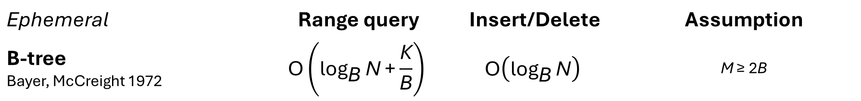
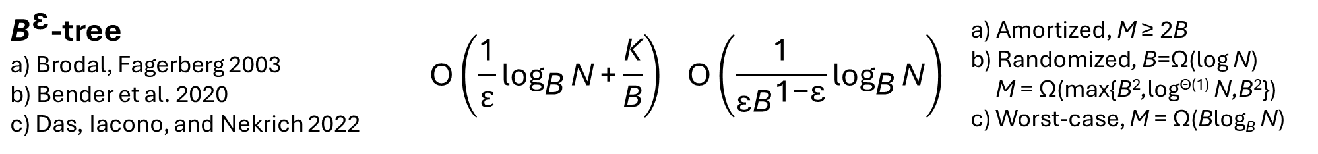
I/O results (all linear space)
Ephemeral | Range query | Insert/Delete | Assumption
B-tree Bayer, McCreight 1972 | $$\text{O}\left({\text{log}}_{\text{B}}{\text{N}}\text{+}\frac{\text{K}}{\text{B}}\right)$$ | $$\text{O}\left({\text{log}}_{\text{B}}{\text{N}}\right)$$ | M ≥ 2B
${\text{B}}^{\text{ε}}$-tree a) Brodal, Fagerberg 2003 b) Bender et al. 2020 c) Das, Iacono, and Nekrich 2022 | $$\text{O}\left(\frac{\text{1}}{ε}{\text{log}}_{\text{B}}{\text{N}}\text{+}\frac{\text{K}}{\text{B}}\right)$$ | $$\text{O}\left(\frac{\text{1}}{{\text{ε}\text{B}}^{\text{1−}\text{ε}}}{\text{log}}_{\text{B}}{\text{N}}\right)$$ | a) Amortized, M ≥ 2B b) Randomized, B=Ω(log N) M = Ω(max{B²,log^{Θ(1)} N,B²}) c) Worst-case, M = Ω(Blog_{B} N)
Partial persistence
Partially-persistent B-tree Becker et al. 1996 | $$\text{O}\left({\text{log}}_{\text{B}}{\text{N}}\text{+}\frac{\text{K}}{\text{B}}\right)$$ | $$\text{O}\left({\text{log}}_{\text{B}}{\text{N}}\right)$$ | M ≥ 2B
This talk | $$\text{O}\left(\frac{\text{1}}{ε}{\text{log}}_{\text{B}}{\text{N}}\text{+}\frac{\text{K}}{\text{B}}\right)$$ | $$\text{O}\left(\frac{\text{1}}{{\text{ε}\text{B}}^{\text{1−}\text{ε}}}{\text{log}}_{\text{B}}{\text{N}}\right)$$ | a) Amortized, M ≥ 2B b) Worst-case, M = Ω(B^{1-ε}log₂ N)
Notes:
Randomized is with high probability
Partial persistence is essentially the node copying technique by Driscoll, Sarnak, Sleator, Tarjan
Our worst-case bound has a slightly weaker assumption on M as the result of Das et al. and our result is partially persistent
In paper we also present a deterministic construction for M ≥ 2B, but with slightly increased IO bounds

Slide 4
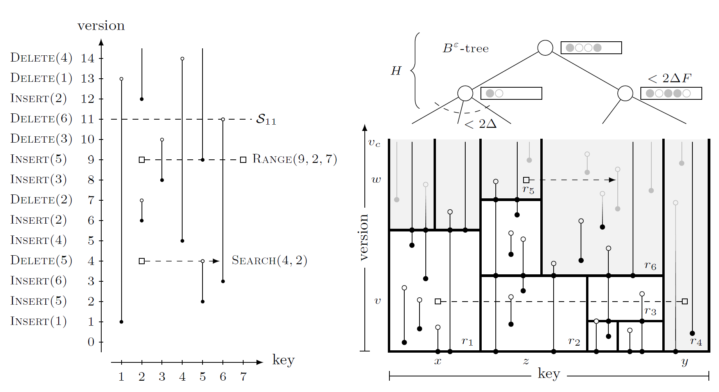
A geometric interpretation
Insertions and deletions are endpoints of vertical segments
Search and range queries are horizontal ray shooting and segment intersection queries

Slide 5
Rectangle partition
Partition plan into rectangles
Topmost rectangles are open (can received more updates)
Segments crossing multiple rectangles are split
Rectangles store O(B∙log_{B} N) endpoints where Ω(B∙log_{B} N) segments span bottom-to-top
Global rebuild when N doubles/halves
Segments in a rectangle are sorted by key
Notes:
Global rebuilding => will have independent structures for a partition of the version universe

Slide 6
Top structure
B^{ε}-tree with updates heading for the open rectangles
Degree B^{ε} , buffer capacity B
Close a rectangle when it has received Θ(Blog_{B} N) updates (move all buffered updates to it)
Join and split open rectangles like in a B-tree (after closing them)

Slide 7
Point location
Queries need to locate relevant rectangles
For each version have a B-tree with the rectangles left-to-right intersection the version
Make it partially-persistent using simple path copying for updates
A query to an open rectangle moves all buffered updates to the rectangle
Notes:
The path to an open rectangle can at most store a fraction of the capacity of the rectangle

Slide 8
Achieving worst-case I/O bounds
Buffer overflow = incremental flush a single path, pushing B^{1-ε} updates to the child with most updates (ensures never more than B^{1-ε}∙log₂ B updates in a buffer heading for a single child)
Incrementally closing an open rectangle, collect all buffered updates in internal memory, requires M = Ω(B^{1-ε}∙log₂ N)
Incremental global rebuild for changing N
Never merge internal nodes (avoids flushing buffers, incremental global rebuilding bounds height)
Notes:
Decremental game ensures that a buffer cannot contain B elements heading for the same child

Slide 9
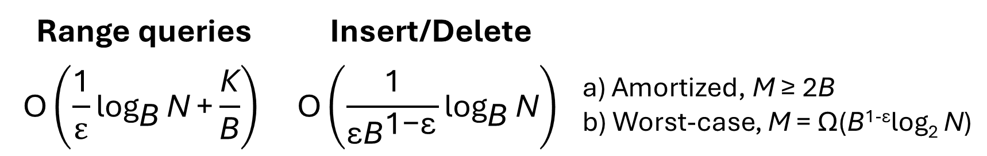
Summary
Linear space buffered partially-persistent B-trees, with I/O bounds
Open problems
Worst-case for M ≥ 2B
Let fully-persistent B-trees meet B^{ε}-trees
Range queries | Insert/Delete
$$\text{O}\left(\frac{\text{1}}{ε}{\text{log}}_{\text{B}}{\text{N}}\text{+}\frac{\text{K}}{\text{B}}\right)$$ | $$\text{O}\left(\frac{\text{1}}{{\text{ε}\text{B}}^{\text{1−}\text{ε}}}{\text{log}}_{\text{B}}{\text{N}}\right)$$ | a) Amortized, M ≥ 2B b) Worst-case, M = Ω(B^{1-ε}log₂ N)

Slide 10
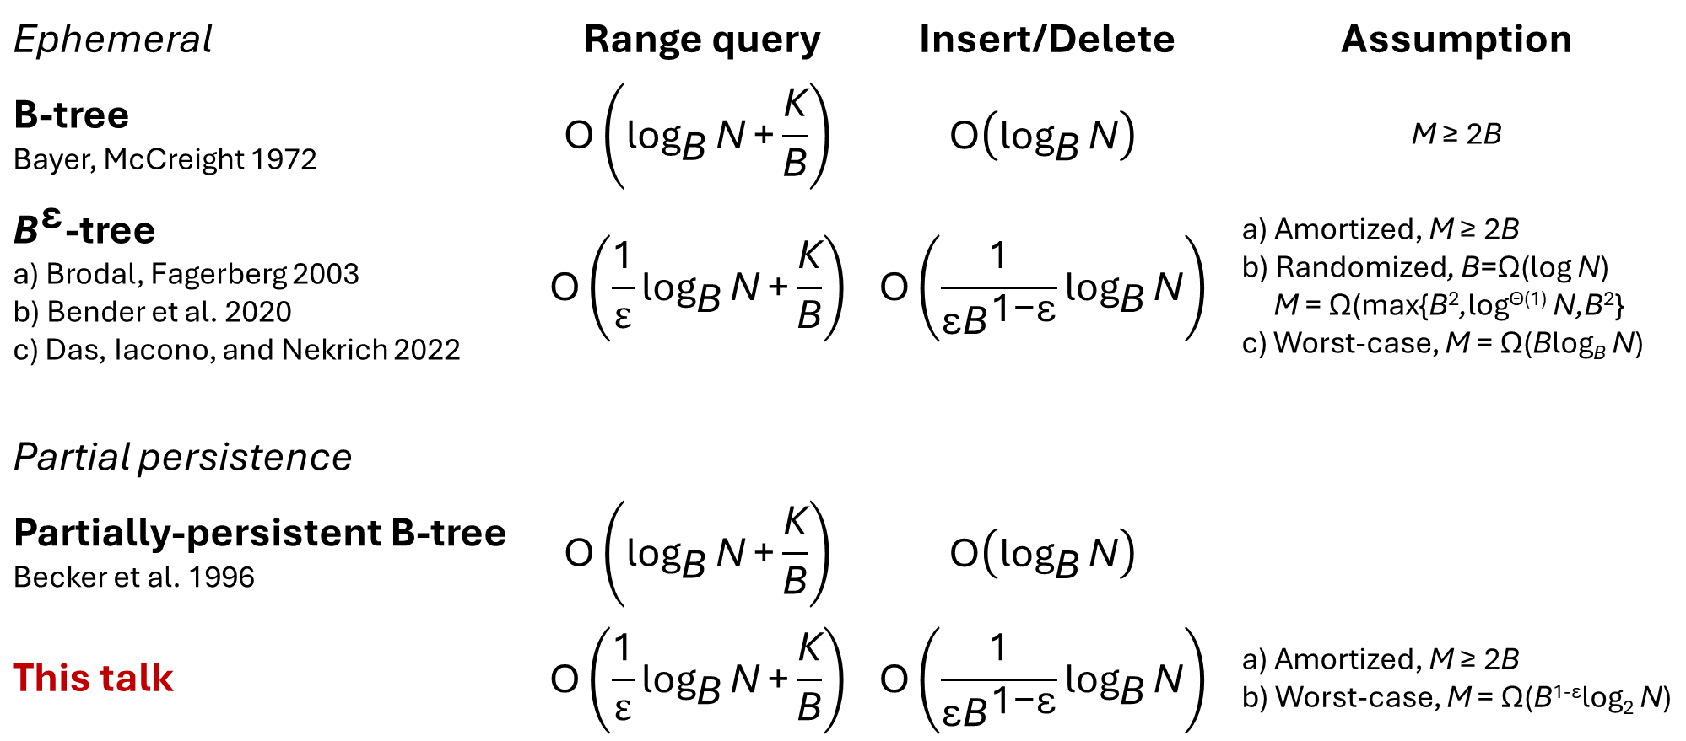
Ephemeral | Range query | Insert/Delete | Assumption
B-tree Bayer, McCreight 1972 | $$\text{O}\left({\text{log}}_{\text{B}}{\text{N}}\text{+}\frac{\text{K}}{\text{B}}\right)$$ | $$\text{O}\left({\text{log}}_{\text{B}}{\text{N}}\right)$$ | M ≥ 2B
${\text{B}}^{\text{ε}}$-tree a) Brodal, Fagerberg 2003 b) Bender et al. 2020 c) Das, Iacono, and Nekrich 2022 | $$\text{O}\left(\frac{\text{1}}{ε}{\text{log}}_{\text{B}}{\text{N}}\text{+}\frac{\text{K}}{\text{B}}\right)$$ | $$\text{O}\left(\frac{\text{1}}{{\text{ε}\text{B}}^{\text{1−}\text{ε}}}{\text{log}}_{\text{B}}{\text{N}}\right)$$ | a) Amortized, M ≥ 2B b) Randomized, B=Ω(log N) M = Ω(max{B²,log^{Θ(1)} N,B²} c) Worst-case, M = Ω(Blog_{B} N)
Partial persistence
Partially-persistent B-tree Becker et al. 1996 | $$\text{O}\left({\text{log}}_{\text{B}}{\text{N}}\text{+}\frac{\text{K}}{\text{B}}\right)$$ | $$\text{O}\left({\text{log}}_{\text{B}}{\text{N}}\right)$$
This talk | $$\text{O}\left(\frac{\text{1}}{ε}{\text{log}}_{\text{B}}{\text{N}}\text{+}\frac{\text{K}}{\text{B}}\right)$$ | $$\text{O}\left(\frac{\text{1}}{{\text{ε}\text{B}}^{\text{1−}\text{ε}}}{\text{log}}_{\text{B}}{\text{N}}\right)$$ | a) Amortized, M ≥ 2B b) Worst-case, M = Ω(B^{1-ε}log₂ N)

