Slide 1
Time-Space Trade-Offs for 2D Range Minimum Queries
Gerth Stølting Brodal Pooya Davoodi
Aarhus University
S. Srinivasa Rao
Seoul National University
18th Annual European Symposium on Algorithms, Liverpool, United Kingdom, September 8, 2010

Slide 2
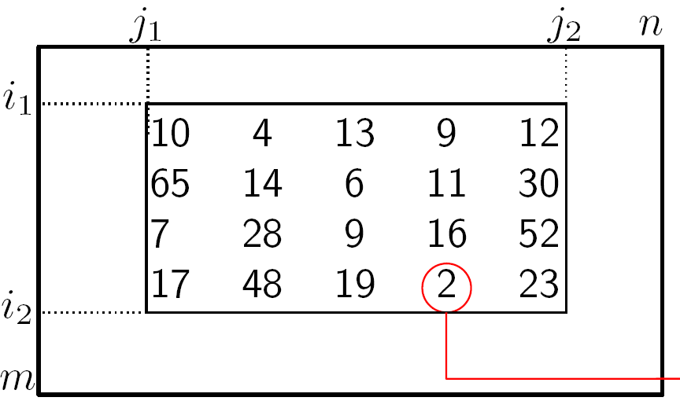
The 2D Range Minimum Problem
j’
i’
Minimum
Preprocess an m x n-matrix of size N = n ∙ m, m ≤ n, to efficiently support range minimum queries
RMQ([i₁, i₂]x[j₁, j₂]) = (i’, j’)
A_{i’, j’} = min{ A_{i’’, j’’} | (i’’, j’’ )∈[i₁,i₂] x [j₁,j₂] }, (i’, j’ )∈[i₁,i₂]x[j₁,j₂]
Notes:
Matric is static

Slide 3
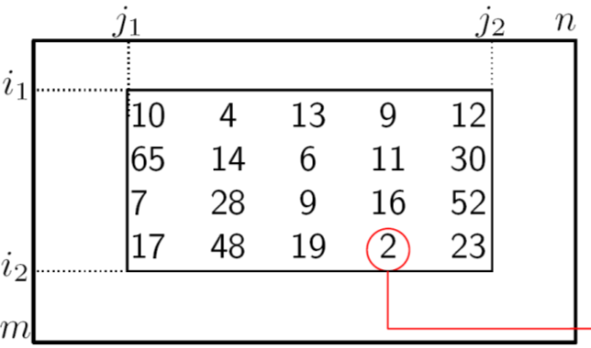
Models
Encoding model
Queries can access data structure but not input matrix
Indexing model
Queries can access data structure and read input matrix
j’
i’
Minimum

Slide 4
Some Trivial Examples...
Solution | Additional space (bits) | Query time | Model
No data structure | 0 | O(N) | Indexing
Tabulate answers | O(N ² log N) | O(1) | Encoding
Store permutation | O(N log N) | O(N) | Encoding
j’
i’
Minimum

Slide 5
Results

Slide 6
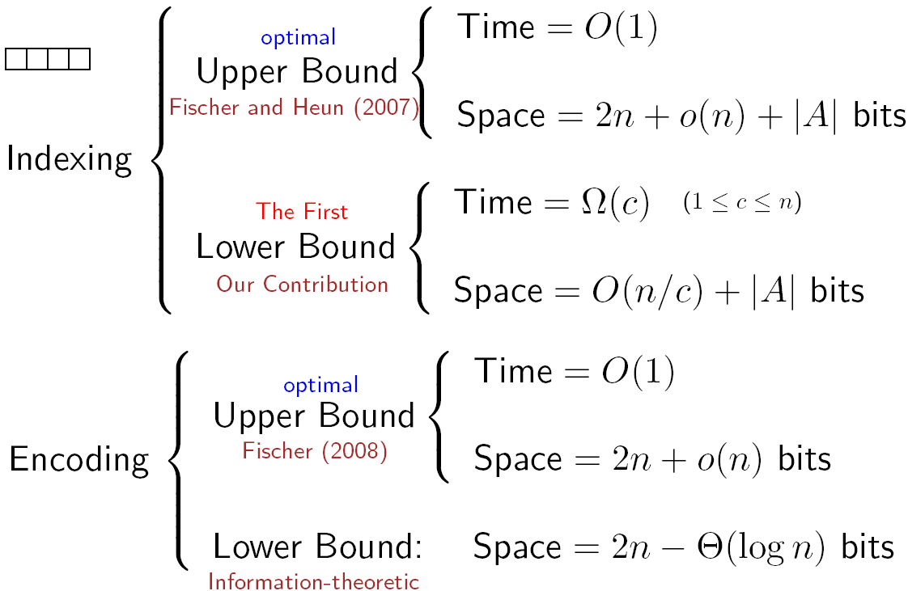
1D Range Minimum Queries
n
Fischer and Heun (2007)
NEW
(matching upper bound)
Fischer (Latin 2010)
Notes:
Fischer & Heun: Show how to answer in O(1) time, but did still access input vector
Fischer (2008): Avoided the lookup of the input vector.

Slide 7
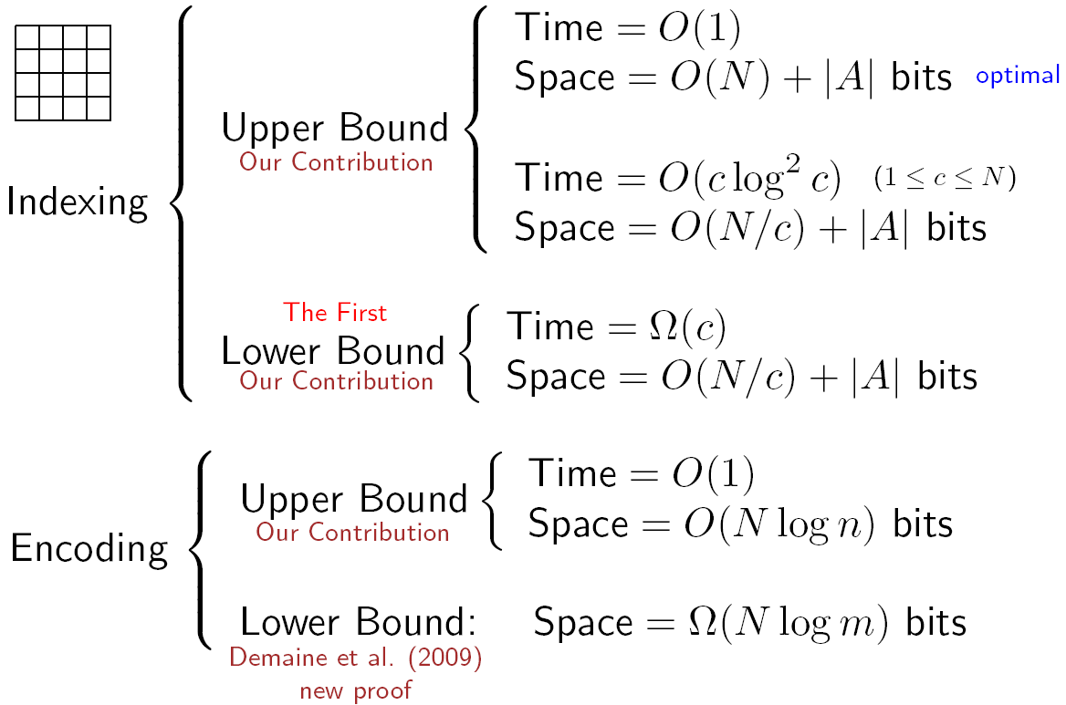
2D Range Minimum Queries
n
NEW
m
m ≤ n
NEW
NEW Proof
Demain et al. (2009)

Slide 8
1D
1D | Encoding model | Index model
Upper bound
Lower bound

Slide 9
Lower Bound (1D, Encoding)
For each input array consider the Cartesian tree
Each binary tree is a possible Cartesian tree
RMQ queries can reconstruct the Cartesian tree
# Cartesian trees is
# bits ≥ = 2n - Θ(log n)
1D | Encoding model | Index model
Upper bound
Lower bound

Slide 10
Upper Bound (1D, Encoding)
For an input array consider the Cartesian tree
Succint representation using 4n+o(n) bits and O(1) query time (Sadakane 2007)
Improved to 2n+o(n) (Fischer 2010)
1D | Encoding model | Index model
Upper bound
Lower bound
Notes:
Fischer is a different approach, not using Cartesian tree

Slide 11
Upper Bounds (1D, Indexing)
C
5 | 2 | 3 | 7 | 4 | 9 | 1 | 10 | 6 | 12 | 8 | 5 | 3 | 7 | 13 | 6 | 11 | 12 | 13 | 2
2 | 1 | 5 | 3 | 2
block minimums (implicit)
Build encoding O(n/c) bit structure for block minimums
RMQ = query to encoding structure + 3c elements, i.e. query time O(c)
1D | Encoding model | Index model
Upper bound
Lower bound

Slide 12
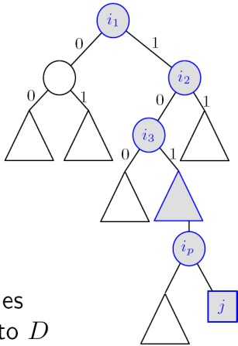
Lower Bounds (1D, Indexing)
Thm Space n/c bits implies Ω(c) query time
Consider n/C queries for c^{n/c} different {0,1} inputs with exactly one zero in each block
c^{n/c} / 2^{n/c} inputs share some data structure
Every query is a
decision tree of
height ≤ d
n/c
q₁
q₂
q_{N/c}
1D | Encoding model | Index model
Upper bound
Lower bound
Notes:
Fix algorithms
Fix set of inputs

Slide 13
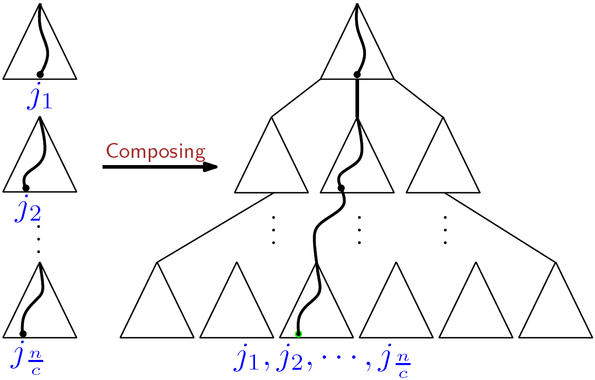
Lower Bounds (1D, Indexing)
cont.
Combine queries to decision tree identifying input
Prune non-reachable branches
# zeroes on any path ≤ n/c
query time d = Ω(c)
n/c
q₁
q₂
q_{n/c}
1D | Encoding model | Index model
Upper bound
Lower bound
Notes:
Fix algorithms
Fix set of inputs

Slide 14
2D
2D | Encoding model | Index model
Upper bound
Lower bound

Slide 15
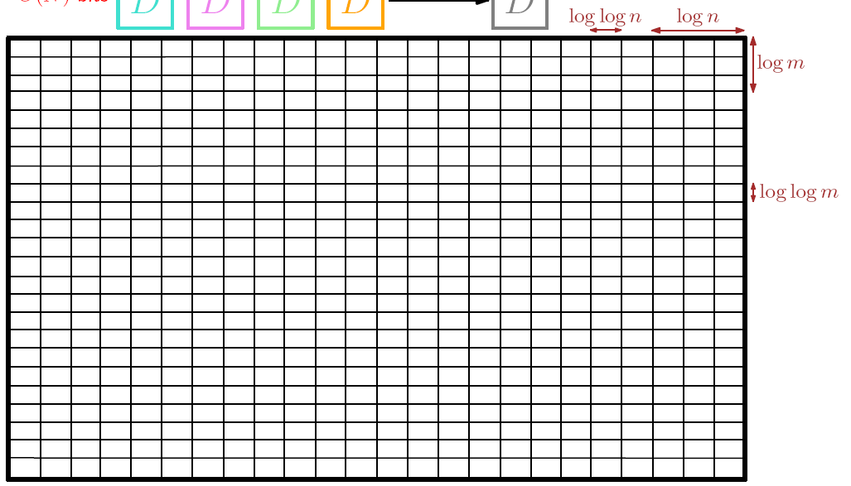
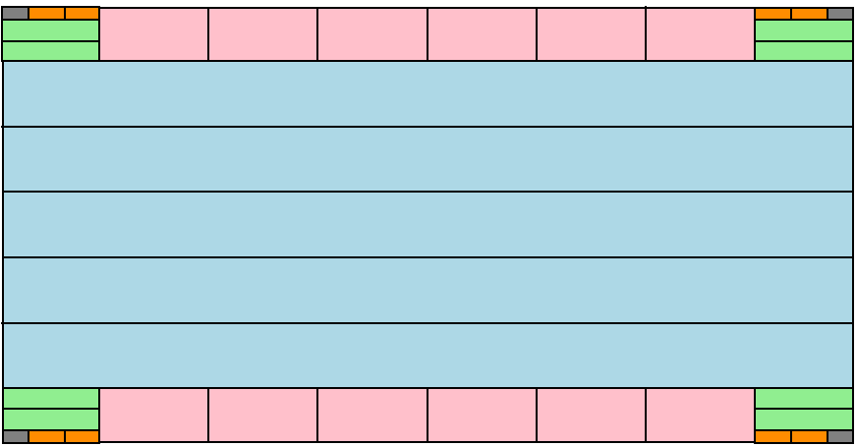
Upper Bounds (2D, Indexing)
O(1) time using O(N) words
Atallah and Yuan (SODA 2010)
Using two-levels of
recursion, tabulating
micro-blocks of size
loglog m x loglog n
O(1) time using O(N) bits
2D | Encoding model | Index model
Upper bound
Lower bound

Slide 16
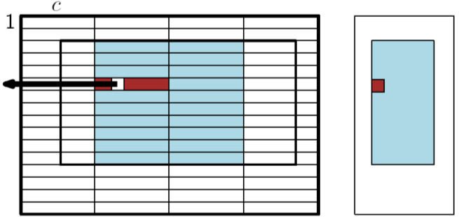
Upper Bounds (2D, Indexing)
cont.
Thm O(N/c ∙ log c) bits and O(c log c) query time
Build log c indexing structures for compressed matrices for block sizes 2^{i} x c/2^{i}, each using O(N/c) bits and can locate O(1) blocks with minimum key in O(1) time
Query: O(1) blocks for each block size in time O(c) + elements not covered by blocks in time O(c log c)
2D | Encoding model | Index model
Upper bound
Lower bound

Slide 17
Lower Bounds (2D, Indexing)
C
1 | 1 | 0 | 1 | 1 | 1 | 1 | 1 | 1 | 0 | 1 | 0 | 1 | 1 | 1 | 1 | 1 | 1 | 0 | 1 | 0 | 1 | 1 | 1 | 1
1 | 0 | 1 | 1 | 1 | 0 | 1 | 1 | 1 | 1 | 1 | 0 | 1 | 1 | 1 | 1 | 1 | 1 | 1 | 0 | 1 | 0 | 1 | 1 | 1
1 | 1 | 1 | 0 | 1 | 1 | 0 | 1 | 1 | 1 | 1 | 1 | 0 | 1 | 1 | 1 | 1 | 1 | 0 | 1 | 1 | 1 | 0 | 1 | 1
1 | 1 | 1 | 1 | 0 | 1 | 1 | 0 | 1 | 1 | 0 | 1 | 1 | 1 | 1 | 1 | 1 | 0 | 1 | 1 | 1 | 1 | 0 | 1 | 1
0 | 1 | 1 | 1 | 1 | 1 | 1 | 0 | 1 | 1 | 1 | 0 | 1 | 1 | 1 | 1 | 0 | 1 | 1 | 1 | 1 | 1 | 1 | 1 | 0
1 | 0 | 1 | 1 | 1 | 1 | 0 | 1 | 1 | 1 | 1 | 1 | 1 | 0 | 1 | 0 | 1 | 1 | 1 | 1 | 1 | 0 | 1 | 1 | 1
As for 1D consider {0,1} matrices and partition the array into blocks of c elements each containing exactly one zero
As for 1D an algorithm being able to identify the zero in each block using N/c bits will require time Ω(c)
2D | Encoding model | Index model
Upper bound
Lower bound

Slide 18
Upper Bounds (2D, Encoding)
29 | -14 | 10 | 15
2 | 7 | 0 | 13
-4 | -5 | -1 | 21
5 | 20 | -17 | 32
15 | 2 | 10 | 12
7 | 9 | 6 | 11
4 | 3 | 5 | 14
8 | 13 | 1 | 16
input matrix
rank matrix
Translate input matrix into rank matrix using O(N log N) bits
Apply index structure to rank matrix using O(N) bits achieving O(1) query time
2D | Encoding model | Index model
Upper bound
Lower bound

Slide 19
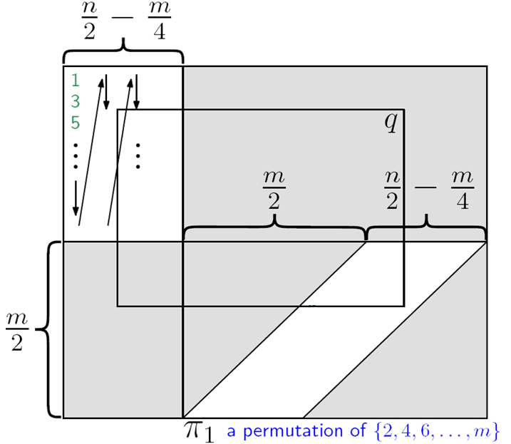
Lower Bound (2D, Encoding) Demaine et al. 2009
NEW Proof
Define a set of
matrices where the RMQ answers differ among all matrices
Bits required is at least
log = Ω(N log m)
.
.
6
.
.
.
2
4
.
.
2D | Encoding model | Index model
Upper bound
Lower bound
Notes:
Grey arrea = N = MAX

Slide 20
Conclusion

Slide 21
1D Range Minimum Queries
n
Fischer and Heun (2007)
NEW
(matching upper bound)
Fischer (Latin 2010)

Slide 22
2D Range Minimum Queries
n
NEW
m
m ≤ n
?
NEW
?
NEW Proof
Demain et al. (2009)
Notes:
Indexing lower bound, comes from 1D – could this be strengthened in 2D? Or is upper bound not optimal?
Encoding model. Upper and lower bound are tight for squared matrices, but for other aspect ratios the bounds are not tight. Recall m≤n.

Slide 23
Tau ∙ Jërë-jëf ∙ Tashakkur ∙ S.aHHa ∙ Sag olun
Giihtu ∙ Djakujo ∙ Dâkujem vám ∙ Thank you
Tesekkür ederim ∙ To-siä ∙ Merci ∙ Tashakur
Taing ∙ Dankon ∙ Efharisto´ ∙ Shukriya ∙ Kiitos
Dhanyabad ∙ Rakhmat ∙ Trugarez ∙ Asante
Köszönöm ∙ Blagodarya ∙ Dziekuje ∙ Eskerrik asko
Grazie ∙ Tak ∙ Bayarlaa ∙ Miigwech ∙ Dank u
Spasibo ∙ Dêkuji vám ∙ Ngiyabonga ∙ Dziakuj
Obrigado ∙ Gracias ∙ A dank aych ∙ Salamat
Takk ∙ Arigatou ∙ Tack ∙ Tänan ∙ Aciu
Korp kun kah ∙ Multumesk ∙ Terima kasih ∙ Danke
Rahmat ∙ Gratias ∙ Mahalo ∙ Dhanyavaad
Paldies ∙ Faleminderit ∙ Diolch ∙ Hvala
Kam-sa-ham-ni-da ∙ Xìe xìe ∙ Mèrcie ∙ Dankie
Thank You

