Slide 1
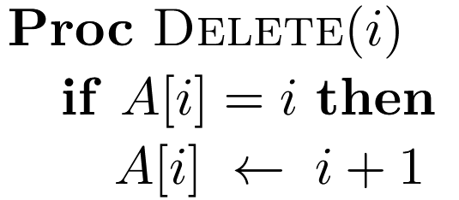
Simple Data Structures with Slightly Worse Bounds ? Gerth Stølting Brodal, Aarhus University
Example : A Simple Integer Successor-Delete Data Structure, Brodal, SEA 25
Problem : Internal union-find Init(n) Delete(i) Succ(i)
Amortized O(1) time [Gabow, Tarjan JCSS 81]
Succ(8) = 12
n
1 | 2 | 3 | 4 | 5 | 6 | 7 | 8 | 9 | 10 | 11 | 12 | 13 | 14 | 15 | 16 | 17 | 18 | 19 | 20
simple
simple
complicated
Θ(log n)
?
2-pass path compression
complicated
complicated
simple
Open problem ▶ Find complicated data structure ▶ Do something simpler ▶ Prove its efficiency ▶ Algorithm engineer it
Notes:
Original source, an exam question in my course in January 2025
Early examples: Splay trees, union find, …
Succ = 2-pass path compression
Theoretical analysis follows Tarjan and van Leeuwen, JACM 1984
Worst-input: Union-find + quick-find take constant time on this input
Random input: Notice y-axis is now e-9 and not e-8, so much small numbers
\documentclass{article}
\usepackage{tikz}
\newcommand{\datastructure}[3]{ %\datastructure{n}{value,value,...}{i1/j1, i2/j2,...}
\begin{tikzpicture}[scale=0.5, baseline=(current bounding box.north)]
\draw[fill=green!10] (0.5,0) rectangle (#1+0.5,1);
\draw (0.5,0) -- (#1+0.5,0);
\draw (0.5,1) -- (#1+0.5,1);
\foreach \i in {0, ..., #1} \draw (\i+0.5, 0) -- ++(0, 1);
\foreach \i in {1, ..., #1} \node at (\i, 1.5) {\sf\scriptsize\i};
\foreach \i in {#2} {
\node[text=green!50!black] at (\i, 0.5) {\sf\textbf{\i}};
}
\foreach \i/\j in {#3} {
\draw[fill=red!20] (\i-0.5, 0) rectangle (\i+0.5, 1);
\node[text=red] at (\i, 0.5) {\sf\textbf{\j}};
\path[-latex,color=blue!60!black] (\i+0.05, -0.1) edge[bend right=30] (\j-0.05, -0.1);
}
\node at (-0.25, 0.5) {$A$};
\end{tikzpicture}} \begin{document}
\datastructure{20}{1, 12, 15, 17, 19, 20}{2/12, 3/7, 4/5, 5/11, 6/7, 7/12, 8/11, 9/10, 10/11, 11/12, 13/15, 14/15, 16/17, 18/19}
\end{document}

