Slide 1
Algorithm Engineering, September 2013 | Data Structures, February-March 2010 | Data Structures, February-March 2006
Cache-Oblivious and Cache-Aware Algorithms, July 2004 | Data Structures, February-March 2002 | Experimental Algorithmics, September 2000
Data Structures, February-March 2000 | Data Structures, March 1998 | Data Structures, February-March 1996
Cache-Oblivious Data Structures and Algorithms
for Undirected BFS and SSSP
Rolf Fagerberg University of Southern Denmark - Odense
with G.S. Brodal, U. Meyer, N. Zeh

Slide 2
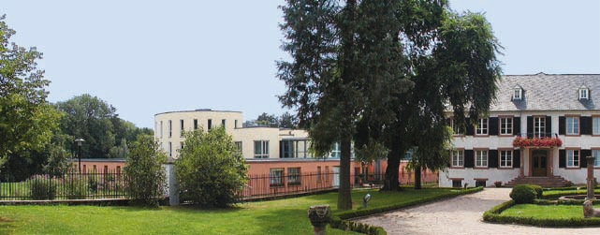
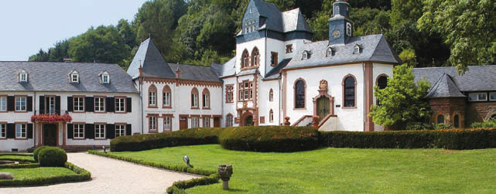
Range Minimum Queries (Part II)
Gerth Stølting Brodal
Aarhus University
Join work with Andrej Brodnik and Pooya Davoodi (ESA 2013)
Dagstuhl Seminar on Data Structures and Advanced Models of Computation on Big Data, February 23-28, 2014

Slide 3
The Problem
Assumption
m ≤ n
Cost
Space (bits)
Query time
Preprocessing time
Models
Indexing (input accessible)
Encoding (input not accessible)
 | 1 | 2 | 3 | 4 | ⋅⋅⋅ | n
1 | 3 | 1 | 3 | 42 | 12 | 8
2 | 7 | 14 | 6 | 11 | 15 | 37
3 | 13 | 99 | 21 | 27 | 44 | 16
⋅⋅⋅ | 23 | 28 | 5 | 13 | 4 | 47
m | 34 | 24 | 1 | 24 | 9 | 11
i₁
i₂
j₁
j₂
RMQ(i₁, i₂, j₁, j₂) = (2,3)
= position of min

Slide 4
Some (Trivial) Results
 | Indexing Model (input accessible) | Encoding Model (input not accessable)
m ≤ n | Preprocessing: Do nothing ! Very fast preprocessing Very space efficient Queries O(mn) | Tabulate the answer to all ~ m²n² possible queries Preprocessing & space O(m²n²⋅log n) bits Queries O(1) Store rank of all elements Preprocessing & space O(mn⋅log n) bits Queries O(mn)

Slide 5
Encoding m = 1 (Cartesian tree)
RMQ(j₁, j₂) = NCA(j₁, j₂)
1
2
8
3
4
9
5
10
6
14
11
7
3 | 5 | 2 | 10 | 4 | 11 | 6 | 7 | 1 | 9 | 14 | 8
1
j₁
min ?
j₂
n
To support RMQ queries we need...
tree structure (111101001100110000100100)
mapping between nodes and cells (inorder)

Slide 6
Some (Less Trivial) Results
 | Indexing Model (input accessible) | Encoding Model (input not accessable)
m = 1 1D | 2n+o(n) bits, O(1) time [FH07] n/c bits ⇒ Ω(c) time [BDS10] n/c bits, O(c) time [BDS10] | ≥ 2n - O(log n) bits 2n+o(n) bits, O(1) time [F10]
1 < m < n | O(mn⋅log n) bits, O(1) time [AY10] O(mn) bits, O(1) time [BDS10] mn/c bits ⇒ Ω(c) time [BDS10] O(c⋅log² c) time [BDS10] O(c⋅log c⋅(loglog c)²) time [BDLRR12] | Ω(mn⋅log m) bits [BDS10] O(mn⋅log n) bits, O(1) time [BDS10] O(mn⋅log m) bits, ? time [BBD13]
m = n squared |  | Ω(mn⋅log n) bits [DLW09] O(mn⋅log n) bits, O(1) time [AY10]
Notes:
FH07 = Fischer & Heun, ESCAPE 2007
DLW09 = Demaine, Landau & Weiman ICALP 2009
AY10 = Atallah, Yuan SODA 2010
F10 = Fischer STACS 2010
BDLRR12 = Brodal, Davoodi, Lewenstein, Raman, Rao ESA 2012

Slide 7
New Results
O(nm⋅(log m+loglog n)) bits
tree representation
component decomposition
O(nm⋅log m⋅log* n)) bits
bootstrapping
O(nm⋅log m) bits
relative positions of roots
refined component construction

Slide 8
Tree Representation
11 | 4 | 1 | 3
9 | 6 | 12 | 8
5 | 2 | 10 | 7
11 | 4 | 1 | 3
9 | 6 | 12 | 8
5 | 2 | 10 | 7
1
12
12
10
10
8
8
11
9
6
6
7
7
5
4
3
2
2
Requirements
Cells ↔ leafs
Query ⇒ Answer = rightmost leaf
Trivial solution
Sort leafs
Ω(mn⋅log n) bits
12
11
10
9
8
7
6
5
4
3
2
1

Slide 9
Components α = 3
11 | 4 | 1 | 3
9 | 6 | 12 | 8
5 | 2 | 10 | 7
11 | 4 | 1 | 3
9 | 6 | 12 | 8
5 | 2 | 10 | 7
11 | 4 | 1 | 3
9 | 6 | 12 | 8
5 | 2 | 10 | 7
11 | 4 | 1 | 3
9 | 6 | 12 | 8
5 | 2 | 10 | 7
11 | 4 | 1 | 3
9 | 6 | 12 | 8
5 | 2 | 10 | 7
11 | 4 | 1 | 3
9 | 6 | 12 | 8
5 | 2 | 10 | 7
11 | 4 | 1 | 3
9 | 6 | 12 | 8
5 | 2 | 10 | 7
11 | 4 | 1 | 3
9 | 6 | 12 | 8
5 | 2 | 10 | 7
11 | 4 | 1 | 3
9 | 6 | 12 | 8
5 | 2 | 10 | 7
11 | 4 | 1 | 3
9 | 6 | 12 | 8
5 | 2 | 10 | 7
11 | 4 | 1 | 3
9 | 6 | 12 | 8
5 | 2 | 10 | 7
11 | 4 | 1 | 3
9 | 6 | 12 | 8
5 | 2 | 10 | 7
11 | 4 | 1 | 3
9 | 6 | 12 | 8
5 | 2 | 10 | 7
11 | 4 | 1 | 3
9 | 6 | 12 | 8
5 | 2 | 10 | 7
11 | 4 | 1 | 3
9 | 6 | 12 | 8
5 | 2 | 10 | 7
C₁
C₂
C₃
1
1
12
10
8
11
7
5
4
3
2
11
9
9
6
12
10
8
6
7
5
4
3
2
L
Construction
Consider elements in decreasing order
Find connected components with size ≥ α
L-adjacency ⇒ |C₁|≤ 4α-3, |C_{i}|≤ 2mα
Representation
O(mn + mn/α⋅log n + mn⋅log m + mn⋅log(mα))
α = log n ⇒ O(mn⋅(log m+loglog n))
L-adjacency
Spanning tree structures
Component
root positions
Spanning tree edges
Local leaf ranks in components

Slide 10
Results
 | Indexing Model (input accessible) | Encoding Model (input not accessable)
m = 1 1D | 2n+o(n) bits, O(1) time [FH07] n/c bits ⇒ Ω(c) time [BDS10] n/c bits, O(c) time [BDS10] | ≥ 2n - O(log n) bits 2n+o(n) bits, O(1) time [F10]
1 < m < n | O(mn⋅log n) bits, O(1) time [AY10] O(mn) bits, O(1) time [BDS10] mn/c bits ⇒ Ω(c) time [BDS10] O(c⋅log² c) time [BDS10] O(c⋅log c⋅(loglog c)²) time [BDLRR12] | Ω(mn⋅log m) bits [BDS10] O(mn⋅log n) bits, O(1) time [BDS10] O(mn⋅log m) bits, ? time [BBD13]
m = n squared |  | Ω(mn⋅log n) bits [DLW09] O(mn⋅log n) bits, O(1) time [AY10]
better upper or lower bound ?
Notes:
FH07 = Fischer & Heun, ESCAPE 2007
DLW09 = Demaine, Landau & Weiman ICALP 2009
AY10 = Atallah, Yuan SODA 2010
F10 = Fischer STACS 2010
BDLRR12 = Brodal, Davoodi, Lewenstein, Raman, Rao ESA 2012

Slide 11
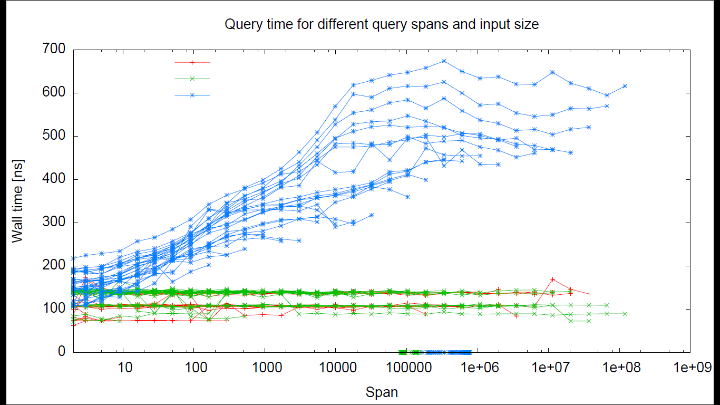
1D Range Minimum Queues
O(n log n) words
O(n) words
Fischer
Kasper Nielsen, Mathieu Dehouck, Sarfraz Raza 2013
Notes:
Each curve correpsonds to one input size

Slide 12
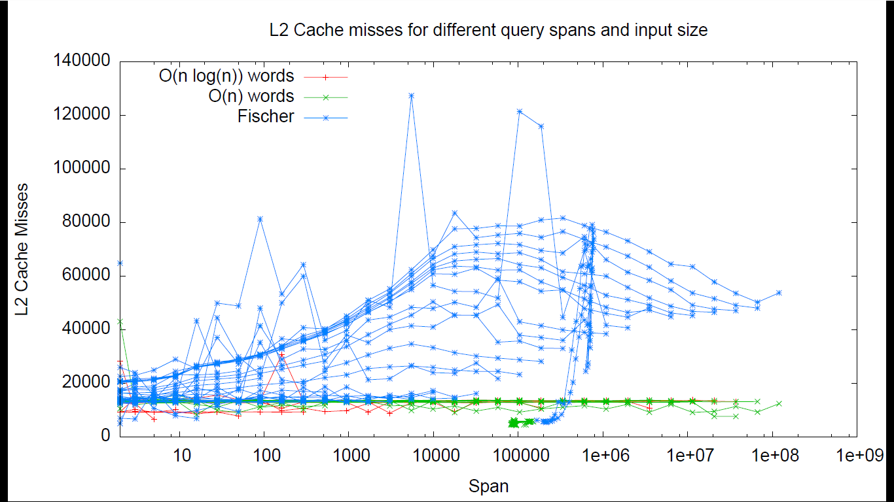
1D Range Minimum Queues
Kasper Nielsen, Mathieu Dehouck, Sarfraz Raza 2013
Notes:
Each curve correpsonds to one input size

Slide 13
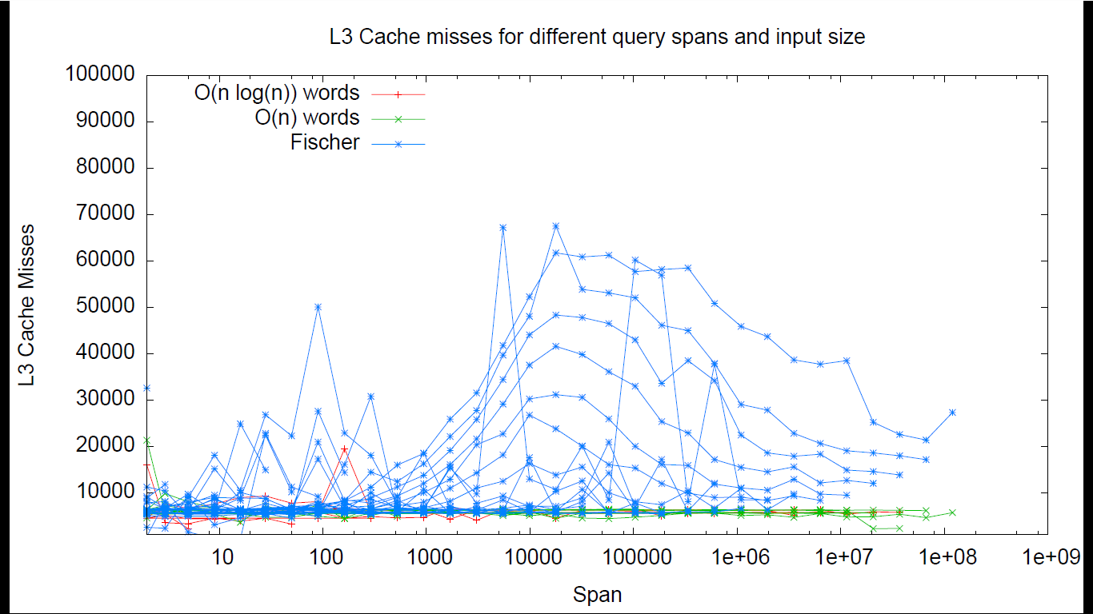
1D Range Minimum Queues
Kasper Nielsen, Mathieu Dehouck, Sarfraz Raza 2013
Notes:
Each curve correpsonds to one input size

Slide 14
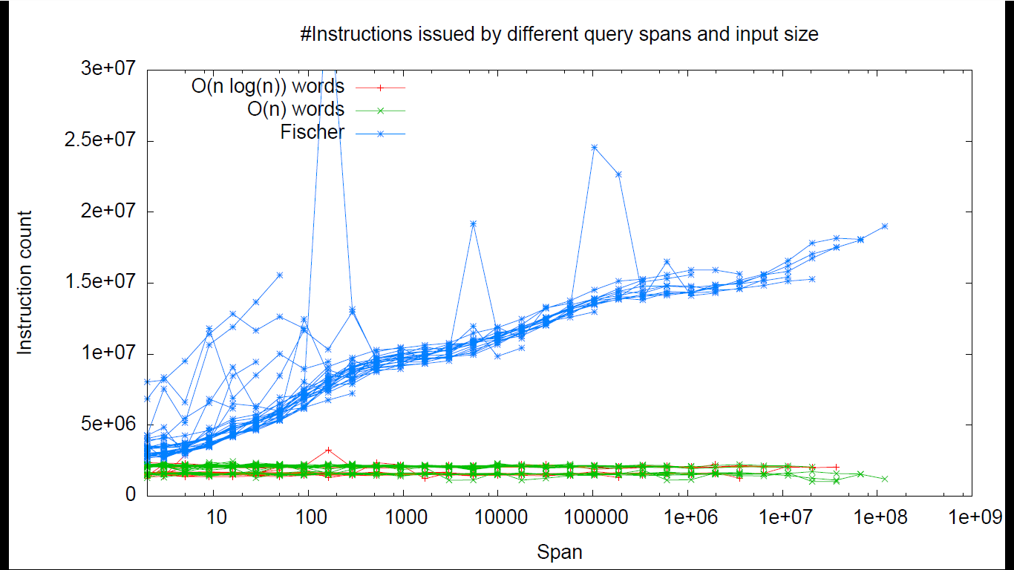
1D Range Minimum Queues
Kasper Nielsen, Mathieu Dehouck, Sarfraz Raza 2013
Notes:
Each curve correpsonds to one input size

