Slide 1
We Blackboard

Slide 2
Background
Blackboard – AU’s central generic course management system
Replacing several existing systems (including CourseAdmin @ CS)
CS started using Blackboard in Spring 2015
System has its and
AU conservative : AU runs a one year old version to ensure stability
Our responsibility – make the best usage of Blackboard !
Patience ... don’t expect the impossible ...
... help each other to find solutions ...
+ -

Slide 3
Forelæsere/Lecturers (= ”Instructor” in Blackboard)
Most lecturers used to use CourseAdmin
...and still obliviously hoping to find the same features in Blackboard
...and definitely never used Blackboard as a student
Several lecturers use <iframe> tags to maintain course content outside Blackboard (Aslan, Gerth, Gudmund, Henrik, ...)
...unrealistic that course pages are uniform across courses

Slide 4
Instruktorer/TAs (= ”Teaching Assistant” in Blackboard)
Powerful – essentially same privileges as instructors
can update webpages (if not <iframe>’ed)
can see and comment on all student handins
cannot enroll new instructors and TAs
Experience Blackboard from both student and instructor view
TAs can have a high influence on how the department uses blackboard !

Slide 5
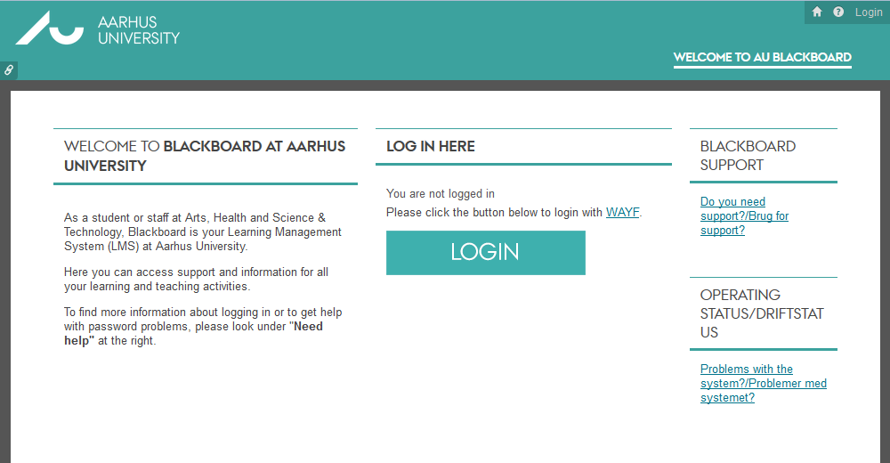
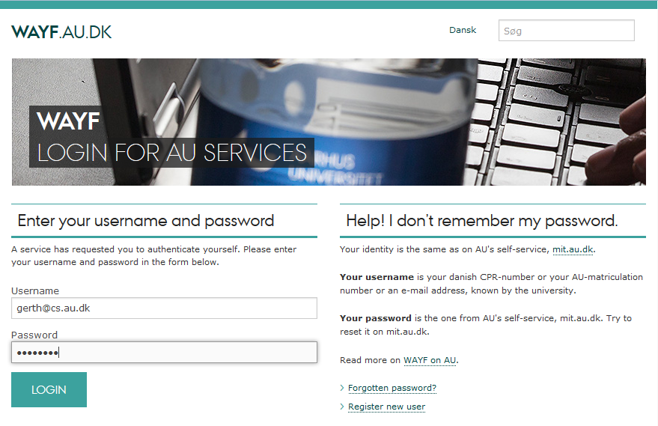
Login – bb.au.dk
blackboard.au.dk is only for BSS courses

Slide 6
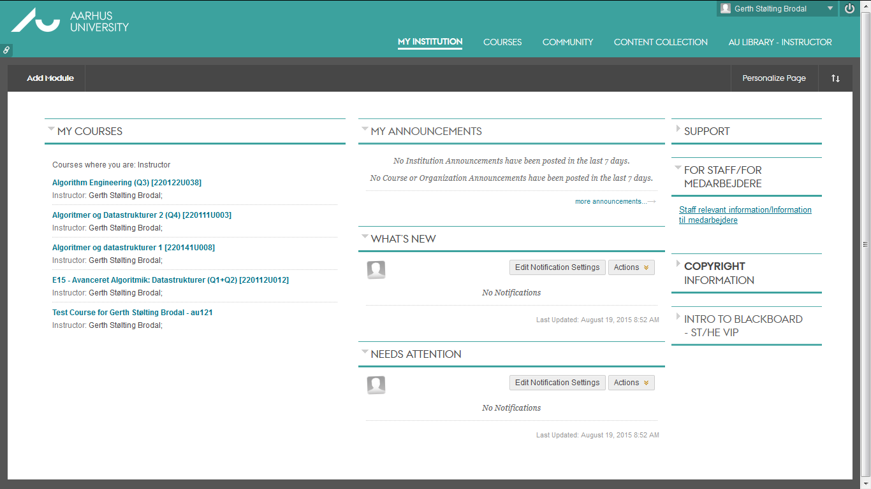
Your home page
find
your course
Course missing? Ask lecturer to enroll you as Teaching Assistant

Slide 7
Course page
Edit
Front page
Menu
Menu Manual setup. Recommended by week/topic
Front page First menu item (title of course)
Edit mode Enable to edit content
Course management Handins, users, ....
Deltagerliste/Roster Remember to press ”Go”
Discussion board Encourage web discussion
Announcements Use this insted of emails to all students!
Management

Slide 8
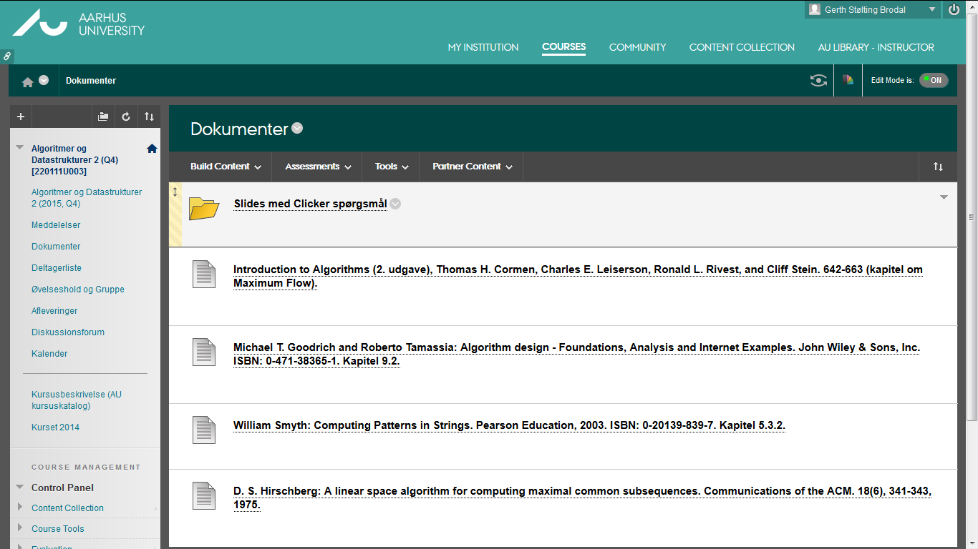
Course page (Edit mode)
Magic menus
Add menu items
Edit : On
Actions on current page

Slide 9
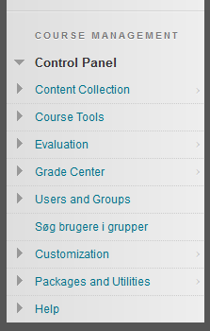
Course Management (Control panel)
Only visible to Instructors and TAs
Grade Center her you find handins to correct
Users and Groups enroll students and manage groups (TA classes, handin groups, ...)
Søg brugere i grupper Greasemonkey browser plugin by Mathias Rav https://github.com/Mortal/bbdyn

Slide 10
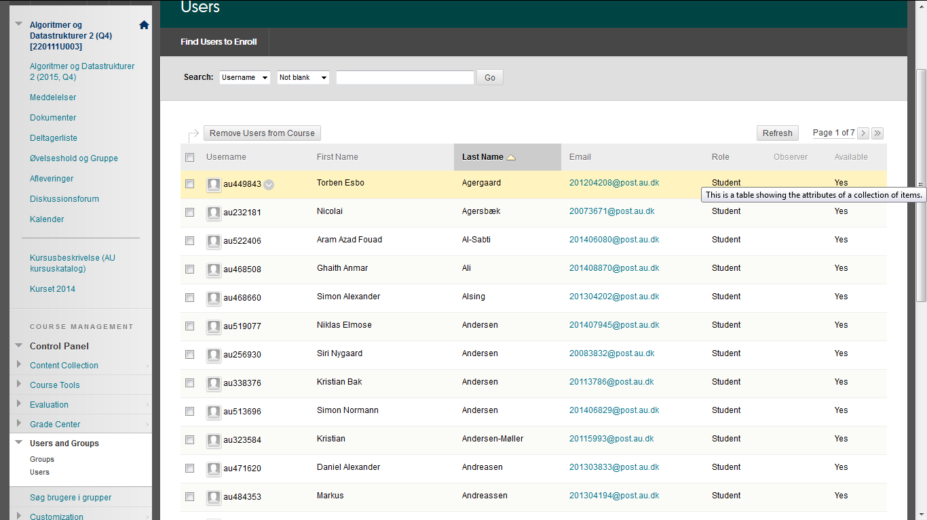
User lists (most students automatically enrolled through STADS)

Slide 11
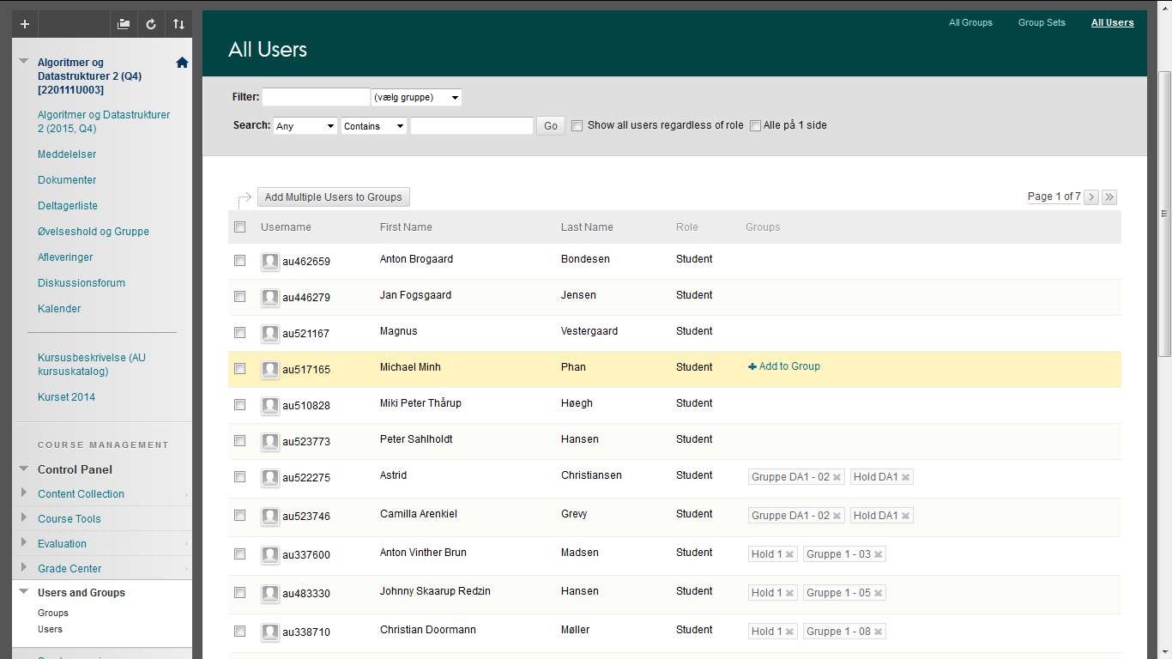
Manual group membership management

Slide 12
Assignments
Blackboard supports many types of assignments
individual assignments
group handins
peer reviewing
quizz
discussion board activity
...

Slide 13
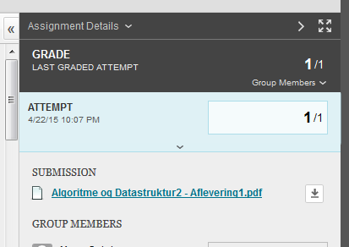
Grading handins

Slide 14
TA classes and group handins
One way (dADS2) : 2 ”group sets” with ”self-enroll”
Each student self-enrolls into one TA class and one group
Class
Group
Hold 1
Gruppe 1 - 01
Gruppe 1 - 02
Gruppe 1 - 03
Gruppe 1 - 04
Gruppe 1 - 05
· · ·
Gruppe 1 - 20
Hold DA1
Gruppe DA1 - 01
Gruppe DA1 - 02
Gruppe DA1 - 03
Gruppe DA1 - 04
Gruppe DA1 - 05
· · ·
Gruppe DA1 - 20
Hold DA2
Gruppe DA2 - 01
Gruppe DA2 - 02
Gruppe DA2 - 03
Gruppe DA2 - 04
Gruppe DA2 - 05
· · ·
Gruppe DA2 - 20
Hold DA3
Gruppe DA3 - 01
Gruppe DA3 - 02
Gruppe DA3 - 03
Gruppe DA3 - 04
Gruppe DA3 - 05
· · ·
Gruppe DA3 - 20
Hold DA5
Gruppe DA5 - 01
Gruppe DA5 - 02
Gruppe DA5 - 03
Gruppe DA5 - 04
Gruppe DA5 - 05
· · ·
Gruppe DA5 - 20
Hold DA6
Gruppe DA6 - 01
Gruppe DA6 - 02
Gruppe DA6 - 03
Gruppe DA6 - 04
Gruppe DA6 - 05
· · ·
Gruppe DA6 - 20
Hold DA7
Gruppe DA7 - 01
Gruppe DA7 - 02
Gruppe DA7 - 03
Gruppe DA7 - 04
Gruppe DA7 - 05
· · ·
Gruppe DA7 - 20
Notes:
Skal oprette 147 grupper i dADS2…

Slide 15
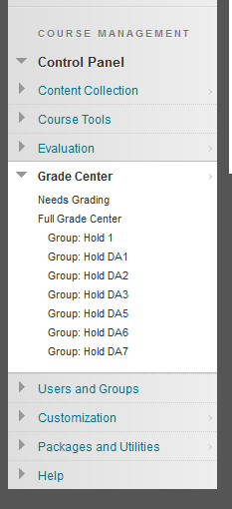
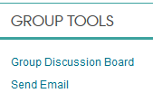
TA classes
Students enrolled into courses & Blackboard through ”STADS”
Students assigned to ta classes through study plan (læseplanen)
By letting students ”self-enroll” into TA classes
Students confirm that they attend the course (many ghost students during first year)
Chaning TA classes does not require TA action (except for an ok)
TAs should ”self-enroll” to their class
The TA class / ”Hold” groups give
possibility to communicate with TA class
”SmartView” in ”Grade Center” for each TA class

Slide 16
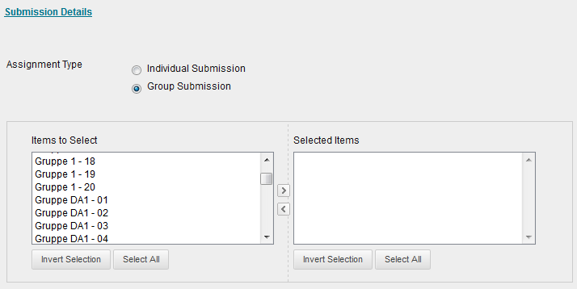
Creating group handins (for lecturers)
Each group assignment must be assigned to a set of groups
A set of empty (handin) groups are created before the course starts
All group handins kan be made available at the beginning of the course by assigning them to these empty groups
Students ”self-enroll” when groups get known (or when first handin)

Slide 17
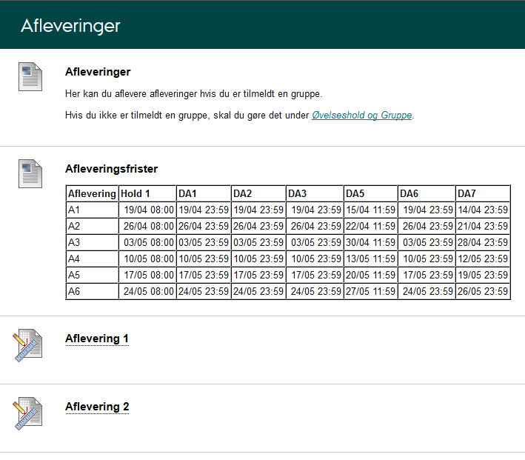
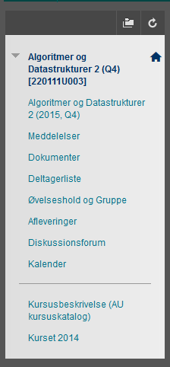
Student view (dADS2)
Kun synlig når man er tilmeldt en gruppe !
Two pages with information on signing up to groups & TA classes and handins

Slide 18
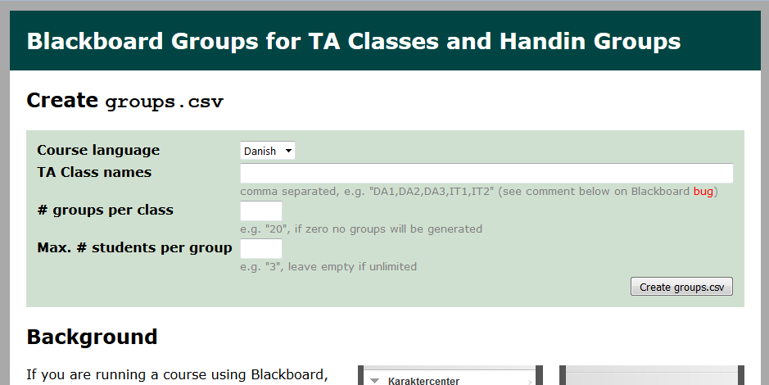
Configuration of groups (for lecturers)
www.cs.au.dk/~gerth/blackboard/groups.php

Slide 19
Resources
CourseAdmin → Blackboard (slides, NFIT login) https://cs.au.dk/~amoeller/talks/pdf/Blackboard.pdf
Creating group sets for handin http://cs.au.dk/~gerth/blackboard/groups.php
Søg brugere i grupper (Search users in groups) Greasemonkey browser plugin by Mathias Rav https://github.com/Mortal/bbdyn
BB support http://bbsupport.au.dk/en/support/

Slide 20
We Blackboard

