Slide 1
Algorithm Engineering the Theory
Gerth Stølting Brodal
Aarhus University
ADYN Summer School on Algorithm Engineering for Network Problems, Hasso Plattner Institute, Potsdam, Germany, September 19-22, 2023
Notes:
https://hpi.de/ae2023/
20/9-2023 15:30-17:00

Slide 2
Gerth Stølting Brodal
Research
Data structures 1993 –
Teaching
Algorithms and Data Structures 2002 – Introduction to Programming (Python) 2018 –Bachelor project advising
Notes:
This talk is based on some observations done during these years of teaching…
WARNING: Code examples will be in Python

Slide 3
Algorithms
Coding is healthy
Coding is fun
Debugging less so…
Procrastinating from writing the theory ?
Document relevance of theory
Study theory vs real world
Identify shortcomings of theory
Inspire new theory
Creating new theory is cool
Filling in proof details less exciting
Uncertainty – have all cases been addressed ? [you prove the algorithm is correct but rarely that your proof is correct]
Frustrating when errors make their way into published papers
Theory
Implementation
Notes:
I am living in the red world… but will try to tell a few stories showing the interaction between these world
Once reviewing a paper improving a result from O(n*log n) to O(n). It was a pleasure to read – and I only found one line with a bug – but that made the result O(n*log n) instead of O(n).
This talk is not addressing potential bugs through formal verification

Slide 4
Goal
Have more celebrations
Make progress on bugs more frequently
Not necessarily fewer bugs !
https://www.commitstrip.com/en/2018/05/09/progress/
Notes:
Title of strip “Progress”

Slide 5
Example : Bipartite graph ?
Graph
Algorithm
Yes
No
A
B
A
B
C
E
C
E
G
G
F
D
F
D
Certificate = two coloring
Certificate = odd cycle
Computer Science Review 5(2), 119-161, 2011
DOI: doi.org/10.1016/j.cosrev.2010.09.009
Notes:
Easy to verify certificates
Certificates can help strengthen the reliability of software

Slide 6
Automatic testing of algorithm implementation
while True:
x = generate_random_input()
answer, certificate = algorithm(x)
assert verify(x, answer, certificate)
print('.')
Happy when sequence of dots grow
Program crashes – debugger can perhaps help you find the bug
Verification fails – a bug somewhere in the program/algorithm
.
.
.
.
.
.
.
.
.
.
.
.
.
.
.
.
.
.
.
.
Notes:
A failed certificate only shows that there is a bug on a certain input…. A chance for the yet another celebration

Slide 7
Simplifying failed input (Greedy DFS)
def simplify_bug(failed_input):
for x in simplifications(failed_input):
try:
algorithm(x)
except Bug:
print('YES! - failed on', x)
return simplify_bug(x)
return failed_input
simplifications could e.g. report all ways of removing a single vertex or edge from a graph
Complex input triggering the bug can sometimes be simplified to an input of manageable size
Notes:
Assumes that buggy input is monotonic property (adding more data to a bad input does not make the bug disappear)
simplify_bug will find a minimal input – not necessarily a minimum input.

Slide 8
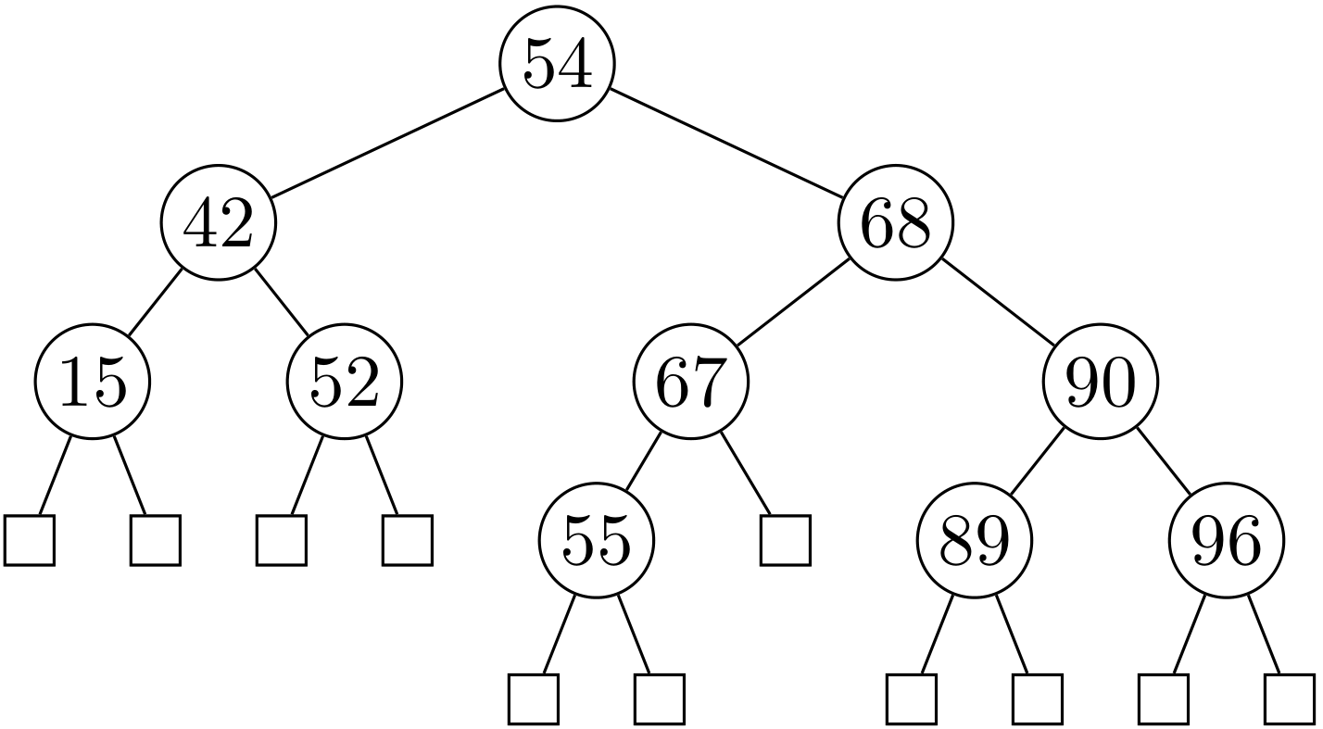
Invariants
Invariants are a fundamental tool when designing and analyzing algorithms and data structures
Capture state of algorithm
Example: AVL tree invariant
Search tree
$∀$ v : |v.left.height – v.right.height | ≤ 1
Invariants can be made assertions in code ensure code integrity

Slide 9
def validate(tree, min_value=None, max_value=None):
'''Validate AVL-tree invariants.'''
if not is_empty(tree):
assert min_value == None or min_value <= tree.root
assert max_value == None or tree.root <= max_value
assert tree.height == 1 + max(tree.left.height, tree.right.height)
assert abs(tree.left.height - tree.right.height) <= 1
validate(tree.left, min_value, tree.root)
validate(tree.right, tree.root, max_value)
def inorder(tree):
'''Generator that yields values in tree in sorted order.'''
if not is_empty(tree):
yield from inorder(tree.left)
yield tree.root
yield from inorder(tree.right)
def test_insertions(n):
data = random.choices(range(10 * n), k=n)
tree = empty_tree
for i, x in enumerate(data):
tree = insert(tree, x)
validate(tree)
assert sorted(data[:i + 1]) == list(inorder(tree))
Write validate and test methods before implementing insert
Notes:
Challenged myself: Try develop details of AVL tree operations from invariants
Inorder traversal to ensure that it is the correct values stored in the tree (e.g. that all values are not just 42, or the tree is the empty tree)
TEST DRIVEN: Write validate and test method before implementing insert
Inorder tested multiple places – but better test twice than not test

Slide 10
“Test driven algorithm design”
Formulate invariants as the driving tool for algorithm design
Implement invariants in code as assertions and verifier methods
Automate stress tests
Develop algorithm through failed tests likely good coverage of special cases little redundant code
Note: verification methods might slow down code significantly (asymptotic slower!), but the focus is on developing correct theory

Slide 11
Visual test/debugging of autogenerated figure
def tikz(tree):
def recurse(tree):
if tree is empty_tree:
return '{}'
else:
return f'[.{tree.root} {recurse(tree.left)} {recurse(tree.right)} ]'
return r'\Tree ' + recurse(tree)
\Tree [.54 [.42 [.15 {} {} ] [.52 {} {} ] ] [.68 [.67 [.55 {} {} ] {} ] [.90 [.89 {} {} ] [.96 {} {} ] ] ] ]

Slide 12
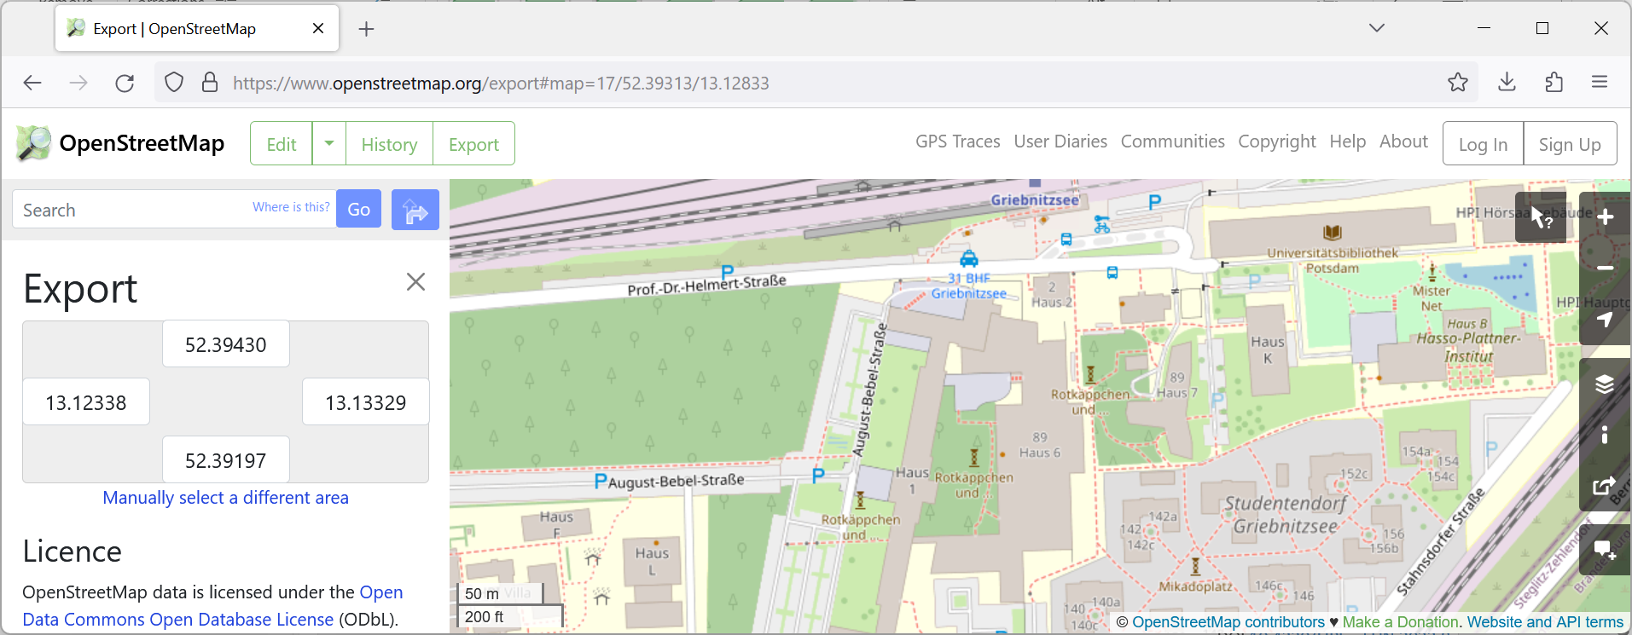
An unexpected journey
Bachelor project = shortest paths on Open Street Map graphs
Students have trouble implementing Dijkstra's algorithm in JavaTM
DOI 10.4230/LIPIcs.FUN.2022.8
Notes:
1st semester computer science students are introduced to Dijkstra’s algorithm
6th semester students try to work with a real-world graph and more advanced shortest path algorithms

Slide 13
<way id="79388407" visible="true" version="17" changeset="107546769" timestamp="2021-07-07T08:48:29Z" user="KartoffelOS" uid="10758523">
<nd ref="296937646"/>
<nd ref="926885043"/>
<nd ref="926884234"/>
<nd ref="4868434116"/>
<nd ref="528571257"/>
<tag k="access" v="private"/>
<tag k="bicycle" v="yes"/>
<tag k="delivery" v="yes"/>
<tag k="emergency" v="yes"/>
<tag k="foot" v="yes"/>
<tag k="highway" v="service"/>
<tag k="lit" v="yes"/>
<tag k="maxspeed" v="20"/>
<tag k="name" v="August-Bebel-Straße"/>
<tag k="postal_code" v="14482"/>
<tag k="service" v="parking_aisle"/>
<tag k="surface" v="paving_stones"/>
</way>
<way id="970133467" visible="true" version="7" changeset="135350751" timestamp="2023-04-25T16:12:30Z" user="tecmap15" uid="4798255">
<nd ref="8977535608"/>
<nd ref="8977535605"/>
<nd ref="8977535606"/>
<nd ref="8977535607"/>
<nd ref="8977535601"/>
<nd ref="8977535602"/>
<nd ref="8977535608"/>
<tag k="addr:city" v="Potsdam"/>
<tag k="addr:country" v="DE"/>
<tag k="addr:housenumber" v="88"/>
<tag k="addr:postcode" v="14482"/>
<tag k="addr:street" v="August-Bebel-Straße"/>
<tag k="addr:suburb" v="Babelsberg"/>
<tag k="building" v="university"/>
<tag k="building:levels" v="3"/>
<tag k="name" v="Haus L"/>
<tag k="roof:levels" v="0"/>
<tag k="roof:shape" v="flat"/>
<tag k="wheelchair" v="yes"/>
</way>

Slide 14
Dijkstra’s algorithm (1956)
2
+∞
B
4
4
6
6
0
2
+∞
+∞
source
A
1
D
2
E
4
Non-negative edge weights
Visits nodes in increasing distance from source
1
C
Q = ⟨0,A⟩
+∞
⟨2,B⟩ ⟨4,C⟩
4
relax
3
⟨3,C⟩ ⟨6,D⟩
⟨4,D⟩
⟨6,E⟩
Fibonacci heaps (Fredman, Tarjan 1984)
⇒ O(m + n ∙ log n)
O(log n) Remove
⇒ O(m ∙ log n)
relax
Notes:
Weights can be physical distance projections or spherical coordinates, travel time using speedlimits, height increase…
Will present 4 variations of Dijkstra’s algorithm typically implemented by the students
CLRS asumes all nodes are inserted with +infty initially
Fibonacci heaps not part of standard library; anyway road maps are sparse, so the theoretical gain from Fibonacci heaps is not relevant
[CLRS4] does not contain Fibonacci heap any longer
Dijkstra2: ”v in Q” could mentain a bitvector/set to test for this.

Slide 15
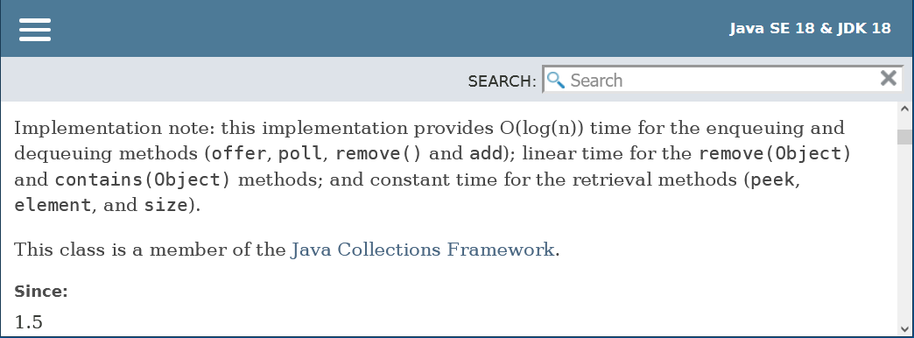
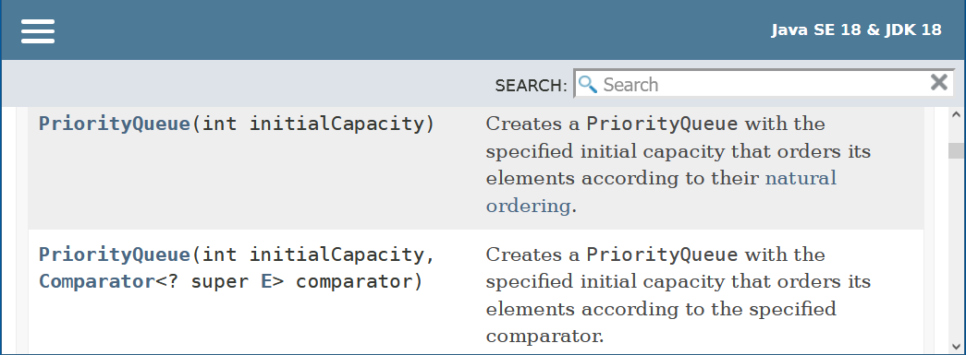
The challenge - Java's builtin binary heap
no decreasekey
remove O(n) time
⇒ Dijkstra O(m ∙ n)
comparator function

Slide 16
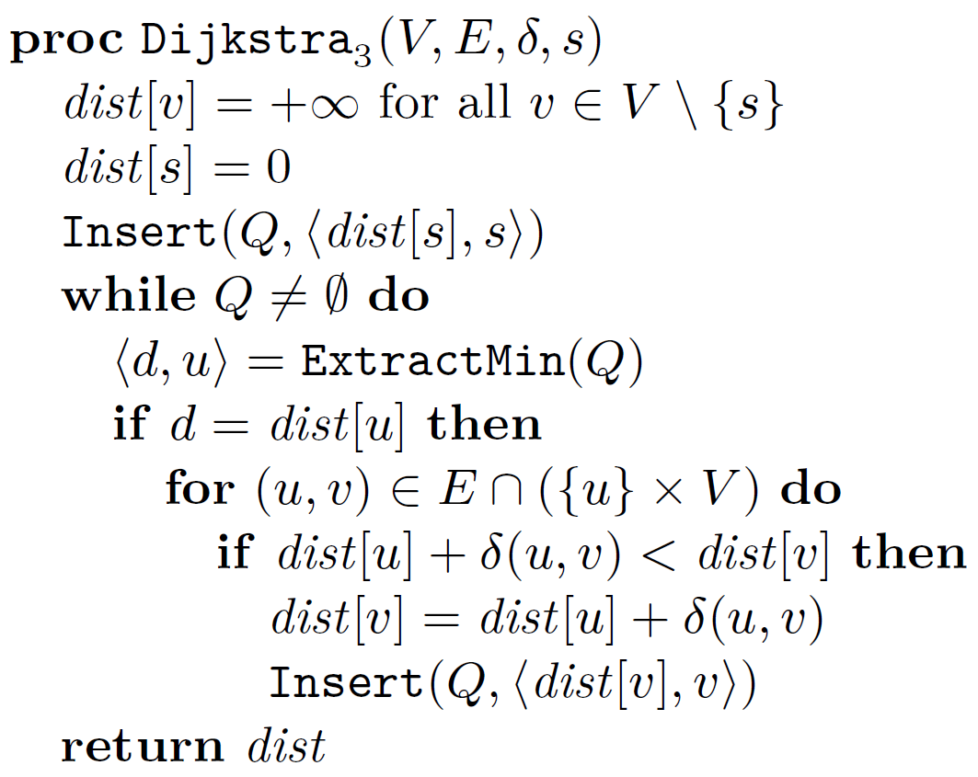
Repeated insertions
2
+∞
B
4
4
6
6
0
2
+∞
+∞
source
A
1
D
2
E
Relax inserts new copies of item
Skip outdated items
4
1
C
+∞
4
Q = ⟨0,A⟩
3
⟨2,B⟩ ⟨4,C⟩
⟨3,C⟩ ⟨4,C⟩ ⟨6,D⟩
⟨4,C⟩ ⟨4,D⟩ ⟨6,D⟩
⟨4,D⟩ ⟨6,D⟩
outdated ?
⟨6,D⟩ ⟨6,E⟩
⟨6,E⟩
relax
= reinsert
Notes:
Fibonacci heaps not part of standard library; anyway road maps are sparse, so the theoretical gain from Fibonacci heaps is not relevant
Dijkstra2: ”v in Q” could mentain a bitvector/set to test for this.

Slide 17
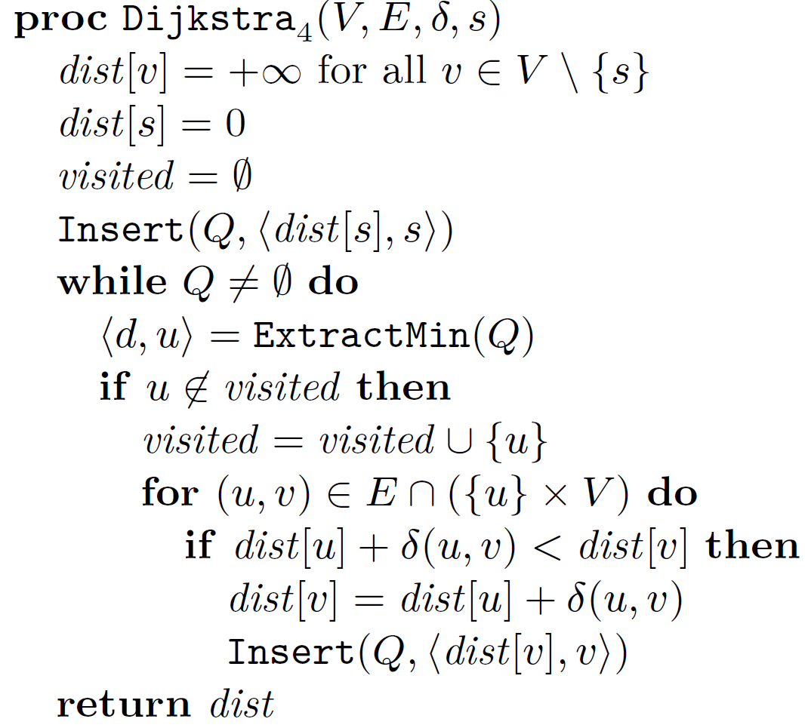
Using a visited set
2
+∞
B
4
4
6
6
0
2
+∞
+∞
source
A
1
D
2
E
4
1
C
+∞
4
Q = ⟨0,A⟩
3
⟨2,B⟩ ⟨4,C⟩
⟨3,C⟩ ⟨4,C⟩ ⟨6,D⟩
⟨4,C⟩ ⟨4,D⟩ ⟨6,D⟩
bitvector
⟨4,D⟩ ⟨6,D⟩
⟨6,D⟩ ⟨6,E⟩
⟨6,E⟩
Notes:
Alternative way to identify outdated extracted pairs
bitvector og hashtable

Slide 18
A shaky idea…
Q only store nodes (save space)
Comparator
Key = current distance dist
Heap invariants break
d never used
Notes:
a-e are nodes in the graph, and associated distances
Student implementations.
Some worked, because they did not use visited and just revisited nodes (no runtime guarantee)
Others essentially worked, except a few test cases having ”nummerical” issues (the heap most of the time does the correct thing)

Slide 19
Experimental study
visited = set()
Q = Queue()
Q.insert(Item(0, source))
while not Q.empty():
u = Q.extract_min().value
if u not in visited:
visited.add(u)
for v in G.out[u]:
dist_v = dist[u] + G.weights[(u, v)]
if dist_v < dist[v]:
dist[v] = dist_v
parent[v] = u
Q.insert(Item(dist[v], v))
Implemented Dijkstra₄ in Python
Stress test on random cliques
Binary heaps
failed
(default priority queue in Java and Python)
Notes:
Class Item implements the comparator to use either the static key or the current dist value
Harvey and Zatloukal, FUN 2004

Slide 20
Binary heaps using dist in a comparator fails
not smallest key
outdated
wrong placement
ignored since visited
Notes:
Autogenerated example from stress test….

Slide 21
Experimental study
visited = set()
Q = Queue()
Q.insert(Item(0, source))
while not Q.empty():
u = Q.extract_min().value
if u not in visited:
visited.add(u)
for v in G.out[u]:
dist_v = dist[u] + G.weights[(u, v)]
if dist_v < dist[v]:
dist[v] = dist_v
parent[v] = u
Q.insert(Item(dist[v], v))
Implemented Dijkstra₄ in Python
Stress test on random cliques
Binary heaps
Skew heaps
Leftist heaps
Pairing heaps
Binomial queues
Post-order heaps
Binary heaps with top-down insertions
failed
worked
worked
worked
worked
worked
worked
(default priority queue in Java and Python)
Pointer based
unexpected
Implicit (space efficient)
Notes:
Class Item implements the comparator to use either the static key or the current dist value
Harvey and Zatloukal, FUN 2004

Slide 22
Binary heap insertions – bottom-up vs top-down
2
2
Insert(7)
3
top-down
5
3
5
9
4
8
bottom- up
12
9
4
7
12
10
14
6
20
17
7
10
14
6
20
17
8
Notes:
Standard heap both in Java and Python

Slide 23
Definition: Priority queues with decreasing keys
Items = ⟨key, value⟩
Over time keys can decrease – priority queue is not informed
Items are compared w.r.t. their current keys
The original key of an item is the key when it was inserted
Insert(item)
ExtractMin() returns an item with current key less than or equal to all original keys in the priority queue
Notes:
In Dijkstra’s algorithm all outdated items are items with current key < original key
Note ExtractMin does not necessarily have to return item with minimum current key

Slide 24
Theorem 1
Dijkstra₄ correctly computes shortest paths when using dist as current key and a priority queue supporting decreasing keys
Theorem 2
The following priority queues support decreasing keys (out of the box)
binary heaps with top-down insertions
skew heaps
leftist heaps
pairing heaps
binomial queues
post-order heaps

Slide 25
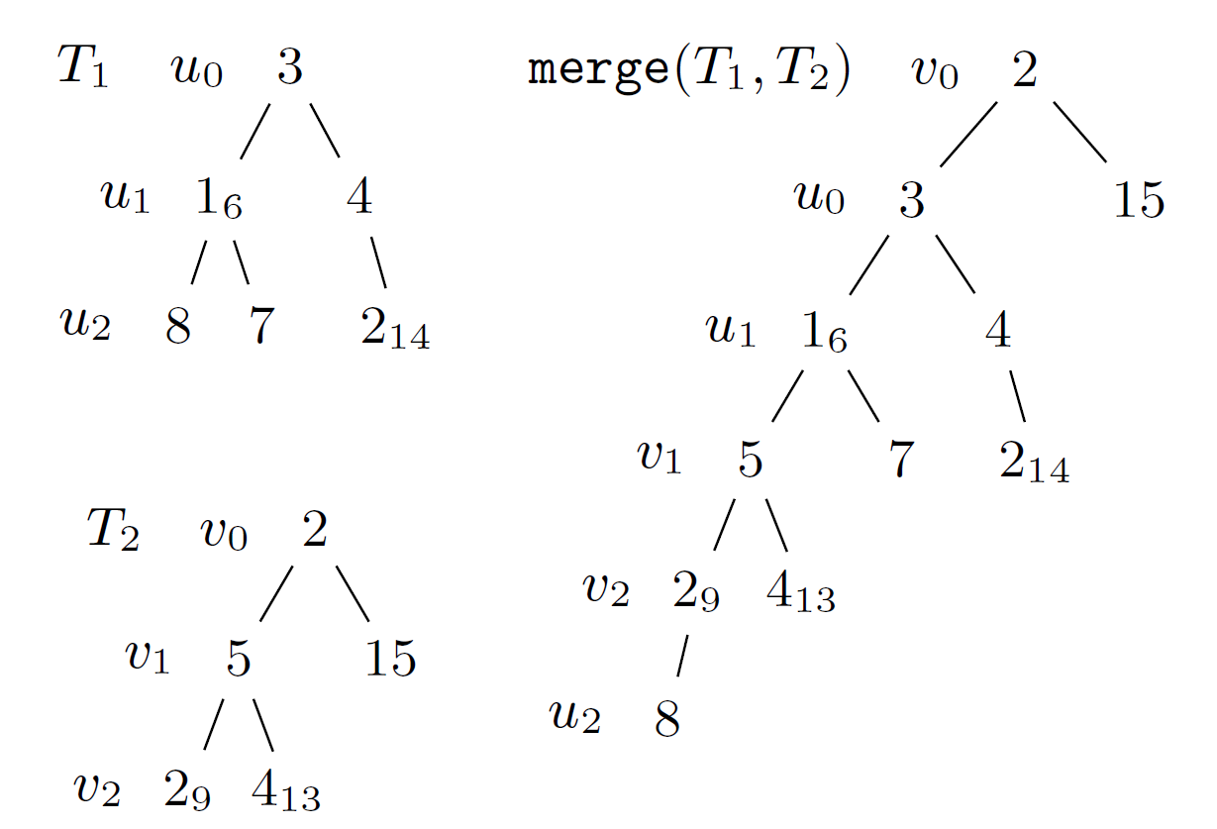
Proof of Theorem 2 - Basic idea
Decreased heap order
u ancestor of v ⇒ current key u ≤ original key v
Root valid item to extract
Top-down merging two paths preserves decreased heap order
⇒ skew heaps and leftist heaps support decreasing keys

Slide 26
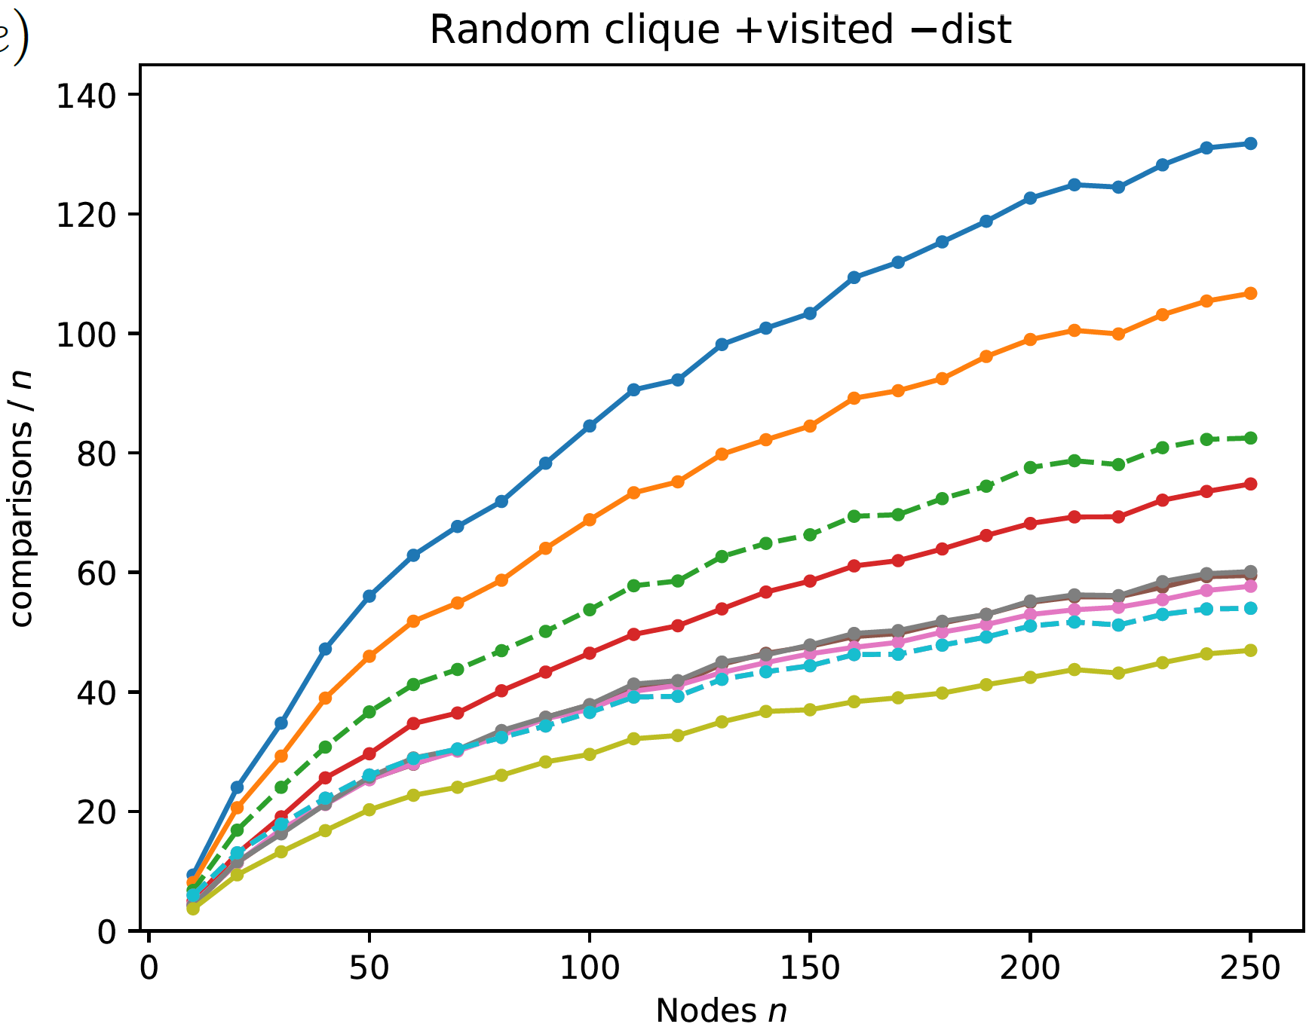
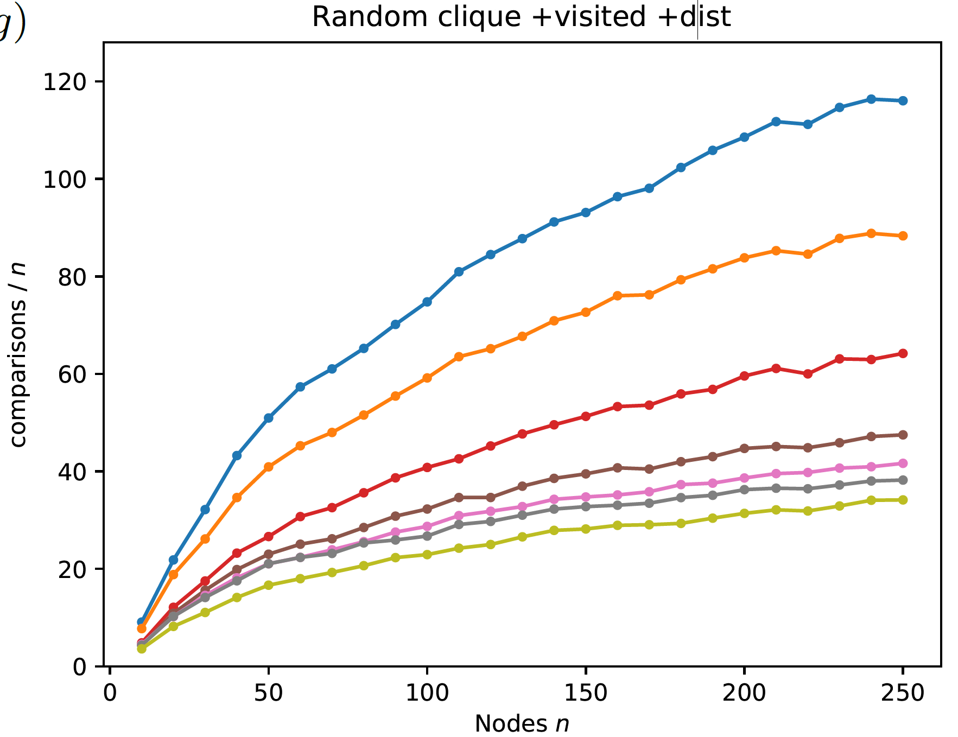
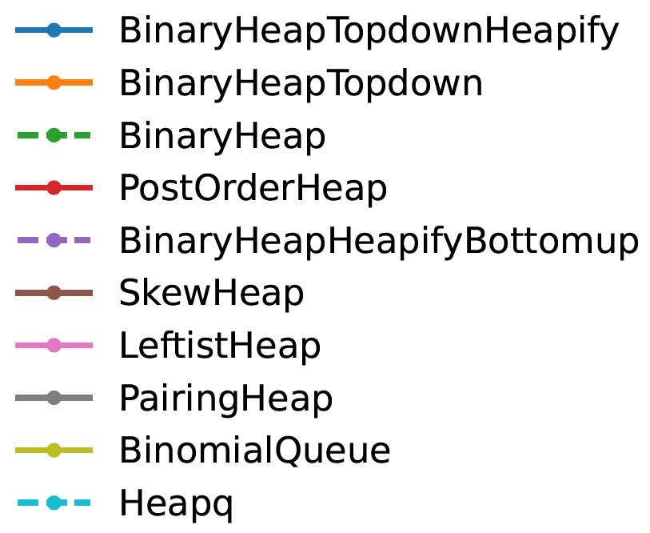
Experimental evaluation of various heaps
Cliques with uniform random weights
With decreasing keys less comparisons (outdated items removed earlier)
⟨key, value⟩ pairs
decreasing keys
smaller
Notes:
Clique uniform random weights => expected O(n*log n) decrease keys, i.e. insertions into priority queues
Only comparisons internal in heap are measured
heapq = BinaryHeapHeapifyBottomup (Heapify = recursive pull up smallest until leaf, and then insert there)
Binary heap = heapify top-down until right position
Binary Heap topdown is bad – although implicit. PostOrderHeap falls in the same category of being implicit.

Slide 27
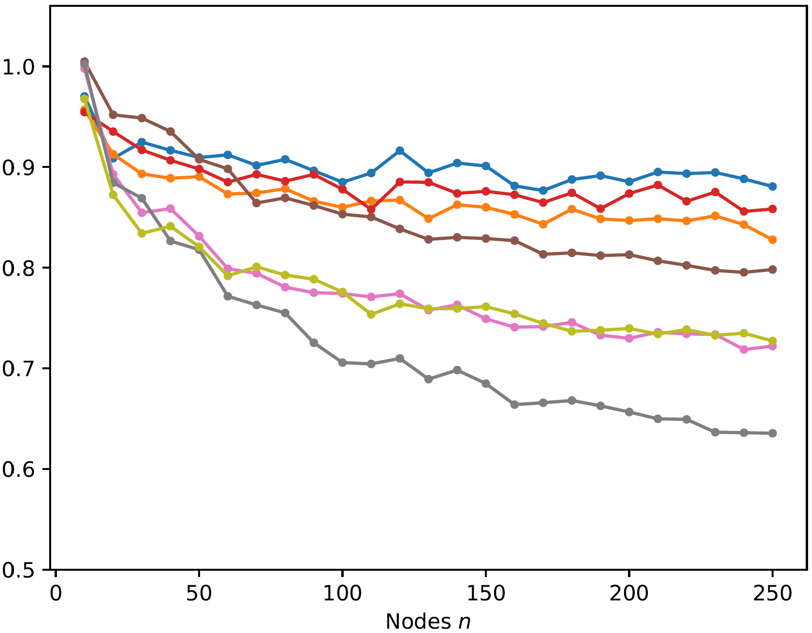
Reduction in comparisons
comparisons decreasing keys / comparisons ⟨key, value⟩ pairs
Notes:
gains largest for pointer-based structures
for worst-case weights on cliques the gains are smaller (alle edges cause a new insertion)

Slide 28
Postorder heap [Harvey and Zatloukal, FUN 2004]
Insert amortized O(1), ExtractMin amortized O(log n)
Implicit (space efficient)
Best implicit comparison performance (and good time performance)

Slide 29
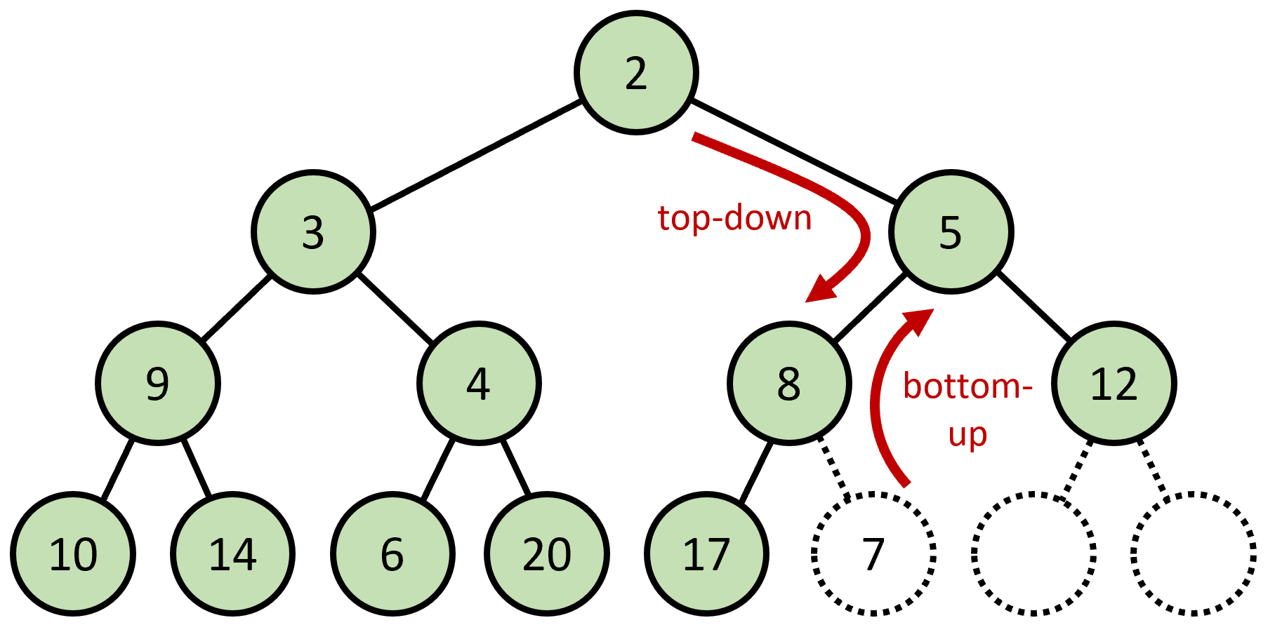
Summary of the unexpected journey
Introduced notion of priority queues with decreasing keys … as an approach to deal with outdated items in Dijkstra’s algorithm
Experiments identified priority queues supporting decreasing keys … just had to prove it
Builtin priority queues in Java and Python are binary heaps … do not support decreasing keys
Binary heaps with top-down insertions do support decreasing keys
… and also
skew heaps, leftist heaps, pairing heaps, binomial queues, post-order heaps
Notes:
What I really liked was that the algorithm came before the proof.

Slide 30
The reviewer is always right

Slide 31
”If there was a implementation where the authors verified that everything did what it was supposed to, I would be more confident that things were correct (I am not talking about a practical implementation, I am talking about one to make sure all invariants hold).”
Anonymous reviewer
Notes:
A recent review on a purely theoretical paper.
Glad to see reviewer agrees that this is a theoretical paper.
Journal review on Strong Fibonacci Heaps

Slide 32
Strict Fibonacci heaps
 | Binary heap [Williams 1964] worst-case | Fibonacci heap [Fredman, Tarjan 1984] amortized | Strict Fibonacci heap [B., Lagogiannis, Tarjan 2012] worst-case
Insert | O(log n) | O(1) | O(1)
ExtractMin | O(log n) | O(log n) | O(log n)
DecreaseKey | O(log n) | O(1) | O(1)
Meld | - | O(1) | O(1)
Notes:
That this is pure theory is supported by the fact that Fibonacci heaps were removed from CLRS 4th Edition.
Fibonacci heaps are cool theory but rarely crucial in practice.
Strict Fibonacci heaps close a theoretical gap… likely never the choice of priority queue in practice.

Slide 33
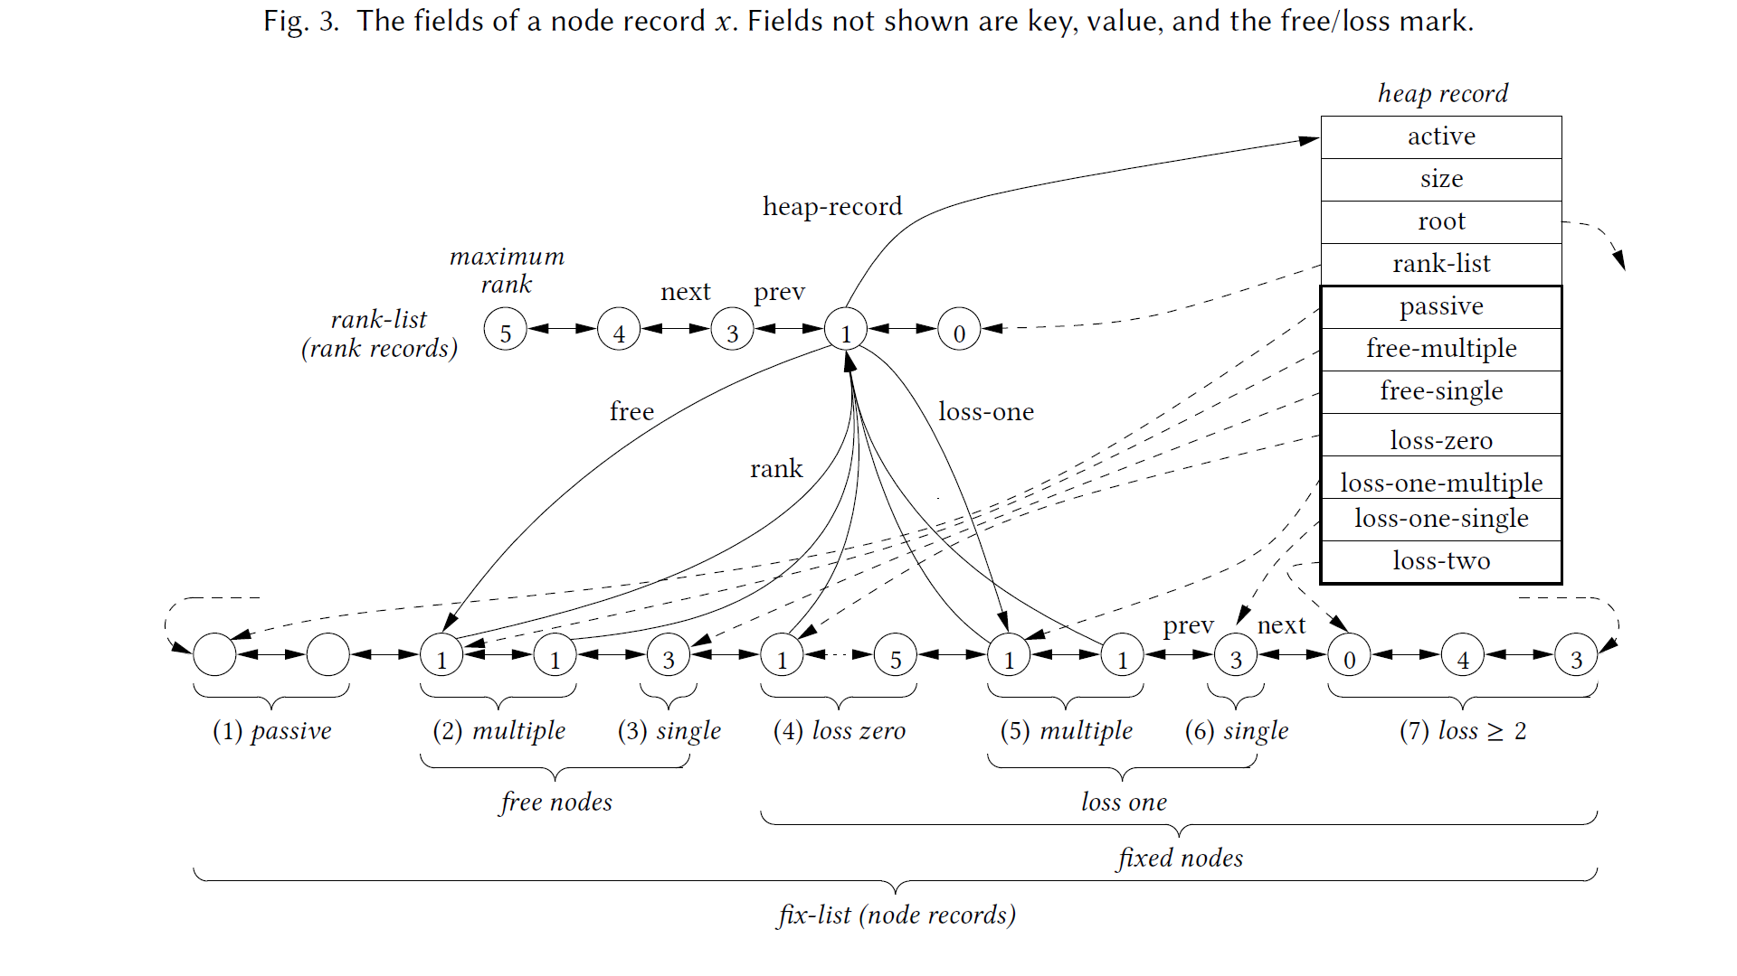
Strict Fibonnacci heaps
+ many structural invariants
Notes:
invariants used as the core data structure design tool

Slide 34
Python implementation
1589 lines
215 assert statements
All claimed invariants turned into assert statements
Validation methods to traverse full structure to verify all claimed invariants
Stress test using random inputs
Supported the theory
www.cs.au.dk/~gerth/strict_fibonacci_heaps.py

Slide 35
Code coverage
Used the Python module coverage
Some code rarely executed
Repeat random test 1.000.000 times
Most code executed at least once
Realized there was code for cases which provably never can occur
Implementation → new invariants discovered
coverage.readthedocs.io
Notes:
Logo of coverage module

Slide 36
Code coverage
odd_even.py
1 def f(x): 2 if x % 2 == 0: 3 return 'even' 4 elif x % 4 == 0: 5 return 'even more even' 6 elif x % 2 == 1: 7 return 'odd' 8 import random 9 for i in range(10): 10 x = random.randint(0, 10) 11 print(x, f(x))
Shell
coverage run odd_even.py 4 even 5 odd ... 1 odd coverage report -m odd_even.py Name Stmts Miss Cover Missing ------------------------------------------- odd_even.py 11 1 91% 5 ------------------------------------------- TOTAL 11 1 91%
Usually, code coverage is a measure of the quality of test cases
…but, can also help to identify missing logical insights
pypi.org/project/coverage
Notes:
code coverage does not ensure all branches are taken (an ”if:” might not have an ”else:” part)
Sometimes you need significant insights into the problem, why some code can never be executed…

Slide 37
Branch coverage
Thought code coverage would find all ”logical errors”
Found several if statements with no else part, where condition provably would always be true
Implementation → new invariants discovered (and assertions added)
always exists
coverage.readthedocs.io
Notes:
Not all ranks need to exist in the linked list, but rank 0 will exist
… again the implementation helped to improve the presentation of the theory

Slide 38
Branch coverage
odd_even.py
1 def f(x): 2 if x % 2 == 0: 3 return 'even' 4 elif x % 4 == 0: 5 return 'even more even' 6 elif x % 2 == 1: 7 return 'odd' 8 import random 9 for i in range(10): 10 x = random.randint(0, 10) 11 print(x, f(x))
Shell
coverage run --branch odd_even.py 5 odd 4 even ... 8 eve coverage report -m odd_even.py Name Stmts Miss Branch BrPart Cover Missing --------------------------------------------------------- odd_even.py 11 1 8 2 84% 5, 6->exit --------------------------------------------------------- TOTAL 11 1 8 2 84%
pypi.org/project/coverage
Notes:
Important: ”--branch” argument
Implicit ”else” for ”elif” is never executed

Slide 39
”The first main suggestion is to have at least one figure with a logical diagram of a non-trivial example structure, […]. This would go a long way in giving some idea of what the structure is.”
Anonymous reviewer
Notes:
Did we actually understand the consequences of our invariants our self?

Slide 40
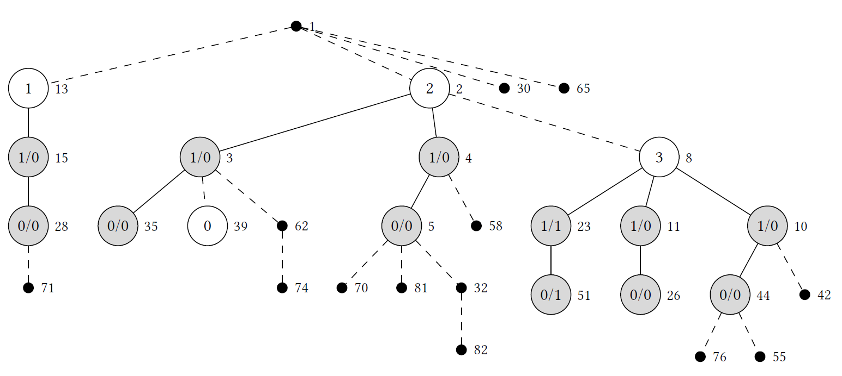
Hard to manually create a figure that was guaranteed to be a real example
Could use implementation to automatically generate (LaTeX tikz) figures
Generated random inputs
Formalized requirements to figure as a loop condition
Repeat until happy
Notes:
Automatically generated an example
Was hard to manually generate a real example that was guaranteed could be the result of a sequence of priority operations
Showed the power of having an implementation
Black = passive, White/grey = active, White = free, Grey = fixed, next to node key, in nodes rank/loss

Slide 41
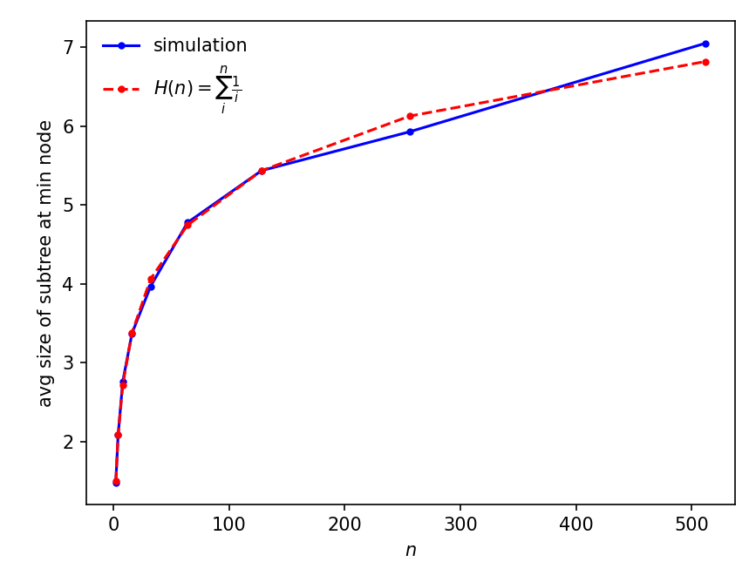
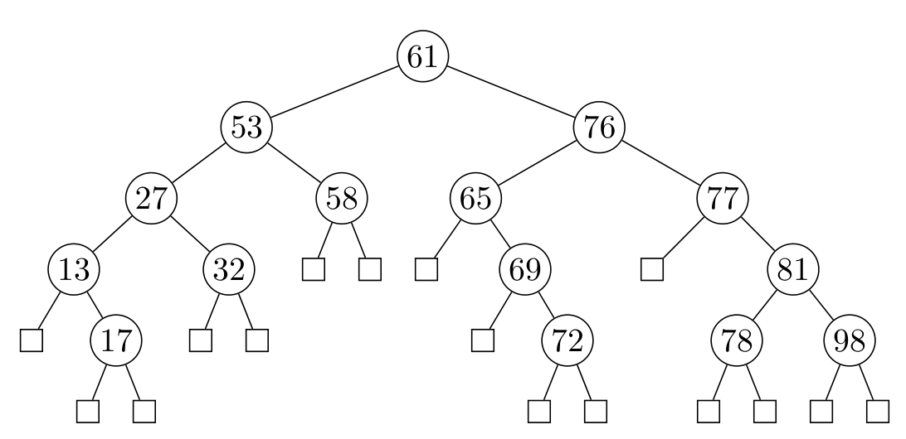
A question by John Iacono at Dagstuhl
After inserting n random elements into an unbalanced binary search tree, what is the expected size of the subtree rooted at the minimum?
size ?
Notes:
The first intuition was that the answer was O(1).
Simulations showed something different.
Simulation triggered a simple backwards analysis proof

Slide 42
Summary
Theory
Creating new theory is cool
Implementation
Coding is fun
Implementations support stronger theory
Experimentation can identify what to prove
Invariants can be verified and identified using assertions in code
Stress tests and code coverage ensures integrity of code and theory

