Slide 1
Memory Hierarchies
[FLPR12] Matteo Frigo, Charles E. Leiserson, Harald Prokop, Sridhar Ramachandran. Cache-Oblivious Algorithms. ACM Transactions on Algorithms, 8(1), Article No. 4, 2012.
[BFJ02] Gerth Stølting Brodal, Rolf Fagerberg, Riko Jacob. Cache-Oblivious Search Trees via Binary Trees of Small Height. In Proc. 13th Annual ACM-SIAM Symposium on Discrete Algorithms (SODA), 39-48, 2002.
[JM13] Tomasz Jurkiewicz, Kurt Mehlhorn. The cost of address translation, In Proc. 15th Annual Meeting on Algorithm Engineering & Experiments (ALENEX), 148-162, 2013.

Slide 2
Memory Hierarchies vs Efficiency
Cache misses (L1, L2, L3, ...)
Prefetching
Cache associativity
Virtual to physical mapping
Translation Look-aside Buffer (TLB)
TLB misses
Notes:
Algorithmic ideas to reduce cache-faults – take IO course (but assumes large cache size)

Slide 3
Some Typical Access times
Level | Access time | Cache line size
L1 Data ~16 KB L1 Instruction ~16 KB | 5 ns | 64 bytes
L2 ~512 KB | 20 ns | 64 bytes
L3 ~10 MB | 30 ns | 64 bytes
Main memory | 60 ns
Disk | 10 ms | 4 KB

Slide 4
Intel(R) Core(TM) i7-3820 CPU @ 3.60GHz
32nm, 4 core [8 threads], L1, L2 and L3 line size 64 bytes
L1 instruction 32K 8-way write-through per core
L1 data 32K 8-way write-back per core
L1 cache latency 3 clock cycles
L2 256KB 8-way write-back unified cache per core
L2 cache latency 12 clock cycles
L3 10MB 20-way write-back unified cache shared by ALL cores
L3 cache latency 26-31 clock cycles
L1 instruction TLB , 4K pages, 64 entries, 4-way
L1 data TLB, 4K pages, 64 entries, 4-way
L2 TLB, 4K pages, 512 entries, 4-way
ALL caches and TLBs use a pseudo LRU replacement policy
Notes:
Data from slides by Jones, Jeremy, Trinity College Dublin

Slide 5
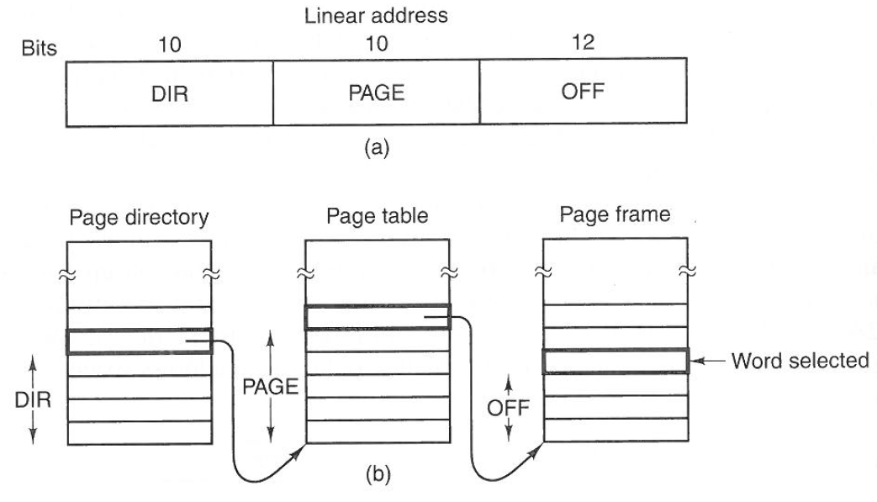
Virtual to Physical Address Mapping

Slide 6
Cost of Address Translation
[JM13] Tomasz Jurkiewicz, Kurt Mehlhorn. The cost of address translation, In Proc. 15th Annual Meeting on Algorithm Engineering & Experiments (ALENEX), 148-162, 2013.

Slide 7
Cache-Oblivious Model
I/O model...but algorithms do not know B and M
Assume optimal cache replacement strategy
Optimal on all levels (under some assumptions)
M
B
[FLPR12] Matteo Frigo, Charles E. Leiserson, Harald Prokop, Sridhar Ramachandran. Cache-Oblivious Algorithms. ACM Transactions on Algorithms, 8(1), Article No. 4, 2012.

Slide 8
Recursive Tree Layout (van Emde Boas layout)
Binary tree
Searches O(log_{B} N) IOs
Range Searches O(log_{B} N + k/B)
Harald Prokop 1999, MIT MSc thesis ”Cache-Oblivious Algorithms”, June 1999

Slide 9
Four Tree Layouts
DFS
Inorder
BFS
Recursive / van Emde Boas

Slide 10
Random Searches in Pointer Layouts
vEB

Slide 11
Random Searches in Implicit Layouts
9-ary bfs

Slide 12
Making Trees Dynamic ?
Trees of bounded depth Andersson and Lai 1990
Rebuild subtrees when depth ≥ log n + O(1)
Insert: O(log² n) amortized
Notes:
Related to order maintenance in an array

Slide 13
Static ⇒ Dynamic
Emded dynamic tree into a complete tree
Static layout of tree (e.g. van Emde Boas layout)
Search O(log_{B} N)
Update O(log_{B} N + (log² N)/B)
[BFJ02] Gerth Stølting Brodal, Rolf Fagerberg, Riko Jacob. Cache-Oblivious Search Trees via Binary Trees of Small Height. In Proc. 13th Annual ACM-SIAM Symposium on Discrete Algorithms (SODA), 39-48, 2002.

Slide 15
Insertions into Implicit Layout
Insertions factor 10-100 slower than searches

Slide 16
Matrix
Transpose N x N matrix, divided by N²
Multiply N x N matrix, divided by N³
[FLPR12] Matteo Frigo, Charles E. Leiserson, Harald Prokop, Sridhar Ramachandran. Cache-Oblivious Algorithms. ACM Transactions on Algorithms, 8(1), Article No. 4, 2012.

