Slide 1
Branch Mispredictions
[KS06] | Kanela Kaligosi, Peter Sanders. How Branch Mispredictions Affect Quicksort. Proc. 14th Annual European Symposium on Algorithms (ESA), Lecture Notes in Computer Science, Volume 4168, 780-791, Springer, 2006.
[BM05] | Gerth Stølting Brodal, Gabriel Moruz. Tradeoffs Between Branch Mispredictions and Comparisons for Sorting Algorithms. Proc. 9th International Workshop on Algorithms and Data Structures (WADS), Lecture Notes in Computer Science, Volume 3608, 385-395, Springer, 2005.
[BFM05] | Gerth Stølting Brodal, Rolf Fagerberg, Gabriel Moruz. On the Adaptiveness of Quicksort. In Proc. 7th Workshop on Algorithm Engineering and Experiments (ALENEX), pages 130-140, 2005.
[BM06] | Gerth Stølting Brodal, Gabriel Moruz. Skewed Binary Search Trees. In Proc. 14th Annual European Symposium on Algorithms (ESA), Lecture Notes in Computer Science, Volume 4168, 708-719, Springer, 2006.

Slide 2
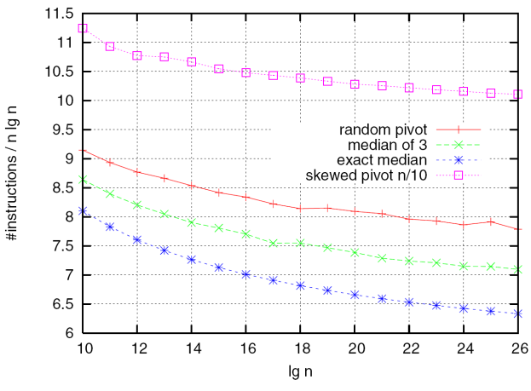
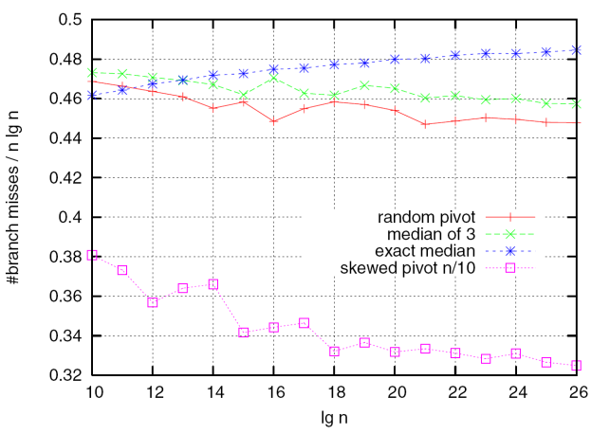
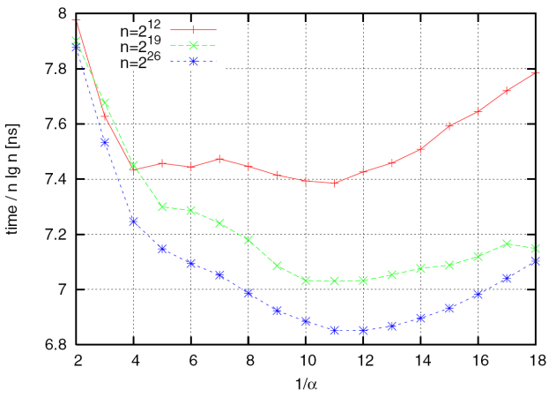
“How Branch Mispredictions Affect Quicksort” Kanela Kaligosi and Peter Sanders 14th Annual European Symposium on Algorithms (ESA 2006)
Choose k random elements Pivot = k/10’th smallest
~ n/10
~ 9n/10
3GHz Pentium 4 Prescott, GCC 3.3, PAPI, avg. 100 runs with random permutations of [1..n]

Slide 3
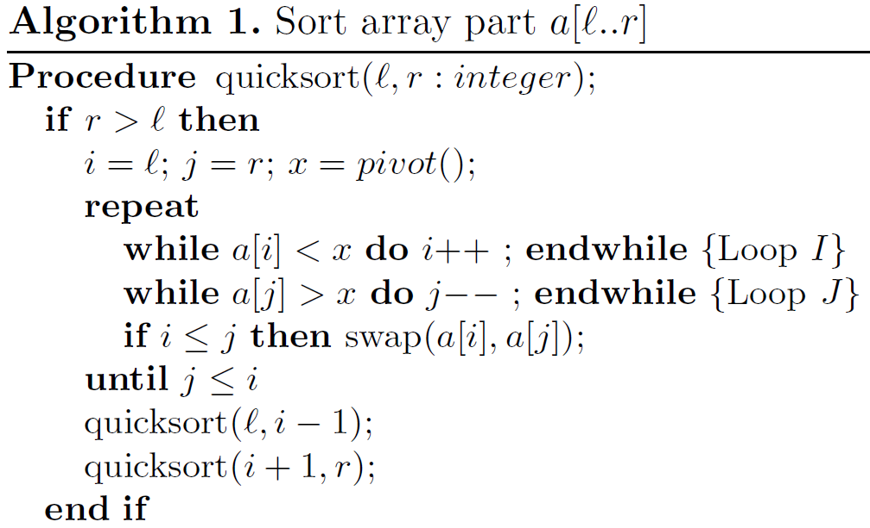
Notes:
Partitition = scanning from both ends + swap; cost = #swaps/writes or #branch mispredictions?

Slide 4
H(α)=-(α·lg(α)+(1- α) ·lg(1- α)
Notes:
k-bit predictor: k-bit counter that is incremented/decremented if the branch is taken/not taken. Predict taken if counter >=max value/2 (analysis requires the study of Markov chains)
Interesting:stadic predictor is the best

Slide 5
Gerth Stølting Brodal, Gabriel Moruz.
Tradeoffs Between Branch Mispredictions and Comparisons for Sorting Algorithms.
Proc. 9th International Workshop on Algorithms and Data Structures (WADS), Lecture Notes in Computer Science, Volume 3608, 385-395, Springer, 2005.
Thm O(d·n·log n) comparisons ⇒ Ω(n·log_{d} n) mispredictions
Assumptions:
Deterministic comparison based sorting algorithm
Each comparison followed by a conditional branch
Proof (sketch)
Consider decision tree
Label edges with “0” or ”1”, “1” if branch misprediction
≤ k mispredictions ⇒ all paths ≤ k edges labeled “1”
Depth D decision tree ⇒ #leaves $≤\left(\begin{matrix}D+k \\ k\end{matrix}\right)$
Theorem follows from constraint $\left(\begin{matrix}D+k \\ k\end{matrix}\right)≥n!$
Upper bound: d-way MergeSort
Notes:
Binomial coefficient = concatenate path labels + padding to make all leaves depth D+k with exactly k mispredictions
(Paper also contains adaptive sorting results, to have sufficient content ☺ )

Slide 6
Gerth Stølting Brodal, Gabriel Moruz. Skewed Binary Search Trees.
In Proc. 14th Annual European Symposium on Algorithms (ESA), Lecture Notes in Computer Science, Volume 4168, 708-719, Springer, 2006.
Average node depth

Slide 7
Notes:
AMD Athlon XP 2400+, 2.0 GHz, 256 KB L2 cache, 64 KB L1 data cache, 64 KB L1 instruction cache, 1GB RAM, Linux 2.6.8.1, GCC 3.3.2,
Tree nodes = 12 bytes, No unsuccesful searches

Slide 9
Memory Layouts

Slide 10
Blocked Memory Layouts
vEB
k-level
pqDFS-k

Slide 11
Gerth Stølting Brodal, Rolf Fagerberg, Gabriel Moruz. On the Adaptiveness of Quicksort.
In Proc. 7th Workshop on Algorithm Engineering and Experiments (ALENEX), pages 130-140, 2005
Thm Expected number of element swaps performed by randomized Quicksort is at most n·ln(1+ 2·INV/n)
Notes:
Analyse,+2 pages of probabilistic arguments!
X-axis = log(INV)
Small d = element i random in i [i-d,i+d]
Large d = d random elements uniform in [1..n], otherwise element i = i
Inv = Theta(sum d_i), d_i distance from correct position of element i

Slide 12
HeapSort

Slide 13
MergeSort

