Slide 1


Data Structures:
Range Queries - Space Efficiency
Pooya Davoodi
Aarhus University
PhD Defense
July 4, 2011

Slide 2
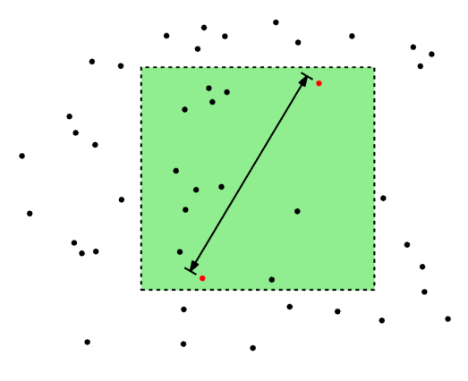
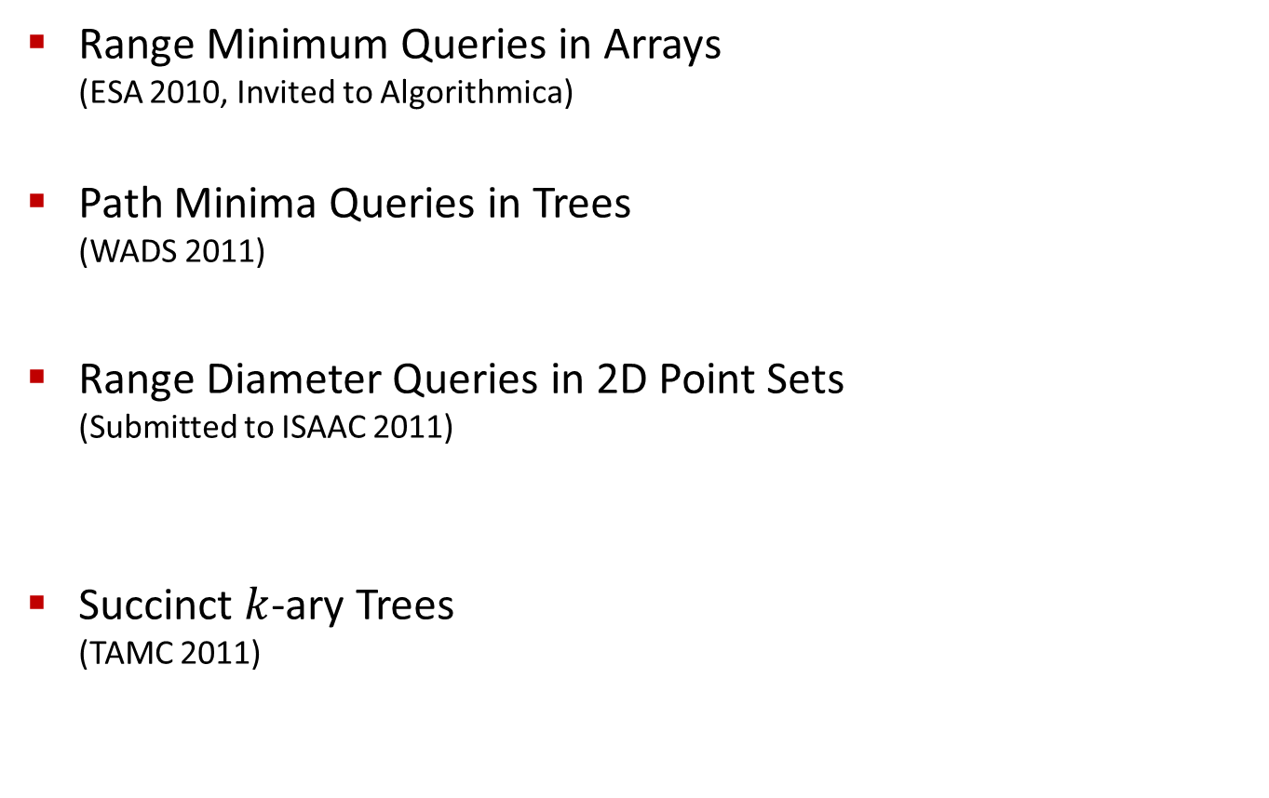
Thesis Overview
25 | 12 | 6 | 8 | 10 | 65 | 7 | 13
12 | 43 | 76 | 31 | 17 | 62 | 9 | 5
14 | 23 | 18 | 79 | 84 | 10 | 8 | 40
4 | 6 | 98 | 45 | 11 | 38 | 58 | 25
Range Minimum Queries in Arrays
(ESA 2010, Invited to Algorithmica)
Path Minima Queries in Trees
(WADS 2011)
Range Diameter Queries in 2D Point Sets
(Submitted to ISAAC 2011)
Succinct $k$-ary Trees
(TAMC 2011)
4
6
7
20
4
3
10
5
4
2
a
b
c
d
e
f

Slide 3
Range Minimum Queries
Database systems
  Lowest average-salary:
Year
1990 | 1995 | 2000 | 2005 | 2010
60
50
40
30
20
80,000 | 85,000 | 115,000 | 120,000 | 118,000
81,000 | 73,000 | 90,000 | 100,000 | 94,000
65,000 | 75,000 | 86,000 | 92,000 | 95,000
72,000 | 91,000 | 89,000 | 103,000 | 102,000
35,000 | 45,000 | 42,000 | 50,000 | 41,000
Age
Minimum:
65,000 at [3,1]

Slide 4

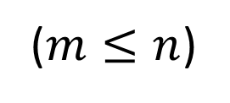






Definition
Input: an array $A=\left[1 .. m\right]×\left[1..n\right]$
Query: where is minimum in $\left[i_{1} .. i_{2}\right]×\left[j_{1}..j_{2}\right]$?
($m≤n$)
$$n$$
$$i_{1}$$
$$m$$
$$i_{2}$$
$$j_{1}$$
$$j_{2}$$

Slide 5





Naïve Solution
Brute force search
Query time: $O(s∙s′)$ time
Worst case : $O(N)$ time ($N=m∙n$)
$$n$$
$$s′$$
$$m$$
$$s$$

Slide 6
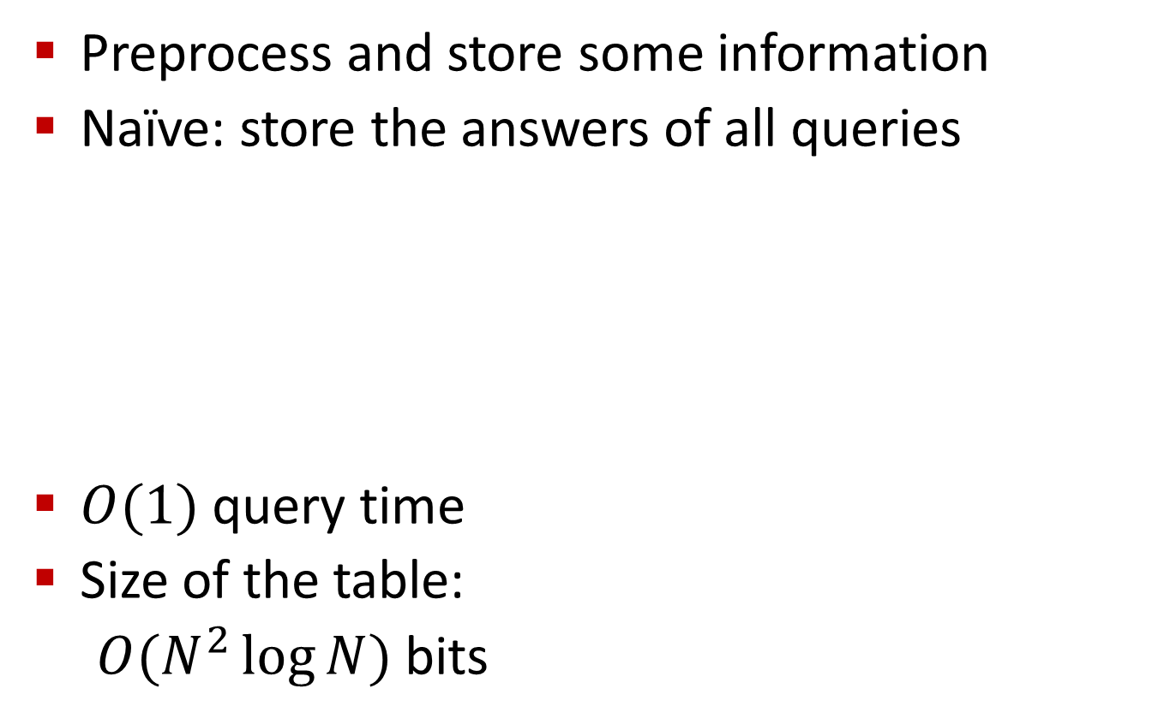
Data Structures
Preprocess and store some information
Naïve: store the answers of all queries
$O(1)$ query time
Size of the table:
  $O(N^{2}\log{N})$ bits
Top-Left | Bottom-Right | Minimum
(1,1) | (1,1) | (1,1): 12
(1,1) | (1,2) | (1,2): 8
(1,1) | (2,1) | (2,1): 5
(1,1) | (2,2) | (2,1): 5
(2,1) | (2,1) | (2,1): 5
(2,1) | (2,2) | (2,2): 5
(1,2) | (1,2) | (1,2): 8
(1,2) | (2,2) | (1,2): 8
(2,2) | (2,2) | (2,2): 10
1 | 2
1
2
12 | 8
5 | 10
Tabulation

Slide 7
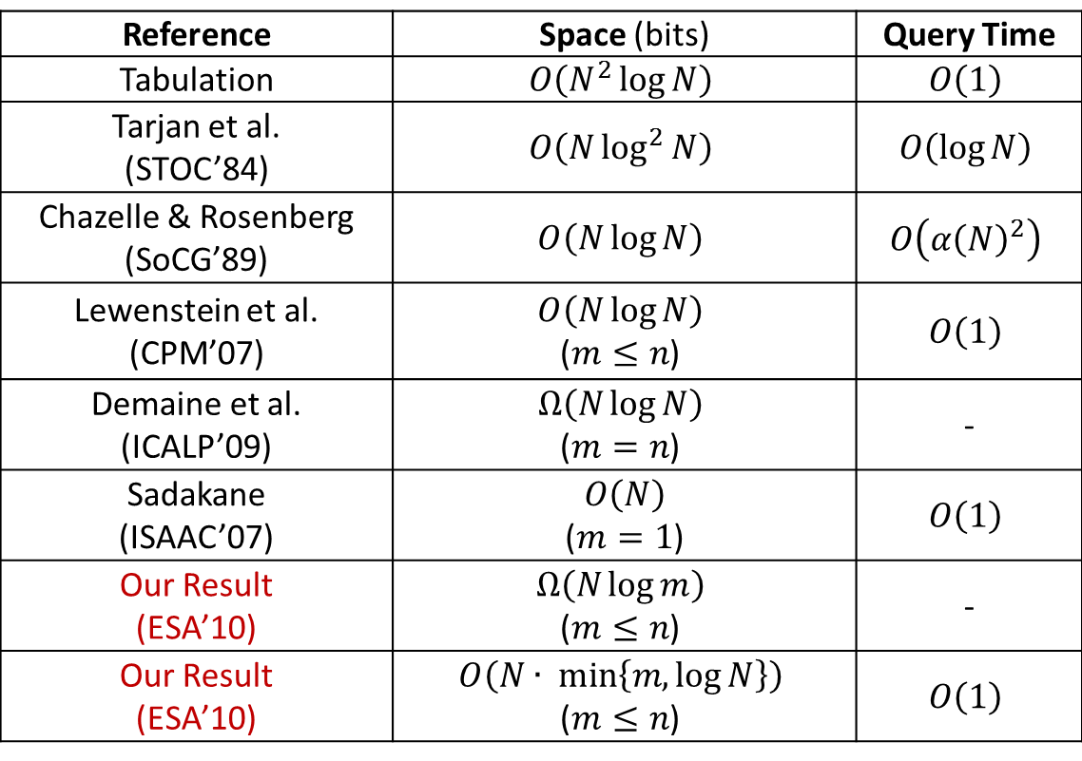
Space-Efficient Data Structures
Reference | Space (bits) | Query Time
Tabulation | $$O\left(N^{2}\log{N}\right)$$ | $$O\left(1\right)$$
Tarjan et al. (STOC’84) | $$O\left(N\log^{2}{N}\right)$$ | $$O\left(\log{N}\right)$$
Chazelle & Rosenberg (SoCG’89) | $$O\left(N\log{N}\right)$$ | $$O\left({α\left(N\right)}^{2}\right)$$
Lewenstein et al. (CPM’07) | $$O\left(N\log{N}\right)$$ ($m≤n$) | $$O\left(1\right)$$
Demaine et al. (ICALP’09) | $$Ω\left(N\log{N}\right)$$ ($m=n$) | -
Sadakane (ISAAC’07) | $$O\left(N\right)$$ ($m=1$) | $$O\left(1\right)$$
Our Result (ESA’10) | $$Ω\left(N\log{m}\right)$$ ($m≤n$) | -
Our Result (ESA’10) | $$O\left(N∙ min\left\{m,log{N}\right\}\right)$$ ($m≤n$) | $$O\left(1\right)$$
Notes:
How to improve from Tarjan to Lewenstein and to ours?

Slide 8


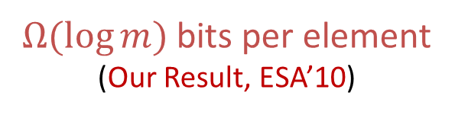
1D vs. 2D
2
Lowest Common Ancestor
1D: Cartesian Trees
$O(\log{N})$ bits per element
  (Tarjan et al., STOC’84)
$O(1)$ bits per element
  (Sadakane, ISAAC’07)
2D: Nothing like Cartesian Trees
7
5
20
8
6
10
16
7 | 20 | 2 | 10 | 8 | 5 | 16 | 6
$Ω(\log{m})$ bits per element
(Our Result, ESA’10)
$$m$$

Slide 9
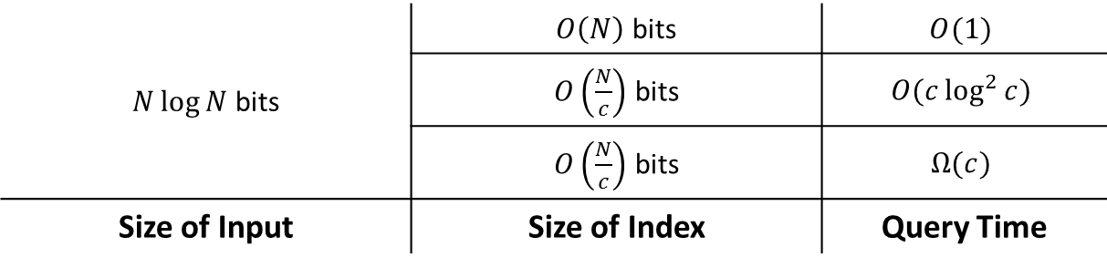


Indexing Data Structures
Popular in Succinct Data Structures
Read-only
Input Array
$$m×n=N$$
Index
$\left\{\begin{matrix}O(1) \\ O\left(\frac{1}{c}\right)\end{matrix}\right.$ bits per element
$N\log{N}$ bits | $O\left(N\right)$ bits | $$O(1)$$
 | $O\left(\frac{N}{c}\right)$ bits | $$O(c\log^{2}{c})$$
 | $O\left(\frac{N}{c}\right)$ bits | $$Ω(c)$$
Size of Input | Size of Index | Query Time
(Our Results, ESA’10)

Slide 10
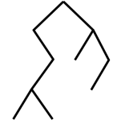





$O(N)$ bits with $O(1)$ query time
2
27 | 30 | 2 | 90 | 28 | 15 | 18 | 6
13 | 20 | 93 | 54 | 17 | 11 | 16 | 12
7 | 74 | 39 | 62 | 8 | 5 | 46 | 23
61 | 38 | 68 | 10 | 9 | 87 | 98 | 21
7
5
Cartesian Trees
20
8
6
10
16
7 | 20 | 2 | 10 | 8 | 5 | 16 | 6
Cartesian Tree:
$$\log{n}$$
$$\log{\log{n}}$$
$$\log{\log{m}}$$
$$\log{m}$$
Tabulation
Atallah and Yuan (SODA’10)

Slide 11
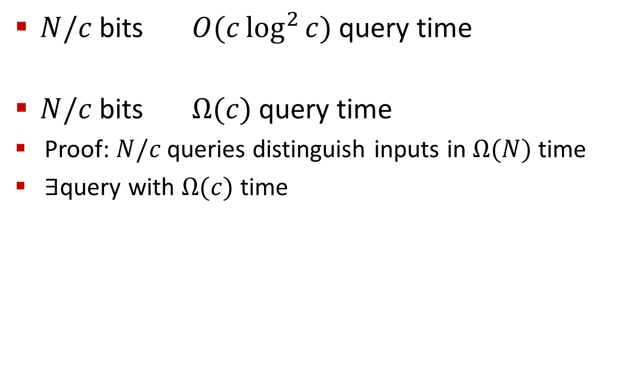

$O\left(\frac{1}{c}\right)$ bits Per Element
$N/c$ bits $O(c\log^{2}{c)}$ query time
$N/c$ bits $Ω(c)$ query time
Proof: $N/c$ queries distinguish inputs in $Ω(N)$ time
$∃$query with $Ω(c)$ time
C
1 | 1 | 0 | 1 | 1 | 1 | 1 | 1 | 1 | 0 | 1 | 1 | 1 | 0 | 1 | 0 | 1 | 1 | 1 | 1
1 | 0 | 1 | 1 | 1 | 0 | 1 | 1 | 1 | 1 | 1 | 1 | 1 | 1 | 0 | 1 | 0 | 1 | 1 | 1
1 | 1 | 1 | 0 | 1 | 1 | 0 | 1 | 1 | 1 | 1 | 1 | 1 | 0 | 1 | 1 | 1 | 0 | 1 | 1
1 | 1 | 1 | 1 | 0 | 1 | 1 | 0 | 1 | 1 | 1 | 1 | 0 | 1 | 1 | 1 | 1 | 0 | 1 | 1
0 | 1 | 1 | 1 | 1 | 1 | 1 | 0 | 1 | 1 | 1 | 0 | 1 | 1 | 1 | 1 | 1 | 1 | 1 | 0
1 | 0 | 1 | 1 | 1 | 1 | 0 | 1 | 1 | 1 | 0 | 1 | 1 | 1 | 1 | 1 | 0 | 1 | 1 | 1

Slide 12
Outline
Range Minimum Queries
(ESA 2010, Invited to Algorithmica)
Path Minima Queries
(WADS 2011)
Range Diameter Queries
(Submitted to ISAAC 2011)
25 | 12 | 6 | 8 | 10 | 65 | 7 | 13
12 | 43 | 76 | 31 | 17 | 62 | 9 | 5
14 | 23 | 18 | 79 | 84 | 10 | 8 | 40
4 | 6 | 98 | 45 | 11 | 38 | 58 | 25
4
6
7
20
4
2
3
10
5
4

Slide 13
Path Minima/Maxima Queries
The most expensive connection between two given nodes?
  between b and k = (c,e)
  between e and k = (j,k)
Update(c,e) = 4
i
4
30
4
6
7
e
j
c
3
b
4
2
10
5
4
h
f
g
a
d
k
Tree-Topology Networks
Trees with Dynamic Weights

Slide 14
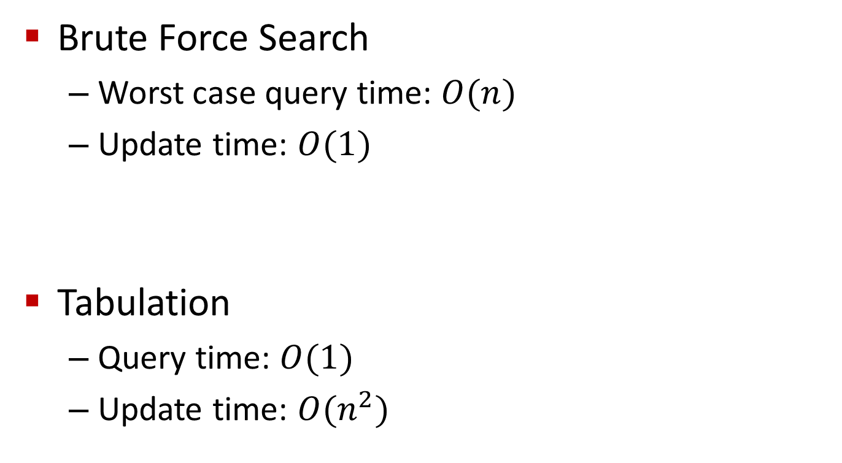
Naïve Structures
Brute Force Search
  Worst case query time: $O(n)$
  Update time: $O(1)$
Tabulation
  Query time: $O(1)$
  Update time: $O(n^{2})$
i
4
30
e
6
j
7
c
3
b
4
2
5
4
h
10
f
g
a
d
k
30
4

Slide 15



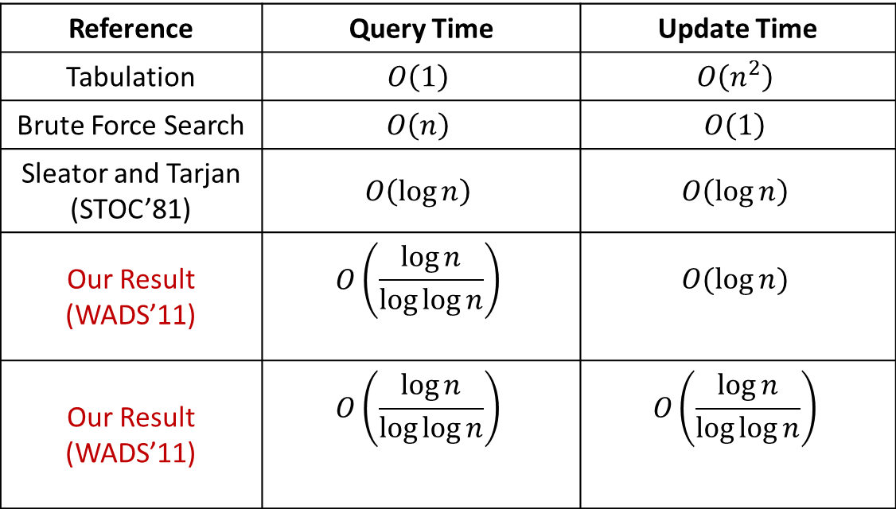



Dynamic Weights
Reduction from Range Minimum Queries in 1D arrays
Reference | Query Time | Update Time
Tabulation | $$O\left(1\right)$$ | $$O\left(n^{2}\right)$$
Brute Force Search | $$O\left(n\right)$$ | $$O\left(1\right)$$
Sleator and Tarjan (STOC’81) | $$O\left(\log{n}\right)$$ | $$O\left(\log{n}\right)$$
Our Result (WADS’11) | $$O\left(\frac{\log{n}}{\log{\log{n}}}\right)$$ | $$O(\log{n})$$
Our Result (WADS’11) | $$O\left(\frac{\log{n}}{\log{\log{n}}}\right)$$ | $$O\left(\frac{\log{n}}{\log{\log{n}}}\right)$$
Comparison
Based
Optimal: Alstrup et al. (FOCS’98)
Optimal: Brodal et al. (SWAT’96)
RAM
Optimal: Alstrup et al. (FOCS’98)
Optimal by conjecture:
Patrascu and Thorup (STOC’06)
$$A[1]$$
$$A[2]$$
$$A[3]$$
$$A[4]$$
$$A[5]$$
$$A[6]$$

Slide 16
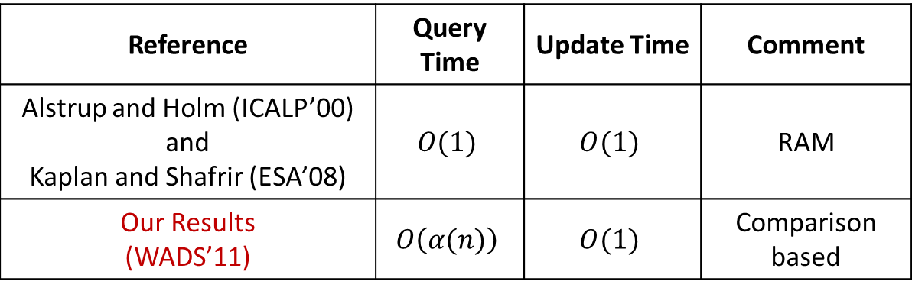
Dynamic Leaves
Reference | Query Time | Update Time | Comment
Alstrup and Holm (ICALP’00) and Kaplan and Shafrir (ESA’08) | $$O(1)$$ | $$O(1)$$ | RAM
Our Results (WADS’11) | $$O\left(α(n)\right)$$ | $$O(1)$$ | Comparison based
Optimal: Pettie (FOCS’02)
i
4
30
e
6
j
7
c
3
b
4
2
4
5
4
h
10
f
g
a
d
k

Slide 17
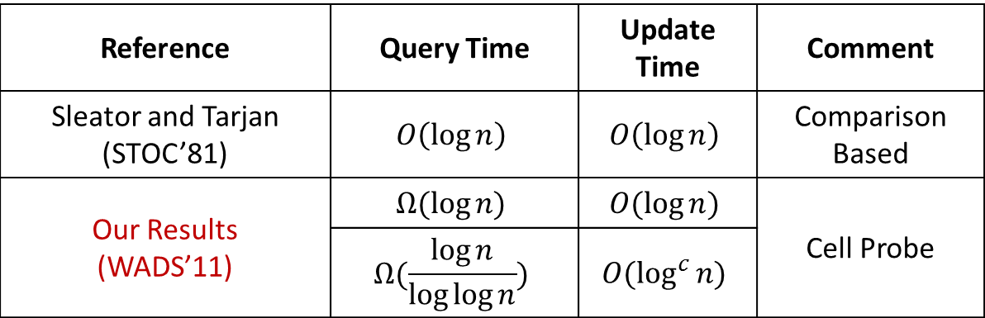
Updates with link and cut
i
4
cut(c,e)
30
e
6
j
7
c
3
b
4
2
link (d,i,12)
5
4
12
10
h
f
g
a
d
k
Reference | Query Time | Update Time | Comment
Sleator and Tarjan (STOC’81) | $$O\left(\log{n}\right)$$ | $$O\left(\log{n}\right)$$ | Comparison Based
Our Results (WADS’11) | $$Ω(\log{n)}$$ | $$O(\log{n})$$ | Cell Probe
 | $$Ω(\frac{\log{n}}{\log{\log{n}}})$$ | $$O(\log^{c}{n)}$$
Proof: by reduction from connectivity problems in graphs

Slide 18
Outline
Range Minimum Queries
(ESA 2010, Invited to Algorithmica)
Path Minima Queries
(WADS 2011)
Range Diameter Queries
(Submitted to ISAAC 2011)
25 | 12 | 6 | 8 | 10 | 65 | 7 | 13
12 | 43 | 76 | 31 | 17 | 62 | 9 | 5
14 | 23 | 18 | 79 | 84 | 10 | 8 | 40
4 | 6 | 98 | 45 | 11 | 38 | 58 | 25
4
6
7
20
4
2
3
10
5
4

Slide 19

Range Diameter Queries
Farthest pair of points
A Difficult Problem

Slide 20

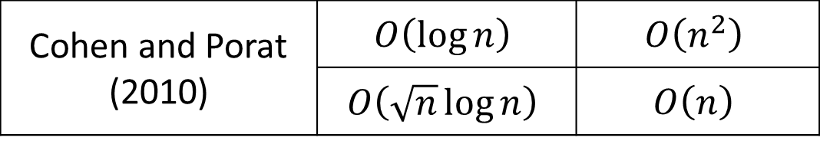
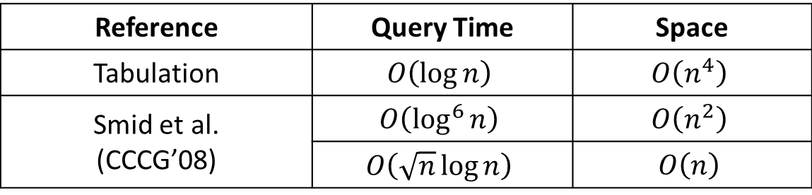
Known Results
Reference | Query Time | Space
Tabulation | $$O\left(\log{n}\right)$$ | $$O\left(n^{4}\right)$$
Smid et al. (CCCG’08) | $$O\left(\log^{6}{n}\right)$$ | $$O\left(n^{2}\right)$$
 | $$O\left(\sqrt{n}\log{n}\right)$$ | $$O\left(n\right)$$
Our Results (Submitted to ISAAC’11) | Reduction from Set Intersection
Set Intersection Problem
Cohen and Porat (2010) | $$O\left(\log{n}\right)$$ | $$O\left(n^{2}\right)$$
 | $$O\left(\sqrt{n}\log{n}\right)$$ | $$O\left(n\right)$$
Conjecture: Set Intersection problem is difficult
(Patrascu and Roditty, FOCS’10)

Slide 21






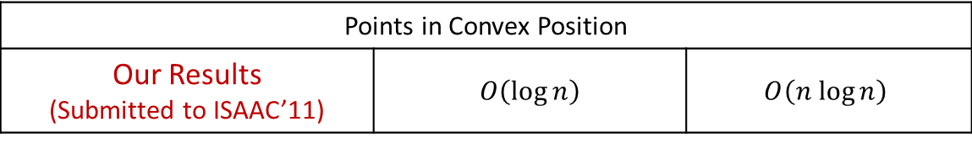


Set Intersection Queries
Reduction
$S_{1}=\left\{0.5,1,2\right\}$
$S_{2}=\left\{1,1.5,\sqrt{3}\right\}$
$S_{3}=\left\{0.2,3\right\}$
Diameter = 3
$$S_{1}∩S_{2}≠∅$$
$S_{i}∩S_{j}=∅$ ?
Diameter < 5
$$S_{1}∩S_{3}=∅$$
$$4$$
$$2$$
$$1$$
$S_{1}∩S_{2}≠∅$
$S_{1}∩S_{3}=∅$
Arithmetic on real numbers
with unbounded precisions
Reference | Query Time | Space
Points in Convex Position
Our Results (Submitted to ISAAC’11) | $$O\left(\log{n}\right)$$ | $$O\left(n log{n}\right)$$

Slide 22

Publications
Range Minimum Queries
(ESA 2010, Invited to Algorithmica)
Path Minima Queries
(WADS 2011)
Range Diameter Queries
(Submitted to ISAAC 2011)
Succinct $k$-ary Trees
(TAMC 2011)
25 | 12 | 6 | 8 | 10 | 65 | 7 | 13
12 | 43 | 76 | 31 | 17 | 62 | 9 | 5
14 | 23 | 18 | 79 | 84 | 10 | 8 | 40
4 | 6 | 98 | 45 | 11 | 38 | 58 | 25
4
6
7
20
4
2
3
10
5
4
a
b
c
d
e
f

