Slide 1
List Order Maintenance
E
B
H
D
I
C
F
G
A
Insert(D,I)
Build data structure
Insert(x,y) Insert y after x
Order(x,y) Returns if x is to the left of y
Monotonic List Labeling
10
12
14
17
18
19
20
21
24
x
y
Each node an integer label
Relabel nodes on insertion
Insert(x,y) Insert y after x
Density Maintenance
1 | 2 | 3 | 4 | 5 | 6 | 7 | 8 | 9 | 10 | 11 | 12 | 13 | 14 | 15 | 16 | 17
 | A |  |  | J | C | G |  | D | B |  |  | F |  | H | E
File
gap O(1)
Shift elements on insertion
Insert(i,x) Insert x at postion i

Slide 2
List Order Maintenance
[P. Dietz, D. Sleator, Two algorithms for maintaining order in a list, ACM Conference on Theory of Computing, 365-372, 1987]
[A. Tsakalidis, Maintaining Order in a Generalized Linked List. Acta Informatica 21: 101-112, 1984]
Query and Insert O(1)
Monotonic List Labeling
[P. Dietz, Maintaining Order in a Linked List, ACM Conference on Theory of Computing, 122-127, 1982]
[P. Dietz, J. Seiferas, J. Zhang: A Tight Lower Bound for On-line Monotonic List Labeling. Scandinavian Workshop on Algorithm Theory, 131-142, 1994]
Max label O(n^{k}), k>1+ε Θ(log n) relabelings
[D. Willard, Maintaining Dense Sequential Files in a Dynamic Environment, ACM Conference on Theory of Computing, 114-121, 1982]
[P. Dietz, J. Zhang: Lower Bounds for Monotonic List Labeling. Scandinavian Workshop on Algorithm Theory, 173-180, 1990]
Max label O(n) Θ(log² n) relabelings
Applications
[G. Brodal, R. Fagerberg, R. Jacob, Cache-Oblivious Search Trees via Binary Trees of Small Height, ACM-SIAM Symposium on Discrete Algorithms, pages 39-48, 2002]
[J. Driscoll, N. Sarnak, D. Sleator, R. Tarjan, Making Data Structures Persistent, Journal of Computer and System Sciences, 38(1), 86-124, 1989]
Notes:
ICALP 2013: Jan Bulánek, Michal Koucký, Michael Saks “On Randomized Online Labeling with Polynomially Many Labels” prove lower bound also holds for randomized algorithms with O(n^k) labels.
ESA 2012: Martin Babka, Jan Bulánek, Vladimír Čunát, Michal Koucký, Michael Saks “On Online Labeling with Polynomially Many Labels” alternative (corrected?) lower bound proof for O(n^k) labels.
STOC 2012: Jan Bulánek, Michal Koucký, Michael Saks “Tight lower bounds for the online labeling problem” proove that O(log(n)³) is optimal for the special case where array size has n, and n insertions are performed

Slide 3
Amortized O(log² n) Density Maintenance
Threshold τ = 1/(2log n)
Level i node overflows if density > 1-i∙τ
Insert redistribute lowest non-overflowing ancestor
⇒ a child requires τ fraction insertions before next overflow
⇒ amoritzed insertion cost = #levels ∙ 1 / τ = O(log² n)
redistribution threshold
level
redistribute
4
4/8
3
density 5/8
5/8
2
4/4
6/8
3/2
1
7/8
0
2/1
1
Insert(6,K)
1 | 2 | 3 | 4 | 5 | 6 | 7 | 8 | 9 | 10 | 11 | 12 | 13 | 14 | 15 | 16
 | A |  |  | J | C | G |  | D | B |  |  | F |  | H | E
before
after
A |  | J | K | C |  | G |  | D | B |  |  | F |  | H | E

Slide 4
Amortized O(log² n) Density Maintenance
Threshold τ = 1/(2log n)
Level i node overflows if density > 1-i∙τ
Insert redistribute lowest non-overflowing ancestor
⇒ a child requires τ fraction insertions before next overflow
⇒ amoritzed insertion cost = #levels ∙ 1 / τ = O(log² n)
⇒ List Order Maintenance
Max label O(n)
Amortized O(log² n) relabelings / insertion
redistribution threshold
level
redistribute
4
4/8
3
density 5/8
5/8
2
4/4
6/8
3/2
1
7/8
0
2/1
1
Insert(6,K)
1 | 2 | 3 | 4 | 5 | 6 | 7 | 8 | 9 | 10 | 11 | 12 | 13 | 14 | 15 | 16
 | A |  |  | J | C | G |  | D | B |  |  | F |  | H | E
before
after
A |  | J | K | C |  | G |  | D | B |  |  | F |  | H | E

Slide 5
Amortized O(log n) List Relabelings
Level i node overflows if density > (2/3)^{i}
Insert redistribute lowest non-overflowing ancestor
⇒ ≤ log_{4/3} n levels ⇒ max label 2^{log4/3 n} ≤ n^{2.41}
⇒ a child requires 1/2 fraction insertions before next overflow
⇒ amortized insertion cost = #levels ∙ 3 = O(log n)
2/3 → 1/2 + ε implies max label O(n^{1/log(1+2ε)})
redistribution threshold
level
redistribute
density 3/16
4
16/81
3
3/8
8/27
2
2/4
4/9
2/2
1
2/1
2/3
0
1
Insert(C,K)
1 | 2 | 3 | 4 | 5 | 6 | 7 | 8 | 9 | 10 | 11 | 12 | 13 | 14 | 15 | 16
 | A |  |  |  |  |  | C
before
after
A |  |  |  |  | C |  |  |  |  | K

Slide 6
Amortized O(log n) List Relabelings
[P. Dietz, D. Sleator, Two algorithms for maintaining order in a list, ACM Conference on Theory of Computing, 365-372, 1987]
1
2
4
5
7
8
9
12
15
17
18
19
21
23
i w_{i} = 12 - 8
2i w_{2i} = 18 - 8
i = 1
while w_{2i} ≤ 4 ∙ w_{i} do
i = i +1
Relabel uniformly ”2i area”
Only relabels to the right
Max label M=4n²
Requires labels mod M+1
Notes:
Insertion: average label of neighbors, otherwise relabel
Proof for amortized complexity: 1 full page

Slide 7
Monotonic List Labeling
O(log N) easy insertions
0
N
0
32
48
56
60
64
128
192
256
x
y
Insert(x,y) Label y = (left + right)/2
⇒ Can perform log N insertions without relabeling

Slide 8
Amortized O(1) List Order Maintenance
top-tree of size ≤ n/log² n
Amortized O(log² n)
Density Maintenance
1
2
4
5
7
8
9
11
12
15
17
18
19
21
23
...
0
12
16
0
7
13
the list
0
8
16
0
4
12
0
5
15
0
2
14
two-level bucket of degree [log n..2log n] and keys [0..n²]
Insertion
  create and label new leaf
  split nodes of degree > 2log n and relabel with gap n
  insert in top tree
Notes:
Alternative: Amortized O(log n) top with n^O(1) labels, and only buckets of size O(log n)

Slide 9

Amortized O(1) List Order Maintenance
Worst-case
Worst-case [Willard 1982]
top-tree of size ≤ n/log² n
Amortized O(log² n)
Density Maintenance
1
2
4
5
7
8
9
11
12
15
17
18
19
21
23
...
0
12
16
0
7
13
three
the list
0
8
16
0
4
12
0
5
15
0
2
14
two-level bucket of degree [log n..2log n] and keys [0..n²]
Insertion
  create and label new leaf
  split nodes of degree > 2log n and relabel with gap n
  insert in top tree
+ incremental insertion into top tree
+ incremental splitting of bucket nodes
+ every O(log² n)’th operation split largest bucket
⇒largest bucket size O(log³ n)

Slide 10
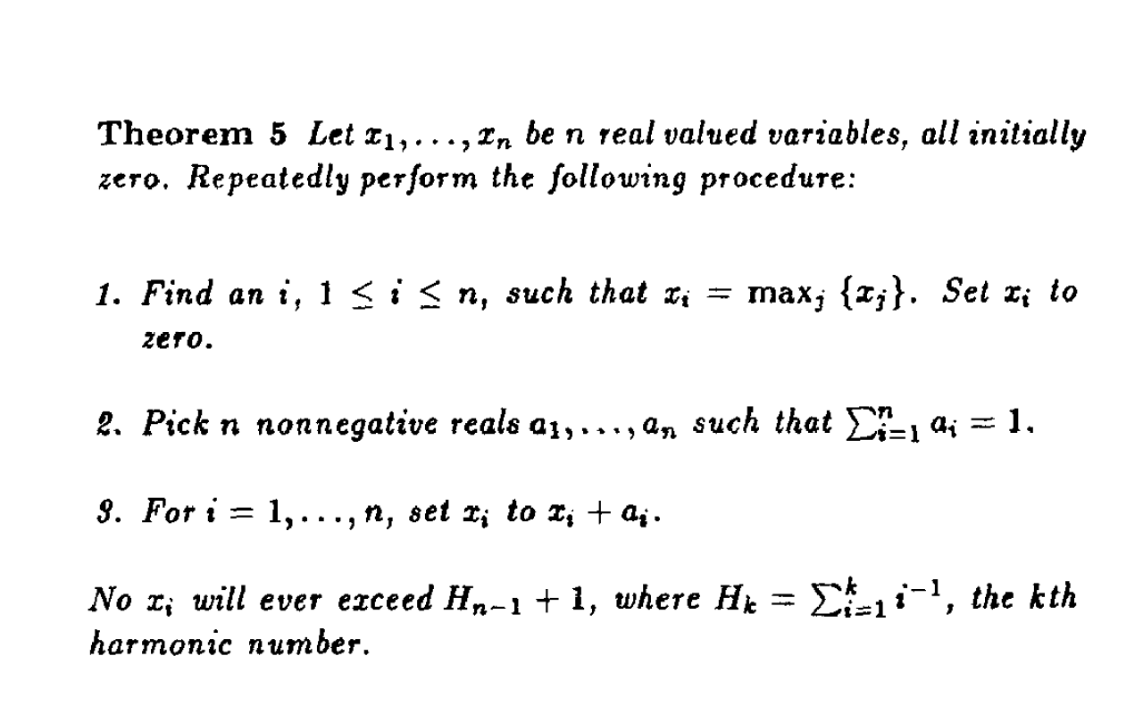
a₉
a₅
a₁₂
a₁₁
x₁
x₂
x₃
x₄
x₅
x₆
x₇
x₈
x₉
x₁₀
x₁₁
x₁₂
...
x_{n}

