Slide 1
Org. [D. Harel, R.E. Tarjan, Fast algorithms for finding nearest common ancestors, SIAM J. on Comp. 13 (2): 338–355, 1984]
Nearest Common Ancestors (NCA)
Preprocessing Time vs Query Time ?
nca(i, j)
13
11
8
11
Cartesian Tree
[Vuillemin 1980]
7
6
5
3
j
4
6
2
2
i
1
1
i
j
Discrete Range Maximum
1 | 2 | 3 | 4 | 5 | 6 | 7 | 8 | 9 | 10 | 11
4 | 7 | 1 | 6 | 11 | 6 | 2 | 13 | 5 | 8 | 3
max(i, j)

Slide 2
Cartesian Tree Construction
Incremental construction left-to-right
O(n) time (Φ = #nodes on rightmost path)
18
18
+
13
13
10
10
8
2
START HERE
8
2
18 | ∙∙∙ | 13 | ∙∙∙ | 8 | ∙∙∙ | 2 | 10

Slide 3
Reduction: NCA ⇒ ±1 Discrete Range Maximum
nca(i, j)
H
Euler Tour
E
J
E
B
F
I
K
A
D
G
G
j
i
C
C
nca(i, j)
i
j
node
H | E | B | A | B | D | C | D | B | E | F | G | F | E | H | J | I | J | K | J | H
1 | 2 | 3 | 4 | 3 | 4 | 5 | 4 | 3 | 2 | 3 | 4 | 3 | 2 | 1 | 2 | 3 | 2 | 3 | 2 | 1
depth
2
minimum depth
Notes:
Neighbours differ by ±1

Slide 4
NCA on Perfect Binary Trees
1
2
3
4
5
i
= nca(11,21)
10
11
2i
2i+1
20
21
22
23
11 = 1011₂
21 = 10101₂
nca(21,21) = 5 = 101₂ = lcp( 1011₂ , 10101₂ )
longest common prefix
proc lcp(x, y)
if y < x then swap (x, y)
return x >> (msb(x XOR (y >> (msb(y)-msb(x)))
position of most significant bit ≠ 0
Notes:
msb = tabulation / int-to-float conversion / using multiplication...

Slide 5
Discrete Range Mimimum – Space O(n∙log n) words
nca(i, j)
1
1
1
1
3
2
1
1
3
3
4
2
3
2
1
1
2
3
4
3
4
5
4
3
2
3
4
3
2
1
2
0 1 i ∙ ∙ ∙
j
1 | 2 | 3 | 4 | 3 | 4 | 5 | 4 | 3 | 2 | 3 | 4 | 3 | 2 | 1 | 2
 | 1 | 3 |  |  |  |  |  |  |  |  |  | 3
 | 2 | 3 |  |  |  |  |  |  |  |  |  | 3
 | 3 | 3 |  |  |  |  |  |  |  |  |  | 3
 | d | 3 |  |  |  |  |  |  |  |  |  | 2
 | 5 | 1 |  |  |  |  |  |  |  |  |  | 1
right_{i}
left_{j}
drm(i, j) = min(right_{i}(d), left_{j}(d)) d = msb(i XOR j)
Notes:
Alternative solution: For each i store intervals of size 2^d only to the right and return min(right_i[d],right_{j-2^d+1}).

Slide 6
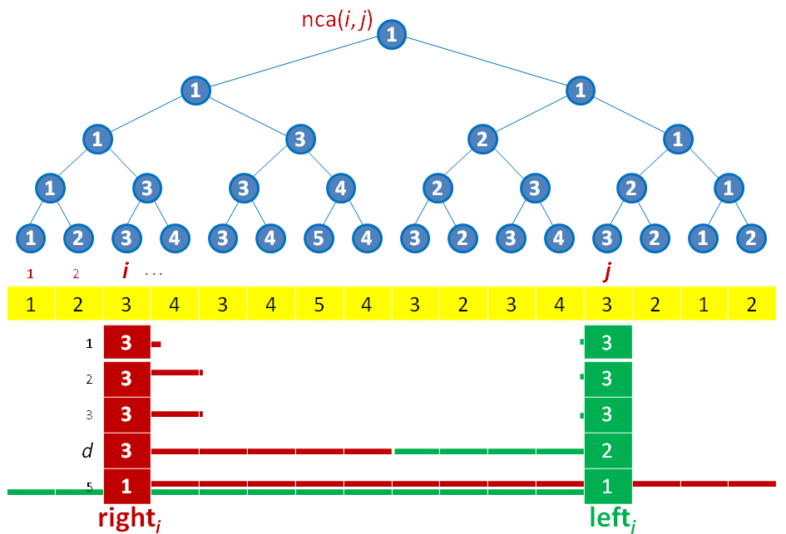
Blocked solution – Space O(n) words
Top structure
O(n/log n) elements
Space O(n)
Query O(1)
1 | 2 | 1 | 2
1 | 2 | 3 | 4 | 3 | 4 | 5 | 4 | 1 | 4 | 3 | 4 | 3 | 2 | 3 | 2
i
j
block of O(log n) elements
0 | 1 | 0 | 1 | 1
5 | 4 | 3 | 2 | 1
W_{j} (One for each j)
Block query: j+1-msb(W_{j} AND ((1 << (j-i+1))-1))
General query: 1 top query + 2 bottom queries
O(n) Preprocessing Time O(1) Query Time

Slide 7
Summary...
General Discrete Range Searching
i
j
1 | 2 | 3 | 4 | 5 | 6 | 7 | 8
4 | 7 | 1 | 6 | 8 | 6 | 2 | 9
Cartesian Tree
nca(i, j)
9
8
NCA
7
6
4
6
2
j
i
1
Discrete Range Max on Depth Array
1 | 2 | 3 | 4 | 3 | 4 | 5 | 4 | 3 | 2 | 3 | 4 | 3 | 2 | 1
”O(n∙log n)” solution on O(n/log n) blocks
O(log n) size blocks
O(n) Preprocessing Time O(1) Query Time

Slide 8
1d & 2D DRM Results
 | Indexing Model (input accessible) | Encoding Model (input not accessable)
m = 1 1D | 2n+o(n) bits, O(1) time [FH07] n/c bits ⇒ Ω(c) time [BDR10] n/c bits, O(c) time [BDR10] | ≥ 2n - O(log n) bits 2n+o(n) bits, O(1) time [F10]
1 < m < n | O(mn⋅log n) bits, O(1) time [AY10] O(mn) bits, O(1) time [BDR10] mn/c bits ⇒ Ω(c) time [BDR10] O(c⋅log² c) time [BDR10] O(c⋅log c⋅(loglog c)²) time [BDLRR12] | Ω(mn⋅log m) bits [BDR10] O(mn⋅log n) bits, O(1) time [BDR10] O(mn⋅log m) bits, O(mn) time [BBD13]
m = n squared |  | Ω(mn⋅log n) bits [DLW09] O(mn⋅log n) bits, O(1) time [AY10]
better upper or lower bound ?
Notes:
FH07 = Fischer & Heun, ESCAPE 2007
DLW09 = Demaine, Landau & Weiman ICALP 2009
AY10 = Atallah, Yuan SODA 2010
F10 = Fischer STACS 2010
BDLRR12 = Brodal, Davoodi, Lewenstein, Raman, Rao ESA 2012

Slide 9
DRM encoding - O(n) bits
i
j
A 1 | B 2 | C 3 | D 4 | E 5 | F 6 | G 7 | H 8 | I 9 | J 10 | K 11
4 | 7 | 1 | 6 | 11 | 6 | 2 | 13 | 5 | 8 | 3
nca(i, j)
H
Euler Tour
Cartesian Tree
E
J
E
B
F
I
K
A
D
G
G
j
i
C
C
nca(i, j)
node
H | E | B | A | B | D | C | D | B | E | F | G | F | E | H | J | I | J | K | J | H
1 | 2 | 3 | 4 | 3 | 4 | 5 | 4 | 3 | 2 | 3 | 4 | 3 | 2 | 1 | 2 | 3 | 2 | 3 | 2 | 1
depth
2
minimum depth
select(i) = i’th ”1”
p
j’th ”1” = select(j)
p_{i}
p_{j}
0 | 0 | 0 | 1 | 1 | 0 | 1 | 1 | 0 | 1 | 1 | 1 | 0 | 0 | 1 | 0 | 1 | 1 | 1 | 0 | 0
+ | + | + | + | - | + | + | - | - | - | + | + | - | - | - | + | + | - | + | - | -
4n bits
rank(p) = drm(i,j) = #₁ left of p
depth = #₊ - #₋ = min-prefix-sum(p_{i},p_{j})

Slide 10
Succinct data structures for DRM, O(n) bits
α = ½⋅log n bits
i’th ”1” = select(i)
0
1
⋅⋅⋅
p
0 | 0 | 0 | 1 | 1 | 0 | 1 | 1 | 0 | 1 | 1 | 1 | 0 | 0 | 1 | 0 | 1 | 1 | 1 | 0 | 0
B₀
B₁
B₂
B₃
…
rank(p) = R₁[└p/α┘] + T_{rank}[B[└p/α┘], p mod α]
R₁[i] = #₁ in first i blocks (n/α⋅log n bits)
T_{rank} = rank inside block, table lookup (2^{α+log α} ⋅log α bits)
α+log α bits
select(i) = αb + T_{select} [B[b], i-rank(αb-1)]
b = R_{nonempty}[rank_{leader}(i)]
i is in block B[b]
leader[i] = is the ith ”1” the first ”1” in its block? (n bits)
rank_{leader}(i) = rank structure for leader array (O(n) bits)
R_{nonempty} = index of nonempty blocks (n/α⋅log n bits)
T_{select} = select inside block, table lookup (2^{α+log α}⋅log α bits)
min-prefix-sum(p_{i}, p_{j}) = α(b_{k}-1)+d_{k}
b₁ = └p_{i}/α┘
b₃ = └p_{j}/α┘
b₂ = drm_{PS}(b₁+1, b₃-1)
d₁ = T_{mps}[B[b₁], p_{i} mod α, α-1]
d₂ = T_{mps}[B[b₂], 0, α-1]
d₃ = T_{mps}[B[b₃], 0, p_{j} mod α]
k = argmin_{t=1..3} PS[b_{t}-1]+T_{ps}[B[b_{t}], d_{t}]
PS[b] = #₊ - #₋ for blocks B₀..B_{b} (n/α⋅log n bits)
T_{ps} = #₊ - #₋ for block prefix,
table lookup (2^{α+log α}⋅(1+log α) bits)
T_{mps} = index of minimum prefix sum #₊ - #₋ inside range in a block, table lookup (2^{α+2log α}⋅log α bits)
MPS[b] = PS[b-1]+ T_{mps}[B[b], 0, α-1] (n/α⋅log n bits)
drm_{MPS} = drmin structure for MPS, O(n/α) words (O(n) bits)
b₁
b₂
b₃
MPS
1 | 3 | 2 | 1 | 2 | 1
d₁=3
d₃=1
p_{i}
d₂=2
p_{j}
+ | + | + | + | - | + | + | - | - | - | + | + | - | - | - | + | + | - | + | - | -
B_{b1}
B_{b2}
B_{b3}

